Slide 1
컴퓨터 공학 설계 및 실험 I
Duplicate ‘Paint’ Program
기말프로젝트
2021.06.21
20201658 GAN EUNICE NELL

Slide 2
Introduction To Paint Program (프로젝트 개요)
Program Description
  이 프로그램은 제한적이지만 다양한 브러시 옵션과 함께 마이크로소프트의 '페인트'의 상당 부분을 복제하고자 한다.
  브러시 옵션은 Windows(윈도우) 대화 상자 메뉴를 통해 선택한다
  다음은 지원되는 몇 가지 브러시 옵션입니다.
      Single Rectangle Brush – a brush that draws solid rectangle shapes
      Single Rectangle Gradient Brush – a brush that draws solid shapes, but each in random color thus making a gradient color palette
      Bursting/Scatter Rectangle Brush – a brush that draws scattered solid rectangle shapes of randomized color
      Glowing Circle Brush – a brush that draws faded and colorful glowing circles

Slide 3
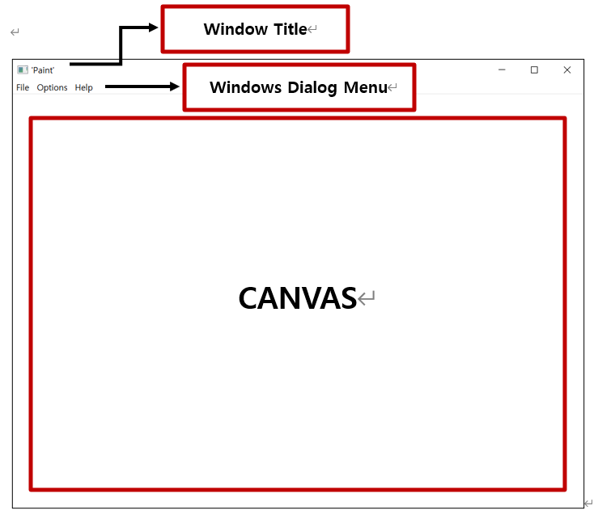
Screen Layout
Window Setup은 다음과 같이 나타난다.

Slide 4
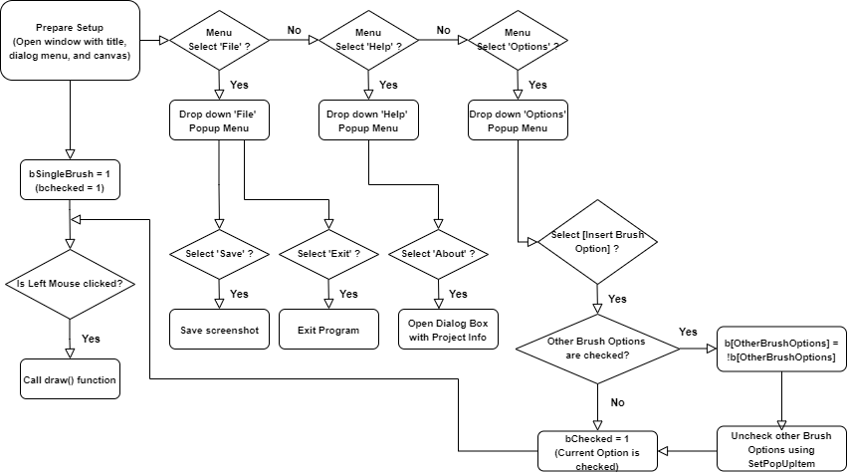
Algorithm & Flowchart
START
FUNCTION setup
Show Program Window
Show white background canvas
Show Windows dialog menu (
File > Save, Exit
Options > [Insert Brush options as popup menu here]
Help > About
)
Select Single Brush by default
END FUNCTION
FUNCTION appMenuFunction
If (Save is selected) {
Save screenshot using separate function
}
If (Exit is selected) {
Exit program
}
For every brush menu :
If (Brush Option is selected) {
Uncheck other brush menus
Check Brush Option menu
Call draw() function
}
END FUNCTION
FUNCTION draw
Verify which Brush option is selected (if-else)
If MOUSE_LEFT_CLICK, then draw according to Brush Option
If MOUSE_RIGHT_CLICK, then erase canvas
END FUNCTION
END

Slide 5
Functions and Variables
프로그램에서 사용한 함수와 변수
FUNCTIONS
void setup()
      Function which prepares the initial window setup
void draw()
      Function which draws strokes on the canvas depending on the brush option selected
void saveScreenshot()
      Function which saves the screenshot of the canvas
void keyPressed(int key)
      Input : int key
      Determines which key was pressed on the keyboard
VARIABLES
bool bSingleBrush – variable to determine if Single Brush is selected
bool bGradientBrush – variable to determine if Gradient Brush is selected
bool bScatterBrush – variable to determine if Scatter Brush is selected
bool bGlowingBrush – variable to determine is Glowing Brush is selected

Slide 6
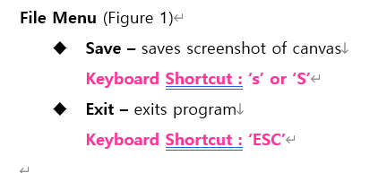
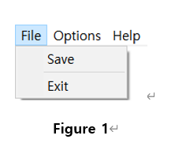
File Menu
Dept. of CS, Sogang Univ.

Slide 7
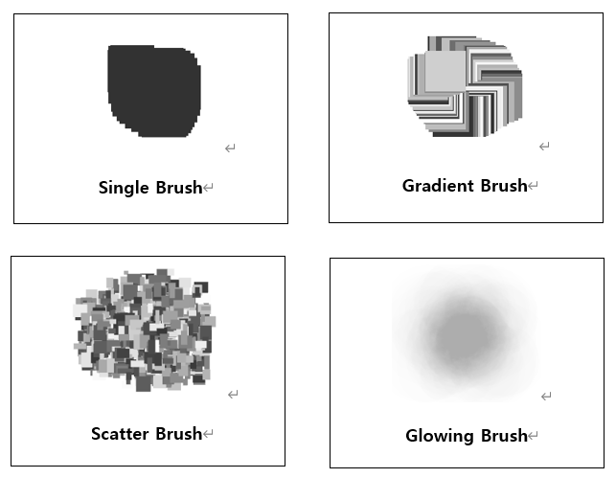
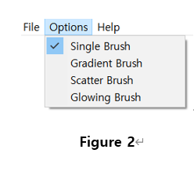
Brush Options Menu

Slide 8
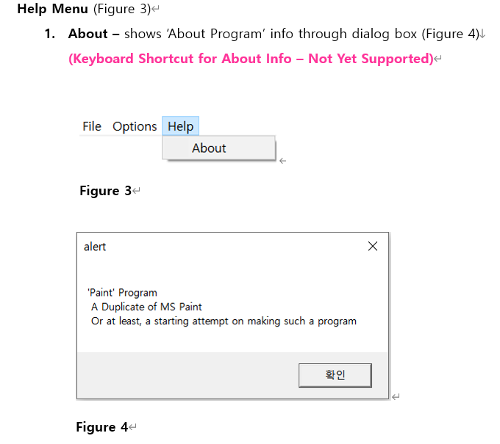
Help Menu
Dept. of CS, Sogang Univ.

Slide 9
Program Run Preview
Visual Studio 2019
Dept. of CS, Sogang Univ.

