Slide 1
X-Ray Spectrograph and crystallography
▶︎ X-ray interaction
▶︎ Spectrograph analysis
▶︎ Decomposition
Presented by Bin CAO
Supervisor : Prof. ZHANG TongYi
Co-supervisor : Prof. WENG Lutao
Contact: binjacobcao@gmail.com ; https://github.com/Bin-Cao

Slide 2
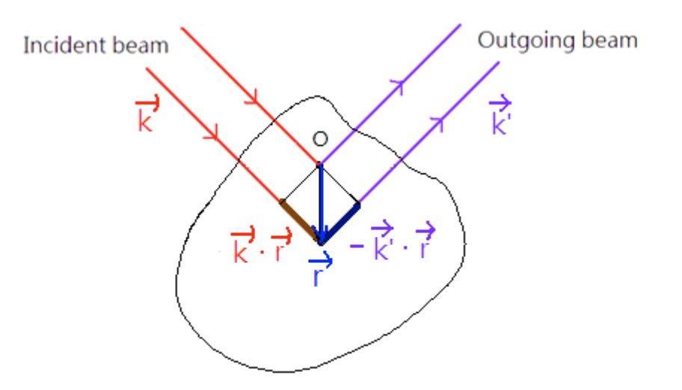


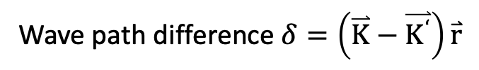


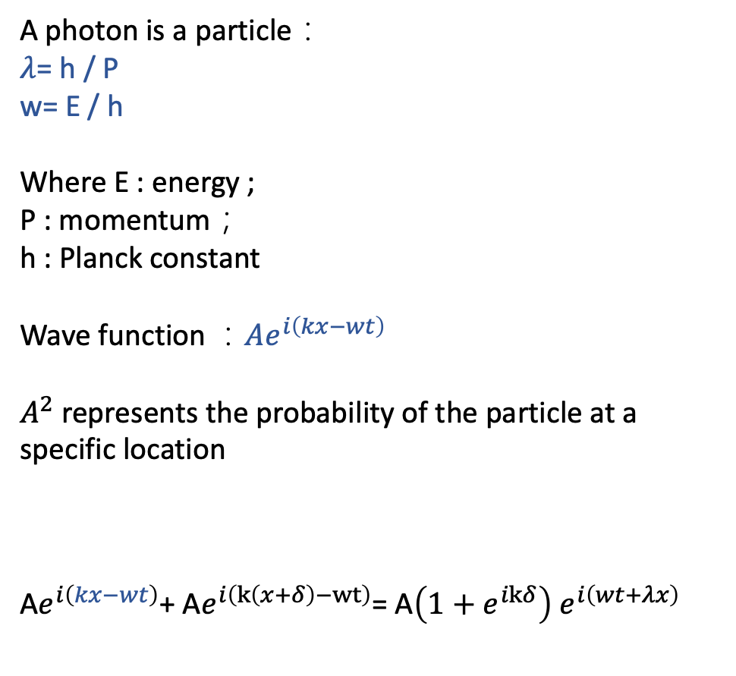
Xray interaction with matter
Photon 1
elastic collision
A photon is a particle：
$λ$= h / P
w= E / h
Where E : energy ;
P : momentum；
h : Planck constant
Wave function ：$Ae^{i\left(kx−wt\right)}$
$A^{2}$ represents the probability of the particle at a specific location
$\text{A}e^{i\left(kx−wt\right)}$+ $\text{A}e^{i\left(k\left(x+δ\right)−wt\right)}$= $\text{A}\left(1+e^{ikδ}\right)$ $e^{i\left(wt+λx\right)}$
Photon 2
Incident beam
diffracted beam
Electron
Wave path difference $δ=\left(\overset{⃑}{K}−\overset{⃑}{K^{‘}}\right)\overset{⃑}{r}$
X-ray Diffraction (XRD)
Photon 1
Photon 2
Euler‘s formula$e^{iωt}=cosωt+isinωt$
$$\sqrt{probability}$$
2
2

Slide 3
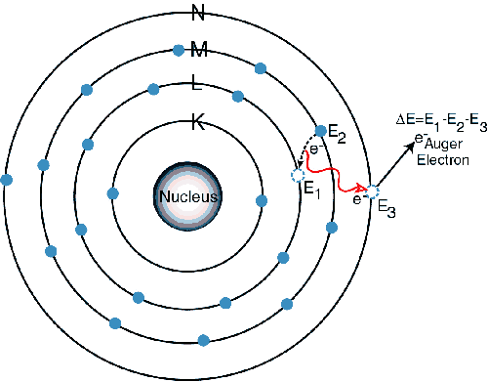
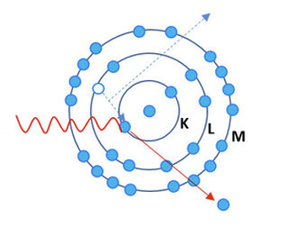
Xray interaction with matter
Auger electron
Auger electron Spectroscopy (AES)
Jump from L-shell to K-shell
Incoming photon
Ejected photonelectron
E_{in} = E_{e} + E_{out}
Fluorescence
X-ray fluorescence Spectroscopy (XRF)
X-ray Photoelectron Spectroscopy (XPS)
3

Slide 4
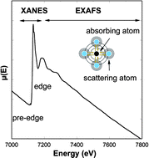
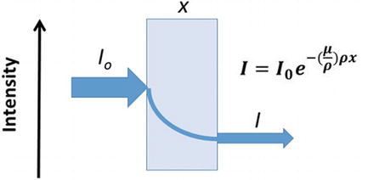
Xray interaction with matter
Jump from L-shell to K-shell
Xray Absorbation Fine structure (XAFS)
the oscillation is induced by the wave property of photoelectrons
Incoming photon
Ejected photonelectron
4

Slide 5
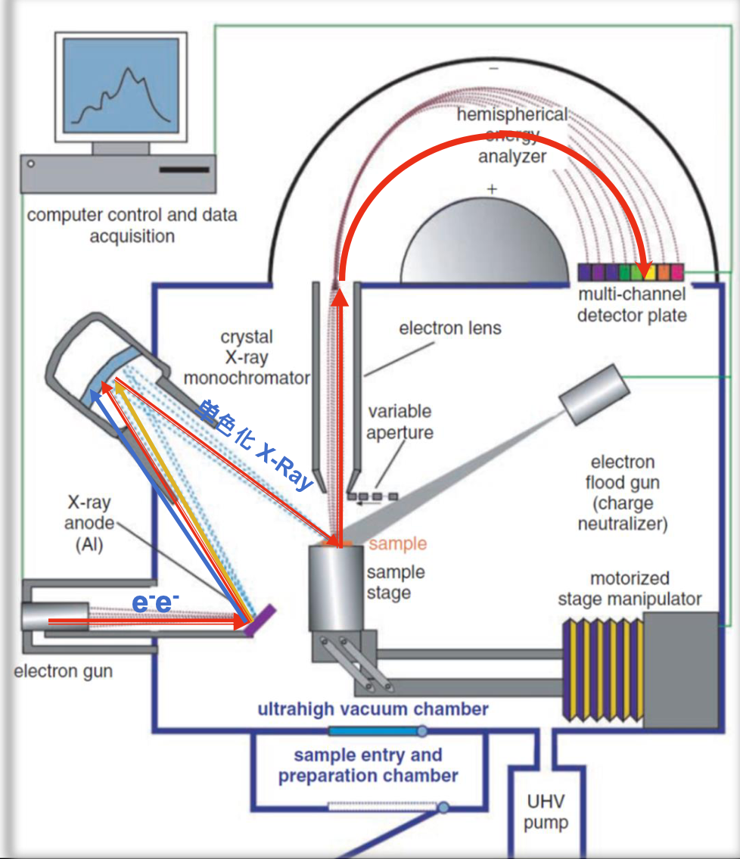
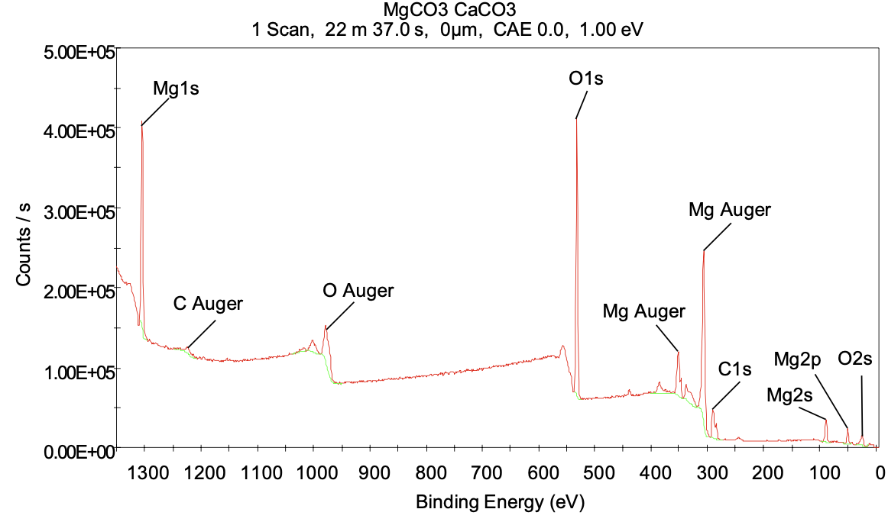
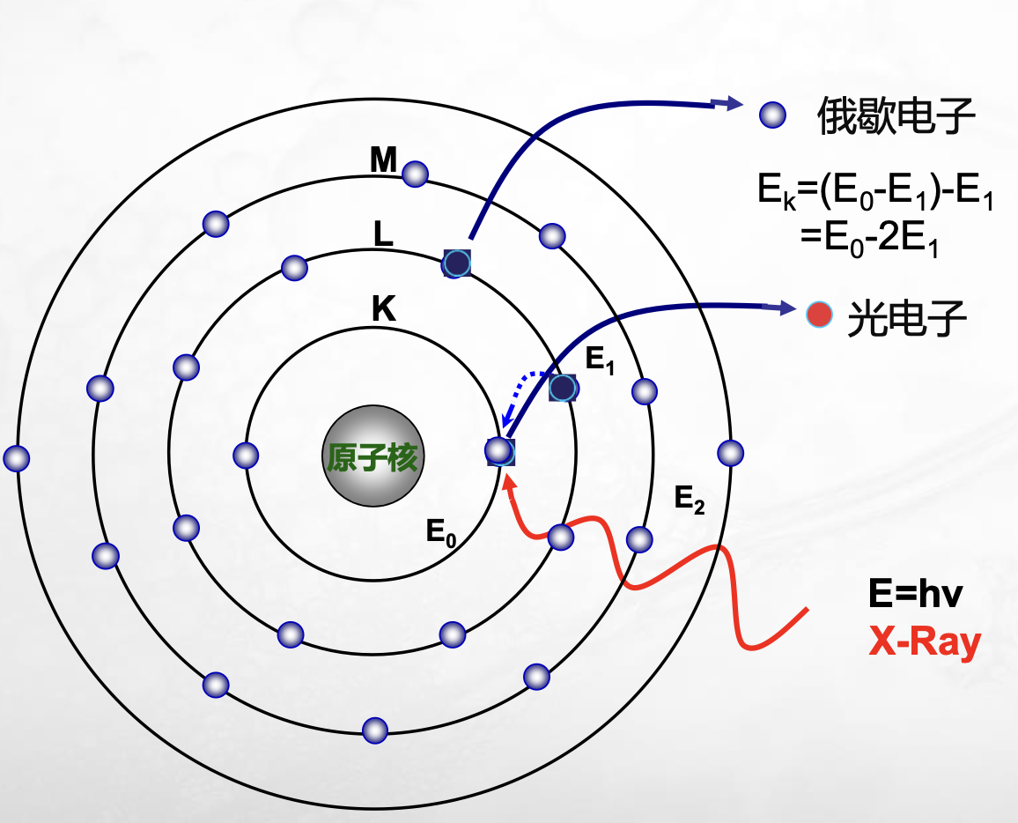
Xray Spectrograph and crystallography : XPS & AES
The photoelectron and the accompanying Auger electron appear at the same point, that is, they jump out of an atom at the same time. It has strong fingerprint properties and can be used for elemental and valence state analysis.
5

Slide 6
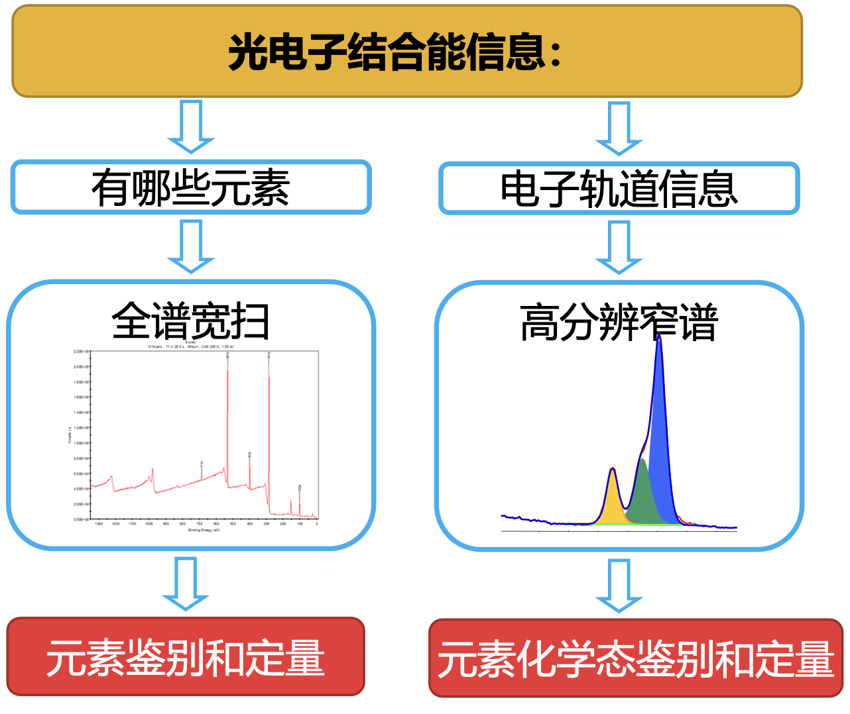
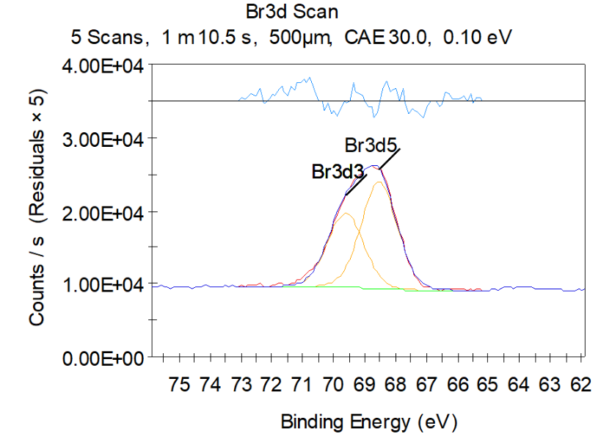
Decomposition
We interest in the high-resolution narrow scan spectrum
3d5/2
3d3/2
Energy level splitting caused by fine structure
6

Slide 7
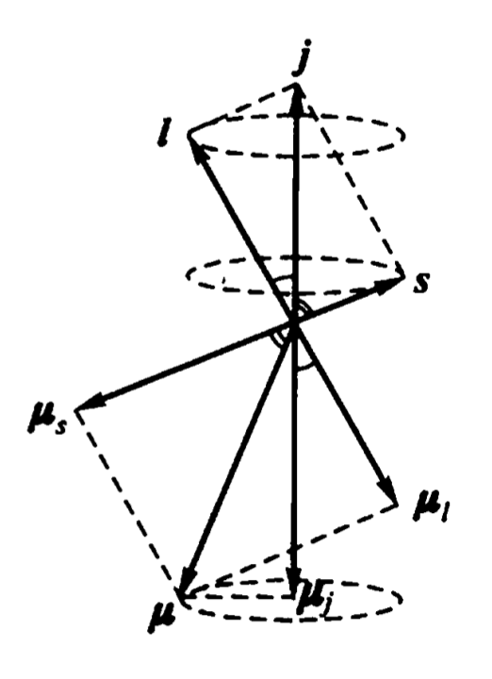
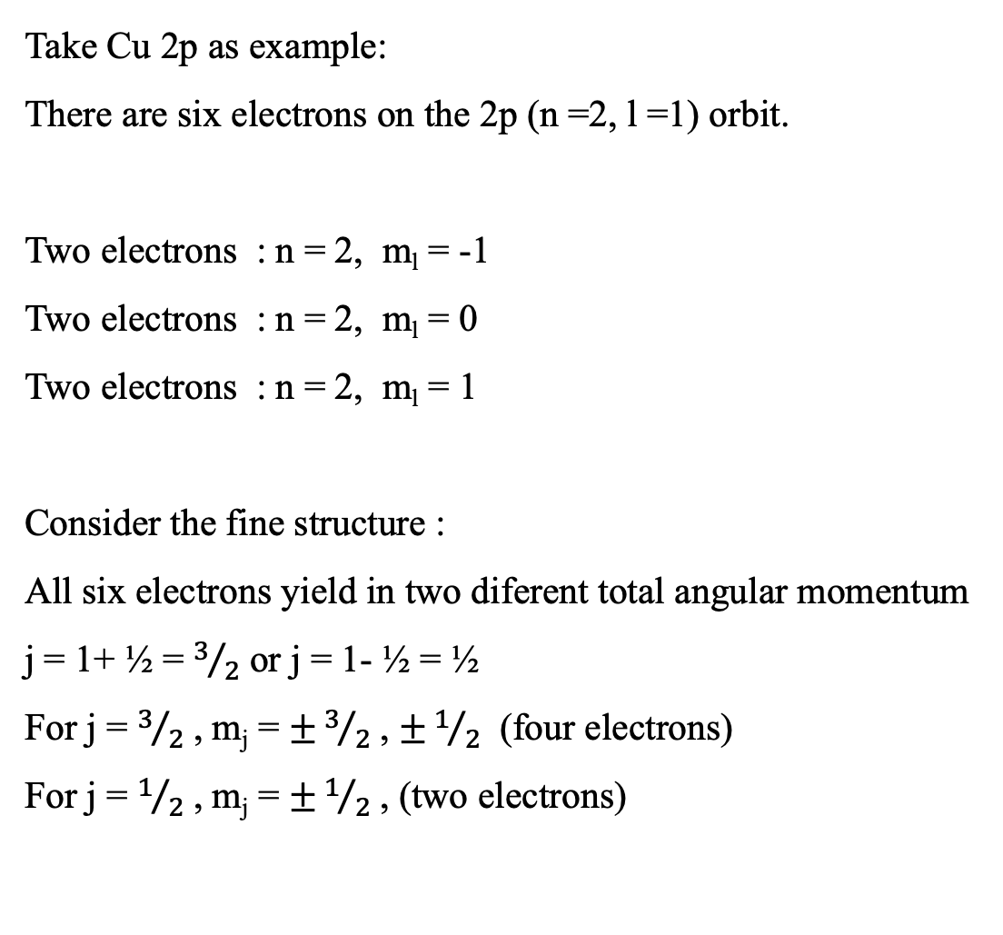
Decomposition
Take Cu 2p as example:
There are six electrons on the 2p (n =2, l =1) orbit.
Two electrons : n = 2, m_{l} = -1
Two electrons : n = 2, m_{l} = 0
Two electrons : n = 2, m_{l} = 1
Consider the fine structure :
All six electrons yield in two diferent total angular momentum
j = 1+ ½ = $3/2$ or j = 1- ½ = ½
For j = $3/2$ , m_{j} = $±3/2$ , $±1/2$ (four electrons)
For j = $1/2$ , m_{j} = $±1/2$ , (two electrons)
S-L couping
7

Slide 8
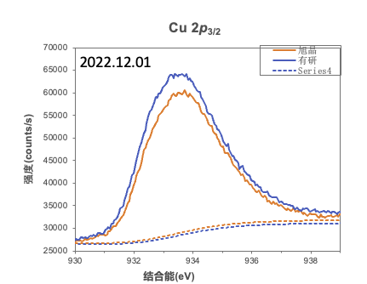
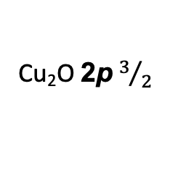
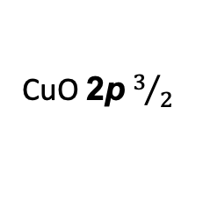
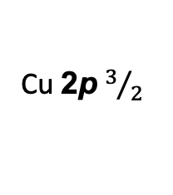
Decomposition
profile
Measure fun.
intensity
electron num
energy
Sample location
Multi-peaks
mixed prob. density
Cu 2p $3/2$
CuO 2p $3/2$
Cu₂O 2p $3/2$
8

Slide 9
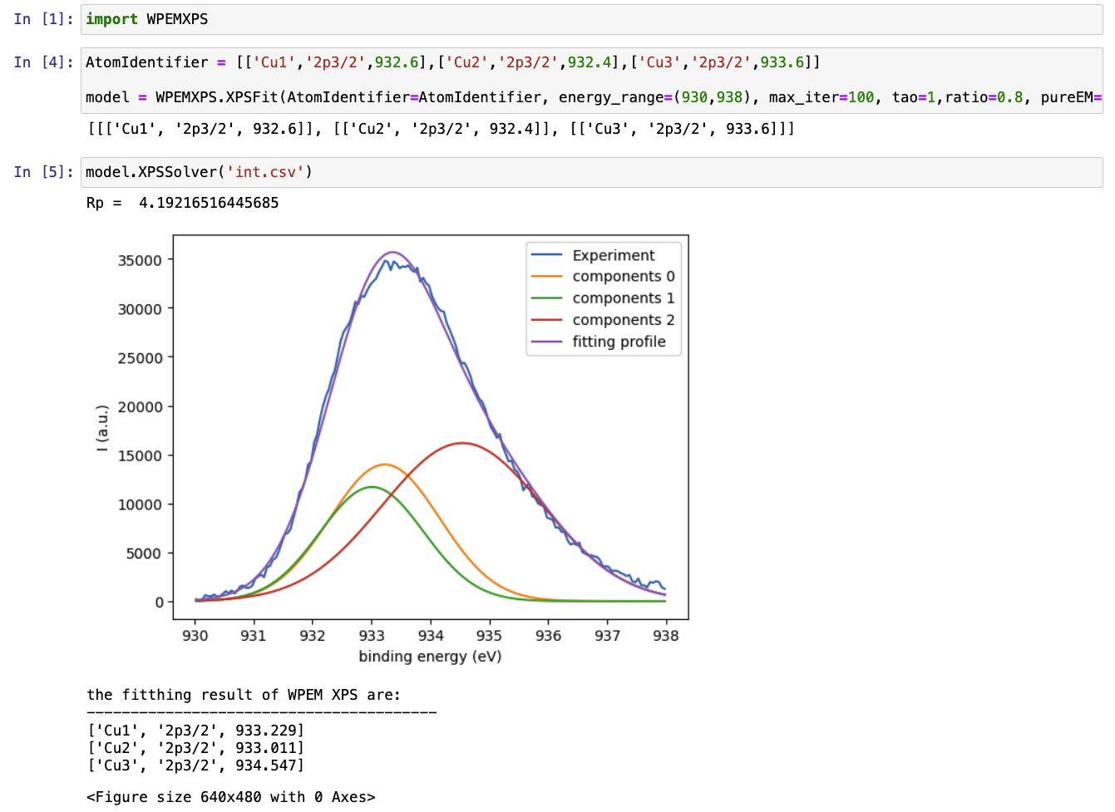
Code Demo
If the energy shift caused by spin-orbit coupling is not considered
Database
http://srdata.nist.gov/xps/
EM optimization
We can decompose it perfectly and achieve good accuracy
9

Slide 10
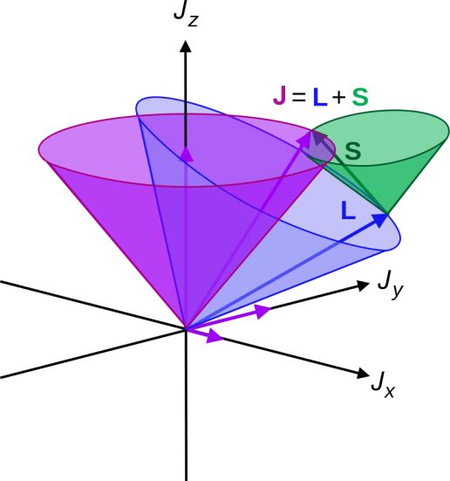



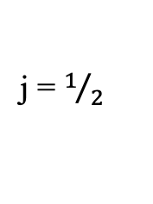



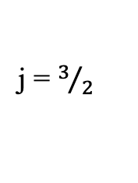




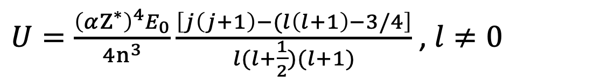


Atom Fine structure
$$e^{−}$$
$$e^{−}$$
$$e^{−}$$
$$e^{−}$$
$$e^{−}$$
$$e^{−}$$
p orbit
$$e^{−}$$
$$e^{−}$$
$$e^{−}$$
$$e^{−}$$
$$e^{−}$$
$$e^{−}$$
$U=\frac{{\left(αZ^{∗}\right)}^{4}E_{0}}{4n^{3}}\frac{\left[j\left(j+1\right)−(l\left(l+1\right)−3/4\right]}{l(l+\frac{1}{2})(l+1)}$ , $l≠0$
Energy gap
j = $1/2$
j = $3/2$
10

Slide 11
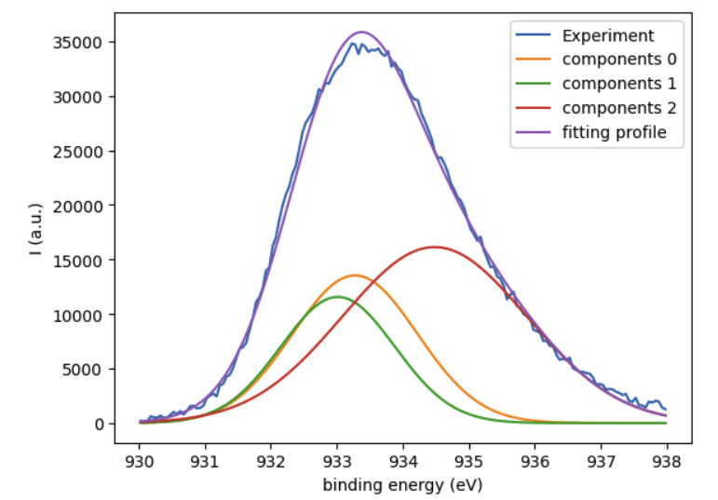
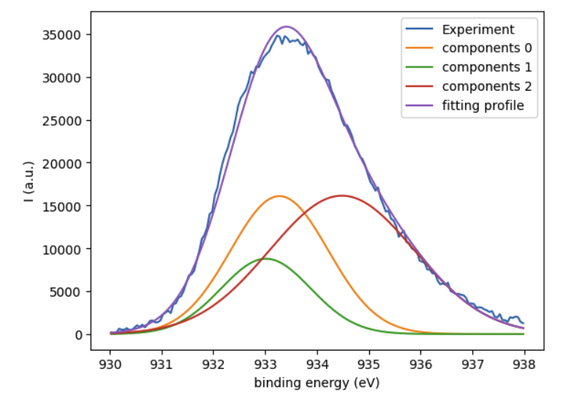
11

Slide 12

Q & A
Thanks for your time!

