Slide 1
机器学习
讲演者：高志远

Slide 2
提问
为什么要学习Machine Learning？
学了Machine Learning 后有什么优势？
这些优势为什么重要？

Slide 3
机器学习背景
基于周志华教授的划分，始于1950年，经历了“推理期”，“知识期”，“统计学习期”，“深度学习”
推理期：赋予机器逻辑，机器具有智能
知识期：仅有逻辑不够，让机器学知识

Slide 4
机器学习
特点：数据逐步增大
现状：人类收集、储存、处理数据能力飞速提升，各行各业都有大量的数据需要分析以及利用。在各行各业都有机器学习技术的身影。
机器学习分支
计算机视觉、语音识别、自然语言处理、数据挖掘、模式识别等

Slide 5
案例
1. 用户在百度，谷歌上的搜索到的精准的结果。
2. 奥巴马有一个基于机器学习的团队，分析社交网络上的信息，针对各个地区的选民进行有针对性的宣传。
3. 依靠大数据来进行编剧，电影创作等。
4.在观看几万条youtube视频后，计算机成功识别出哪条是狗

Slide 6
什么是Machine Learning
定义1：
Machine learning is the field of study that gives computers the ability to learn without being explicitly programmed.
定义2：
A computer program is said to learn from experience E with respect to some class of tasks T and performance measure P, if its performance at tasks in T, as measured by P, improves with experience E.

Slide 7
例子
问题：
Suppose your email program watches which emails you do or do not mark as spam, and based on that learns how to better filter spam. What is T, P, E?
Classifying emails as spam or not spam.
Watching label emails as spam or not spam.
The number of emails correctly classified as spam/not spam.
A computer program is said to learn from experience E with respect to some class of tasks T and performance measure P, if its performance at tasks in T, as measured by P, improves with experience E.

Slide 8
监督学习（Supervised Learning）
Supervised learning is a machine learning task of inferring a function from labeled training data.
Ex1. predict tumor malignant
Ex2. predict spam email
Ex3. predict housing price

Slide 9
非监督学习
Unsupervised learning is the machine learning task of inferring a function to describe hidden structure from unlabeled data.
Clustering the data based on the relationship
Ex1. 广告精确定位，人群分类
Ex2. 新闻分类，将同样新闻分为一类。
Ex3. 推荐电影系统

Slide 10
算法
Supervised Learning:
Neural network
Linear Regression
Logistic Regression

Slide 11
算法
Unsupervised Learning
Support Vector Machines
Kmeans clustering

Slide 12
线性模型
D = training set
m = number of data in training set
(x,y) = instance, x is input
= the i th instance
h = hypothesis
Theta(i) = the i th parameter

Slide 13
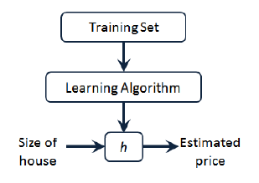
模型

Slide 14


Hypothesis
线性回归：
其他模型函数：

Slide 15
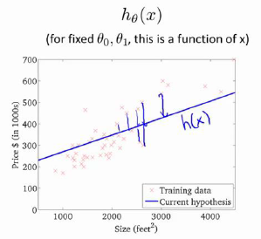
房价例子

Slide 16

Cost Function

Slide 17
Cost function
Goal: minimize the cost function
m is to average the cost, not affect by the size of data
2 is for easier calculation when taking derivative.

Slide 18
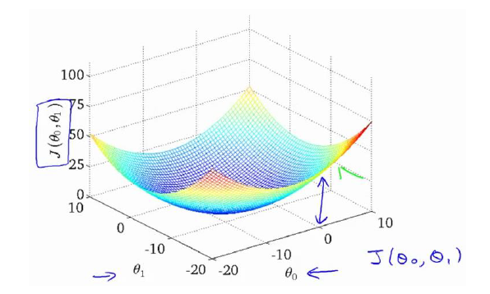
Gradient Decent
The graph of J

Slide 19

Gradient Decent
Alpha is learning rate
Notes:
A

Slide 20

Gradient Decent
Code

Slide 21
Gradient Decent 问题
Alpha 问题：
Alpha 怎么选？
Alpha 过大的影响？
Alpha 过小的影响？
Alpha 需要在下降的过程中进行修改吗？

Slide 22
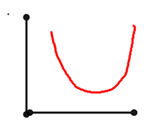
Alpha 问题
x-axis Theta
y-axis J(theta)

Slide 23
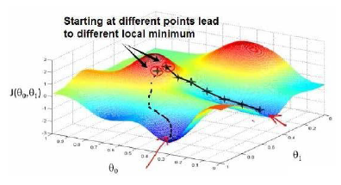
问题2：
Global minimum VS local minimum

Slide 24
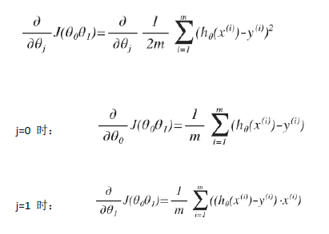
计算

Slide 25
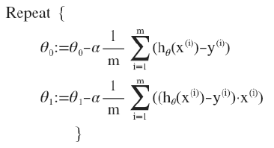
算法

