Slide 1
Cloud movement detection
Presented by Tianheng

Slide 2
OUTLINES
Introduction
System Structure
Three Algorithms
Performance Analysis
Problems and Potential Solutions
Conclusion

Slide 3
Introduction
Cloud movement detection is under the project of solar farm output power prediction
In order to predict solar farm power output, we need to do the following steps:
1. Modeling of solar panel with variables of shading effect and sun irradiance
2. Use camera to predict the movement of the cloud
3. Find relationship between the cloud motion and shading as well as sun irradiance for each panel
4. Combine all the other facts (e.g. rotation of the sun)to predict the output power

Slide 4
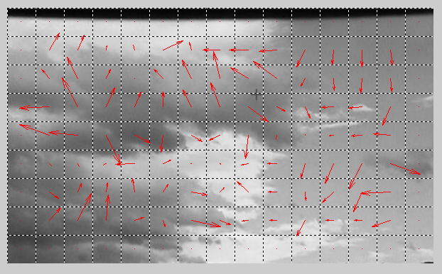
Introduction
Definition -- Cloud movement detection is a part of cloud movement prediction, which is to determine the direction and relative velocity of each segment between two continuous frames
Red vector is the motion vector contains direction and velocity info

Slide 5
System Structure
The system has input source, the computation unit and output
Input source: gives the continuous image frames into the computation units. Each frame is fixed length and width grey image.
Computation unit: matlab based kernel to compute the motion vectors of the image compared to the former frame; it has multiple algorithms
Output: motion vectors of each frame

Slide 6
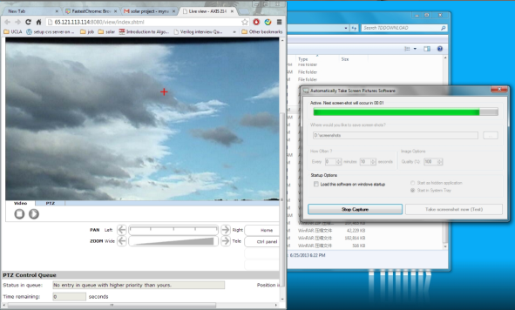
System Structure
Input source:
We use the live camera as the input source to capture the cloud movement: http://65.121.113.114:8080/view/index.shtml, when we set the angle and everything correctly, we can see the cloud like this:

Slide 7
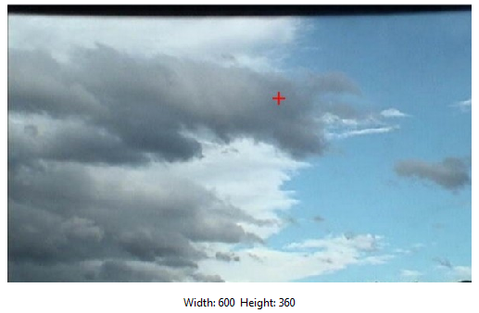
System Structure
Input source:
We use the screenshot software to capture the movement for example every 10 seconds and use matlab to exact the picture as the frames we wanted as following:

Slide 8
System Structure
Computation unit:
Matlab uses three different algorithm to calculate the motion vectors of the frame between two frames.
The three algorithms are:
A. Brutal force (very slow, but accurate)
B. Simulate annealing hexagonal based search(quick, less accurate)
C. Low Pass filter hexagonal based search (quick, less accurate)
The B and C can be combined together because they are all revised version of original hexagonal base search (HBS) on different aspect
(add reference)

Slide 9
Three Algorithms
We segment each frames into small square segments – blocks, and predict the movement of each block
The criterion we use is MAD – mean absolute difference.(亮度difference) It is suggested in the paper for less computation.

Slide 10
Three Algorithms – Brutal Force
It will search all the neighbors of the block and determine which one is closest to the original block
The deviation of center of original block and the most-like block is the motion vector
The result is regarded as the ground truth
The problem is the speed is very slow!!

Slide 11
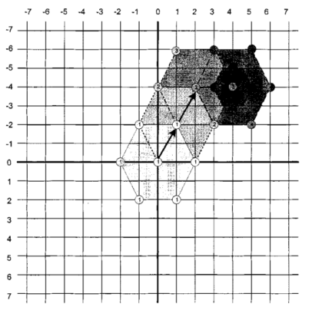
Three Algorithms – HEXBS
In order to achieve real time computation we use the algorithm from the paper “Hexagon-Based Search Pattern for Fast Block Motion Estimation”
The basic idea is as
the beside picture

Slide 12
Three Algorithms – HEXBS
Problem:
It assumes that global minimum has a monotonic distortion and the nearer to the global minimum the smaller the distortion in all directions.
When the object is moving fast, the assumption is no longer standing.
We use two way to fix that:
A. simulate annealing
B. low pass filter
They all try to step out of the local optimal

Slide 13
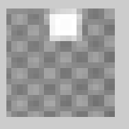

Three Algorithms – HEXBS
The low pass filter blurs the object so that a object far away from the original point can “leak” its impact
Assume the original write block is at the red point
The left guy cannot see the tracking because the object is moving so fast that the connect is cut
The right guy can see the next movement because it follows the leaking trace of the next position

Slide 14
Three Algorithms – Improved HEXBS
Thus, we have the simulate annealing HEXBS algorithm and low pass filter HEXBS algorithm
The low pass filter can also applied into the SA_HEXBS algorithm
These two algorithm are really fast but no as accurate as the brutal force one

Slide 15
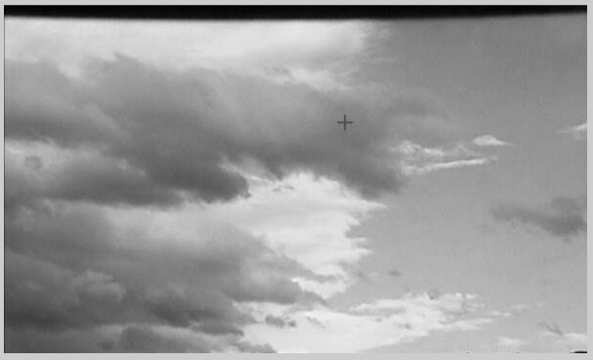
Performance Analysis
The following two pictures are two consecutive frames from a live streaming camera
Frame1

Slide 16
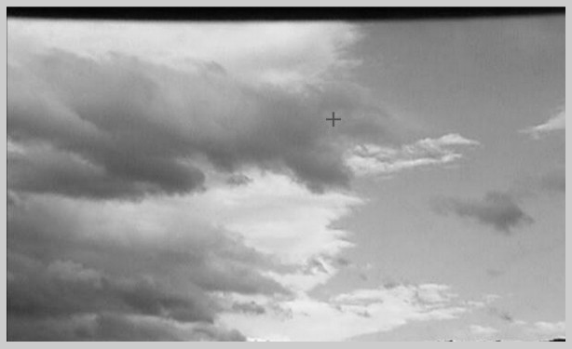
Performance Analysis
The following two pictures are two consecutive frames from a live streaming camera
Frame2

Slide 17
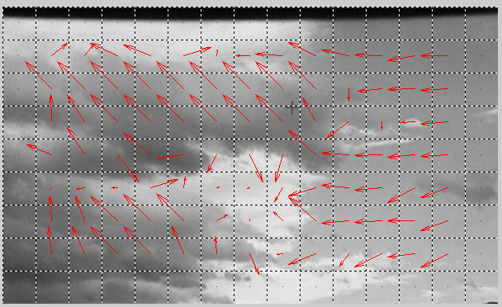
Performance Analysis
The following three pictures are the result from three algorithm under a certain case
Brutal

Slide 18
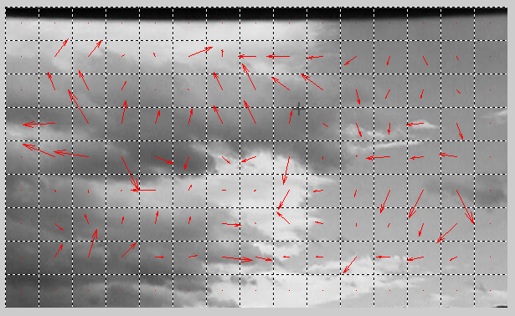
Performance Analysis
The following three pictures are the result from three algorithm under a certain case
LP_HEXBS

Slide 19
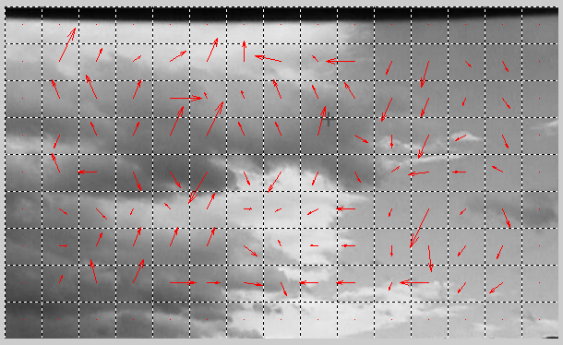
Performance Analysis
The following three pictures are the result from three algorithm under a certain case
SA_HEXBS

Slide 20
Performance Analysis
The time for executing two 600*360 frames with the block size 40*40 is:
Algorithm | Elapse time(s)
Brutal Force | 16.79
LP_HEXBS | 0.78
SA_HEXBS | 0.35

Slide 21
Performance Analysis
We compare the direction and velocity accuracy of the LP_HEXBS and SA_HEXBS from brutal force
algorithm | director | velocity
LP_HEXBS | 0.79 | 0.47
SA_HEXBS | 0.75 | 0.14

Slide 22
Problems and Potential Solutions
We can see that the results of fast algorithms still have differences with the brutal force
Some of the regions of clouds have good results – the boundaries
Some of the regions have really poor results – the inside of the cloud, the block is nearly filled with black or while pixels
The fast algorithm cannot tell the movement of a nearly pure color block. This is because the SNR of the block is very low. The object itself looks like the noise

Slide 23
Problems and Potential Solutions
Another problem is that due to the reason we need to zoom in the camera so much that we can only see the cloud, the movement of the cloud is so quick. The maximum sampling rate of the screenshot software is 10 seconds per frame, and fast algorithm is vulnerable to fast movement. So I guess the result will be better, because the result is good when using iphone shoot a video of the moving FPGA block in the lab

Slide 24
Problems and Potential Solutions
Increase the sampling rate
Can we only analyze the boundaries of the cloud
How to increase the SNR for a nearly pure color block

Slide 25
Conclusion
We present three algorithm to detect the movement of cloud, an example is given and corresponding analysis is done. The problem is that
1. the fast algorithm cannot capture the fast moving object that good
2. the fast algorithm as well as the brutal force algorithm are vulnerable to the pure color block which has low SNR
Increasing the sampling rate might be a good solution, but limited to the software. However, the most important part is that how to overcome the intrinsic weakness of the algorithm

