Slide 1
ALGORITHM FOR ABNORMAL DRIVING BEHAVIOR DETECTION
MAIN PROJECT
NAME : Vinu Xavier, MUHAMMADALI K P
REGISTER Number : 16MPD0024 , 16MPD0017

Slide 2
ABSTRACT
The studies say that the driver negligence plays a vital role in the in the various reasons which cause an accident.
Each and every abnormality in the driving behavior is visible as a pattern
This thesis would like to consider various algorithms based on Steering wheel angle sensor (SAS) to detect the abnormalities in the driving behavior and thereby either taking failed reactions in an appropriate manner so that prevention of accidents are possible.

Slide 3
System Block Diagram
Suspension Behavior
Acceleration behavior
ABNORMAL DRIVING BEHAVIOR DETECTION & CONTROL
Engine torque control
Braking behavior
Brake torque control
Steering Behavior
Steering stability control
Learned history and standard behaviors
O:Heart Beat Sensor for driver

Slide 4
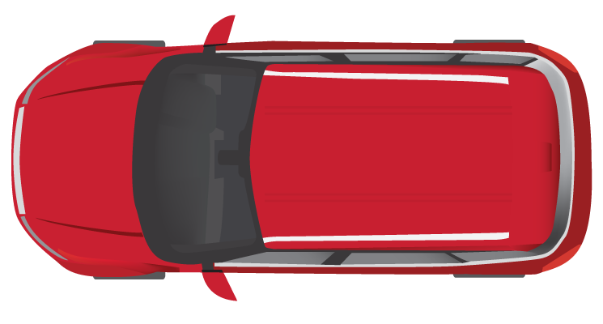
SIDE SLIPPING DETECTION ALGORITHM
This is very common behavior that keeping a straight line is so hard for a drunken driver or driver who is out of his mind.
The result is visible on the steering wheel angle sensor
A continuous error accumulation followed by detection of abrupt counter steering is the behavior of this abnormality

Slide 5
WAVING DETECTION ALGORITHM
Visible even both in the straight line and immediately after negotiating a curve
This algorithm should detect the driver's inability to keep the steering on the desired set point to keep the vehicle in control.
Algorithm considers oscillations in a higher frequency in the range of seconds

Slide 6
SWERVING DETECTION ALGORITHM
An abrupt turning or swerving is always root cause for the high amount of lateral acceleration which can cause instability towards the lateral
When the lateral forces are more than the traction which can be handled by the tire, the static friction immediately changes to dynamic friction and results into the slipping of the Wheels

Slide 7
FAST U-TURN DETECTION ALGORITHM
The very immediate reaction order fast U-turn is drifting away of the car towards outside the curve.
The centrifugal force is directly proportional to the velocity with which it is taking the turn and inversely proportional to radius of the turn.

Slide 8
TURNING WITH WIDE RADIUS ALGORITHM
Wide radius turning will cause collision with other vehicles which is moving around and anticipating right turning behavior from all the moving vehicles.
The data from steering wheel sensor has to be correlated with reference data for the particular location..

Slide 9
GENERIC STRUCTURE OF ALGORITHM
Reference Data from
Cloud
Signal Processing
Error
Detection and
Accumulation
Logic of Algorithm
Degree of abnormality
Run Time Data

Slide 10
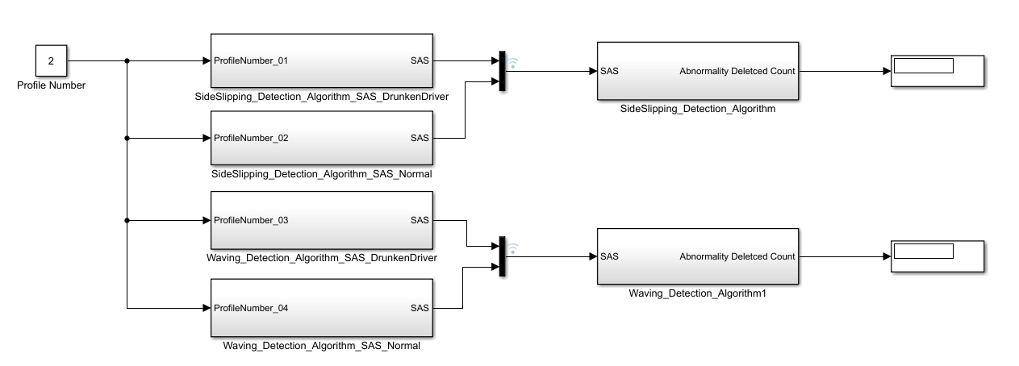
IMPLEMENTATION of Side SLIPPING AND WAVING DETECTION

Slide 11
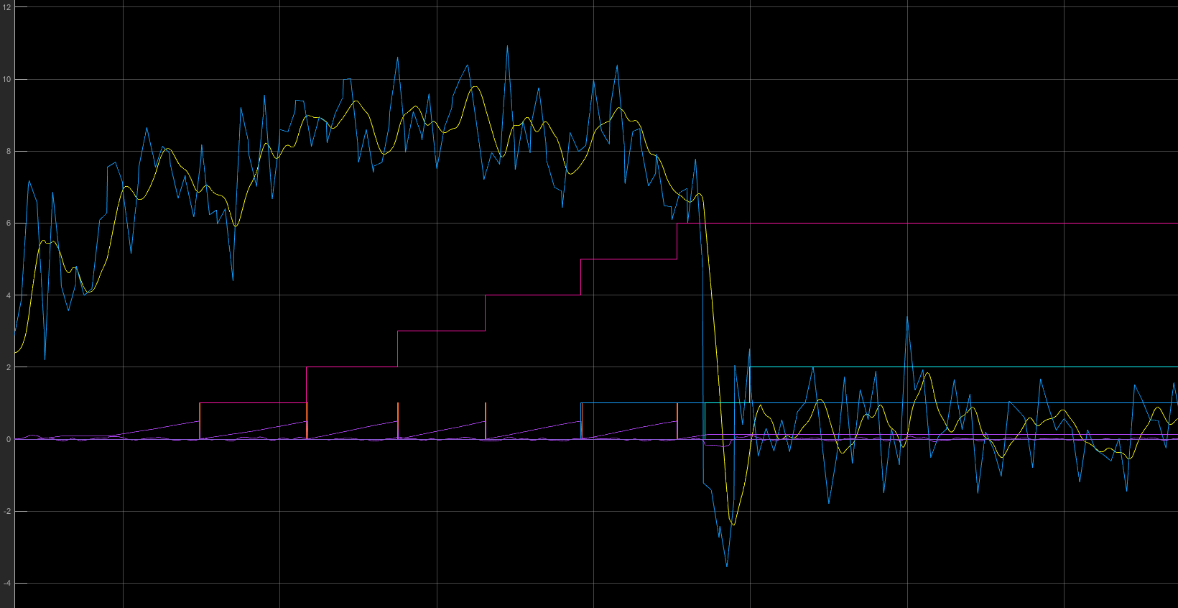
RESULTS – SIDE SLIP ALGORITHM – ABNORMAL BEHAVIOR

Slide 12
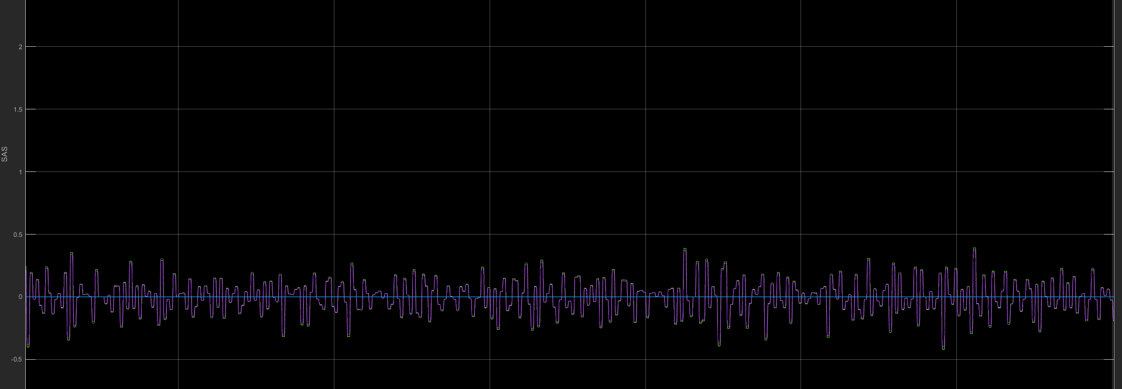
RESULTS – SIDE SLIP ALGORITHM –NORMAL BEHAVIOR

Slide 13
CONCLUSION
Implementation of various algorithms done in Matlab Simulink with real time SAS inputs.
Algorithm is verified against normal and abnormal behavior.
Future scope is to integrate additional inputs from
Wheel speed sensors
Brake pressure sensor
Suspension sensor

