Slide 1

JOnion:
Code Metrics Calculation
Feng Gao, Emad Gohari, April 17th 2015

Slide 2
Agenda
Background and Introduction
Project overview
JOnion Developing and Testing
Other Tools and Dataset
Evaluation and Conclusion

Slide 3
Background
A quantitative measure used to measure software product quality
fundamental and important not only for researchers but also developers
So far, lots of tools available online. But all have serious restrictions
Urgent on a better tool!

Slide 4
Introduction
Develop a better tool than current tools
Comp up idea during assignment period
Focus on object-oriented language, Java
Add more functionality
Improve the accuracy
Achieve general better performance
Give a meaningful name: JOnion!

Slide 5
Project overview
Developing the software metrics tool
Software testing for the tool
Selecting other software metrics tools
Choose test software systems for dataset
Generating metrics reports from all tools
Evaluation of results
Report works and findings

Slide 6
JOnion Developing
Evolved from the older version: AssignmentParser
Based on the framework: Java Parser
revolutionary change on architecture
Enhance the recursive call
Tighter encapsulation

Slide 7
JOnion Developing
Easy-understanding hierarchy:
Method Level ---aggregate---> Class Level
---aggregate---> File Level ---aggregate--->
Package Level ---aggregate---> Project Level
A new data structure with greater capability

Slide 8
JOnion Developing
Technical Detail:
“StoreMetrics” holds owner, aggregated metrics and calculated metrics.
“VisitMethods”(up to “VisitProject”) class calculate metrics for each level
CA, CE and I calculate at Project level

Slide 9
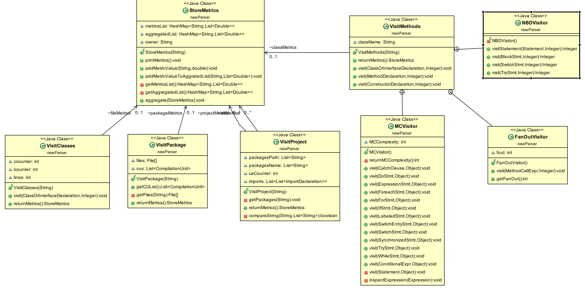

Slide 10
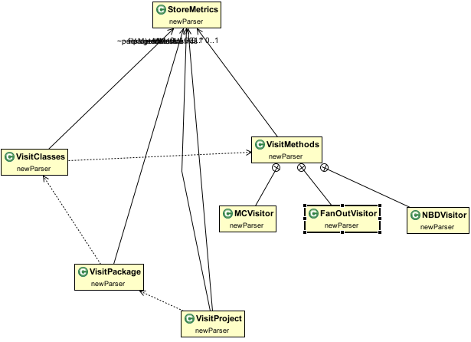

Slide 11
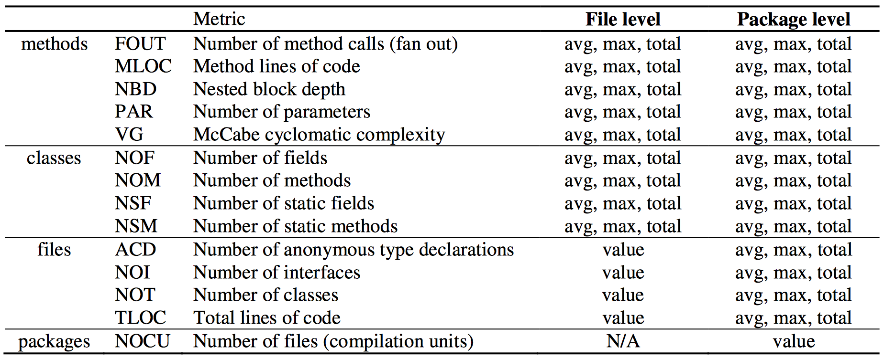
Software Metrics

Slide 12
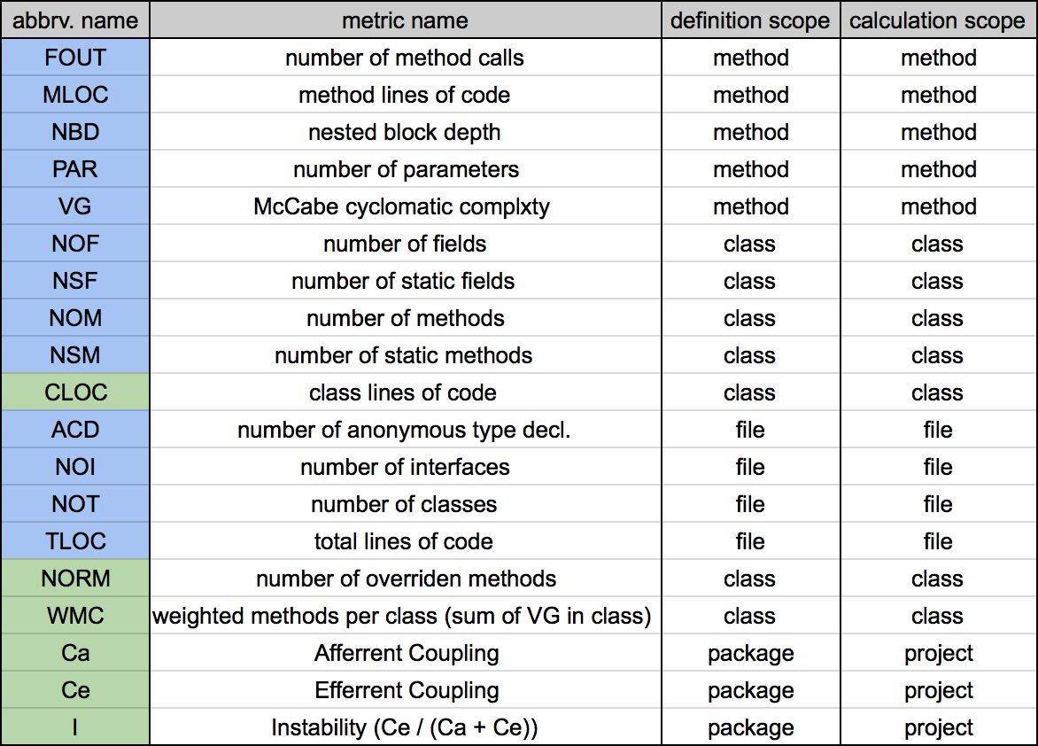

Slide 13
JOnion Testing
Adopt JUnit test framework
Unit tests at three level
At least 1 for every metrics developed
Limitation: designated test cases
Have datasets for integrated test
try our best to enlarge the coverage

Slide 14
JOnion Testing
Technical Detail:
One test suite controls all
Assertment of metrics value in test case classes
One test case for the specific metric

Slide 15
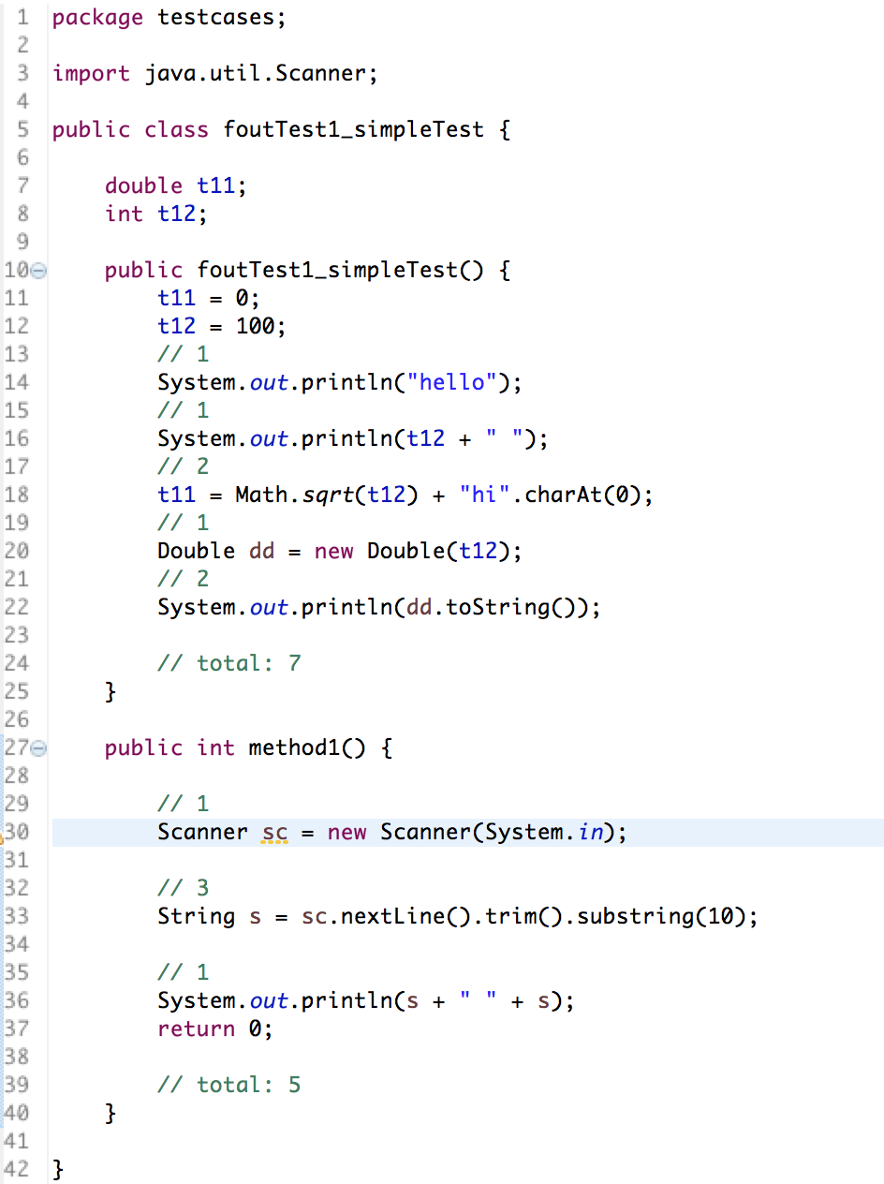
JOnion Testing

Slide 16
Other tools
Eclipse Metrics Plugin 1.3.6
Eclipse Metrics Plugin 1.3.8
Most professional on calculation
SourceMonitor 3.5 (Windows only)
JMetric Beta (particular for Java)
Perhaps more

Slide 17
Datasets
Jaim ----- 46 source files
implements the AOL IM TOC protocol as a Java library.
jTcGUI ----- 5 source files
a Linux tool for managing TrueCrypt volumes.

Slide 18
Datasets
ProGuard ----- 465 source files
a free Java class file shrinker, optimizer, and
obfuscator.
Already got the source code from SourceForge
All gets built in Eclipse properly

Slide 19
Evaluation
Best way is to compare with an “oracle”
Different definition of metrics and different values
Manual calculation would be exhaustive or impossible
Doing statistical analysis on results

Slide 20
Evaluation
Examples:
Random sampling
Evaluation based on model of quality (ISO 9126)
Most challenging part: find a better way to do it …

Slide 21
Conclusion
What made us feel good:
Already implement most metrics calculation
Sufficient test cases developed
Dataset has been chosen and ready to test
Done some manual comparisons

Slide 22
Conclusion
What will make us feel good:
More other similar tools needed
Comp up with new evaluation method
Run all tools against dataset
Accuracy and coverage analysis

Slide 23
Overall Conclusion
Efficient code metrics calculation tool
Realistic meaning for researchers
Generally speaking, better than other tools
A better evaluation methods required
Need more useful metrics
Become developers friendly

Slide 24
Thank You!
Please Remember JOnion!

