Slide 1

五子棋游戏分析
演讲人:陈天琪

Slide 2
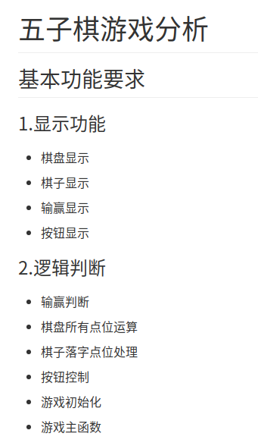
1.明白这个游戏怎么玩,怎么才算赢
2.再做简单的分析,理清大致的思路
3.列出要实现的最基本功能(一开始不能想的太复杂)

Slide 3
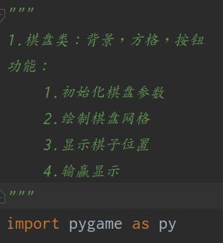
五子棋游戏
开发环境:
语言:Python
工具:pycharm
第三方库:pygame

Slide 4


五子棋游戏
显示功能:
棋盘类Checker

Slide 5
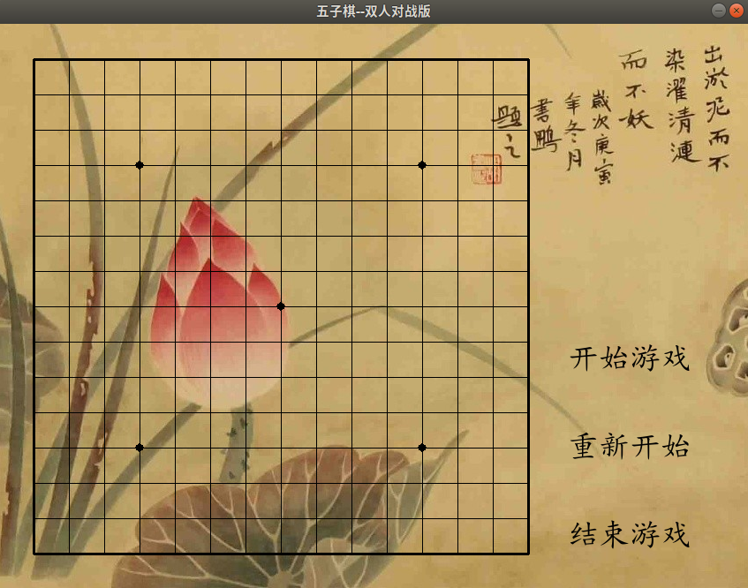
五子棋游戏
界面效果展示:

Slide 6
五子棋游戏
def work(self,value): # 显示棋子
if value[2] == 1:
self.screen.blit(white,(value[0]-18,value[1]-18))
else:
self.screen.blit(black,(value[0]-18,value[1]-18))
py.display.flip()
每一个棋子点位是一个拥有三个元素的元组,通过下标访问,前两个是x轴和y轴数据,第三位是棋子的标志位有三种状态0,1,2;1显示白棋,2显示黑棋!

Slide 7
五子棋游戏
def win(self,value): # 显示胜负
if value == 1:
self.screen.blit(win_white, (50, 50))
py.display.flip()
return True
elif value == 2:
self.screen.blit(win_black, (50, 50))
py.display.flip()
return True
elif value == 3:
self.screen.blit(win_draw, (50, 50))
py.display.flip()
return True
这里通过后台judge函数判断输赢返回的值而进行判断显示,也存在三种情况:1显示白棋胜利;2显示黑棋胜利;3显示平局,通过计算黑白棋数量判定平局!

Slide 8
五子棋游戏
后台逻辑:
三个模块:
game_main:主模块,里面包含两个函数init_game和main
botton:按钮功能模块,里面包含gmstart,gmagain,gmend三 个函数
piece:运算模块,包含qipan,state,judge三个函数

Slide 9
game_main模块
五子棋游戏
import pygame as py
from checker import *
import piece as pe
import botton as bt
list_QPZB = [] # 棋盘坐标
fps = 100
start_game = False
end_game = False
def init_game(): # 初始化函数
py.init()
py.mixer.init()
py.mixer.music.load("和平天下.mp3")
py.mixer.music.play(-1, 0.0)
pe.qipan(list_QPZB) # 初始化棋盘
global ch
ch = Checker() # 创建一个对象
ch.show() # 显示棋盘
将整个游戏初始化

Slide 10
game_main模块
五子棋游戏
def main():
init_game() # 初始化
running = True
fcc = py.time.Clock()
count_num = 0 # 棋子数重置
global start_game,end_game
while running:
fcc.tick(fps)
for event in py.event.get():
if event.type == py.MOUSEBUTTONDOWN:
x, y = py.mouse.get_pos()
if bt.gmstart(x,y): # 开始游戏
start_game = True
elif bt.gmend(x,y): # 结束游戏
end_game = True
elif bt.gmagain(x,y): # 重新开始
pe.qipan(list_QPZB)
count_num = 0
ch.show() # 显示棋盘
start_game = True
if start_game == True:
value = pe.state(x, y, list_QPZB)
if value: # 鼠标点中位置在棋盘规定范围，进行处理；否则不做处理
count_num += 1
ch.work(value)
if count_num >= 9: # 当总棋子数大于9时才开始判断输赢
if ch.win(pe.judge(list_QPZB)): # 判断游戏输赢
start_game = False
if event.type == py.QUIT or end_game == True: # 结束退出游戏
py.quit()
running = False
exit()

Slide 11
botton模块
五子棋游戏
def gmstart(x,y): # 开始按钮
if 645 < x < 790 and 350 < y < 410:
# print('请开始游戏')
return 1
def gmagain(x,y): # 重新开始游戏
if 645 < x < 790 and 450 < y < 510:
# print('重新开始游戏')
return 1
def gmend(x,y): # 结束按钮
if 645 < x < 790 and 550 < y < 610:
return 1

Slide 12
piece模块
五子棋游戏
def qipan(list1): # 初始化棋盘坐标
list1.clear() # 清空列表，确保每次初始化，列表长度一致(重新开始游戏才有用)
for i in range(1,16):
list_line = [] # 每行交叉点
for j in range(1,16):
point_x = j * 40
point_y = i * 40
po = (point_x, point_y, 0)
list_line.append(po)
list1.append(list_line) # 总交叉点

Slide 13
piece模块
五子棋游戏
def state(x,y,list1): # 棋子状态运算
global Qizi
i = j = 0
for temp in list1:
for pos in temp:
if x >= pos[0] - 10 and x <= pos[0] + 10 and y >= pos[1] - 10 and y <= pos[1] + 10:
if pos[2] == 0 and Qizi == 1:
work = (pos[0], pos[1], 1)
list1[j][i] = work # 改变棋盘点位列表，一个点只能放一个棋子
Qizi = 2 # 切换成黑棋
return work
elif pos[2] == 0 and Qizi == 2:
work = (pos[0], pos[1], 2)
list1[j][i] = work
Qizi = 1 # 切换成白棋
return work
i += 1
j += 1
i = 0

Slide 14
piece模块
五子棋游戏
def judge(list1): # 输赢判断函数
count = 0
for i in range(len(list1)):
for j in range(len(list1[i])):
if j <= len(list1[i])-5:
# 横向判断
if list1[i][j][2] == 1 and list1[i][j+1][2] ==1 and list1[i][j+2][2] ==1 and list1[i][j+3][2] ==1 \
and list1[i][j+4][2] == 1:
return 1
elif list1[i][j][2] == 2 and list1[i][j+1][2] ==2 and list1[i][j+2][2] == 2 and list1[i][j+3][2] == 2 \
and list1[i][j+4][2] == 2:
return 2
......
if list1[i][j][2] == 1 or list1[i][j][2] == 2:
count += 1
if count == 255:
return 3

Slide 15

Thank you!

