Slide 1
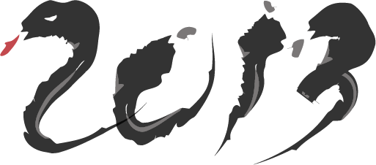
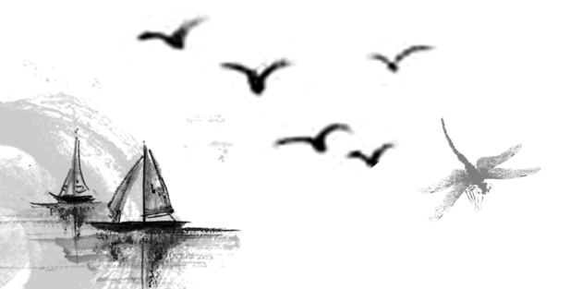
贪吃蛇
喻朗PPT展示

Slide 2
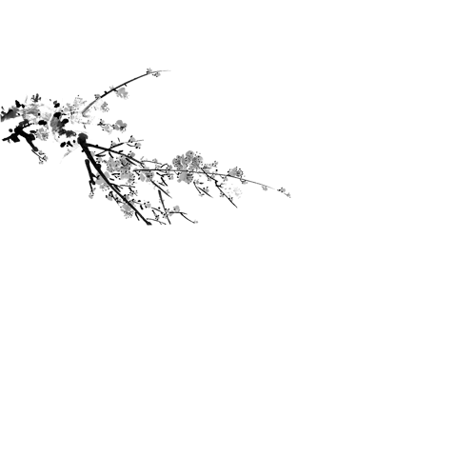


导入模块
import random
import pygame
import sys
from pygame.locals import *
#将pygame的所有常量都导入

Slide 3
属性定义
# 定义颜色
White = (255, 255, 255)
Black = (0, 0, 0)
Red = (255, 0, 0)
Green = (0, 255, 0)
DARKGreen = (0, 155, 0)
DARKGRAY = (40, 40, 40)
YELLOW = (255, 255, 0)
Red_DARK = (150, 0, 0)
BLUE = (0, 0, 255)
BLUE_DARK = (0, 0, 150)
BGCOLOR = Black # 背景颜色
# 定义键盘
UP = 'up'
DOWN = 'down'
LEFT = 'left'
RIGHT = 'right'
HEAD = 0
Snakespeed = 17
# 蛇的移动速度
Window_Width = 800
Window_Height = 500
Cell_Size = 20
# 单个单元格的大小
assert Window_Width % Cell_Size == 0, "Window width must be a multiple of cell size."
# 不满足条件则返回提示
# 保证窗口宽度必须是单元格的整数倍.
assert Window_Height % Cell_Size == 0,
"Window height must be a multiple of cell size."
# 保证窗口的高度必须是单元格的整数倍
Cell_W = int(Window_Width / Cell_Size) # 单元格宽度
Cell_H = int(Window_Height / Cell_Size) # 单元格高度

Slide 4
定义蛇、苹果和分割线
def drawApple(coord): # 画苹果
x = coord['x'] * Cell_Size
y = coord['y'] * Cell_Size
appleRect = pygame.Rect(x, y, Cell_Size, Cell_Size) # x,y 坐标位置 Cell_Size 宽高大小
pygame.draw.rect(DISPLAYSURF, Red, appleRect)
def drawWorm(wormCoords): # 画蛇
for coord in wormCoords:
x = coord['x'] * Cell_Size
y = coord['y'] * Cell_Size
wormSegmentRect = pygame.Rect(x, y, Cell_Size, Cell_Size)
pygame.draw.rect(DISPLAYSURF, DARKGreen, wormSegmentRect)
wormInnerSegmentRect = pygame.Rect(
x + 4, y + 4, Cell_Size - 8, Cell_Size - 8)
pygame.draw.rect(DISPLAYSURF, Green, wormInnerSegmentRect)
def drawGrid(): # 画分割线的函数
for x in range(0, Window_Width, Cell_Size): # 画垂直线
pygame.draw.line(DISPLAYSURF, DARKGRAY, (x, 0), (x, Window_Height))
for y in range(0, Window_Height, Cell_Size): # 画水平线
pygame.draw.line(DISPLAYSURF, DARKGRAY, (0, y), (Window_Width, y))

Slide 5
退出
定义游戏主函数
定义游戏开始时的一些要素值
def main():
global SnakespeedCLOCK, DISPLAYSURF, BASICFONT
pygame.init()
SnakespeedCLOCK = pygame.time.Clock()
# 创建时钟对象 (可以控制游戏循环频率)
DISPLAYSURF = pygame.display.set_mode((Window_Width, Window_Height)) # 窗口大小
BASICFONT = pygame.font.Font('freesansbold.ttf', 18)
pygame.display.set_caption('Snake')
showStartScreen()
while True:
runGame()
showGameOverScreen()
def runGame():
# 定义了一个随机的贪吃蛇的坐标
startx = random.randint(5, Cell_W - 6)
starty = random.randint(5, Cell_H - 6)
wormCoords = [{'x': startx, 'y': starty}, # 贪吃蛇坐标
{'x': startx - 1, 'y': starty},
{'x': startx - 2, 'y': starty}]
direction = RIGHT
# 定义苹果起始的随机位置
apple = getRandomLocation()
def getRandomLocation(): # 随机苹果位置
return {'x': random.randint(0, Cell_W - 1), 'y': random.randint(0, Cell_H - 1)}

Slide 6
判断蛇方向和退出情况
while True: # 死循环让游戏一直持续下去
for event in pygame.event.get(): # 事件循环
if event.type == QUIT:
terminate()
elif event.type == KEYDOWN:
if (event.key == K_LEFT) and direction != RIGHT:
direction = LEFT
elif (event.key == K_RIGHT) and direction != LEFT:
direction = RIGHT
elif (event.key == K_UP) and direction != DOWN:
direction = UP
elif (event.key == K_DOWN) and direction != UP:
direction = DOWN
elif event.key == K_ESCAPE:
terminate()
核心
关键
# 通过在snake的移动方向上增加一个段来移动
if direction == UP:
newHead = {'x': wormCoords[HEAD]['x'],
'y': wormCoords[HEAD]['y'] - 1}
elif direction == DOWN:
newHead = {'x': wormCoords[HEAD]['x'],
'y': wormCoords[HEAD]['y'] + 1}
elif direction == LEFT:
newHead = {'x': wormCoords[HEAD][
'x'] - 1, 'y': wormCoords[HEAD]['y']}
elif direction == RIGHT:
newHead = {'x': wormCoords[HEAD][
'x'] + 1, 'y': wormCoords[HEAD]['y']}

Slide 7
判断蛇现在情况及处理方式
# 判断snake是否碰撞到墙壁或者碰撞到自己本身
if wormCoords[HEAD]['x'] == -1 or wormCoords[HEAD]['x'] == Cell_W or wormCoords[HEAD]['y'] == -1 or \
wormCoords[HEAD]['y'] == Cell_H:
return # game over 撞到墙了
for wormBody in wormCoords[1:]:
if wormBody['x'] == wormCoords[HEAD]['x'] and wormBody['y'] == wormCoords[HEAD]['y']:
return # game over 撞到自己了
# 判断snake是否吃到了苹果
if wormCoords[HEAD]['x'] == apple['x'] and wormCoords[HEAD]['y'] == apple['y']:
apple = getRandomLocation() # 当苹果被吃了后重新随机一个坐标
else:
del wormCoords[-1] #删除尾部

Slide 8
结束函数
def showGameOverScreen(): # 游戏结束界面
gameOverFont = pygame.font.Font('freesansbold.ttf', 100)
gameSurf = gameOverFont.render('Game', True, White)
overSurf = gameOverFont.render('Over', True, White)
gameRect = gameSurf.get_rect()
overRect = overSurf.get_rect()
gameRect.midtop = (Window_Width / 2, 10)
overRect.midtop = (Window_Width / 2, gameRect.height + 10 + 25)
DISPLAYSURF.blit(gameSurf, gameRect)
DISPLAYSURF.blit(overSurf, overRect)
drawPressKeyMsg()
pygame.display.update()
pygame.time.wait(500)
checkForKeyPress() # 清空事件中所有的按键
while True:
if checkForKeyPress():
pygame.event.get() # 清空事件队列
return

Slide 9
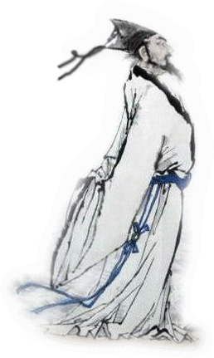
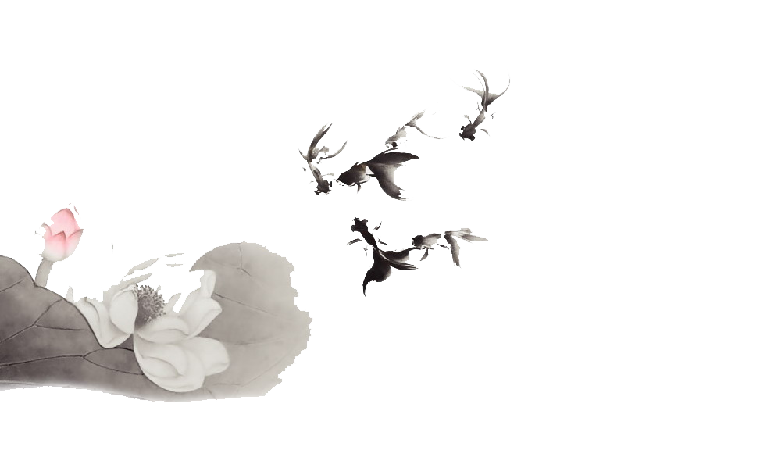
谢谢

