Slide 1
EVOAGENTX STUDIO
Build, run, evaluate and improve agent workflows in one place
Seven features, shown on one example pipeline from start to finish.
Example used throughout: a customer-feedback pipeline
Notes:
EvoAgentX Studio is a general platform for agent workflows. This deck walks through its seven features, always on the same example: a pipeline that reads customer feedback, classifies it and writes a report.

Slide 2
What the platform does
1
2
3
4
Canvas
Data
Batch runs
Memory
Build a pipeline by dragging nodes and drawing links.
Datasets are defined in Python and read in batches.
Node by node, batch by batch, with live progress and cost.
Kept per entity and per date; a step never reads the future.
5
6
7
Each one is shown next, on the same customer-feedback pipeline.
Chat assistant
Evaluation
Evolve
Create a pipeline, or change one, by asking in plain words.
Your own code scores every result.
Prompts improve automatically and are checked on held-out data.
Notes:
Seven features in one place. The rest of the deck takes them in this order, each on the same example pipeline, so the audience follows one thing from start to finish.

Slide 3
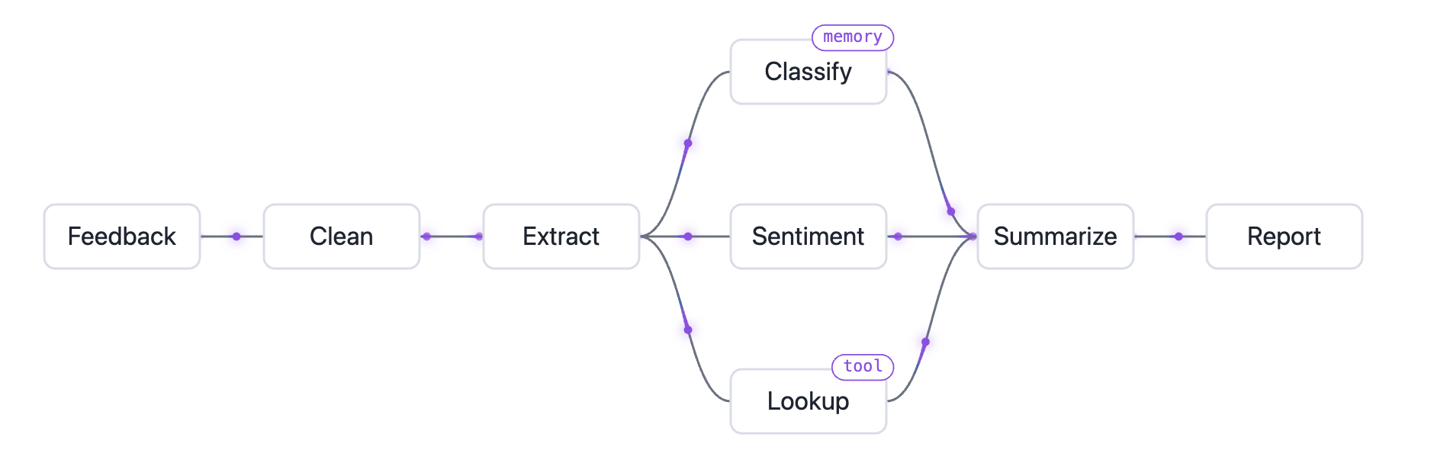
The example: a customer-feedback pipeline
Feedback is cleaned and extracted, then classified with each customer’s history, scored for sentiment and enriched by a tool, before a summary and a report.
Notes:
Eight steps. Classify reads memory: each customer’s earlier feedback. Lookup calls a tool to fetch the customer’s plan. The three middle steps run side by side and join at Summarize.

Slide 4
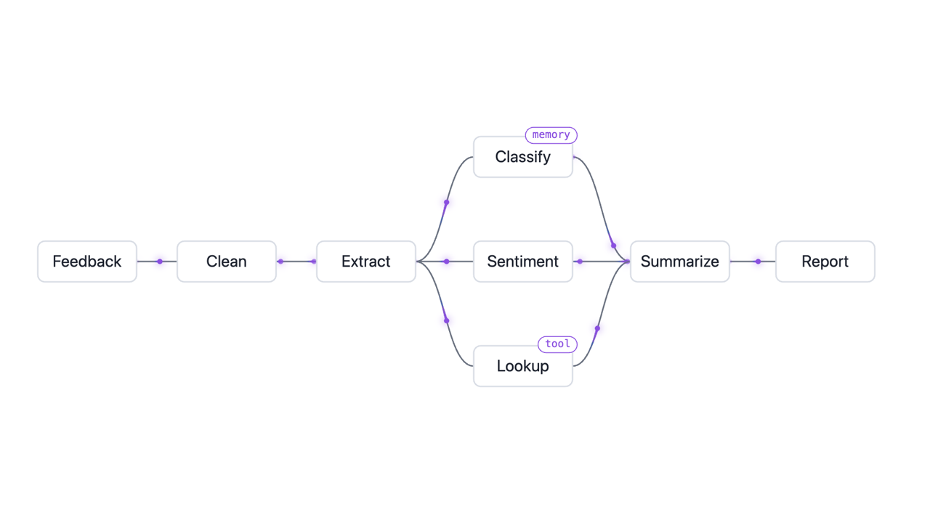
FEATURE 1 OF 7
Canvas
Drag nodes and draw links. What you see is the pipeline that runs.
• Prompt, model and tools per node
• Branches run side by side
• Save, undo and rename like a document
Notes:
The canvas is the pipeline. Nodes appear, one is dragged into place, and the links draw in. Each node holds its own prompt, model and tools. The clip starts with the slide and loops.

Slide 5
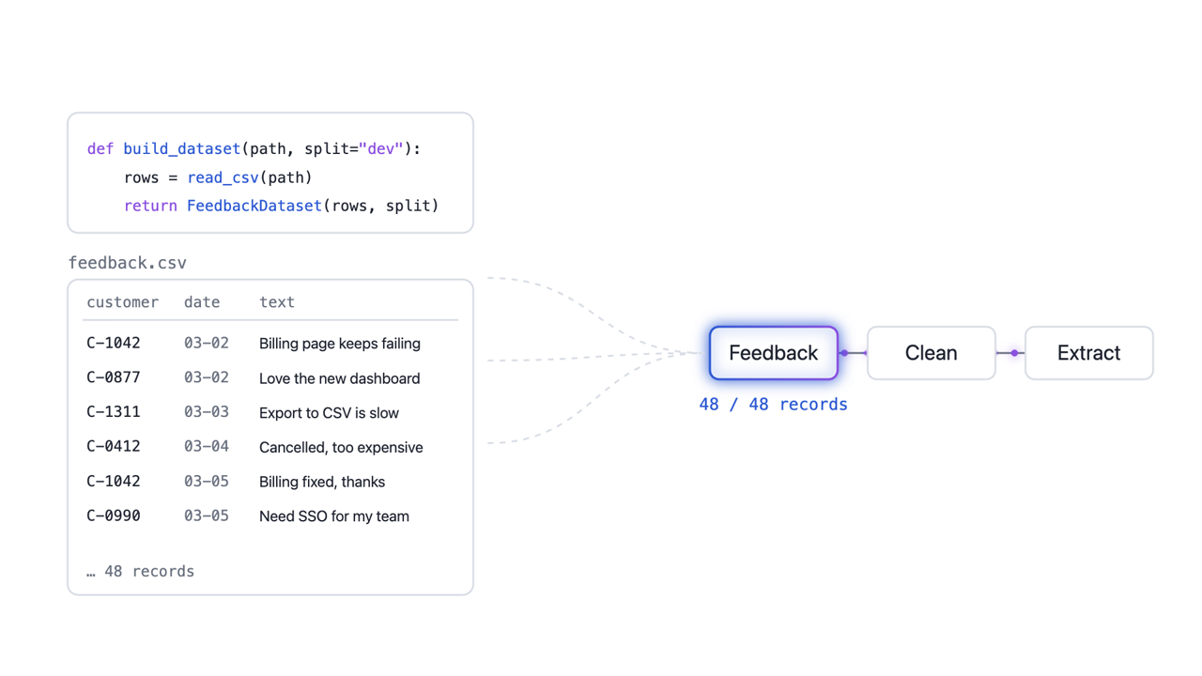
FEATURE 2 OF 7
Data
Your dataset is a Python function. Its records stream in batches.
• build_dataset returns a PyTorch Dataset
• Batch size and split are set per run
• Each batch enters at the first node
Notes:
The dataset is plain Python. Its 48 records leave the file in three batches of 16 and enter the Feedback node, which passes them down the pipeline. The clip starts with the slide and loops.

Slide 6
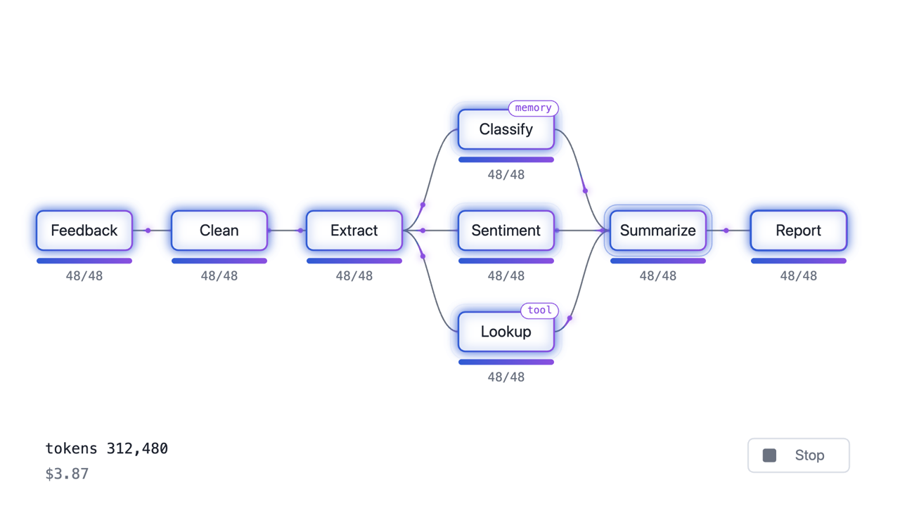
FEATURE 3 OF 7
Batch runs
Every step runs batch by batch, and you watch it happen.
• Branches run in parallel
• Progress, tokens and cost update live
• Stop at any time, resume later
Notes:
Each step starts a batch once the steps before it have. The three middle branches run in parallel. Tokens and cost count up live, and Stop ends every model call at once. Numbers are illustrative. The clip starts with the slide and loops.

Slide 7
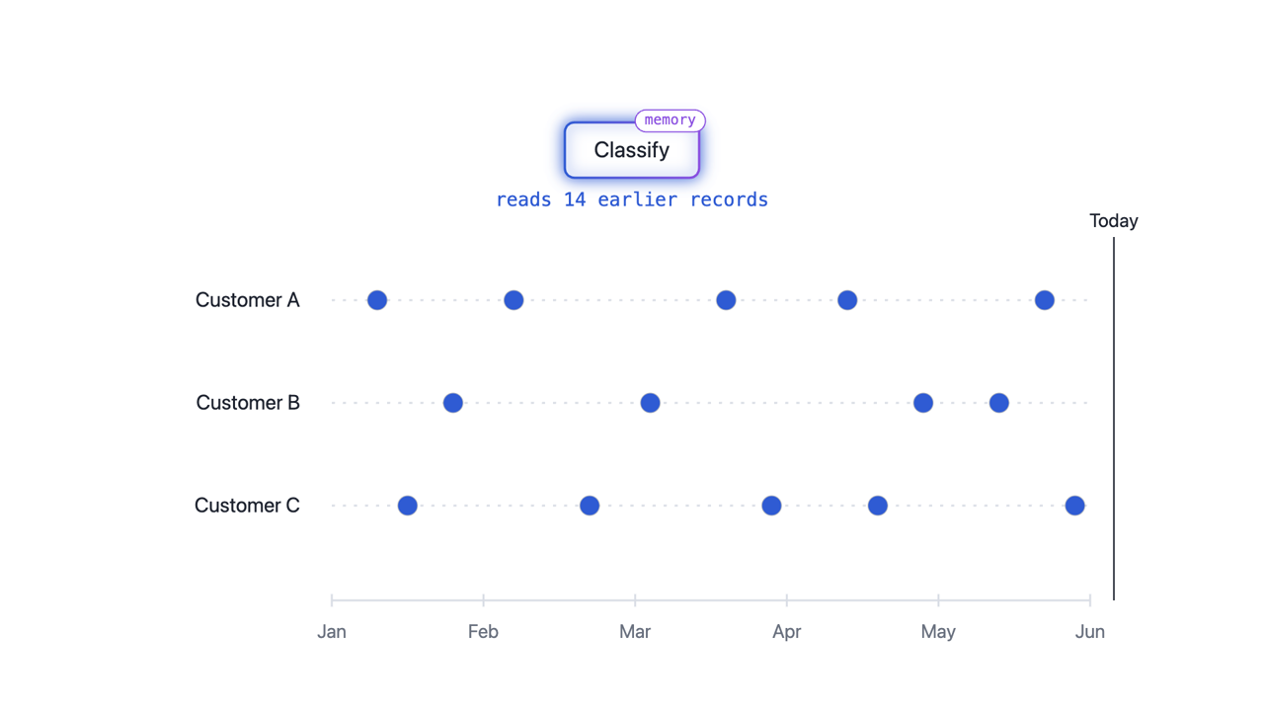
FEATURE 4 OF 7
Memory
Classify reads each customer’s earlier feedback, never anything later.
• Kept per entity: here, per customer
• Every record is filed under its date
• A run sees only what came before
Notes:
As the Today line moves, each customer’s records become readable only once their date has passed. Classify never sees later feedback, so a backtest never leaks the future. The clip starts with the slide and loops.

Slide 8
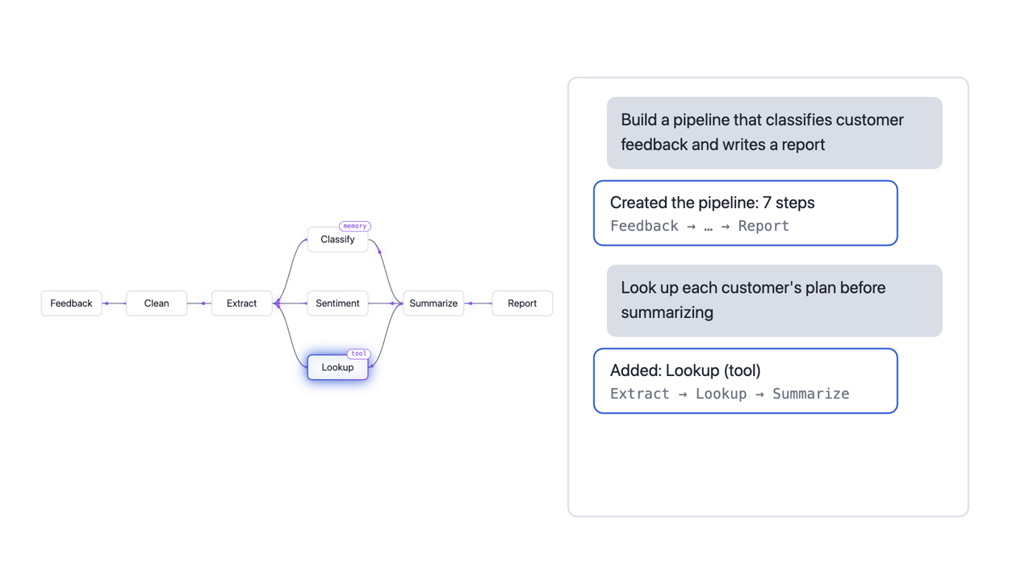
FEATURE 5 OF 7
Chat assistant
Describe a pipeline and it is built. Ask for a change and it is edited.
• Builds a whole pipeline from one sentence
• Adds, changes or removes steps
• Every change can be undone
Notes:
Two requests in one conversation. The first builds the pipeline on an empty canvas. The second adds the Lookup tool step and wires it between Extract and Summarize. The clip starts with the slide and loops.

Slide 9
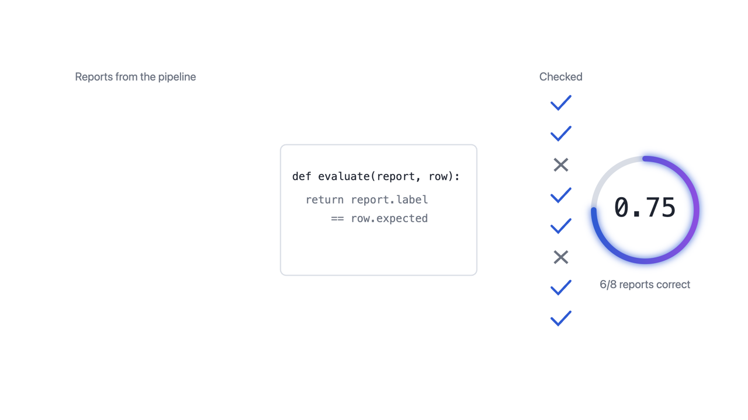
FEATURE 6 OF 7
Evaluation
Your own code decides what “correct” means.
• Paste a Python evaluate function
• Run it on any batch of reports
• The score is what Evolve raises
Notes:
Evaluation is a Python function you paste in. Each report is checked, and the score it produces is the target Evolve tries to raise. The 6 of 8 is illustrative. The clip starts with the slide and loops.

Slide 10
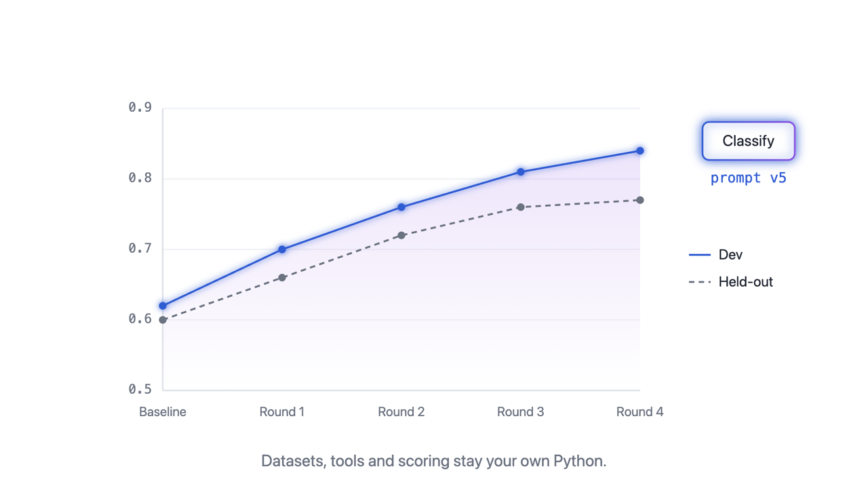
FEATURE 7 OF 7
Evolve
Each round closes the loop, and the score rises on data it never saw.
• Rewrites the Classify prompt each round
• Optimises on the dev split
• Confirms on a held-out split
Notes:
First the loop each round closes: feedback runs through the pipeline, gets scored, and Evolve writes a better Classify prompt. Then the result: dev and held-out scores rising round by round. Numbers are illustrative. The clip starts with the slide and loops.

Slide 11
IN SHORT
Every round closes the loop
Feedback
Pipeline
Score
Better prompts
every round
Datasets, tools and scoring stay your own Python. Studio runs, measures and improves the rest.
Notes:
The loop in one picture: feedback goes through the pipeline, your code scores it, Evolve writes better prompts, and the next round starts.

