Slide 1
CLIMB
When to Call the Team
Save tokens on multi-agent LLM pipelines, with a guarantee on accuracy
Jianjun Gao, Jinxin Liu, Dongyun Lin, Hongyun Cai, Zheng Ma
Notes:
Teams of LLM agents can be more accurate than one model call, but they cost several times as much. This talk is about when the team is worth calling, and how to skip it safely.

Slide 2
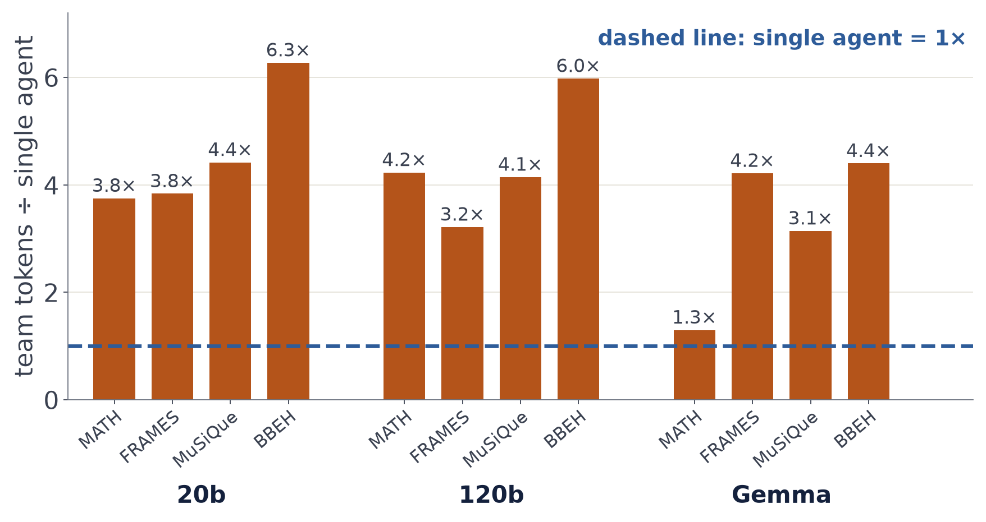
THE PROBLEM
Agent teams cost several times more
up to 6.3×
the tokens of one agent answering alone
Planner, executor and reviewer each add calls, for up to 5 rounds.
2
Notes:
Our team is a standard plan, execute, review pipeline. Each bar is one model on one benchmark. The team uses 1.3 to 6.3 times the tokens of a single agent answering on its own.

Slide 3
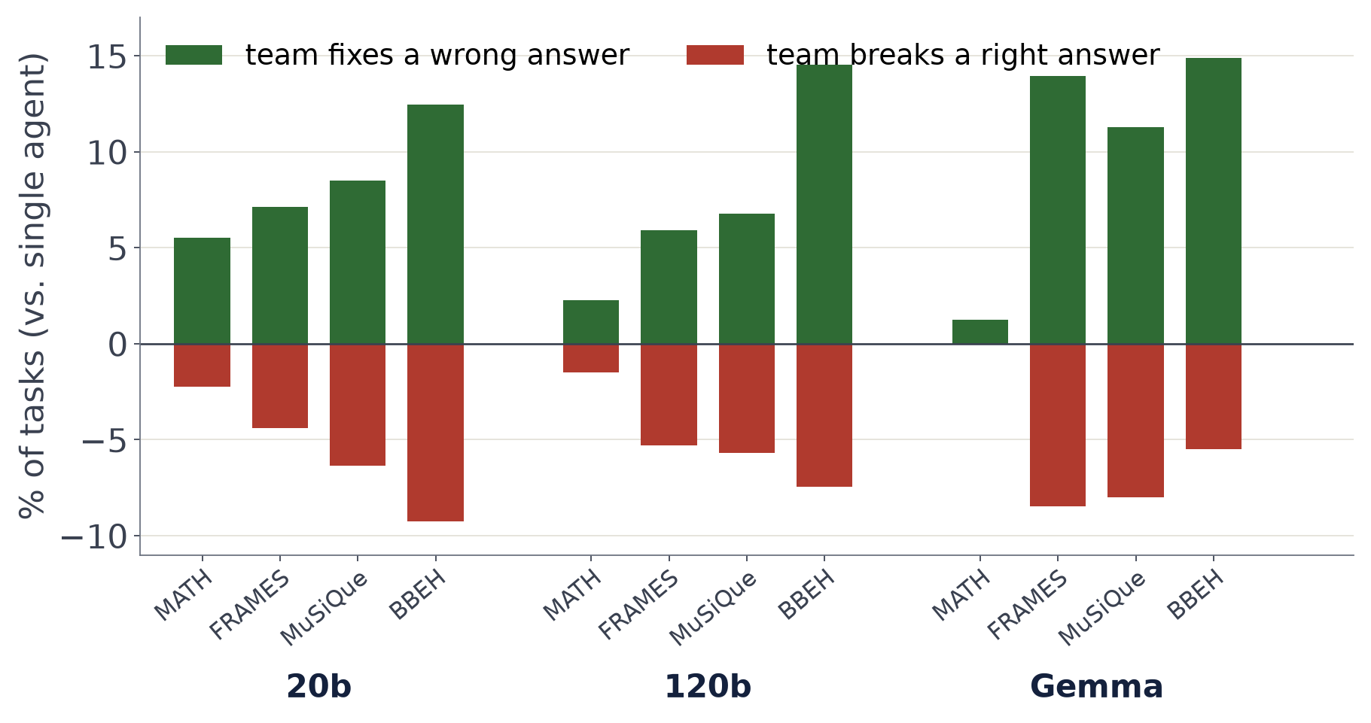
THE PROBLEM
…and they are not always better
up to 15%
of tasks: the team fixes a wrong answer
up to 9%
of tasks: the team breaks a right answer
3
Notes:
Green: tasks the single agent got wrong and the team fixed. Red: tasks the single agent got right and the team got wrong. The team wins on balance, but it also breaks answers, up to 9 percent of tasks.

Slide 4
THE PROBLEM
Why does the team break right answers?
Planner
writes a plan
Executor
first draft is WRONG
Reviewer
“Looks good” ACCEPTED
Final answer
WRONG
84%
of broken answers start as a wrong first draft the reviewer did not catch
23–58%
of wrong answers are accepted by the reviewer
4
Notes:
Where do the broken answers come from? In 84 percent of them the executor's first draft is already wrong, and the reviewer accepts it. Reviewers accept 23 to 58 percent of wrong answers. This is not just noise: rerunning the team reproduces about half of these losses.

Slide 5
THE IDEA
Climb a ladder: call the team only when needed
Agent team
most expensive
Single agent
medium
not sure?
go up
Direct answer
cheapest
not sure?
go up
sure? stop and answer
sure? stop and answer
always answers
5
Notes:
The idea is a ladder. Try the cheapest configuration first: a direct answer. If it looks reliable, stop. Otherwise try a single agent. Only if that also looks unreliable, call the full team. All three use the same model. The question is how to decide 'looks reliable'.

Slide 6
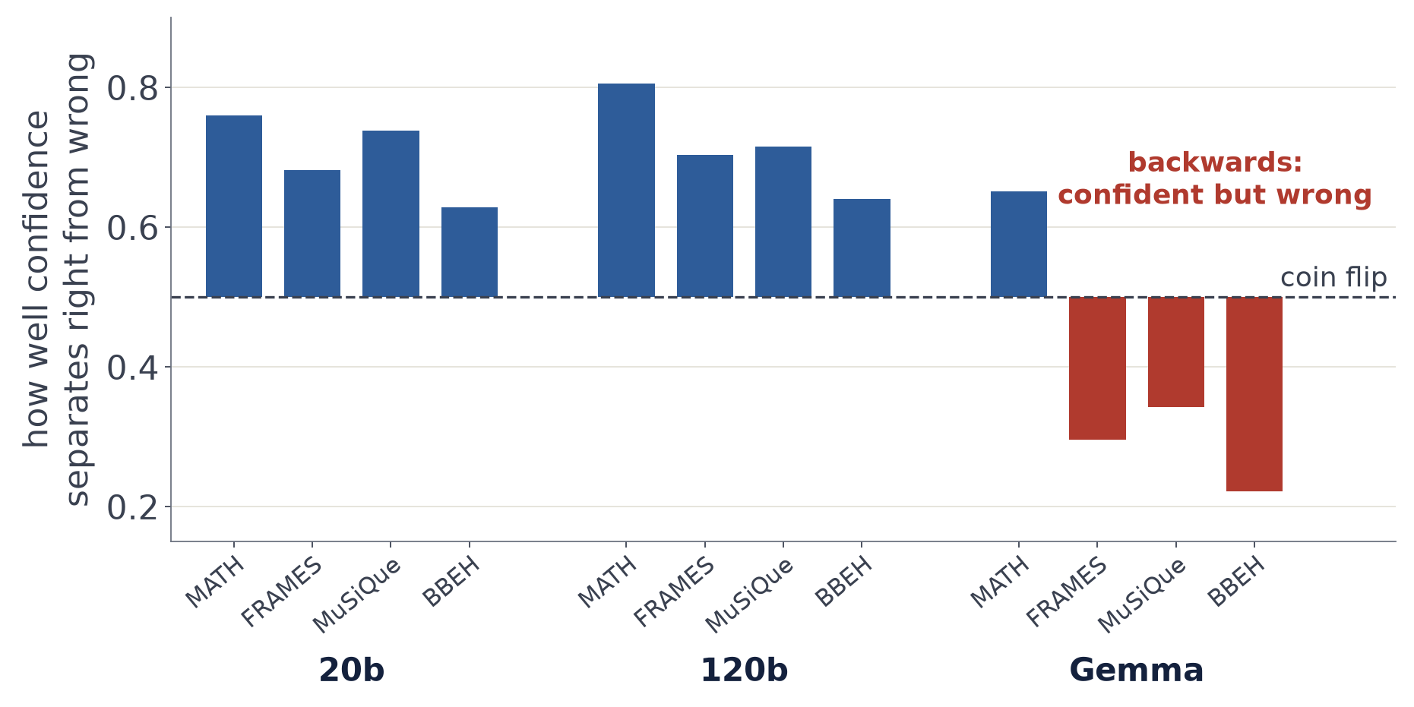
SIGNALS
Signal 1: how confident is the direct answer?
usually helps
confident answers tend to be right
3 of 12
settings where it points the wrong way
6
Notes:
How do we know a cheap answer is reliable? The first signal is free: the model's own confidence, its average token probability. Above the dashed line, confident answers are more often right. On three Gemma settings it points the wrong way: the model is confidently wrong. So any rule built on this signal must be checked, not trusted.

Slide 7
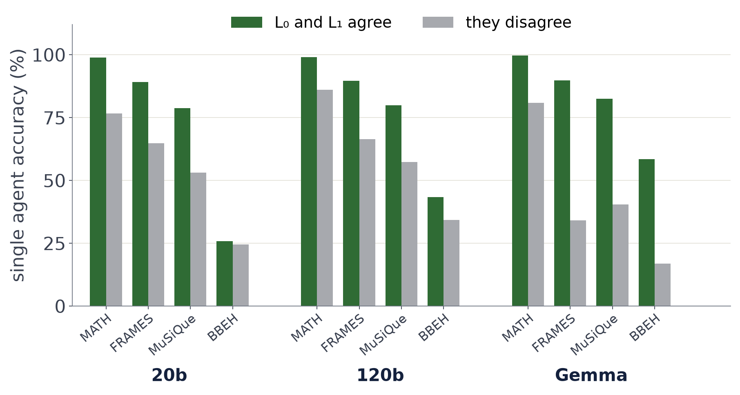
SIGNALS
Signal 2: do two cheap answers agree?
agree
→ the single agent is usually right
Neither answer sees the other, so agreement costs nothing extra.
7
Notes:
The second signal is also nearly free. The direct answer and the single agent answer independently. When they agree, the single agent is much more often right, for example 99 against 77 percent on gpt-oss-20b MATH. So CLIMB stops on agreeing tasks first.

Slide 8
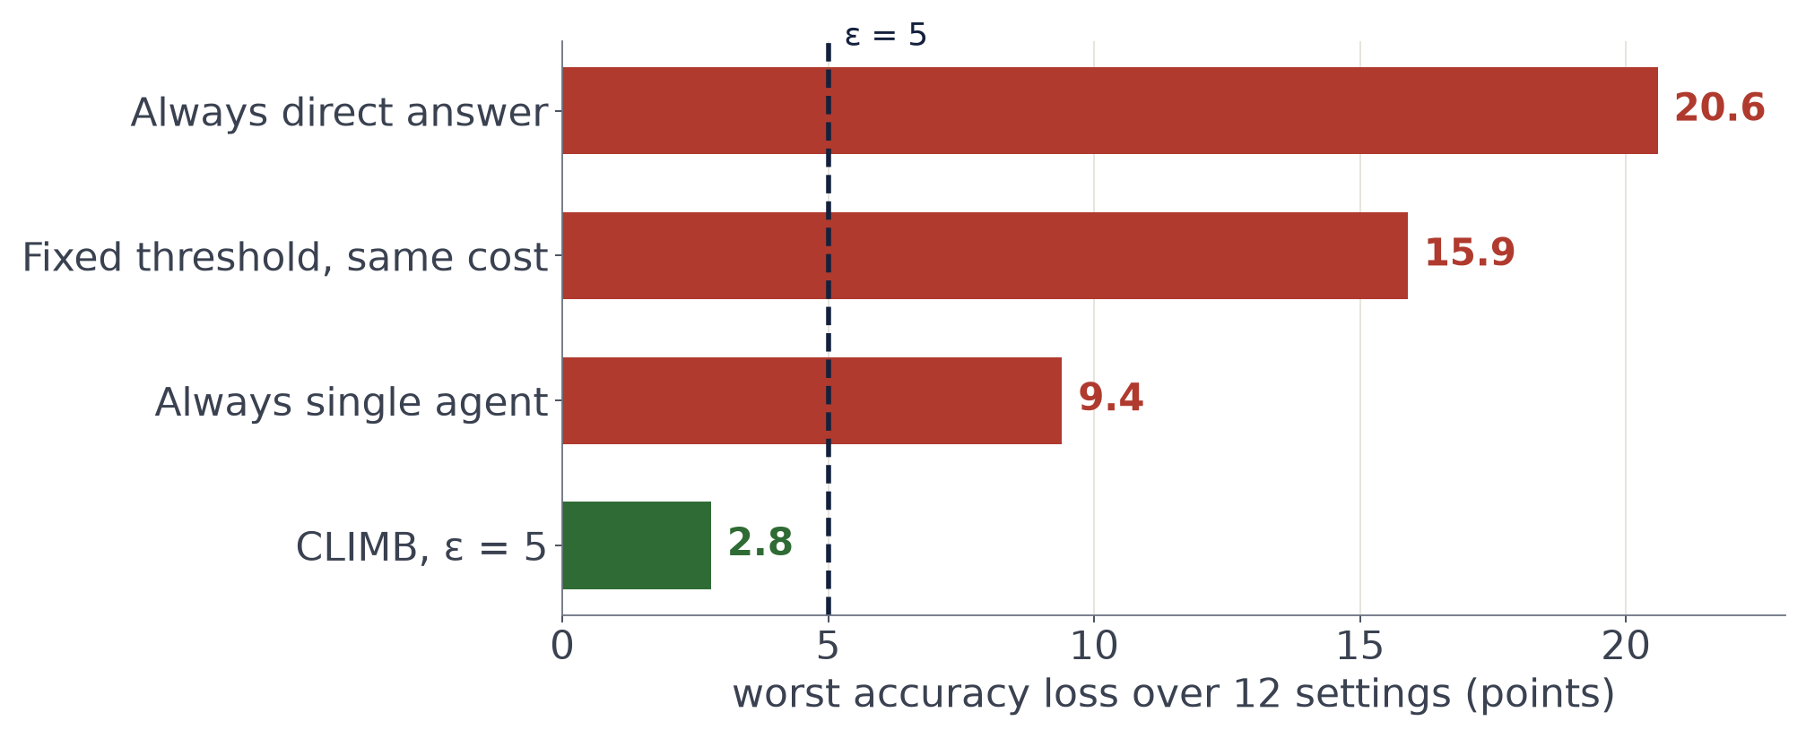
THE PROBLEM
Guessing a rule can go badly
16 points
lost by a hand-picked threshold on one setting
Nothing at deployment says which setting will go wrong.
8
Notes:
A natural shortcut is to pick a threshold by hand or by intuition. These rules can look fine on average but lose a lot on some settings. A fixed confidence threshold with the same average cost as CLIMB loses up to 16 points. Always using the single agent loses up to 9. CLIMB at a 5 point tolerance loses at most 2.8. In deployment, nothing tells you which setting is the bad one.

Slide 9
CLIMB
What CLIMB promises
You choose
“I can lose at most 5 points of accuracy”
CLIMB checks
a few hundred labelled tasks
You get
the cheapest rule that keeps the promise, 9 times out of 10
No cheaper rule passes? → call the team every time. Worst case: no savings, not lost accuracy.
9
Notes:
CLIMB turns this into a promise. You choose how much accuracy you can give up, say 5 points. CLIMB looks at a few hundred labelled tasks and returns the cheapest rule that keeps that promise, with 90 percent probability. If no cheaper rule qualifies, it simply calls the team every time, so the worst case is no savings, not lost accuracy.

Slide 10
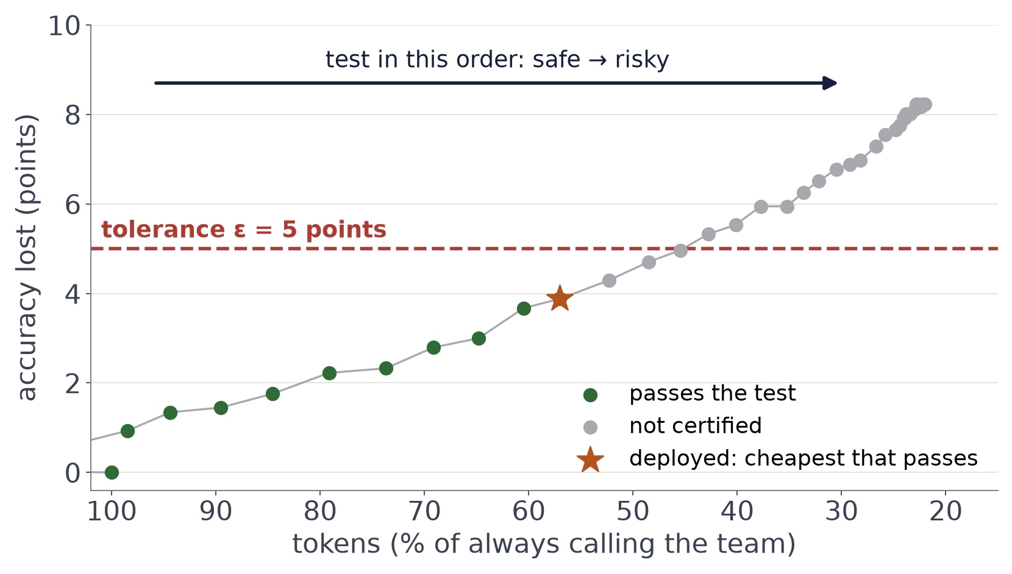
HOW IT WORKS
Keep the cheapest rule that passes
gpt-oss-120b on MuSiQue, thresholds on the direct answer’s confidence, one calibration half.
10
Notes:
Here is a real example: gpt-oss-120b on MuSiQue. Each dot is one possible threshold. On the left, almost everything goes to the team: safe but expensive. Moving right, more tasks stop early: cheaper but riskier. CLIMB tests them in this order and stops at the first one that fails. It deploys the cheapest one that passed, the star, at 57 percent of the tokens. Some grey dots are still under the line: the test is cautious, it needs evidence.

Slide 11
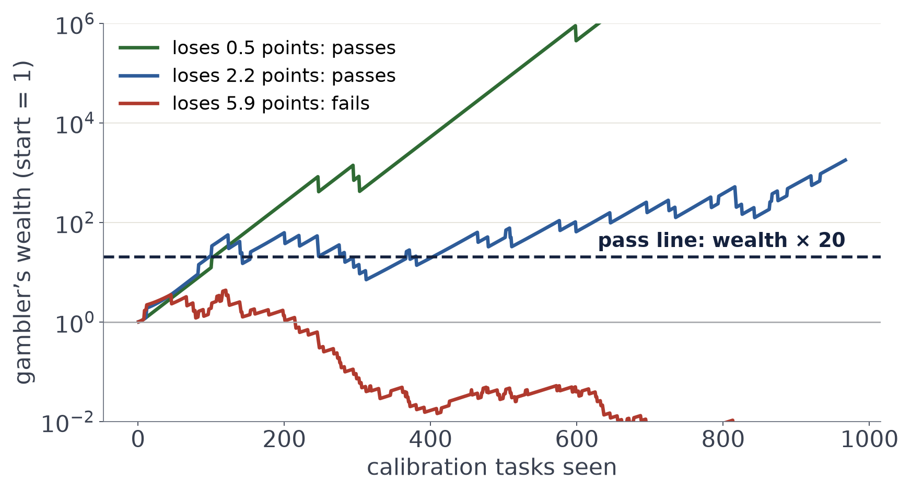
HOW IT WORKS
The test is a betting game
1
Start with $1.
2
Each task: bet that skipping the team does no harm.
3
No harm: win a little. Broken answer: lose.
4
Reach $20: the rule passes.
11
Notes:
How does the test decide pass or fail? Think of a gambler who bets that skipping the team is harmless. Start with one dollar. For each calibration task, if skipping did no harm, the gambler wins a little. If it broke an answer, the gambler loses. If the wealth ever reaches 20 times the start, the rule passes. A safe rule makes the gambler rich fast. A rule that loses 6 points makes the gambler broke. The bet size adapts to how often skipping changes anything, which makes the test efficient.

Slide 12
HOW IT WORKS
Skipping the team can also save answers
Cheap answer wrong,
team right
we lose a point
Both right,
or both wrong
no change (most tasks)
Cheap answer right,
team wrong
we save a point
Usual tests count only the left box. CLIMB counts both sides.
12
Notes:
One detail matters a lot. Skipping the team is not only a risk. Sometimes the cheap answer is right and the team would have broken it. Standard tests count only the losses. CLIMB counts both sides, so these saved answers offset the lost ones.

Slide 13
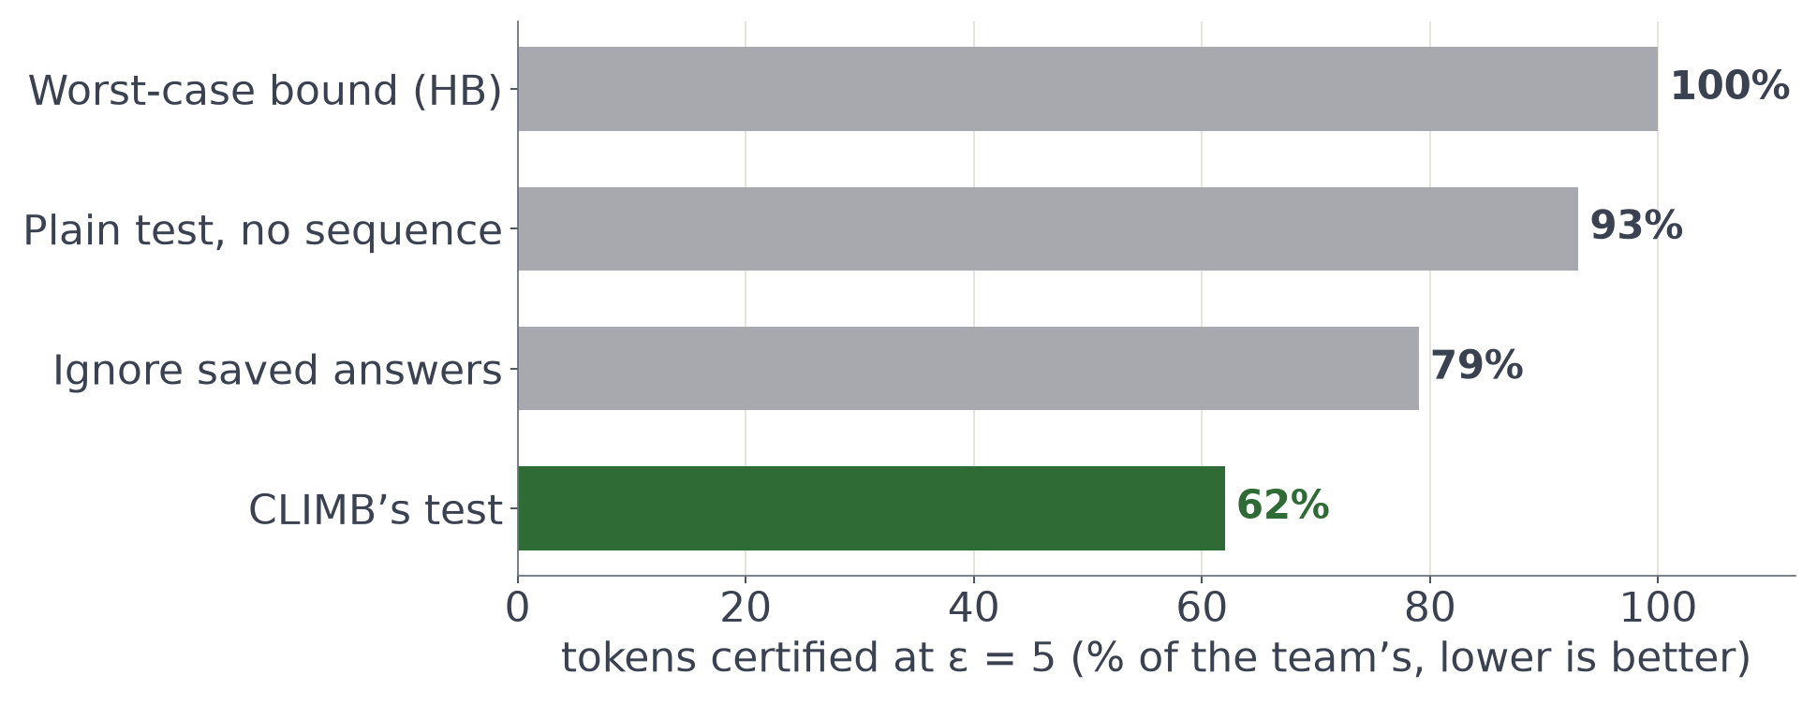
HOW IT WORKS
Counting both sides certifies much more
62%
of the team’s tokens with CLIMB’s test. A worst-case bound: 100%.
13
Notes:
Does the choice of test matter? Every test here is valid, they differ only in how much they can certify. A worst-case bound certifies nothing cheaper than the team. Ignoring the saved answers keeps 79 percent of tokens. CLIMB's test, which counts both sides and adapts to the variance, keeps 62 percent.

Slide 14
EXPERIMENTS
3 models × 4 benchmarks = 12 settings
MATH
math
FRAMES
open-book QA
MuSiQue
open-book QA
BBEH
hard reasoning
gpt-oss-20b
94.8%
team accuracy
76.1%
team accuracy
64.9%
team accuracy
28.0%
team accuracy
gpt-oss-120b
97.0%
team accuracy
79.8%
team accuracy
71.1%
team accuracy
45.1%
team accuracy
Gemma-4-26B
99.8%
team accuracy
67.9%
team accuracy
65.3%
team accuracy
36.4%
team accuracy
Record every task once, then replay 200 random splits: half to calibrate CLIMB, half to test it.
14
Notes:
We test on three open models and four benchmarks: math, two open-book question answering sets, and hard reasoning. We record every rung for every task once, then replay 200 random splits: half to calibrate CLIMB, half to evaluate it.

Slide 15
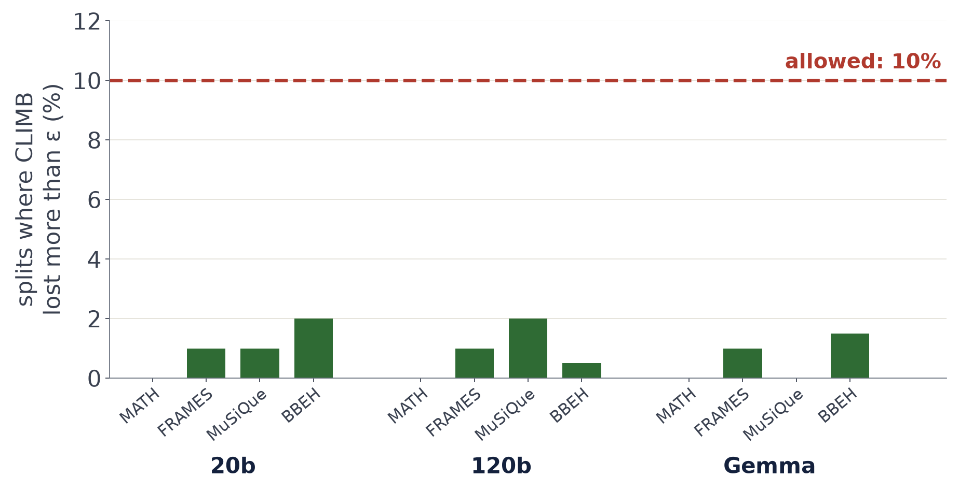
RESULTS
The promise holds on every setting
≤ 2%
of splits broke the promise. Allowed: 10%.
15
Notes:
Does the promise hold? For each setting, the share of splits where CLIMB lost more than its tolerance. The guarantee allows up to 10 percent. We see at most 2 percent. A separate check with 5,000 random calibration draws per setting gives at most 3.4 percent.

Slide 16
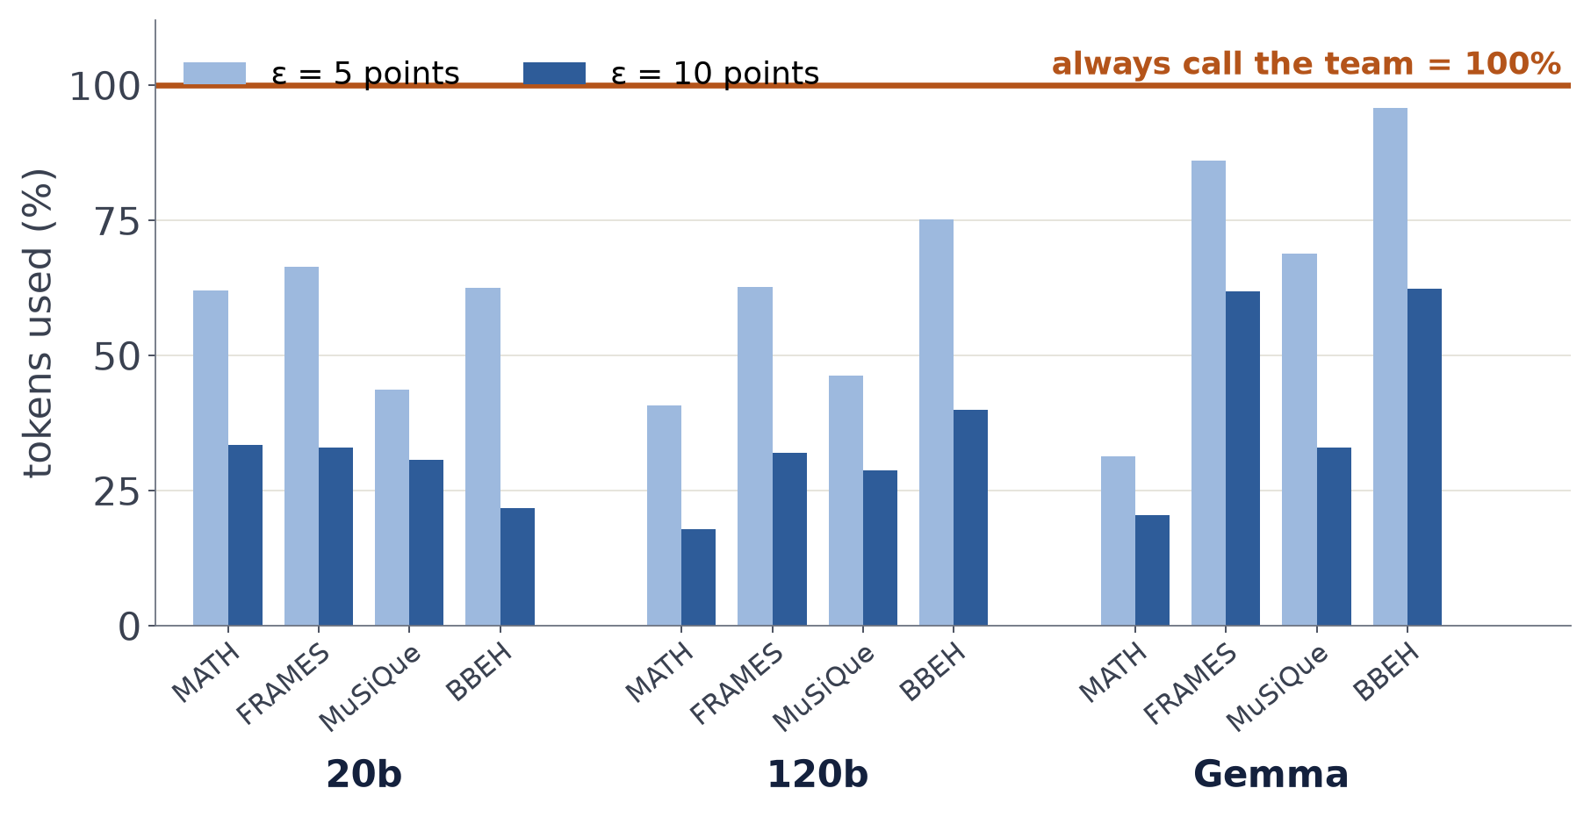
RESULTS
How much it saves
38% saved
allowing 5 points of loss
65% saved
allowing 10 points of loss
16
Notes:
How much does it save? Each bar is the share of the team's tokens CLIMB uses. At a 5 point tolerance it saves 38 percent on average, at 10 points 65 percent. Savings are smallest where confidence points the wrong way, on Gemma, and the guarantee still holds there: CLIMB just calls the team more often.

Slide 17
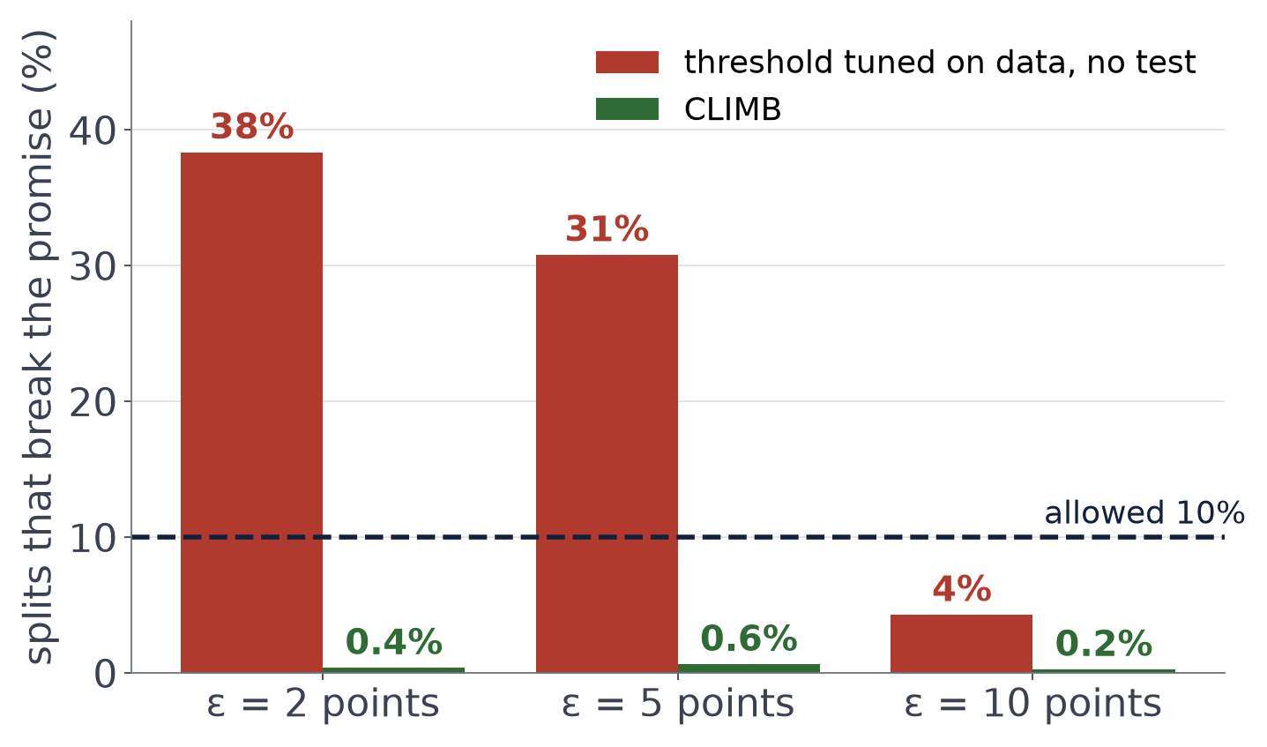
RESULTS
Without the test, the promise breaks
31%
of splits broken at ε = 5 by the tuned rule. CLIMB: 0.6%.
17
Notes:
Why not just tune the threshold on the same data, without the test? It is cheaper on paper, but it breaks the promise: at 5 points it fails on 31 percent of splits on average, against at most 2 percent for CLIMB. A rule tuned to the edge on one sample tends to cross it on the next. The extra tokens CLIMB spends are the price of the guarantee.

Slide 18
TAKEAWAYS
Call the team only when you must
Teams are costly
and sometimes break right answers.
CLIMB keeps a promise
you choose the accuracy loss, it finds the cheapest safe rule.
38–65% saved
at 5 and 10 points, with the promise kept.
Assumes calibration tasks resemble deployment tasks. Recalibrating takes under a second.
Thank you. Questions?
18
Notes:
To sum up. Agent teams are expensive and sometimes hurt. CLIMB calls them only when cheaper answers cannot be certified, keeps a user-chosen accuracy promise, and saves 38 to 65 percent of tokens. The guarantee assumes calibration tasks look like deployment tasks. Thank you.

