Slide 1

Cloud-based database
Postgresql & aws rds

Slide 2
Table of contents
Introduction
PostgreSQL asynchronous streaming master-slave replication
Amazon RDS
Amazon Aurora
Conclusion
References

Slide 3
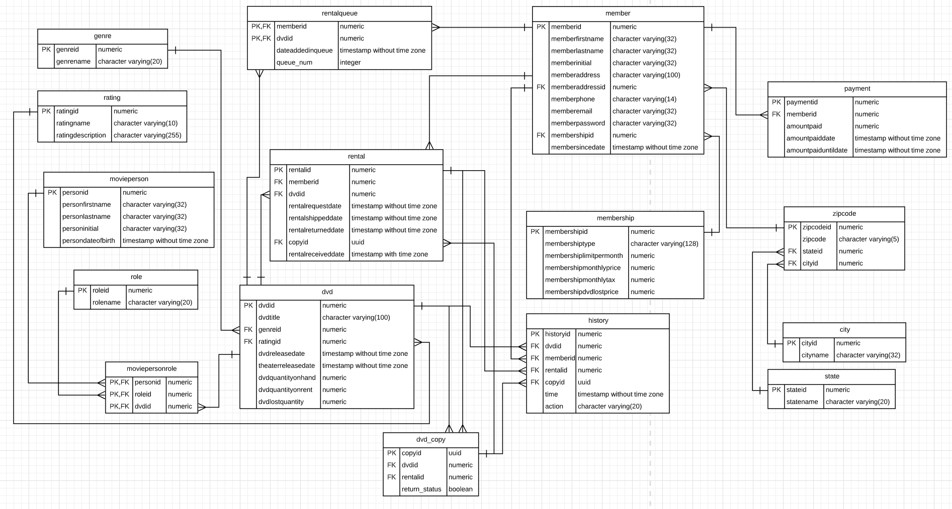
Introduction

Slide 4
Introduction
Netflix database
The business has developed and grown very fast
To be close to end users and to improve disaster tolerance
One-write and multiple-reads

Slide 5
PostgreSQL asynchronous streaming replication
System: CentOS release 6.6.
PostgreSQL 9.6.6.
SELinux = disabled
Iptables closed
The master database IP: 192.168.221.161
The slave database IP: 192.168.221.160

Slide 6
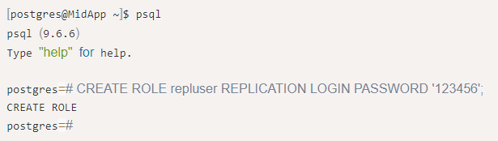
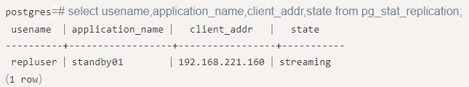
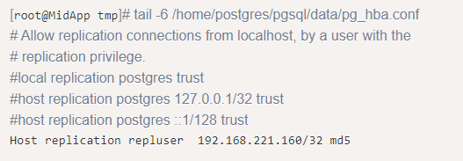
Master database

Slide 7
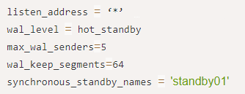

Master database

Slide 8
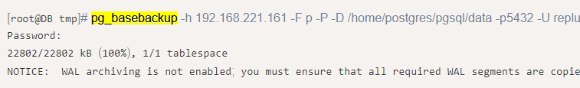
slave database

Slide 9


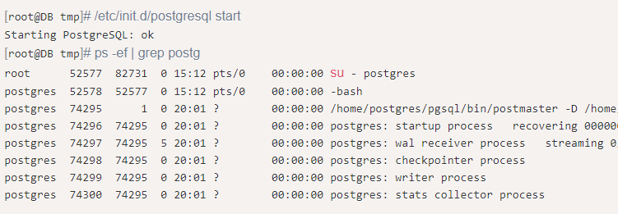
slave database

Slide 10
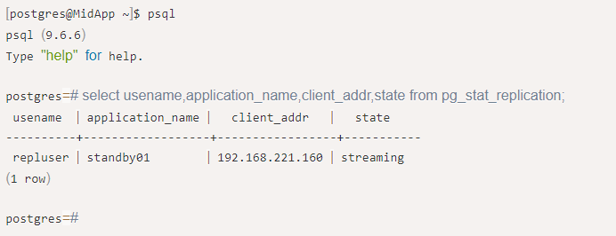
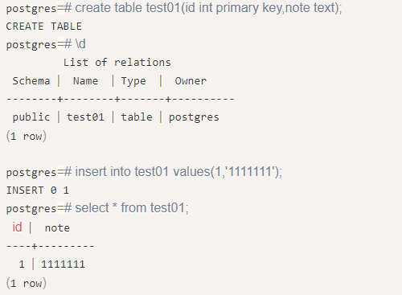
Test results

Slide 11
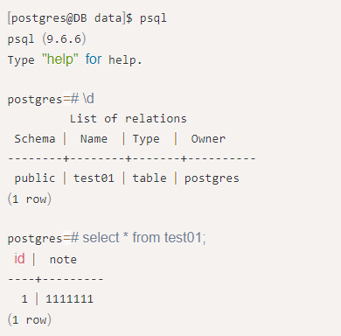

Test results

Slide 12
Aws rds for postgresql
Complex and difficult deployment task to manually set up replication
Operations and maintenance tasks that follow

Slide 13
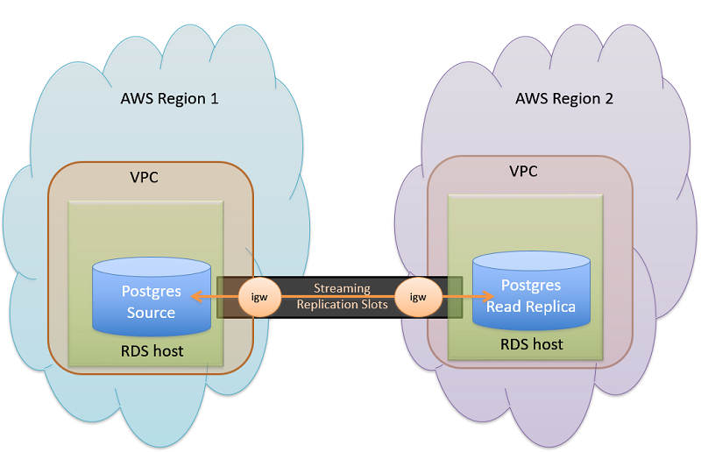
Aws rds for postgresql

Slide 14
Aws Aurora
The amount of user’s input has gradually increased and become very dense
The network latency requirements of read-only nodes are kept as low as possible

Slide 15
Aws Aurora
Network latency of replication was lower than another
Relatively little impact on the input performance of the master database which in main region
Disaster preparedness in Amazon Aurora had been improved as much as possible

Slide 16
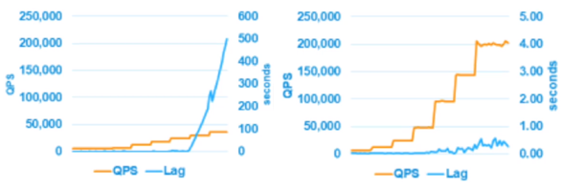
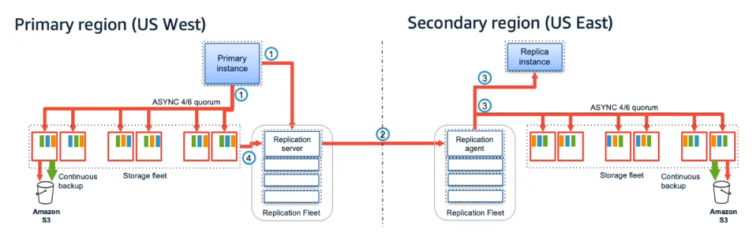
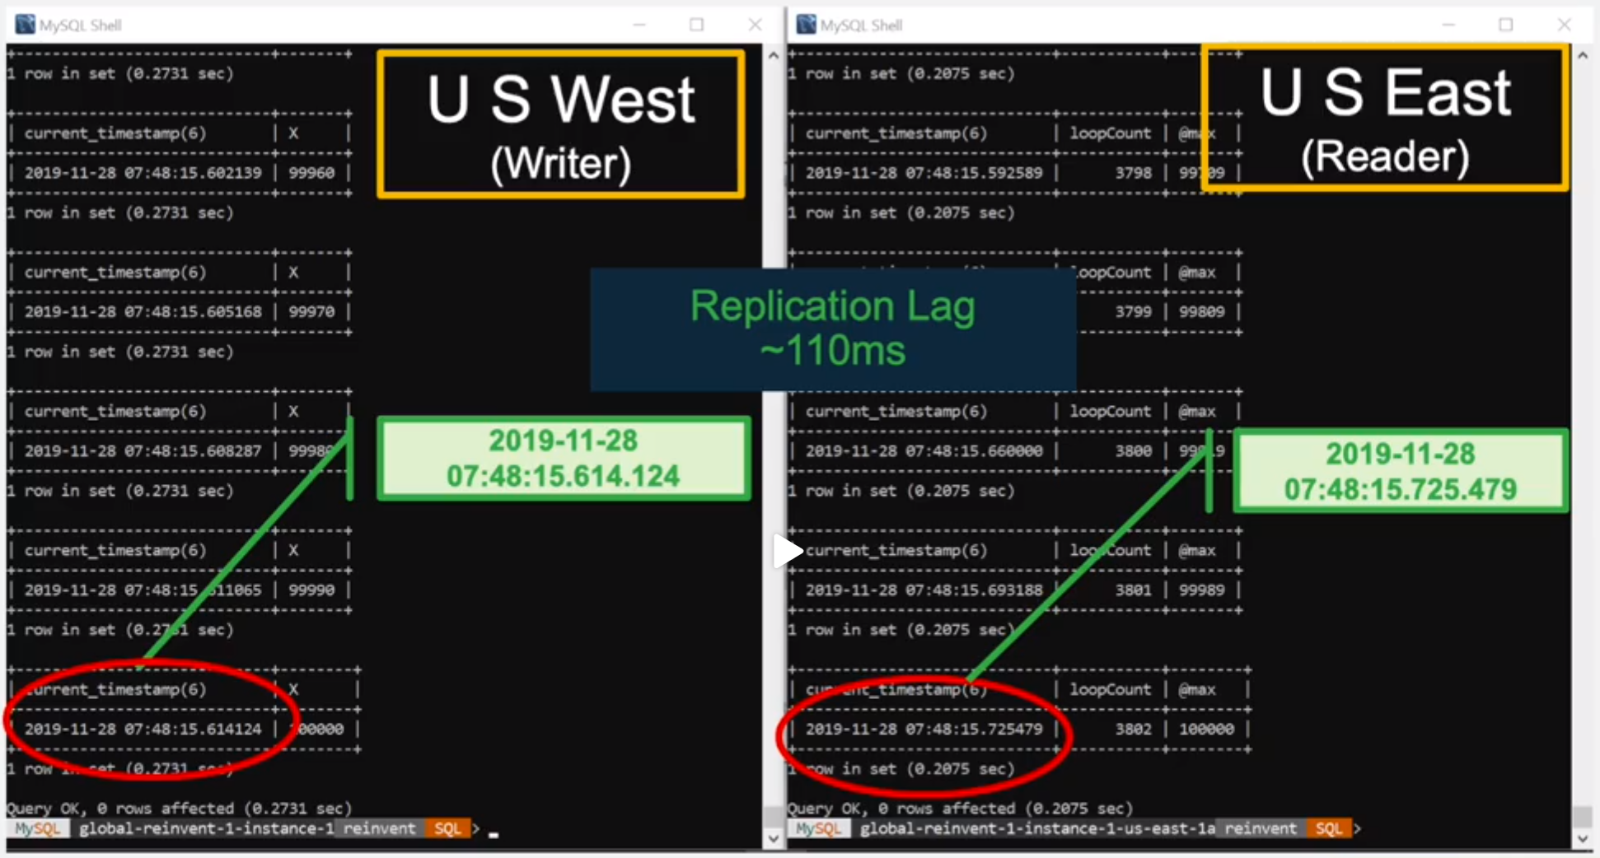
Aws Aurora

Slide 17
Conclusion
Replication
Partitioning (shards)
Distributed database

