Slide 1
c w f t
A simple yet powerful translator that
converts Swift into C++.

Slide 2
Our Goal
...
print("Hello, World!")
class A {
var a: Int = 1
}
var b = "Aha!"
for i in 1...10 {
b += "yo"
}
...
Convert a Swift file ...

Slide 3
Our Goal
...
class A {
int a = 1;
};
int main() {
print("Hello, World!");
string b = "Aha!";
for (int i = 0; i <= 10; ++i) {
b += "yo";
}
...
... into an equivalent cpp file that can be compiled and run
instantly

Slide 4
Overview
inout
class
struct
enum
func
switch
while
repeat while
if else
typealias
for in

Slide 5
Overview
no auto
type inference
no c++11 for style
simple error checking

Slide 6

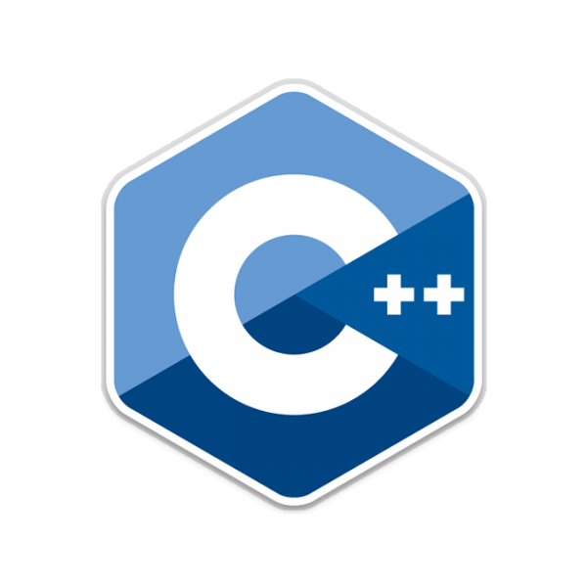


Tools

Slide 7
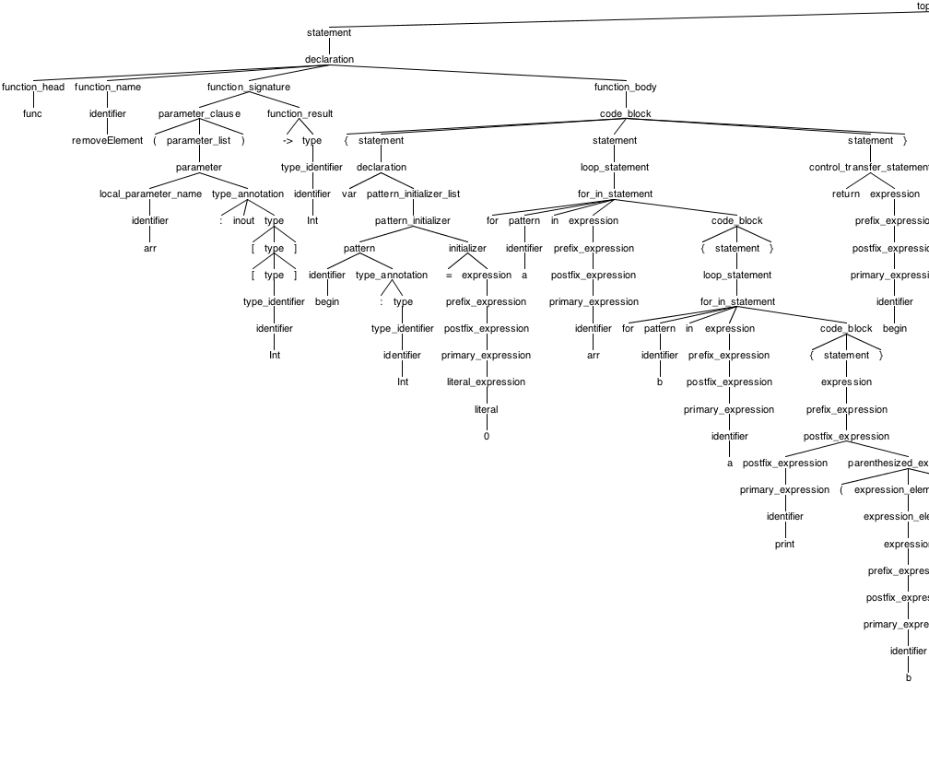
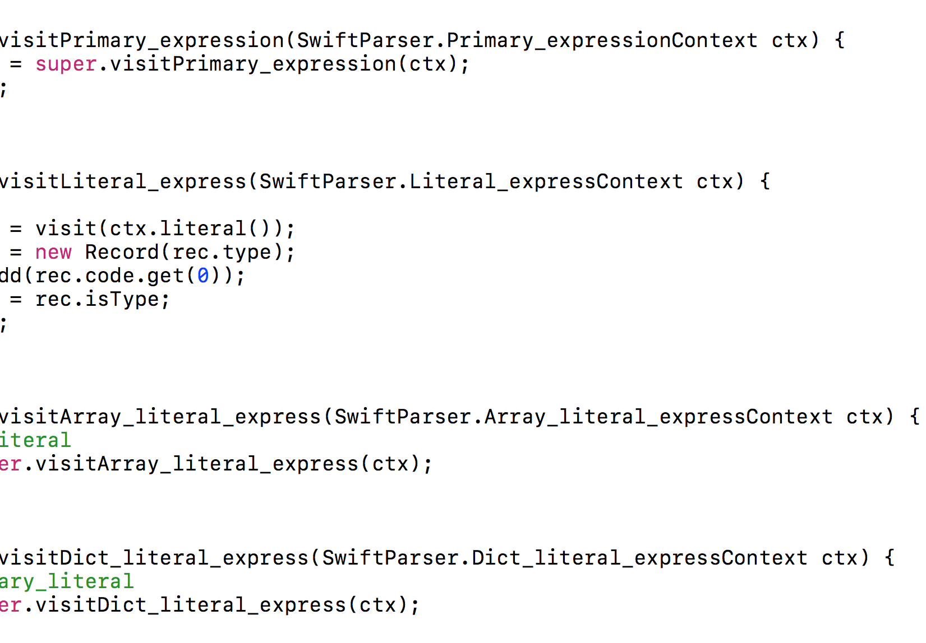
A two-step procedure
Recognition & Translation

Slide 8
Architecture
Symbol
Table
tokens
AST
Code
Generator
input file
Lexer
Parser
output file
Swift.g4
CwftVisitor.java

Slide 9
Architecture
Symbol
Table
tokens
AST
Code
Generator
input file
Lexer
Parser
output file
Swift.g4
CwftVisitor.java
Recognition

Slide 10
Architecture
Symbol
Table
tokens
AST
Code
Generator
input file
Lexer
Parser
output file
Swift.g4
CwftVisitor.java
Translation

Slide 11
Recognition
lexer
parser

Slide 12
lexer
comment
key word
operator
separator
literal
identifier
white space

Slide 13
lexer
comment
key word
operator
separator
literal
identifier
white space
// a comment

Slide 14
lexer
comment
key word
operator
separator
literal
identifier
white space
inout class enum

Slide 15
lexer
comment
key word
operator
separator
literal
identifier
white space
-> + - ... +=

Slide 16
lexer
comment
key word
operator
separator
literal
identifier
white space
, . : [] () {}

Slide 17
lexer
comment
key word
operator
separator
literal
identifier
white space
123 12.34 true "hello"

Slide 18
lexer
comment
key word
operator
separator
literal
identifier
white space
abc a_b_c_

Slide 19
lexer
comment
key word
operator
separator
literal
identifier
white space
\r\n\t

Slide 20
parser
statement

Slide 21
parser
statement
expression
declaration
loop statement
branch statement
control transfer statement

Slide 22
parser
statement
expression

Slide 23
parser
statement
expression
prefix-expression binary-expression_{opt}

Slide 24
parser
expression
binary-expression
binary-operator prefix-expression
= prefix-expression
? expression : prefix-expression

Slide 25
parser
statement
declaration
constant-declaration
variable-declaration
typealias-declaration
function-declaration
enum-declaration
struct-declaration
class-declaration

Slide 26
parser
statement
loop-statement
for-in-statement
while-statement
repeat-while-statement

Slide 27
parser
statement
branch-statement
if-statement
switch-statement

Slide 28
parser
statement
control-transfer-statement
break
continue
fallthrough
return expression

Slide 29
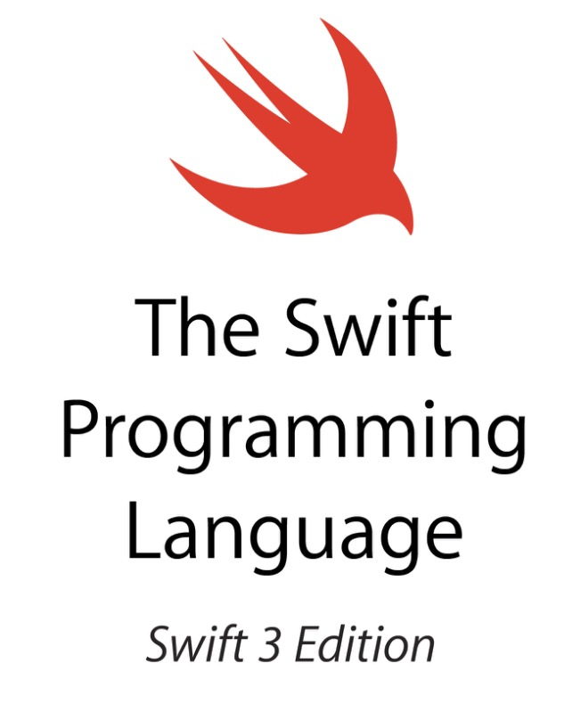
Reference

Slide 30
Translation
Int : int
Bool : bool
A : A
a : int
b : bool
c : A
count : size()
append : push_back
Symbol
Table I
Symbol
Table II
Symbol
Table III
declaration
code
#include ”helper.h"
class A {
...
};
int a = ...
int main() {
print(”Hi!");
...
}
AST
visitor
main
code

Slide 31
Visitor Review

Slide 32
visitor
you travel the tree on your own,
decide the order, or even stop

Slide 33
YOU
pattern

Slide 34
visitPattern
pattern

Slide 35
visitPattern
pattern
?
?
?

Slide 36
visitPattern {
// do sth
// sth more
// still not done
return val;
}

Slide 37
Details

Slide 38
literal
123
12.3
true
"123"
123
12.3
true
"123"

Slide 39
typealias
typealias A = Int
typedef int A;

Slide 40
class member
array.count
array.append(1)
array.size();
array.push_back(1);

Slide 41
while
while true {
}
while (true) {
}

Slide 42
if
if a < b {
} else {
}
if (a < b) {
} else {
}

Slide 43
struct / class
struct A {
var a: Int = 8
}
class B {
var b: Int = 8
}
class A {
int a = 8;
};
class B {
int b = 8;
};

Slide 44
array / dict
[1,2,3,4,5]
["a":1,"b":2,"c":3]
{1,2,3,4,5}
{{"a",1},{"b",2},{"c",3}}

Slide 45
declaration
let a: Int = 4, b = 3.14,
c = [1,2,3]
const int a = 4;
const double b = 3.14;
const vector<int> c = {1,2,3};
* need c++11

Slide 46
enum
enum C {
case a, b, c
case d, e, f
}
enum C {
a,b,c,d,e,f
};

Slide 47
function
func f(a:Int) -> [Int] {
...
}
vector<int> f(int a) {
...
}

Slide 48
switch
switch a {
case 1:
fallthrough
case 2:
print("ha")
default:
break
}
switch (a) {
case 1:
case 2:
print("ha");
break;
default:
break;
}

Slide 49
for-in
for (vector<int>::iterator it = array.begin(); it != array.end(); ++it) {
int item = *it;
}
for (int i = 0; i < 5; ++i) {
}
for item in array {
}
for i in 1..<5 {
}

Slide 50
visitPattern {
// do sth
// sth more
// still not done
return val;
}

Slide 51
Return Type
class Record {
List<String> code;
Type type;
boolean isType;
}

Slide 52
isType
var a = [6]
var b = [Int]()
vector<int> a = {6};
vector<int> b = vector<int>();

Slide 53
Type Class
class Type {
String basic;
Type type1;
Type type2;
int wrap;
public String toString();
}

Slide 54
Type Inference
Add
Check
init
typealias
enum(case)
struct
class
declaration
function(param)
identifier
declaration
param
enum(case)

Slide 55
Type Inference
var array = [1,2,3,4,5,6]
var item = array[1]
for i in array {
}

Slide 56
Process
// generate parser and lexer
$ antlr4 -no-listener -visitor Swift.g4
// hook them up
$ javac Master.java Swift*.java
// generate target code
$ java Master test.swift > res.cpp
// compile…
$ g++ -std=c++11 res.cpp
// …and run
$ ./a.out

Slide 57
Examples

Slide 58
var randomNumbers = [42, 12, 88, 62, 63, 56, 1, 77, 88, 97, 97, 20, 45, 91, 62, 2, 15, 31, 59, 5]
func quickSort(array: [Int]) -> [Int] {
var less = [Int]()
var equal = [Int]()
var greater = [Int]()
if array.count > 1 {
let pivot = array[0]
for x in array {
if x < pivot {
less.append(x)
} else if x == pivot {
equal.append(x)
} else {
greater.append(x)
}
}
return (quickSort(array: less) + equal + quickSort(array: greater))
} else {
return array
}
}
print(quickSort(array: randomNumbers))

Slide 59
#include "helper.cpp"
vector<int> randomNumbers = {42, 12, 88, 62, 63, 56, 1, 77, 88, 97, 97, 20, 45, 91, 62, 2, 15, 31, 59, 5};
vector<int> quickSort(vector<int> array)
{
vector<int> less = vector<int>();
vector<int> equal = vector<int>();
vector<int> greater = vector<int>();
if (array.size() > 1)
{
const int pivot = array[0];
for (vector<int>::iterator it = array.begin(); it != array.end(); ++it)
{
int x = *it;
if (x < pivot)
{
less.push_back(x);
}
else
if (x == pivot)
{
equal.push_back(x);
}
else
{
greater.push_back(x);
}
}
return (quickSort(less) + equal + quickSort(greater));
}
else
{
return array;
}
}
int main() {
print(quickSort(randomNumbers));
return 0;
}

Slide 60
#include "helper.cpp"
vector<int> randomNumbers = {42, 12, 88, 62, 63, 56, 1, 77, 88, 97, 97, 20, 45, 91, 62, 2, 15, 31, 59, 5};
vector<int> quickSort(vector<int> array)
{
vector<int> less = vector<int>();
vector<int> equal = vector<int>();
vector<int> greater = vector<int>();
if (array.size() > 1)
{
const int pivot = array[0];
for (vector<int>::iterator it = array.begin(); it != array.end(); ++it)
{
int x = *it;
if (x < pivot)
{
less.push_back(x);
}
else
if (x == pivot)
{
equal.push_back(x);
}
else
{
greater.push_back(x);
}
}
return (quickSort(less) + equal + quickSort(greater));
}
else
{
return array;
}
}
int main() {
print(quickSort(randomNumbers));
return 0;
}
const int pivot = array[0];
for (vector<int>::iterator it = array.begin(); it != array.end(); ++it)
{
int x = *it;

Slide 61
#include "helper.cpp"
class A
{
public:
int a = 5;
double b = 6;
int f(int d)
{
return a + b;
}
};
A c = A();
int main() {
print(c.f(2));
return 0;
}
class A {
var a: Int = 5
var b: Double = 6
func f(d:Int)->Int {
return a+b
}
}
var c = A()
print(c.f(d:2))

Slide 62
#include "helper.cpp"
enum A
{
a,b,c,
};
A cc = a;
int main() {
switch (cc)
{
case a:
print("haha");
break;
case b:
print("hehe");
break;
default:
print("hoho");
}
return 0;
}
enum A {
case a, b, c
}
var cc = A.a
switch cc {
case .a:
print("haha")
case .b:
print("hehe")
default:
print("hoho")
}

Slide 63
#include "helper.cpp"
int f(int & a)
{
a = 10;
return 8;
}
int b = 5;
int main() {
print(f(b) + b);
return 0;
}
func f(a: inout Int) -> Int {
a = 10
return 8
}
var b = 5
print(f(a:&b)+b)

Slide 64
#include "helper.cpp"
void printElement (vector<vector<int>> & arr)
{
int begin = 0;
for (vector<vector<int>>::iterator it = arr.begin(); it != arr.end(); ++it)
{
vector<int> a = *it;
for (vector<int>::iterator it = a.begin(); it != a.end(); ++it)
{
int b = *it;
print(b);
}
}
}
vector<vector<int>> c = {{1, 2, 3, 4}, {5, 6, 7, 8}};
int main() {
printElement(c);
return 0;
}
func printElement(arr: inout [[Int]]) {
for a in arr {
for b in a {
print(b)
}
}
}
var c = [[1,2,3,4],[5,6,7,8]]
printElement(arr: &c)

Slide 65
You WISH!!
#include "helper.cpp"
int a = 10;
int main() {
print(a);
return 0;
}
var a = 10
// please don't ignore me!!
print(a)

Slide 66
Error Checking
var a = 1
var a = "a string"
Error: a already defined!

Slide 67
Future Work
works that are not done yet and will never be done
generics
optional
tuple
where-clause
…

Slide 68
Lessons Learned
start early!
start with simple cases
first make it run, then make it run fast (and beautiful)
languages are alike
don’t try to make it right at the 1st time

Slide 69
c w f t
A simple yet powerful translator that
converts Swift into C++.

