Slide 1
Improving the Robustness of Neural Network via Data Augmentation
12/13/2018

Slide 2
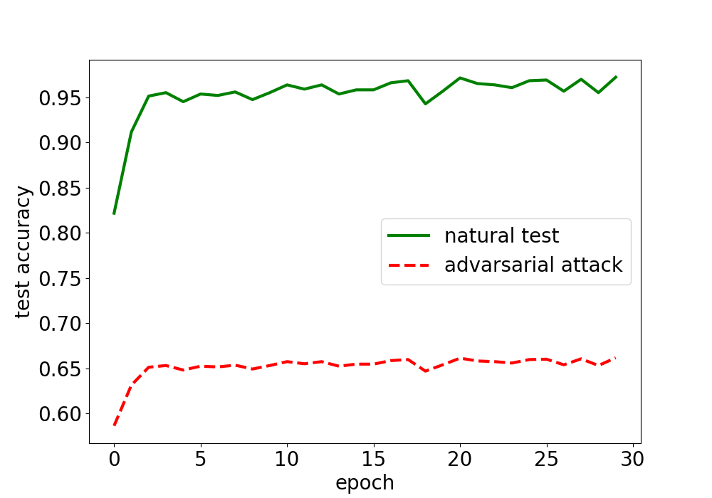
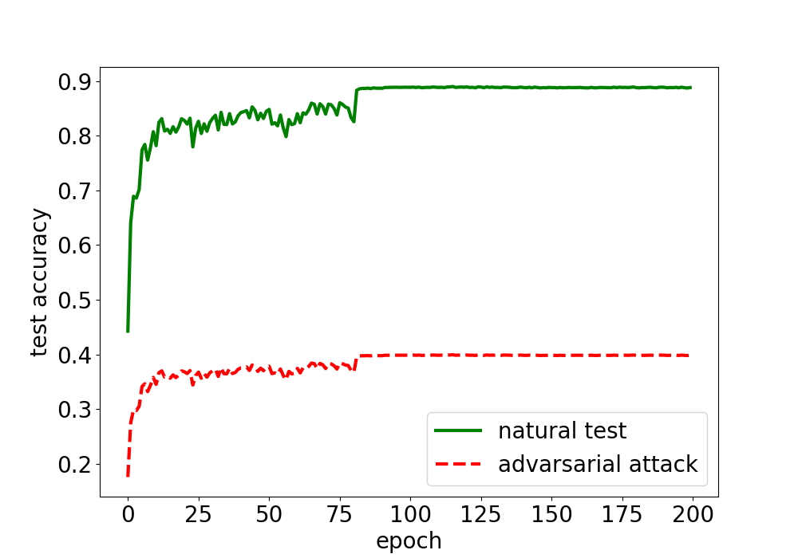
Problem definition
Robust generalization is quite different from standard generalization^{[1]}
Some data sets may not large enough to train a robust model
Neural Network can be fooled with simple spacial transformation (rotation, translate)^{[2]}
GTSRB
Cifar10

Slide 3

Existing approaches
Adversarial learning: existing strategy tries to perturb the training data set in each step with the goal to learn the features of potential adversarial variances
random perturbation
Worst-of-n: select the most representative images from randomly generated n perturbations
Limitation: input space is too large, especially with more transformations. Random perturbation may not be able to find representative images.
For GTSRB, even though start-of-the-art model archives 98% test accuracy, we can generate adversarial example for more then 17% with rotation range (-30∘,30∘) and translation range(-3p, 3p).

Slide 4


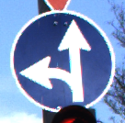
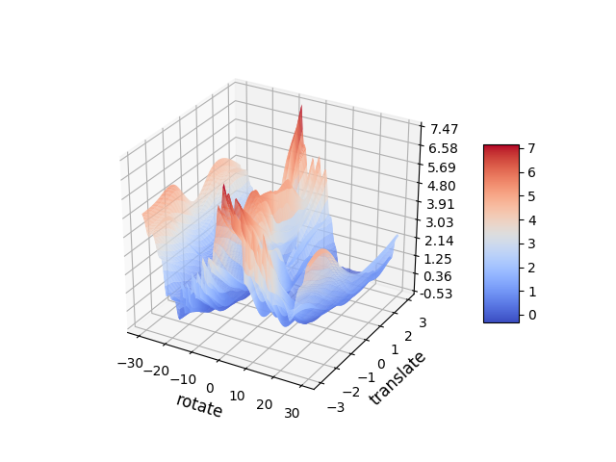
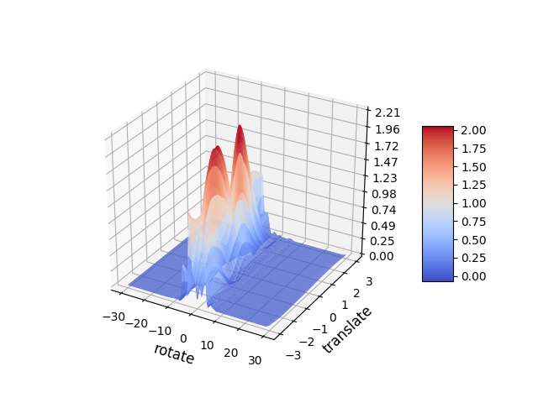
Adversarial examples
Rotate 1∘
One adversarial example from GTSRB dataset. The model trained using worst-of-10 approach still misclassifies the perturbations (rotate 1∘).
traditional model
worst-of-10 model
The loss of perturbed images with rotation (-30, 30) and translate (-3, 3)
Better, but not good enough

Slide 5
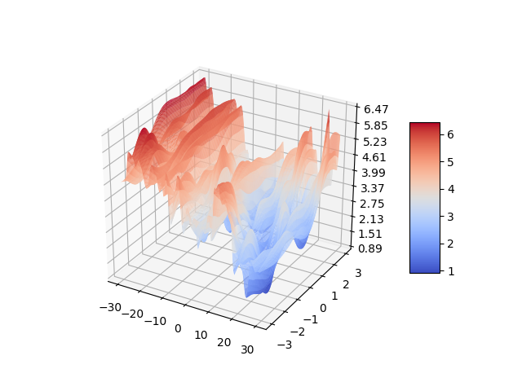
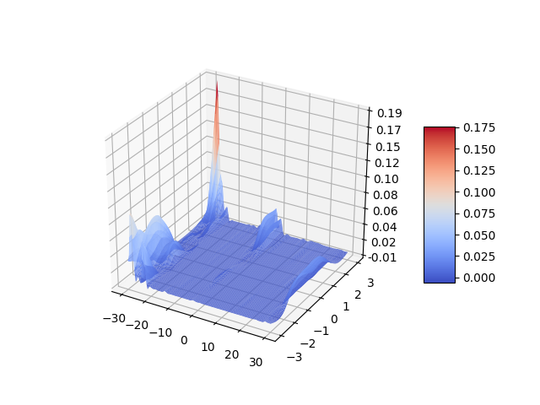
Challenges
Input space is too large, especially with more transformations, computing all adversarial variances is a time-consuming and sometimes impossible task
Input space is unstructured (non-concave maximization), gradient-based approach cannot directly applied
The loss of two examples with rotation (-30, 30) and translate (-3, 3)

Slide 6
Intuition
Model training can be regarded as AI-based program synthesis process. Given a set of specifications, it will generate a program satisfying all the specifications
Adversarial learning
Representative training set
Data augmentation
Program synthesis
Complete specifications
Test case generation
Data augmentation can be used to provide more complete specifications
We can formalize representative training data generation as a search problem within the attack space
If one perturbation is misclassified, its neighbours are more likely to be misclassified

Slide 7

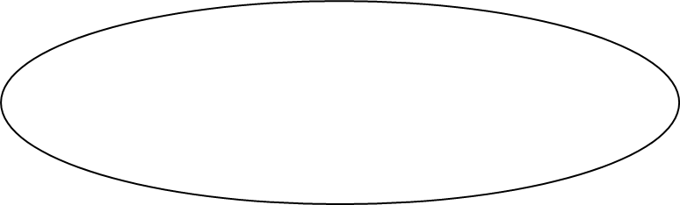
Overall workflow
Using genetic algorithm to generate representative perturbations.
The goal is to maximise the diversity of samples in the distribution
Mutated inputs
}
Mutator
Selector
Training data-set (Seeds)
Seed pool
interesting
inputs
model
Mutator generates new perturbations based on existing seed
Selector selects interesting perturbation and continually maintains the seed pool

Slide 8
Mutator
: rotation
: horizontal translate
: vertical translate
: shear
: zoom
: Brightness
: contrast
Mutation:
transformation parameter
existing transformation:
R
T1
T2
S
Z
B
C
+
randomly generated
mutate step:
+1
0
0
+1
0
-2
0
newly generated transformation paras:
R’
T1
T2
S’
Z
B’
C
Crossover:
R1
T11
T21
S1
Z1
B1
C1
R1
T11
T21
S1
Z2
B2
C2
R2
T12
T22
S2
Z2
B2
C2

Slide 9
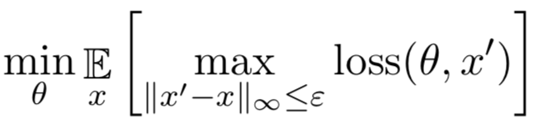
Fitness function
Loss-based approach
Saddle point problem
Where x is original data, and x’ is the perturbed data
Prefer perturbation with higher loss value (categorical cross-entropy)
Neural coverage-based approach (ongoing strategy)
Take the model structure into consideration
Prefer perturbation that can improve neural coverage
I1
O1
L1
For instance, suppose inputs covering I1 and L1 are correctly classified, in the next step, we prefer inputs that cover I1 and L2.
I2
L2
I3
O2

Slide 10
Evaluation
Dataset:
GTSRB: German Traffic Sign Benchmarks with 50,000 images and 43 labels
Cifar10: Cifar-10 Benchmark with 60,000 images and 10 labels
Data augmentation strategy:
Standard: model trained based on original training data
Aug.30(40): model trained based on randomly perturbed training data, 30 (40) is the perturbation parameter range
Worst-of-10: randomly generating 10 perturbations for each image, and train the model using the one with highest loss
Genetic algorithm(GA)

Slide 11
Evaluation
Evaluation
Attack Space:
- Rotation: rotate image with degree in range [-30, 30]
- Translate: horizontally and vertically shift image at most 10% pixels [-3,3]
- Shear: shear image at most 10% pixels [-0.1, 0.1]
- Zoom: zoom up or zoom down with range [-0.9, 1.1]
- Brightness: change brightness by uniformly adding or subtracting a value for each pixel, the value is in range [-32, 32]
- Contrast: change contrast by scale the RGB value of each pixel with a factor in range [0.8, 1.2]
Attack Strategy:
- Nature: original testing set
- Random: perturb original testing set using random perturbation parameters
- Grid: perturb using grid parameters, and regard the image is misclassified if one of perturbation is misclassified

Slide 12
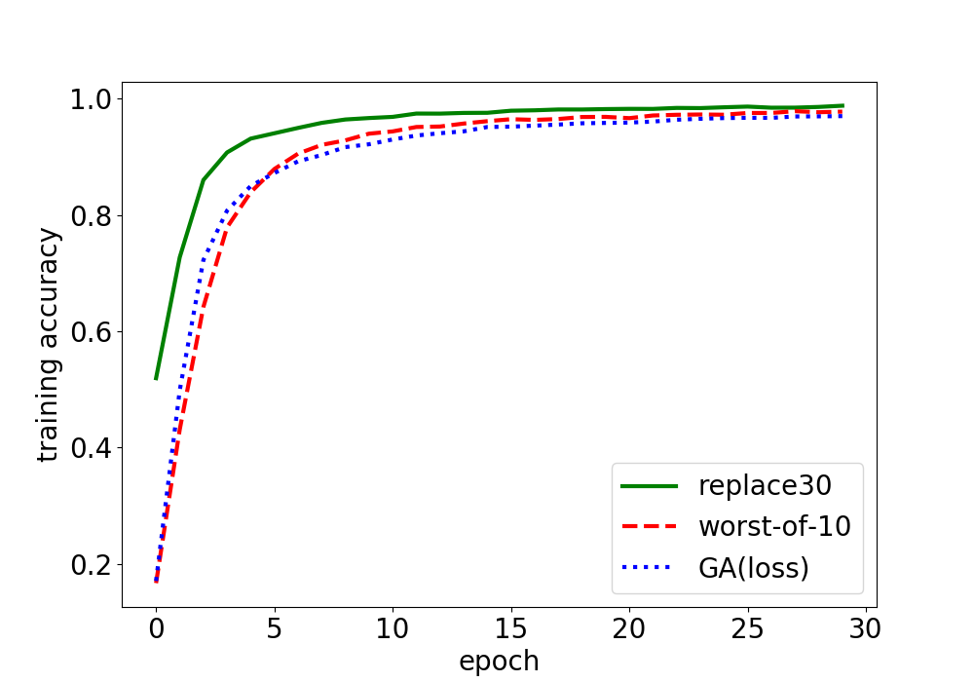
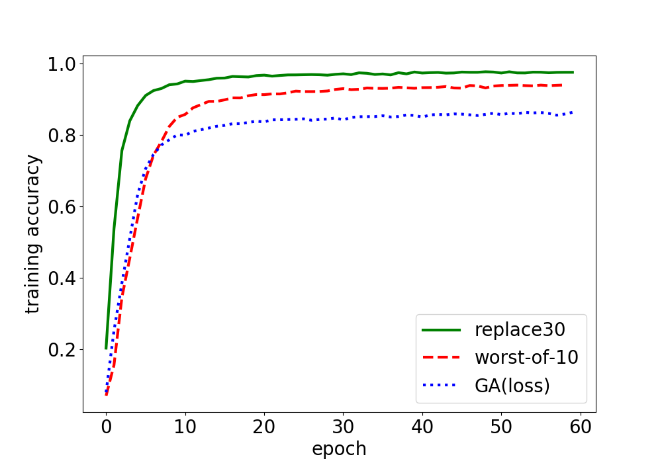
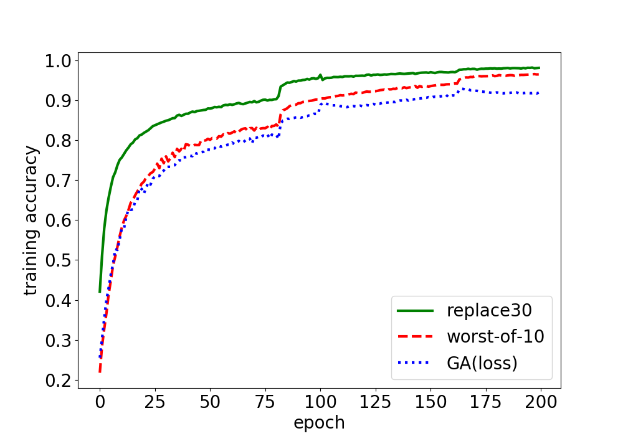
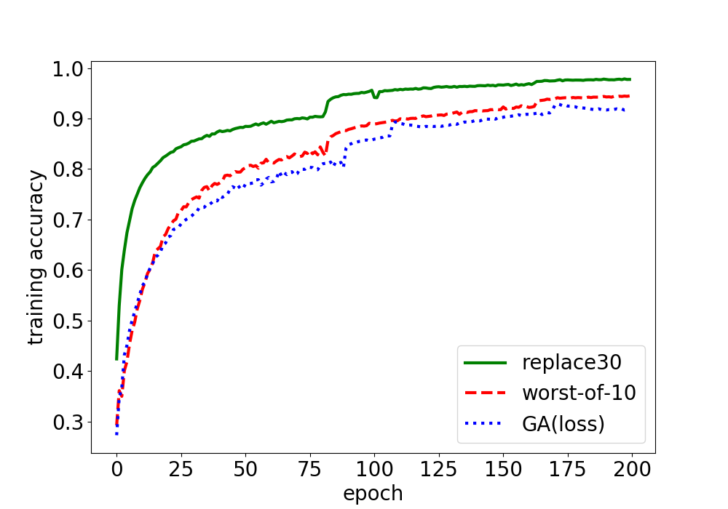
Evaluation
We evaluated the training accuracy based on different augmentation strategies.
The training accuracy of Genetic algorithm is lower than both replace30 and worst-of-10
Genetic algorithm is able to find more misclassified perturbations in each step
GA-based approach is more effective to solve the inner minimization of Saddle point problem
GTSRB
GTSRB
Cifar10
Cifar10
Training accuracy with 3 transformations
(rotate, translate, shear)
Training accuracy with 6 transformations
(rotate, translate, shear, zoom, brightness, contrast)

Slide 13
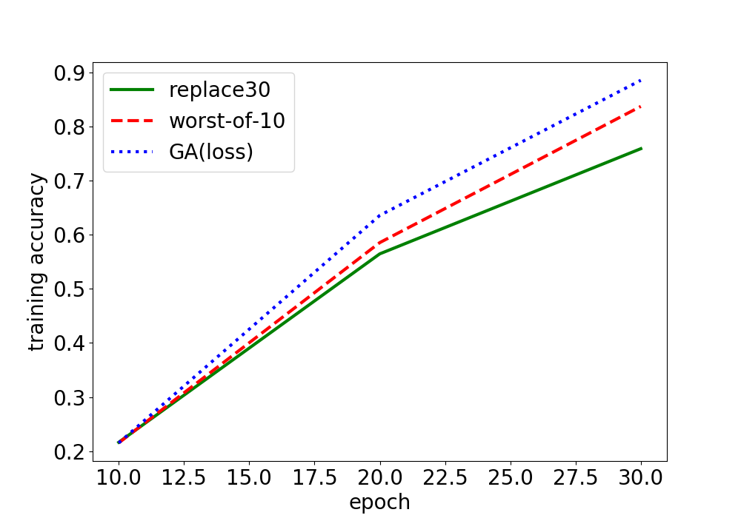
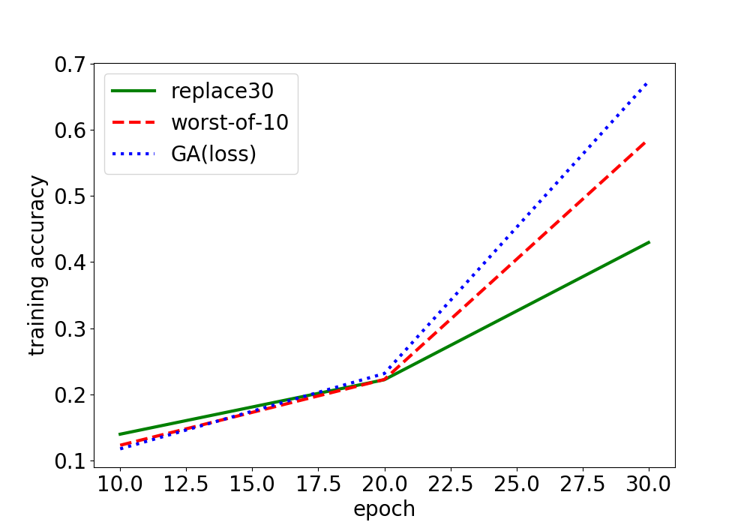
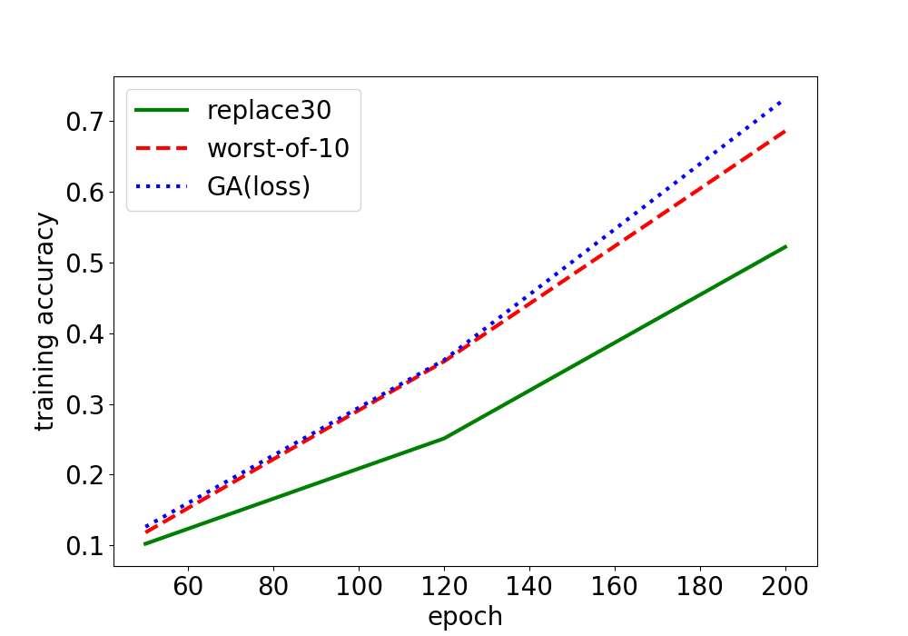
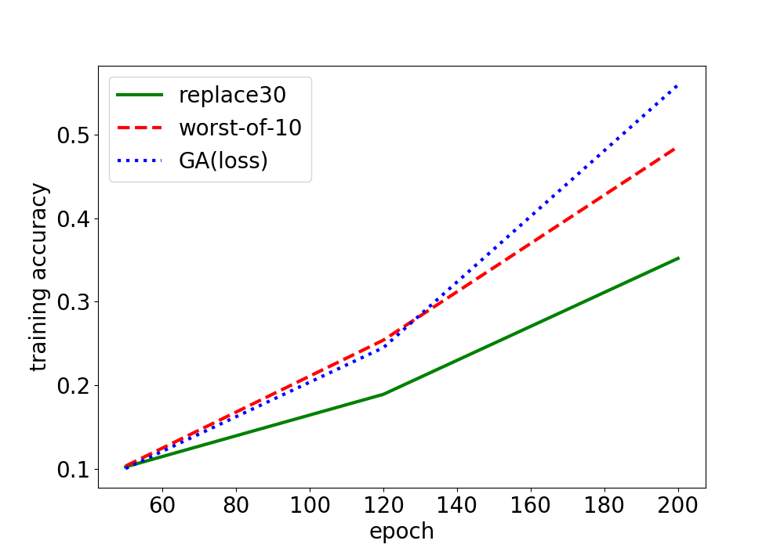
Evaluation
We evaluated the testing accuracy based on grid attack.
Genetic algorithm is able to generate highest testing accuracy under the grid attack.
GTSRB
GTSRB
Cifar-10
Cifar-10
Testing accuracy based on grid attack
with 3 transformations
Testing accuracy based on grid attack
with 6 transformations

Slide 14

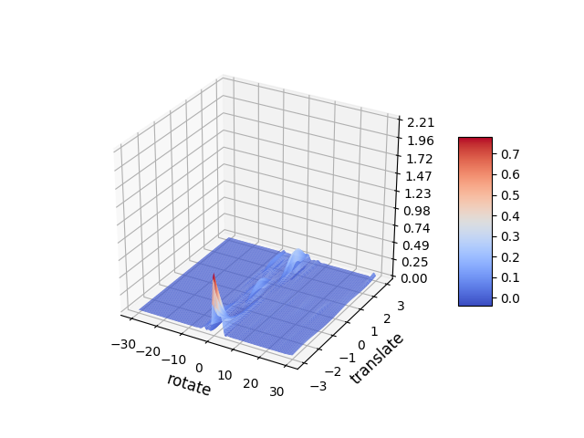
Evaluation - example
The model trained using GA-based augmentation correctly classifies the following example:
Rotate 1∘
The loss of the perturbed images is significantly reduced by genetic algorithm.
traditional model
worst-of-10 model
GA model
The loss of perturbed images with rotation (-30, 30) and translate (-3, 3)

Slide 15
Raw experimental results for GTSRB
Test accuracy of GTSRB dataset with 3 transformations(rotation, translate, shear).
Aug. strategy | Natural | Random | Grid
Standard | 0.979 | 0.662 | 0.007
Replace30 | 0.983 | 0.978 | 0.759
Replace40 | 0.978 | 0.977 | 0.795
Worst-of-10 | 0.980 | 0.976 | 0.837
Worst-of-10(cov) | 0.983 | 0.980 | 0.845
GA(loss) | 0.986 | 0.983 | 0.888
Test accuracy of GTSRB dataset with 6 transformations.
Aug. strategy | Natural | Random | Grid
Standard | 0.973 | 0.586 | 0.067
Replace30 | 0.979 | 0.956 | 0.430
Worst-of-10 | 0.985 | 0.961 | 0.586
GA(loss) | 0.988 | 0.972 | 0.673

Slide 16
Raw experimental results for GTSRB
Test accuracy of GTSRB dataset based on each transformation (the model is trained based on three transformations).
Aug. strategy | Rotation | Translate | Shear
Standard | 0.122 | 0.404 | 0.939
Replace30 | 0.901 | 0.864 | 0.947
Replace40 | 0.909 | 0.846 | 0.941
Worst-of-10 | 0.918 | 0.906 | 0.946
GA(loss) | 0.925 | 0.921 | 0.958

Slide 17
Raw experimental results for GTSRB
Average number of misclassified perturbations (totally 81 perturbations for each image). For the model trained using three transformations.
Model | Standard | Rep.30 | Rep.40 | Worst-of-10 | GA
#misclassfied | 47.2 | 3.1 | 2.67 | 2.66 | 1.87
Average number of misclassified perturbations (totally 2187 perturbations for each image). For the model trained using six transformations.
Model | Standard | Rep.30 | Worst-of-10 | GA
#misclassfied | 789 | 164 | 117 | 98

Slide 18
Raw experimental results for Cifar10
Test accuracy of Cifar10 dataset with 3 transformations(rotation, translate, shear).
Aug. strategy | Natural | Random | Grid
Standard | 0.875 | 0.496 | 0.013
Replace30 | 0.897 | 0.897 | 0.522
Replace40 | 0.872 | 0.891 | 0.626
Worst-of-10 | 0.892 | 0.893 | 0.686
GA(loss) | 0.915 | 0.913 | 0.732
Test accuracy of Cifar10 dataset with 6 transformations.
Aug. strategy | Natural | Random | Grid
Standard | 0.890 | 0.435 | 0.011
Replace30 | 0.901 | 0.892 | 0.352
Worst-of-10 | 0.892 | 0.893 | 0.486
GA(loss) | 0.915 | 0.913 | 0.560

Slide 19
Raw experimental results for Cifar10
Test accuracy of Cifar10 dataset based on each transformation (the model is trained based on three transformations).
Aug. strategy | Rotation | Translate | Shear
Standard | 0.093 | 0.202 | 0.494
Replace30 | 0.697 | 0.651 | 0.788
Worst-of-10 | 0.738 | 0.701 | 0.811
GA(loss) | 0.786 | 0.740 | 0.841

Slide 20
Raw experimental results for GTSRB
Average number of misclassified perturbations (totally 81 perturbations for each image). For the model trained using three transformations.
Model | Standard | Rep.30 | Worst-of-10 | GA
#misclassfied | 45.0 | 10.4 | 9.8
Average number of misclassified perturbations (totally 2187 perturbations for each image). For the model trained using six transformations.
Model | Standard | Rep.30 | Worst-of-10 | GA
#misclassfied | 1316 | 263 |  | 232

