Slide 1






Congestion Control for Cross-Datacenter Networks
Gaoxiong Zeng, Wei Bai (Microsoft), Ge Chen, Kai Chen,
Dongsu Han (KAIST), Yibo Zhu (ByteDance), Lei Cui (Huawei)
SING Lab @ Hong Kong University of Science and Technology
Notes:
Hello everyone, I am Gaoxiong Zeng from SING Lab of Hong Kong University of Science and Technology. Today, I am going to present our work: Congestion Control for Cross-Datacenter Networks. This is a joint work with Microsoft，KAIST，ByteDance and Huawei.

Slide 2


Geo-Distributed Applications
Geo-distributed apps are becoming prevalent.
Video storage and streaming, online retailing…
Many of them collect/distribute/sync data across multiple regional data centers (DCs).
Notes:
This work originates from application demands in real life. There is a trend that various online applications are moving to the cloud, examples like video streaming, online retailing… Many of them prefer to distribute their data across multiple regional data centers. One of the benefits of doing so is to provide faster access to the application users.

Slide 3
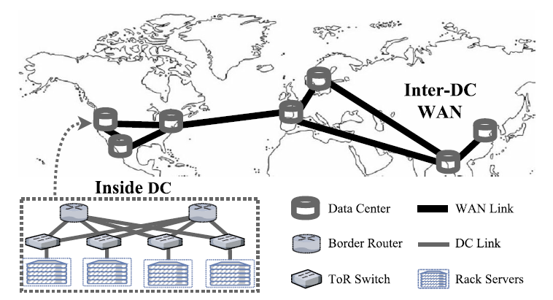
Cross-Datacenter Network
To support geo-distributed apps in the cloud:
The underlying infrastructure is a Cross-DC Network.
Data center network (DCN): connects servers within DC.
Wide area network (WAN): connects multiple DCs.
Notes:
To support these geo-distributed apps, the underlying networking infrastructure is a cross-DC network. The network consists of two heterogeneous network segments: data center network (DCN) connecting servers within single data center; and wide area network (WAN) connecting multiple DCs.

Slide 4
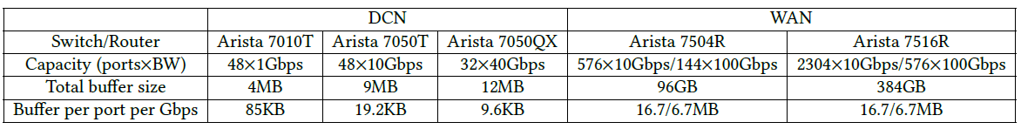
Heterogeneity in Cross-DC Networks
Heterogeneous structure and components:
Two heterogeneous segments: DCN & WAN
Buffer depth:
DCN switch buffer is shallow, ~100KB per port per Gbps.
WAN router buffer is deep, ~10MB per port per Gbps.
E.g., typical switches used in Microsoft datacenter:
Notes:
We investigated the Microsoft datacenter and found that the cross-datacenter network presents quite heterogeneous characteristics.
The networking devices are diversified. DCN switches are shallow-buffered with ~100KB per port per Gbps while WAN routers are deep-buffered with ~10MB per port per Gbps. Shallow buffer can easily lead to buffer overflow while deep buffer can cause bufferbloat.

Slide 5
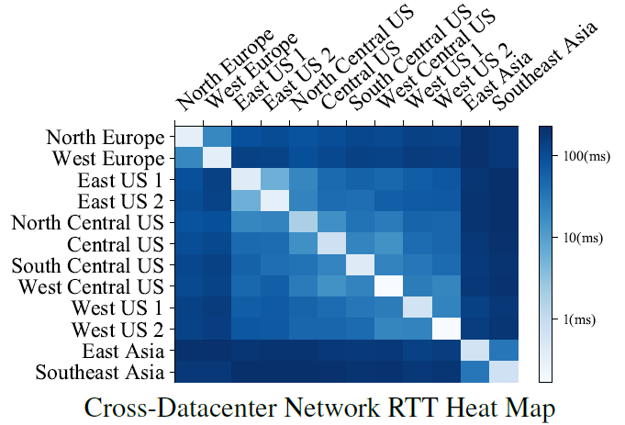
Heterogeneity in Cross-DC Networks
Mixed intra-DC and inter-DC traffic:
High RTT difference:
Intra-DC RTTs are small.
~100s of microseconds.
Inter-DC RTTs are large.
~100s of milliseconds.
RTTs differ by >1000 times.
Different administrative control:
Cloud operators have full control in DCN; but only partial control over WAN (mostly leased from ISPs).
Notes:
There is a high RTT difference. The intra-DC RTTs are small, typically 100s of µs. The inter-DC RTTs are large, varying from a few ms (regional) to 100s of ms (intercontinental).
Cloud operators have full control over DCN, including ECN. But they have only partial control over the WAN, because most of the facilities are leased from ISPs.

Slide 6
Transport for Cross-DC Networks
To support geo-distributed apps in the cloud:
The underlying infrastructure is a Cross-DC Network.
Data center network (DCN): connects servers within DC.
Wide area network (WAN): connects multiple DCs.
How do the existing transport protocols perform under the heterogeneous cross-DC network?
Notes:
The heterogeneous characteristics of cross-DC network impose great challenges for transport design. So we further evaluated the performance of the existing transport protocols. We found that existing DCN or WAN transports reacting to ECN or delay signal alone do not (and cannot be extended to) work well for such an environment.

Slide 7
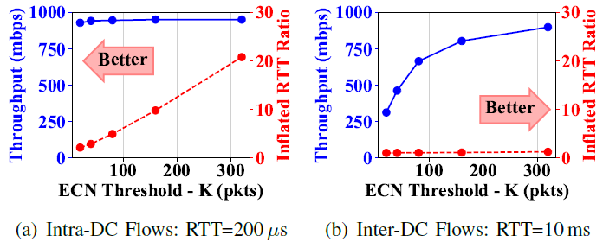
Problems of Existing Transports
ECN-signal-only solutions:
Mixed traffics impose different requirements
Intra-DC traffic → Low BDP → Low ECN threshold.
Inter-DC traffic → High BDP → High ECN threshold.
DCTCP
Intra-DC and inter-DC traffic requirements conflict.

Slide 8
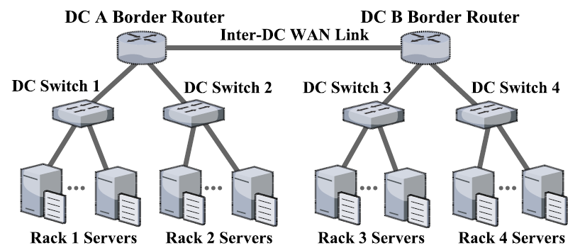

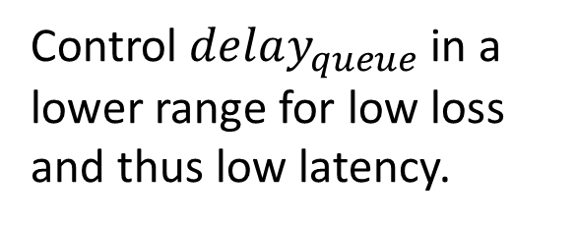
Problems of Existing Transports
Delay-signal-only solutions:
Delay signal reflects cumulated delay along a path.
$$rtt=rtt_{base}+delay_{queue}$$
Directly perceived
Fixed for a path
Congestion detected
Case1: Congestion in DCN.
DC switch buffer is shallow.
Control $delay_{queue}$ in a lower range for low loss and thus low latency.

Slide 9
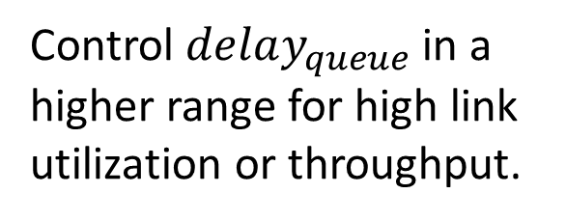
Problems of Existing Transports
Delay-signal-only solutions:
Delay signal reflects cumulated delay along a path.
$$rtt=rtt_{base}+delay_{queue}$$
Directly perceived
Fixed for a path
Congestion detected
Case2: Congestion in WAN.
WAN switch buffer is deep.
Control $delay_{queue}$ in a higher range for high link utilization or throughput.

Slide 10
Problems of Existing Transports
Delay-signal-only solutions:
Delay signal reflects cumulated delay along a path.
$$rtt=rtt_{base}+delay_{queue}$$
Directly perceived
Fixed for a path
Congestion detected
?
Heterogeneity → Dilemma
either hurt latency for DC congestion.
or hurt throughput for WAN congestion.
Notes:
At runtime, delay signal cannot differentiate congestions in WAN and DCN. So delay-based transports usually face a dilemma…

Slide 11
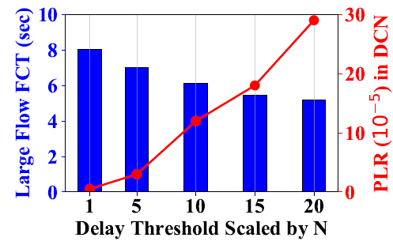

Problems of Existing Transports
Delay-signal-only solutions:
Delay signal reflects cumulated delay along a path.
$$rtt=rtt_{base}+delay_{queue}$$
Testbed Demonstration:
Directly perceived
Fixed for a path
Congestion detected
Heterogeneity → Dilemma
either hurt latency for DC congestion.
or hurt throughput for WAN congestion.
TCP Vegas
Notes:
Result

Slide 12
Transport for Cross-DC Networks
To support geo-distributed apps in the cloud:
The underlying infrastructure is a Cross-DC Network.
Data center network (DCN): connects servers within DC.
Wide area network (WAN): connects multiple DCs.
How to design a transport for data communication under the heterogeneous cross-DC network?
Notes:
To address these problems, we then ask how to design a transport protocol that works well under the heterogeneous cross-DCNs.

Slide 13
Design Rationales
How to achieve persistent low latency in the heterogeneous network environment?
Persistent Low Latency
Require
Low Loss
Low RTT
Controlled by
Controlled by
Per-hop Queue
End-to-end Delay
Controlled by
Controlled by
Key1: Integration!
ECN Signal
Delay Signal
Notes:
We now present our design rationales. Our primary goal is to achieve low latency and high throughput.
To achieve persistent low latency, we need to guarantee both low packet loss rate and low round-trip time. On one hand, low loss should be controlled by the bounded queueing at each hop. We need to prevent buffer overflow. Obviously, ECN is a good choice for that. On the other hand, low RTT should be bounded by the end-to-end delay signal. Therefore, our first design key is to integrate ECN and delay signal for low latency.

Slide 14

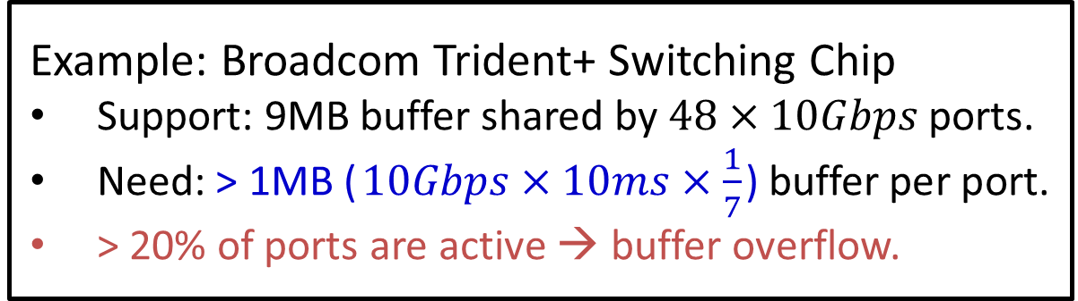
Design Rationales
How to achieve high throughput for inter-DC traffic with shallow-buffered DC switches?
For full throughput, $\text{b}\text{uffer} \text{per} \text{p}\text{ort}≥C×RTT×λ$.
$λ$ is determined by the congestion control (e.g., $\frac{1}{7}$ in DCTCP).
Example: Broadcom Trident+ Switching Chip
Support: 9MB buffer shared by $48×10Gbps$ ports.
Need: > 1MB ($10Gbps×10ms×\frac{1}{7}$) buffer per port.
> 20% of ports are active → buffer overflow.
Notes:
The second goal is to achieve high throughput. Theoretical analysis show that buffer required for full throughput equals to bandwidth capacity (C) times RTT times lambda, where the coefficient lambda is determined by the specific congestion control algorithm. Therefore, the most challenging part is the inter-DC traffics. Because these traffics have larger RTTs and require much higher buffer size, especially when they go through the shallow buffer DCNs. Let’s use the Broadcom Trident+ Switching Chip for example. It supports 9MB buffer shared by 48 10Gbps ports. After calculation, we find that buffer overflows when 20% of ports are active.

Slide 15
Design Rationales
How to achieve high throughput for inter-DC traffic with shallow-buffered DC switches?
For full throughput, $\text{b}\text{uffer} \text{per} \text{p}\text{ort}≥C×RTT×λ$.
$λ$ is determined by the congestion control (e.g., $\frac{1}{7}$ in DCTCP).
Key2: Modulating the window reduction aggressiveness by RTT.
When BDP (C×RTT) is large, λ gets smaller.
When BDP (C×RTT) is small, λ gets larger.
Notes:
To resolve the problem, we propose the second design key, which is to modulate the window reduction aggressiveness by RTT. For large RTT traffics, lambda should be adapted to a smaller value, so these traffics can still maintain full throughput even under shallow buffers.

Slide 16
Design Rationales
How to balance convergence and stability between intra-DC and inter-DC flows?
Key3: Window increase that adapts to RTT variation.
When RTT is large, grow window size faster.
When RTT is small, grow window size slower.
Notes:
Besides, we also need to balance convergence speed and system stability among mixed inter-DC and intra-DC flows. To this end, our window increase function should also adapt to RTT variation. When RTT is large, grow window faster for quicker convergence. When RTT is small, grow window slower for better stability. This design choice is also helpful to achieve better RTT-fairness.

Slide 17
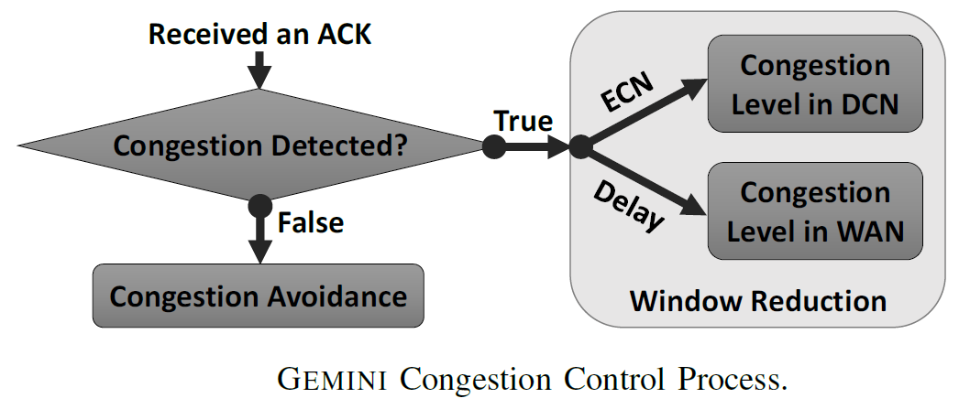
GEMINI Algorithm
Overview:
Notes:
Here is the overview of the Gemini congestion control algorithm.

Slide 18

GEMINI Algorithm
Window reduction phase,
$cwnd=cwnd×(1−max⁡(f_{DCN},f_{WAN}))$
$f_{WAN}=β$, where $β$ is a constant for WAN congestion control.
$f_{DCN}=α×F$, where $α$ is ECN fraction, $F=\frac{4K}{C×RTT_{base}+K}$.
Congestion avoidance phase,
$cwnd=cwnd+\frac{h}{cwnd}$, where $h=H×RTT_{base}$.
Key1:
Integrate ECN & Delay.
DCN congestion;
Using ECN signals.
WAN congestion;
Using RTT signals.
Key2: Auto-tune λ.
Key3: Window increase adapts to RTT variation.

Slide 19
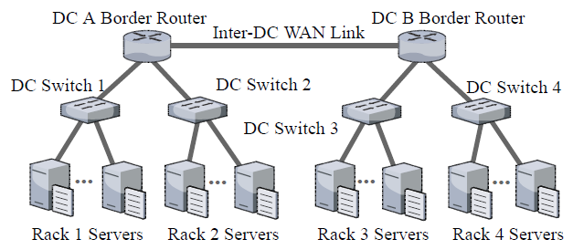
Evaluation
Gemini is implemented as a Linux kernel module.
Commodity Testbed:
Large-scale 1Gbps testbed & Small-scale 10Gbps testbed.
Protocols Evaluated: Cubic, Vegas, BBR, DCTCP & Gemini.
Notes:
We implemented Gemini as a Linux kernel module and conducted extensive experiments under both large-scale 1Gbps testbed and small-scale 10Gbps testbed. We evaluated Cubic, Vegas, BBR, DCTCP to compare with Gemini.

Slide 20
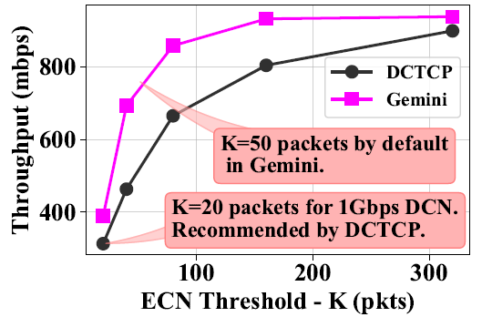
Evaluation
Can Gemini achieve high throughput and low latency?
In static 2-to-1 experiments, Gemini achieves higher throughput and equally low latency compared to DCTCP.

Slide 21
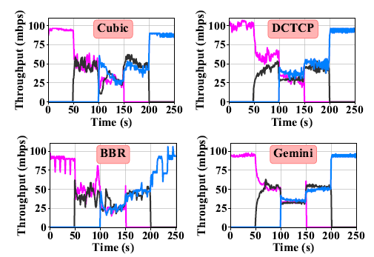
Evaluation
Can Gemini converge quickly, fairly and stably?
In static traffic experiments, Gemini converges to the bandwidth fair-sharing point quickly and stably.

Slide 22
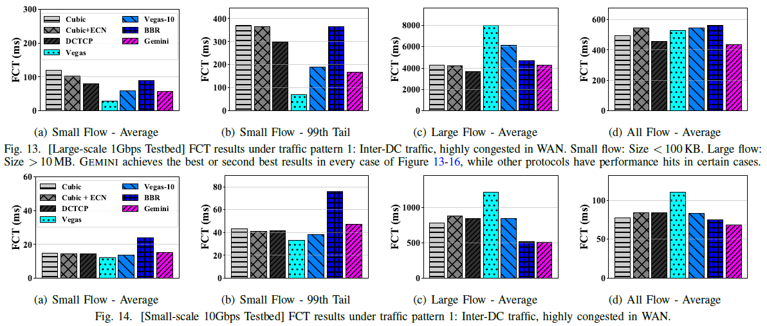
Evaluation
How does Gemini perform under realistic workload?

Slide 23
Concluding Remarks
Investigated the cross-DC network in the wild, and uncovered its heterogeneous characteristic.
Demonstrated the problems of existing transports over the cross-DC network.
Designed a novel transport protocol – Gemini, and conducted extensive evaluation that show its superior performance.
Notes:
To conclude the work, we first investigated the cross-DC network in the wild and uncovered its heterogeneous characteristic. We then demonstrated the problems of existing transports over the heterogeneous cross-DC network. To address these problems, we designed the Gemini transport protocol and conducted extensive testbed evaluation that show its superior performance.

Slide 24
Thanks!

