Slide 1



FlashPass: Proactive Congestion Control for Shallow-buffered WAN
Gaoxiong Zeng, Jianxin Qiu, Yifei Yuan (Alibaba),
Hongqiang Liu (Alibaba), Kai Chen
iSING Lab @ Hong Kong University of Science and Technology
Notes:
Hello everyone, I am Gaoxiong Zeng from iSING Lab of Hong Kong University of Science and Technology. Today, I am going to present our work – FlashPass: Proactive Congestion Control for Shallow-buffered WAN. This is a joint work with Alibaba.

Slide 2
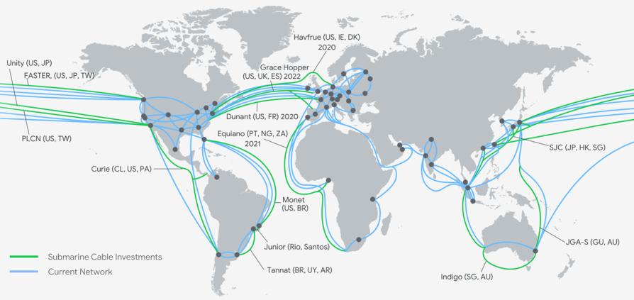
Inter-DC Wide-area Network
Inter-DC WAN traffic (e.g., Google) is doubling every 9 months in the recent five years!
Source: https://www.google.com/about/datacenters
Notes:
Our work aims to optimize the communication on the inter-datacenter wide-area network. As reported by Google, the inter-DC traffic is doubling every 9 months in recent five years.

Slide 3
Shallow-buffered WAN
For flexible & cost-effective evolution, enterprises start to build their own customized WAN routers.
They are often based on the shallow-buffered chips.
ASIC | BCM Trident+ | BCM Trident2 | BCM Trident3 | BCM Trident4
Capacity (ports * BW) | 48 * 10Gbps | 32 * 40Gbps | 32 * 100Gbps | 32 * 400Gbps
Total Buffer | 9MB | 12MB | 32MB | 132MB
Buffer per port | 192KB | 384KB | 1MB | 4.125MB
Buffer per port per Gbps | 19.2KB | 9.6KB | 10.2KB | 10.56KB
High buffer pressure on WAN communication!
Notes:
To support the network evolution flexibly and cost-effectively, large enterprises such as Google and Alibaba start to build their customized wide-area facilities based on the commodity switching chips. These switching chips are often shallow-buffered.
The table shows the mainstream commodity switching chips of Broadcom. Based on the calculation, we find that the shallow buffers are often smaller than 20KB per port per Gbps. This imposes great buffer pressure on WAN communication.

Slide 4
Reactive CC is Insufficient
Buffer Requirement Analysis in Theory
WAN BDP ~= 25MB >> 20KB (i.e., shallow buffer).
Transport | Signal | Algorithm | Buffer requirement for high throughput & low loss
TCP Reno [1] | Loss | AIMD | BDP*beta/(1-beta) = BDP (beta=0.5)
TCP Cubic | Loss | AIMD | BDP*beta/(1-beta) = BDP/4 (beta=0.2)
TCP Vegas | Delay & loss | AIAD (MD on loss) | 5*n pkts, n=flow#
Copa | Delay only | AIAD | 2.5*n/delta = 5*n pkts, n=flow# (delta=0.5)
BBR | No direct signal | Not incremental | (cwnd_gain-1)*BDP in Probe_BW phase (cwnd_gain = 2)
[1] Guido Appenzeller, Isaac Keslassy, and Nick McKeown, "Sizing Router Buffers", in SIGCOMM 2004.
Notes:
We first investigate the conventional reactive congestion control such as TCP Cubic, BBR, etc. These protocols often react to the congestion reactively after it occurs.
Based on the theoretical analysis, we find that the buffer requirement for high throughput and low loss rate is often a constant of BDP, while BDP is several magnitudes larger than the shallow buffers. Thus, existing reactive transports may not work well under the shallow-buffered WAN.

Slide 5
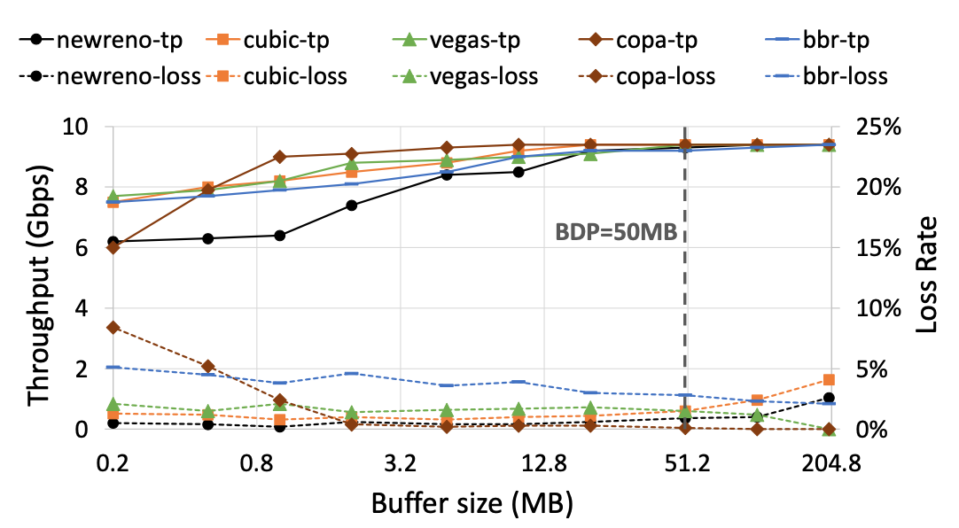
Reactive CC is Insufficient
Experimental Results (10Gbps; RTT=40ms):
With shallow buffer (~0.2MB in 10Gbps), network performance degrades significantly.
Up to 40% reduction!
Notes:
To demonstrate the performance impact of shallow buffer.
We conduct a static experiment with ns3 simulation. We compare TCP newreno, cubic, vegas, copa and BBR. And we measure the throughput and loss rate as the main metrics.
The results are shown in the figure. We can see that the throughput decreases and loss rate increases when buffer size gets smaller.
The throughput reduction can get up to 40% under shallow buffers.

Slide 6
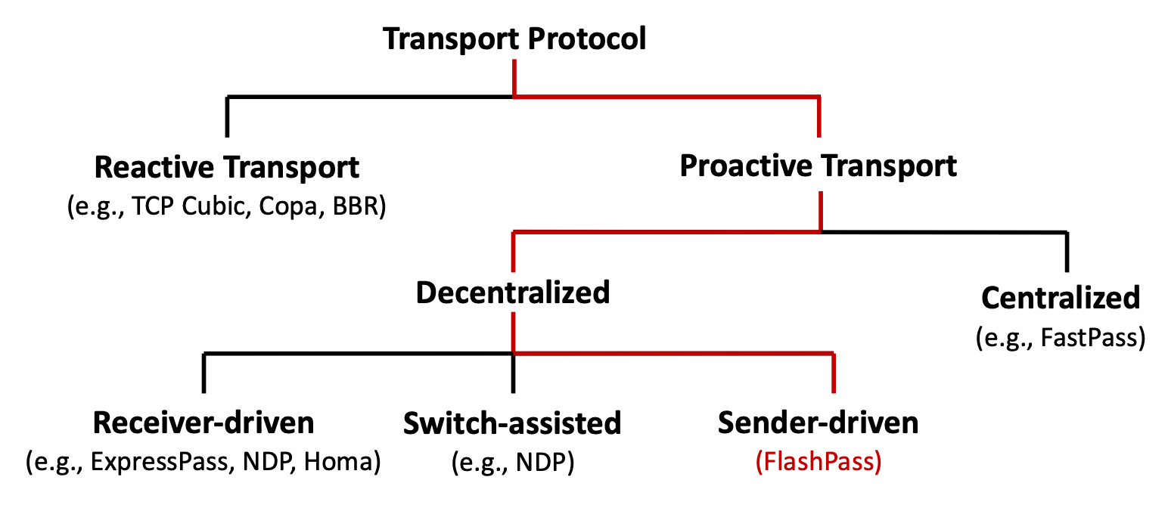
Proactive CC as a Solution
?
Notes:
After observing the insufficiencies of the reactive transport, we then turn to the emerging proactive transport solutions.

Slide 7

Proactive CC as a Solution
Proactive congestion control (PCC) is promising to achieve zero queueing and high throughput.
ExpressPass [sigcomm’17] (our baseline): credits emulate data sending in separate queue.
NDP [sigcomm’17]: pure receiver scheduling + switch cutting payload.
Homa [sigcomm’18]: pure receiver scheduling + switch multiple Q + overcommitment.
credit request
credit
1st RTT
credit
data
2nd RTT
1st rtt:
2nd rtt:
Credit
Credit
Sender
Receiver
Sender
Receiver
Credit Request
Data
Existing PCCs are mostly designed for DCN, and have issues to work practically on WAN!
Notes:
Unlike reactive transport that reacts to the congestion only after it occurs, proactive protocol often allocates bandwidth before the data sending. Therefore, in theory, proactive transport is promising to achieve zero queueing and high throughput.
The figures show the general workflow of a receiver-based proactive congestion control. In the first RTT, senders will send a credit request to the receiver. After that, receivers will start to generate credits to the senders. Then in the second RTT, senders will send the data packets based on the received credits.
There are some existing protocols in this line, such as ExpressPass, NDP and Homa.
We take ExpressPass as the baseline protocol. It uses credit emulation on the reverse path to allocate bandwidth. It is the only protocol that can handle the congestion in network core without modifying the switch hardware, which is more practical for WAN.
However, the existing proactive transports are mostly designed for DCN, and we find some issues when applying them directly on WAN.

Slide 8
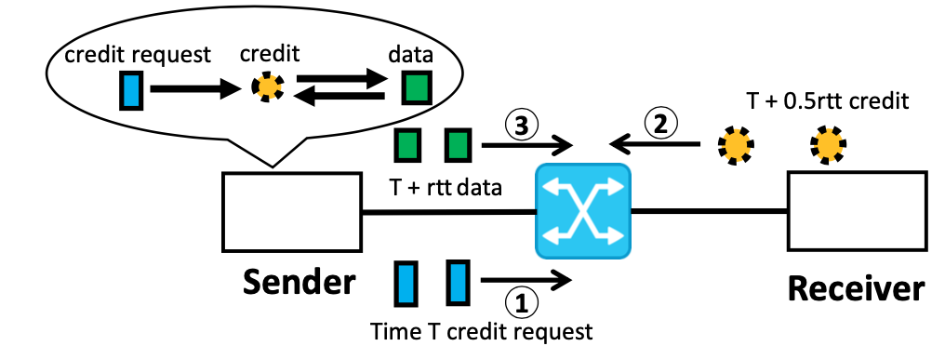
Problem 1: Imperfect Scheduling Issue
Data sending time has at least 1-way network delay after the credit sending.
However, different flows have different delays/RTTs.
→ Data Crash / Under-utilization
Notes:
The first problem is what we call ``the imperfect scheduling issue’’.
For proactive transport, data sending time has 1-way network delay after the credit sending. However, different flows have different RTTs or delays.
Therefore, the well-scheduled credit packets can still lead to the data packet crash or network under-utilization.

Slide 9
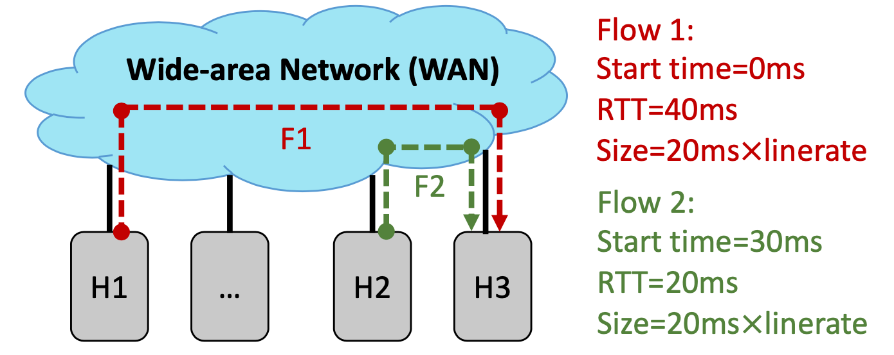
Problem 1: Imperfect Scheduling Issue
Example (data crash):
 | Start time | Credit send | Data Send | Data arrive
Flow 1 | 0ms | 20-40ms | 40-60ms | ~60-80ms
Flow 2 | 30ms | 40-60ms | 50-70ms | ~60-80ms
Interleaved.
Different
RTTs
Data crash!
Notes:
We use an example to illustrate this problem.
In this example, two flows share the same bottleneck link to the same receiver. The two flows have different RTTs. After analysis, we find that they can trigger interleaved credit sending at the receiver side. However, due to different RTTs, these credits trigger out data packets to arrive at the bottleneck link simultaneously, leading to the unwanted data crash.

Slide 10
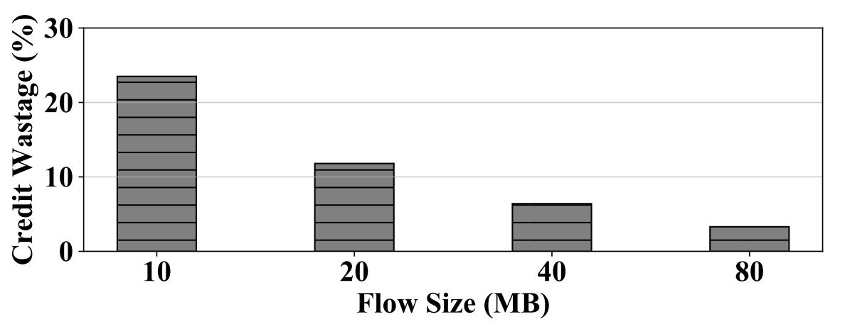
Problem 2: Credit Termination Issue
What to do after sending credits for the last data byte?
Aggressive credit generation: keep sending credits until receivers ack back. → Credit Wastage
Passive credit generation: not sending credits without further credit requests. → Long Tail Latency
ExpressPass
(Aggressive credit generation)
1Gbps, RTT=60ms
Notes:
The second problem is called ``the credit termination issue’’. The question is what to do after sending credits for the last data byte? We should notice that the credits are not guaranteed to pass the emulation network without dropping.
There are two choices.
The first choice is aggressive credit generation, which is to… However, this may lead to credit wastage in the last RTT.
The second choice is passive credit generation, which is to… This may lead to long tail latency when some credits are lost.
To demonstrate the problem, we run ExpressPass in NS2 simulation. ExpressPass adopts the aggressive credit generation approach. We find that the credit wastage is significant, especially for small flows. For example, when flow size equals to 10MB, the wastage can get up to 23%, thus leading to severe bandwidth under-utilization.

Slide 11
FlashPass Design
Challenges:
Handle imperfect scheduling under diverse RTTs.
Handle credit termination issue in the last RTT.
Design Choices:
Sender-driven emulation mechanism (C1).
Send time calibration with timestamp info.
Over-provisioning with selective dropping (C2).
Notes:
After observing the insufficiencies of existing solutions, we now present our FlashPass design to address these challenges.
There are two main design choices.
Firstly, we use a sender-driven emulation mechanism together with send time calibration to handle the imperfect scheduling issue.
At the same time, we use an over-provisioning with selective dropping mechanism to address the credit termination issue in the last RTT.
We now introduce each one of these designs in more detail.

Slide 12
Sender-driven Emulation
FlashPass is the first sender-driven PCC design.
Notes:
Firstly, FlashPass is the first sender-driven proactive transport protocol.

Slide 13
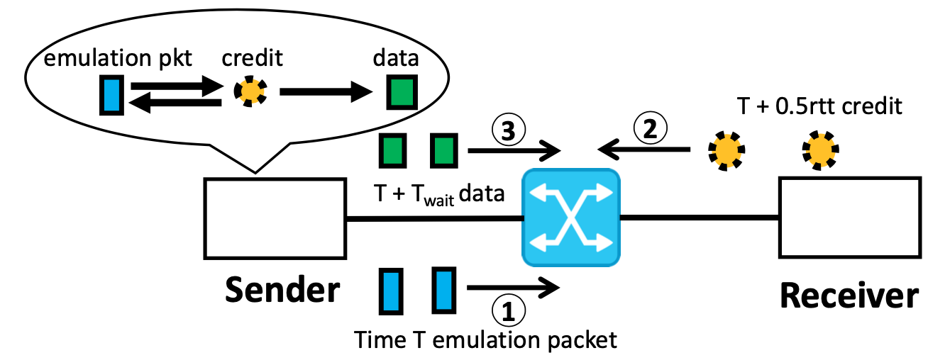
Sender-driven Emulation
Sender-driven emulation rehearses the future transmission with forward emulation packets (1).
Same direction as the real data forwarding, unlike backward emulation (2) of receiver-driven solutions.
Notes:
Similar to the receiver-driven emulation, FlashPass also rehearses the future data transmission in a separated emulation network, and sends out the real data based on the credit feedback.
The difference is that FlashPass is sender-driven, which means that the emulation follows the same direction as the real data forwarding. This can help achieve the perfect scheduling in time together with the send time calibration. Besides, there are other advantages such as no need of symmetric routing, simplified emulation control loop.

Slide 14
Sender-driven Emulation
Send time calibration:
Add timestamp on the emulation and credit packets.
Data sending is scheduled to a fixed time after emulation.
Example:
 | Start time | Credit send | Data Send | Data arrive
Flow 1 | 0ms | 20-40ms | 40-60ms | ~60-80ms
Flow 2 | 30ms | 40-60ms | 70-90ms | ~80-100ms
Interleaved.
Fixed time
delay
No crash!
Notes:
For send time calibration, FlashPass adds timestamps on both emulation and credit packets. The real data sending can then be scheduled to a fixed time after emulation.
We now use an example to show how this resolves the imperfect scheduling issue.
In this example, again, there are two flows sharing the same link to the same receiver. The flows have different RTTs. At the beginning, they can trigger out the interleaved credits at the receiver side. And after a fixed time delay, the real data arrives at the bottleneck link, thus avoiding the packet crash.

Slide 15

Over-Provisioning with Selective Dropping
Sending over-provisioned packets in the last RTT.
Packet tagging at end-host
Selective dropping in the network
2
2
Dropping Threshold
1
2
2
1
2
Emulation Queue
1
1
Network Fabric
Ordinary emulation packets.
Last RTT over-provisioned emulation packets.
Notes:
The second design choice is the over-provisioning with selective dropping mechanism. This is to send over-provisioned emulation packets when the flow is about to finish.
As we can see in the figure, at the end-host, we perform packet tagging to differentiate the ordinary emulation packets and the over-provisioned emulation packets. The in the network fabric, over-provisioned packets will get selectively dropped when there is congestion while the ordinary packets can pass through as normal.
For the implementation, we show that this can be achieved with the commodity switches. If we tag packets with ECT or non-ECT, then selective dropping can be achieved simply with the RED/ECN function of commodity switches.

Slide 16
Over-Provisioning with Selective Dropping
Case-1: network is under-utilized.
Dropping Threshold
2
2
2
2
Egress Queue
Network Fabric
Spare bandwidth is utilized & no extra delay for credit generation.
Ordinary emulation packets.
Last RTT over-provisioned emulation packets.
Notes:
We now illustrate how it works in different cases.
In the first case, the network is under-utilized and thus no queueing and congestion. The spare bandwidth will be utilized with the over-provisioned packets and there will be no extra delay for credit generation.

Slide 17
Over-Provisioning with Selective Dropping
Case-2: network is fully-utilized.
1
1
Dropping Threshold
2
2
1
1
2
Egress Queue
2
2
Network Fabric
Credit wastage can be prevented & No link under-utilization.
Ordinary emulation packets.
Last RTT over-provisioned emulation packets.
Notes:
In the second case, the network is fully-utilized. The ordinary packets will not be affected and thus no credit wastage and link under-utilization.

Slide 18
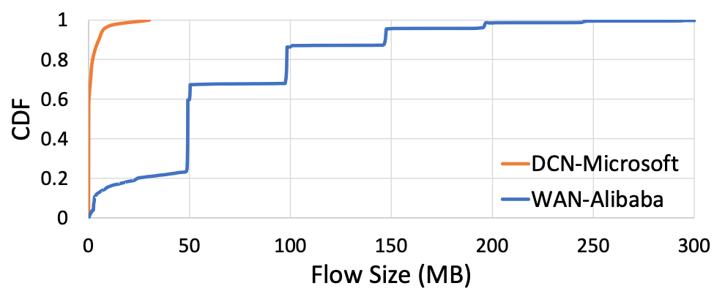
Evaluation
Measurement on a regional WAN of Alibaba:
We conduct evaluation with ns2 simulation.
Protocols evaluated: TCP Cubic, ExpressPass & FlashPass.
Notes:
To evaluate how FlashPass performs, we conduct measurement on a regional WAN of Alibaba. We find that the flow sizes are much larger than that of DCN.
And based the measurement, we use NS2 simulation to evaluate the performance of FlashPass. We compare TCP Cubic and ExpressPass in our evaluation.

Slide 19
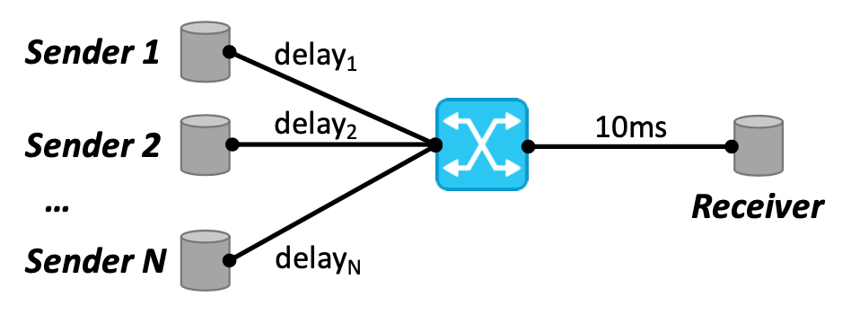
Evaluation
Can FlashPass achieve high throughput and low loss?
Experiment setting:
Static flows from N senders to the same receiver;
All links have 10Gbps capacity;
Metrics: throughput & loss rate.
Notes:
The first question is: can FlashPass achieve high throughput and low loss rate?
We answer this question with static traffic experiments.
All links have 10Gbps capacity and we measure the throughput and loss rate as the main metrics.

Slide 20
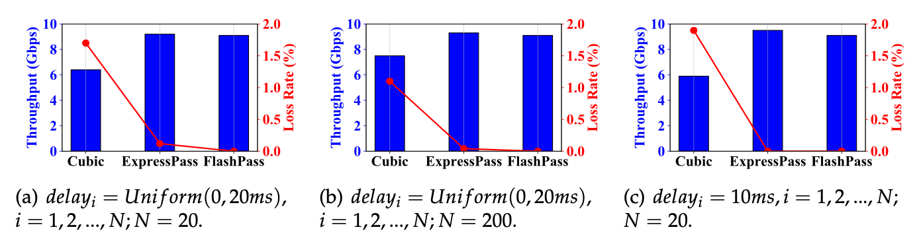
Evaluation
Can FlashPass achieve high throughput and low loss?
In static traffic experiments, FlashPass consistently achieves high throughput with zero loss.
Notes:
The results are shown in the figures. We find that FlashPass achieves consistently high throughput and low loss rate. The throughput is up to 40% higher than that of Cubic. And the loss rate is near zero compared to that of ExpressPass.

Slide 21
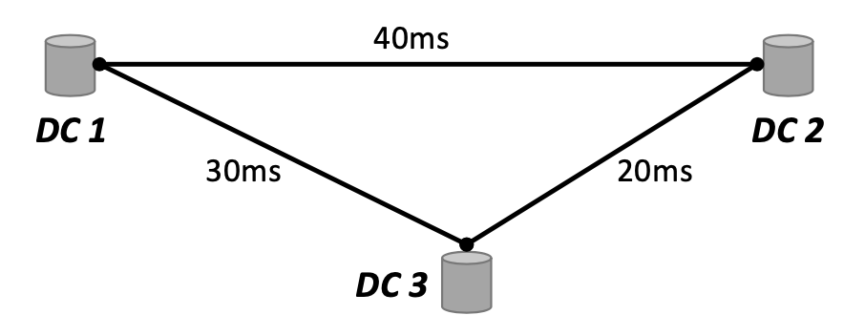
Evaluation
How does FlashPass perform under realistic workload?
Experiment setting:
Dynamic flows are generated based on our measurement;
All links have 10Gbps capacity;
Metrics: flow completion time (FCT).
Notes:
The second question is: how does FlashPass perform under the realistic workload?
We answer this question with dynamic traffic experiments.
All links have 10Gbps capacity and we measure the flow completion time as the main metric.

Slide 22
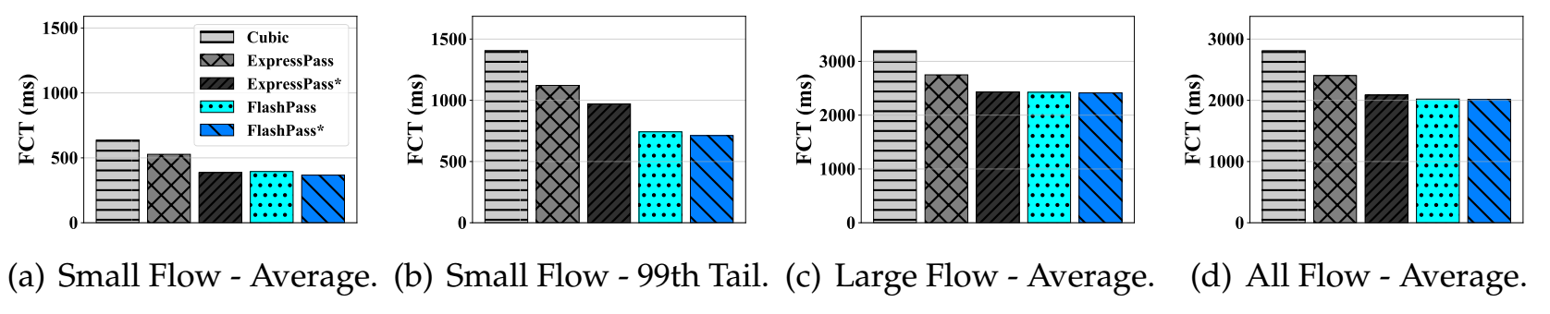
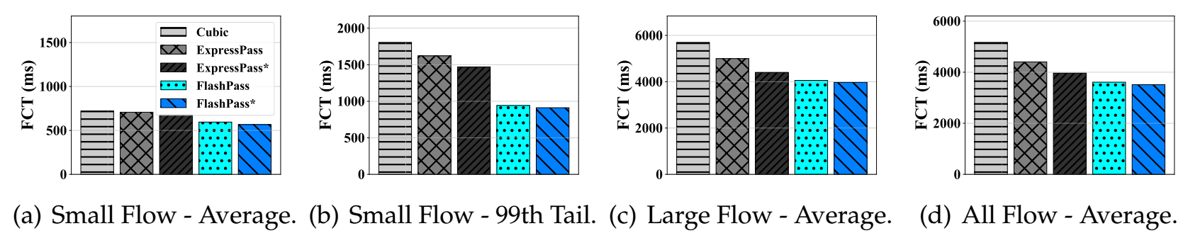
Evaluation
How does FlashPass perform under realistic workload?
Overall flow completion times:
-32% (vs TCP Cubic) and -11.4% (vs ExpressPass)
99-th tail small flow completion times:
-49.5% (vs TCP Cubic) and -38% (vs ExpressPass)
Figure 1: FCT results. Average load = 0.4. * indicates the Aeolus-enhanced version.
Figure 2: FCT results. Average load = 0.8. * indicates the Aeolus-enhanced version.
Notes:
The results are shown in the figures. We find that…

Slide 23
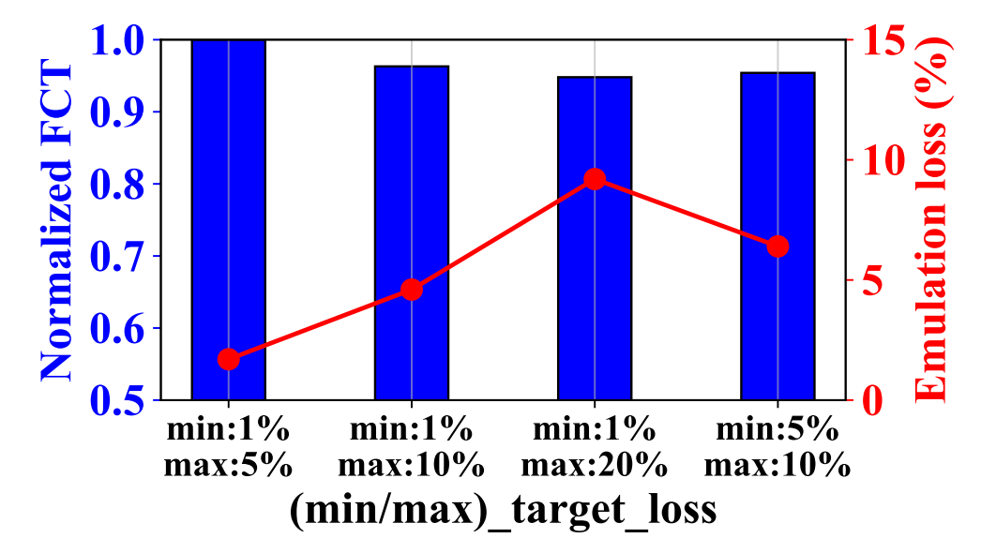
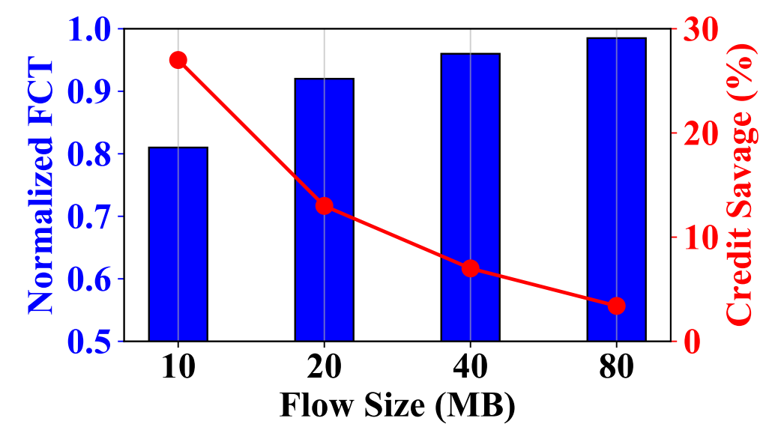
Evaluation Deep Dive
How do parameters of FlashPass affect its network performance? - Figure A.
How effective is the over-provisioning with selective dropping mechanism of FlashPass? - Figure B.
Figure A
Figure B
Notes:
We also dived into the different parameter settings and design choices.
For parameter settings in figure A, we select the parameters that achieves both small FCT and low emulation loss rate.
Then we check the effectiveness of the over-provisioning mechanism, we find that FlashPass saves credits by up to 27% and improves the FCTs by up to 19%.

Slide 24
Summary of FlashPass
Revealed the trend of using shallow-buffered switches on the inter-DC WAN.
Demonstrated the insufficiencies of reactive congestion control for shallow-buffered WAN.
Explored the proactive congestion control on WAN, and designed FlashPass that addresses several practical challenges.
Notes:
Here is a summary of this work.

Slide 25
Thanks!

