Slide 1
文本分类／聚类分享
朱文静 2019.3.21
00

Slide 2
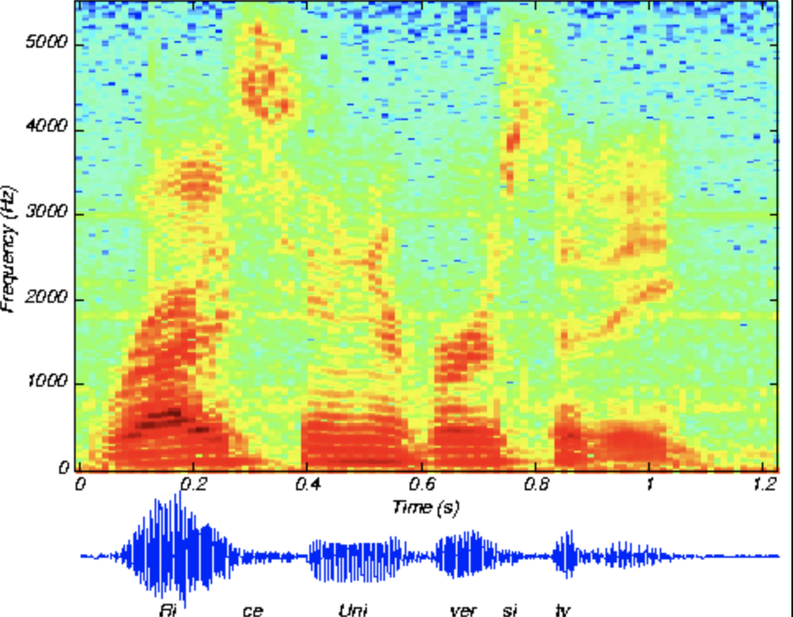
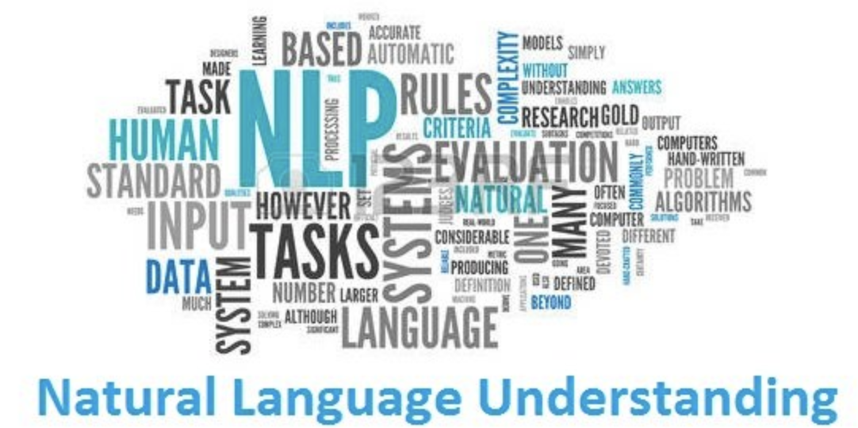
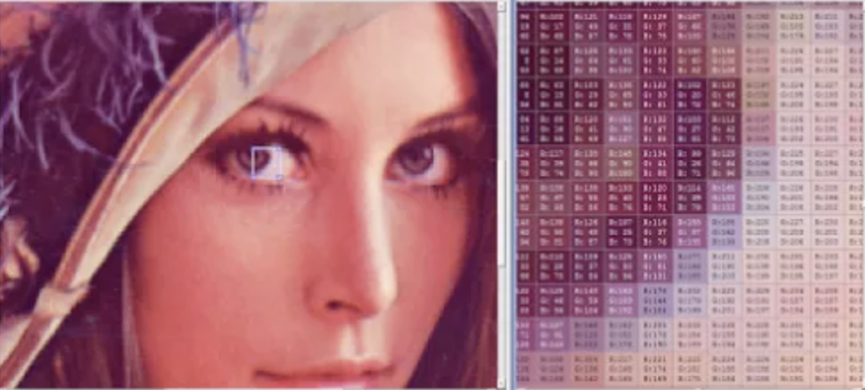
Why learn representation?
By 韩堃
speech
image
language
Perception
Understanding

Slide 3
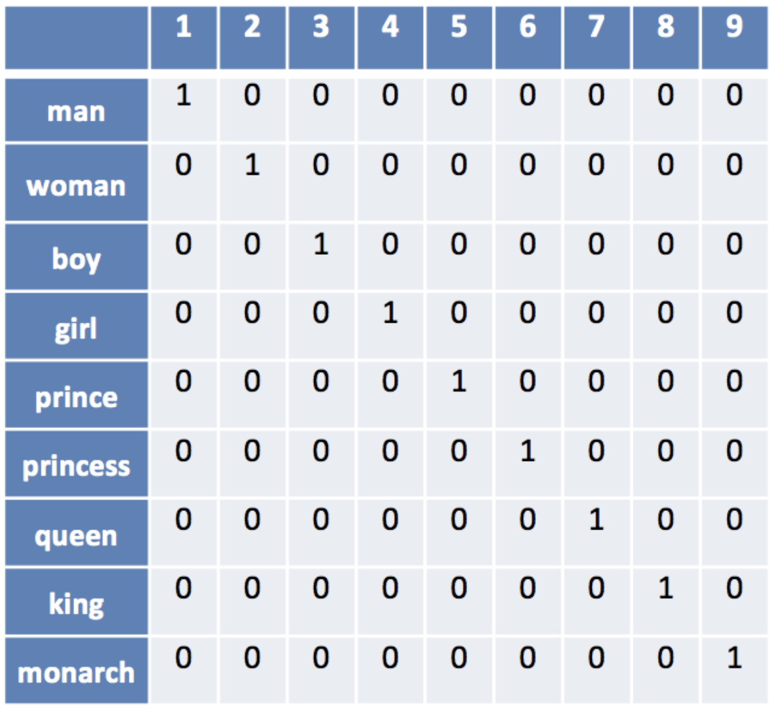

Word Representation
Non-distributed representation
By 韩堃
Local representation (non-distributed)
One-hot representation on a vocabulary V, or use index
Sparse vector: only a few elements (feature) are active, binary or real number
Easy and fast
The distance metric is constant between words (not true for documents)
These discrete atomic symbols provide little information to the system

Slide 4
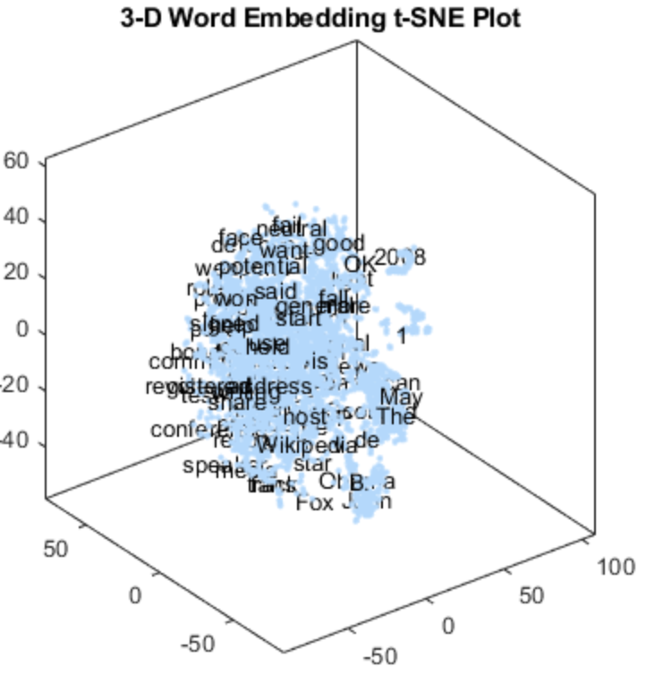
Word Representation
Distributed representation
By 韩堃
Distributed representation
Each word is represented by a vector in a d-dimensional real vector space
Low dimensionality
The distance is measured by the geometric structure, e.g., Euclidean distance. Hopefully!
word2vec
训练方式：CBOW、Skip-gram

Slide 5
第一部分：顺风车乘客评论情感分类
Step1: 提取数据
Step2: 训练基于顺风车评论场景的word2vec
Step3: 建立分类模型
数据表：beatles_dwd.dwd_addtag_statistic_d
数据范围：2018-03-03（train/test) & 评论长度大于20
数据范围：2018-03-02~ 2018-03-15
00

Slide 6
评论情感分类效果
模型 | 训练集 | 测试集
DNN | 86.17 | 81.87
DNN+dropout | 88.01 | 84.68
CNN | 86.18 | 84.05
00

Slide 7
第二部分：顺风车乘客评论聚类
Step1: 提取数据
Step2: 使用doc2vec训练句子向量
Step3: 使用K-means聚类
数据表：beatles_dwd.dwd_addtag_statistic_d
数据范围：2018-03-03（train/test) & 评论长度大于20
00

Slide 8
THANK
YOU
朱文静 2019.03.21
00

