Slide 1
NYU Cyber Fellows
CS GY 6573
Penetration Testing
Automated Vulnerability Scanners -
Nessus and OpenVAS
©2020 NYU Tandon School of Engineering

Slide 2
Network Setup
Complete scanning lab first
For this lab, Kali will need to be connected to the internet
Switch to NAT or bridged, whichever works better for you
Only need to download packages
Will not be scanning over the network
We will then need to switch our networking to host only
Scan Metasploitable
This lab is optional - Nessus and OpenVAS will not be covered will not be assessed in assignments or the final
However, they may help and you may be authorized to use them
OpenVAS will be very helpful and may show up later

Slide 3
Vulnerability Scanning
Nessus and OpenVAS are an automated vulnerability detection tool
To complete the Nessus section lab, you will be required to install Nessus and register for a free license
I believe that being forced to register for commercial tools should not be necessary
You can skip to the OpenVAS section if you don't want to register for Nessus
Therefore, Nessus section is optional and you will not be required to use Nessus later in this semester
These are valuable tools, Nessus is one of the industry standards for automated scanning and published vulnerability detection
Mostly used by Blue Teams performing white/crystal box scans

Slide 4

Nessus
(optional)

Slide 5
Nessus - Download and Install
Not include with Kali
Home license is free!
Student/Training license is Free!
Limited by certain scans and 16 hosts
Download
https://www.tenable.com/products/nessus/select-your-operating-system
Install and start the service
$ sudo dpkg -i Nessus-8.9.0-debian6_amd64.deb
8.9.0 may not the version you downloaded!
$ sudo /etc/init.d/nessusd start
Access the front end
https://localhost:8834

Slide 6
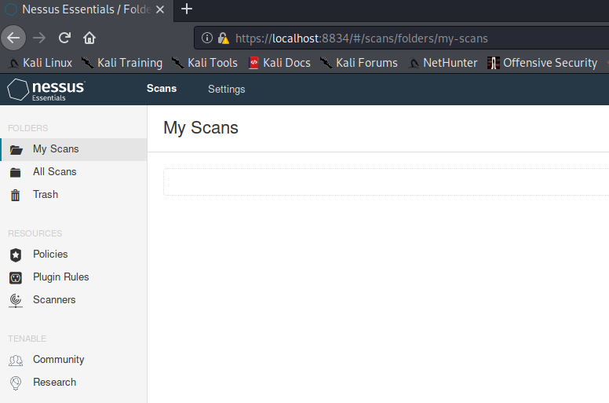
Nessus - Basic Usage
We will be using Nessus for labs and assignments later
Download, Install, Start
Visit front end
Choose “Nessus Essentials”
Activate, Initialize
Login
You will see this page
Click ‘New Scan’

Slide 7
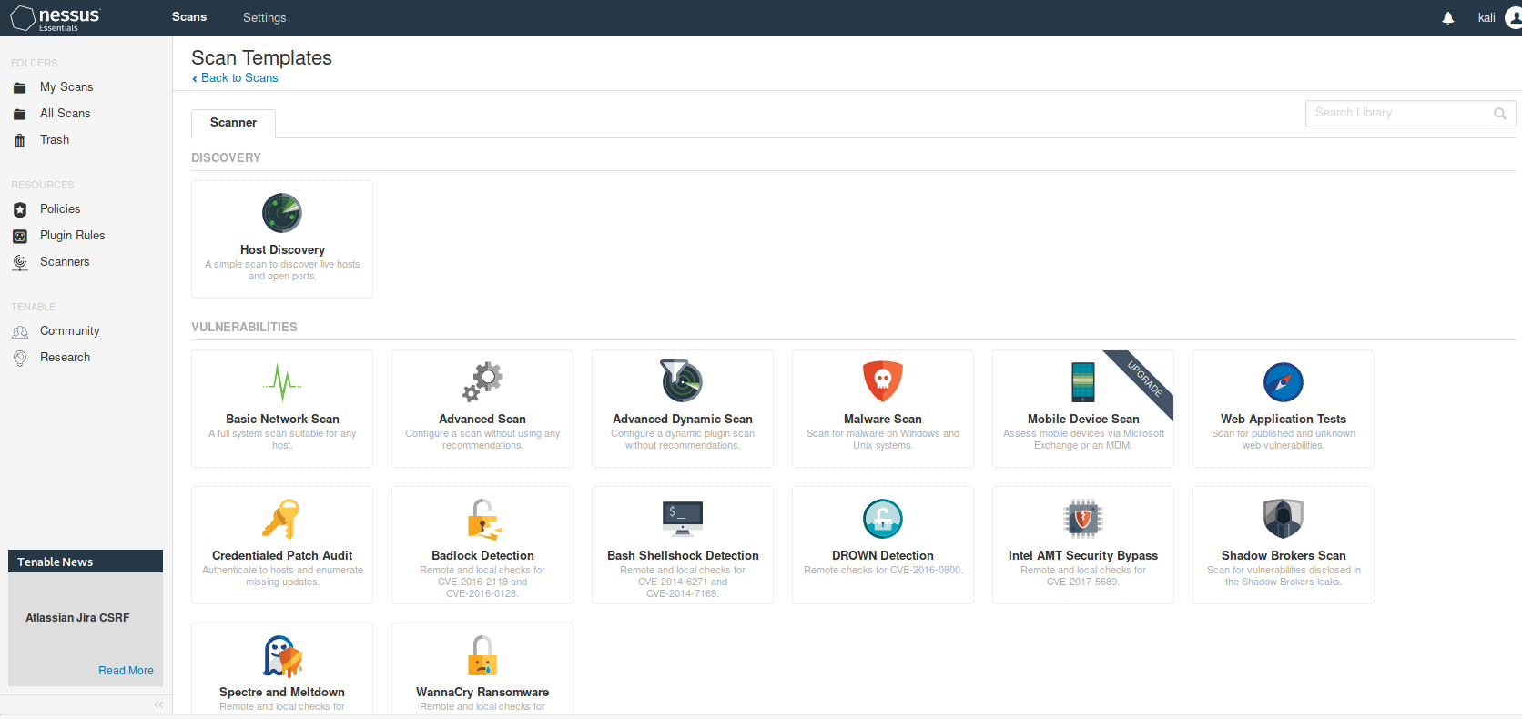
Nessus - Basic Usage
Lots of options, we will focus on Advanced Scan

Slide 8
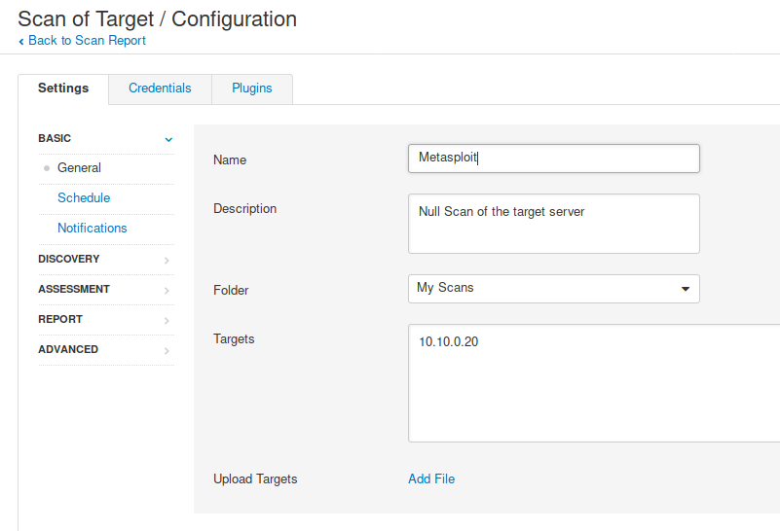
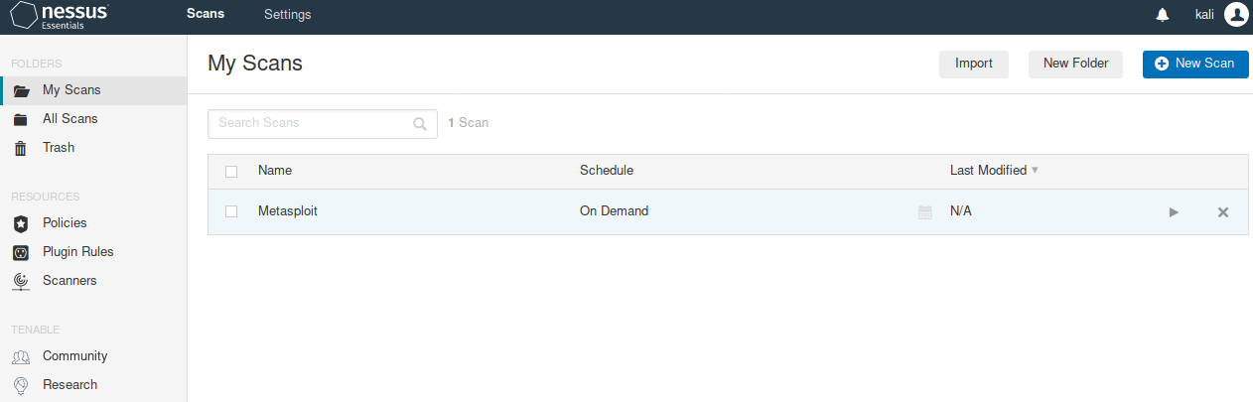
Nessus - Basic Usage
Configure the scan
You can add user credentials in top tabs
Otherwise, it’s a “Null scan”
Null scan is similar to nmap -A
After we save, we can start the scan

Slide 9
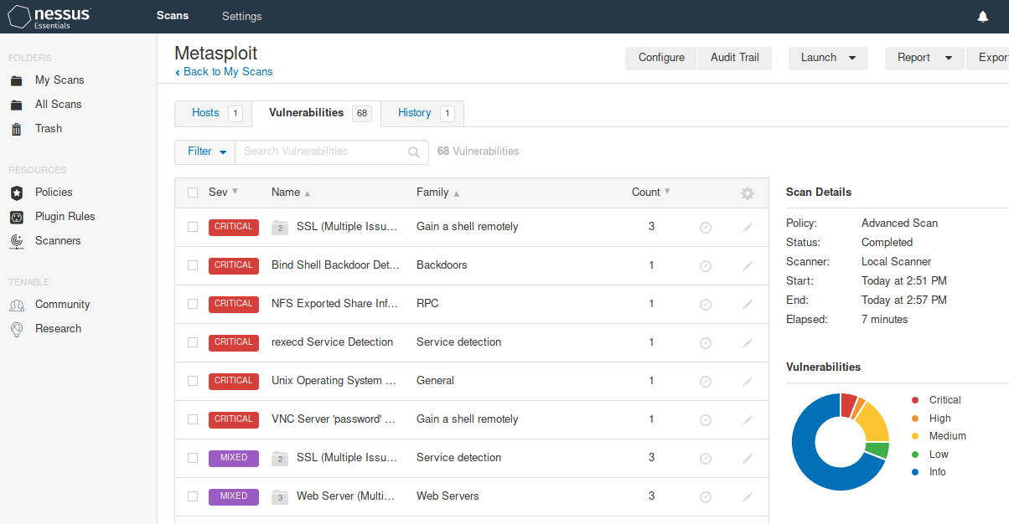
Nessus - Basic Usage
Our nmap version + NSE scan showed us the same exposures
We had to research to understand the exposures and research vulnerabilities
Nessus includes vulnerability database and organized better

Slide 10
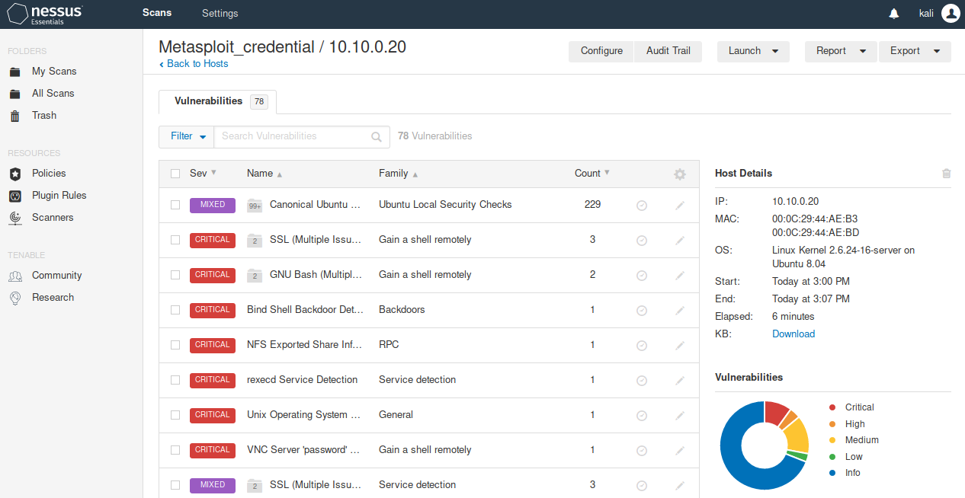
Nessus - Basic Usage
If we add credentials, Nessus can go more in-depth and improve results
68 vs 78
vulnerabilities in
Metasploitable

Slide 11
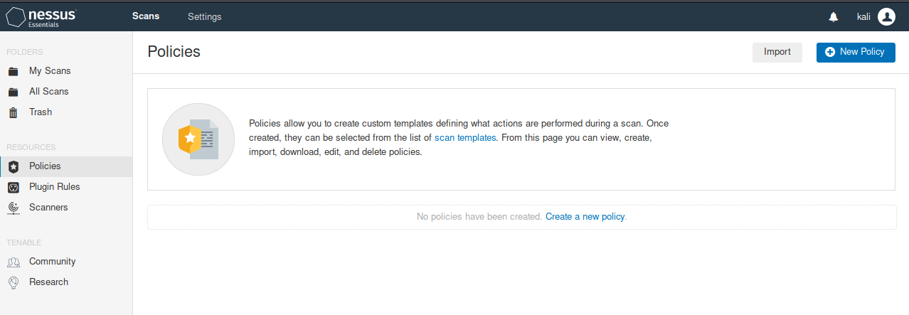
Creating Scan Templates - Policies
A policy is a type of scan template
We can reuse common credentials or options
We use the template and specify a target in the Scan menu
Instead of Scanner templates, we see our policies

Slide 12
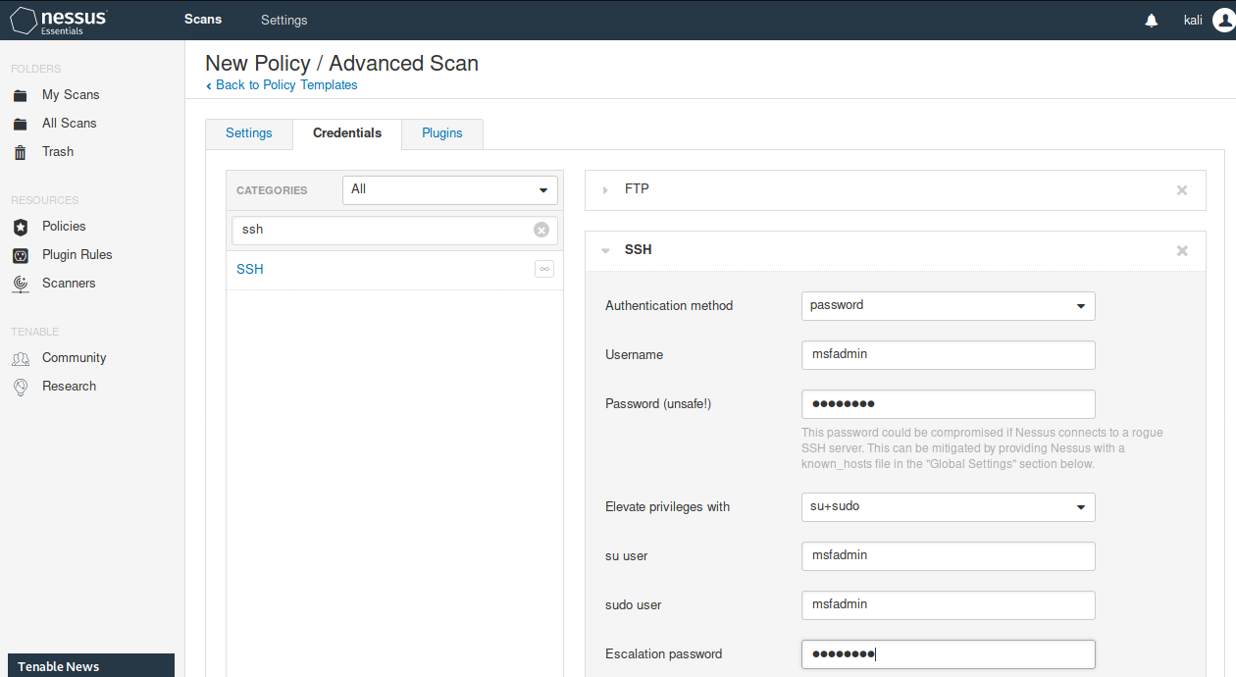
Adding Credentials
We can add credentials in the scan option

Slide 13
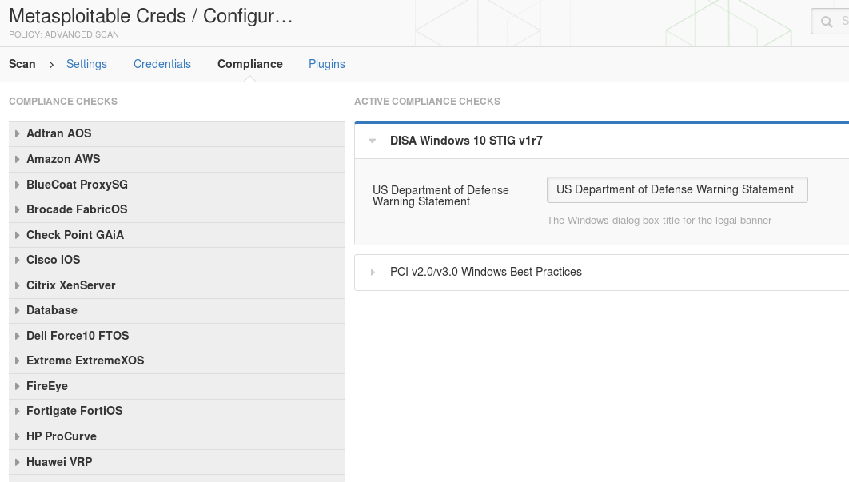
Compliance Checking
Nessus can be used to check for industry standard compliance(not in Nessus Essentials)

Slide 14
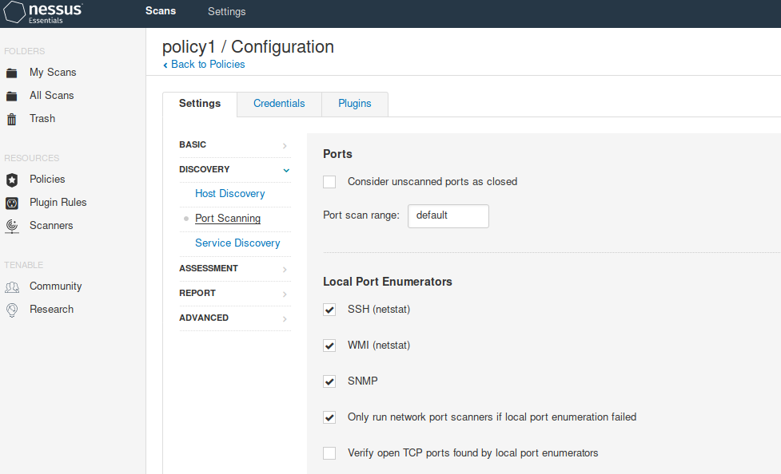
Scan type
Just like nmap, Nessus lets of graphically select our options
Host discovery
ICMP
ARP
TCP
Port scanning
Select ports
Scan type
TCP
SYN stealth
Version detection
Timing
Intrusive
Additional options
Nessus vulnerability detection

Slide 15
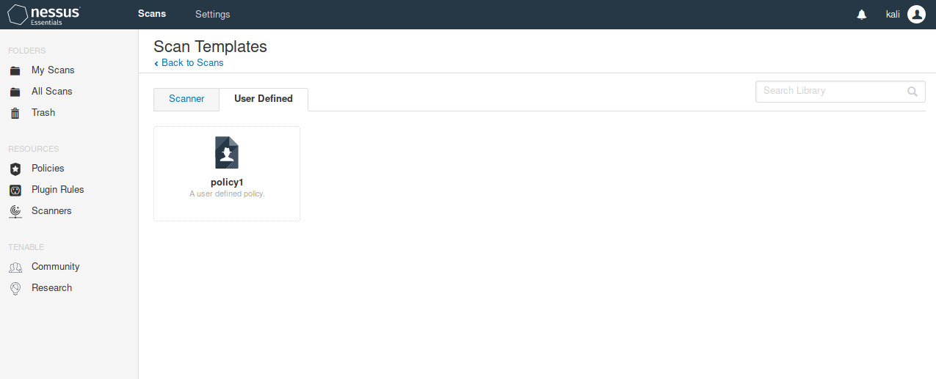
Scan using policy
Create a new scan, instead of choosing scanner, use the policy defined just now

Slide 16
Try a scan
Perform a scan of your local machine if Kali is virtualized
EC2 Kali does not have authorization to scan anything, yet
You can try uploading another image from the Amazon Marketplace
https://aws.amazon.com/marketplace/search/results?x=0&y=0&searchTerms=&page=1&ref_=nav_search_box
If you are on your home network, you can also try a scan of your local network including your home router
You can try downloading VMs like Metasploitable too
See any interesting results or critical vulnerabilities?

Slide 17
OpenVAS

Slide 18
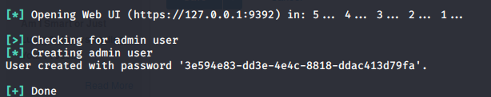
OpenVAS Installation
For Kali, we will need at least 2GB of RAM to run OpenVAS
If you don't have 2GB available, let me know. If there are requirements in the future for OpenVAS, we can coordinate workarounds (such as nmap NSE)
Start off by downloading and installing
$ sudo apt install openvas
$ sudo openvas-setup
After setup, you will get a password. Remember it

Slide 19
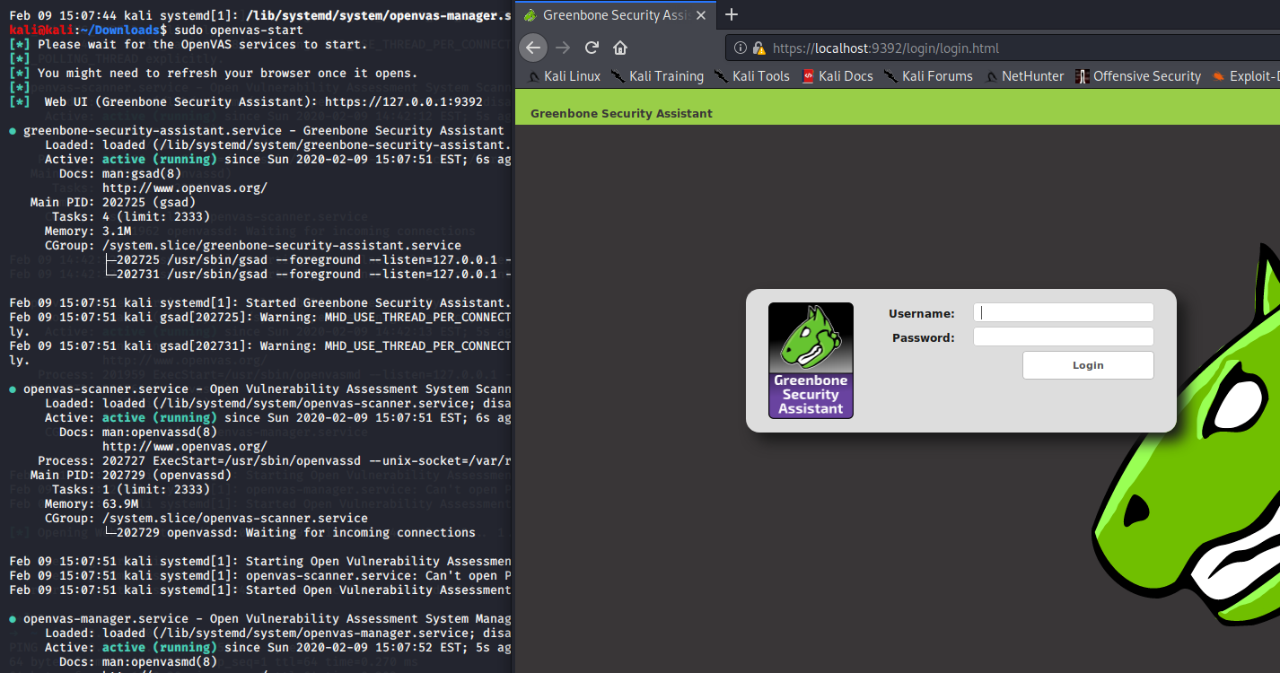
Start OpenVAS
$ sudo openvas-start
Open a web browser and go to localhost and port 9392

Slide 20
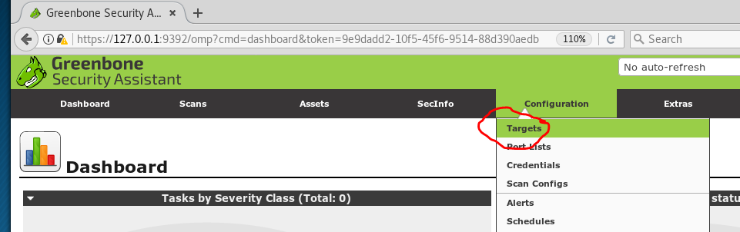
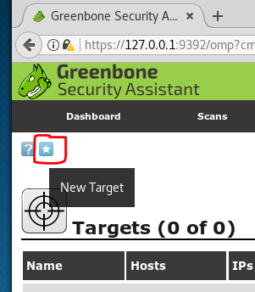
Create a New Target
OpenVAS offers a Scan Wizard for doing a quick scan but as testers, we always want to understand exactly what we are doing against what targets
Create a new target: 10.10.0.20

Slide 21
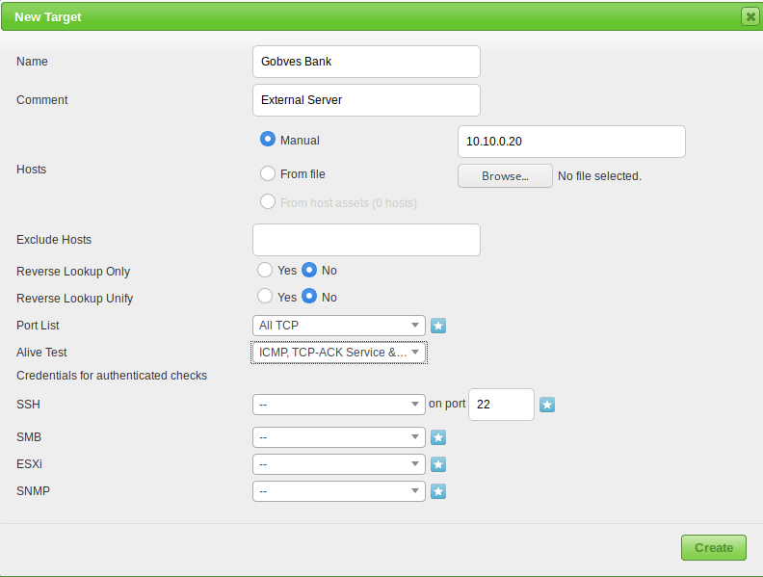
Target Setting
Change the target IP, ports to all, alive detection to ICMP, TCP-ACK, ARP

Slide 22
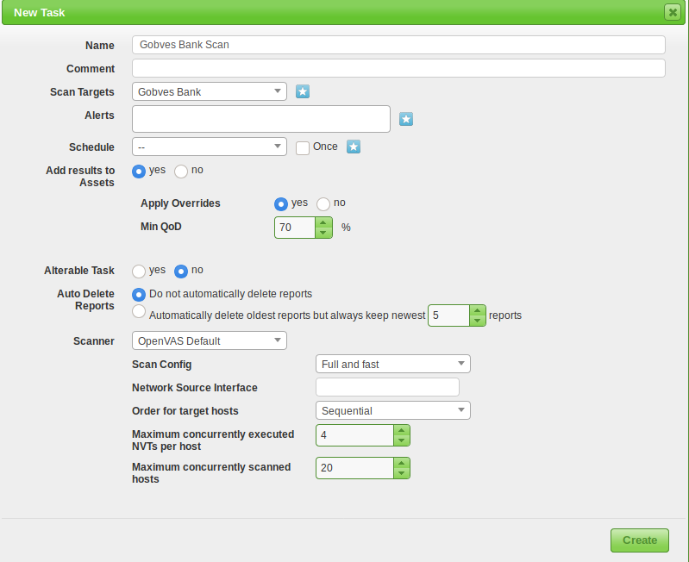
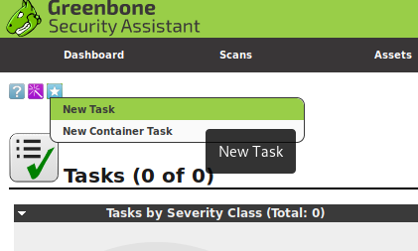
Scan Settings
Now create a new task, under Scans. See setting below

Slide 23
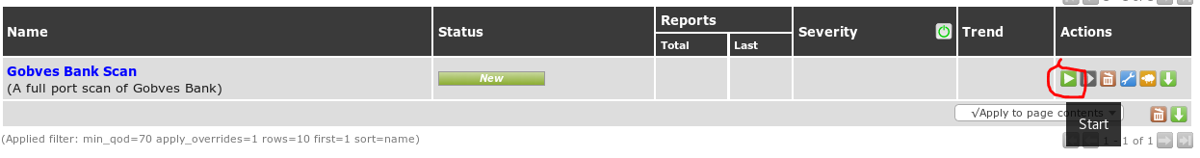
Scan Settings
OpenVAS is a very power tool to assist with network security administration
Create different targets, networks, or reference hosts by filename
Create different scan types and schedule as needed: on-demand or reoccurring
Very flexible, fully customizable!
Start the scan

Slide 24
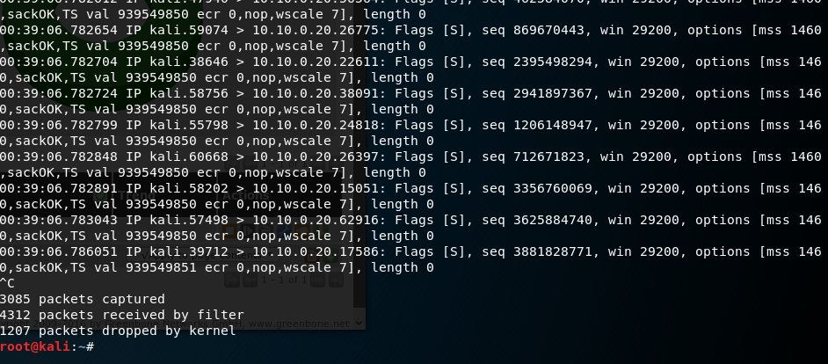
While Scanning
We can manually F5 refresh the browser to get an update on the scan
Open a new window, try running tcpdump
Kill it after a few seconds
$ sudo tcpdump host 10.10.0.20
It's scanning

Slide 25
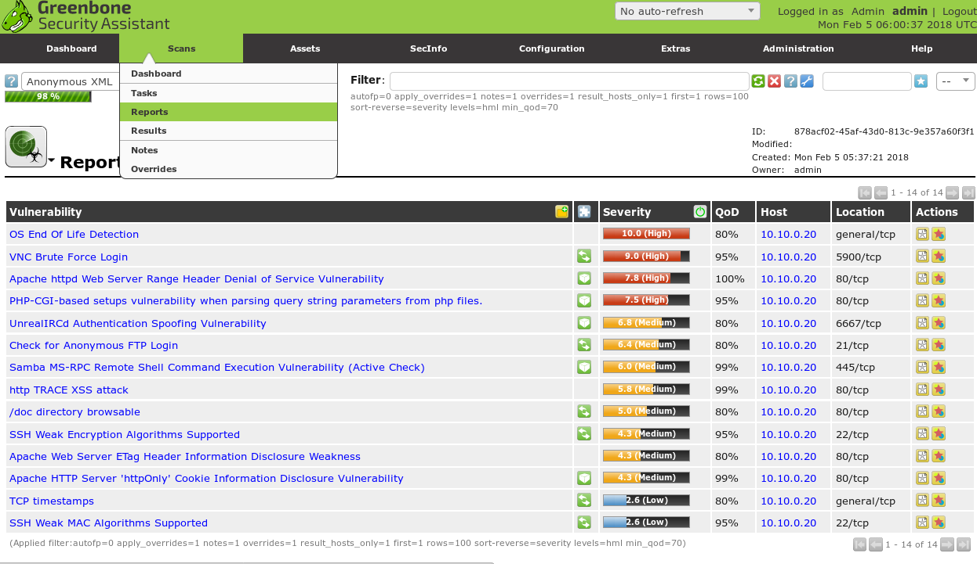
View Results
Even before the scan completely finishes, watch the results trickle in
Now we can research these vulnerabilities
prepare for validation through exploitation
Prioritize them by exposure, severity, and impact

