Slide 1













IoT Device
Access Point
Base Station
Turned ON
IoT Device
Keep OFF
Relatively Far
Nearby
Relatively Far
Nearby
UAV
Rapid Rescue
User: “Turn on the TV”
User: In danger, waiting for rescue.

Slide 2


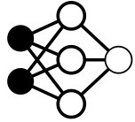








Data Collection
Raw CSI Tensor
§ 3 Multi-Resolution Spatio-Temporal Encoder
§ 4 Proximity Metric Adaptation Network
Source
Domain
Multi-Resolution Feature Extraction
Fully Connected
Layers
Transformer-based Temporal Encoder
Cosine
Similarity
Pre-training
Q
R
Complex-to-real
Transformation
Proximity
Mapping
$$𝒟_{S}$$
I
Spatial Blocks
Temporal Blocks
Proximity
Metric
Target
Domain
Multi-Resolution Feature Extraction
Fully Connected
Layers
Transformer-based Temporal Encoder
Cosine
Similarity
Fine-tuning
Q
R
Complex-to-real
Transformation
Proximity
Mapping
$$𝒟_{T}$$
I
Pre-train with
Source Domain Data
Fine-tune with
Target Domain Data
Backpropagate
(Update Parameter)
Stop-grad (Parameter Frozen)
Parameter Sharing

Slide 3











Spatio-Temporal
Feature $X_{ST}$
Complex2Real
Block
ResBlock
@(c, k, s)
$$X_{S}$$
Linear
$$S_{i}$$
Linear
Transformer Block
Add
PReLU
Spatial Feature
$X_{S}∈ℝ^{T×H}$
Complex
BatchNorm
Linear
Complex
Conv2d
@(c, k, s)
×N
Real
Imag
Complex2Real
$$S$$
Pooling & Flatten
$$H$$
Channel Concat
ResBlock
@(32, 5$×$3, 2$×$1)
ResBlock
@(16, 5$×$3, 2$×$1)
ResBlock
@(16, 3$×$1, 1$×$1)
ResBlock
@(32, 5$×$1, 2$×$1)
Raw CSI Tensor $H$ $∈ ℂ^{T×S×A}$

Slide 4



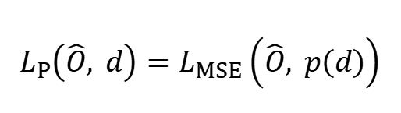



Input
Fully Connected Layers
Output
$$X_{ST}^{A}$$
Shared
Parameter
Supervision
$$\hat{O}$$
$$d$$
Cosine
$$X_{ST}^{B}$$
Proximity Loss
Backpropagation
$$L_{P}\left(\hat{O}, d\right)=L_{MSE}\left(\hat{O}, p\left(d\right)\right)$$

