Slide 1
Chapter 1: Introduction
Operating Systems:
What and Why?

Slide 2
What is Operating Systems?
The concept of operating system is pretty straightforward:
A piece of software that manages a computer, making computer’s hardware resources accessible to software through a consistent set of interfaces.
An OS is usually designed for
Abstracting away the hardware
Providing a consistent set of interfaces
Creating over entire ecosystems

Slide 3
What is Operating Systems?
Some Concepts with Operating Systems
Mac、Linux、Windows、Android、iOS
虚拟化
  内存、cpu、设备、网络
分布式对象
分布式内存/文件
规模计算
  Mapreduce
  数据中心
实时和多媒体

Slide 4
Why Study Operating Systems?
Run the computer in an efficient manner
How a program is structured so that an operating system can run.
A big picture of how each layer of a computer is related to the other, from hardware to software.
…...
授人以鱼，不如授人以渔
Notes:
How to write an operating system from scratch by reading hardware datasheets. In the real world, it works like that. You won’t be able to consult Google for a quick answer.
A big picture of how each layer of a computer is related to the other, from hardware to software.
Write code independently. It’s pointless to copy and paste code. Real learning happens when you solve problems on your own. Some examples are given to kick start, but most problems are yours to conquer. However, the solutions are available online for you to examine after giving a good try.
Linux as a development environment and how to use common tools for low-level programming.
Understand x86 assembly in-depth.
How a program is structured so that an operating system can run.
How to debug a program running directly on hardware with gdb and QEMU.
Linking and loading on bare metal x86_64, with pure C. No standard library. No runtime overhead.

Slide 5
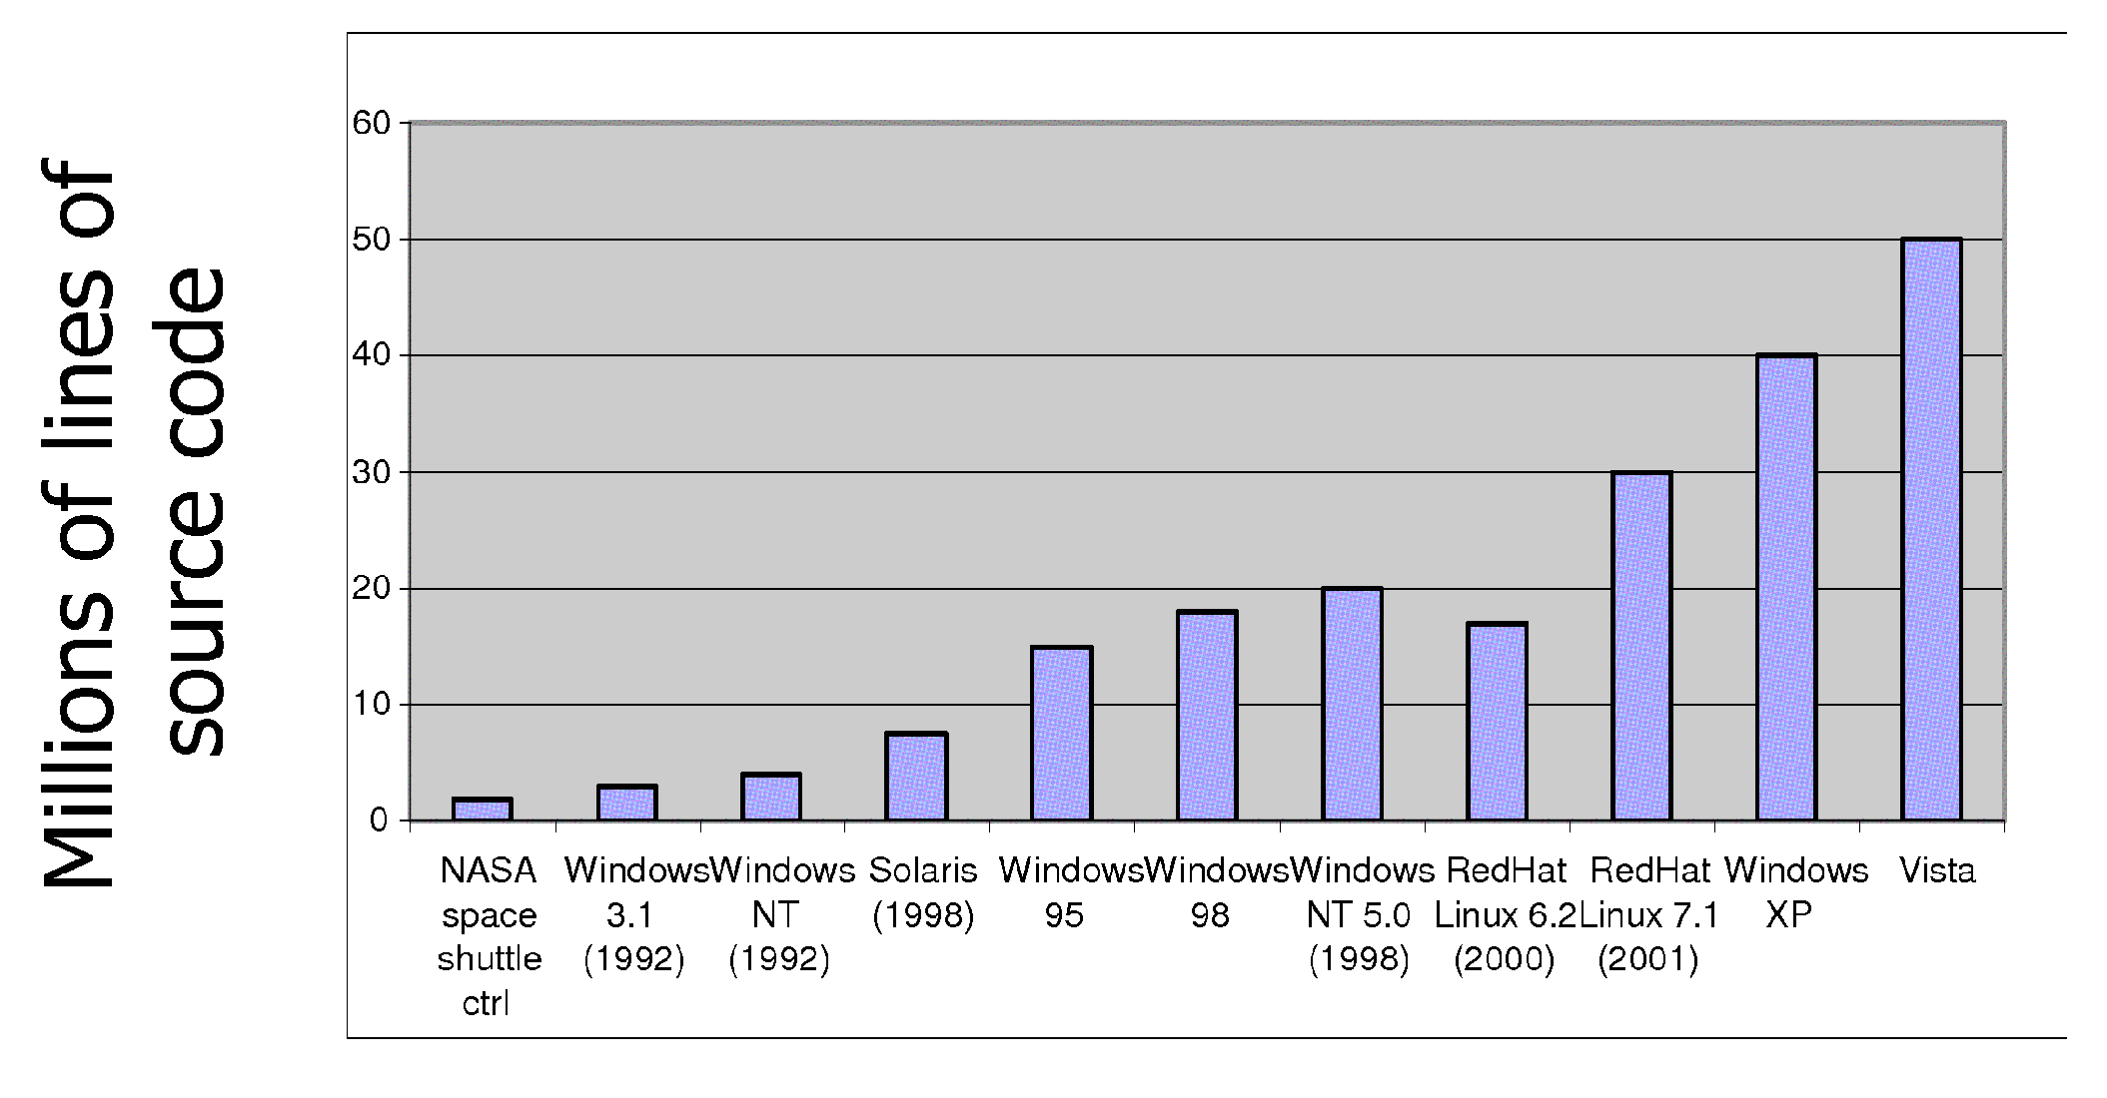
Increasing Software Complexity
From MIT’s 6.033 course

Slide 6
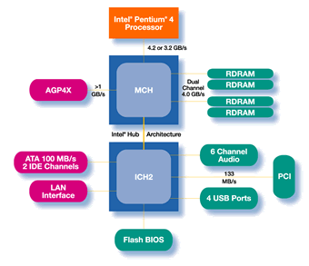
Functionality comes with great complexity!
Pentium IV Chipset
Proc
Caches
Busses
adapters
Memory
Controllers
Disks
Displays
Keyboards
I/O Devices:
Networks

Slide 7
Sample of Computer Architecture Topics
Input/Output and Storage
Disks, WORM, Tape
RAID
Emerging Technologies
Interleaving
Bus protocols
DRAM
Memory
Hierarchy
Coherence,
Bandwidth,
Latency
L2 Cache
Network
Communication
Other Processors
L1 Cache
Addressing,
Protection,
Exception Handling
VLSI
Instruction Set Architecture
Pipelining, Hazard Resolution,
Superscalar, Reordering,
Prediction, Speculation,
Vector, Dynamic Compilation
Pipelining and Instruction
Level Parallelism

Slide 8
Operating Systems
中央处理机（CPU）
内存
I/O设备（键盘、显示器、鼠标）
外部设备（打印机、扫描仪、MODEM 等）
外存设备（硬盘、软盘、光盘、磁带等）

Slide 9
What if we didn’t have an Operating System?
人工操作
  用户独占全机
  CPU等待人工操作
脱机输入/输出

Slide 10

What if only one application?
MS-DOS

Slide 11
What if only one application?
单道批处理系统
  自动性
  顺序性
  单道性
  资源（cpu,内存,I/O设备）利用率？
  系统吞吐量？

Slide 12
More complex OS: Multiple Apps
Multi-programming (多道程序)
Problem: Run multiple applications in such a way that they are protected from one another
Goal:
  Keep User Programs from Crashing OS
  Keep User Programs from Crashing each other
  [Keep Parts of OS from crashing other parts?]
(Some of the required) Mechanisms:
  Address Translation
  Dual Mode Operation
Simple Policy:
  Programs are not allowed to read/write memory of other Programs or of Operating System

Slide 13
Multi-programming (多道程序)
多道性
无序性
调度性
平均周转时间？
交互能力？
处理机/内存/I/O设备/文件/…管理？

Slide 14
Time-Sharing Systems–Interactive Computing
The CPU is multiplexed among several jobs that are kept in memory and on disk (the CPU is allocated to a job only if the job is in memory)
A job swapped in and out of memory to the disk
On-line communication between the user and the system is provided
  When the operating system finishes the execution of one command, it seeks the next “control statement” from the user’s keyboard
  多路性
  独立性
  及时性
  交互性

Slide 15
Real-Time Systems
Often used as a control device in a dedicated application such as controlling scientific experiments, medical imaging systems, industrial control systems, and some display systems
Well-defined fixed-time constraints
Real-Time systems may be either hard or soft real-time
实时控制
实时信息处理
可靠性

Slide 16
Real-Time Systems (Cont.)
Hard real-time:
  Secondary storage limited or absent, data stored in short term memory, or read-only memory (ROM)
  Conflicts with time-sharing systems, not supported by general-purpose operating systems
Soft real-time
  Limited utility in industrial control of robotics
  Integrate-able with time-share systems
  Useful in applications (multimedia, virtual reality) requiring tight response times

Slide 17
Handheld Systems
Personal Digital Assistants (PDAs)
Cellular telephones
Issues:
  Limited memory
  Slow processors
  Small display screens

Slide 18
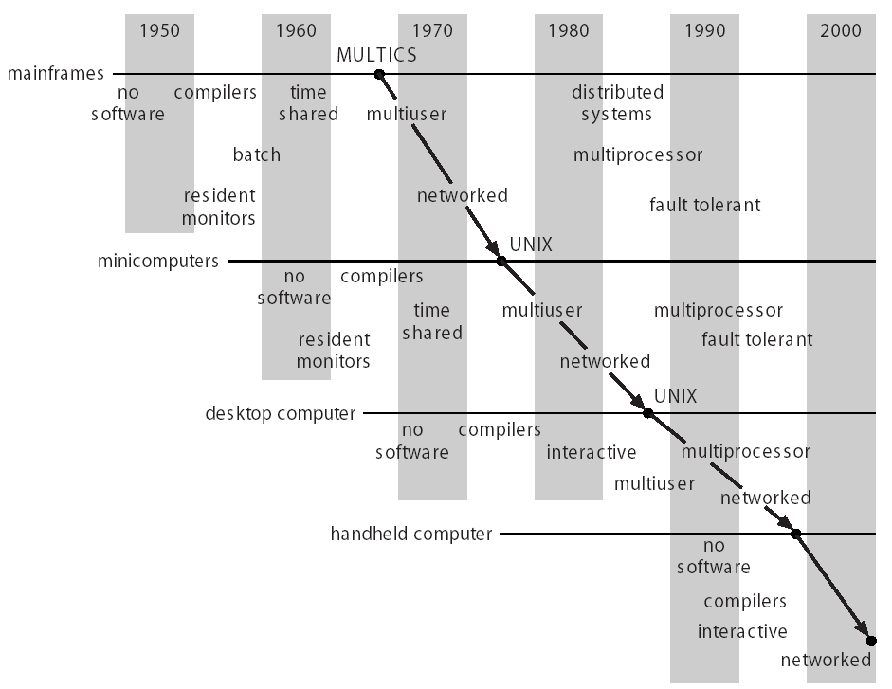
Migration of Operating-System Concepts and Features

Slide 19
OS Characteristics
并发(Concurrence)
共享(Sharing)
虚拟(Virtual)
异步(Asynchronism)

Slide 20
Why Study Operating Systems?
Learn how to build complex systems:
  How can you manage complexity for future projects?
Engineering issues:
  Why is the web so slow sometimes? Can you fix it?
  What features should be in the next mars Rover?
  How do large distributed systems work? (Kazaa, etc)

Slide 21
Why Study Operating Systems?
Buying and using a personal computer:
  Why different PCs with same CPU behave differently
  How to choose a processor (Opteron, Itanium, Celeron, Pentium, Hexium)? [ Ok, made last one up ]
  Should you get Windows XP, 2000, Linux, Mac OS …?
  Why does Microsoft have such a bad name?
Business issues:
  Should your division buy thin-clients vs PC?
Security, viruses, and worms
  What exposure do you have to worry about?

