Slide 1
OS Structures
Simple
  Only one or two levels of code
Layered
  Lower levels independent of upper levels
Microkernel
  OS built from many user-level processes
Modular
  Core kernel with Dynamically loadable modules

Slide 2

System Calls
System calls provide the interface between a running program and the operating system

Slide 3

System Calls
Three general methods are used to pass parameters between a running program and the operating system
  Pass parameters in registers
  Store the parameters in a table in memory, and the table address is passed as a parameter in a register
  Push (store) the parameters onto the stack by the program, and pop off the stack by operating system

Slide 4
Types of System Calls
Process control
File management
Device management
Information maintenance
Communications

Slide 5
Abstraction from the Hardware
From transistors to 0/1 bits
Logic gates abstract away the details of CMOS.
Machine language abstracts away the details of logic gates.
Assembly language abstracts away the details of machine languages.
Programming language abstracts away the details of assembly languages

Slide 6
The History of OS
1940s and 1950s
  IOCS, Storage, Batch processing
1960s
  Time sharing, Multiprogramming
  IBM OS/360, Multics
1960s-1970s
  UNIX
  “the genius of the UNIX system is its framework, which enables programmers to stand on the work of others”
1980s
  PC
  Apple, IBM, CP/M, Bill Gates
  Macintosh, Windows
1990s
  Windows, Unix, Linux

Slide 7

Simple Structure
MS-DOS – written to provide the most functionality in the least space
  Not divided into modules
  Interfaces and levels of functionality not well separated

Slide 8
UNIX: Also “Simple” Structure
UNIX – limited by hardware functionality
Original UNIX operating system consists of two separable parts:
  Systems programs
  The kernel
    Consists of everything below the system-call interface and above the physical hardware
    Provides the file system, CPU scheduling, memory management, and other operating-system functions;
    Many interacting functions for one level

Slide 9

UNIX System Structure
Applications
User Mode
Standard Libs
Kernel Mode
Hardware

Slide 10
Layered Structure
Operating system is divided many layers (levels)
  Each built on top of lower layers
  Bottom layer (layer 0) is hardware
  Highest layer (layer N) is the user interface

Slide 11

Layered Operating System

Slide 12
Layered Structure
Each layer uses functions (operations) and services of only lower-level layers
  Advantage: modularity ⇒ Easier debugging/Maintenance
  Not always possible: Does process scheduler lie above or below virtual memory layer?
    Need to reschedule processor while waiting for paging
    May need to page in information about tasks
Machine-dependent vs independent layers
  Easier migration between platforms
  Easier evolution of hardware platform

Slide 13

An Operating System Layer

Slide 14
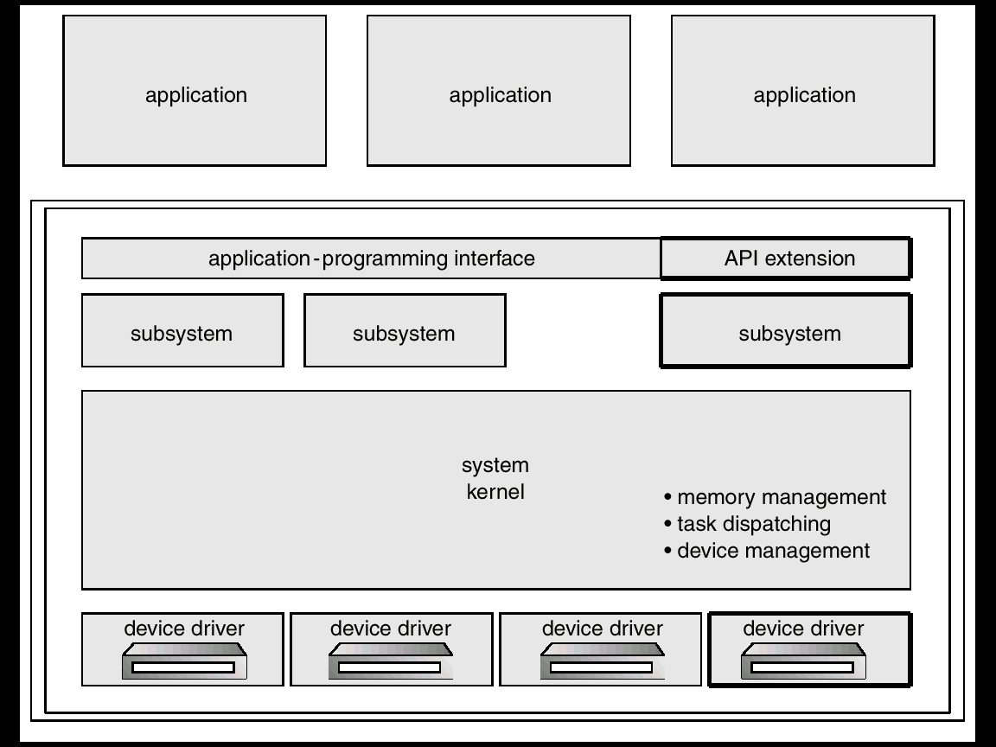
OS/2 Layer Structure

Slide 15
Microkernel System Structure
Moves as much from the kernel into “user” space as possible
Communication takes place between user modules using message passing
Benefits:
  Easier to extend a microkernel
  Easier to port the operating system to new architectures
  More reliable (less code is running in kernel mode)
  More secure
Detriments:
  Performance overhead of user space to kernel space communication

Slide 16
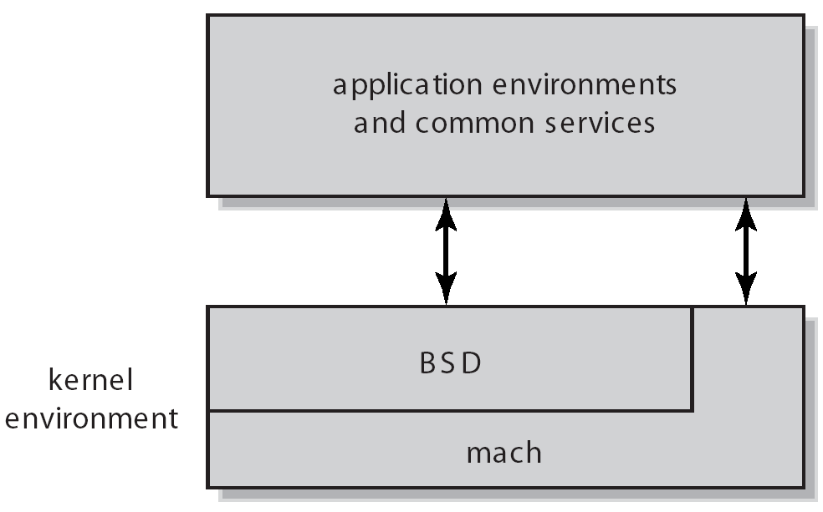
Mac OS X Structure

Slide 17

Windows NT Client-Server Structure

Slide 18
Module based
Most modern operating systems implement kernel modules
  Uses object-oriented approach
  Each core component is separate
  Each talks to the others over known interfaces
  Each is loadable as needed within the kernel
Overall, similar to layers but with more flexible

Slide 19
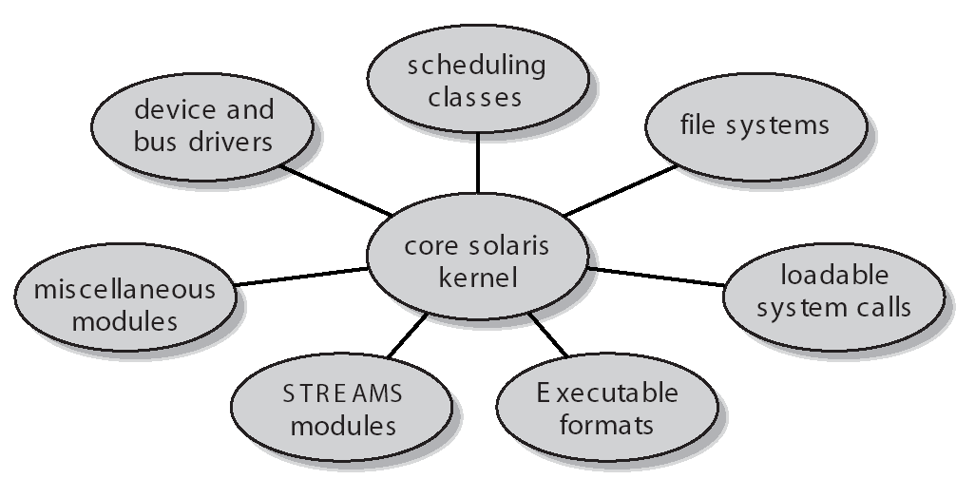
Solaris Modular Approach

Slide 20
Virtual Machines
A virtual machine takes the layered approach to its logical conclusion. It treats hardware and the operating system kernel as though they were all hardware
A virtual machine provides an interface identical to the underlying bare hardware
The operating system creates the illusion of multiple processes, each executing on its own processor with its own (virtual) memory

Slide 21

System Models
Non-virtual Machine
Virtual Machine

Slide 22
Advantages/Disadvantages of Virtual Machines
Isolation from all other virtual machines.
No disruption on normal system operation.
Difficult to implement due to the effort required to provide an exact duplicate to the underlying machine

Slide 23
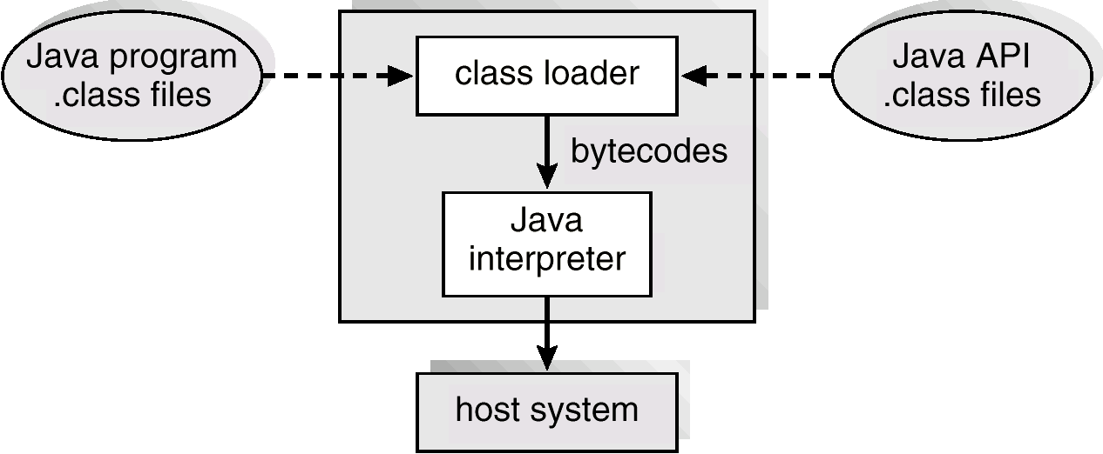
The Java Virtual Machine

Slide 24
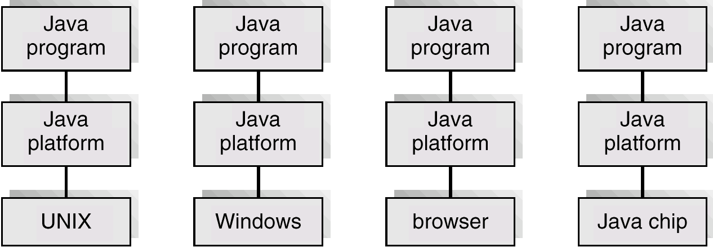
The Java Platform

Slide 25
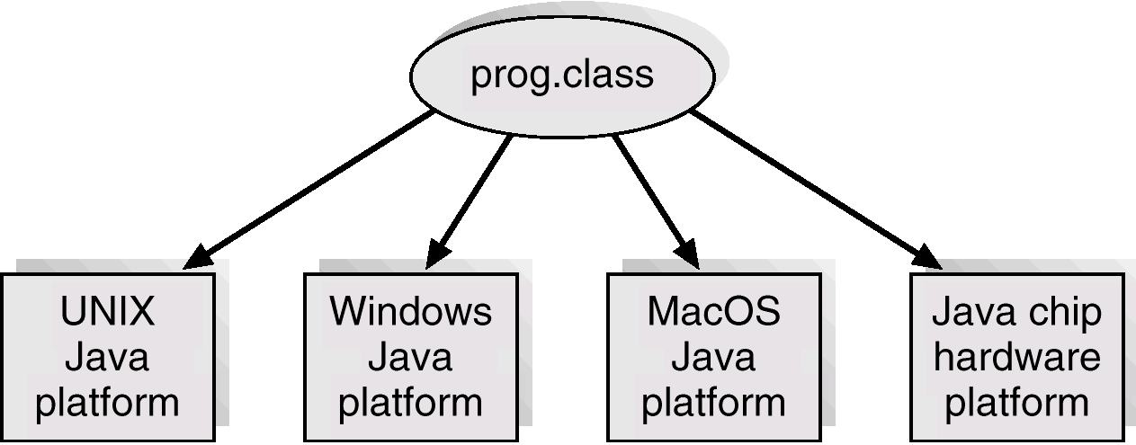
Java .class File on Cross Platforms

Slide 26
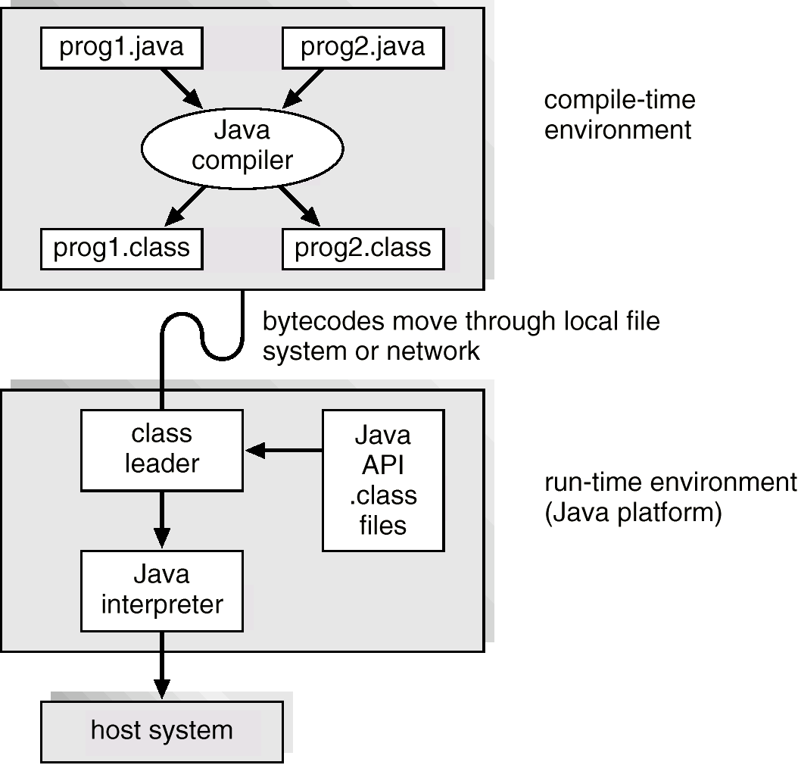
Java Development Environment

Slide 27
Implementation Issues
Policy vs. Mechanism
  Policy: What will be done?
  Mechanism: How to do it?
  Should be separated, since both change
High-level language?
Backward compatibility issues
  Very important for Windows 2000/XP

Slide 28
Implementation Issues
Algorithms used
  Linear, Tree-based, Log Structured, etc…
Event models used
  threads vs event loops
System generation/configuration
  How to make generic OS fit on specific hardware
Rapid Change in Hardware Leads to changing OS
  Batch ⇒ Multiprogramming ⇒ Timeshare ⇒ Graphical UI ⇒ Ubiquitous Devices ⇒ Cyberspace/Metaverse/??

Slide 29




Slide 30
作业调度
作业集
作业发布时间, 耗费时间, 截止期,容易程度
July 3, 2008
IUCEE: Algorithms

Slide 31
作业集
作业名称 | 发布时间 | 耗费时间 | 距截止期剩余时间 | 容易程度
AI, paper | 4 days ago | 2.5 days | 25 days left | * * * *
Game design, homework | today | 4 day | 20 days left | * * * * *
Stat Learning, project | 2 days ago | 6 days | 20 days left | * *
Adv. Prog, midterm | yesterday | 3 days | 10 days left | *
Senior soft. & Engi., project | today | 5 days | 50 days left | * * *

Slide 32
调度策略
First come first serve
Easiest first
Shortest time-cost first
Earliest deadline first
July 3, 2008
IUCEE: Algorithms

Slide 33
First come first serve
作业名称 | 发布时间 | 耗费时间 | 距截止期剩余时间 | 容易程度
AI, paper | 4 days ago |  | 25 days left
Game design, homework | today |  | 20 days left
Stat Learning, project | 2 days ago |  | 20 days left
Adv. Prog., midterm | yesterday |  | 10 days left
Senior soft. & Engi., project | today |  | 50 days left

Slide 34
Easiest first
作业名称 | 发布时间 | 耗费时间 | 距截止期剩余时间 | 容易程度
AI, paper |  |  | 25 days left | * * * *
Game design, homework |  |  | 20 days left | * * * * *
Stat Learning, project |  |  | 20 days left | * *
Adv. Prog, midterm |  |  | 10 days left | *
Senior soft. & Engi., project |  |  | 50 days left | * * *

Slide 35
Shortest time-cost first
作业名称 | 发布时间 | 耗费时间 | 距截止期剩余时间 | 容易程度
AI, paper |  | 2.5 days | 25 days left
Game design, homework |  | 4 day | 20 days left
Stat Learning, project |  | 6 days | 20 days left
Adv. Prog, midterm |  | 3 days | 10 days left
Senior soft. & Engi., project |  | 5 days | 50 days left

Slide 36
Earliest deadline first
作业名称 | 发布时间 | 耗费时间 | 距截止期剩余时间 | 容易程度
AI, paper |  |  | 25 days left
Game design, homework |  |  | 20 days left
Stat Learning, project |  |  | 20 days left
Adv. Prog, midterm |  |  | 10 days left
Senior soft. & Engi., project |  |  | 50 days left

Slide 37
最优策略?
First come first serve?
Easiest first?
Shortest time-cost first?
Earliest deadline first?

Slide 38
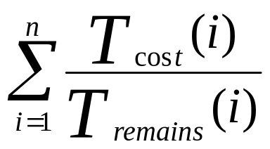
如何判断策略是否可行?
可调度性
  The tasks are schedulable if there exists a scheduling solution such that all the tasks can be scheduled to meet their deadlines
可调度性测试
U =
The tasks are schedulable if U <=1 !

Slide 39
可调度性
作业名称 | 发布时间 | 耗费时间 | 距截止期剩余时间 | 容易程度
AI, paper |  | 2.5 days | 25 days left
Game design, homework |  | 4 day | 20 days left
Stat Learning, project |  | 6 days | 20 days left
Adv. Prog, midterm |  | 3 days | 10 days left
Senior soft. & Engi., project |  | 5 days | 50 days left

Slide 40
Earliest deadline first (EDF)
Order jobs by deadline
EDF is optimal
  EDF can always produce a feasible schedule for a set of tasks if they are schedulable (U<=1).
This result may be surprising, since it ignores the job lengths
July 3, 2008
IUCEE: Algorithms

Slide 41
Question
你的作业是可调度的么?
Schedulability test result ?

Slide 42
延伸思考
What about the overload case (U>1)?
What if the objective is to minimize the sum of the lateness?
  EDF does not seem to work

