Slide 1
Deep Specification Mining
Duy T. B. Lê and David Lo
27th ACM SIGSOFT International Symposium on Software Testing and Analysis (ISSTA 2018)

Slide 2

Software Systems Usually Lack Formal Specifications
SOFTWARE EVOLUTION
V1.0
V1.1
V1.2
…
V1.10
…
Spec
Spec
Spec
…
Spec
No Formal Specifications
Negative Impact on Software Quality & Reliability
More difficult to find code comprehension
More bugs due to wrong assumptions
Hard to use bugs finding & testing tools

Slide 3

Writing Specifications Are Costly
SOFTWARE EVOLUTION
V1.0
V1.1
V1.2
…
V1.10
…
Spec
Spec
Spec
…
Spec
I need Specification Mining Tools.
Cost
Developers lack skills & motivations to write formal specifications
Manual Labor

Slide 4
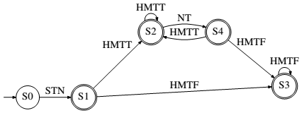



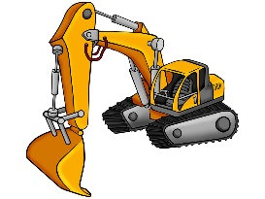
Automated Tools Are Needed
Many existing specification mining algorithms
Most automatically infer specifications from execution traces
Mined specifications in forms of
Finite State Automata (FSA)
Cost
K-tails
SEKT
TEMI
CONTRACTOR++
Manual Labor
Tools

Slide 5
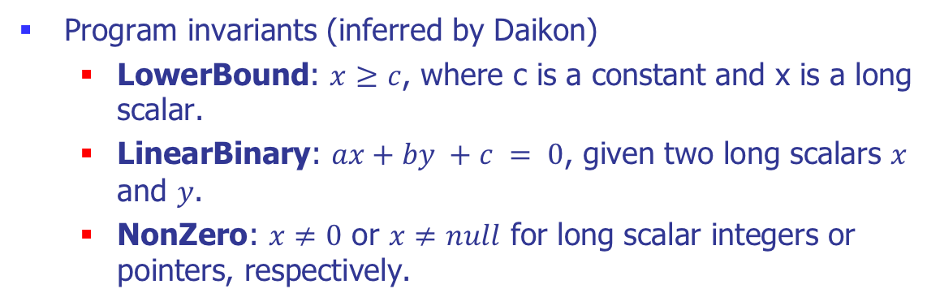
Automaton based Spec. Miners
<START> Signature initVerify update ... verify:FALSE <END>
<START> Signature initVerify ... initVerify verify:FALSE <END>
. . .
<START> Signature initVerify ... verify:FALSE <END>
Program invariants (inferred by Daikon)
LowerBound: $x≥c$, where c is a constant and x is a long scalar.
LinearBinary: $ax+by +c = 0$, given two long scalars $x$ and $y$.
NonZero: $x≠0$ or $x≠null$ for long scalar integers or pointers, respectively.
INPUT
OUTPUT

Slide 6

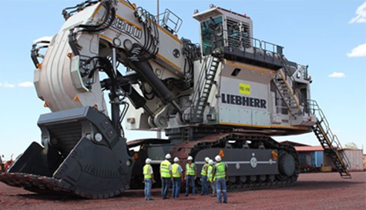
A.I. for Mining Specification?
Deep Learning has not been utilized for mining specifications
Deep Specification Mining (DSM)
DSM

Slide 7







Deep Specification Mining (DSM)
DSM
Deep Learning
Randoop
Execution
FSA Construction
FSA
Library Class
Test Cases
Traces
RNN Lang. Model

Slide 8
Step 1: Testcase Generation
Randoop
Execution
Library Class
Test Cases
Traces
Randoop is lightweight & widely used & well-maintained.
Large amount of test cases
Cover possible behaviors of input library
More data for deep learning

Slide 9
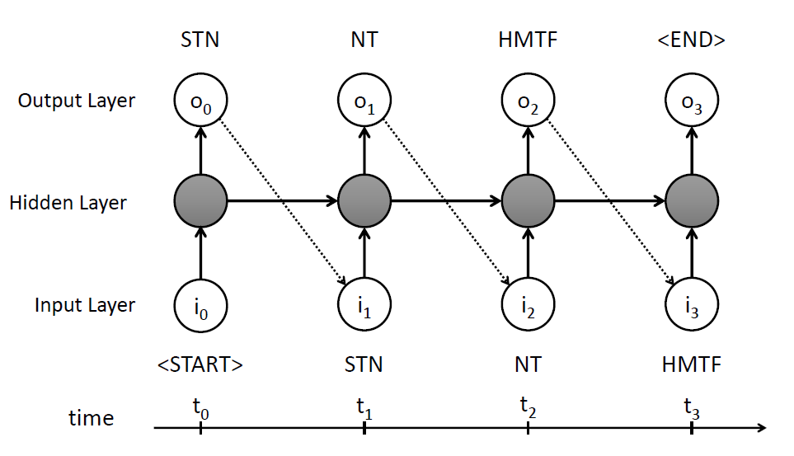
Step 2: Training of RNN Language Model
Deep Learning
Traces
RNNLM
Recurrent Neural Network
Well-known of its ability to model sequence data and deal with long sequences
We use it to predict the likelihood of the next API call given a series of prior calls
We use Long Short-Term Memory (LSTM) RNN variant

Slide 10






Step 3: FSA Construction
RNNLM
K-means
Model Selection
Trace Sampling
Feature Extraction
S0
<START>
S1
S3
close
S4
<END>
S5
<init>
close
FSA
S2
putNextEntry
S6
write
S7
close
S8
<END>
S9
closeEntry
S10
close
S11
<END>
S12
Features
FSA Candidate
Original Traces
Selected Traces
Prefix Tree Acceptor
Hierarchical Clustering

Slide 11
3A: Trace Sampling
Trace Sampling
Original Traces
Selected Traces
Collected traces are big  costly to mine spec
Select traces of minimal lengths that cover all co-occurrence pairs of methods
StringTokenizer: nextToken() & hasMoreTokens()==False
StringTokenizer: hasMoreTokens()==True & hasMoreTokens()==False ✕

Slide 12
3B: Prefix Tree Acceptor (PTA) Construction
Selected Traces
S0
<START>
S1
close
<END>
S3
S4
S5
close
<init>
putNextEntry
close
<END>
S2
S6
write
S7
S8
S9
S10
close
S11
<END>
S12
closeEntry

Slide 13

3C: Feature Extraction
Every state of PTA
Feature Extraction
I
S0
Previously Invoked Methods
<START>
S1
S3
close
S4
<END>
S5
<init>
close
S2
putNextEntry
S6
write
S7
close
S8
<END>
S9
II
Probability of Next Invoked Method (estimated by RNNLM)
closeEntry
S10
close
S11
<END>
S12
Selected Traces
Features
Prefix Tree Acceptor
S0
<START>
Example: features of S3 state
S1
S3
close
S4
<END>
S5
close
Type I
F_{<START>} = F_{<init>} = F_{close}=1
F_{write} = F_{putNextEntry} = F_{closeEntry} = F_{<END>} = 0
Type II
P_{close} = P_{<END>} = 0.4
P_{<START>} = P_{<init>} = P_{write} = P_{putNextEntry} = P_{closeEntry} = 0.04
<init>
S2
putNextEntry
S6
write
S7
close
S8
<END>
S9
closeEntry
S10
close
S11
<END>
S12

Slide 14
3C: Node Merging
Feature Extraction
Every state of PTA
S0
I
<START>
S1
S3
close
S4
<END>
S5
Previously Invoked Methods
<init>
close
S2
putNextEntry
S6
write
S7
close
S8
<END>
S9
closeEntry
S10
close
S11
<END>
S12
II
Probability of Next Invoked Method (estimated by RNNLM)
Prefix Tree Acceptor
Features
K-means
Number of Clusters Settings
+
2 → MAX_CLUSTER = 20
Total FSA candidates:
2 x (MAX_CLUSTER-1)
Prefix Tree Acceptor
Features
FSA Candidates
Hierarchical Clustering

Slide 15
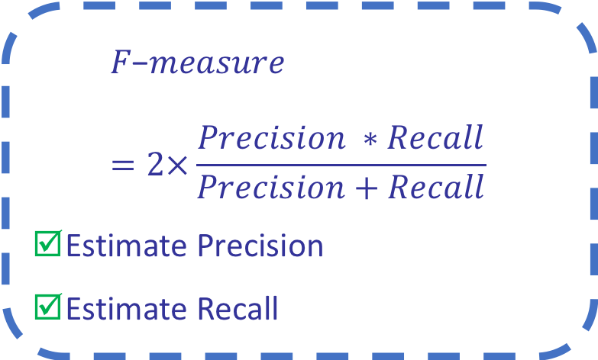
3D: Candidate Selection
Candidate Selection
How to select most promising candidate?
$$F\text{−}measure=2×\frac{Precision ∗Recall}{Precision+Recall}$$
Estimate Precision
Estimate Recall
FSA
FSA Candidates

Slide 16
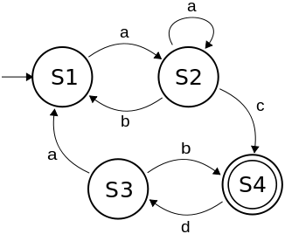
Estimating Recall
Estimated Recall
The percentage of training traces accepted by the FSA candidate.
Training
Execution Traces
FSA Candidate

Slide 17
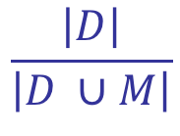

Estimating Precision
(m₁,m₂)
D
m₁ and m₂ appear consecutively
m₁ is called right before m₂
(m₁,m₂)
Training
Execution Traces
M
Estimated Precision
(m₁,m₂)
$$\frac{\left|D\right|}{\left|D ∪M\right|}$$
FSA Candidate

Slide 18
Deep Specification Mining (DSM)
DSM
Deep Learning
Randoop
Execution
FSA Construction
FSA
Library Class
Test Cases
Traces
RNN Lang. Model

Slide 19

Evaluation: Inferring Library Specs
Randoop
Execution
Deep Learning
FSA
Library
Class
Test Cases
Traces
RNN Based Model
FSA Construction
Library Class | Socket, HashSet, LinkedList, StackAr, NFST, Signature, StringTokenizer, ZipOutputStream

Slide 20
Statistics of Generated Test Cases

Slide 21
Baselines
Traces-only
Traditional 1-tails & Traditional 2-tails [1]
Daikon invariants
CONTRACTOR++ [2]
SEKT 1-tails & SEKT 2-tails [2]
Optimistic TEMI [2]
6 Baselines
[1] A. W. Biermann and J. A. Feldman, “On the synthesis of finite- state machines from samples of their behavior”, IEEE Transactions on Computers, 1972
[2] I. Krka, Y. Brun, and N. Medvidovic, “Automatic mining of specifications from invocation traces and method invariants”, FSE 2014

Slide 22
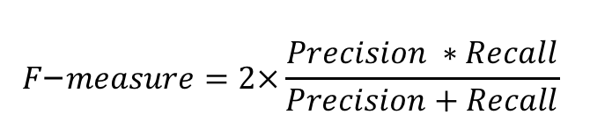
Evaluation Metrics
Ground Truth Model
Precision
Inferred Model
Ground Truth Model
Percentage of inferred traces accepted by GT model
Inferred Traces
Inferred Model
Recall
Percentage of GT traces accepted by inferred model
Ground Truth Traces
Ground Truth Traces
Inferred Traces
$$F\text{−}measure=2×\frac{Precision ∗Recall}{Precision+Recall}$$

Slide 23
DSM vs. Baselines

Slide 24
LSTM vs. RNN vs. GRU

Slide 25
Opportunities for Future Work
Better Inputs:
Capture not only ordering of method calls but also parameters, dependencies, etc.
Integrate additional information to DSM such as Daikon-inferred likely invariants, etc. (Krka et al., FSE14)
Better Models:
Go beyond FSA to e.g., EFSA, Context Free Grammar, etc.

Slide 26
Thank you!
Comments? Feedback? Advice?
btdle.2012@smu.edu.sg

