Slide 1



33rd International Symposium on Software Testing and Analysis (ISSTA 2024)
An Empirical Study on Kubernetes
Operator Bugs
Qingxin Xu, Yu Gao, Jun Wei
Institute of Software,
Chinese Academy of Sciences
University of Chinese Academy of Sciences
Notes:
Hello, everyone. I am Xu Qingxin from University of Chinese Academy of Sciences. It’s my honor to be here and talk about our work：An Empirical Study on Kubernetes Operator Bugs

Slide 2







Kubernetes: Popular Cluster Management Platform
Kubernetes simplifies the management of containerized applications through various built-in controllers.
Deployment
controller
Deployment
StatefulSet
controller
……
Pod
Service
controller
PersistentVolume
StatefulSet
Attach/Detach
controller
Node
Service
……
Notes:
Since its release in 2015, Kubernetes has become the de facto standard for cloud native
Kubernetes manages the cluster via controllers by operating different resources

Slide 3
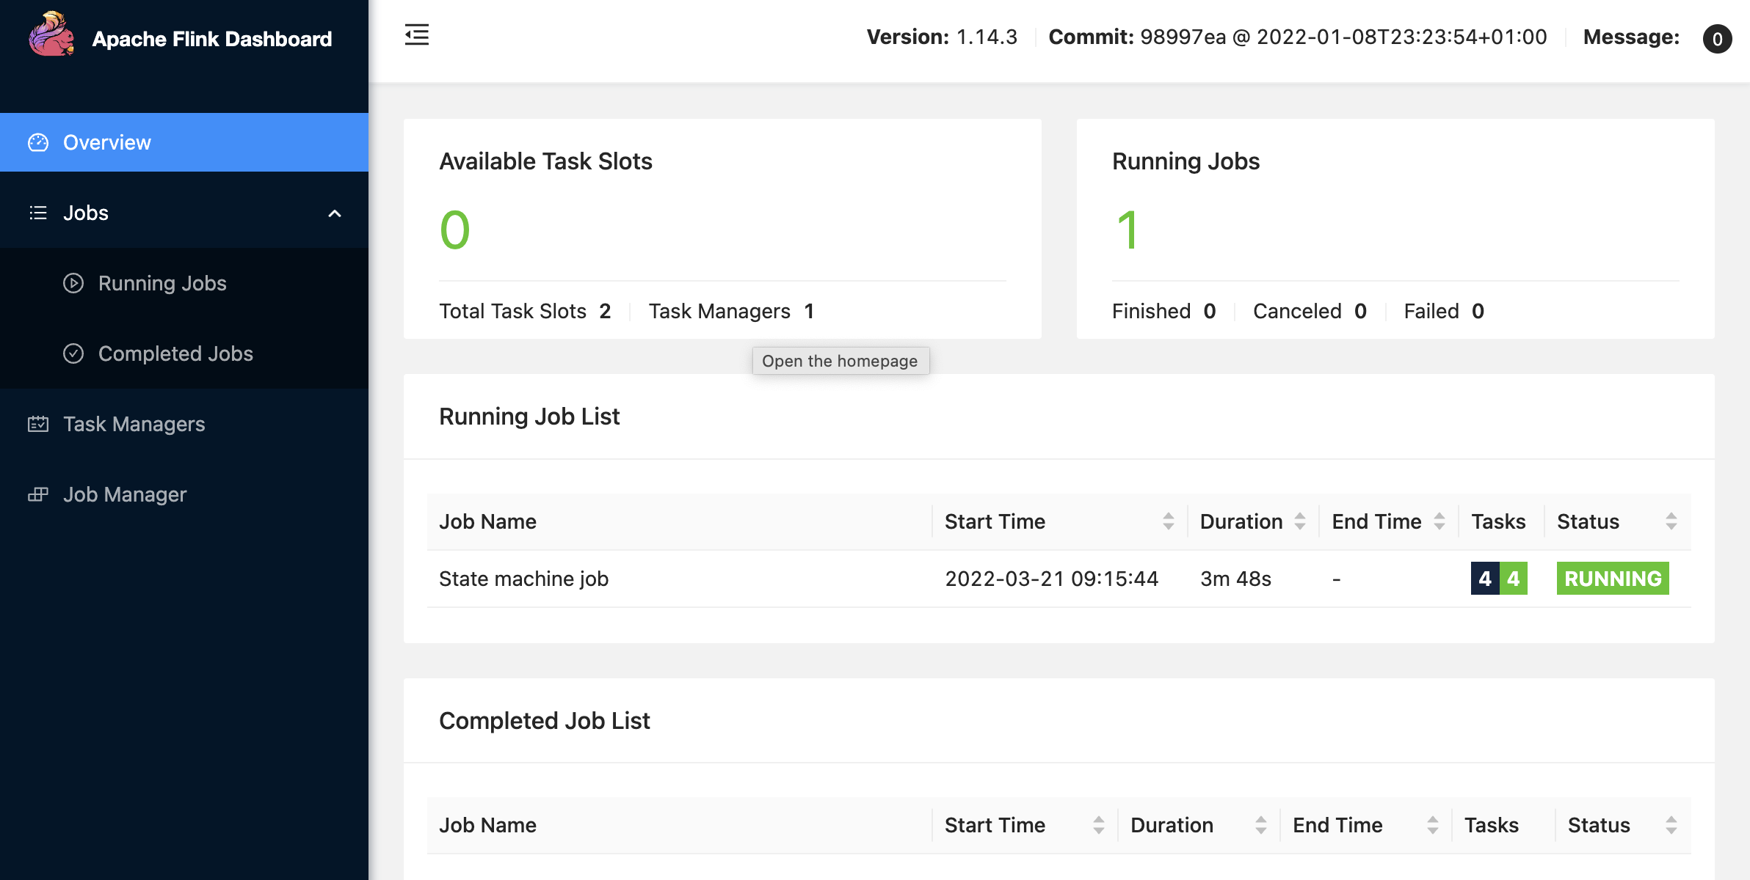



Kubernetes Operator
Operators are introduced to automate complex application-specific operation tasks beyond what Kubernetes itself provides
Deploy
Flink Operator
Flink Cluster
Scale up
etcd Operator
etcd Cluster
Backup
S3
TiDB Operator
volume snapshot
TiDB Cluster
backup meta
……
Notes:
In order to manage specific applications, Kubernetes provide with operator pattern
There are a number of operators which manage their applications.
With the help of operator, developers can automate the cluster operation, such as deploying, scaling up or backup

Slide 4

State Reconciliation in Kubernetes Operator
User
Declares the
desired state
Reconcile the current state
to the desired state
Cluster
State
Operator
A set of objects that represent the managed cluster
Notes:
Kubernetes operator follows the state reconciliation principle
In which, we first define the cluster state as a set of properties for specific cluster resources
Operator keeps observing the cluster state, compare the current state with a desired one, and reconcile to drive the cluster state to the desired one

Slide 5



Real World Example
Pod
Current State
Desired State
# CDC
spec:
...
node: 1 # <- 2
...
② Analysis
Declare
① Observe
③ Reconcile
Volume
Operator
Pod and Volume are removed
✓
Notes:
Take a real world example in Cassandra operator
(Click) When user declares a desired state by setting node from 2 to 1, the change event is observed and analyzed by operator
(Click) Then it reconcile the cluster, and as a result, the Pod and Volume are removed from the cluster

Slide 6

Operator Bug
Operators run within complex, dynamic and distributed environments, which makes Kubernetes operators prone to operator bugs
Pod
Current State
Desired State
# CDC
spec:
...
node: 1 # <- 2
...
② Analysis
Declare
① Observe
③ Reconcile
Volume
Operator
Operator correctness is critical for the reliability of cloud native application
Pod is removed,
but Volume remains in the cluster
Notes:
Unfortunately, operator runs within complex, dynamic and distributed environments, which makes Kubernetes operators prone to operator bugs
(Click) In the example we talk above, operator may fails to remove the Volume attached to Pod, and causing resource leak
(Click) Since operator has been widely used in cluster management, operator correctness if critical for the reliability of cloud native application

Slide 7

Existing Works
Empirical bug studies
Kubernetes failures: Mutiny! [1]
Cloud bug study [2]
Distributed concurrency bugs [3]
Existing operator bug detection
Sieve [4]: testing the reliability of controllers by injecting specific faults
Acto [5]: testing the correctness of controllers by generating various desired state declarations
Lack of operator bugs dataset for research
How effective existing approaches are in detecting real-world operator bugs?
[1] Marco, Barletta, et.al. “Mutiny! How Does Kubernetes Fail, and What Can We Do About It?”. DSN. 2024.
[2] H. Gunawi, et al., “What Bugs Live in the Cloud? A Study of 3000+ Issues in Cloud Systems”. SoCC. 2014.
[3] T. Leesatapornwongsa, et al., “TaxDC: A Taxonomy of Non-Deterministic Concurrency Bugs in Datacenter Distributed Systems”. ASPLOS. 2016.
[4] Sun, Xudong, et al. "Automatic reliability testing for cluster management controllers." OSDI. 2022.
[5] Gu, Jiawei Tyler, et al. "Acto: Automatic End-to-End Testing for Operation Correctness of Cloud System Management." SOSP. 2023.
Notes:
Existing empirical bug studies conduct research on Kubernetes failures, cloud bug study and distributed concurrency bugs, which do not target at operator mechanism itself
For operator bug testing, Sieve tests the reliability of controllers by injecting specific faults
While Acto tests the correctness of controllers by generating various desired state declarations
And we do not know how effective these approaches are in detecting real-world operator bugs

Slide 8







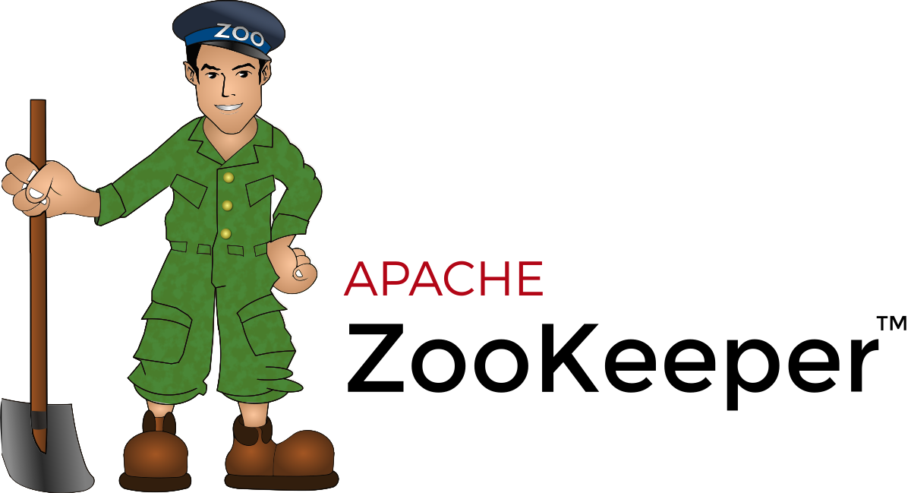


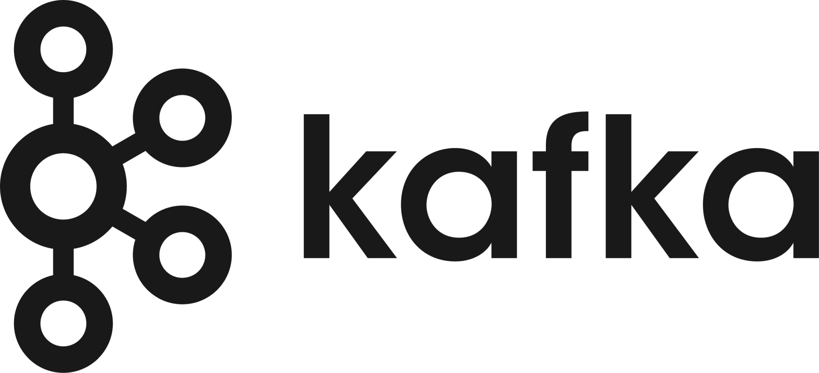
Target Operator
We collect 210 operator bugs from 36 open source operator projects
Developed by official teams, commercial vendors, open-source communities
Contain 10K – 1884K lines of code
Manage various systems such as distributed storage systems, database management systems, machine learning platforms, search engines, etc
Notes:
We collect 210 operator bugs from 36 open source operator projects,
these operators are developed by various teams, contain different size of code and manage various systems

Slide 9

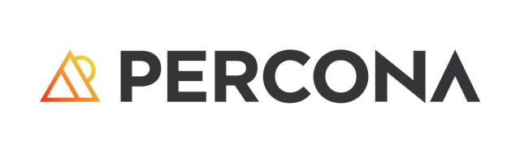
Study Methodology
Step 1
Step 2
Step 3
Keyword search
Issue filter
Bug analysis
Remove issues that
lack clear description,
not related to operator,
without available
fixing
Open card sorting
source code
discussions
fixing patch
…
e.g., operator
controller
reconcile
is:closed
36 operator projects
210 issues
3049 issues
210 Operator Bugs
Notes:
Specifically, we collect issues by keyword searching from open source platform, Github and Jira Percona. This search returns 3049 issues.
Then, we filter these issue by removing issues that lack clear description, not related to operator or without available fixing. We also exclude the issues relevant to document, feature or we cannot fully understand. This filtering returns us with 210 issue from 36 repositories.
Last we conduct the bug analysis with the open card sorting on these bugs

Slide 10





Bug Analysis
Analyze operator bug
Root cause
Bug manifestation
Bug impact
Bug fixing
Detection capability of existing approaches
Issue descriptions
Project source code
Developer discussions
Available fixing patches
Notes:
We analyze these operator based on their issue descriptions, project source code, developer discussions, and available fixing patches, and further assign them into different categories according to bug manifestations, root causes, bug impacts, and detection capability of existing approaches.

Slide 11
Research Questions
RQ1 (Root cause): What are root causes for operator bugs?
RQ2 (Bug manifestation): How are operator bugs triggered?
RQ3 (Bug impact): What impacts do operator bugs have?
RQ4 (Bug fixing): How do developers fix the operator bugs? How complex?
RQ5 (Detection capability of existing approaches): How effectively can existing approaches detect operator bugs?
Notes:
To thoroughly analyze these operator bugs, we try to answer five research questions.
The root cause, the bug manifestation, the bug impact, the bug fixing and the detection capability of existing approaches

Slide 12





State Reconciliation in Kubernetes Operator
Managed Cluster
Operator
Built-in Controllers
# Custom Resource Definition (CRD)
spec:
properties:
node:
type: integer
...
Analysis
STS controller
Volume controller
Observe
Reconcile
Custom controller
…
# Declare a desired state
spec:
node: 1 # <- 2
Update CR
API Server
Custom Resource (CR)
Secret
ConfigMap
StatefulSet
Pod
Volume
Custom Resource
Secret
StatefulSet
Pod
Volume
State Objects
Notes:
Before we display our study result, let us have a glance over the state reconciliation in Kubernetes operator
An operator is composed of custom resource definition and custom controller
The custom resource definition, we simplify as CRD in the follow, defines how developers can define the desired state in custom resource
When user declare a desired state, the custom resource is updated
Then operator observes the change and analysis
To drive the cluster from current state to desired state, various resources are operated them
As a result, the built-in controllers can also become participants due to the update to built-in resources
At the last, the actual instances in the managed cluster are updated

Slide 13
RQ1: Root Cause
Managed Cluster
Operator
Built-in Controllers
Incorrect state observation and analysis
（60%）
Analysis
Incorrect reconciliation
（27%）
# Custom Resource Definition (CRD)
spec:
properties:
node:
type: integer
...
STS controller
Volume controller
Observe
Reconcile
Custom controller
…
Incorrect access control management configuration
（4%）
Incorrect CRD
（9%）
# Declare a desired state
spec:
node: 1 # <- 2
Update CR
API Server
Custom Resource (CR)
Secret
ConfigMap
StatefulSet
Pod
Volume
Custom Resource
Secret
StatefulSet
Pod
Volume
State Objects
Notes:
Before we display our study result, let us have a glance over the state reconciliation in Kubernetes operator
An operator is composed of custom resource definition and custom controller
The custom resource definition, we simplify as CRD in the follow, defines how developers can define the desired state in custom resource
When user declare a desired state, the custom resource is updated
Then operator observes the change and analysis
To drive the cluster from current state to desired state, various resources are operated them
As a result, the built-in controllers can also become participants due to the update to built-in resources
At the last, the actual instances in the managed cluster are updated

Slide 14
RQ1: Root Cause
Incorrect access control configuration (9/210)
CMT/CassOp # 30 [1]
# Fixing patch
kind: ClusterRole
apiVersion: rbac.authorization.k8s.io/v1beta1
rules:
+ - apiGroups: [""]
+ resources: ["nodes"]
+ verbs: ["get", "watch", "list"]
List Node
Operator
Node
Error: “cassandra-operator” cannot get resource "nodes"
Developers forget to configure access control configuration on Node resource
[1] https://github.com/cscetbon/casskop/issues/30
Notes:
The first category is the incorrect access control configuration.
When operator tries to list Node in Kubernetes cluster, an error is thrown, which says that the operator does not have permission to get the resource
The bug is caused by the reason that developers forget to configure access control configuration on Node resource
(Click) By adding necessary permission to operator, the bug is fixed

Slide 15
RQ1: Root Cause
Incorrect custom resource definition (20/210)
Incorrect custom resource definition specification (10/20)
Incorrect validation logic (10/20)
# CRD
spec:
properties:
...
replicas:
default: 1
...
required: null
# replicas is optional in CRD
RabbitMQOp # 404 [1]
Desired state
Operator
# CR
spec:
...
replicas: # not specify
...
struct Spec{
// replicas is required in operator
- Replicas `json:”replicas”`
+ Replicas `json:”replicas,omitempty”`
}
[1] https://github.com/rabbitmq/cluster-operator/issues/404
Notes:
Custom resource definition can also be incorrect.
As is shown in the example, the custom resource definition does not require the replicas to be specified
However, in operator, the replicas is required to provide
The inconsistency caused the issue, in which the desired state cannot be correctly declared

Slide 16
RQ1: Root Cause
Incorrect custom resource definition (20/210)
Incorrect custom resource definition specification (10/20)
Incorrect validation logic (10/20)
KubeflowOp # 1745 [1]
func ValidateV1PyTorchJob(){
+ NameIsDNS1035Label()
......
}
if err := ValidateV1PyTorchJob(); err != nil{
createService()
}
# CR
metadata:
...
name: 1test # <- test
...
Cannot create Service, since a DNS-1035 label must start with an alphabetic character
Operator
[1] https://github.com/kubeflow/training-operator/issues/1745
Notes:
The validation logic of custom resource should ensure the correctness of input
However, there can be incorrect validation logic
In this example, when custom resource is declared with a name starting with numeric character, custom controller fails to create the corresponding Service
(Click) That is because that the name of Service should follows the DNS-1035 convention, which requires a name starting with an alphabetic character
The lack of relevant validation logic causes the bug

Slide 17
RQ1: Root Cause
Incorrect state observation and analysis (125/210)
No observation of resource changes (5/125)
No analysis of resource changes (38/125)
Incorrect analysis logic (29/125)
Incorrect state identification (53/125)
VMOp # 222 [1]
Only register watcher on CR
Custom resource
Operator
Secret
Change events
Operator cannot trigger reload when Secret or ConfigMap is updated
ConfigMap
[1] https://github.com/VictoriaMetrics/operator/issues/222
Notes:
Operator needs to register watcher for resource, in case that it can receive change event when the resource is updated
If the watcher is missing, operator will ignore the change
(Click) In this example, only the custom resource is watched by operator
(Click) As a result, when Secret and ConfigMap are modified, the change event never reach, operator cannot trigger reload based on the update as well

Slide 18
RQ1: Root Cause
Incorrect state observation and analysis (125/210)
No observation of resource changes (5/125)
No analysis of resource changes (38/125)
Incorrect analysis logic (29/125)
Incorrect state identification (53/125)
MinioOP # 449 [1]
Change in Env is not reflected in StatefulSet
StatefulSet
# CR
spec:
...
env:
- name: MINIO_PROMETHEUS_AUTH_TYPE
value: public # <- private
...
auth_type: prviate
func poolSSMatchesSpec(){
......
DetectChangesInLabelOrAnno()
+ DetectChangesInEnv()
}
Operator
StatefulSet
StatefulSet
auth_type: public
auth_type: public
[1] https://github.com/minio/operator/issues/449
Notes:
When change event comes, operator needs to analyze the detailed changes in cluster state
In this example, though the environment variable in custom resource is changed, there seems to be no differences in StatefulSet
That is because operator does not analyze the change in env property
By adding relevant logic, the StatefulSet is correctly updated based on the environment variable

Slide 19
RQ1: Root Cause
Incorrect state observation and analysis (125/210)
No observation of resource changes (5/125)
No analysis of resource changes (38/125)
Incorrect analysis logic (29/125)
Incorrect state identification (53/125)
VMOp # 298 [1]
Skip
if cr.Spec.Datasource.BasicAuth != nil {
// do something
if cr.Spec.Datasource.TLSConfig != nil {
// do something
}
}
spec:
datasource:
basicAuth: null
tlsConfig:
caFile: root-cert.pem
ca: {}
Change in TLSConfig is not detected
Operator
Custom Resource
[1] https://github.com/VictoriaMetrics/operator/issues/298
Notes:
Operator needs to analyze the state change and decides how to reconcile, and buggy analysis logic can cause bug
(Click) In this example, since basicAuth is null, operator skips the following analysis logic
(Click) As a result, though the tlsConfig is not null,
(Click) it will never detect the change in it

Slide 20
RQ1: Root Cause
Incorrect reconciliation (56/210)
Reconciliation loop (7/56)
NifiOp # 119 [1]
State keeps flickering!
# NifiCluster
status:
...
State: …
...
# NifiCluster
status:
...
State: Reconciling
...
# NifiCluster
status:
...
State: Running
...
# NifiCluster
status:
...
State: Reconciling
...
# NifiCluster
status:
...
State: Running
...
……
Change event
Change event
Change event
Change event
Nifi Controller
State != RollingUpgrading
State != RollingUpgrading
[1] https://github.com/konpyutaika/nifikop/issues/119
Notes:
The last category is the incorrect reconciliation
There are various scenarios in this category, and we will show several examples
The first is the reconciliation loop
(Click) In this example, when State of custom resource is not RollingUpgrading,
(Click) The State is then updated to Reconciling, which also triggers a new change event
(Click) In the next reconciliation iteration, the State is updated to Running, which is not RollingUpgrading as well
(Click) Therefore, we will see that the State keeps flickering between Reconciling and Running
And this is the reconciliation loop, which prevents the cluster from being operated in the future

Slide 21
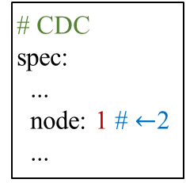
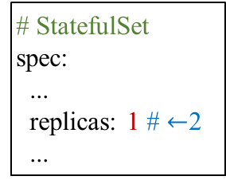
RQ1: Root Cause
Incorrect reconciliation (56/210)
Inconsistent reconciliation (2/56)
# CDC
spec:
...
node: 1 # $←$2
...
# StatefulSet
spec:
...
replicas: 1 # $←$2
...
IST/CassOp # 400 [1]
Operator
podsInRack = ListPod()
//[ca0,ca1] or [ca1, ca0]
newestPod = podsInRack[len(podsInRack)-1]
Decommission(newestPod)
STS Controller
TryToDeletePodWithMaxOrdinal() //ca1
Operator and STS controller modifies different Pods
Decommission ca0
Cluster state
ca0
ca1
ca0
ca1
ca0
ca1
Scaling down is
blocked
[1] https://github.com/instaclustr/cassandra-operator/issues/400
Notes:
The next example is inconsistent reconciliation.
In this example, we declare a desired state in which the node becomes from 2 to 1
(Click) As a result, the operator starts to work. It first fetches all Pods from cluster, and due to the random order of API results, the Pod list can be in different order as well, in this buggy case, we get ca0 as the last element of the Pod list
Then, operator tries to decommission ca0
(Click) At the same time, StatefulSet is also updated to scale down, and it tries to delete the Pod with max ordinal, which is ca1 in this example
(Click) Now the StatefulSet controller operates the different Pods with operator. As a result, the scaling down is blocked now

Slide 22



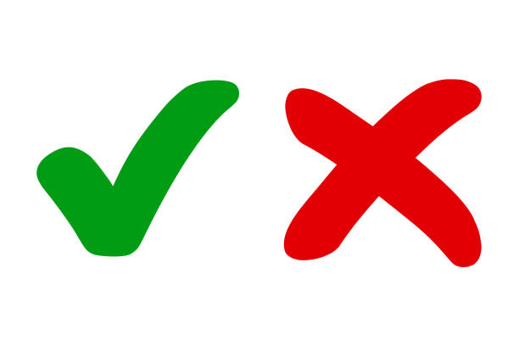
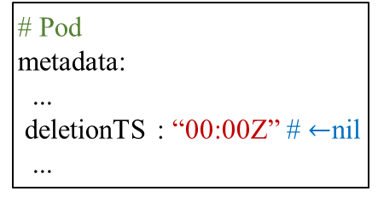
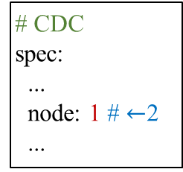
RQ1: Root Cause
Incorrect reconciliation (56/210)
No synchronization of resource operations (7/56)
CDC Controller
IST/CassOp # 398 [1]
//⑦ Delete PVC
if pod.deletionTS != nil {
...
DeletePVC( )
...
}
# CDC
spec:
...
node: 1 # $←$2
...
# Pod
metadata:
...
deletionTS : “00:00Z” # $←$nil
...
① Scale down
CDC
② Notify CDC
change
③ Scale down
STS
⑤ Mark Pod
for deletion
⑥ Notify
Pod change
⑦ Delete attached
Volume
⑧ Delete
Pod
API Server
CDC Controller
STS Controller
④ Notify STS
change
[1] https://github.com/instaclustr/cassandra-operator/issues/398
Notes:
Another example is the no synchronization of resource operations
(Click) We have show a simplified version of this bug at start. When we declare a desired state which scaling down the cluster
(Click) The operator is notified about the change, (Click) and it will scale down the StatefulSet
(Click) StatefulSet controller is then notified about the change, (Click) and mark Pod for deletion
Before the Pod is actually deleted, (Click) operator is notified about the Pod change, (Click) and delete the Volume attached to the Pod
(Click) Afterwards, the Pod is removed, all reconciliation is done

Slide 23
RQ1: Root Cause
Incorrect reconciliation (56/210)
No synchronization of resource operations (7/56)
CDC Controller
IST/CassOp # 398 [1]
//⑧ Pod does not exist
if pod.deletionTS != nil {
...
DeletePVC( )
...
}
# CDC
spec:
...
node: 1 # $←$2
...
# Pod
metadata:
...
deletionTS : “00:00Z” # $←$nil
...
① Scale down
CDC
② Notify CDC
change
③ Scale down
STS
⑤ Mark Pod
for deletion
⑥ Delete
Pod
⑦ Notify
Pod change
⑧ Fail to remove
attached PVC
API Server
CDC Controller
STS Controller
④ Notify STS
change
[1] https://github.com/instaclustr/cassandra-operator/issues/398
Notes:
However, in buggy scenario, (Click) the Pod can be removed before operator receives the change event
(Click) And since the Pod does not exist, the operator fails to remove the attached PVC and suffers from the issue

Slide 24
RQ1: Root Cause
Incorrect reconciliation (56/210)
Incorrect resource update (19/56)
K8s specification violation (9/56)
Reconciliation loop (7/56)
No synchronization of resource operations (7/56)
Incorrect order of resource operations (3/56)
Inconsistent reconciliation (2/56)
Other (9/56)
For more details,
please look into our paper
Notes:
There are more categories about incorrect reconciliation, for more details about them, please take a look into our paper

Slide 25
RQ2: Bug Manifestation
Most of the operator bugs can be triggered with no more than 2 operation requests, by at most 1 changed property and no fault
84%
83%
90%
Implication:
Operator bugs follow the small scope hypothesis
Most of operator bugs do not need fault as input event
Notes:
For bug manifestation, we first study the input conditions
The operation request represents the process of declaring the desired state.
The changed property represents the detailed change in desired state.
As is shown in the figures, we find out that most of the operator bugs can be triggered with no more than 2 operation request, by at most 1 changed properties and no fault
This implies that operator bugs follow the small scope hypothesis, and most of operator bugs do not need fault as input events

Slide 26
RQ2: Bug Manifestation
86% of operator bugs can be triggered by deterministically executing a sequence of input events in a certain order
# RabbitMQ
spec:
...
capacity: 10Gi
...
①
RabbitMQ
Operator
User
# RabbitMQ
spec:
...
capacity: 15Gi
...
rabbitMQOp #782
②
Implication:
Deterministically triggering operator bugs can reduce the space of testing
Notes:
We also study the determinism of operator bugs
That is to say, when we take operator as black box, and we send operation requests in a certain order, the bug can trigger deterministically
We find out that 86% of operator bugs can be triggered deterministically
And this implies that deterministically triggering operator bugs can reduce the space of testing

Slide 27

RQ3: Bug Impact
Operator bugs can impact both operators and the managed cluster
Operator outage
Operator malfunction
Explicit system errors
Operator
Operator
Operator
Cluster
Cannot serve certain operation
requests
Restart and fail
over and over again
Unstable state
Undesired state
S2
S1
S2
S1
S2
…
S1
S2’
27
Notes:
We study the bug impact and divide them into five main categories
The Operator outage represents that the cluster restarts and fails over and over again
The operator malfunction is caused when the operator cannot serve certain operation requests
When operator bugs manifest, operator or cluster may throw explicit system errors
The unstable state means that operator keeps flickering between specific states and fails to converge to a stable one
And the undesired state means that operator reaches a state which is not desired by developers

Slide 28
RQ3: Bug Impact
54% of operator bugs only lead to silent failures
Silent failures
Unstable state
Undesired state
Silent operator malfunction
Explicit failures
Operator outage
Explicit system errors
Explicit operator malfunction
54%
Implication:
Revealing silent operator bugs needs to develop new test oracles
28
Notes:
We divide the bug impacts into silent and explicit ones, and we find out that 54% of operator bugs only lead to silent failures, which need to be manually determined for detection
This implies that we need to develop new test oracles for these bugs

Slide 29
RQ5: Detection Capability of Existing Approaches
45% of operator bugs cannot be detected by existing operator testing approaches [1][2]
Undetectable operator bugs
Detected operator bugs
[1] Sun, Xudong, et al. "Automatic reliability testing for cluster management controllers." OSDI. 2022.
[2] Gu, Jiawei Tyler, et al. "Acto: Automatic End-to-End Testing for Operation Correctness of Cloud System Management." SOSP. 2023.
Notes:
We theoretically investigate how effectively existing operator testing approaches can detect operator bugs.
In total, we find that existing approaches cannot detect 45% operator bugs

Slide 30
RQ5: Detection Capability of Existing Approaches
91% of operator bugs cannot be detected by Sieve [1]
90% operator bugs do not involve faults
Crash on controller | ✓
Network delay for controller | ✓
Brain split on API Server | ✓
CPU overload | ✗
Crash on application Pod | ✗
…
Among 20 bugs that involve faults, 18 can be detected by Sieve
Unsatisfied precondition
Unsupported fault scenarios
Implication:
More fault scenarios need to be supported for detecting more operator bugs
[1] Sun, Xudong, et al. "Automatic reliability testing for cluster management controllers." OSDI. 2022.
Notes:
Sieve tests the reliability of controllers by injecting specific faults
However, we find out that most of operator bugs do not involve faults, making them unsatisfy Sieve’s preconditions
Among the bugs which are caused by faults, there could be unsupported fault scenarios, such as CPU overload, crash on application on Pod
This implies that more fault scenarios need to be supported for detecting ore operator bugs

Slide 31
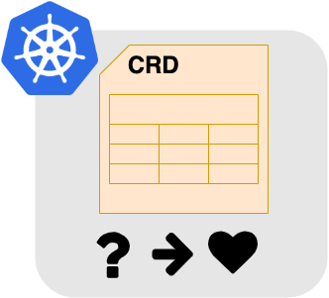
RQ5: Detection Capability of Existing Approaches
53% of operator bugs cannot be detected by Acto [1]
Property with specific data type
✓
S
S’
Property with specific semantic
✓
Combination of specific properties
✗
Explicit error
✓
Resource-level operation
✗
Inconsistent differential results
✓
Domain-specific failures
✗
Faults
✗
Uncovered workload
Domain-specific oracle
Implication:
Operator bug testing approaches should support more types of workloads
[1] Gu, Jiawei Tyler, et al. "Acto: Automatic End-to-End Testing for Operation Correctness of Cloud System Management." SOSP. 2023.
Notes:
Acto tests the correctness of controllers by generating various desired state declarations
However, there are uncovered workload such as combination of specific properties, resource-level operation and faults
And even if it can generate workload, there are domain-specific failures which cannot be detected by Acto’s oracle
This implies that operator bug testing approaches should support more types of workloads

Slide 32
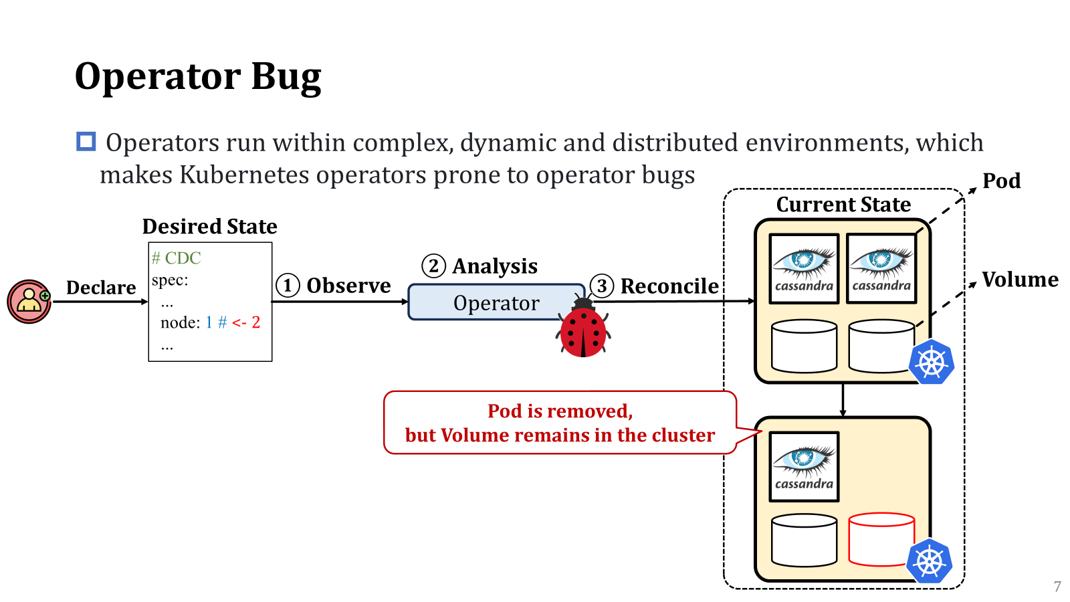
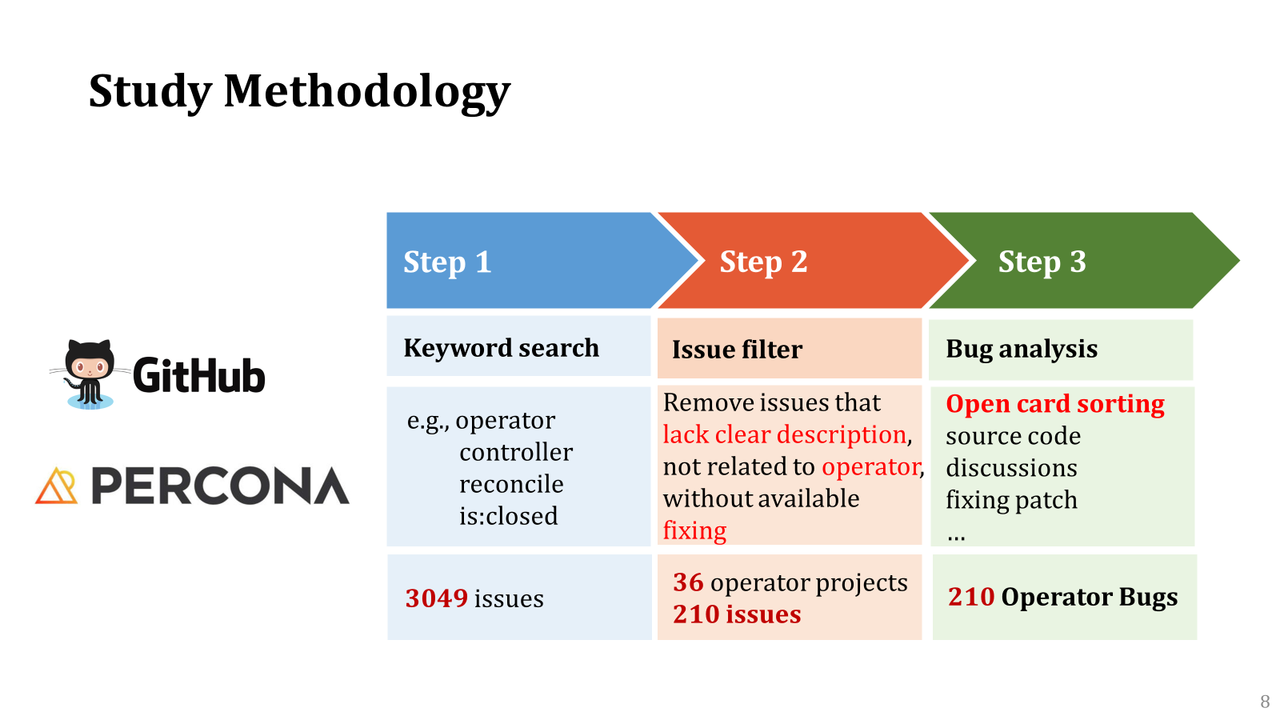
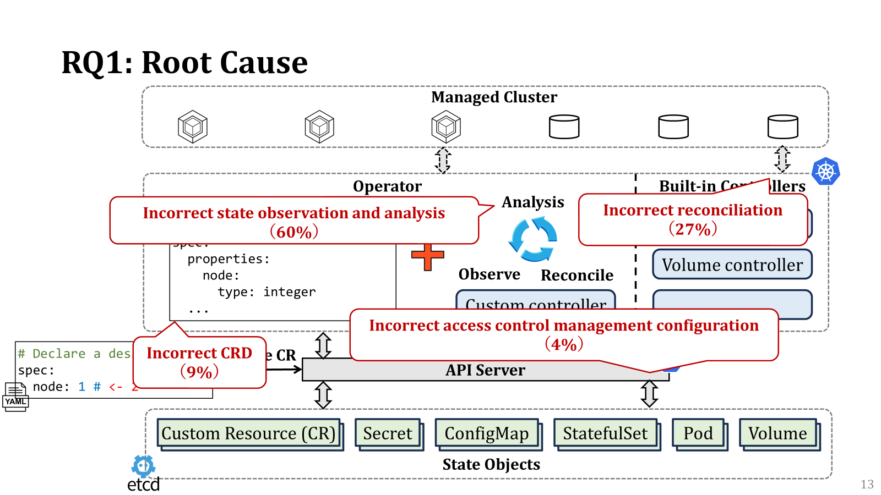
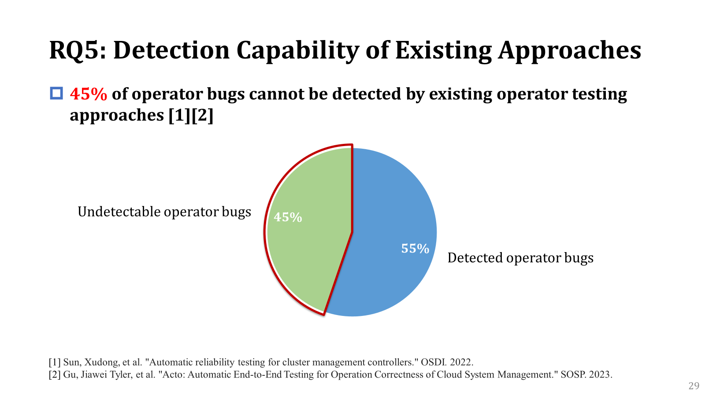
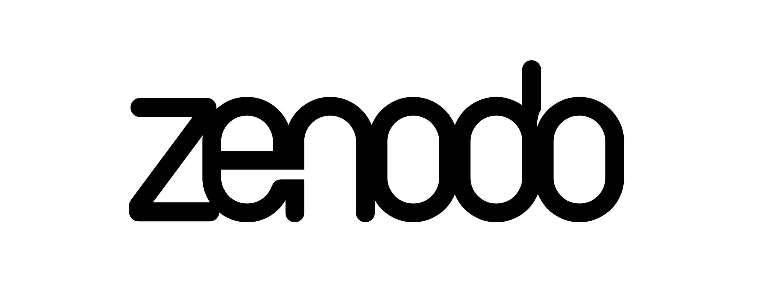
Conclusion
https://doi.org/10.5281/zenodo.13340387
Notes:
In conclusion, we conduct the first comprehensive study on 210 operator bugs from 36 open source operator projects.
We find out that operator bugs can happen in each stage of operator lifetime and existing approaches can only detect a limited set of them.
More details can be found in our paper and the dataset has become available. That’s all, thanks.

Slide 33
RQ2: Bug Manifestation
Most of operator bugs involve less than 1 built-in resource, no built-in controller and are triggered in less than 2 reconciliation iterations
82%
96%
85%
Notes:
We then study the bug triggering process, in which built-in resource and controller participate the reconciliation
We find out that most of the operator bugs involve less than 1 built-in resource, no built-in controller and are triggered in less than 2 reconciliation iteration

Slide 34
RQ4: Bug Fixing
Fixing an operator bug requires 97 lines of code and 28 days in average
No common fixed strategy: operator bugs fixing highly depend on their root causes
 | 25th | Median | 75th | Max
# of days to confirm | 0 | 1 | 6 | 673
# of days to fix | 1 | 7 | 25 | 395
# of changed files | 1 | 2 | 4 | 21
LOC of patch | 9 | 34 | 92 | 2091
Notes:
On average, fixing an operator bug involves 97 lines of code change, and takes 28 days.
We find out that the fixing strategies for operator bugs highly depend on their root causes.
However, a limited set of fix pattern can also be applied to the bugs caused by specific root cause, as is shown in the following
We notice that Kubernetes mechanism, such as finalizer can be utilized to ensure the correctness of reconciliation, which may give guidance to further bug fixing and operator generation work

