Slide 1
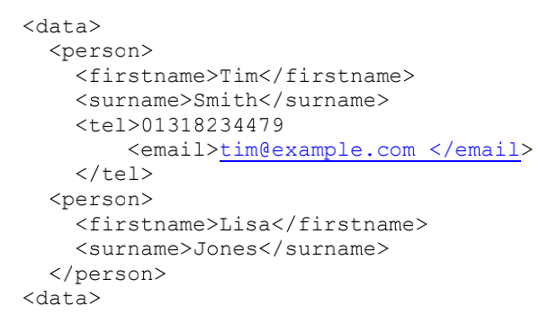
Errror 3: The value of <tel> 01318234479 is not quotated. It should be ”01318234479”.
Errror 1: Elements are not closed: the first <person> should be coupled with a </person> at this location, but it is missing
Errror 4: <tel> and <email> are not nested propoerly. The <email> should not be in <tel> since <tel> has its own body. The correct nesting is
<tel>”01318234479”</tel>
<email>tim@example.com</email>
Errror 2: Elements are not closed: <date> should be chagned to </data>

