Slide 1
Lagrangian relaxation for tree-structured covariance estimation
Xiyang Dai, Zebao Gao, Hao Zhou

Slide 2
Why use a tree structure covariance?
In many fields, large numbers of objects need to be categorized, a tree structure covariance is a nature way to model these categorizes, find interrelationships between categorizes and visualize them.
Especially true for Bioinformatic problems:
Bioinformatic problems usually have
Large feature dimensions
Large number of samples
Relatively small differences
Traditional distance based measurements suffer from modeling large scale data
Tree structure covariance can provide an intuitive way to understand the similarity/differences from the data
Notes:
In many fields where large numbers of objects must be categorized, including computer vision, bioinformatics, and document classification, an underlying tax- onomic structure is applied. While such taxonomies are useful visualization tools to organize data, and to talk about inter-relationships between (sub)categories, it is less clear whether taxonomies can help to perform structured learning, or whether learned taxonomies outperform those imposed by domain experts.
Understanding similarities in expression profiles from a set of samples, e.g., multiple brain regions, is valuable to help understand many biological processes.
Example: differential expression analysis

Slide 3
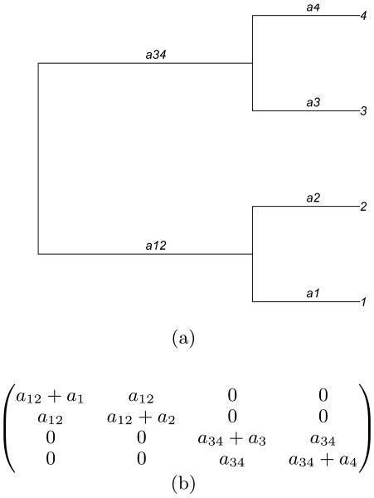
How to approach a tree structure covariance?
Let d = [a12 a34 a1 a2 a3 a4]^{T} be a column vector containing the branch lengths of the tree and D = diag(d).
Define a basis matrix V such that each row is associated with a node in the tree and each column contains a set of binary variables corresponding node in the tree is on the path to the leaf associated with that row.
The covariance matrix B = VDV^{T}
Notes:
Each column of V can be associated with a node in the tree. Each row of V contains a set of binary variables that are equal to 1 iff a corresponding node in the tree is on the path to the leaf associated with that row.
1 1 0 1 0 0 0
V = ( 1 1 0 0 1 0 0 )
1 0 1 0 0 1 0
1 0 1 0 0 0 1
http://cs.nyu.edu/~zaremba/docs/ecml2013main.pdf

Slide 4
Tree-structured Covariance Matrix
Partition Property
The basis matrix V (size p x 2p-1, where p is the #leaves) models the Partition Property if it satisfies
V contains one column of all ones (root)
For every column w in V with more than one non-zero entry, it contains exactly two columns u and v such that u + v = w. (binary tree partition property)
(Every column w in V with one non-zero entry is a leave)
Notes:
A basis matrix V of size p-by-(2p–1) with entries in {0,1} and unique columns has the partition property for trees of size p if it satisfies the

Slide 5
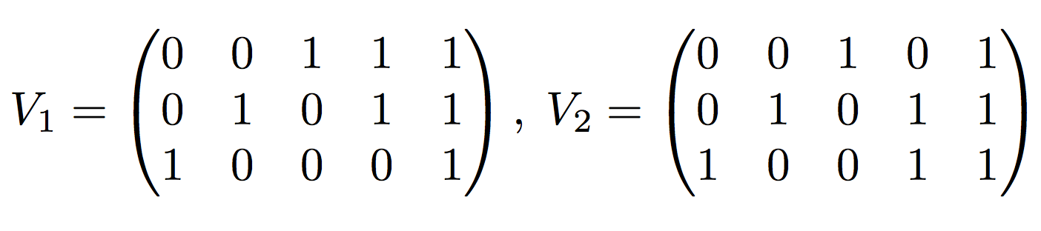
Tree-structured Covariance Matrix
Get t-s cov matrix B from basis matrix V
Matrix B is a t-s cov matrix ⇔ B=VDV^{T}
Characteristics
B=VDV^{T} generated by a single basis matrix V is convex
The set of all t-s cov matrices is not convex
If B is a convex combination of B₁ and B₂
we will have B₁₂ != 0 and B₂₃ != 0 but B₁₃ = 0
Notes:
1. V has the partition property; D is a diagonal matrix with nonnegative entries
2. If B is a convex combination of B1 and B2, we will have B12 != 0 and B23 != 0 but B13 = 0.

Slide 6
Projection by Mixed-Integer Programming
Problem
Estimating a t-s cov matrix when tree topology is unknown
Combinational optimization over set of B → Mixed-Integer Programs
MIP algorithms are well-studied and tools/libs available
Constraints to minimize objective functions
B_{ij} >= 0 for all i and j
B_{ii} >= B_{ij} for all i and j
B_{ij} >= min(B_{ik}, B_{jk}) for all i, j and k
Rewrite the third constraint for each distinct triplet i > j > k
B_{ij} >= B_{ik} = B_{jk}
B_{ik} >= B_{ij} = B_{jk}
B_{jk} >= B_{ij} = B_{ik}
Notes:
We model the problem as mixed-integer programs.
The third constraint is not convex.
Each item can be further divided into 3 inequalities.

Slide 7
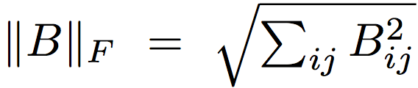

Projection by Mixed-Integer Programming
MIP formulation to the Problem:
Given a sample covariance matrix S ⇒ nearest t-s cov matrix B in norm ||•||
Objective functions
Frobenius norm:
min ||S - B||_{F}
or min f(b) = ½ b^{T}b - s^{T}b (where b and s are vectorization of B and S)
sum-absolute-value (sav) norm:
min f(b) = ||s - b||₁

Slide 8

Lagrangian Relaxation
Solve constrained optimization problem.

Slide 9



Lagrangian Relaxation
Solving its dual problem
Property

Slide 10
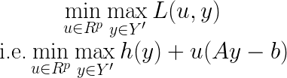
Lagrangian Relaxation
Subgradient algorithm
Solving above problem w.r.t. u, y alternatively.

Slide 11
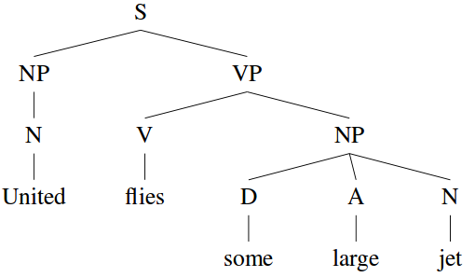

Dual Decomposition an NLP example
Parse tree

Slide 12

Dual Decomposition an NLP example
Parse tree

Slide 13
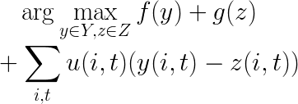
Dual Decomposition an NLP example
Parse tree

Slide 14
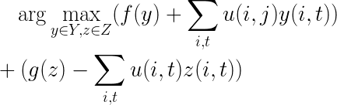
Dual Decomposition an NLP example
Parse tree

Slide 15
In this project...
Try to reformulate the tree structured covariance problem
Using Lagrangian relaxation to solve the problem

Slide 16
References
[1] H ́ector Corrada Bravo, Stephen J. Wright, Kevin H. Eng, Sunduz Keles, and Grace Wahba. Estimating tree-structured covariance matrices via mixed-integer programming. In AISTATS, JMLR Proceedings, pages 41–48, 2009.
[2] Alexander M. Rush and Michael Collins. A tutorial on dual decomposition and lagrangian relaxation for inference in natural language processing. Journal of Artificial Intelligence Research, 2012.

