Slide 1
Report on transforming XML data to mysql database
Zheyuan Gao

Slide 2
ETL Process
Extract
Transform
Load
Extract data from homogeneous or heterogeneous data sources.
Transform the data for storing it in the proper format or structure
for the purposes of querying and analysis.
Load into the final target (database, more specifically, operational data store,
data mart, or data warehouse).

Slide 3
Mission to be accomplished
XML data from National University Hospital (Including personal , disease, doctor information…).
Store the data into relational(Mysql) database following the data structure represented in XML file.
The speed of processing the XML file should be fast.(Data might be measured in gigabites).
Written in C++.

Slide 4
Existing Tools
Semi-automatic method: Manually create table before loading(Most relational databases support).
Altova: Industrial-strength products for XML, SQL, and UML software development.
Adeptia: https://www.youtube.com/watch?v=dMPOyzJ1OtU
Open source Resources:
(Python) https://sourceforge.net/projects/xml2db/
(JAVA) http://www.rpbourret.com/xmldbms/index.htm

Slide 5

General structure
XML Processor
XML Reader
Transformation into representations
DBConnect

Slide 6
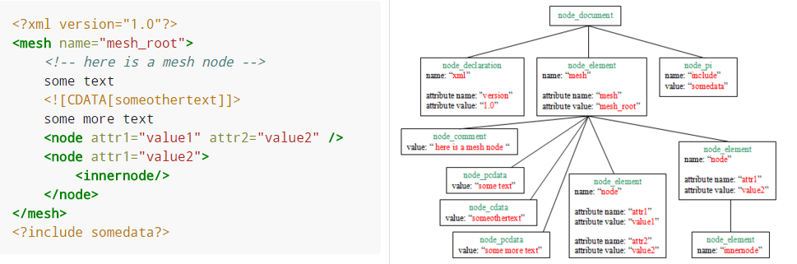
xML data transformation
PugiXML: Fast Speed, Unicode conversion support, http://pugixml.org/
Tree structure of XML.

Slide 7
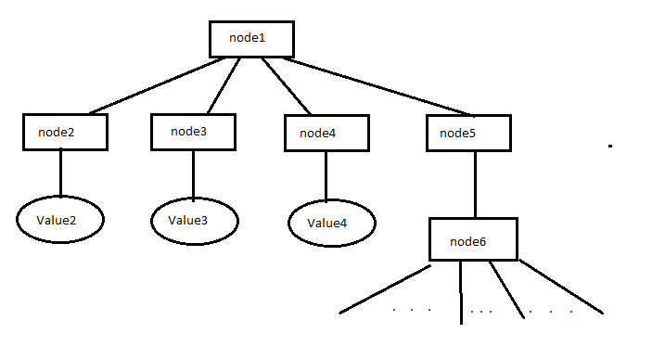
mapping XML tree to SQL
CREATE TABLE node1 (node1_id int, node2 TEXT, node3 TEXT, node4 TEXT);
Table node1
node1_id
node2
node3
node4
Table node5
node1_key
CREATE TABLE node5 ( node1_key int, FOREIGN KEY(node1_key) REFERENCES(node1_id));

Slide 8
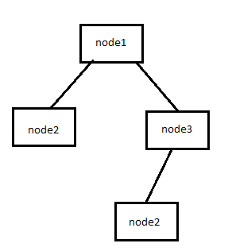
Problem encountered
1. Same node name at different position
Solution: Use a table to map the relationship between a node position and a specific table name.
node1->node2: node2_1
node1->node3->node2: node2_2

Slide 9
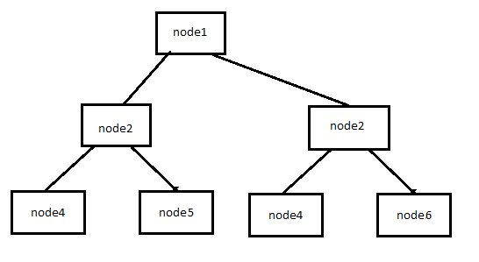
Problem encountered
2. Same node position contains different column names
Solution: When detected no column error, alter the table by adding the missing column
ALTER TABLE node2 ADD node6 TEXT;
node4 | node5 | node6

Slide 10

Problem encountered
3. Speed may be slow when directly operating on Mysql database.
XML Processor
XML Reader
Transformation into representations
DBConnect
In memory
database

Slide 11
Demo

