Slide 1
Meridian
AI-powered regulatory review for BSR Gateway 2 submissions
Our mission: get more safe homes built, faster
Reducing rejections, delays, and financing risk in UK housing delivery
George Clarke & Hugo Hiley, Co-Founders

Slide 2
The Scale of the Problem
London cannot build homes at scale
88,000
5,891
94%
40yr
Target homes/year
2024 starts
Below target
Lowest level
Worst of any major developed city this century
This is not a planning failure. It is a delivery failure.

Slide 3
This Affects Everyone
The collapse is universal
-79%
-85%
-94%
281,000
Private developers
Affordable housing
Council housing
Approved, not built
£120m of council-funded homes on hold
281,000 approved homes not being built
Market and public sector actors cite the same bottleneck.

Slide 4


The Real Bottleneck
Post-Grenfell regulation is necessary. The process is broken.
The new regulatory landscape:
Reality today:
Building Safety Act 2022
Building Safety Regulator (BSR) created
Mandatory gateway between planning approval and construction start
Only ~1/3 of submissions approved
Average review time: ~8 months
Capital already committed when delays hit
Financing costs inflate projects 15%+

Slide 5
The Insight
Most Gateway 2 failures are not unsafe buildings.
They are unsafe submissions.
Missing documents
Incomplete cross-references
Inconsistent evidence across reports
Errors found too late to fix cheaply
There is no pre-submission intelligence layer.
Developers submit and hope. Rejections cost months. There is no systematic way to check readiness before engaging the regulator.

Slide 6
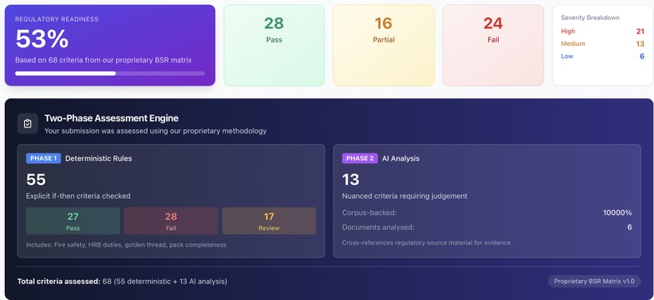
The Product
Meridian: Pre-submission regulatory review for Gateway 2
Proprietary BSR matrix
55 deterministic rules (explicit pass/fail)
13 AI-assessed judgement criteria
Single readiness score before submission
This is regulatory infrastructure, not document review.

Slide 7
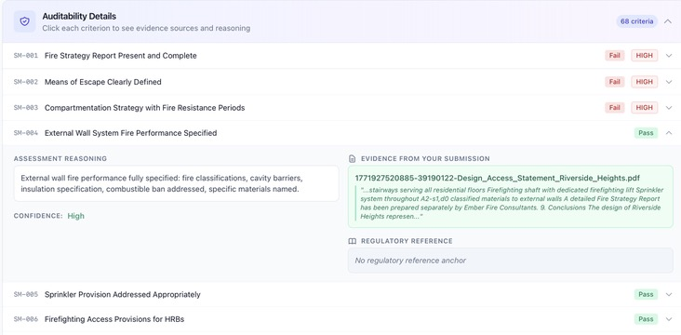
Why This Is Defensible
Purpose-built, not a ChatGPT wrapper
Every finding linked to: - Specific regulation - Specific document - Exact extract
Fully auditable
Regulator-safe by design
No black box. Every decision is inspectable.

Slide 8
Agentic, But Safe
AI that knows its limits
AI proposes fixes only when text changes are sufficient
Flags when issues require: - New documents - Expert judgement - Physical testing
Human always stays in control
!
Requires Human Intervention
This issue cannot be fixed by text changes alone. It may require:
Creating a new document or report
Expert analysis or professional judgement
Physical evidence, testing, or certifications
Meridian reduces risk. It never invents compliance.

Slide 9
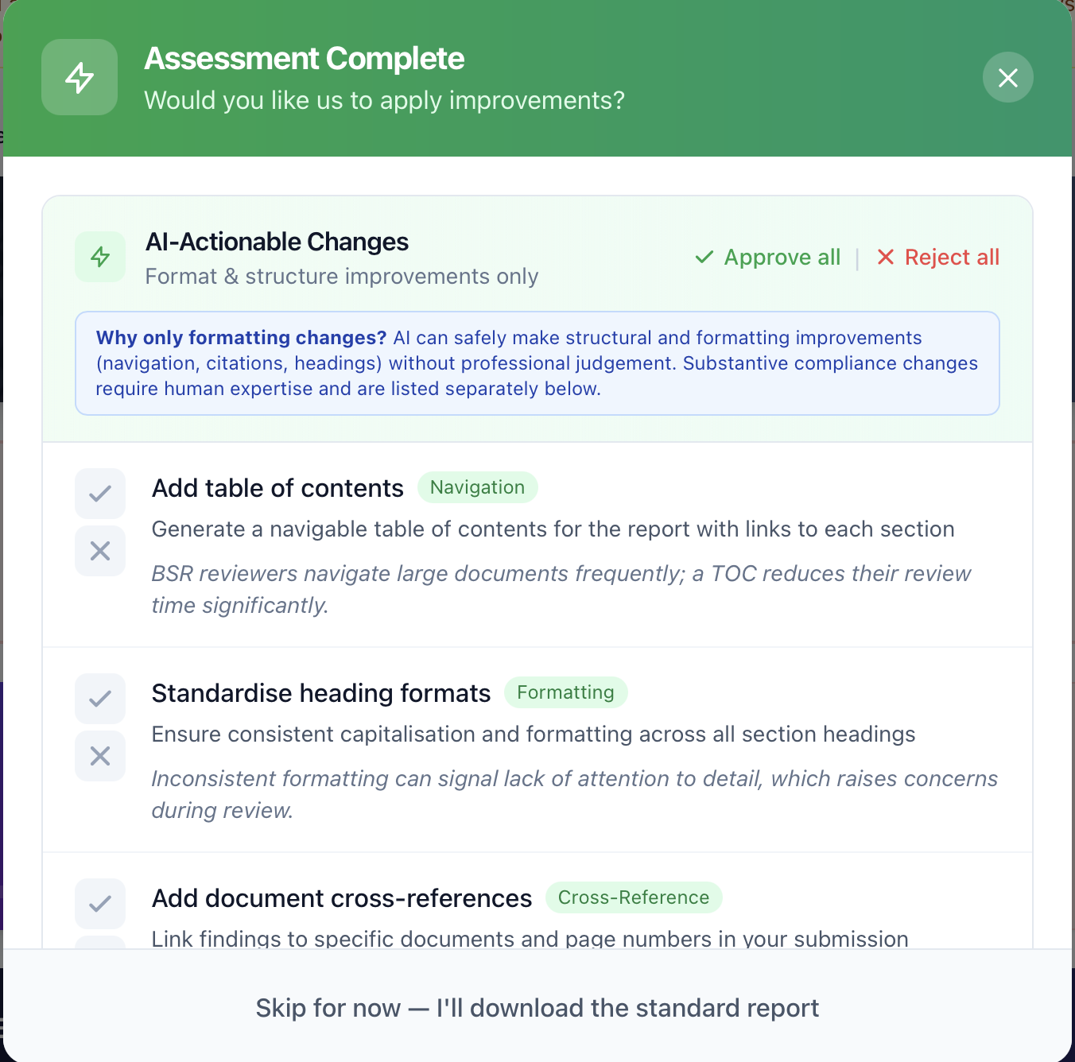
Human-in-the-Loop Workflow
One click per criterion. You approve. We generate.
Review findings one-by-one
Accept or skip each change
Full transparency before generation
See exactly what text will be added
This fits professional accountability models.

Slide 10
Outputs
From analysis to submission-ready documents
Clean submission pack with approved changes
Separate list of unresolved issues
Clear ownership for follow-up work
Table of contents and explanatory front matter
✓
Your Documents Are Ready
Amended Document (DOCX)
PDF Version
Outstanding Issues Report
Meridian completes the workflow, not just the analysis.

Slide 11
Business Model
Two complementary paths
SaaS
Agency / Hybrid
Self-service assessments
Unlimited re-runs
Annual licence per organisation
Lower touch, scalable
Full AI platform assessment
Expert human review
Remediation guidance call
High-ACV, fast revenue
Same platform. Different depth.

Slide 12


Founders
Met at Blenheim Chalcot
Hugo Hiley
George Clarke
Co-Founder (Commercial)
Co-Founder (Product / Tech)
Led global sales at Fospha
Deep enterprise B2B experience
Qualified lawyer
BC Centre for Generative AI
AI products in regulated domains
MSc, Imperial College London
We combine enterprise commercial execution with deep product, AI, and regulatory system-building experience.

Slide 13
Why Now
Why now
Why us
Regulation is permanent
Complexity is increasing
BSR capacity will not scale linearly
Developers will pay for predictability
Deep AI product experience from BC
Enterprise sales capability proven at Fospha
Regulatory systems expertise
Already built and deployed the platform
The regulatory burden is permanent. The question is who builds the infrastructure to manage it.

Slide 14
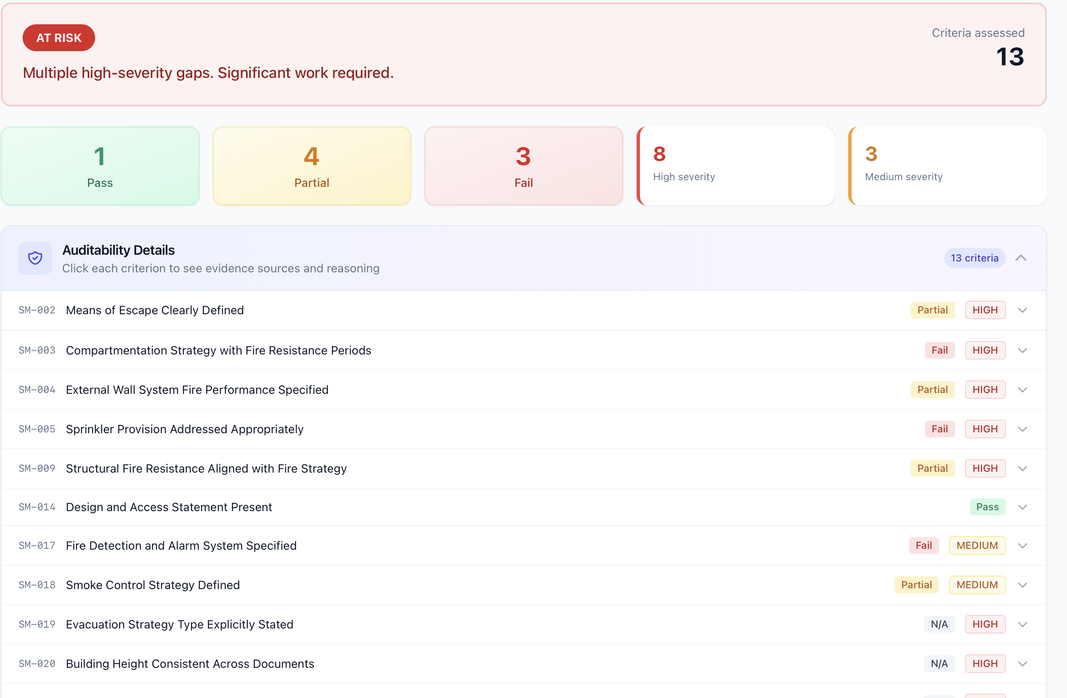
Top Risk Themes
What we find in every submission

