Slide 1
HYBRID GRAPH · TEXT · TABULAR
Hybrid Graph-Text Architecture for
Sports Match Outcome Prediction
Predicting FIFA World Cup outcomes — win / draw / loss — by fusing tabular, textual, and graph signals under a strict leakage-safe protocol.
A multimodal study — and what it taught us about graph neural networks on small data.
World Cup matches 1994–2022

Slide 2
MOTIVATION
Why match prediction is hard — and where models miss
Outcome prediction matters across machine learning, sports analytics, and betting markets.
Tabular models (rankings, form, xG, odds) are informative but blind to context:
injuries, managerial changes, tactical shifts, travel fatigue, and psychological momentum.
Graph-only models capture relational structure but ignore unstructured text — exactly where late-breaking signals live.
RESEARCH QUESTION
Can integrating graph neural networks with textual embeddings improve match prediction over graph-only and statistical baselines?
Target — 3 classes
0
home_win
1
draw
2
away_win
1

Slide 3
RELATED WORK
Positioning: the graph × text gap
Family | Representative work | Reported acc. | Limitation
Statistical | Dixon–Coles Poisson; Elo ratings | ≈50–53% | Simple dependency structure
ML / tabular | Schauberger & Groll (RF); Dolores | ≈53–63% | Matches treated as independent
Graph | Francis — bipartite + centrality + random walk | ~60% (WC'22) | Hand-crafted graph statistics
Text + ML | Beal et al. — ML + expert text | 63.2% | No relational structure
This work | Hybrid graph + text + tabular | 57.8% | Fills the graph × text gap
Little prior work combines learned graph embeddings with contextual text — this study targets exactly that intersection.
2

Slide 4
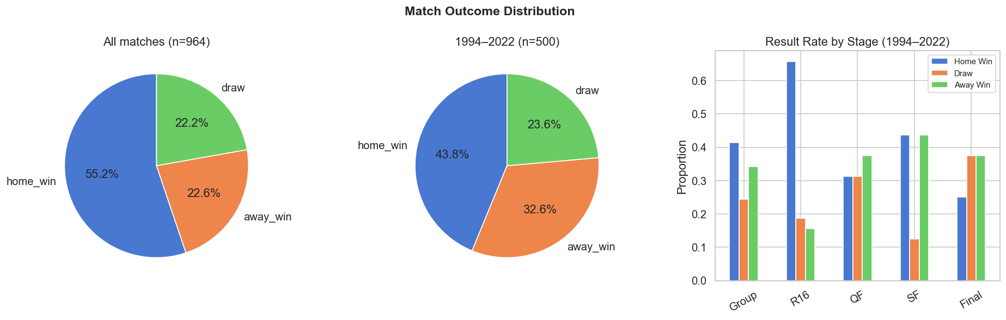
DATA
A consistent World Cup dataset, 1994–2022
500
8
105
1992
matches modelled
tournaments
raw columns
FIFA rankings begin
Home advantage is strong overall (55%); restricting to 1994–2022 lifts the draw and away-win share. Draws are the persistent minority class.
3

Slide 5
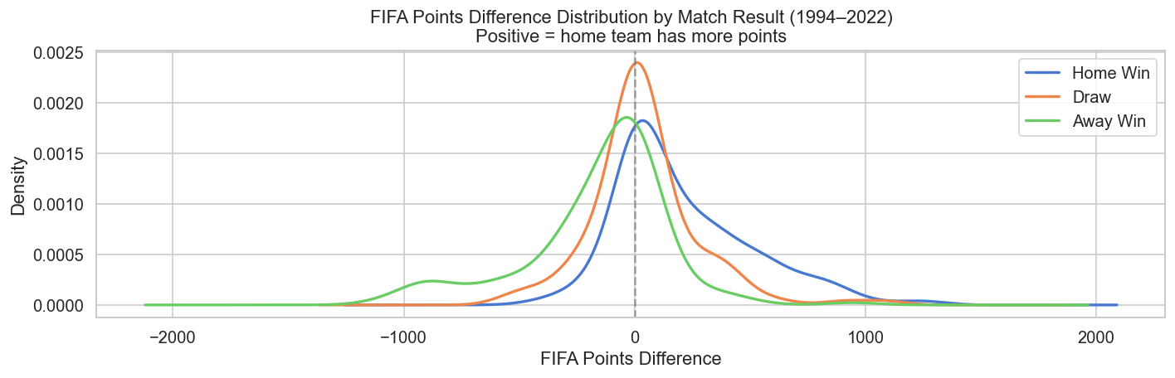
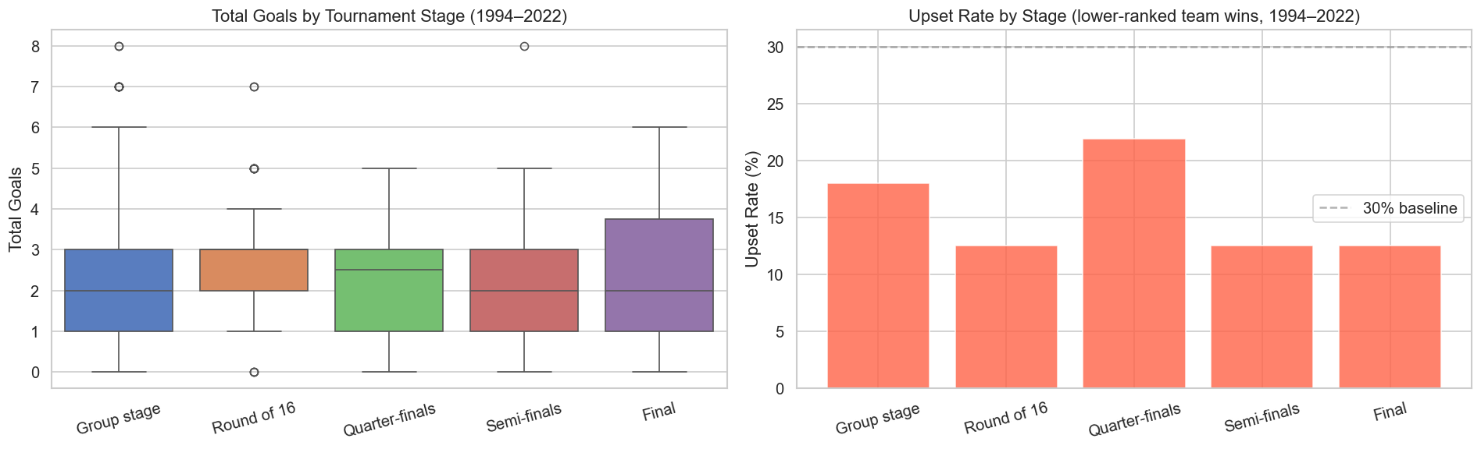
EXPLORATORY ANALYSIS
Why draws are the hard class
Draws concentrate at zero rank gap
Upsets are common, even late
The draw density peaks where the two teams have near-equal FIFA points — evenly-matched games are exactly the ambiguous ones.
Lower-ranked teams still win 12–22% of matches across every stage — ranking alone cannot separate the classes cleanly.
4

Slide 6
METHODOLOGICAL CORE
Leakage-safe design
Chronological split — no tournament leakage
TRAIN
VALIDATION
TEST
1994 – 2014
2018
2022
6 tournaments
model selection
used once
Excluded leakage columns
Text timing rule
home_score · away_score · result · target · home_xg · away_xg · xg · post-match text
Only articles with published_at ≤ match_date − 6h
Selection metric fixed before seeing test: validation macro-F1 (3 classes, imbalanced, draws hard). Test evaluated exactly once.
5

Slide 7
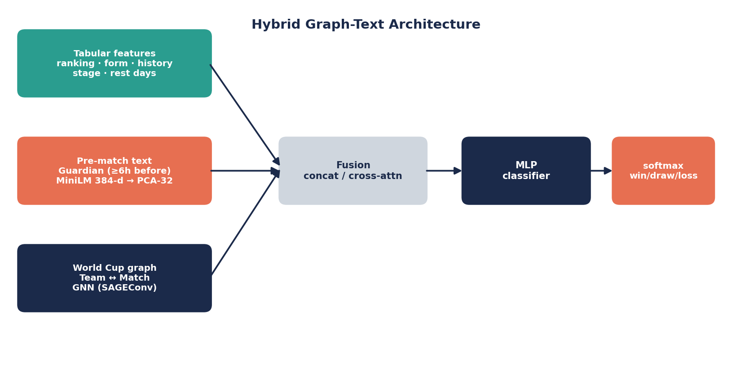
METHOD
Three input branches, fused into one classifier
Tabular ranking · form · history · stage · rest Text Guardian → MiniLM 384-d → PCA-64 Graph Team↔Match GNN embeddings
Fusion via concatenation (early) or cross-attention; an MLP head produces a softmax over {win, draw, loss}.
6

Slide 8
TEXT LAYER
Leakage-safe contextual embeddings
1
Collect
Guardian pre-match articles, ≥6h before kickoff
Text availability features
text_available
text_count
log_text_count
guardian_text_flag
no_text_flag
article timing info
2
Encode
sentence-transformers/all-MiniLM-L6-v2 → 384-d, mean-pooled per match
3
Compress
PCA → 64-d for the GNN, fit on train only
384
embedding dims
(→ 32 via PCA)
4
Flag missing
Zero vector + explicit availability features
7

Slide 9
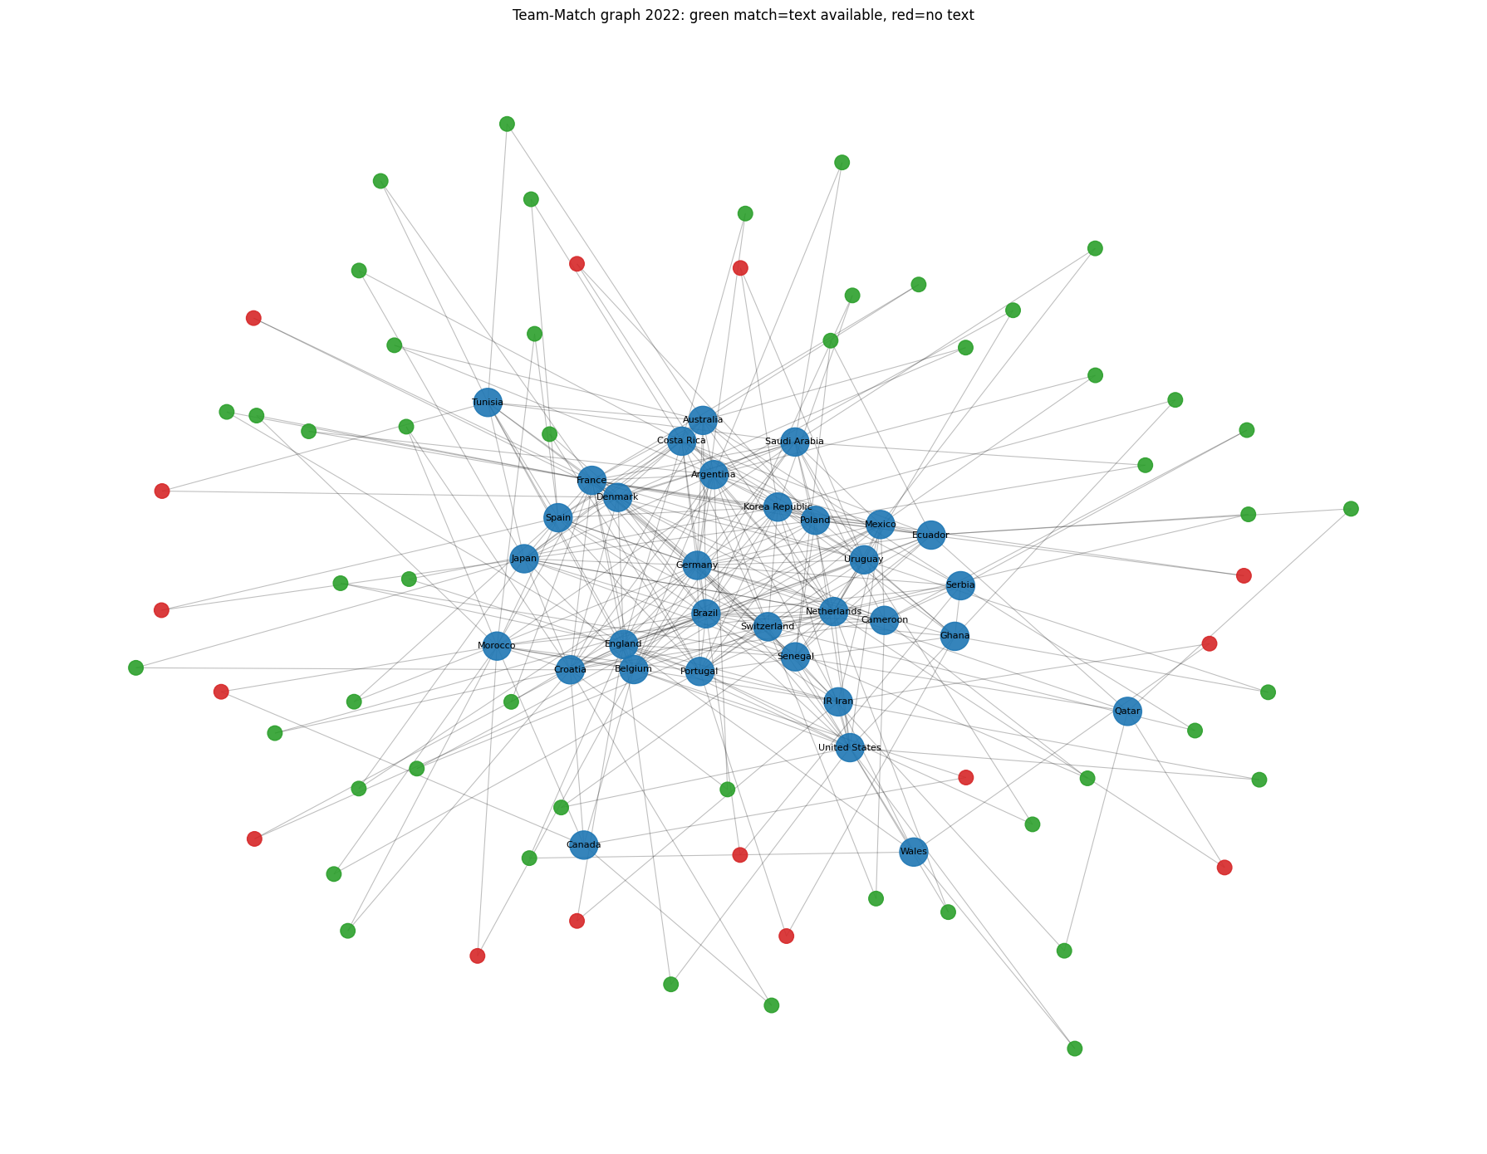
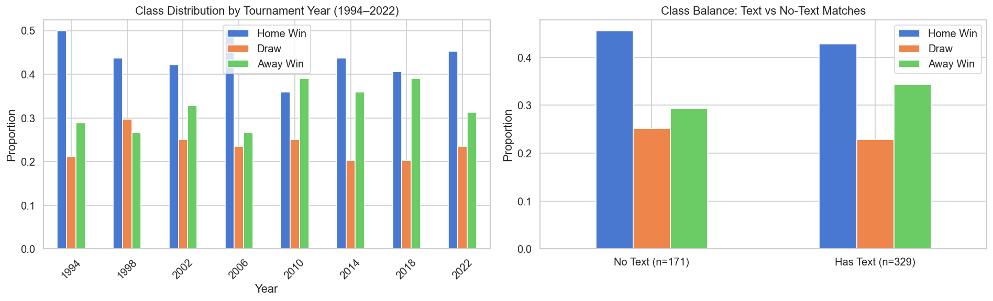
TEXT COVERAGE
Where text exists — and whether it biases classes
Coverage is partial but unbiased
329 / 500 matches have pre-match text. Class balance is nearly identical for text vs no-text matches — so missing text adds no obvious outcome bias.
Team–Match graph, 2022 · green = article available, red = none
8

Slide 10
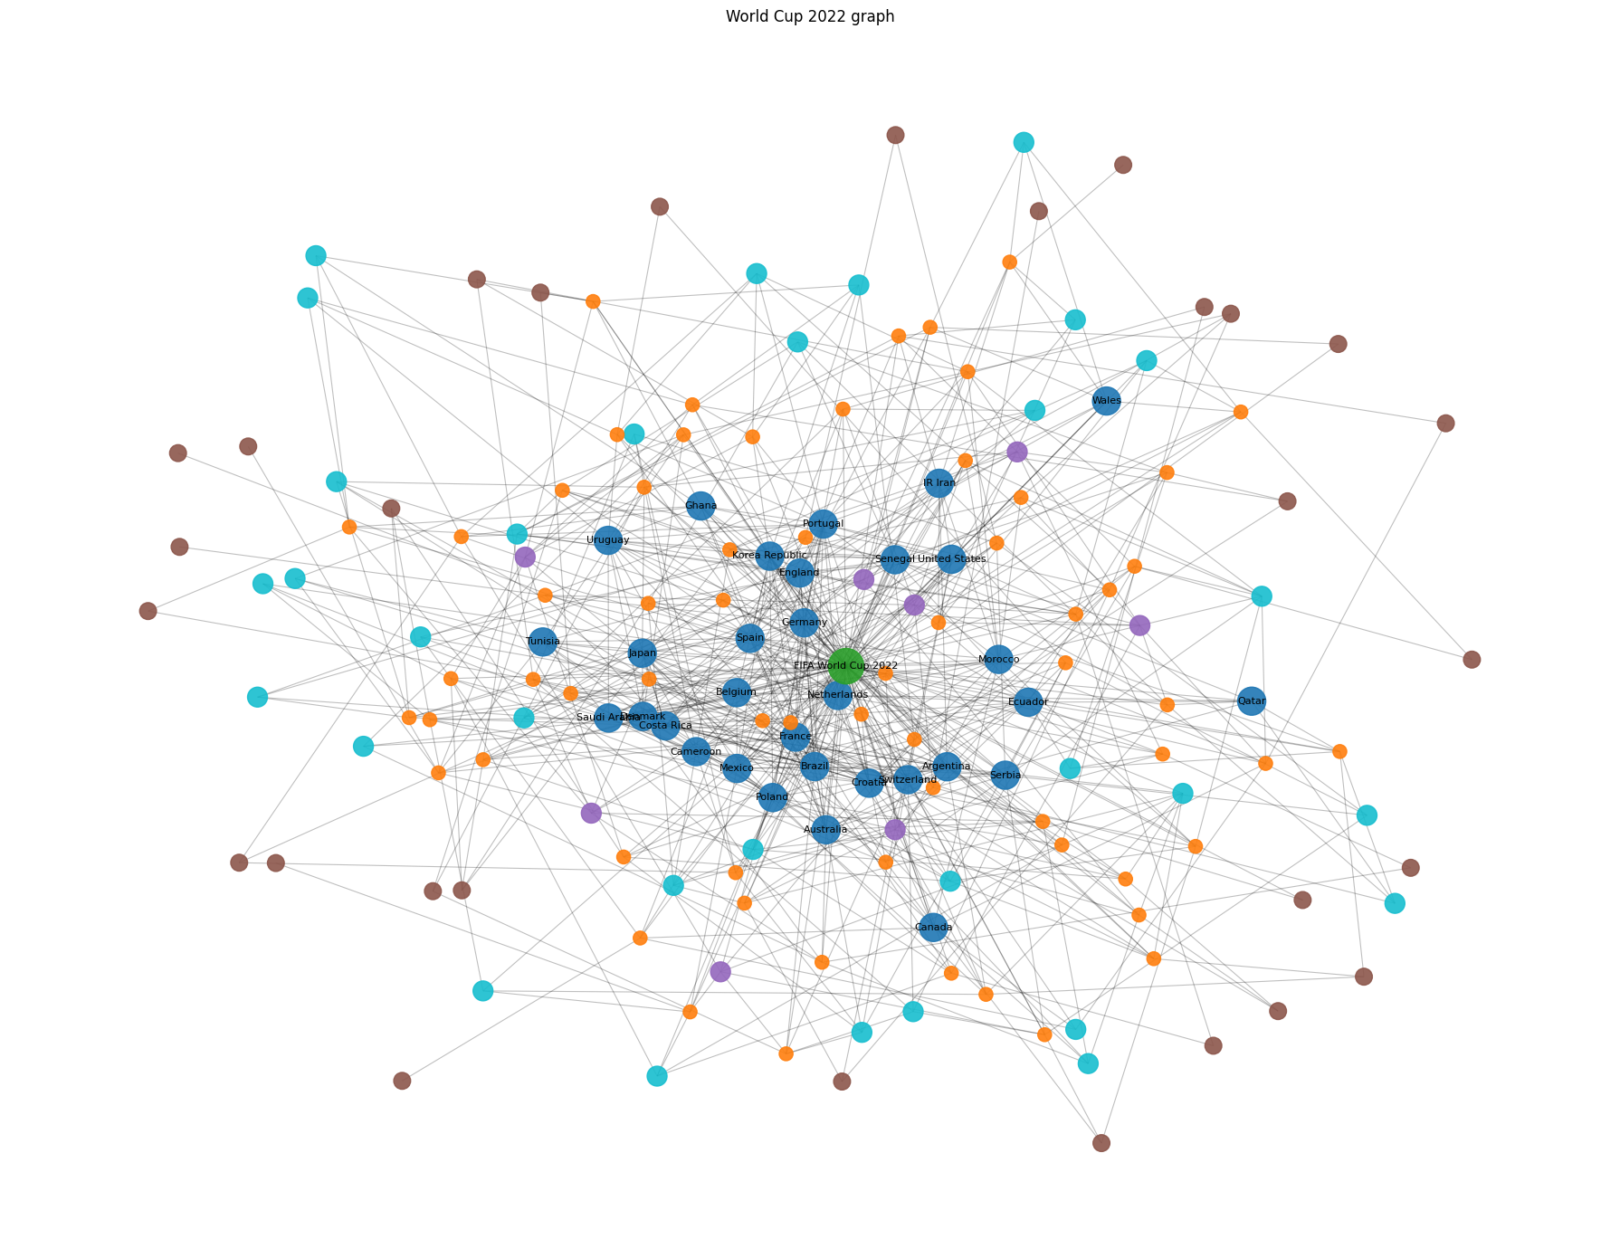
GRAPH LAYER
The full heterogeneous World Cup graph
Node types (full graph)
Match
500
8
TeamTournament
248
edge types
Stadium
93
Referee
88
Team
70
Tournament
8
Edge types
team_played_match · team_played_against_team · team_tournament_played_match · match_belongs_to_tournament · match_played_at_stadium · team_participated_in_tournament · team_has_tournament_instance · referee_officiated_match
World Cup 2022 subgraph — node colour = type
9

Slide 11
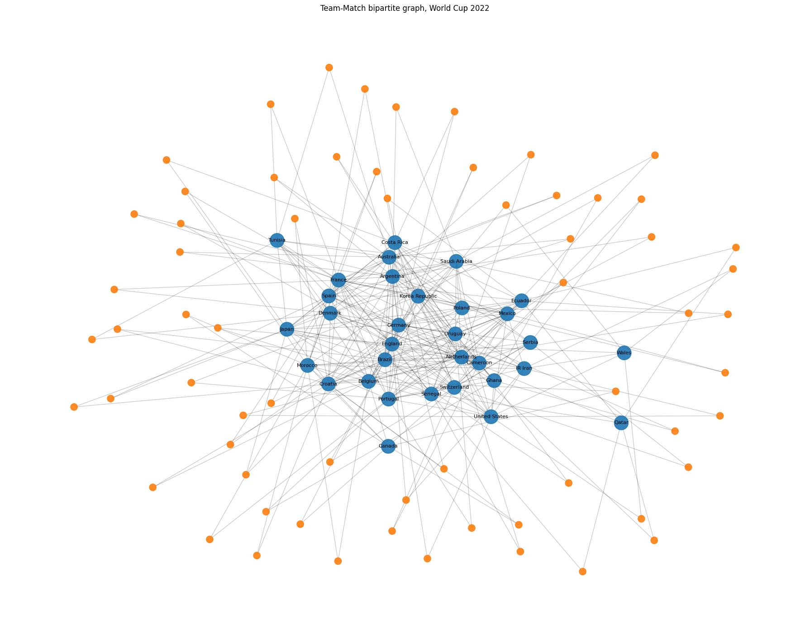
GRAPH → GNN
What the GNN actually sees
The prototype GNN keeps only a strict subset
Nodes kept: team (70) and match (500) only.
Edges kept: team→plays→match, match→rev_plays→team, plus an optional team→played_against→team rivalry edge.
Dropped from the full graph: TeamTournament, Stadium, Referee, Tournament nodes and their edges.
Why the heavy simplification?
With only ~500 matches, a full heterograph would overfit. The Team–Match graph is the smallest structure that still carries shared-opponent signal — complexity is added later, with evidence.
Team–Match bipartite, 2022 · blue = match (500), orange = team (70)
10

Slide 12
MODEL
GNN prototype — architecture & caveat
Architecture
Match-node feature variants
Team↔Match HeteroData (+ optional team↔team rivalry edge)
PyTorch Geometric · HeteroConv wrapping SAGEConv
Per-node-type input projection → hidden dim 32/64
1–2 message-passing layers · dropout 0.35–0.50
Classifier on Match-node embeddings · weighted CE
AdamW · early stopping on validation macro-F1
1. numeric only
2. numeric + text PCA-64
3. numeric + text PCA-64 + metadata / stage
⚠ Transductive caveat
The graph spans 1994–2022. Labels are masked, but future graph structure may still leak through message passing.
→ GNN results are exploratory, not the final leakage-safe benchmark.
Message passing
hᵥ⁽ᵏ⁾ = σ( W⁽ᵏ⁾ · AGGREGATE( { hᵤ⁽ᵏ⁻¹⁾ : u ∈ N(v) } ) )
Loss: L = −Σ Σ yᵢ,c log ŷᵢ,c (3-class cross-entropy)
11

Slide 13
EXPERIMENTS
Baselines, model families, and metrics
Baseline configurations
Model families
Evaluation metrics
Majority class
Stage-only
Text-meta-only
Text-only
Team form
WC history
Ranking
Combined numeric
Numeric + text
Simple graph
Numeric + text + graph
Logistic Regression
Random Forest
Gradient Boosting
HistGradientBoosting
XGBoost
MLP
Graph Neural Network
Macro-F1 (primary)
Balanced accuracy
Weighted F1
Draw recall
Draw F1
Log loss
12

Slide 14
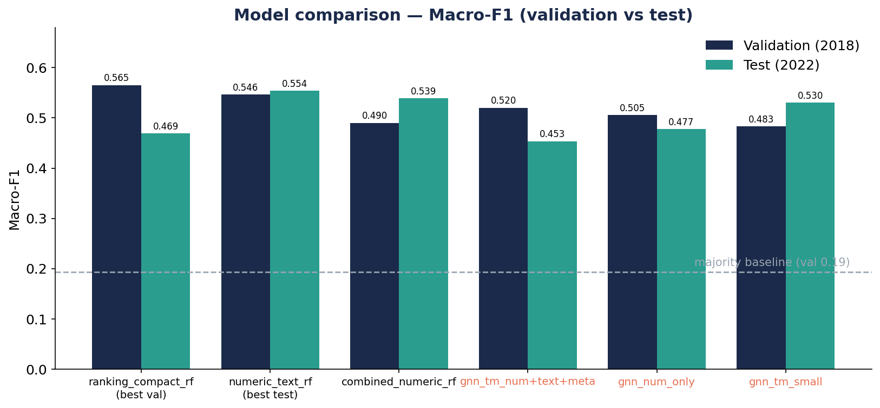
RESULTS
Macro-F1 across the strongest models
BEST BY VALIDATION
ranking_compact_rf
0.565
val macro-F1 · also best val draw F1 (0.40)
BEST ON TEST
numeric_text_rf
0.554
test macro-F1 · best test draw F1 (0.46)
13

Slide 15
RESULTS
14
Headline comparison
Model | Features | Val mF1 | Test mF1 | Test draw F1
ranking_compact_rf | ranking | 0.565 | 0.469 | 0.276
numeric_text_rf | numeric + text | 0.546 | 0.554 | 0.462
combined_numeric_rf_safe | numeric | 0.490 | 0.539 | 0.457
gnn_team_match_numeric_text_meta | num + text + meta | 0.520 | 0.453 | 0.231
gnn_team_match_numeric_text_small | numeric + text PCA | 0.483 | 0.530 | 0.357
majority baseline | — | 0.193 | 0.208 | 0.000
Two headline models. ranking_compact_rf is the validation pick; numeric_text_rf is the best hybrid-text model on test.
GNNs competitive, not better. Best GNN val mF1 (0.520) trails both Random Forests.

Slide 16
FINDINGS
What the experiments actually show
Text helps — when fused
Text-only is weak overall…
numeric_text_rf reaches the best test macro-F1 (0.554) and draw F1 (0.462). Leakage-safe pre-match text adds real value.
…but oddly good at draws on test — text seems to encode match closeness and uncertainty.
Trees dominate small data
Simple graph features fail
Random Forest beats boosting and linear models; the task has nonlinear interactions linear models can't capture.
Degree and centrality barely beat the majority baseline — hand-crafted structure isn't enough.
15

Slide 17
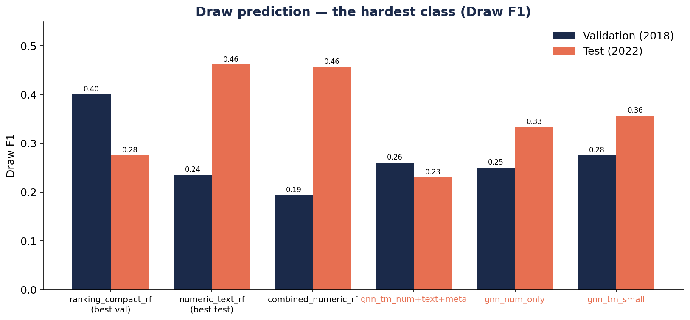
ANALYSIS
Why the GNN did not beat the baselines
1
Small data
~500 matches — RF is more stable than a GNN learning projections, message passing, and fusion.
2
Graph too simple
Team↔Match adds little over ranking/form; one Team node conflates Brazil-1994 with Brazil-2022.
3
Text fused worse in GNN
PCA compression, zero-vector missing text, and Guardian bias hurt the neural text branch.
4
High variance
One tournament per split — small macro-F1 gaps are noisy; smaller GNNs generalized better.
Draws stay hard for every model — the GNN does not solve them.
16

Slide 18
CONCLUSIONS
A working, leakage-safe hybrid pipeline
val macro-F1 0.565 · FIFA rankings are very strong predictors
PRIMARY — validation-selected
ranking_compact_rf
test macro-F1 0.554 · leakage-safe pre-match text adds value
BEST HYBRID-TEXT MODEL
numeric_text_rf
pipeline works, but does not beat strong RF baselines on 500 matches
EXPLORATORY — graph
Team–Match GNN
Draw prediction remains the single hardest part of the task.
17

Slide 19
FUTURE WORK
Where the graph branch should go next
1
2
3
TeamTournament–Match graph
Time-aware / inductive benchmark
Smaller GNNs + variance
Highest-priority fix: Brazil_1994 ≠ Brazil_2022. Use the 248 TeamTournament nodes already in the graph.
Use only edges earlier than each match — removes structural leakage.
Multi-seed reporting; MLP sanity check to test if message passing helps at all.
4
5
6
Better text fusion
Model draws as uncertainty
Ablate node types gradually
Compare raw 384-d vs PCA; learned missing-text embedding instead of zeros.
Two-stage (draw vs non-draw), focal loss, probability calibration, threshold tuning.
Add Tournament → Stadium → Referee only with evidence, to avoid overfitting.
18

