Slide 1
Coursework Project
Urban Climate Insights API
6
180
seeded UK cities
seeded records
A RESTful backend for UK city weather and air-quality data, combining authenticated CRUD, external data import, and analytics.
JWT
FastAPI + SQLAlchemy + JWT + Open-Meteo
protected write operations
Student: Yuan Rui
ID: 2022115981
https://github.com/gapmaker1/urban-climate-insights-api

Slide 2
PROJECT FOCUS
From basic CRUD to a small analytical platform
The project was designed to meet the minimum requirements and then extend them with real web data and analysis.
1. Core backend service
2. External web data
3. Analytics layer
Database-backed CRUD for cities and daily records
Clear JSON responses and standard status codes
Imports historical weather and air-quality data
Uses Open-Meteo geocoding, archive, and AQ APIs
Summary, trend, compare, and anomaly endpoints
Designed to support meaningful oral demonstration
Why this topic?
It fits the module well because it combines web services, SQL persistence, open data integration, and measurable analytics.
The outputs are easy to explain visually: real cities, real dates, real environmental indicators, and clear comparisons.

Slide 3
ARCHITECTURE
Layered design keeps HTTP, validation, storage, and integration concerns separate
This structure made the API easier to maintain, test, and explain during the oral examination.
Services + Validation
SQLite
Open-Meteo
Client / Swagger UI
FastAPI Routers
Pydantic validates payloads while service modules handle analytics, security helpers, and Open-Meteo logic.
Persistent local data store
External data source
Users send HTTP requests, authenticate, and inspect responses through interactive documentation.
Route handlers expose auth, cities, records, imports, and analytics endpoints.
Key design decision
Read endpoints remain easy to demonstrate, while all write operations are protected by JWT authentication.
External data import is isolated behind a service layer, so route handlers remain small and focused.

Slide 4
DATA MODEL
Three core entities support authentication, city metadata, and daily environmental observations
The schema is simple enough for coursework, but structured enough to support real analytical queries.
UrbanClimateRecord
User
City
id, city_id, record_date
temperature_max_c / min_c
precipitation_sum_mm
wind_speed_max_kmh
pm2_5, pm10
nitrogen_dioxide, ozone
european_aqi, source
id
username
email
hashed_password
is_active
created_at
id, name, country_code
region
latitude, longitude
timezone
source
created_at, updated_at
1 → *
Used for registration, login, and protected write access.
Unique: (name, country_code)
Unique: (city_id, record_date)

Slide 5
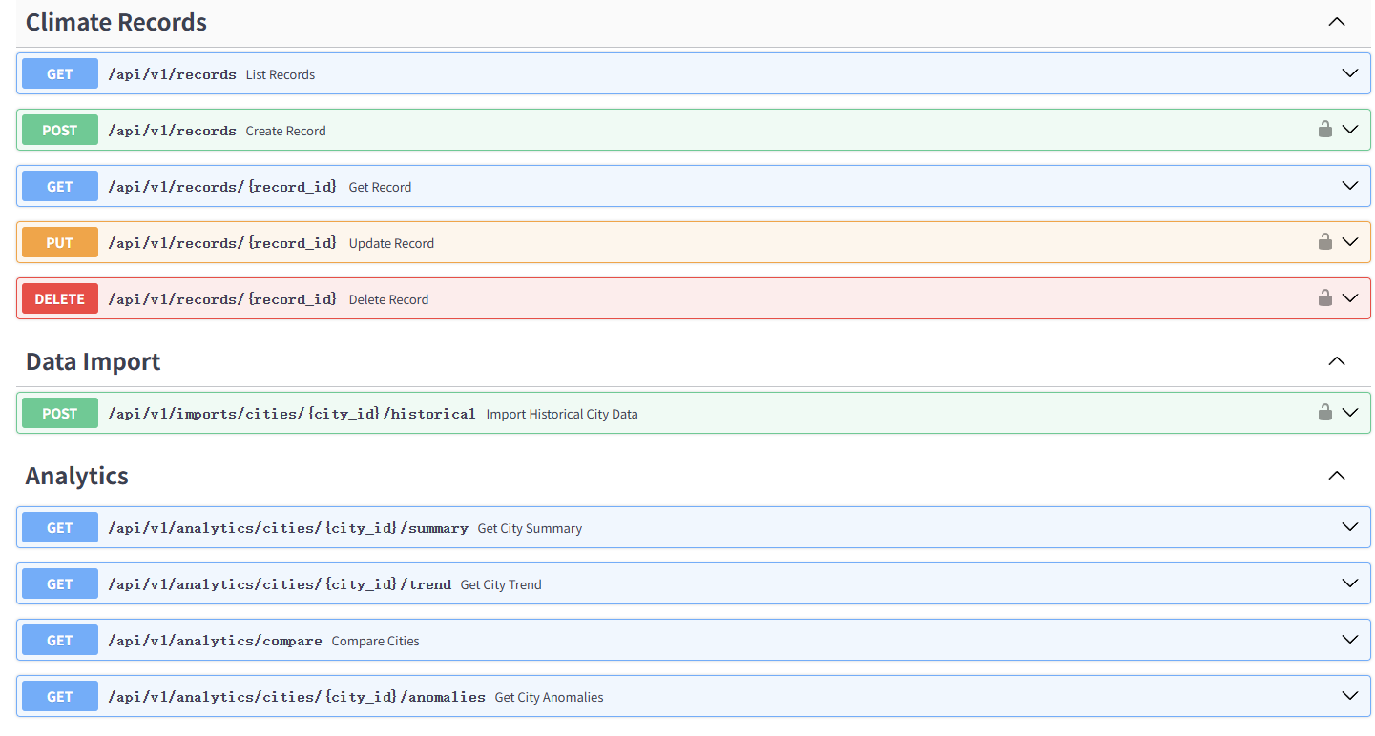
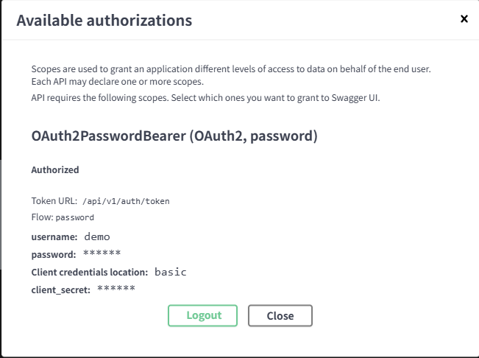
LIVE DOCUMENTATION
Swagger UI makes the API easy to demonstrate and inspect
The interactive docs helped during development and will also be used directly in the oral exam.
Interactive endpoint testing
JWT login through Authorize
OpenAPI schema export included

Slide 6
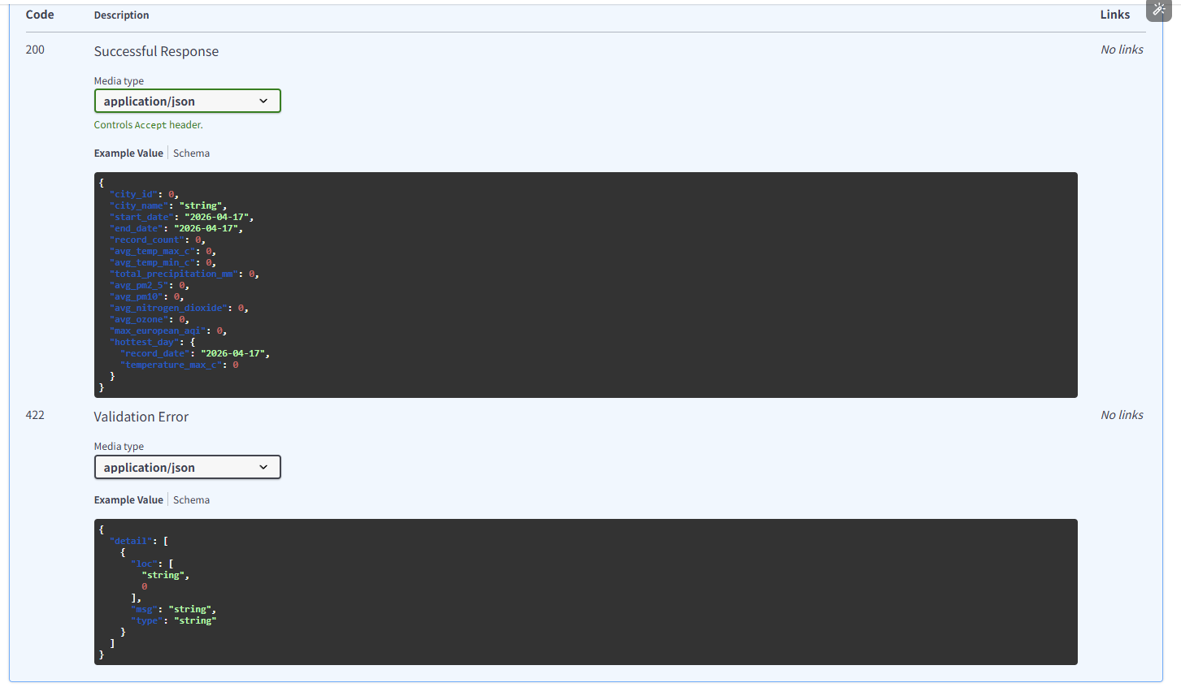
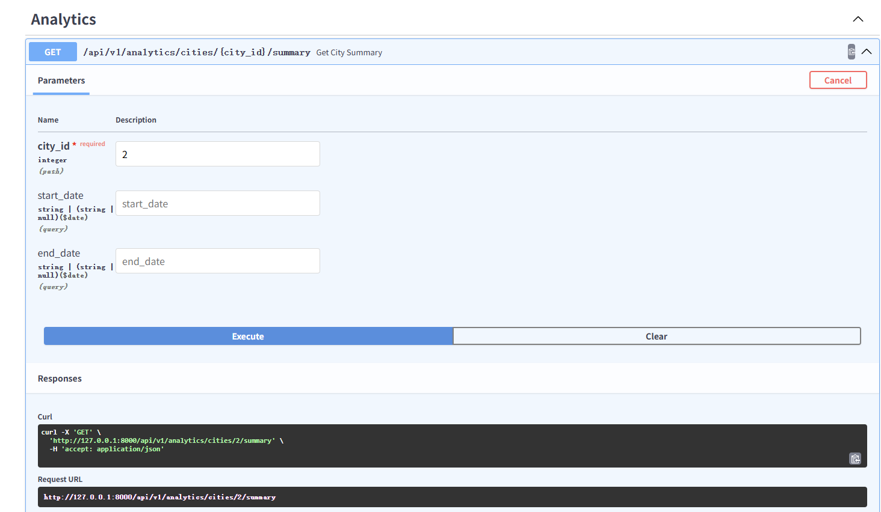
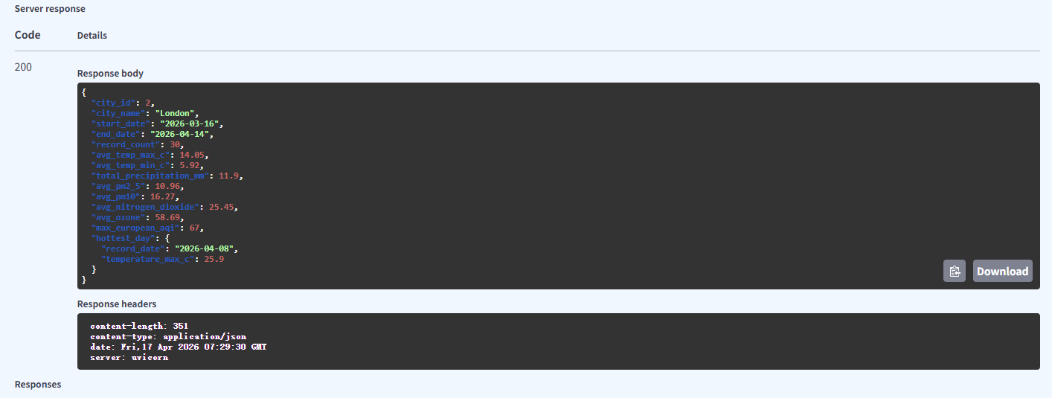
ANALYTICS OUTPUT
The API goes beyond CRUD by returning meaningful aggregated insights
These screenshots show real outputs from the seeded Leeds data rather than manually mocked examples.
What this demonstrates
Summary endpoint returns averaged metrics and the hottest day.
Outputs are suitable for comparison, dashboarding, and explanation in viva questions.

Slide 7
QUALITY AND DELIVERABLES
The repository includes the materials examiners are expected to inspect
I prepared the project so the code, documentation, tests, and presentation all point to the same final version.
Version Control
API Documentation Overview
Technical Report Highlights
Testing
Public GitHub repo | Commit history: setup, core API, tests, docs, cleanup | Runnable final version
Swagger UI
OpenAPI JSON export
PDF endpoint guide
Stack justification | Architecture and testing approach | Limitations, future work, and GenAI declaration
Pytest coverage
Auth, CRUD, analytics
Repeatable local verification
All Deliverables
Code repository, API documentation PDF, technical report PDF, presentation slides, OpenAPI export, and reproducible seed script.

Slide 8
REFLECTION
The project is complete for coursework, but it also suggests clear next steps
This slide helps transition from demonstration to discussion during the Q&A section.
Strengths
Current limitations
Future improvements
Clear modular code structure
Real external data integration
Automated testing and seeded demo data
Complete submission materials
SQLite is best for local use
Imports are synchronous
Authentication is still simple
No frontend dashboard yet
Move to PostgreSQL and hosted deployment
Schedule background imports
Add role-based access control
Build a small analytics dashboard

