Slide 1




Developing a Movie Recommender System Using Apache Spark

Slide 2
Project Overview and Goals
In the digital era, recommender systems are crucial for guiding users through vast amounts of content across various platforms like e-commerce and streaming services. Our focus is on a hybrid movie recommender systems, aimed at providing personalized viewing experiences by leveraging user data (ratings, demographics) and movie attributes (genres, directors).
Our goal is to create a robust movie recommender system that combines the strengths of CF and CB to improve the accuracy and diversity of suggestions, ensuring relevant recommendations even with minimal user interaction history.

Slide 3
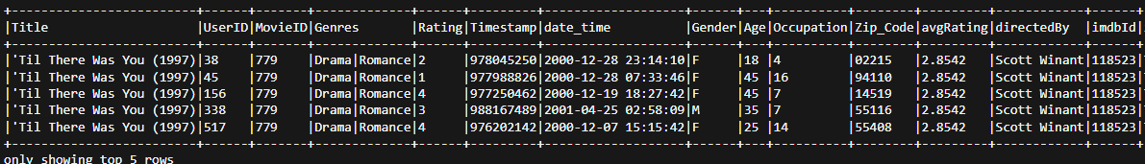
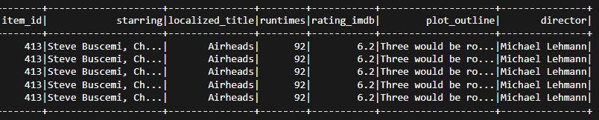
Data Pulling and Preprocessing
User Review Dataset from Movie Lens
Movie details from IMDBPY API
Navigating the rise, fall, and trends of civilizations and societies
IMDb Movie Dataset pulled from the IMDb API

Slide 4
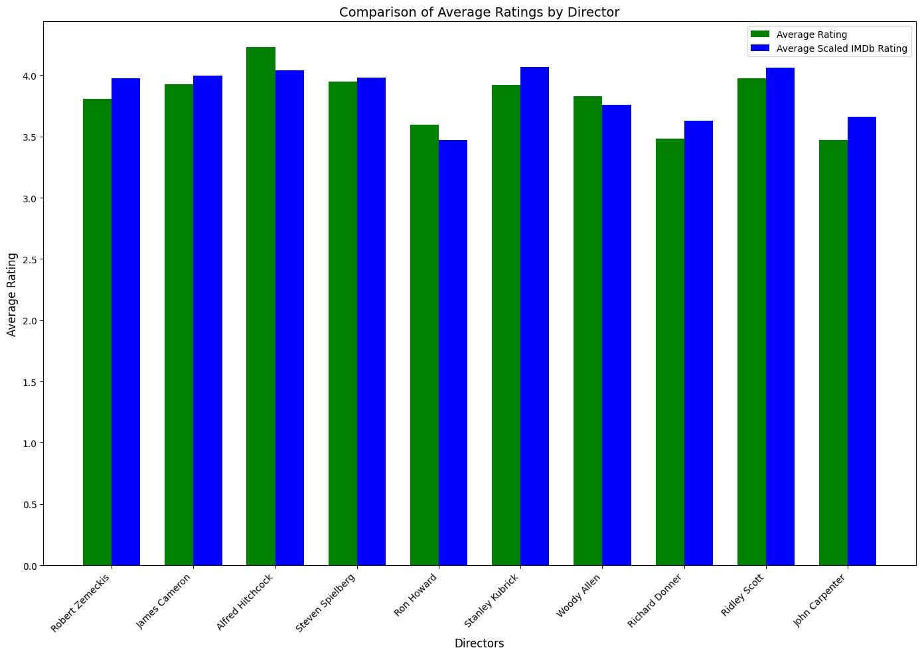
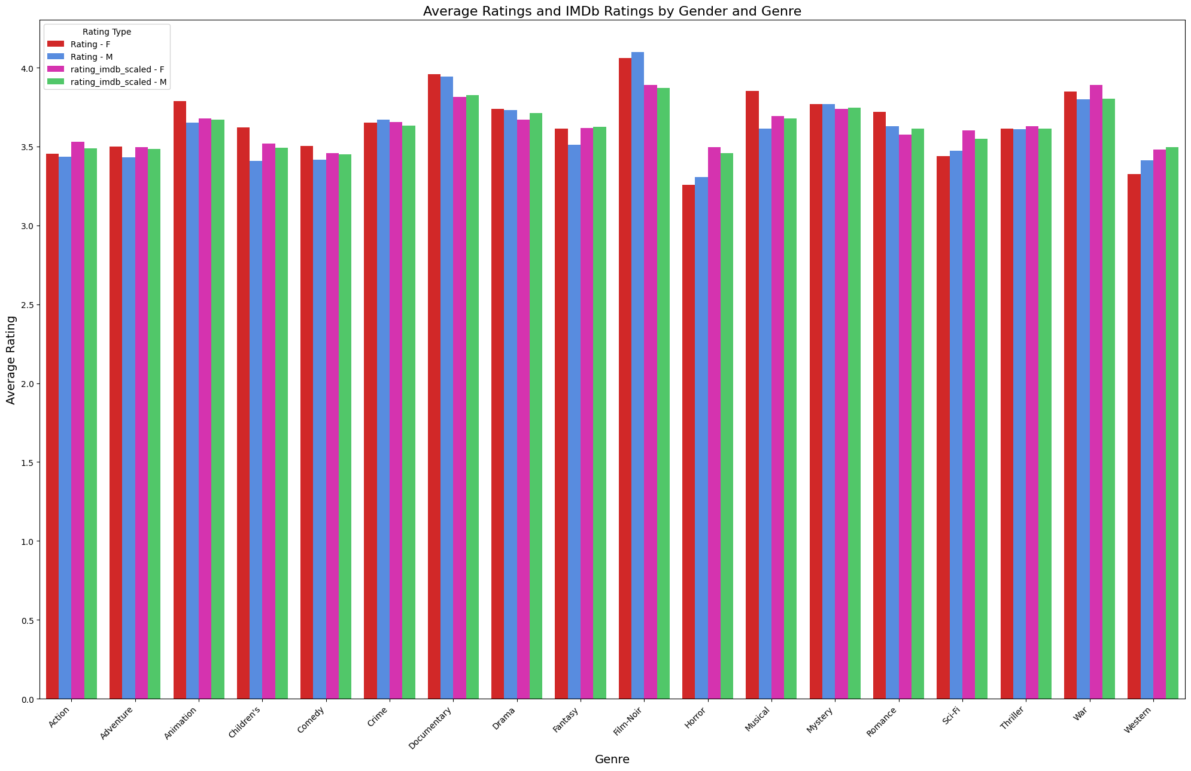
Exploratory Data Analysis

Slide 5
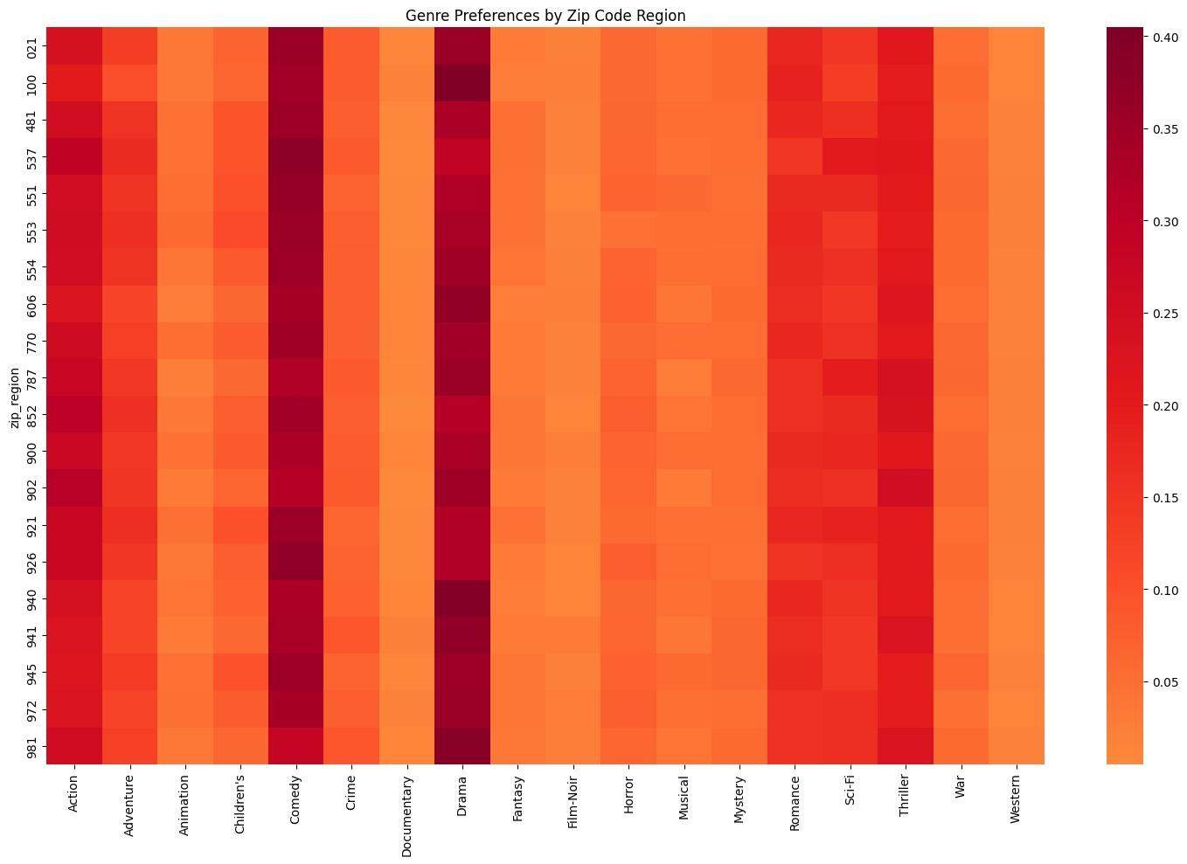
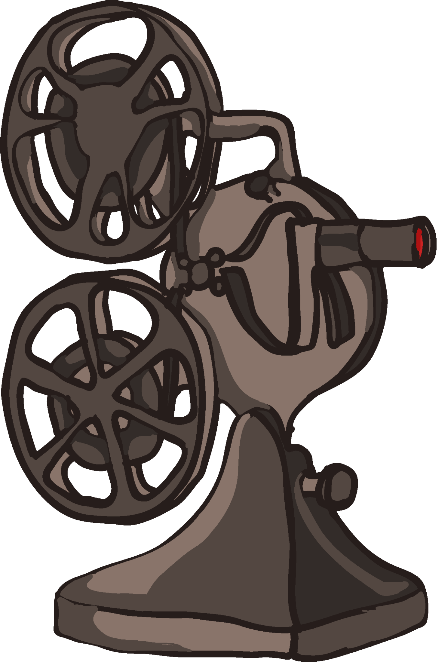
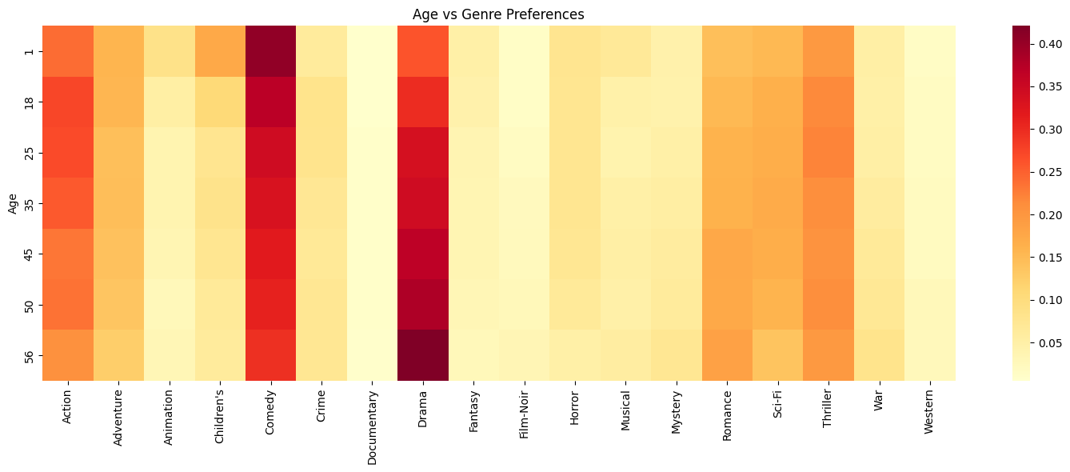
Exploratory Data Analysis Cont.

Slide 6
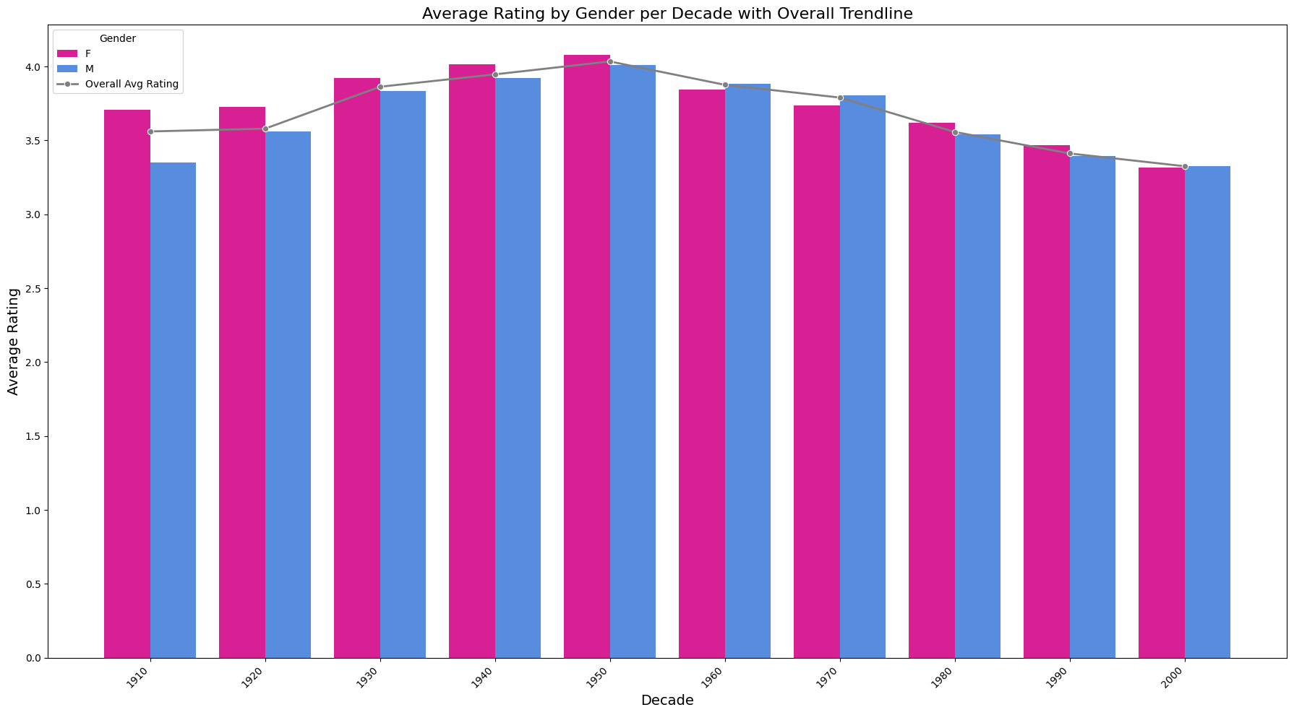

Exploratory Data Analysis Cont.

Slide 7

Methods
The code builds a hybrid movie recommender system using PySpark by combining collaborative filtering with Alternating Least Squares (ALS) and content-based filtering. First, the dataset is sampled, and collaborative filtering is applied using ALS to predict movie ratings based on user interactions.
For content-based filtering, movie genres, plotline, and directors are tokenized and transformed into TF-IDF features, with an average movie rating used as a simple content-based score. The results from both methods are combined into a hybrid prediction, weighted 60% from collaborative filtering and 40% from content-based scores. (Note that the alpha value is 0.6 in our case.)

Slide 8

Metrics Used for Evaluation
RMSE (Root Mean Square Error): Measures how well the model predicts actual ratings.
MAE (Mean Absolute Error): Measures the average magnitude of prediction errors.
HR@K: Measures how often at least one of the top-K recommendations appears in the actual high ratings (Rating >= 4.0).
Catalog Coverage: Measures the percentage of unique movies recommended out of the total catalog.
Precision@K: Fraction of recommended movies that are relevant.
Recall@K: Fraction of relevant movies that are recommended.

Slide 9

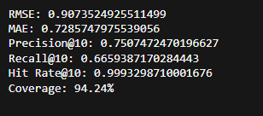
Metrics Used for Evaluation Cont.
Initial Model
Current Model

Slide 10
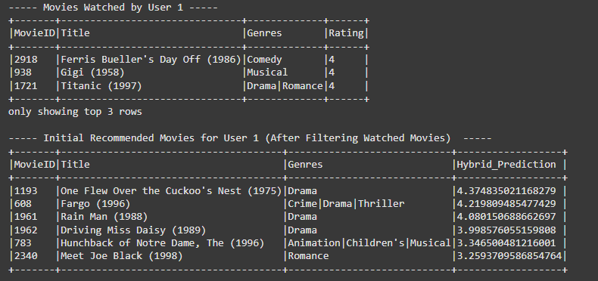
Some Results!

Slide 11
Challenges
Plotline Processing Trade-off
Large plot text data forced us to cut our dataset from 500k to 100k rows.
This reduced movie diversity and user interactions in our model.
The smaller dataset impacted how well we could match users to movies.
IMDb API Issues
Unstable API made data collection difficult.
Couldn't get reliable data about recent movies.
Missing newer releases limited our recommendations.

Slide 12
What’s Next?
Implement categorical fields like plotline, directors, and starring actors more effectively in our model.
The model currently favors numerical variables, reducing its overall diversity score.
Improve new user preference projections.
The model currently struggles with missing information.
Create user personas to help with new user recommendations.
This would allow the model to be robust in the face of missing values.

Slide 13
Thank You!
Questions are welcome!

