Slide 1
Some basic maths for seismic data processing and inverse problems
(Refreshement only!)
Complex Numbers
Vectors
  Linear vector spaces
  Linear systems
Matrices
  Determinants
  Eigenvalue problems
  Singular values
  Matrix inversion
Series
  Taylor
  Fourier
Delta Function
Fourier integrals
The idea is to illustrate these mathematical tools with examples from seismology

Slide 2
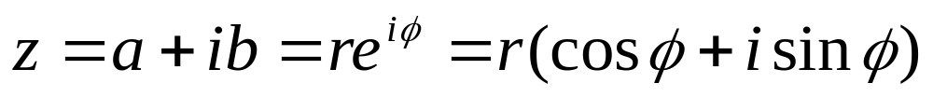
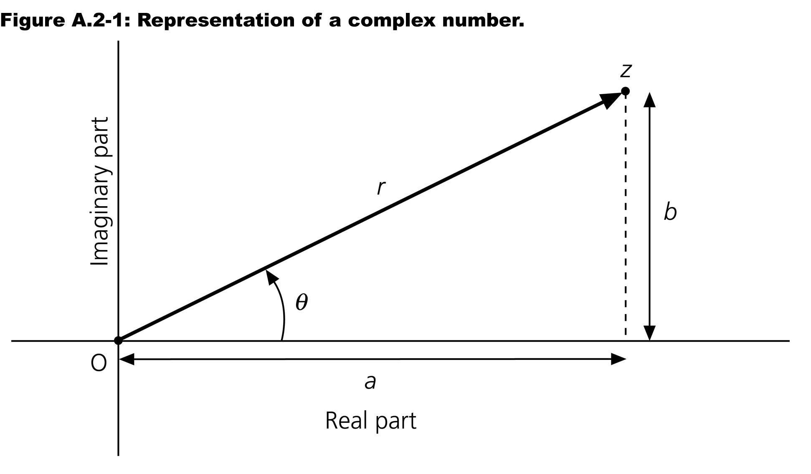
Complex numbers

Slide 3
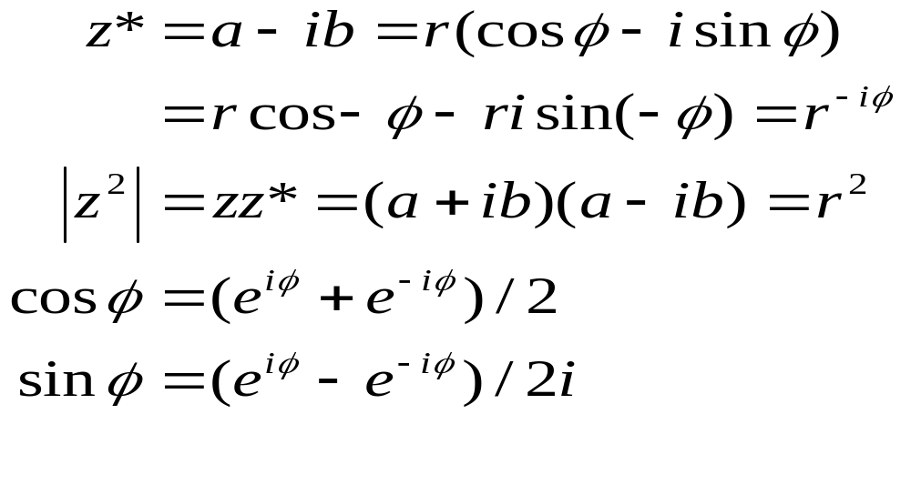
Complex numbers conjugate, etc.

Slide 4
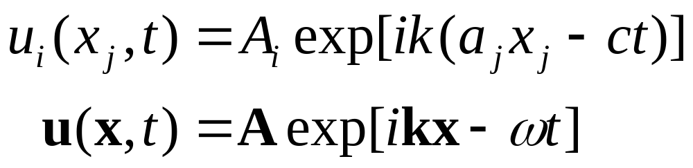
Complex numbers seismological applications
Discretizing signals, description with e^{iwt}
Poles and zeros for filter descriptions
Elastic plane waves
Analysis of numerical approximations

Slide 5
Vectors and Matrices
For discrete linear inverse problems we will need the concept of
linear vector spaces. The generalization of the concept of size of a vector
to matrices and function will be extremely useful for inverse problems.
Definition: Linear Vector Space. A linear vector space over a field F of
scalars is a set of elements V together with a function called addition
from VxV into V and a function called scalar multiplication from FxV into
V satisfying the following conditions for all x,y,z ∈ V and all a,b ∈ F
(x+y)+z = x+(y+z)
x+y = y+x
There is an element 0 in V such that x+0=x for all x ∈ V
For each x ∈ V there is an element -x ∈ V such that x+(-x)=0.
a(x+y)= a x+ a y
(a + b )x= a x+ bx
a(b x)= ab x
1x=x

Slide 6
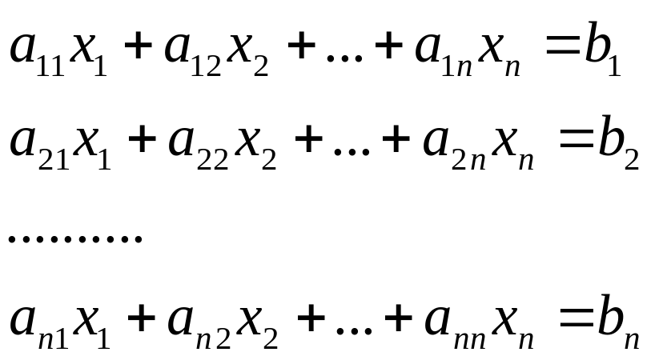

Matrix Algebra – Linear Systems
Linear system of algebraic equations
... where the x₁, x₂, ... , x_{n} are the unknowns ...
in matrix form

Slide 7
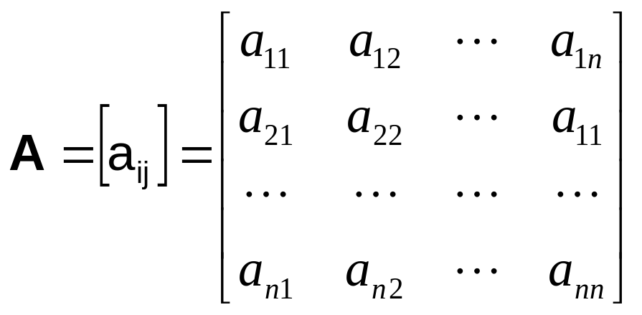
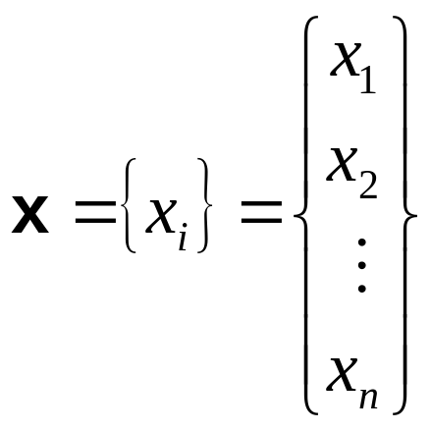
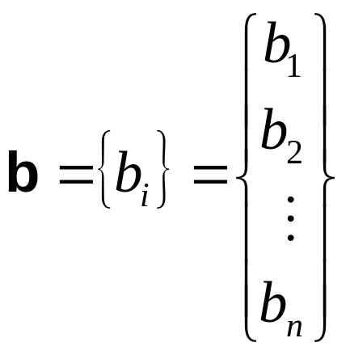
Matrix Algebra – Linear Systems
where
A is a nxn (square) matrix, and x and b are column vectors of dimension n

Slide 8
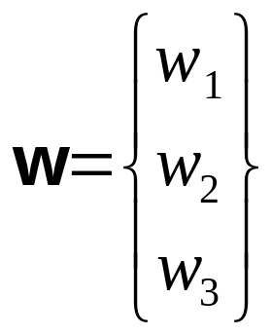
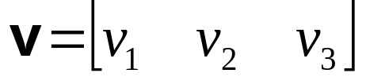
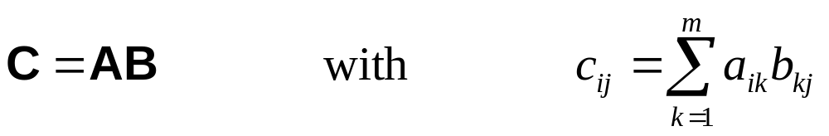
Matrix Algebra – Vectors
Row vectors Column vectors
Matrix addition and subtraction
Matrix multiplication
where A (size lxm) and B (size mxn) and i=1,2,...,l and j=1,2,...,n.
Note that in general AB≠BA but (AB)C=A(BC)

Slide 9
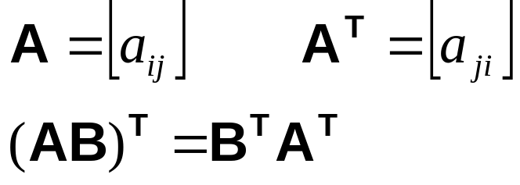
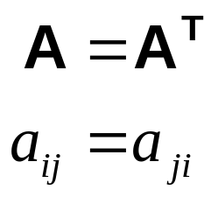
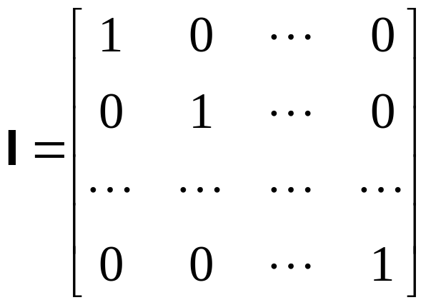
Matrix Algebra – Special
Transpose of a matrix Symmetric matrix
Identity matrix
with AI=A, Ix=x

Slide 10
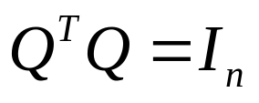
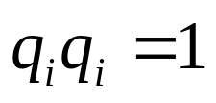
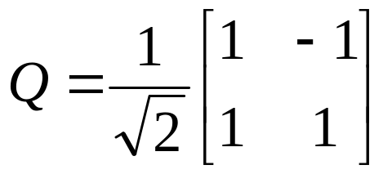
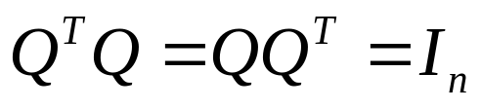
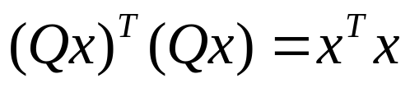
Matrix Algebra – Orthogonal
Orthogonal matrices
a matrix is Q (nxn) is said to be orthogonal if
... and each column is an orthonormal vector
... examples:
it is easy to show that :
if orthogonal matrices operate on vectors their size (the result of their inner product x.x) does not change -> Rotation

Slide 11

Matrix and Vector Norms
How can we compare the size of vectors, matrices (and functions!)?
For scalars it is easy (absolute value). The generalization of this concept to vectors, matrices and functions is called a norm. Formally the norm is a function from the space of vectors into the space of scalars denoted by
with the following properties:
Definition: Norms.
||v|| > 0 for any v∈0 and ||v|| = 0 implies v=0
||av||=|a| ||v||
||u+v||≤||v||+||u|| (Triangle inequality)
We will only deal with the so-called l_{p} Norm.

Slide 12
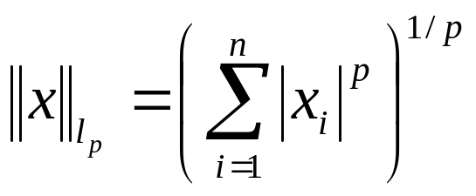
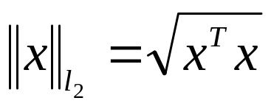
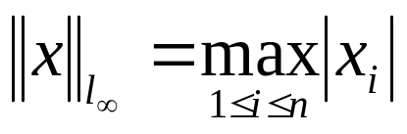
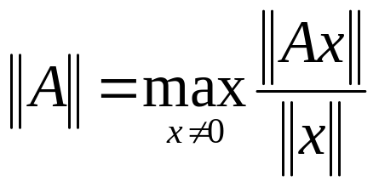
The l_{p}-Norm
The l_{p}- Norm for a vector x is defined as (p≥1):
Examples:
- for p=2 we have the ordinary euclidian norm:
for p= ∞ the definition is
a norm for matrices is induced via
for l₂ this means :
||A||₂=maximum eigenvalue of A^{T}A

Slide 13
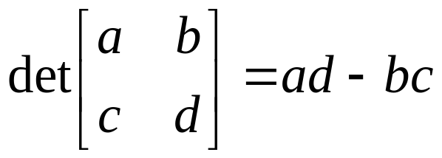
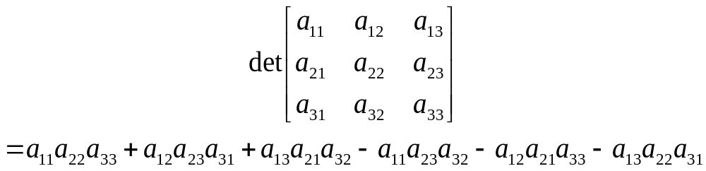
Matrix Algebra – Determinants
The determinant of a square matrix A is a scalar number denoted det (A) or |A|, for example
or

Slide 14

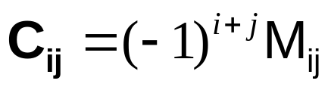
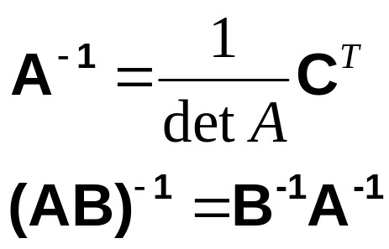
Matrix Algebra – Inversion
A square matrix is singular if det A=0. This usually indicates problems with the system (non-uniqueness, linear dependence, degeneracy ..)
Matrix Inversion
For a square and non-singular matrix A its inverse is defined such as
The cofactor matrix C of matrix A is given by
where M_{ij} is the determinant of the matrix obtained by eliminating the i-th row and the j-th column of A.
The inverse of A is then given by

Slide 15


Matrix Algebra – Solution techniques
... the solution to a linear system of equations is the given by
The main task in solving a linear system of equations is finding the inverse of the coefficient matrix A.
Solution techniques are e.g.
Gauss elimination methods
Iterative methods
A square matrix is said to be positive definite if for any non-zero vector x
... positive definite matrices are non-singular

Slide 16

Eigenvalue problems
… one of the most important tools in stress, deformation and wave problems!
It is a simple geometrical question: find me the directions in which a square matrix does not change the orientation of a vector … and find me the scaling …
.. the rest on the board …

Slide 17
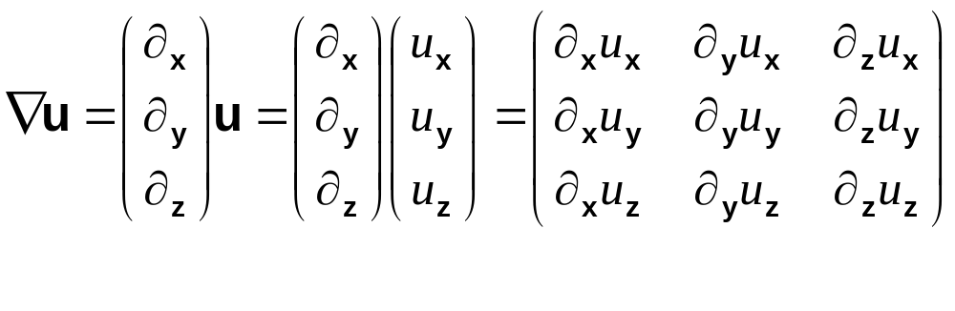
Some operations on vector fields
Gradient of a vector field
What is the meaning of the gradient?

Slide 18
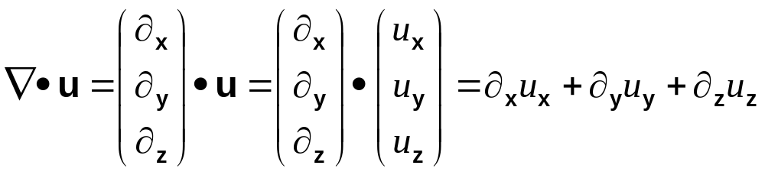
Some operations on vector fields
Divergence of a vector field
When u is the displacement what is ist divergence?

Slide 19
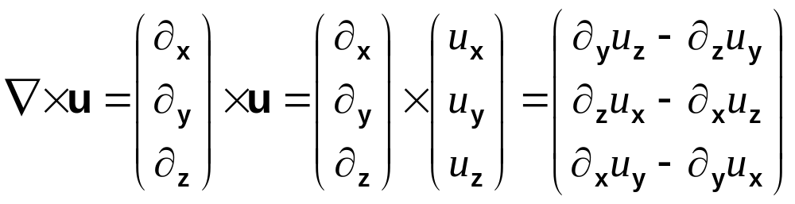
Some operations on vector fields
Curl of a vector field
Can we observe it?

Slide 20
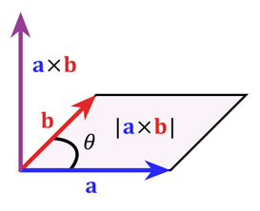
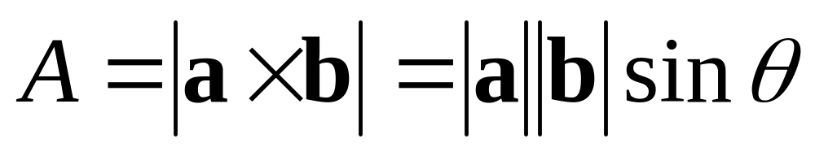
Vector product

Slide 21
Matrices –Systems of equations
Seismological applications
Stress and strain tensors
Calculating interpolation or differential operators for finite-difference methods
Eigenvectors and eigenvalues for deformation and stress problems (e.g. boreholes)
Norm: how to compare data with theory
Matrix inversion: solving for tomographic images
Measuring strain and rotations

Slide 22
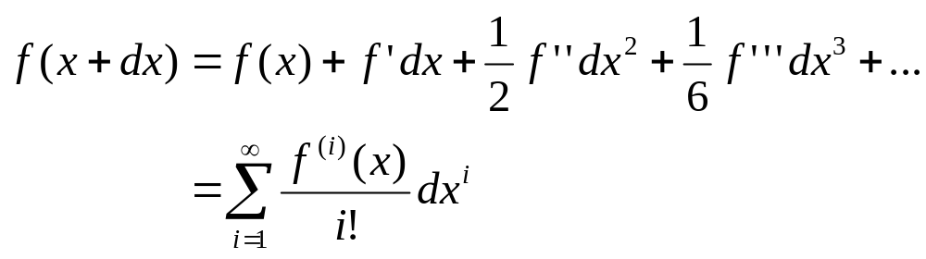
The power of series
Many (mildly or wildly nonlinear) physical systems are transformed to linear systems by using Taylor series

Slide 23
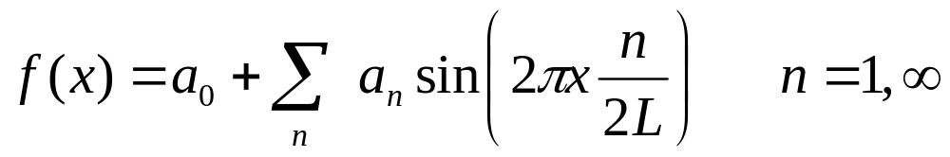
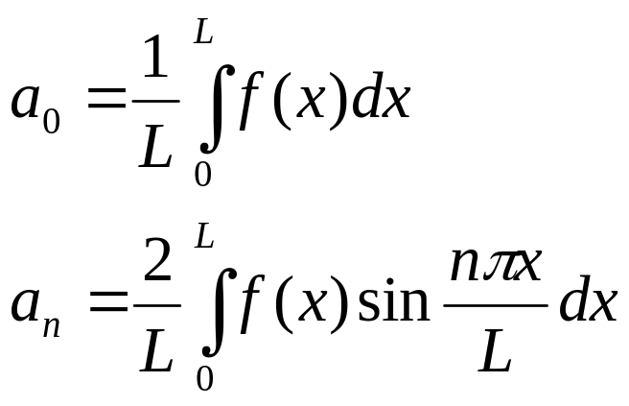
… and Fourier
Let alone the power of Fourier series assuming a periodic function …. (here: symmetric, zero at both ends)

Slide 24
Series –Taylor and Fourier
Seismological applications
Well: any Fouriertransformation, filtering
Approximating source input functions (e.g., step functions)
Numerical operators (“Taylor operators”)
Solutions to wave equations
Linearization of strain - deformation

Slide 25
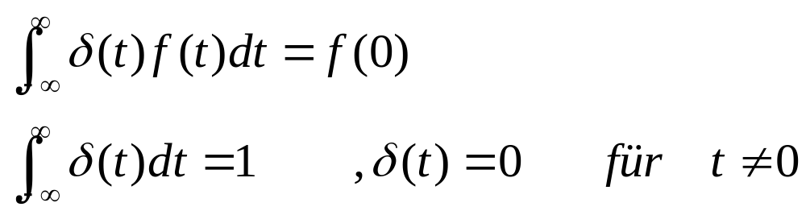
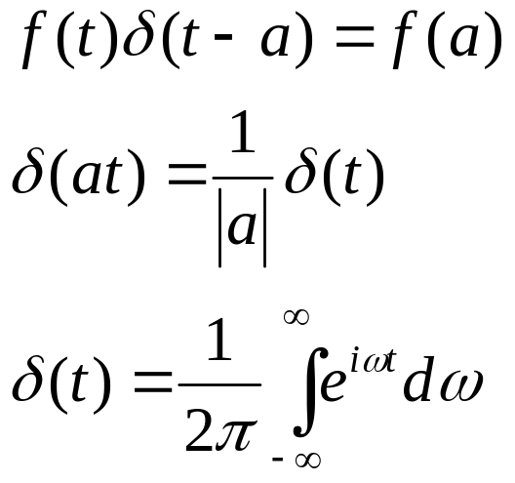
The Delta function
… so weird but so useful …

Slide 26
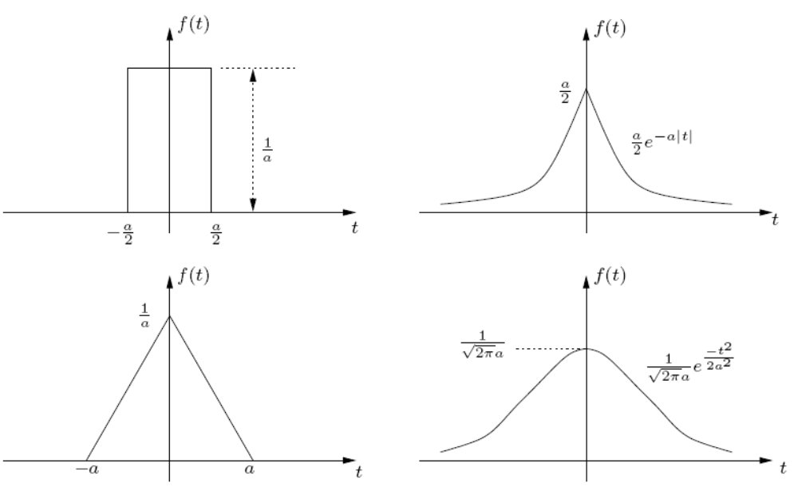
Delta function – generating series

Slide 27
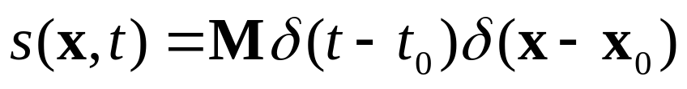
The delta function
Seismological applications
As input to any system (the Earth, a seismometers …)
As description for seismic source signals in time and space, e.g., with M_{ij} the source moment tensor
As input to any linear system -> response Function, Green’s function

Slide 28
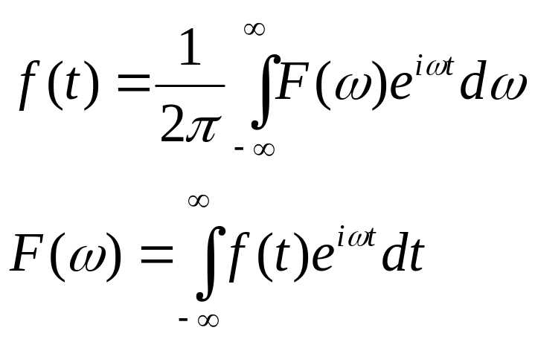
Fourier Integrals
The basis for the spectral analysis (described in the continuous world) is the transform pair:
For actual data analysis it is the discrete version that plays the most important role.

Slide 29
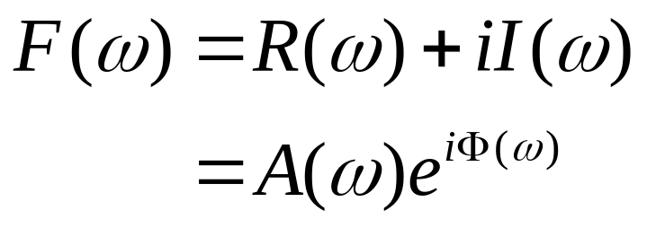
Complex fourier spectrum
The complex spectrum can be described as
… here A is the amplitude spectrum and Φ is the phase spectrum

Slide 30
The Fourier transform
Seismological applications
Any filtering … low-, high-, bandpass
Generation of random media
Data analysis for periodic contributions
  Tidal forcing
  Earth’s rotation
  Electromagnetic noise
  Day-night variations
Pseudospectral methods for function approximation and derivatives

