Slide 1
Complex Numbers
Lesson 5.1

Slide 2

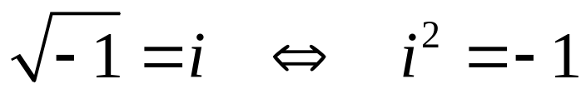
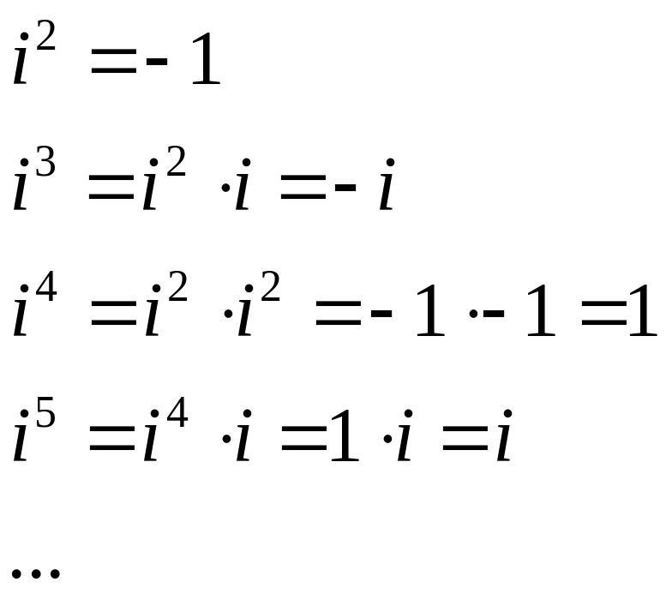
The Imaginary Number i
It's any number you can imagine
By definition
Consider powers if i

Slide 3
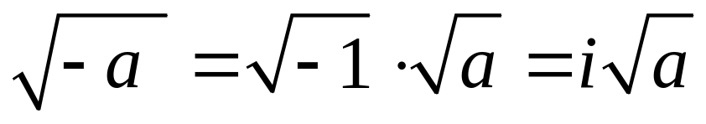
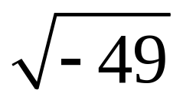
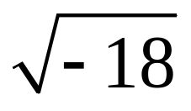
Using i
Now we can handle quantities that occasionally show up in mathematical solutions
What about

Slide 4
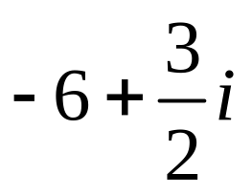
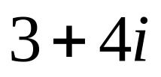
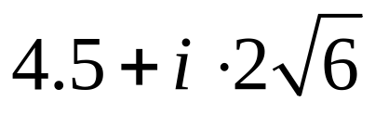
Complex Numbers
Combine real numbers with imaginary numbers
  a + bi
Examples
Imaginary part
Real part

Slide 5
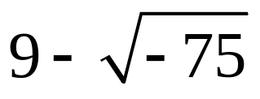
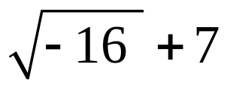
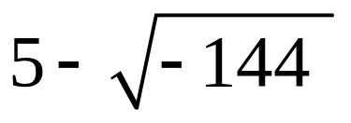
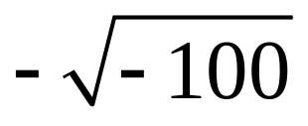
Try It Out
Write these complex numbers in standard form a + bi

Slide 6
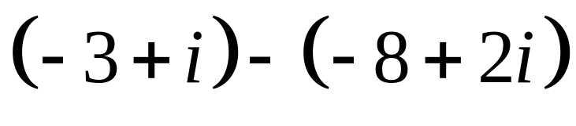
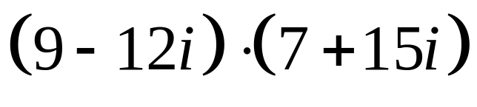
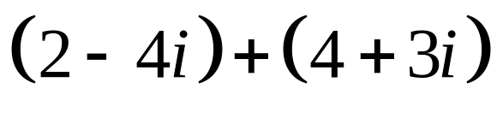
Operations on Complex Numbers
Complex numbers can be combined with
  addition
  subtraction
  multiplication
  division
Consider

Slide 7
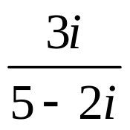
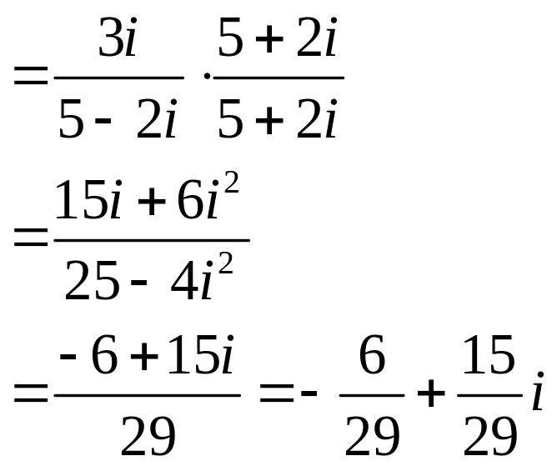
Operations on Complex Numbers
Division technique
  Multiply numerator and denominator by the conjugate of the denominator

Slide 8
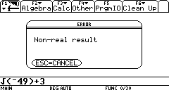
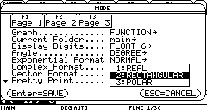
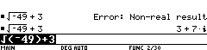
Complex Numbers on the Calculator
Possible result
Reset mode
Complex format
to Rectangular
Now calculator does
desired result

Slide 9
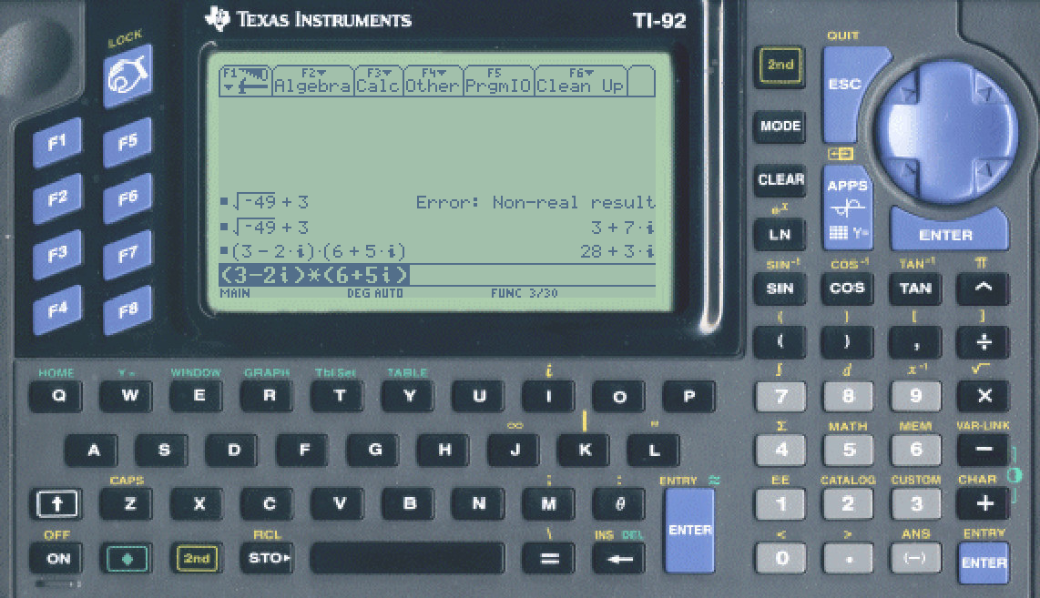
Complex Numbers on the Calculator
Operations with complex on calculator
Make sure to use the correct character for i. Use 2nd-i

Slide 10

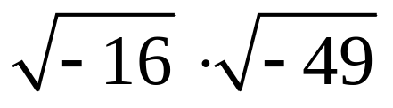
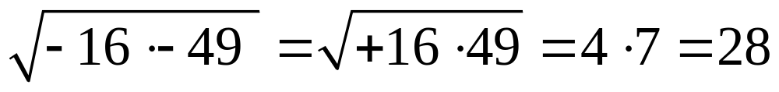

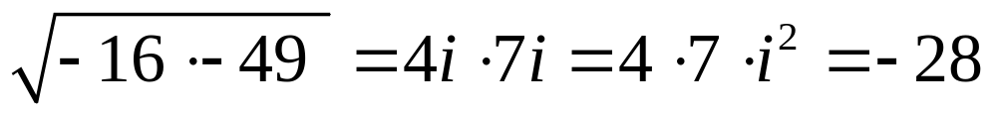
Warning
Consider
It is tempting to combine them
  The multiplicative property of radicals only works for positive values under the radical sign
  Instead use imaginary numbers

Slide 11
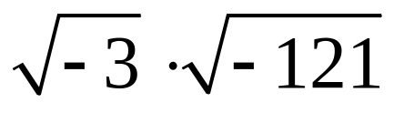
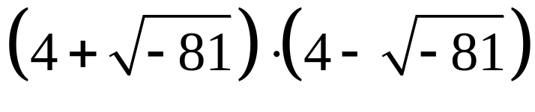
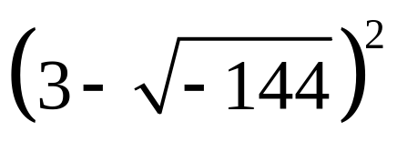
Try It Out
Use the correct principles to simplify the following:

Slide 12
Assignment
Lesson 5.1
Page 340
Exercises 1 – 69 EOO

