Slide 1


C Program Partitioning with Fine-Grained Security Constraints and Post-Partition Verification
Maxwell Levatich, Robert Brotzman, Benjamin Flin, Ta Chen,
Rajesh Krishnan, Michael Kaplan, and Stephen A. Edwards
MILCOM ‘22 Technical Program
Notes:
10s

Slide 2
Distributed systems need security policies
Software running on different computer systems should communicate according to a security policy which limits the flow of information. Why?
Reduces the attack surface; a compromised machine only has limited knowledge.
Ensures unprivileged parties can never see privileged information.
(slide consists of the above bullet – shortened - and a diagram of different systems/vehicles communicating in the wild, with a policy being enforced)
C Program Partitioning with Fine-Grained Security Constraints …
MILCOM ’22
Notes:
50s

Slide 3
Generating secure systems with a Program Partitioner
Writing compliant distributed systems is hard, and error-prone!
We can automate the work of securely distributing a computation with a program partitioner. Accepts:
A serial program modelling the entire computation
Annotations within the program that identify:
Sensitive data
A security policy expressing how that data may be shared between communicating parties
The target hardware enclaves
Outputs several programs which communicate according to the security policy, ready to run on the target enclaves.
C Program Partitioning with Fine-Grained Security Constraints …
MILCOM ’22
Notes:
60s

Slide 4
Key obstacles to using partitioners
Can the partitioner accept sufficiently complex security policies, involving multiple parties and arbitrary access privileges?
What guarantees do we have that the partitioner has done its job correctly? That is, that the output system:
Performs the same function as the original program?
Adheres to the expressed security policy?
State-of-the-art partitioners use a simple security model, which can only express ordered access privileges, rather than fine-grained data sharing, and they offer no assurances of partition correctness.
C Program Partitioning with Fine-Grained Security Constraints …
MILCOM ’22
Notes:
30s

Slide 5
Our contribution
CAPO, a partitioning tool with a fine-grained annotation language that lets a developer express and partition according to detailed security policies that permit the disclosure of specific data only to specific parties.
ParTV, a post-partition verification pass that provides an assurance that the generated code is equivalent in function to the original program and satisfies annotated security policy.
C Program Partitioning with Fine-Grained Security Constraints …
MILCOM ’22
Notes:
30s

Slide 6
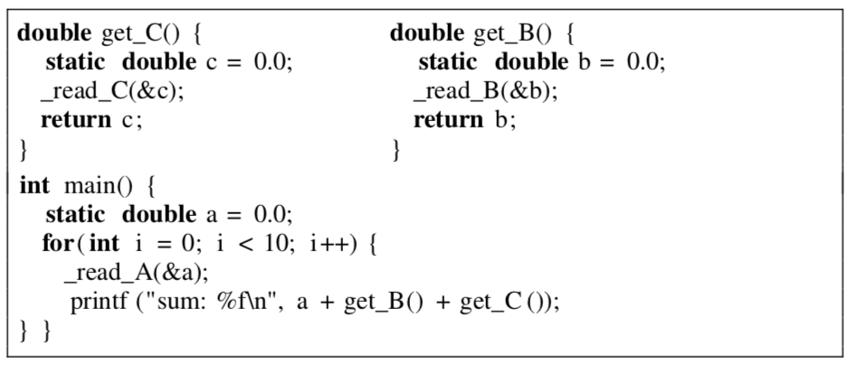
Motivating example (1)
Consider this code, which reads three sensitive data sources and sums the values.
We would like to partition this application, so each sensitive data stream is isolated on its own hardware, and an attacker who hijacks one stream cannot also read the others.
C Program Partitioning with Fine-Grained Security Constraints …
MILCOM ’22
Notes:
40s

Slide 7
Motivating example (2)
We can express this requirement as a security policy:
(insert expanded security policy figure from the OOPSLA submission)
C Program Partitioning with Fine-Grained Security Constraints …
MILCOM ’22
Notes:
20s

Slide 8
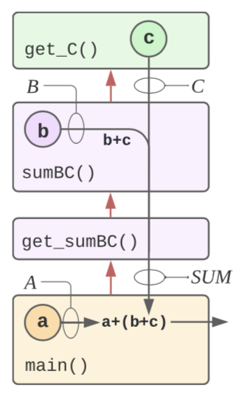
Motivating example (3)
However, the security policy as written cannot be satisfied by the application. CAPO is able to tell the developer that a program cannot be partitioned according to the desired policy.
To compute a sum, at least one party must read two of the original values. We can relax our security policy as follows:
(new policy figure)
C Program Partitioning with Fine-Grained Security Constraints …
MILCOM ’22
Notes:
1min

Slide 9
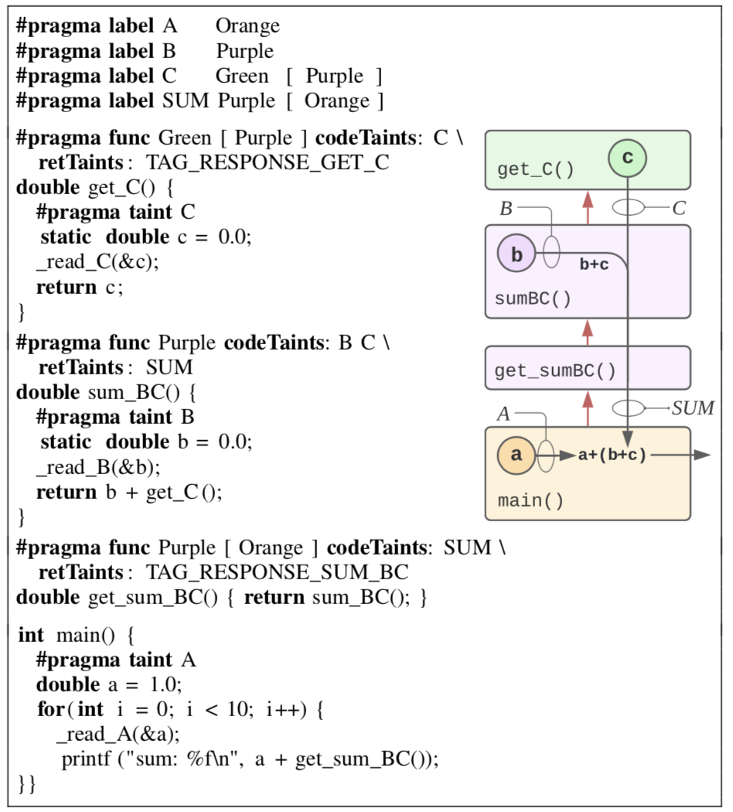
Motivating example (4)
The code is refactored according to the new policy, and the policy is expressed via annotations in the code. So our input to the partitioner takes the following form:
(complete code sample)
This code partitions correctly, placing each function in its own hardware enclave and isolating the sensitive data streams.
C Program Partitioning with Fine-Grained Security Constraints …
MILCOM ’22
Notes:
1min

Slide 10
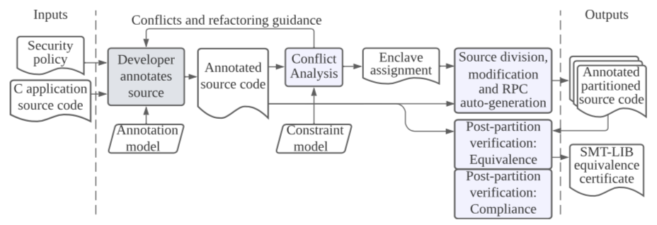
CAPO and ParTV operation
C Program Partitioning with Fine-Grained Security Constraints …
MILCOM ’22
Notes:
1min

Slide 11
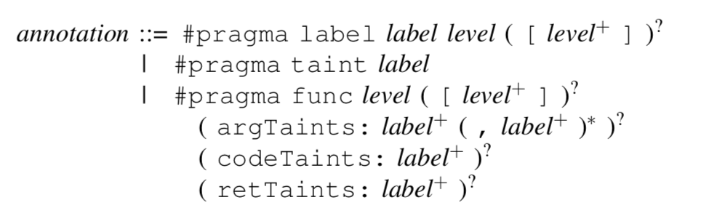
Technical details: Annotation syntax and semantics
Grammar (add some snippets from the motivating example)
C Program Partitioning with Fine-Grained Security Constraints …
MILCOM ’22
Notes:
1min

Slide 12
CAPO and ParTV operation
C Program Partitioning with Fine-Grained Security Constraints …
MILCOM ’22
Notes:
10s

Slide 13
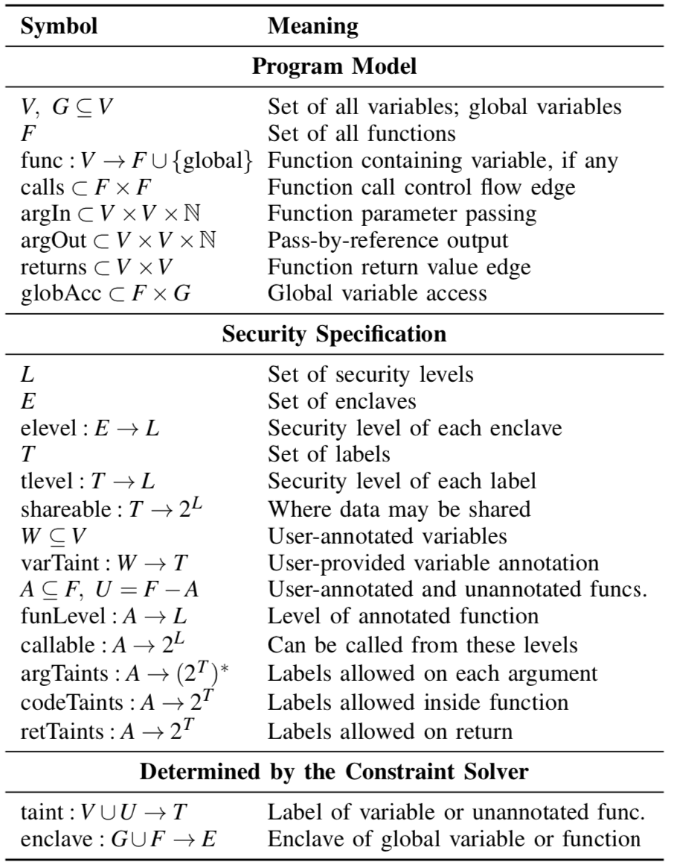
Technical details: Constraint model
C Program Partitioning with Fine-Grained Security Constraints …
MILCOM ’22
Notes:
50s

Slide 14
Technical details: Constraint solving
C Program Partitioning with Fine-Grained Security Constraints …
MILCOM ’22
Notes:
1min

Slide 15
CAPO and ParTV operation
C Program Partitioning with Fine-Grained Security Constraints …
MILCOM ’22
Notes:
10s

Slide 16
Technical details: Code generation
C Program Partitioning with Fine-Grained Security Constraints …
MILCOM ’22
Notes:
50s

Slide 17
CAPO and ParTV operation
C Program Partitioning with Fine-Grained Security Constraints …
MILCOM ’22
Notes:
10s

Slide 18
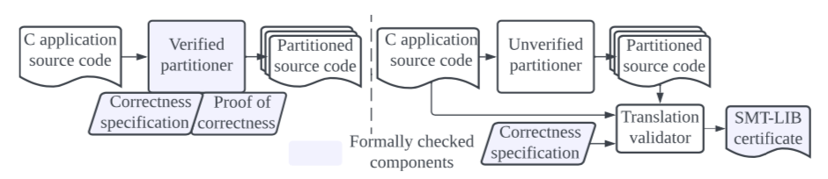
Technical details: Translation validation
C Program Partitioning with Fine-Grained Security Constraints …
MILCOM ’22
Notes:
50s

Slide 19
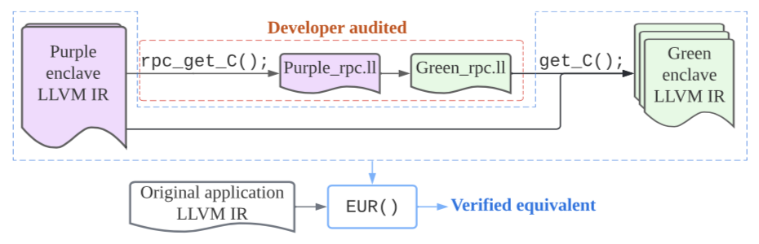
Technical details: ECT (1)
C Program Partitioning with Fine-Grained Security Constraints …
MILCOM ’22
Notes:
1min

Slide 20
Technical details: ECT (2)
Explain the use of SMT. Provide SMT snippet.
C Program Partitioning with Fine-Grained Security Constraints …
MILCOM ’22
Notes:
1min

Slide 21
Technical details: Compliance verification
C Program Partitioning with Fine-Grained Security Constraints …
MILCOM ’22
Notes:
30s

Slide 22
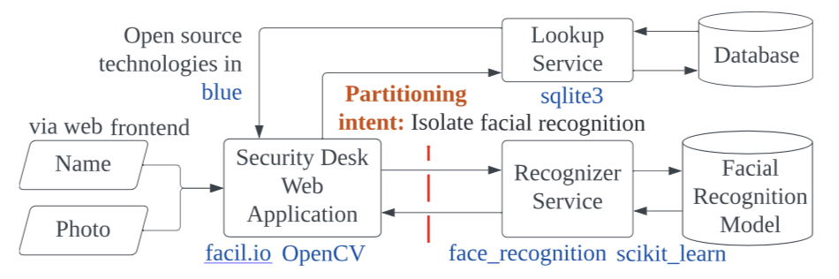
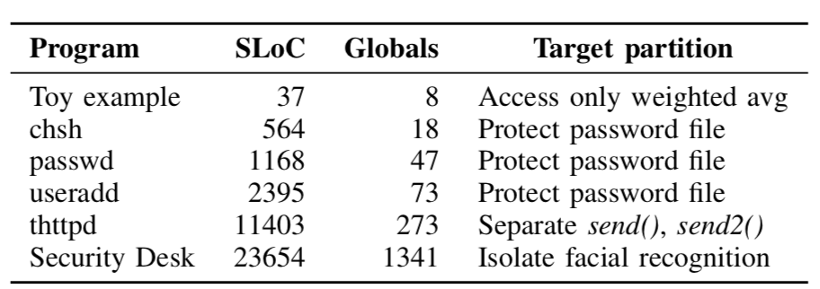
Results: Benchmark set
C Program Partitioning with Fine-Grained Security Constraints …
MILCOM ’22
Notes:
30s

Slide 23
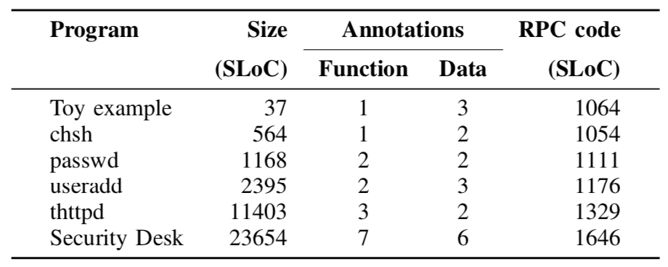
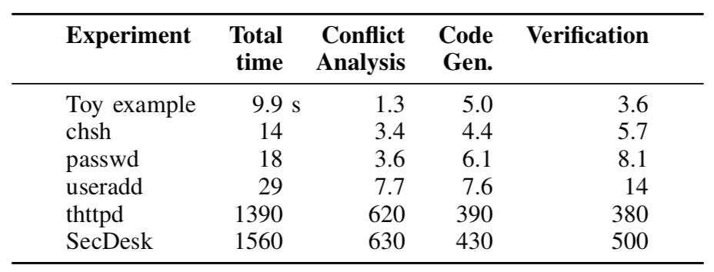
Results: Performance and scalability
C Program Partitioning with Fine-Grained Security Constraints …
MILCOM ’22
Notes:
30s

Slide 24
Results: Post-partition verification
ParTV caught interesting bugs in CAPO. The most substantial was an un-closed #pragma pack(1) in auto-generated RPC header files. At best this incurs a performance hit, but it could have caused undefined behavior on some architectures, and yet would go undetected without either carefully examining auto-generated header files or the compiled LLVM IR.
Other problems we found include an incorrect conversion from zero-argument functions to variadic functions and inconsistent string outputs from applications that printed __FILE__.
This is clearly important!
Mention our future work – RPC equivalence verification!
C Program Partitioning with Fine-Grained Security Constraints …
MILCOM ’22
Notes:
30s

Slide 25
Q&A
C Program Partitioning with Fine-Grained Security Constraints …
MILCOM ’22

