Slide 1


C Program Partitioning with Fine-Grained Security Constraints and Post-Partition Verification
Maxwell Levatich, Robert Brotzman, Benjamin Flin, Ta Chen,
Rajesh Krishnan, Michael Kaplan, and Stephen A. Edwards
MILCOM ‘22 Technical Program
Notes:
Diagrams for verif slide
use icons not text for white boxes in roadmap

Slide 2
Applications have emergent data-sharing constraints
C Program Partitioning with Fine-Grained Security Constraints …
MILCOM ’22

Slide 3
Applications have emergent data-sharing constraints
National lab
Application uses sensitive data.
Application
High fidelity sensor data
Analysis
C Program Partitioning with Fine-Grained Security Constraints …
MILCOM ’22

Slide 4
Applications have emergent data-sharing constraints
National lab
Application uses sensitive data.
Partner organizations join.
Application
High fidelity sensor data
Analysis
Tactical unit
Coalition partner
C Program Partitioning with Fine-Grained Security Constraints …
MILCOM ’22

Slide 5
Applications have emergent data-sharing constraints
National lab
Application uses sensitive data.
Partner organizations join.
Partners may access some/filtered data. Can’t share as written!
Application
High fidelity sensor data
Analysis
Tactical unit
Coalition partner
C Program Partitioning with Fine-Grained Security Constraints …
MILCOM ’22

Slide 6
Applications have emergent data-sharing constraints
National lab
Application uses sensitive data.
Partner organizations join.
Partners may access some/filtered data. Can’t share as written!
Must quickly refactor into “partitioned” version.
Lab partition
High fidelity sensor data
Analysis
Unit partition
Coalition partition
Tactical unit
Coalition partner
C Program Partitioning with Fine-Grained Security Constraints …
MILCOM ’22

Slide 7
Applications have emergent data-sharing constraints
National lab
Application uses sensitive data.
Partner organizations join.
Partners may access some/filtered data. Can’t share as written!
Must quickly refactor into “partitioned” version.
Lab partition
High fidelity sensor data
Analysis
Unit partition
Coalition partition
Sensor data
Analysis
Tactical unit
Coalition partner
C Program Partitioning with Fine-Grained Security Constraints …
MILCOM ’22

Slide 8
Applications have emergent data-sharing constraints
National lab
Application uses sensitive data.
Partner organizations join.
Partners may access some/filtered data. Can’t share as written!
Must quickly refactor into “partitioned” version.
Lab partition
High fidelity sensor data
Analysis
Unit partition
Coalition partition
Sensor data
Analysis
Tactical unit
Coalition partner
C Program Partitioning with Fine-Grained Security Constraints …
MILCOM ’22

Slide 9
Challenges of partitioning applications
Application
High fidelity sensor data
Analysis
C Program Partitioning with Fine-Grained Security Constraints …
MILCOM ’22

Slide 10
Challenges of partitioning applications
Application
Lab partition
High fidelity sensor data
High fidelity sensor data
Abstract analysis
Analysis
Unit partition
Coalition partition
Sensor data
Analysis
C Program Partitioning with Fine-Grained Security Constraints …
MILCOM ’22

Slide 11
Challenges of partitioning applications
Concisely express data-sharing constraints
Application
Lab partition
High fidelity sensor data
High fidelity sensor data
Abstract analysis
Analysis
Unit partition
Coalition partition
Sensor data
Analysis
- Coalition may access data analysis
- Tactical unit may access sensor data
- Coalition may NOT access sensor data
C Program Partitioning with Fine-Grained Security Constraints …
MILCOM ’22

Slide 12
Challenges of partitioning applications
Concisely express data-sharing constraints
Support fine-grained policies
Application
Lab partition
High fidelity sensor data
High fidelity sensor data
Abstract analysis
Analysis
Unit partition
Coalition partition
Sensor data
Analysis
- Coalition may access data analysis
- Tactical unit may access sensor data
- Coalition may NOT access sensor data
C Program Partitioning with Fine-Grained Security Constraints …
MILCOM ’22

Slide 13
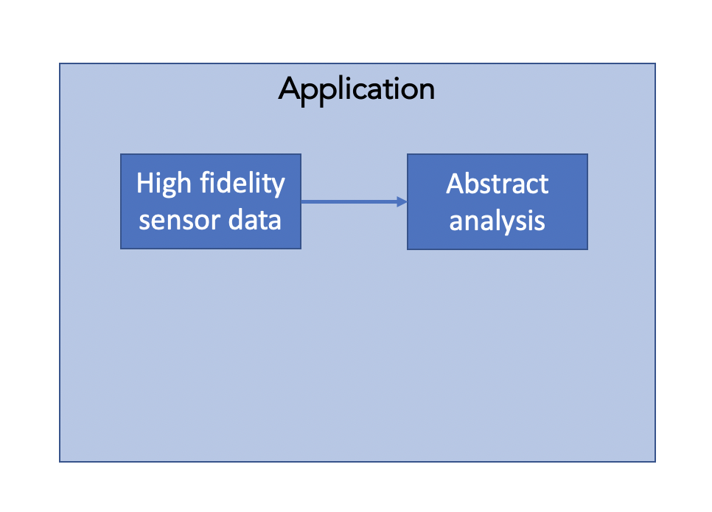
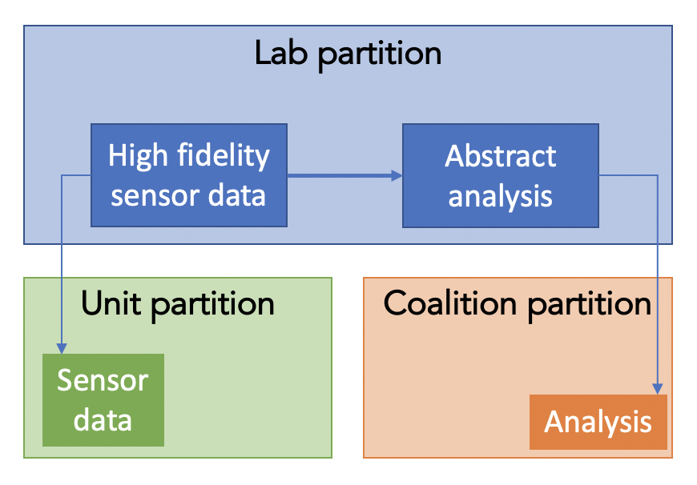
Challenges of partitioning applications
Concisely express data-sharing constraints
Support fine-grained policies
Automate partitioning
- Coalition may access data analysis
- Tactical unit may access sensor data
- Coalition may NOT access sensor data
Automatic partitioner
C Program Partitioning with Fine-Grained Security Constraints …
MILCOM ’22

Slide 14
Challenges of partitioning applications
Concisely express data-sharing constraints
Support fine-grained policies
Automate partitioning
Make formal guarantees of correctness?
- Coalition may access data analysis
- Tactical unit may access sensor data
- Coalition may NOT access sensor data
Automatic partitioner
Proof of correctness
C Program Partitioning with Fine-Grained Security Constraints …
MILCOM ’22

Slide 15
Our approach: Partitioning C applications
C Program Partitioning with Fine-Grained Security Constraints …
MILCOM ’22

Slide 16

Our approach: Partitioning C applications
Data-sharing intent
- A may access X
- B may access Y
- A may NOT access Y
Application source
C
C Program Partitioning with Fine-Grained Security Constraints …
MILCOM ’22

Slide 17
Our approach: Partitioning C applications
Data-sharing intent
- A may access X
- B may access Y
- A may NOT access Y
Developer annotates source code
Application source
C
C Program Partitioning with Fine-Grained Security Constraints …
MILCOM ’22

Slide 18
Our approach: Partitioning C applications
Data-sharing intent
- A may access X
- B may access Y
- A may NOT access Y
Developer annotates source code
Application source
C
C
Annotated application
C Program Partitioning with Fine-Grained Security Constraints …
MILCOM ’22

Slide 19
Our approach: Partitioning C applications
Data-sharing intent
- A may access X
- B may access Y
- A may NOT access Y
Developer annotates source code
Application source
C
C
Annotated application
C Program Partitioning with Fine-Grained Security Constraints …
MILCOM ’22

Slide 20
Our approach: Partitioning C applications
Data-sharing intent
- A may access X
- B may access Y
- A may NOT access Y
Developer annotates source code
No partition exists
Application source
Consistency check
C
C
Annotated application
C Program Partitioning with Fine-Grained Security Constraints …
MILCOM ’22

Slide 21
Our approach: Partitioning C applications
Data-sharing intent
- A may access X
- B may access Y
- A may NOT access Y
Developer annotates source code
No partition exists
Application source
Consistency check
Code generation
Code can be partitioned
C
C
Annotated application
C Program Partitioning with Fine-Grained Security Constraints …
MILCOM ’22

Slide 22
Our approach: Partitioning C applications
Data-sharing intent
- A may access X
- B may access Y
- A may NOT access Y
Developer annotates source code
No partition exists
Partitioned application
Application source
Consistency check
Code generation
Code can be partitioned
C
C
Annotated application
C Program Partitioning with Fine-Grained Security Constraints …
MILCOM ’22

Slide 23
Our approach: Partitioning C applications
Data-sharing intent
- A may access X
- B may access Y
- A may NOT access Y
Developer annotates source code
No partition exists
Partitioned application
Application source
Consistency check
Code generation
Code can be partitioned
C
C
Annotated application
Verification pass
C Program Partitioning with Fine-Grained Security Constraints …
MILCOM ’22

Slide 24

Our approach: Partitioning C applications
Data-sharing intent
- A may access X
- B may access Y
- A may NOT access Y
Developer annotates source code
No partition exists
Partitioned application
Correctness certificate
Application source
Consistency check
Code generation
Code can be partitioned
C
C
Annotated application
Verification pass
C Program Partitioning with Fine-Grained Security Constraints …
MILCOM ’22

Slide 25
Our approach: Partitioning C applications
Data-sharing intent
- A may access X
- B may access Y
- A may NOT access Y
Developer annotates source code
No partition exists
Partitioned application
Correctness certificate
Application source
Consistency check
Code generation
Code can be partitioned
C
C
Annotated application
Verification pass
C Program Partitioning with Fine-Grained Security Constraints …
MILCOM ’22

Slide 26
Data-sharing constraints are annotations
C Program Partitioning with Fine-Grained Security Constraints …
MILCOM ’22

Slide 27
Data-sharing constraints are annotations
double getAnalysis(int m) {
C Program Partitioning with Fine-Grained Security Constraints …
MILCOM ’22

Slide 28
Data-sharing constraints are annotations
double getAnalysis(int m) {
double v = readSensor();
double f = analyze(v);
return f * m;
}
int main() {
double s = getAnalysis(2);
}
C Program Partitioning with Fine-Grained Security Constraints …
MILCOM ’22

Slide 29
Data-sharing constraints are annotations
#pragma label LAB Blue
#pragma label LAB_TO_CLT Blue { Orange }
double getAnalysis(int m) {
double v = readSensor();
double f = analyze(v);
return f * m;
}
int main() {
double s = getAnalysis(2);
}
C Program Partitioning with Fine-Grained Security Constraints …
MILCOM ’22

Slide 30
Data-sharing constraints are annotations
Labels
#pragma label LAB Blue
#pragma label LAB_TO_CLT Blue { Orange }
double getAnalysis(int m) {
double v = readSensor();
double f = analyze(v);
return f * m;
}
int main() {
double s = getAnalysis(2);
}
C Program Partitioning with Fine-Grained Security Constraints …
MILCOM ’22

Slide 31
Data-sharing constraints are annotations
Labels
#pragma label LAB Blue
#pragma label LAB_TO_CLT Blue { Orange }
double getAnalysis(int m) {
#pragma taint LAB
double v = readSensor();
double f = analyze(v);
return f * m;
}
int main() {
double s = getAnalysis(2);
}
C Program Partitioning with Fine-Grained Security Constraints …
MILCOM ’22

Slide 32
Data-sharing constraints are annotations
Labels
#pragma label LAB Blue
#pragma label LAB_TO_CLT Blue { Orange }
double getAnalysis(int m) {
#pragma taint LAB
double v = readSensor();
double f = analyze(v);
return f * m;
}
int main() {
double s = getAnalysis(2);
}
Data annotations
C Program Partitioning with Fine-Grained Security Constraints …
MILCOM ’22

Slide 33
Data-sharing constraints are annotations
Labels
#pragma label LAB Blue
#pragma label LAB_TO_CLT Blue { Orange }
#pragma func Blue \
codeTaints: LAB \
retTaints: LAB_TO_CLT
double getAnalysis(int m) {
#pragma taint LAB
double v = readSensor();
double f = analyze(v);
return f * m;
}
int main() {
double s = getAnalysis(2);
}
Data annotations
C Program Partitioning with Fine-Grained Security Constraints …
MILCOM ’22

Slide 34
Data-sharing constraints are annotations
Labels
#pragma label LAB Blue
#pragma label LAB_TO_CLT Blue { Orange }
#pragma func Blue \
codeTaints: LAB \
retTaints: LAB_TO_CLT
double getAnalysis(int m) {
#pragma taint LAB
double v = readSensor();
double f = analyze(v);
return f * m;
}
int main() {
double s = getAnalysis(2);
}
Function annotations
Data annotations
C Program Partitioning with Fine-Grained Security Constraints …
MILCOM ’22

Slide 35
Our approach: Partitioning C applications
Data-sharing intent
- A may access X
- B may access Y
- A may NOT access Y
Developer annotates source code
No partition exists
Partitioned application
Correctness certificate
Application source
Consistency check
Code generation
Code can be partitioned
C
C
Annotated application
Verification pass
C Program Partitioning with Fine-Grained Security Constraints …
MILCOM ’22

Slide 36
Consistency analysis determines a partition
C Program Partitioning with Fine-Grained Security Constraints …
MILCOM ’22

Slide 37
Consistency analysis determines a partition
Which functions from the application belong in each partition component?
C Program Partitioning with Fine-Grained Security Constraints …
MILCOM ’22

Slide 38
Consistency analysis determines a partition
Which functions from the application belong in each partition component?
#pragma func Blue \
codeTaints: LAB \
retTaints: LAB_TO_CLT
double getAnalysis(int m) {
#pragma taint LAB
double v = readSensor();
double f = analyze(v);
return f * m;
}
int main() {
double s = getAnalysis(2);
}
C Program Partitioning with Fine-Grained Security Constraints …
MILCOM ’22

Slide 39
Consistency analysis determines a partition
Which functions from the application belong in each partition component?
#pragma func Blue \
codeTaints: LAB \
retTaints: LAB_TO_CLT
double getAnalysis(int m) {
#pragma taint LAB
double v = readSensor();
double f = analyze(v);
return f * m;
}
int main() {
double s = getAnalysis(2);
}
v
m
f
s
C Program Partitioning with Fine-Grained Security Constraints …
MILCOM ’22

Slide 40

Consistency analysis determines a partition
Which functions from the application belong in each partition component?
#pragma func Blue \
codeTaints: LAB \
retTaints: LAB_TO_CLT
double getAnalysis(int m) {
#pragma taint LAB
double v = readSensor();
double f = analyze(v);
return f * m;
}
int main() {
double s = getAnalysis(2);
}
v
m
f
s
C Program Partitioning with Fine-Grained Security Constraints …
MILCOM ’22

Slide 41
Consistency analysis determines a partition
Which functions from the application belong in each partition component?
#pragma func Blue \
codeTaints: LAB \
retTaints: LAB_TO_CLT
double getAnalysis(int m) {
#pragma taint LAB
double v = readSensor();
double f = analyze(v);
return f * m;
}
int main() {
double s = getAnalysis(2);
}
getAnalysis()
Lab partition
v
v
m
m
f
f
main()
Coalition partition
s
s
C Program Partitioning with Fine-Grained Security Constraints …
MILCOM ’22

Slide 42
Our approach: Partitioning C applications
Data-sharing intent
- A may access X
- B may access Y
- A may NOT access Y
Developer annotates source code
No partition exists
Partitioned application
Correctness certificate
Application source
Consistency check
Code generation
Code can be partitioned
C
C
Annotated application
Verification pass
C Program Partitioning with Fine-Grained Security Constraints …
MILCOM ’22

Slide 43
Automated code generation
main() to Coalition
getAnalysis() to Lab
readSensor() to Lab
C Program Partitioning with Fine-Grained Security Constraints …
MILCOM ’22

Slide 44
Automated code generation
main() to Coalition
getAnalysis() to Lab
Lab partition
readSensor() to Lab
Unit partition
Coalition partition
C Program Partitioning with Fine-Grained Security Constraints …
MILCOM ’22

Slide 45
Automated code generation
main() to Coalition
getAnalysis() to Lab
Lab partition
readSensor() to Lab
getAnalysis()
analyze()
readSensor()
Unit partition
Coalition partition
main()
C Program Partitioning with Fine-Grained Security Constraints …
MILCOM ’22

Slide 46
Automated code generation
main() to Coalition
getAnalysis() to Lab
Lab partition
readSensor() to Lab
getAnalysis()
analyze()
readSensor()
Unit partition
Coalition partition
main()
C Program Partitioning with Fine-Grained Security Constraints …
MILCOM ’22

Slide 47
Automated code generation
int main()
{
double s =
_rpc_getAnalysis(2);
}
main() to Coalition
getAnalysis() to Lab
Lab partition
readSensor() to Lab
getAnalysis()
analyze()
readSensor()
Unit partition
Coalition partition
main()
C Program Partitioning with Fine-Grained Security Constraints …
MILCOM ’22

Slide 48
Automated code generation
int main()
{
double s =
_rpc_getAnalysis(2);
}
main() to Coalition
getAnalysis() to Lab
Lab partition
readSensor() to Lab
getAnalysis()
analyze()
dbl _rpc_getAnalysis(int m)
{
... // Send message
... // Wait on response
}
readSensor()
Unit partition
Coalition partition
main()
C Program Partitioning with Fine-Grained Security Constraints …
MILCOM ’22

Slide 49
Automated code generation
int main()
{
double s =
_rpc_getAnalysis(2);
}
main() to Coalition
getAnalysis() to Lab
Lab partition
readSensor() to Lab
getAnalysis()
analyze()
dbl _rpc_getAnalysis(int m)
{
... // Send message
... // Wait on response
}
readSensor()
Unit partition
Coalition partition
main()
C Program Partitioning with Fine-Grained Security Constraints …
MILCOM ’22

Slide 50
Automated code generation
int main()
{
double s =
_rpc_getAnalysis(2);
}
main() to Coalition
getAnalysis() to Lab
Lab partition
readSensor() to Lab
getAnalysis()
analyze()
dbl _rpc_getAnalysis(int m)
{
... // Send message
... // Wait on response
}
readSensor()
Unit partition
Coalition partition
main()
void handle_getAnalysis()
{
... // Receive message
_rpc_send(getAnalysis(m));
}
C Program Partitioning with Fine-Grained Security Constraints …
MILCOM ’22

Slide 51
Automated code generation
int main()
{
double s =
_rpc_getAnalysis(2);
}
main() to Coalition
getAnalysis() to Lab
Lab partition
readSensor() to Lab
getAnalysis()
analyze()
dbl _rpc_getAnalysis(int m)
{
... // Send message
... // Wait on response
}
readSensor()
Unit partition
Coalition partition
main()
void handle_getAnalysis()
{
... // Receive message
_rpc_send(getAnalysis(m));
}
Automation removes tedium, reduces mistakes
More automation compared to state of the art
C Program Partitioning with Fine-Grained Security Constraints …
MILCOM ’22

Slide 52
Our approach: Partitioning C applications
Data-sharing intent
- A may access X
- B may access Y
- A may NOT access Y
Developer annotates source code
No partition exists
Partitioned application
Correctness certificate
Application source
Consistency check
Code generation
Code can be partitioned
C
C
Annotated application
Verification pass
C Program Partitioning with Fine-Grained Security Constraints …
MILCOM ’22

Slide 53
Post-partition verification
C Program Partitioning with Fine-Grained Security Constraints …
MILCOM ’22

Slide 54
Post-partition verification
Verify both behavioral equivalence and data-sharing compliance of partition
C Program Partitioning with Fine-Grained Security Constraints …
MILCOM ’22

Slide 55
Post-partition verification
Verify both behavioral equivalence and data-sharing compliance of partition
C Program Partitioning with Fine-Grained Security Constraints …
MILCOM ’22

Slide 56
Post-partition verification
Verify both behavioral equivalence and data-sharing compliance of partition
Compliance
C Program Partitioning with Fine-Grained Security Constraints …
MILCOM ’22

Slide 57
Post-partition verification
Verify both behavioral equivalence and data-sharing compliance of partition
Compliance
Consistency check
C Program Partitioning with Fine-Grained Security Constraints …
MILCOM ’22

Slide 58
Post-partition verification
Verify both behavioral equivalence and data-sharing compliance of partition
Compliance
Consistency check
C Program Partitioning with Fine-Grained Security Constraints …
MILCOM ’22

Slide 59
Post-partition verification
Verify both behavioral equivalence and data-sharing compliance of partition
Compliance
Consistency check
C Program Partitioning with Fine-Grained Security Constraints …
MILCOM ’22

Slide 60
Post-partition verification
Verify both behavioral equivalence and data-sharing compliance of partition
Equivalence
Compliance
Consistency check
C Program Partitioning with Fine-Grained Security Constraints …
MILCOM ’22

Slide 61
Post-partition verification
Verify both behavioral equivalence and data-sharing compliance of partition
Equivalence
Compliance
Consistency check
orange.ll
orange_rpc.ll
blue_rpc.ll
blue.ll
C Program Partitioning with Fine-Grained Security Constraints …
MILCOM ’22

Slide 62
Post-partition verification
Verify both behavioral equivalence and data-sharing compliance of partition
Equivalence
Compliance
Consistency check
orange.ll
orange_rpc.ll
blue_rpc.ll
blue.ll
C Program Partitioning with Fine-Grained Security Constraints …
MILCOM ’22

Slide 63
Post-partition verification
Verify both behavioral equivalence and data-sharing compliance of partition
Equivalence
Compliance
orange.ll
blue.ll
Consistency check
original.ll
C Program Partitioning with Fine-Grained Security Constraints …
MILCOM ’22

Slide 64
Post-partition verification
Verify both behavioral equivalence and data-sharing compliance of partition
Equivalence
Compliance
orange.ll
blue.ll
Consistency check
original.ll
Z3 equivalence check
SMT-LIB certificate
C Program Partitioning with Fine-Grained Security Constraints …
MILCOM ’22

Slide 65
Results
C Program Partitioning with Fine-Grained Security Constraints …
MILCOM ’22

Slide 66
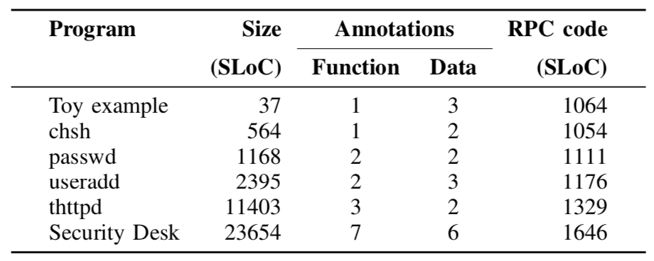
Results
C Program Partitioning with Fine-Grained Security Constraints …
MILCOM ’22

Slide 67
Results
Low annotation burden
C Program Partitioning with Fine-Grained Security Constraints …
MILCOM ’22

Slide 68
Results
Low annotation burden
C Program Partitioning with Fine-Grained Security Constraints …
MILCOM ’22

Slide 69
Results
Low annotation burden
C Program Partitioning with Fine-Grained Security Constraints …
MILCOM ’22

Slide 70
Results
Low annotation burden
Code generation scales
C Program Partitioning with Fine-Grained Security Constraints …
MILCOM ’22

Slide 71
Results
Low annotation burden
Code generation scales
C Program Partitioning with Fine-Grained Security Constraints …
MILCOM ’22

Slide 72
Results
Low annotation burden
Code generation scales
C Program Partitioning with Fine-Grained Security Constraints …
MILCOM ’22

Slide 73
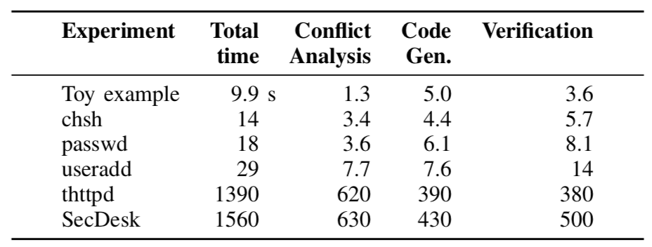
Results
Low annotation burden
Code generation scales
C Program Partitioning with Fine-Grained Security Constraints …
MILCOM ’22

Slide 74
Results
Low annotation burden
Code generation scales
Reasonable performance overhead: 10sec - 30min
C Program Partitioning with Fine-Grained Security Constraints …
MILCOM ’22

Slide 75
Results
Low annotation burden
Code generation scales
Reasonable performance overhead: 10sec - 30min
C Program Partitioning with Fine-Grained Security Constraints …
MILCOM ’22

Slide 76
Results
C Program Partitioning with Fine-Grained Security Constraints …
MILCOM ’22

Slide 77
Results
Verification caught subtle bugs
C Program Partitioning with Fine-Grained Security Constraints …
MILCOM ’22

Slide 78
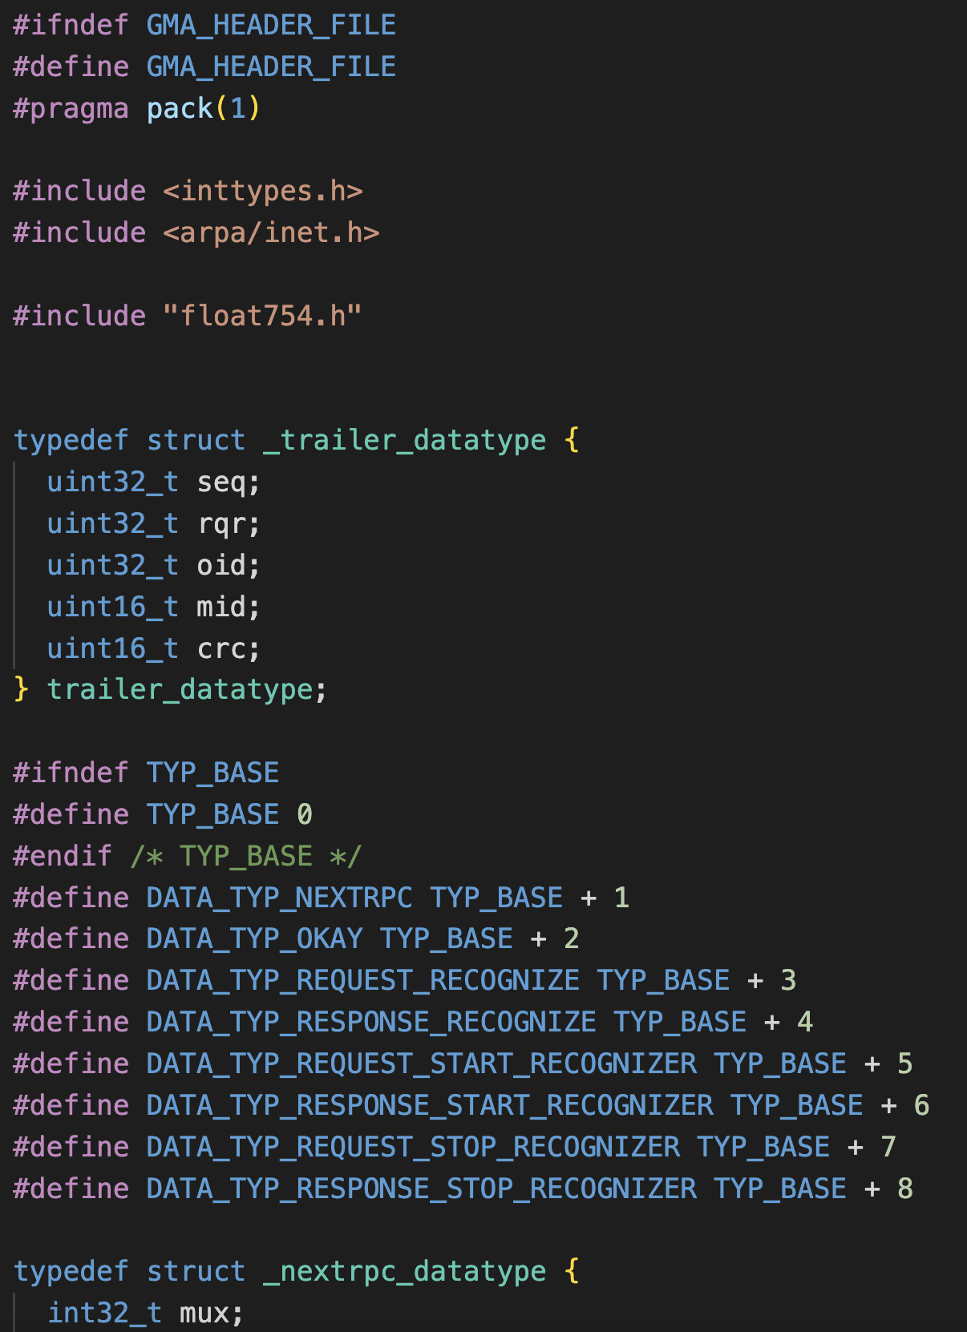
Results
Verification caught subtle bugs
C Program Partitioning with Fine-Grained Security Constraints …
MILCOM ’22

Slide 79
Results
Verification caught subtle bugs
Unclosed pack(1) in auto-generated header leaks to entire application
C Program Partitioning with Fine-Grained Security Constraints …
MILCOM ’22

Slide 80
Results
Verification caught subtle bugs
Unclosed pack(1) in auto-generated header leaks to entire application
C Program Partitioning with Fine-Grained Security Constraints …
MILCOM ’22

Slide 81
Results
Verification caught subtle bugs
Unclosed pack(1) in auto-generated header leaks to entire application
Causes massive performance hit / platform-dependent bugs
C Program Partitioning with Fine-Grained Security Constraints …
MILCOM ’22

Slide 82
Results
Verification caught subtle bugs
Unclosed pack(1) in auto-generated header leaks to entire application
Causes massive performance hit / platform-dependent bugs
Invisible without inspecting LLVM or all auto-generated files
C Program Partitioning with Fine-Grained Security Constraints …
MILCOM ’22

Slide 83
Conclusion
C Program Partitioning with Fine-Grained Security Constraints …
MILCOM ’22

Slide 84
Conclusion
An annotation-driven C program partitioner with fine-grained data sharing constraints and post-partition verification
C Program Partitioning with Fine-Grained Security Constraints …
MILCOM ’22

Slide 85
Conclusion
An annotation-driven C program partitioner with fine-grained data sharing constraints and post-partition verification
Useful for applications manipulating sensitive data with emergent sharing requirements
C Program Partitioning with Fine-Grained Security Constraints …
MILCOM ’22

Slide 86
Conclusion
An annotation-driven C program partitioner with fine-grained data sharing constraints and post-partition verification
Useful for applications manipulating sensitive data with emergent sharing requirements
Few annotations needed and acceptable overhead for mid-sized programs
C Program Partitioning with Fine-Grained Security Constraints …
MILCOM ’22

Slide 87
Conclusion
An annotation-driven C program partitioner with fine-grained data sharing constraints and post-partition verification
Useful for applications manipulating sensitive data with emergent sharing requirements
Few annotations needed and acceptable overhead for mid-sized programs
Public repository: https://github.com/gaps-closure
Manual: https://gaps-closure.github.io/cdoc.html
C Program Partitioning with Fine-Grained Security Constraints …
MILCOM ’22

Slide 88
Conclusion
An annotation-driven C program partitioner with fine-grained data sharing constraints and post-partition verification
Useful for applications manipulating sensitive data with emergent sharing requirements
Few annotations needed and acceptable overhead for mid-sized programs
Public repository: https://github.com/gaps-closure
Manual: https://gaps-closure.github.io/cdoc.html
Q/A
C Program Partitioning with Fine-Grained Security Constraints …
MILCOM ’22

