Slide 1


C Program Partitioning with Fine-Grained Security Constraints and Post-Partition Verification
Maxwell Levatich, Robert Brotzman, Benjamin Flin, Ta Chen,
Rajesh Krishnan, Michael Kaplan, and Stephen A. Edwards
MILCOM ‘22 Technical Program
Notes:
10s

Slide 2
Applications have emergent data-sharing constraints
National lab
Application utilizes sensitive data.
Application
High fidelity sensor data
Abstract analysis
C Program Partitioning with Fine-Grained Security Constraints …
MILCOM ’22
Notes:
50s
(e.g. with another organization), such that we have data sharing constraints. In a military context, a joining coalition partner. National lab has high fidelity sensors, but we only share low fidelity data (or "abstract analysis") with coalition partner (constraints are “fine-grained”). But still some high fidelity data to tactical unit.

Slide 3
Applications have emergent data-sharing constraints
National lab
Application utilizes sensitive data.
Partner organizations join.
Application
High fidelity sensor data
Abstract analysis
Tactical unit
Coalition partner
C Program Partitioning with Fine-Grained Security Constraints …
MILCOM ’22
Notes:
50s
(e.g. with another organization), such that we have data sharing constraints. In a military context, a joining coalition partner. National lab has high fidelity sensors, but we only share low fidelity data (or "abstract analysis") with coalition partner (constraints are “fine-grained”). But still some high fidelity data to tactical unit.

Slide 4
Applications have emergent data-sharing constraints
National lab
Application utilizes sensitive data.
Partner organizations join.
Partners may only access some/filtered data. Cannot share application as written!
Application
High fidelity sensor data
Abstract analysis
Tactical unit
Coalition partner
C Program Partitioning with Fine-Grained Security Constraints …
MILCOM ’22
Notes:
50s
(e.g. with another organization), such that we have data sharing constraints. In a military context, a joining coalition partner. National lab has high fidelity sensors, but we only share low fidelity data (or "abstract analysis") with coalition partner (constraints are “fine-grained”). But still some high fidelity data to tactical unit.

Slide 5
Applications have emergent data-sharing constraints
National lab
Application utilizes sensitive data.
Partner organizations join.
Partners may only access some/filtered data. Cannot share application as written!
Must quickly analyze and refactor application into a “partitioned” version.
Lab partition
High fidelity sensor data
Abstract analysis
Unit partition
Coalition partition
Tactical unit
Coalition partner
C Program Partitioning with Fine-Grained Security Constraints …
MILCOM ’22
Notes:
50s
(e.g. with another organization), such that we have data sharing constraints. In a military context, a joining coalition partner. National lab has high fidelity sensors, but we only share low fidelity data (or "abstract analysis") with coalition partner (constraints are “fine-grained”). But still some high fidelity data to tactical unit.

Slide 6
Applications have emergent data-sharing constraints
National lab
Application utilizes sensitive data.
Partner organizations join.
Partners may only access some/filtered data. Cannot share application as written!
Must quickly analyze and refactor application into a “partitioned” version.
Lab partition
High fidelity sensor data
Abstract analysis
Unit partition
Coalition partition
Sensor data
Analysis
Tactical unit
Coalition partner
C Program Partitioning with Fine-Grained Security Constraints …
MILCOM ’22
Notes:
50s
(e.g. with another organization), such that we have data sharing constraints. In a military context, a joining coalition partner. National lab has high fidelity sensors, but we only share low fidelity data (or "abstract analysis") with coalition partner (constraints are “fine-grained”). But still some high fidelity data to tactical unit.

Slide 7
Applications have emergent data-sharing constraints
National lab
Application utilizes sensitive data.
Partner organizations join.
Partners may only access some/filtered data. Cannot share application as written!
Must quickly analyze and refactor application into a “partitioned” version.
Lab partition
High fidelity sensor data
Abstract analysis
Unit partition
Coalition partition
Sensor data
Analysis
Tactical unit
Coalition partner
C Program Partitioning with Fine-Grained Security Constraints …
MILCOM ’22
Notes:
50s
(e.g. with another organization), such that we have data sharing constraints. In a military context, a joining coalition partner. National lab has high fidelity sensors, but we only share low fidelity data (or "abstract analysis") with coalition partner (constraints are “fine-grained”). But still some high fidelity data to tactical unit.

Slide 8
Challenges of partitioning applications
Application
High fidelity sensor data
Abstract analysis
C Program Partitioning with Fine-Grained Security Constraints …
MILCOM ’22
Notes:
- What are the hard challenges (shortfalls of state-of-the-art):
How to express policy in a straightforward way on top of application?
Can policy be sufficiently fine-grained?
How to automate partitioning?
How to make guarantees about correctness/compliance?

Slide 9
Challenges of partitioning applications
Application
Lab partition
High fidelity sensor data
High fidelity sensor data
Abstract analysis
Abstract analysis
Unit partition
Coalition partition
Sensor data
Analysis
C Program Partitioning with Fine-Grained Security Constraints …
MILCOM ’22
Notes:
- What are the hard challenges (shortfalls of state-of-the-art):
How to express policy in a straightforward way on top of application?
Can policy be sufficiently fine-grained?
How to automate partitioning?
How to make guarantees about correctness/compliance?

Slide 10
Challenges of partitioning applications
How to concisely express data-sharing constraints over original application?
Application
Lab partition
High fidelity sensor data
High fidelity sensor data
Abstract analysis
Abstract analysis
Unit partition
Coalition partition
Sensor data
Analysis
- Coalition may access data analysis
- Tactical unit may access sensor data
- Coalition may NOT access sensor data
C Program Partitioning with Fine-Grained Security Constraints …
MILCOM ’22
Notes:
- What are the hard challenges (shortfalls of state-of-the-art):
How to express policy in a straightforward way on top of application?
Can policy be sufficiently fine-grained?
How to automate partitioning?
How to make guarantees about correctness/compliance?

Slide 11
Challenges of partitioning applications
How to concisely express data-sharing constraints over original application?
...While still supporting fine-grained policies?
Application
Lab partition
High fidelity sensor data
High fidelity sensor data
Abstract analysis
Abstract analysis
Unit partition
Coalition partition
Sensor data
Analysis
- Coalition may access data analysis
- Tactical unit may access sensor data
- Coalition may NOT access sensor data
C Program Partitioning with Fine-Grained Security Constraints …
MILCOM ’22
Notes:
- What are the hard challenges (shortfalls of state-of-the-art):
How to express policy in a straightforward way on top of application?
Can policy be sufficiently fine-grained?
How to automate partitioning?
How to make guarantees about correctness/compliance?

Slide 12
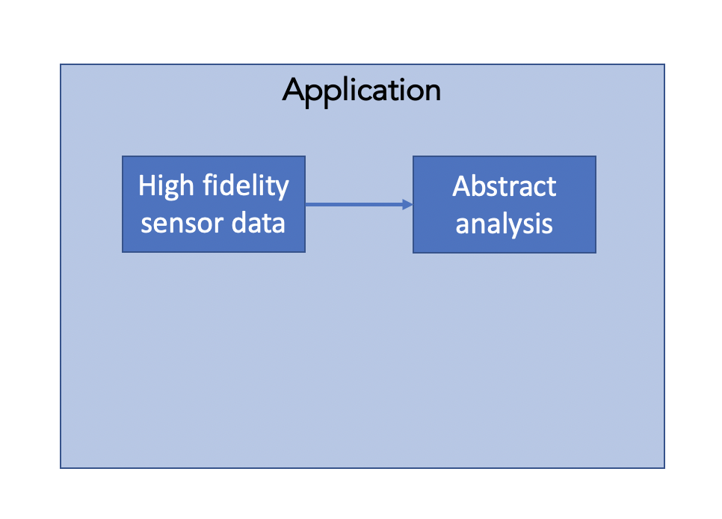
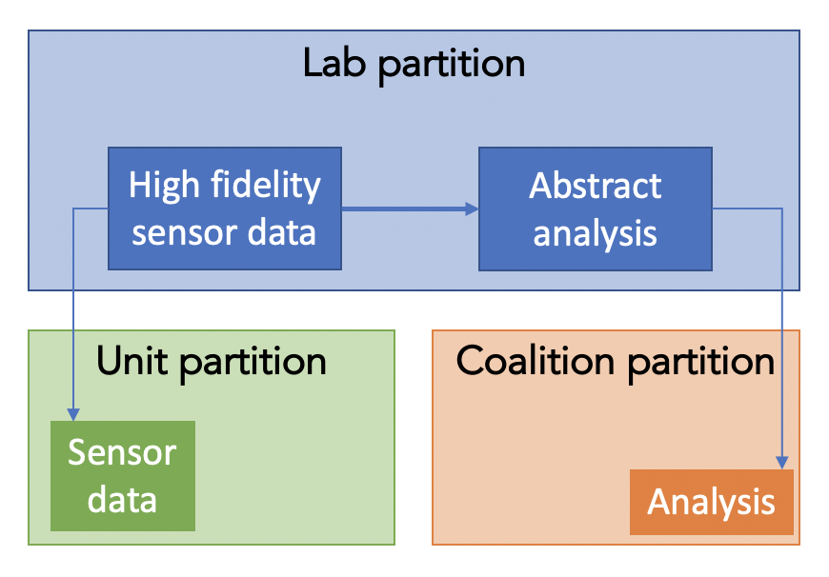
Challenges of partitioning applications
How to concisely express data-sharing constraints over original application?
...While still supporting fine-grained policies?
How to automate constraint analysis and partitioning?
- Coalition may access data analysis
- Tactical unit may access sensor data
- Coalition may NOT access sensor data
Automatic partitioner
C Program Partitioning with Fine-Grained Security Constraints …
MILCOM ’22
Notes:
- What are the hard challenges (shortfalls of state-of-the-art):
How to express policy in a straightforward way on top of application?
Can policy be sufficiently fine-grained?
How to automate partitioning?
How to make guarantees about correctness/compliance?

Slide 13
Challenges of partitioning applications
How to concisely express data-sharing constraints over original application?
...While still supporting fine-grained policies?
How to automate constraint analysis and partitioning?
...While making formal guarantees of partition correctness?
- Coalition may access data analysis
- Tactical unit may access sensor data
- Coalition may NOT access sensor data
Automatic partitioner
Proof of correctness
C Program Partitioning with Fine-Grained Security Constraints …
MILCOM ’22
Notes:
- What are the hard challenges (shortfalls of state-of-the-art):
How to express policy in a straightforward way on top of application?
Can policy be sufficiently fine-grained?
How to automate partitioning?
How to make guarantees about correctness/compliance?

Slide 14
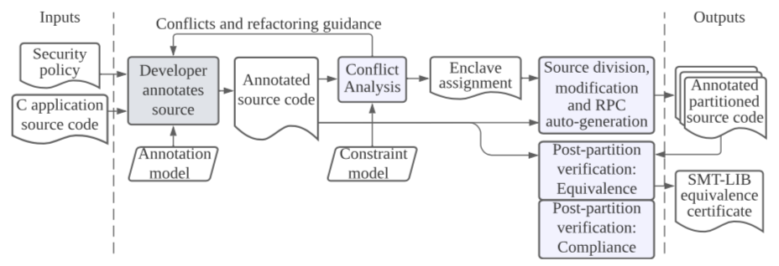
Our approach
Data-sharing constraints are Annotations in the original program
Solver-backed conflict analysis of the application determines a partition
Post-partition verification validates individual
C Program Partitioning with Fine-Grained Security Constraints …
MILCOM ’22
Notes:
50s

Slide 15
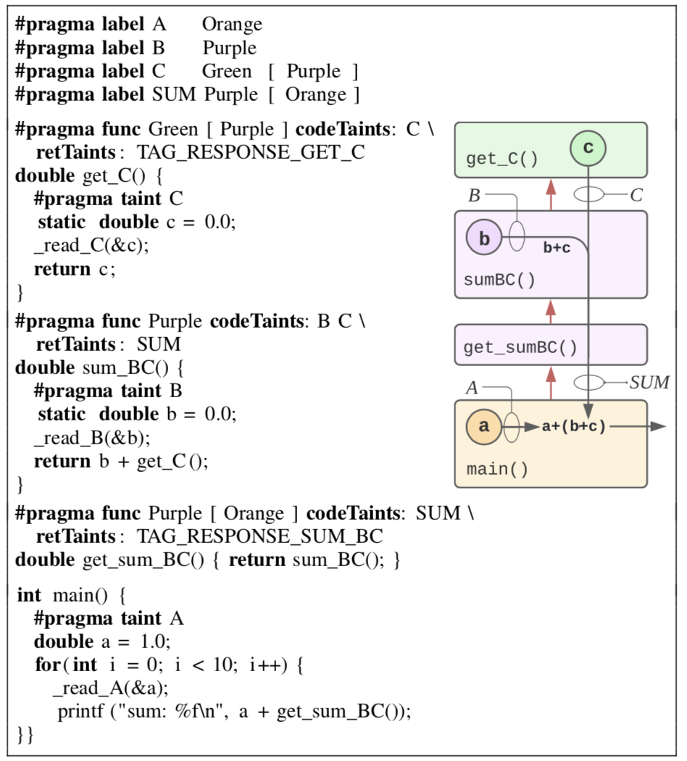
How to express policy: CLE model/annotations
Model diagram, example annotations
Example annotated program (e.g. from the motivating example of the paper)
C Program Partitioning with Fine-Grained Security Constraints …
MILCOM ’22
Notes:
50s

Slide 16
Conflict analysis and feedback
High-level view of constraint model
If success, partition, if fail, give feedback.
Differences from state of the art: MIPS solver with constraint model for speed/comprehension
C Program Partitioning with Fine-Grained Security Constraints …
MILCOM ’22
Notes:
50s

Slide 17
Code generation
What is automatically generated? (DFDL)
RPC stub code
Touch on benefits of automated code gen, removes tedium
C Program Partitioning with Fine-Grained Security Constraints …
MILCOM ’22
Notes:
50s

Slide 18
Verification:
What are we verifying? Equivalence and compliance
What is our approach (translation validation vs traditional correctness proof)
Benefits and alternatives
Diagram of approach
Maybe mention future work here.
C Program Partitioning with Fine-Grained Security Constraints …
MILCOM ’22
Notes:
50s

Slide 19
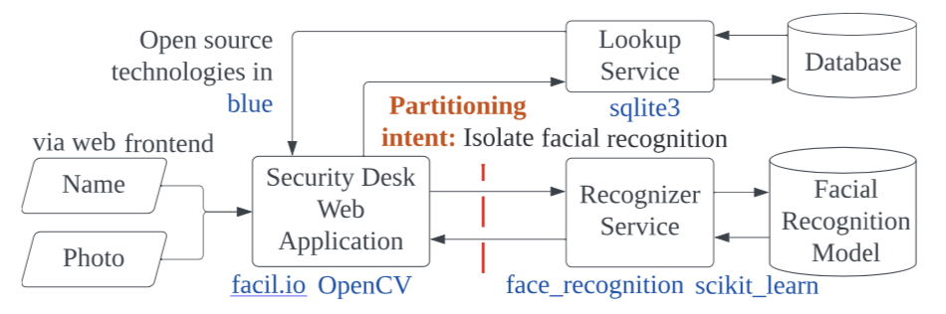
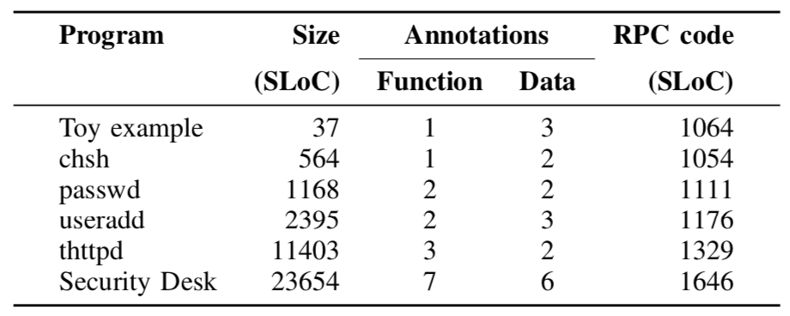
Results
Mention SecDesk, thttpd explicitly.
Point to table for low number of annotations and amt of generated code.
Mention performance overhead (no more than half an hour).
Bugs caught
C Program Partitioning with Fine-Grained Security Constraints …
MILCOM ’22
Notes:
ParTV caught interesting bugs in CAPO. The most substantial was an un-closed #pragma pack(1) in auto-generated RPC header files. At best this incurs a performance hit, but it could have caused undefined behavior on some architectures, and yet would go undetected without either carefully examining auto-generated header files or the compiled LLVM IR.
Other problems we found include an incorrect conversion from zero-argument functions to variadic functions and inconsistent string outputs from applications that printed __FILE__.
Mention our future work – RPC equivalence verification!

Slide 20
Conclusion
An annotation-driven C program partitioner supporting fine-grained data sharing constraints and a post-partition verification pass.
Useful for applications manipulating sensitive data with emergent sharing requirements and constraints.
Public repository: https://github.com/gaps-closure
Manual: https://gaps-closure.github.io/cdoc.html
Q/A
C Program Partitioning with Fine-Grained Security Constraints …
MILCOM ’22
Notes:
50s

