Slide 1

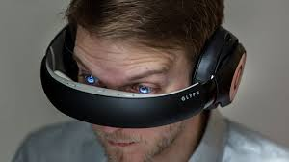
Avegant Headset
By Eddie Garcia
▶ 1:00

Slide 2
How does it work?
Avegant Retinal Imaging Technology is a viewing experience for wearable displays, recreating natural sight to deliver incredibly crisp, clear images. A low-power light-source beams HD imagery through a set of optics onto millions of microscopic mirrors, which shape and focus the picture, projecting it directly to the user.

Slide 3
Strengths
Private
Turns your phone screen into a portable theater
Perfect for travel

Slide 4
Weaknesses/issues
4 hour battery life
Price ($399.99)
Minor blue on the far corners
Heavy

Slide 5
Motion-sickness
There is no motion-sickness because of the way the Avegant’s Glyph is designed you can look down and see your hands or up and see the sky. This helps prevent motion sickness.

Slide 6
Conclusion
This is a nice product to try out once the price goes down over the years.
I wouldn’t recommend buying them
It is only good for watching movies

