Slide 1
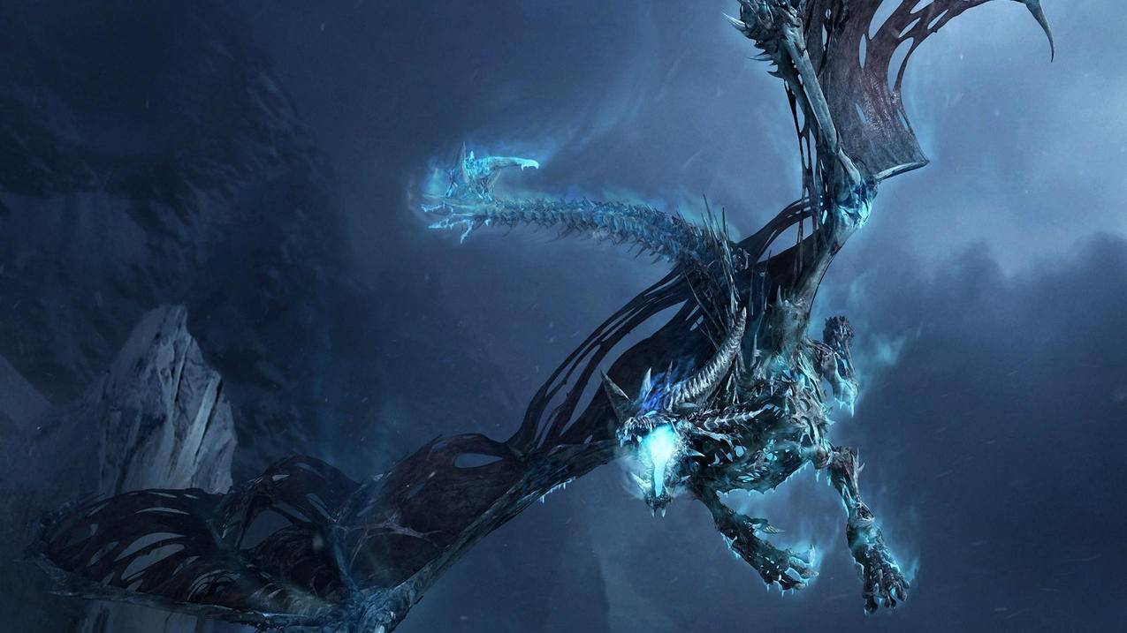
Simulation of competitive game player’s MMR distribution using Monte Carlo Simulation.
Players would battle with randomly assigned players who have similar MMR, using a simple game that would be affected by the players’ skill level and luck.
IS590PR Xiaojun You(github: garagekit)

Slide 2
1. Introduction
What’s MMR?
MMR means matchmaking rating, which is the hidden skill rating to determine the skill level of each player. If a player win a game, his MMR points would increase. If he lose a game, his MMR points would decrease. When a player plays more games, the more the MMR points reflects the player’s skill rating.

Slide 3
1. Introduction
How to simulate?
Using a simple game that would be affected by the players’ skill level and luck to simulate the matches among players. Players would battle with randomly assigned players who have similar MMR. After the matches, I would be able to get the updated MMR values of each player. Then I would build a scatter plot to have a look at the distribution of game player’s MMR.

Slide 4
1. Introduction
What’s the game?
For player A and player B who are at the similar level of MMR, the scales are engraved with natural numbers 1 to 10000, which determines the position of victory and defeat. So the pivot of destiny is initially at the position of 5000.5. A and B stand on both ends of the left and right cantilevers ([1, 5000] and [5001, 10000]). The system randomly generates a natural number belonging to [1, 10000]. If it falls on the left side, A wins; if it falls on the right side, B wins.

Slide 5
1. Introduction
What’s the game?
The strong players with high MMR should have a higher winning rate against the weak players with low MMR, push the fulcrum of fate to the weaker players with low MMR, increase their own cantilevers, and shorten the cantilevers of their opponents to reduce the probability of winning for the weak.

Slide 6
2. Variables
Variables:
1. the initial value of MMR
2. the compensation of winning probability for players with high MMR value in the game
3. the maximum MMR difference between two players in a randomly matched game(If the MMRs of the two players differ more than the maximum gap, the battle would not proceed)
4. the player's MMR change value after the game
5. the amount of games

Slide 7
3. Hypothesis
Hypothesis:
1. the distribution of MMR would be more concentrated when the maximum MMR difference between two players in a randomly matched game decrease.
2. the distribution of MMR would be more concentrated when the initial value of MMR decrease.

Slide 8
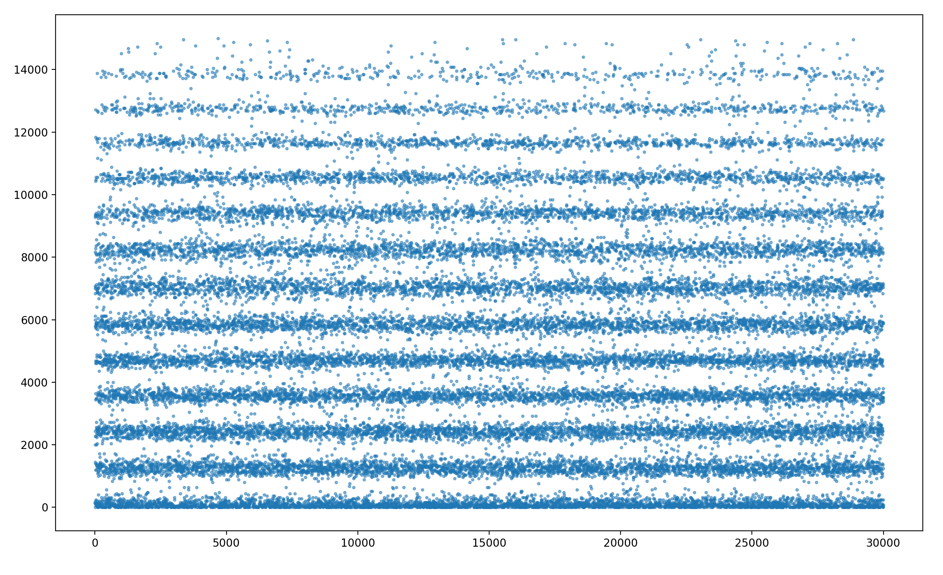
3. Result
I am still testing various parameters to prove my hypothesis. The following scatterplot is the result of 10,000 rounds of battle against 30,000 players whose initial MMR are 1,000.

Slide 9
Thank You!

