Slide 1
History of digital watches
Garasev Nikita
ui7-22b

Slide 2
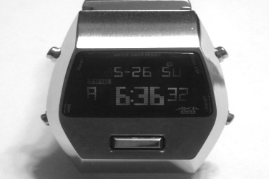
The first mention of digital or electronic watches

Slide 3
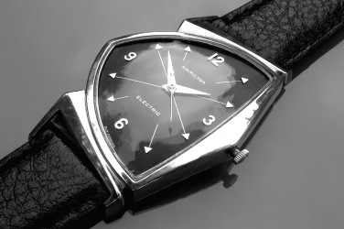
Although Hamilton Electric 500

Slide 4
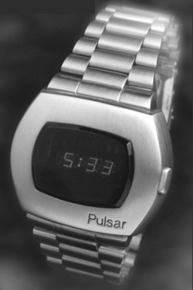
Seiko Pulsar.

Slide 5
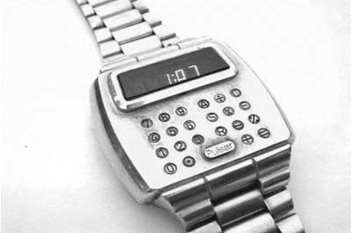
Pulsar Module 1

Slide 6
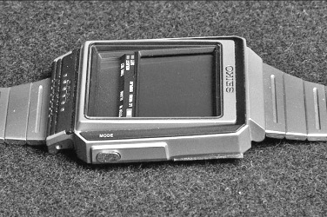
Casio wv-59de

Slide 7
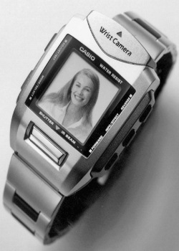
Casio wqv-1

