Slide 1

AeroPulse-NG
Offline air surveillance for Nigerian operations
National Drone & Aerospace Innovation Expo 2026
National Innovation Pitch Challenge
Primary category: Flight Planning & Air Traffic Management
Air-gapped • Offline-first • SI metric presentation
AeroPulse-NG | NDAIE 2026 | Title

Slide 2
A surveillance gap remains below and between radar sites
Cost
Conventional primary and secondary radar installations require major capital and specialist maintenance.
Coverage
Low-altitude corridors, secondary aerodromes and terrain-shadowed sectors remain difficult to monitor.
Resilience
Loss of connectivity or a radar head removes the traffic picture during periods of elevated risk.
Cooperation
Transponder-silent or unidentified aircraft are difficult to track with dependent surveillance alone.
AeroPulse-NG | NDAIE 2026 | The Problem

Slide 3
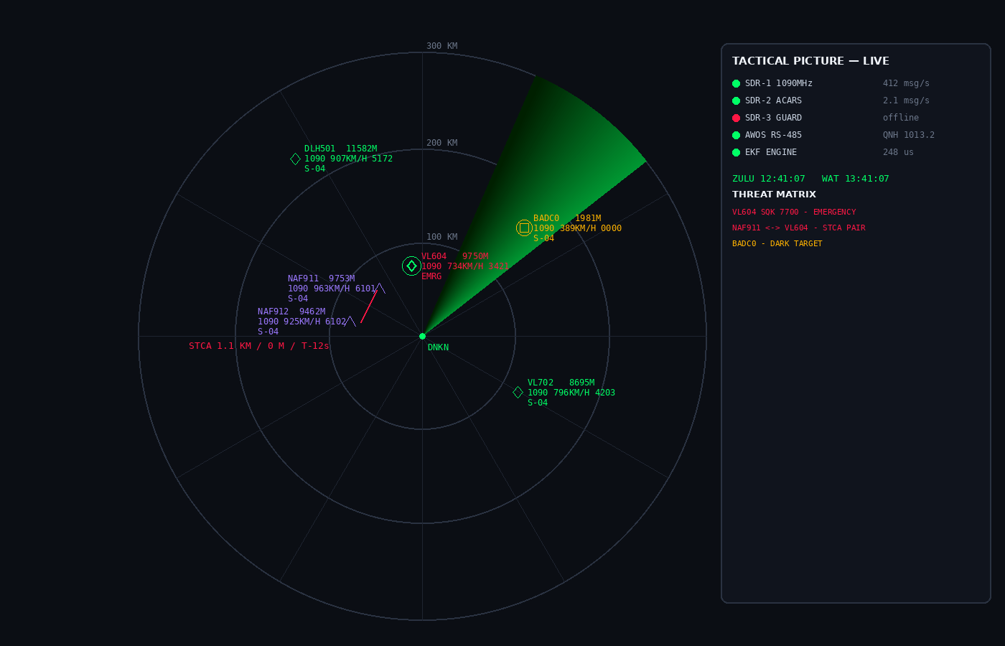
A local surveillance workstation from affordable receiver hardware
AeroPulse-NG combines:
• 1090 MHz ADS-B and Mode S decoding
• Filtered tracks with dead reckoning
• Conflict alerting within a 120-second lookahead
• Offline weather fusion for local conditions
• A dual-display operator workspace
• No cloud service required
AeroPulse-NG | NDAIE 2026 | The Solution

Slide 4
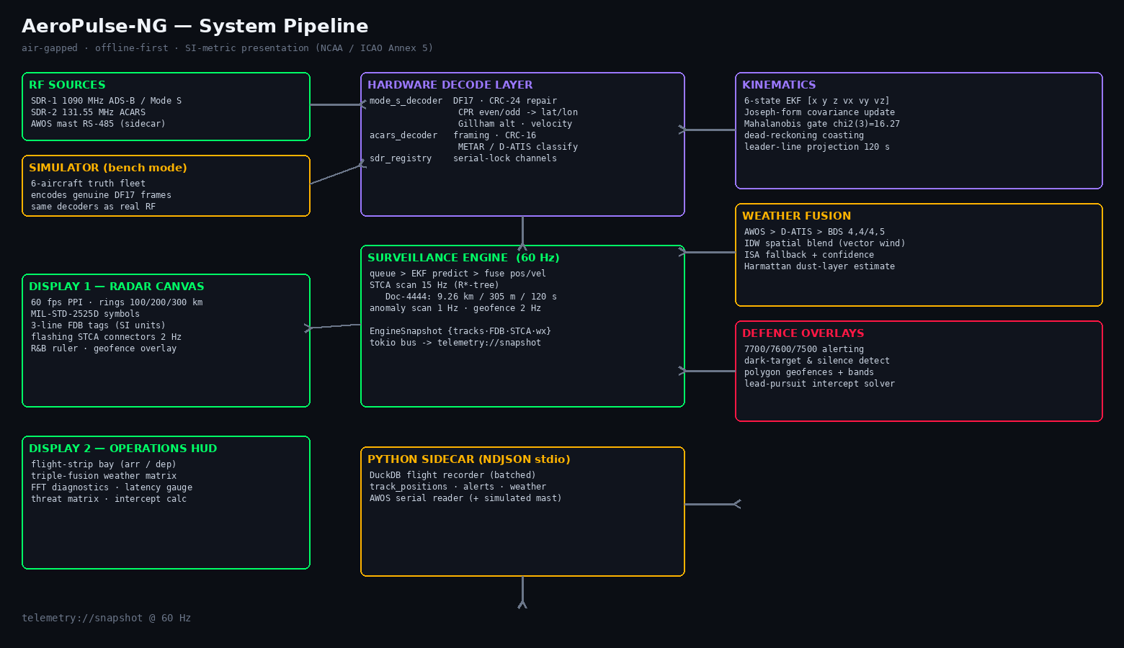
One processing chain from signal to decision support
AeroPulse-NG | NDAIE 2026 | How It Works

Slide 5
Engineering depth is measurable, not decorative
Signal
Track
Safety
Weather
• DF17 CRC validation and repair
• 6-state Kalman filter (CV)
• 9.26 km / 305 m separation view
• AWOS + ACARS + BDS inputs
• CPR even/odd position resolution
• R*-tree spatial indexing
• 120-second lookahead
• Vector wind interpolation
• ACARS message integrity
• Dead-reckoning during dropouts
• Emergency and silence alerts
• Standard-atmosphere fallback
Prototype verification: 90 Rust tests • 14 Python tests • strict TypeScript build
AeroPulse-NG | NDAIE 2026 | Engineering

Slide 6
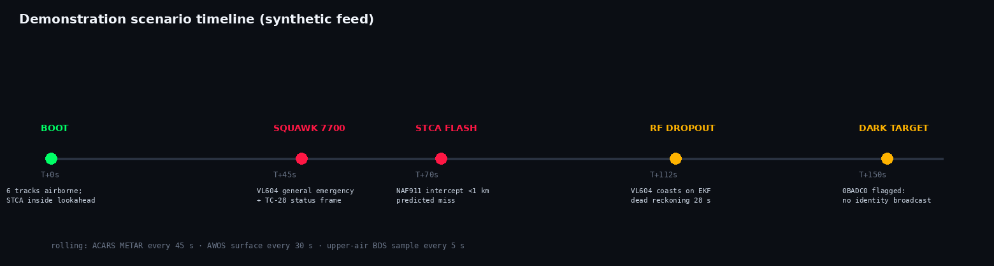
A scenario the judges can observe
The simulator exercises the same event path used by the future receiver integration.
AeroPulse-NG | NDAIE 2026 | Demonstration

Slide 7
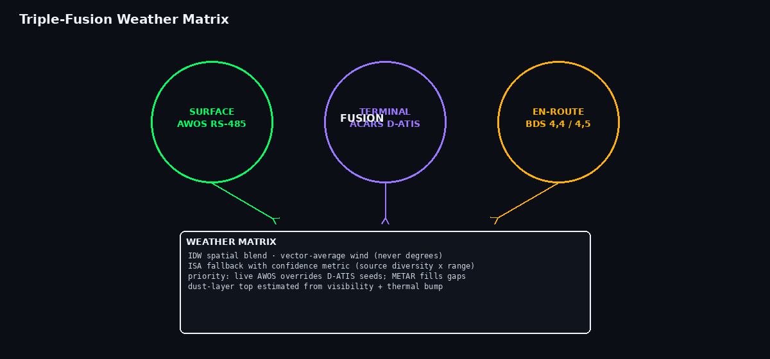
Three local sources, one weather picture
Surface observations take priority; sparse upper-air observations fall back to the standard atmosphere with an explicit confidence value.
AeroPulse-NG | NDAIE 2026 | Weather

Slide 8
Standards and presentation policy
Units
NCAA / ICAO Annex 5
km · m · km/h · hPa
Surveillance
DO-260B
Mode S / ADS-B / CPR
Separation
ICAO Doc 4444
9.26 km · 305 m · 120 s
Display
HF-STD-010A
Readable, consistent data blocks
Symbology
MIL-STD-2525D
Consistent civil/military frames
Integrity
NDAIE Rulebook
AI assistance disclosed
AeroPulse-NG | NDAIE 2026 | Standards

Slide 9
A practical path to local capability
>99%
24/7
SI
Local
potential capital reduction per station
local decision support without cloud dependence
metric-first display for Nigerian operators
maintainable engineering and training platform
The prototype is designed for progressive validation: simulator → bench receivers → controlled field trial.
AeroPulse-NG | NDAIE 2026 | Impact

Slide 10
Ready for the next validation stage
1
Purchase the bench receiver kit
2
Validate ADS-B, ACARS and receive-only VHF paths
3
Complete controlled hardware and safety assessment before any transmission
AeroPulse-NG | Nigerian airspace, locally supported
AeroPulse-NG | NDAIE 2026 | Next Steps

