Slide 1
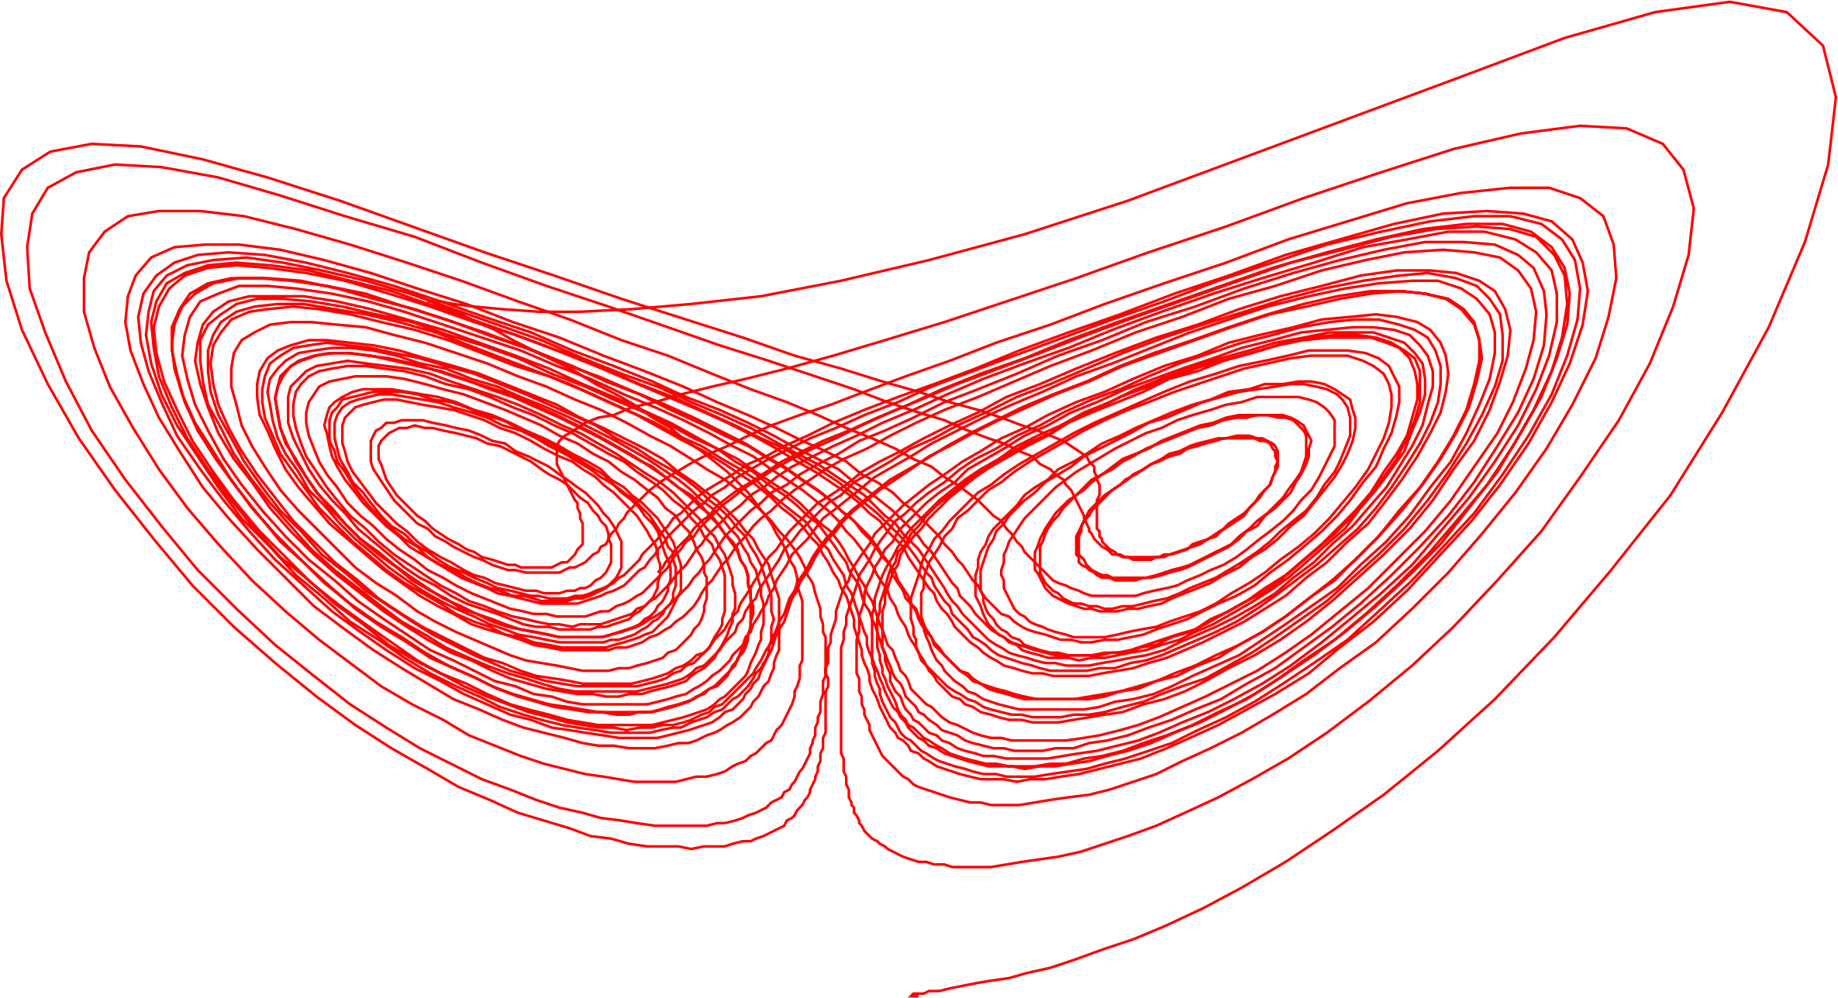

Bridging Deterministic Chaos and Uncertainty Quantification: Polynomial Chaos Approaches to the Largest Lyapunov Exponent A. García-Gutiérreza*, A. Delgado, F. Parra, R. Echeverría * Aerospace Engineering Department, I4 Institute, Universidad de León, Spain agarcg@unileon.es
Photo: AGG

Slide 2
Motivation
Stochastic ≠ Chaotic
▸ Stochastic systems are driven by external randomness — noise is injected from outside the dynamics.
▸ Chaotic systems are purely deterministic — apparent randomness emerges intrinsically from sensitivity to initial conditions.
▸ Their mathematical tools have historically evolved in separate communities: UQ/PCE for stochastic, Lyapunov exponents & attractor theory for chaos.
▸ Yet both share exponential divergence of nearby states, statistical uncertainty in long-term predictions, and sensitivity to perturbations.
An open cross-disciplinary question
▸ Can PCE tools — designed for stochastic propagation — be reused to characterize chaotic instability?
▸ This work explores one possible bridge: variance growth as a proxy for Lyapunov divergence.
▸ Potential advantages include black-box solvers, ensemble reuse, and natural UQ integration — concepts borrowed from stochastic analysis.
▸ This is an initial idea, not a finished framework — it is intended to open new research lines at the intersection of chaos theory and uncertainty quantification.

Slide 3

Key Ideas
$$λ^{1}=\lim_{t→∞}\left(\frac{1}{t}\right)\ln\left(\frac{\left\|δ\left(t\right)\right\|}{\left\|δ^{0}\right\|} \right)$$
The largest Lyapunov exponent λ₁ quantifies the exponential rate of separation of infinitesimally close trajectories.
Limitations of Classical Methods
Traditional trajectory-based methods (Wolf, Benettin, Rosenstein):
Require tracking nearby trajectories
Sensitive to:
Noise
Embedding parameters
Long-time numerical errors
Computationally expensive for high-dimensional systems
Provide limited statistical information
Core Idea of This Work
Instead of tracking individual trajectories:
Propagate an entire probability distribution of initial conditions
Compute the LLE from the exponential growth of ensemble variance
García-Gutiérrez, A., Rubio, C., Domínguez, D., & López, D. (2026). Chaos meets stochasticity: A variance-based method for Lyapunov exponent estimation. Chaos: An Interdisciplinary Journal of Nonlinear Science, 36(1).

Slide 4





The traditional approach: Wolf algorithm
Algorithm sketch
1.
Integrate reference $x(t)$ and perturbed $x(t)+δ(t).$
Wolf et al. (1985) introduced the standard recipe still used today: evolve a reference trajectory together with a perturbed companion and accumulate the logarithmic separation.
Periodic renormalization of the perturbation prevents numerical overflow once trajectories diverge by orders of magnitude.
The result is a running mean that converges to λ₁ as the integration time grows — but each run yields a single realization that depends on the chosen perturbation and reference orbit.
2.
After interval $τ$, measure separation $‖δ(τ)‖$.
3.
Accumulate $ln⁡(‖δ(τ)‖ / ‖δ₀‖)$ into a running sum.
4.
Renormalize $δ → δ₀·δ/‖δ‖$ and repeat.
5.
$$λ^{1}≈ \left(\frac{1}{Nτ}\right)Σ\ln\left(\frac{\left\|δᵢ\right\|}{\left\|δ^{0}\right\|}\right).$$
4 / 15

Slide 5
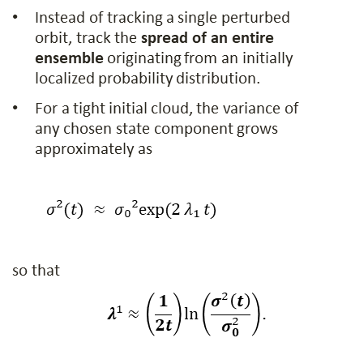
A statistical alternative: variance growth
Why this is appealing
Chaotic and stochastic systems share fundamental connections.
Variance growth encodes the same instability information as trajectory divergence.
Chaos can therefore be analyzed through:
Probability distributions
Ensemble statistics
Uncertainty propagation
Natural fit for UQ pipelines.
Reuses ensembles already produced for uncertainty quantification.
No tangent system required (in the nonintrusive version).
The solver is called as-is — useful for legacy and industrial codes.
Instead of tracking a single perturbed orbit, track the spread of an entire ensemble originating from an initially localized probability distribution.
For a tight initial cloud, the variance of any chosen state component grows approximately as
$σ²(t) ≈ σ₀²exp⁡(2 λ₁ t)$
so that
$$λ^{1}≈\left(\frac{1}{2t}\right)\ln\left(\frac{σ^{2}\left(t\right)}{σ_{0}^{2}}\right).$$
5 / 15

Slide 6
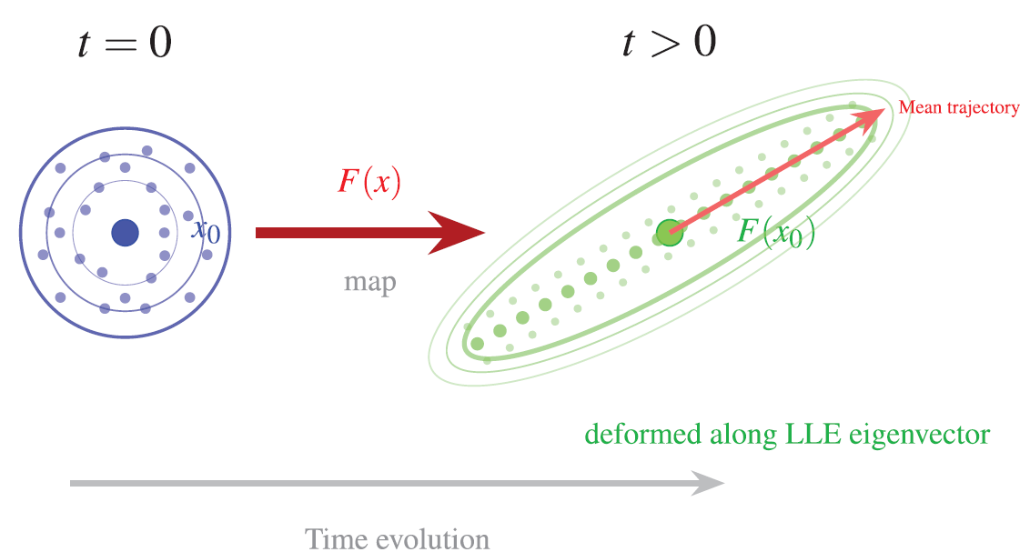
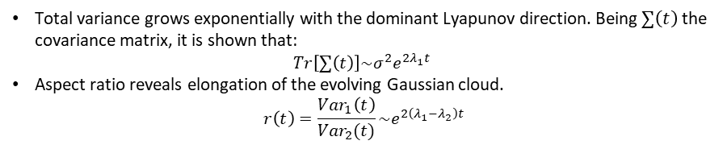
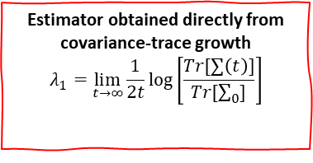
Variance-based Lyapunov exponent estimation
Total variance grows exponentially with the dominant Lyapunov direction. Being $∑\left(t\right)$ the covariance matrix, it is shown that:
$$Tr\left[∑\left(t\right)\right]\sim σ^{2}e^{\left.2λ_{1}t\right.}$$
Aspect ratio reveals elongation of the evolving Gaussian cloud.
$$r\left(t\right)=\frac{Var_{1}\left(t\right)}{Var_{2}(t)}\sim e^{2\left(λ_{1}−λ_{2}\right)t}$$
Estimator obtained directly from covariance-trace growth
$$λ_{1}=\lim_{t→∞}{\frac{1}{2t}\log\left[\frac{Tr[∑\left(t\right)]}{Tr[\sum_{0}{]}}\right]}$$
Geometric evolution of a Gaussian distribution under deterministic dynamics.

Slide 7
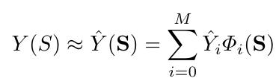

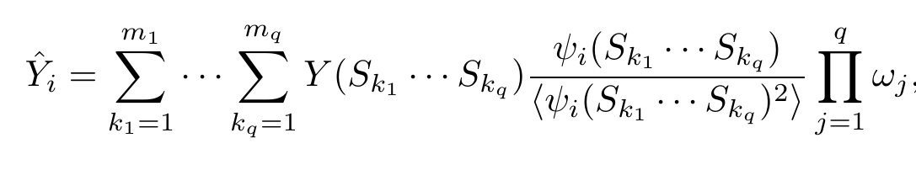
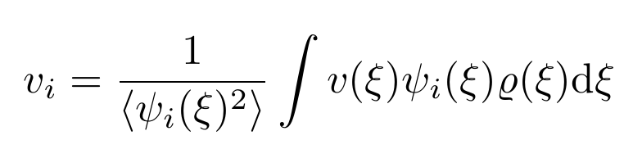
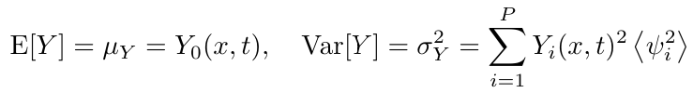

Nonintrusive polynomial chaos method
Solution
Source Terms
Differential operator
Problem Formulation
Selection of the chaotic Polynomial Basis
Computation of the expansion coefficients
Statistical moments
L$\left(x,t,S;Y\left(x,t,S\right))=G(x,t,S\right)$
Stochastic variables
Probability density function

Slide 8
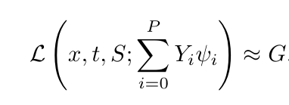
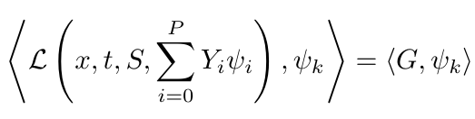

Intrusive polynomial chaos method
Solution
Source Terms
Differential operator
Problem Formulation
Selection of the chaotic Polynomial Basis
Computation of the expansion coefficients
Statistical moments
L$\left(x,t,S;Y\left(x,t,S\right))=G(x,t,S\right)$
Stochastic variables

Slide 9
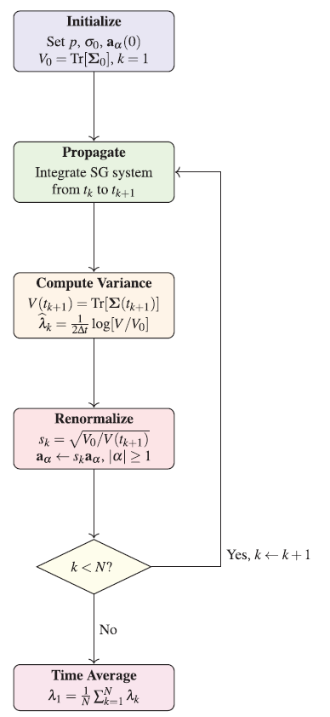
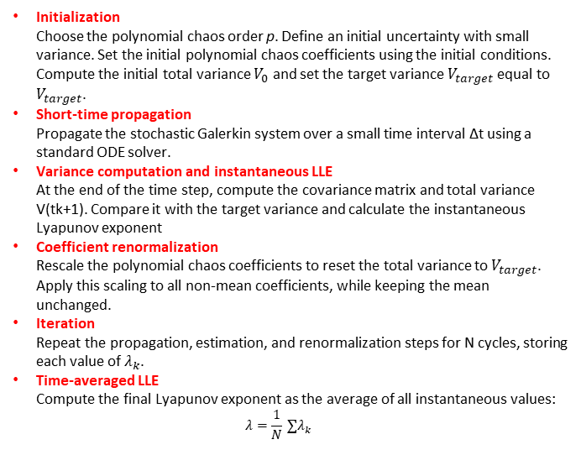
Initialization Choose the polynomial chaos order p. Define an initial uncertainty with small variance. Set the initial polynomial chaos coefficients using the initial conditions. Compute the initial total variance $V_{0}$ and set the target variance $V_{target}$ equal to $V_{target}$.
Short-time propagation Propagate the stochastic Galerkin system over a small time interval Δt using a standard ODE solver.
Variance computation and instantaneous LLE At the end of the time step, compute the covariance matrix and total variance V(tk+1). Compare it with the target variance and calculate the instantaneous Lyapunov exponent
Coefficient renormalization Rescale the polynomial chaos coefficients to reset the total variance to $V_{target}$. Apply this scaling to all non-mean coefficients, while keeping the mean unchanged.
Iteration Repeat the propagation, estimation, and renormalization steps for N cycles, storing each value of $λ_{k}$.
Time-averaged LLE Compute the final Lyapunov exponent as the average of all instantaneous values: $λ=\frac{1}{N} ∑λ_{k}$

Slide 10
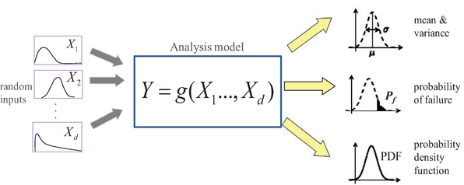
Intrusive Polynomial Chaos (IPC)
Advantages:
High Accuracy: directly reformulates model equations.
Disadvantages:
Complex Implementation
Intrusive: modifies original model equations.
Computationally Expensive
Advantages and disadvantages
Non-Intrusive Polynomial Chaos (NIPC)
Advantages:
Simple Implementation: No need to modify original model.
Flexible: applicable to any deterministic model.
Computationally Efficient
Disadvantages:
Potentially Lower Accuracy
Sampling Dependent
Yang, S., Xiong, F., & Wang, F. (2017)
10.5772/intechopen.68484

Slide 11
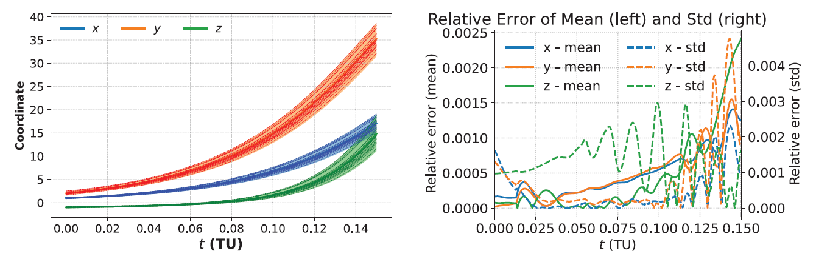
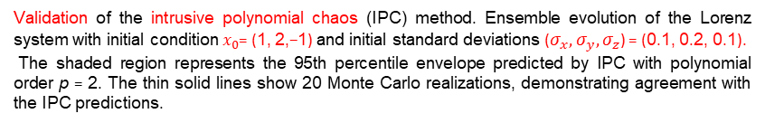
Validation
Validation of the intrusive polynomial chaos (IPC) method. Ensemble evolution of the Lorenz system with initial condition $x_{0}$= (1, 2,−1) and initial standard deviations ($σ_{x}, σ_{y},σ_{z}$) = (0.1, 0.2, 0.1).
The shaded region represents the 95th percentile envelope predicted by IPC with polynomial order p = 2. The thin solid lines show 20 Monte Carlo realizations, demonstrating agreement with the IPC predictions.

Slide 12
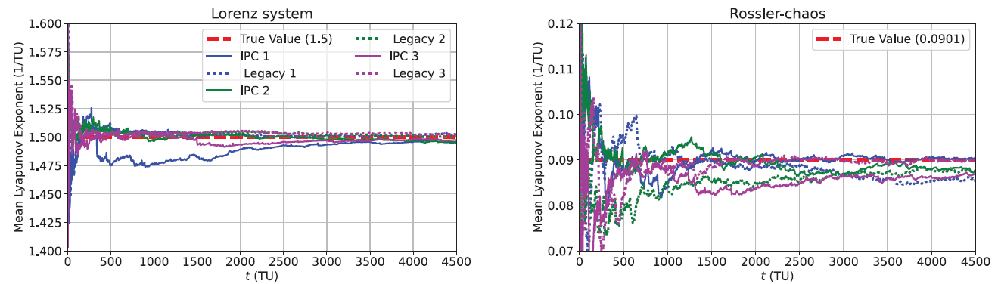
Example using Intrusive Polynomial Chaos
Comparison of Lyapunov exponent estimation methods.
Left panel: Lorenz system with true largest Lyapunov exponent 1 = 1.5. The proposed IPC method with polynomial order p = 2 (solid lines) is compared against the legacy Wolf two-particle method (dashed lines) for three different initial conditions.
Right panel: Rössler system with true 1 = 0.0901

Slide 13
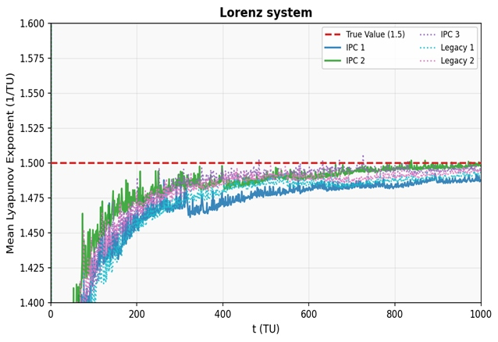
Non Intrusive Polynomial Chaos & Wolf convergence on the Lorenz system
Running-mean LLE · True λ₁ = 1.5 · σ=16, r=45.92, b=4 · σ₀=0.01, N=50, Δt=0.05 TU/segment · 20 000 segments
01 Slow transient — t < 200 TU
All curves start ~0.40 below true value. Ensemble not yet in asymptotic regime; running mean biased low initially.
02 Monotone convergence
Running mean increases steadily and approaches λ₁ = 1.5 after ~600 TU. Accumulated time is the key quantity.
03 Seed robustness
3 NIPC seeds (IPC 1–3) collapse to the same limit — estimator is consistent across initializations.
04 NIPC ≈ Wolf (1985)
Legacy Wolf curves follow same path. Both methods asymptotically equivalent; NIPC avoids tangent-system integration.
IPC 1/2/3 = NIPC p=2, seeds 12345/1/100 · Legacy 1/2 = Wolf (1985), seeds 99/777
18 / 18

Slide 14
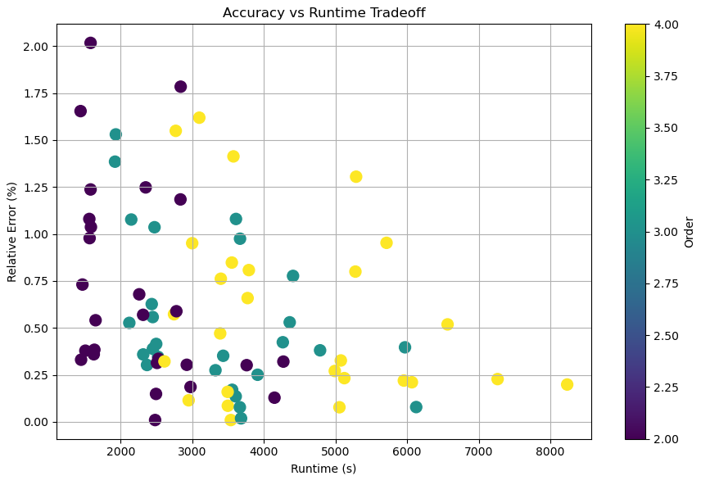
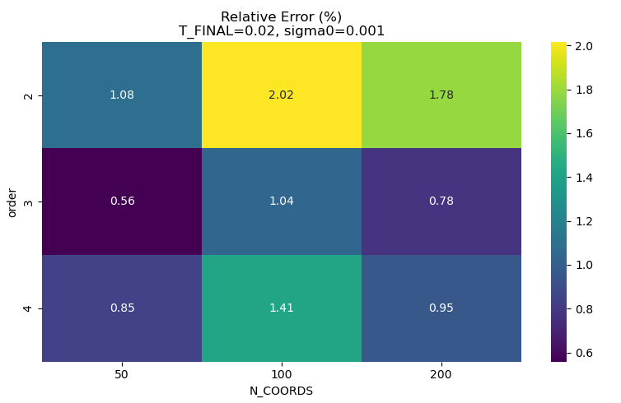
The parameter sweep varies four NIPC configuration parameters (plus measures two outputs):
Segment length TFINAL : {0.02, 0.05, 0.10} TU.
Initial ensemble spread σ0 : {0.001, 0.01, 0.05}.
Polynomial chaos order: {2, 3, 4}.
Time grid per segment
N COORDS : {50, 100, 200}.
For each combination, it keeps NSAMPLES = 50 and ITERATIONS = 20000 fixed
Best error < 0.3% at low runtime. High-order (p=3–4, yellow/teal) points cluster near the Pareto front at 1500–3500 s
Purple (p=2) spans 0.25–2.0% error; cheapest but high variance across seeds/N_COORDS
At T_FINAL=0.02, σ₀=0.001 → order 3 gives 0.56% (min), vs 1.08% (p=2) and 0.85% (p=4)
Columns 50→100→200 in the heatmap show no monotone improvement — T_FINAL and order dominate

Slide 15
CONCLUSIONS
What the experiment tells us
01 Variance growth tracks chaos
σ²(t) ≈ σ₀² exp(2λ₁t) for a tight initial ensemble. Tr[Σ(t)] grows as σ²e^(2λ₁t); Gaussian cloud deforms along LLE eigenvector.
02 LLE estimator without tangent system
λ₁ = lim(t→∞) 1/(2t) · log[Tr[Σ(t)] / Tr[Σ₀]]. No adjoint, no recompilation — solver called as-is.
03 IPC: high accuracy, intrusive
Directly reformulates model equations (Stochastic Galerkin). High accuracy; complex implementation; computationally expensive.
04 NIPC: flexible, sampling-dependent
No model modification; applicable to any deterministic code. Computationally efficient, but potentially lower accuracy.
05 IPC validated on Lorenz (λ₁=1.5)
IPC p=2 converges to true LLE = 1.5; Also validated on Rössler (λ₁=0.0901).
06 NIPC also converges on Lorenz
Running-mean LLE converges to 1.5 (Lorenz) with all IC sets. Convergence slower than IPC; fluctuations large in early time.
→ Open lines: Extend to high-dimensional / CFD systems · Higher-order PCE for non-Gaussian chaos · Hybrid PCE–Wolf estimators · Uncertainty quantification reuse in chaotic solvers

Slide 16
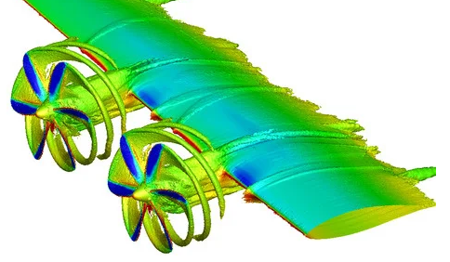
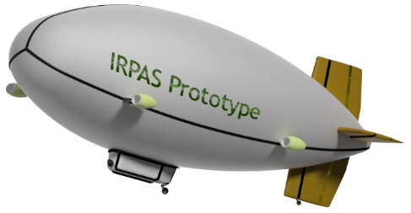


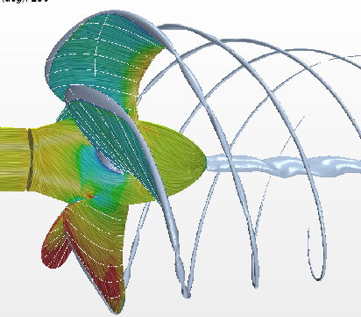









Low Reynolds Propellers
National R&D Program
iRPAS – Lighter-than-air vehicle technologies
Fundación John Goelet Entrepreneurial Enterprises
NextProp II
Space Debris Propagation
AEROSPACE TECHNOLOGY RESEARCH GROUP
Active projects 25/26
Satellite Constellations
HAPS thermal modelling

Slide 17



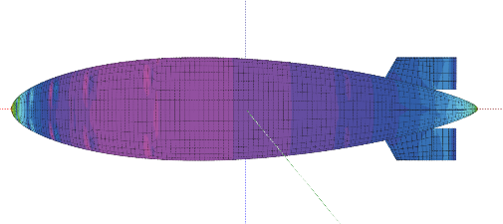
Thank you for your attention
Feel free to reach out for further discussion or follow-up questions.
a.gutierrez@unileon.es
unileon.es
Photo: AGG

