Slide 1
DBOwlizer

Slide 2
Challenges
The increasing amount of scientific data produced and managed using heterogeneous formats and schemas has created the need to automate the access, search, and retrieval of this data.
Semantic Web technologies provide a promising solution for this challenge through the creation of ontologies that further describe scientific data.
Cardoza/Villanueva-Rosales

Slide 3
Introduction
DBOWLizer: A novel framework for the automatic design of
expressive ontologies from (normalized) relational databases.
Represent mappings between relational databases and OWL
Automatically generate such mappings using rule‐based heuristics.
Execute these mappings to generate a populated OWL ontology.

Slide 4
Comparing to other approaches
Representing mappings using standardized Semantic Web languages.
Facilitating the modification and reuse of mapping heuristics.
Enabling the comparison of heterogeneous heuristics that map relational databases to ontologies.
Automatically generating decidable database‐to‐ontology mappings for more expressive ontologies.
Separating domain knowledge from model knowledge in the output ontology.
Mapping semantics from database views, including a pattern to characterize aggregation functions.

Slide 5
Implementation
Maven – Project Management and Build Tool
SchemaCrawler - Free database schema discovery and comprehension tool.
JDBC Connectors
OWL API
RESTful WebServices
Web Based FrontEnd

Slide 6
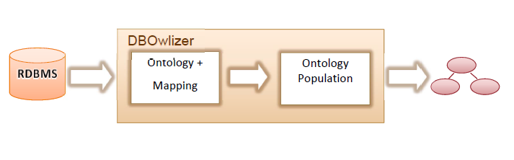
General Approach
Villanueva-Rosales, Building a semantic-based CI for scientific research, s22

Slide 7
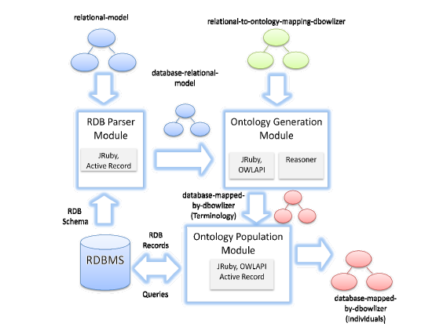
Implementation

Slide 8
Project Modules
Database Parser Module
Database crawlers and targeted parsing
Ontology Generation Module
Set of rules based on established heuristics.
R2ML Mapping Module

Slide 9
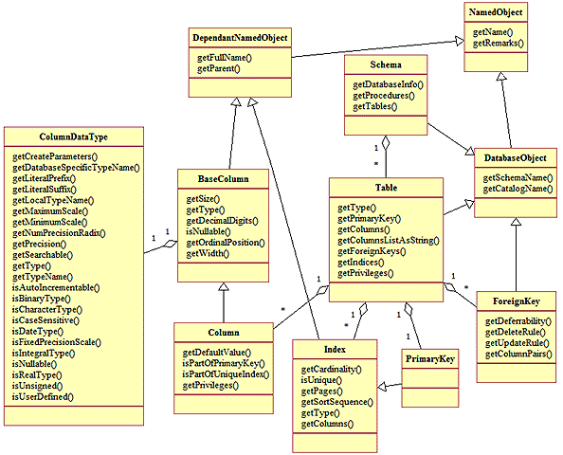
ShemaCrawler UML Summary

Slide 10

Spring Framework

Slide 11
What is Spring Framework?
Spring is the most popular application development framework for enterprise Java.
Open source Java platform since 2003.
Spring supports all major application servers and JEE standards.
Spring handles the infrastructure so you can focus on your application.
11

Slide 12
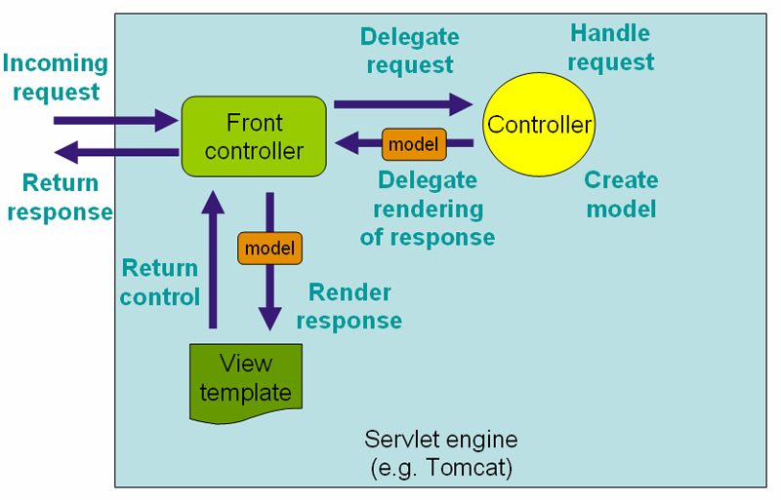
Spring MVC
The Spring web MVC framework provides model-view-controller architecture and ready components that can be used to develop flexible and loosely coupled web applications.
12

Slide 13
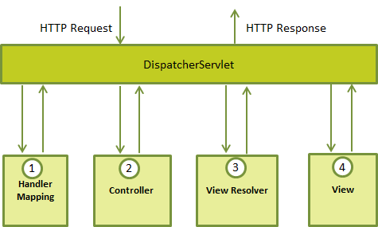
Spring MVC The DispatcherServlet
The Spring Web model-view-controller (MVC) framework is designed around a DispatcherServlet that handles all the HTTP requests and responses.
13
Notes:
Web.xml file

Slide 14
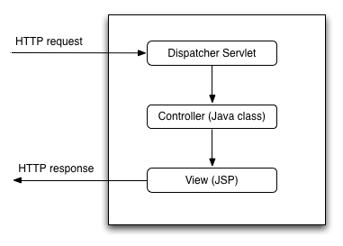
Spring MVC Web.xml
You need to map requests that you want the DispatcherServlet to handle, by using a URL mapping in the web.xml file.

Slide 15
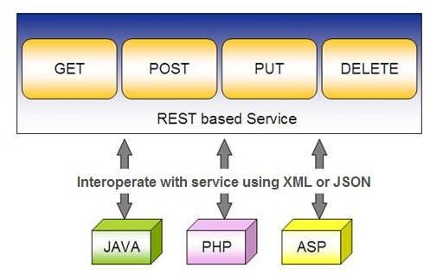
Spring RESTful Services
REST does not require the client to know anything about the structure of the API. Rather, the server needs to provide whatever information the client needs to interact with the service.
Notes:
Representational State Transfer
Resource identification through URI
Uniform interface: http requests
Self-descriptive messages: Resources are decoupled from their representation so that their content can be accessed in a variety of formats, such as HTML, XML, plain text, PDF, JPEG, JSON, and others.

Slide 16
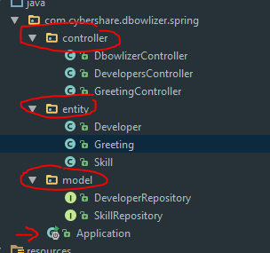
Spring RESTful Services
Spring project structure

Slide 17
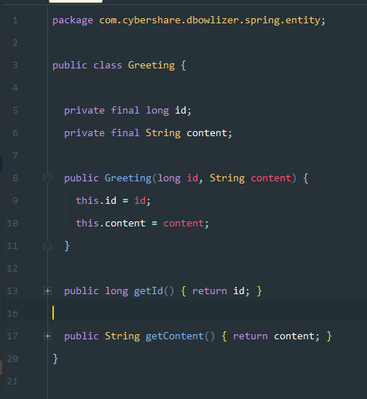
Spring RESTful Services
Greeting Entity

Slide 18
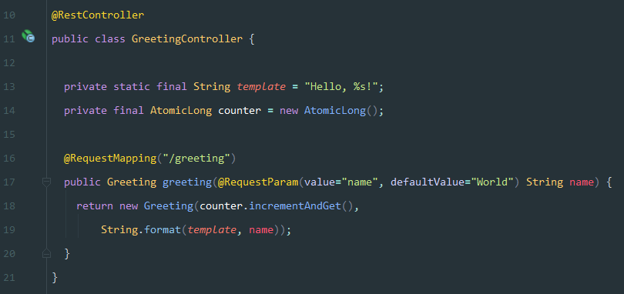
Spring RESTful Services
Spring uses the @RequestMapping method annotation to define the URI Template for the request. The @PathVariable annotation is used to extract the value of the template variables and assign their value to a method variable.
Greeting Controller

Slide 19
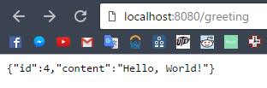
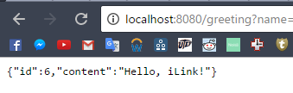
Spring RESTful Services

Slide 20
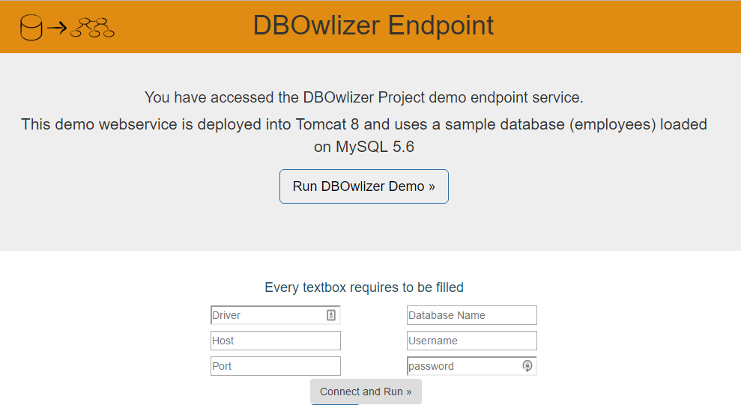
Spring for DBOwlizer

Slide 21
References
Villanueva-Rosales N. (2011). Formalizing Relational Databases as OWL Ontologies, Ottawa, Ontario, Canada, 2011
Cardoza J, Villanueva-Rosales N. Comparing and Extending Approaches that Access Scientific Databases Through Semantic Web Ontologies
SchemaCrawler - http://schemacrawler.sourceforge.net/
Spring Framework: https://projects.spring.io/spring-framework/
Spring Framework Beginners Guide: https://www.toptal.com/spring/beginners-guide-to-mvc-with-spring-framework

