Slide 1

Intel Internship – STHI / APSE
Erick Garcia
ww 25 – 33
INTEL CONFIDENTIAL, FOR INTERNAL USE ONLY

Slide 2


Background
Graduate student pursuing a Master of Science in Software Engineering
at the University of Texas at El Paso (UTEP)
Plans for the following 5 years include:
Graduating from my Masters (December 2018)
Studying abroad 1 semester
Get a job/internship! (possibly as a PPV Software Developer)
Strengths:
Problem Solver
People’s Person
Perseverance
Areas I wish to improve:
I am good in software but I lack experience in hardware knowledge
Get better at reading documentation
Hobbies:
Musician
Green Belt in Limalama Martial Arts
Videogames
Traveling
Intel Badge Photo 2016
Intel Badge Photo 2017

Slide 3
Things Learned during the internship
During this internship I developed a functionality for APSE in which I put into practice unit and mock testing and code coverage
Code should always be tested in a production environment
Never trust old code

Slide 4
Projects
Enhanced Log Collector Functionality (Apse)
Web Development Skeleton
Continuous Integration System (Demo)

Slide 5
Enhanced Log Collector
Task: Enhance the current functionality of the log collector. Add extra features that enables the development team to get meaningful logs, without the user getting into any unwanted states.
Business Value:
Good UX design practices
Code was unit tested
Code was mocked
Good coding practices
Removed all of the previous code with code smells
Fixed modules involved with this one with more modular and high quality code
Unit testing Mock testing Good UX design practices Good coding practices Removed all of the previous code with code smells Fixed modules involved with this one with more modular and high quality code

Slide 6
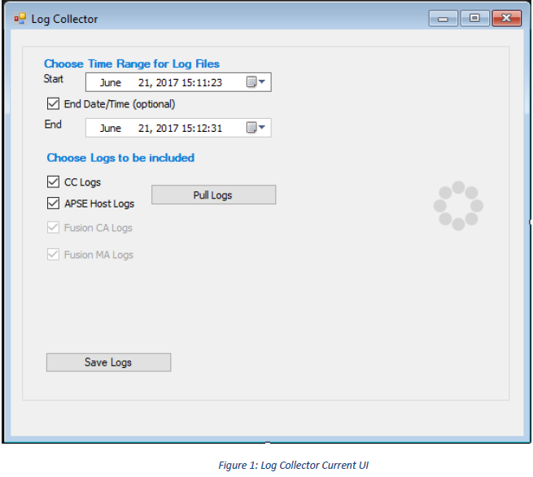
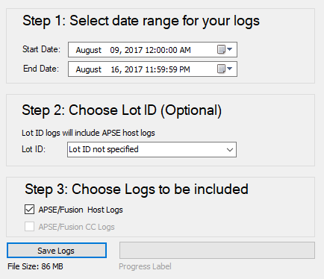
Enhanced Log Collector
Fig. 1: Previous Log Collector UI
Fig. 2: New Log Collector UI

Slide 7
Web Development Skeleton
Task: We currently handle some test documenting with an Excel worksheet that is automated with VBscript. In the future this process should be improved.
Business Value:
Automate this process
Code Igniter back-end framework (MVC Architecture)
Materialize.css front-end framework that enables a minimalistic and simple front end
JQuery & Ajax increases usability

Slide 8
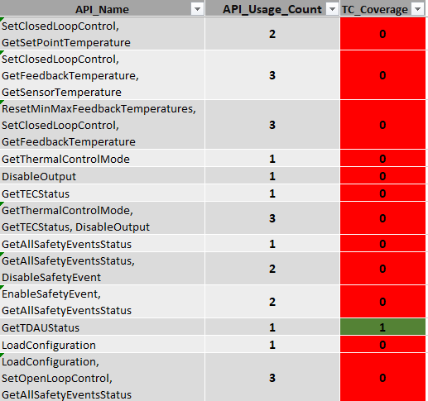
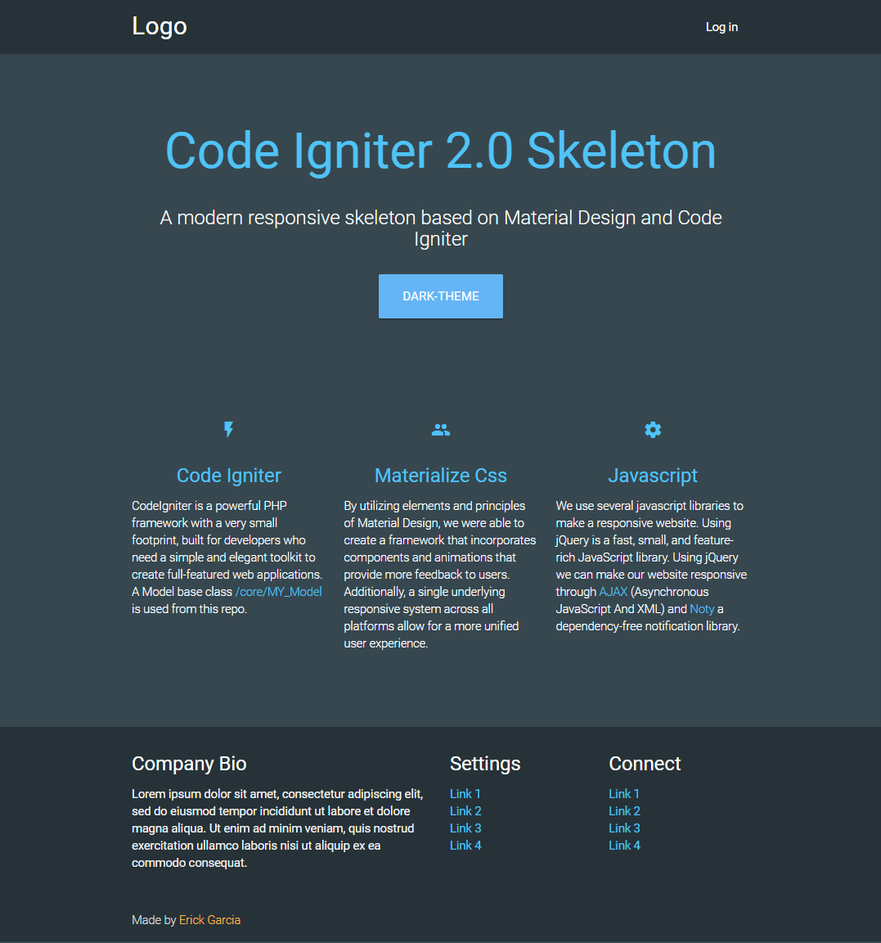
Web Development Skeleton
Fig. 3: Current Excel worksheet
Fig. 4: Web skeleton homepage and sample of UI

Slide 9
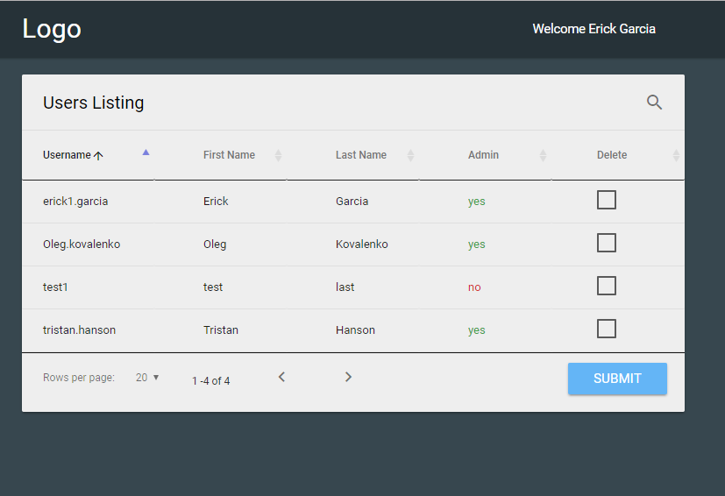
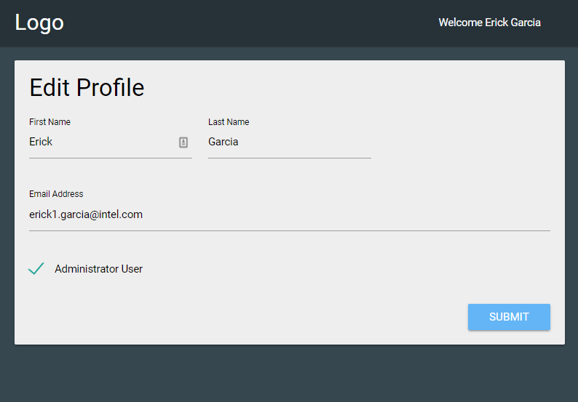
Web Development Skeleton cont.
Fig. 5: Sample web skeleton functionality and UI

Slide 10
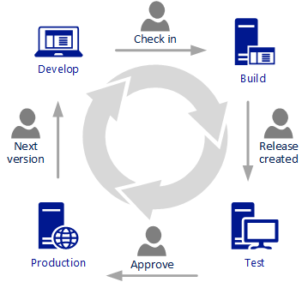
Continuous Integration (CI) System
Task: Continuous Integration is a software development practice in which you build and test software every time a developer pushes code to the application.
Business Value:
Manual Tests Are Only a Snapshot
Increase Your Code Coverage
Deploy Your Code to Production
Never Ship Broken Code
Build faster: Split tests and build processes on different machines (VMs)
Merge faster: You can have your CI and Version Control System communicate
with each other Build Repeatable Processes

Slide 11

Evaluation
 | Agree | Neutral | Disagree
I understood my tasks and responsibilities
Someone was available to provide assistance
I was given assignments that were my primary responsibility.
My site supervisor monitored my progress during the internship
I was assigned an appropriate amount of work.
This experience gave me a realistic preview of a field of interest.
I assumed additional responsibility as my experience increased.
The environment encouraged me to participate.
I was treated professionally.
The work I did was challenging and stimulating.

Slide 12
Special Thanks
I would like to give special thanks to Jeff my manager who in conjunction with Tristan Hanson worked hard to give me the opportunity to come back to this second internship. Also thanks to Tristan Hanson and Oleg Kovalenko, from whom I learnt a great deal of varied skillsets and gave me a helping hand whenever I was stuck in work and non-work related issues. Last but not least to the rest of the team who have always welcomed me with open hands.

