Slide 1


Lecture 4: EDA and PANDAS
Exploring, investigating, and reconfiguring data.
Harvard IACS
CS109A
Pavlos Protopapas, Kevin Rader, and Chris Tanner

Slide 2
ANNOUNCEMENTS
Homework 1 has been released. Due Sept 16 (Wed) @ 11:59pm
Study Break right after lecture (at 10:15am)
Standard Sections will be:
today at 1:30pm-2:45pm and
Monday 8:30pm-9:45pm
After lecture, please update your Zoom to the latest version

Slide 3
Learning Objectives
Understand the importance of exploring and investigating your data
Feel comfortable using PANDAS to inspect your data
Be able to perform advanced PANDAS operations

Slide 4
Agenda
EDA
Advanced PANDAS

Slide 5
Why is performing exploratory data analysis (EDA) important?

Slide 6
EDA helps you:
Ensure your data is as expected/valid/appropriate for the task
Provides insights into a dataset
Extract/determine important variables/attributes/features
Detect outliers and anomalies
Test underlying assumptions
Make informed decisions in developing models

Slide 7
Approach:
EDA is an approach/philosophy not just a set of tools or techniques.
Explore global properties: use histograms, scatter plots, and aggregation functions to summarize the data
Explore group properties: group like-items together to compare subsets of the data (are the comparison results reasonable/expected?)
This approach can be done at any time and any stage of the data science process

Slide 8
Example:
Let’s say that we are interested in the English Premier League (football/soccer) and want to build a model to predict a player’s market value.
Question
Does age affect one’s market value?

Slide 9
Example: Get the data
name
club
age
position
market value
Alexis Sanchez
Arsenal
28
LW
65
Mesut Ozil
Arsenal
28
AM
50
Petr Cech
Arsenal
35
GK
7
Theo Walcott
Arsenal
28
RW
20
Laurent Koscielny
Arsenal
31
CB
22
from www.transfermarkt.us

Slide 10
Example: Explore the data
name
club
age
position
market value
Alexis Sanchez
Arsenal
28
LW
65
Mesut Ozil
Arsenal
28
AM
50
Petr Cech
Arsenal
35
GK
7
Credible/Trustworthy?
Possibly subjective market values?
Sampled data
Theo Walcott
Arsenal
28
RW
20
Laurent Koscielny
Arsenal
31
CB
22
from www.transfermarkt.us

Slide 11
Example: Explore the data
name
club
age
position
market value
Alexis Sanchez
Arsenal
28
LW
65
Mesut Ozil
Arsenal
28
AM
50
Petr Cech
Arsenal
35
GK
7
Theo Walcott
Arsenal
28
RW
20
Laurent Koscielny
Arsenal
31
CB
22
from www.transfermarkt.us

Slide 12
Example: Explore the data
name
club
age
position
market value
Alexis Sanchez
Arsenal
28
LW
65
Mesut Ozil
Arsenal
28
AM
50
Petr Cech
Arsenal
35
GK
7
Theo Walcott
Arsenal
28
RW
20
Laurent Koscielny
Arsenal
31
CB
22
Does it contain the necessary information?
from www.transfermarkt.us

Slide 13
Example: Explore the data
name
club
age
position
market value
Alexis Sanchez
Arsenal
28
LW
65
Mesut Ozil
Arsenal
28
AM
50
Petr Cech
Arsenal
35
GK
7
Theo Walcott
Arsenal
28
RW
20
Laurent Koscielny
Arsenal
31
CB
22
from www.transfermarkt.us
Missing data? Imputation needed?

Slide 14
Example: Explore the data
name
club
age
position
market value
Alexis Sanchez
Arsenal
28
LW
65
Mesut Ozil
Arsenal
28
AM
50
Petr Cech
Arsenal
35
GK
7
Theo Walcott
Arsenal
28
RW
20
Laurent Koscielny
Arsenal
31
CB
22
Are the data types okay (df.dtypes)? Should be casted?
from www.transfermarkt.us

Slide 15
Example: Explore the data
name
club
age
position
market value
Alexis Sanchez
Arsenal
28
LW
65
Mesut Ozil
Arsenal
28
AM
50
Petr Cech
Arsenal
35
GK
7
Theo Walcott
Arsenal
28
RW
20
Laurent Koscielny
Arsenal
31
CB
22
Are the values reasonable? DataFrame.describe() …
from www.transfermarkt.us

Slide 16
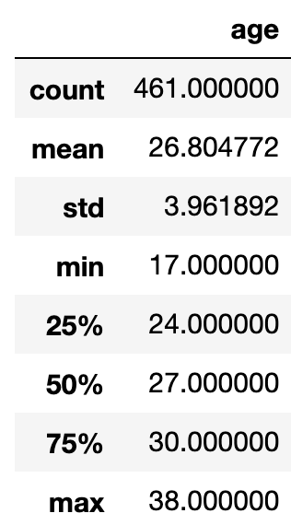
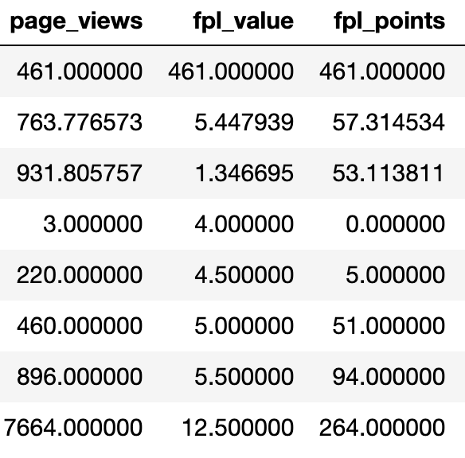
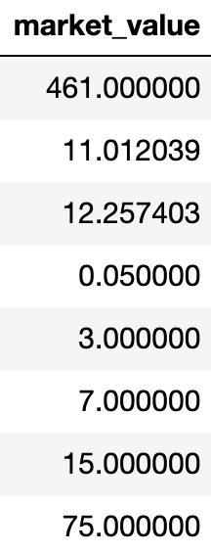
Example: Explore the data
Are the values reasonable? DataFrame.describe() …
from www.transfermarkt.us

Slide 17
Example: Explore the data
This seems abnormally low. Is it correct? Who is this?
Are the values reasonable? DataFrame.describe() …
from www.transfermarkt.us

Slide 18
Example: Explore the data
This also seems suspicious. Is it correct? Who is this?
Are the values reasonable? DataFrame.describe() …
from www.transfermarkt.us

Slide 19
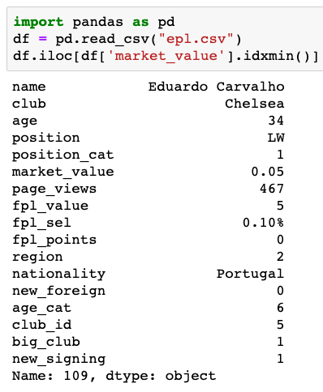
Inspecting suspicious data
This accounts for both extreme values that we noticed. But, is this data truly accurate? It’s worth validating online, elsewhere.

Slide 20
Example: Explore the data
What is going on here?! Is someone actually paid that much more than others? And someone scores that much more?
from www.transfermarkt.us

Slide 21
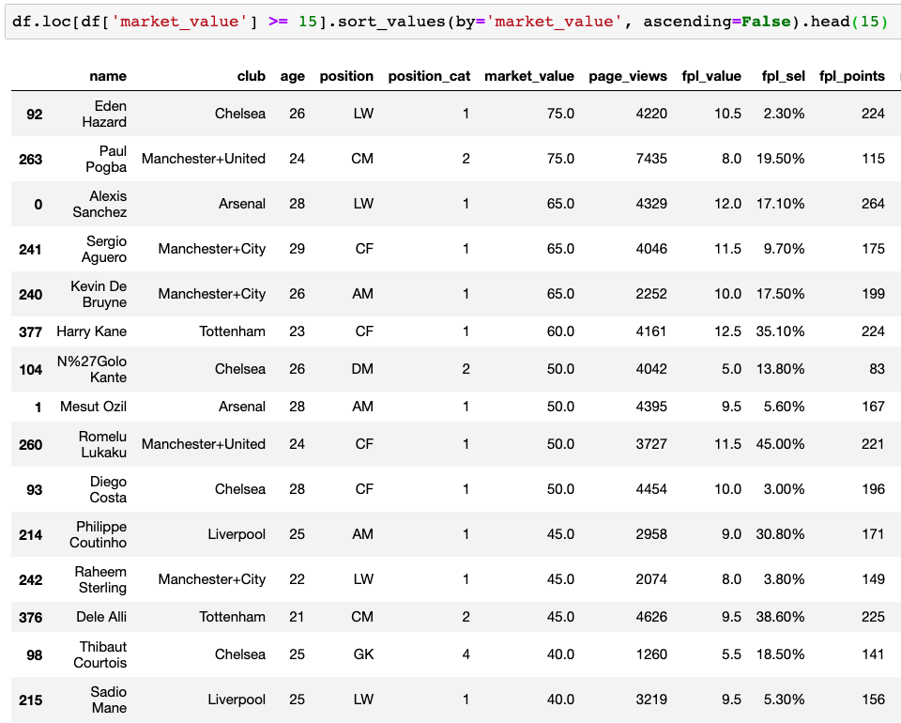

Slide 22
Example: Explore the data
Summary statistics can only reveal so much
from www.transfermarkt.us

Slide 23
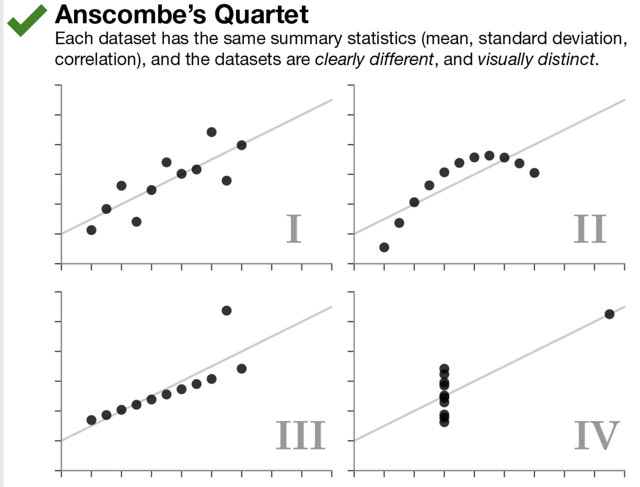
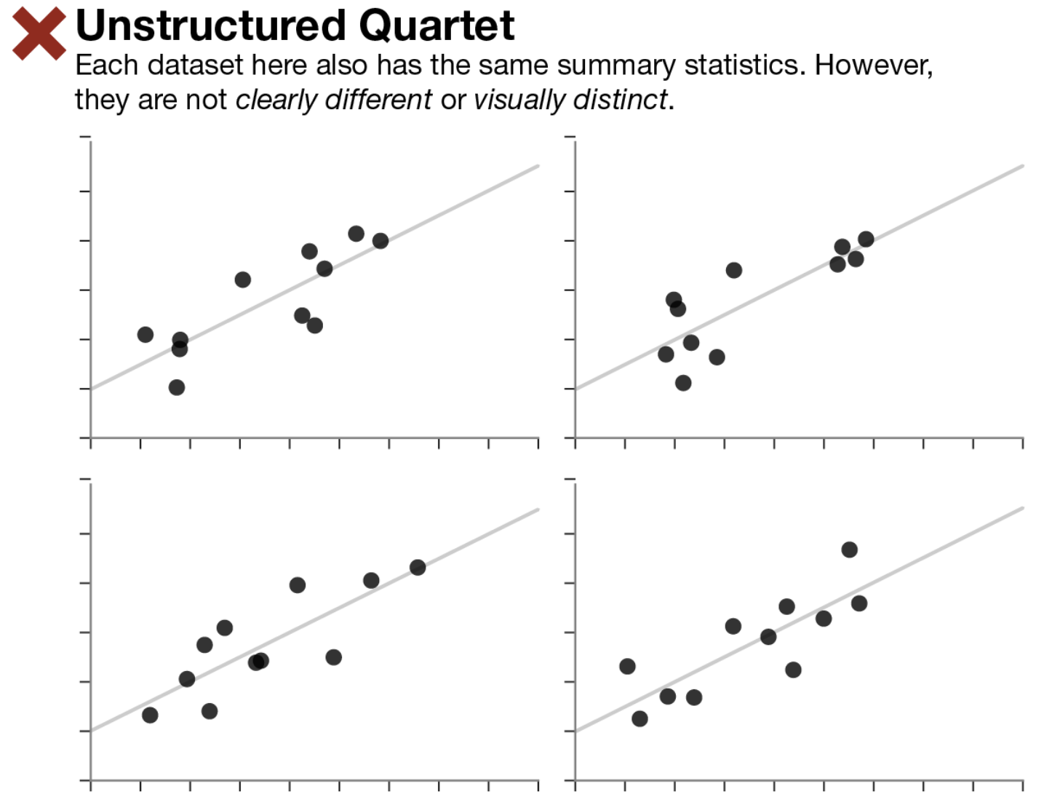
Visualization
Same stats do not imply same graphs
Same graphs do not imply same stats

Slide 24
Visualization
Visualization is incredibly important, both for EDA and for communicating your results to others.
Visualization packages will be used throughout the semester.

Slide 25
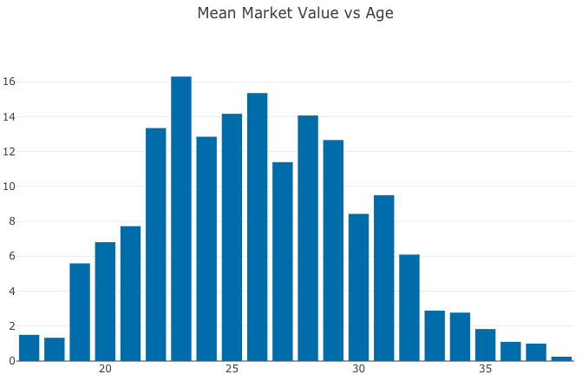
Mean Market Value
Age

Slide 26
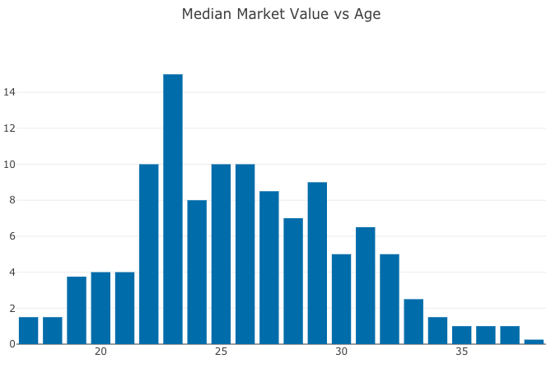
Median Market Value
Age

Slide 27
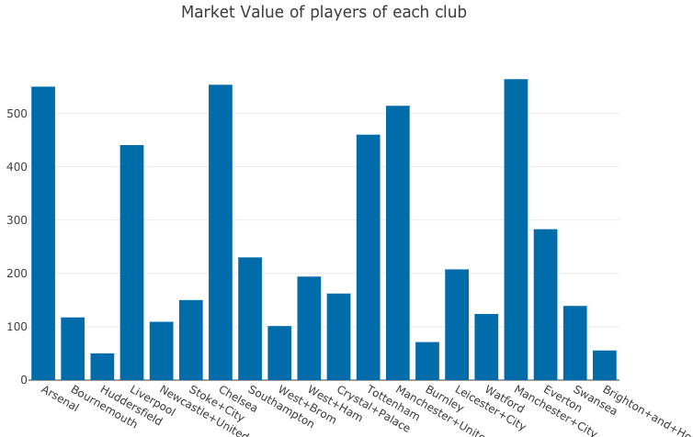
Market Value
Club

Slide 28
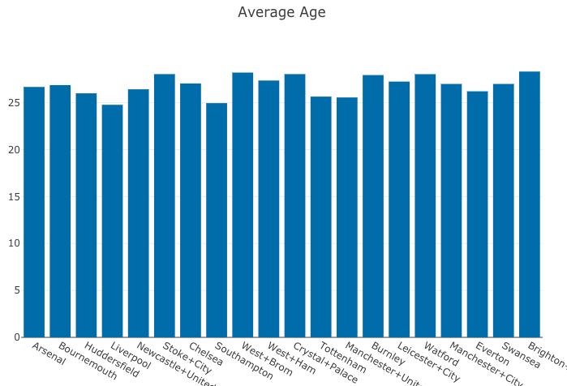
Market Value
Club

Slide 29
Useful PANDAS functions
Grouping/Splitting/Aggregating:
.groupby(),
.get_groups()
.drop()
.merge(), .concat() .aggregate()
.append()
.sum() .median() .mean()
.read_csv() # loads a .csv file
Accessing/processing:
df[“column_name”]
.max(), .min(),
.idxmax(), .idxmin()
<dataframe> <conditional>
.loc[] – label-based accessing
.iloc[] – index-based accessing
.sort_values()
.isnull(), .notnull()
.dropna()
.any()
.values() E.g., df[‘column’].values()
(df[‘name’] == “Chris”).any()
[0:3] # grab the first 3 rows of the DataFrame
High-level viewing:
.head() – first N observations
.tail() – last N observations
.describe() – statistics of the quantitative data
.dtypes – the data types of the columns
.columns – names of the columns
.shape – the # of (rows, columns)

Slide 30
Exercise 1 time!

Slide 31
Useful PANDAS functions
Grouping/Splitting/Aggregating:
.groupby(),
.get_groups()
.drop()
.merge(), .concat() .aggregate()
.append()
.sum() .median() .mean()
.read_csv() # loads a .csv file
Accessing/processing:
df[“column_name”]
.max(), .min(),
.idxmax(), .idxmin()
<dataframe> <conditional>
.loc[] – label-based accessing
.iloc[] – index-based accessing
.sort_values()
.isnull(), .notnull()
.dropna()
.any()
.values() E.g., df[‘column’].values()
(df[‘name’] == “Chris”).any()
[0:3] # grab the first 3 rows of the DataFrame
High-level viewing:
.head() – first N observations
.tail() – last N observations
.describe() – statistics of the quantitative data
.dtypes – the data types of the columns
.columns – names of the columns
.shape – the # of (rows, columns)

Slide 32

Useful PANDAS functions
Grouping/Splitting/Aggregating:
.groupby(),
.get_groups()
.drop()
.merge(), .concat() .aggregate()
.append()
.sum() .median() .mean()
.read_csv() # loads a .csv file
Accessing/processing:
df[“column_name”]
.max(), .min(),
.idxmax(), .idxmin()
<dataframe> <conditional>
.loc[] – label-based accessing
.iloc[] – index-based accessing
.sort_values()
.isnull(), .notnull()
.dropna()
.any()
.values() E.g., df[‘column’].values()
(df[‘name’] == “Chris”).any()
[0:3] # grab the first 3 rows of the DataFrame
High-level viewing:
.head() – first N observations
.tail() – last N observations
.describe() – statistics of the quantitative data
.dtypes – the data types of the columns
.columns – names of the columns
.shape – the # of (rows, columns)

Slide 33
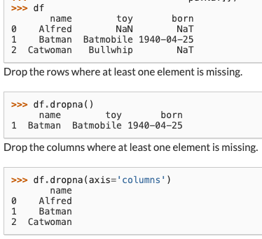
Useful PANDAS functions
Grouping/Splitting/Aggregating:
.groupby(),
.get_groups()
.drop()
.merge(), .concat() .aggregate()
.append()
.sum() .median() .mean()
.read_csv() # loads a .csv file
Accessing/processing:
df[“column_name”]
.max(), .min(),
.idxmax(), .idxmin()
<dataframe> <conditional>
.loc[] – label-based accessing
.iloc[] – index-based accessing
.sort_values()
.isnull(), .notnull()
.dropna()
.any()
.values() E.g., df[‘column’].values()
(df[‘name’] == “Chris”).any()
[0:3] # grab the first 3 rows of the DataFrame
High-level viewing:
.head() – first N observations
.tail() – last N observations
.describe() – statistics of the quantitative data
.dtypes – the data types of the columns
.columns – names of the columns
.shape – the # of (rows, columns)

Slide 34
Useful PANDAS functions
Grouping/Splitting/Aggregating:
.groupby(),
.get_groups()
.drop()
.merge(), .concat() .aggregate()
.append()
.sum() .median() .mean()
.read_csv() # loads a .csv file
Accessing/processing:
df[“column_name”]
.max(), .min(),
.idxmax(), .idxmin()
<dataframe> <conditional>
.loc[] – label-based accessing
.iloc[] – index-based accessing
.sort_values()
.isnull(), .notnull()
.dropna()
.any()
.values() E.g., df[‘column’].values()
(df[‘name’] == “Chris”).any()
[0:3] # grab the first 3 rows of the DataFrame
“Do any of my values equal True?”
High-level viewing:
.head() – first N observations
.tail() – last N observations
.describe() – statistics of the quantitative data
.dtypes – the data types of the columns
.columns – names of the columns
.shape – the # of (rows, columns)
DataFrame → Series
Series → Boolean

Slide 35
You can keep stacking operations, since it’s just Python functions
df.sort_values(by=["Popularity"], ascending=False).dropna().head(30)[['Energy’, ', 'Genre']].groupby(by="Genre").median()

Slide 36
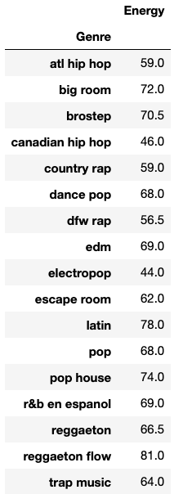
df.sort_values(by=["Popularity"], ascending=False).dropna().head(30)[['Energy’, ', 'Genre']].groupby(by="Genre").median()

Slide 37
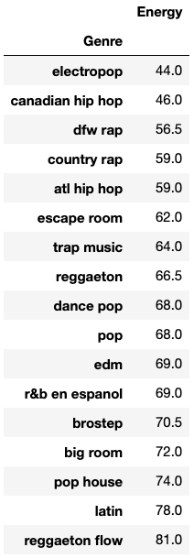
df.sort_values(by=["Popularity"], ascending=False).dropna().head(30)[['Energy’, ', 'Genre']].groupby(by="Genre").median(). . sort_values(by =["Energy"])

Slide 38
combine results
df.groupby(by=”Team").count()
split
apply a function
“A groupby operation involves some combination of splitting the object, applying a function, and combining the results.”
https://pandas.pydata.org/pandas-docs/stable/reference/api/pandas.DataFrame.groupby.html

Slide 39
Exercise 2 time!

Slide 40
Up Next
Modelling!
kNN Regression
Linear Regression
Multi- and Polynomial Regression
Model selection and cross validation
Inference: Bootstrapping and Confidence Intervals
Regularization
Visualization
Classification: kNN and Logistic Regression
Missing data
PCA
Trees
Boosting
Neural Networks!

