Slide 1
Machine Learning Fundamentals Final Project
Andres Garcia Angulo
January 21st, 2019

Slide 2
Table of Contents
Exploration of the Data Set
Questions to Answer
Augmenting the Data Set
Classification Approaches
Regression Approaches
Conclusions and Next Steps

Slide 3
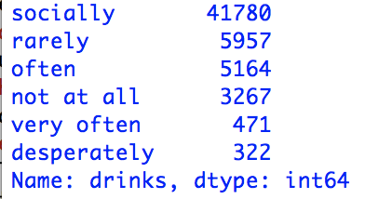
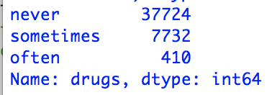
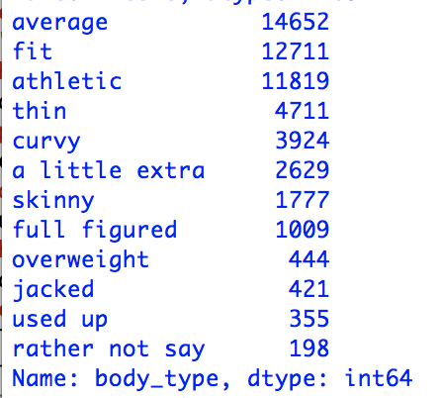
Exploration of the Data Set
I wanted to look into the physicality of the people involved in the data and how behavior can predict their body type
I looked into how much they drink, smoke and do drugs
I also evaluated their diet and their height

Slide 4
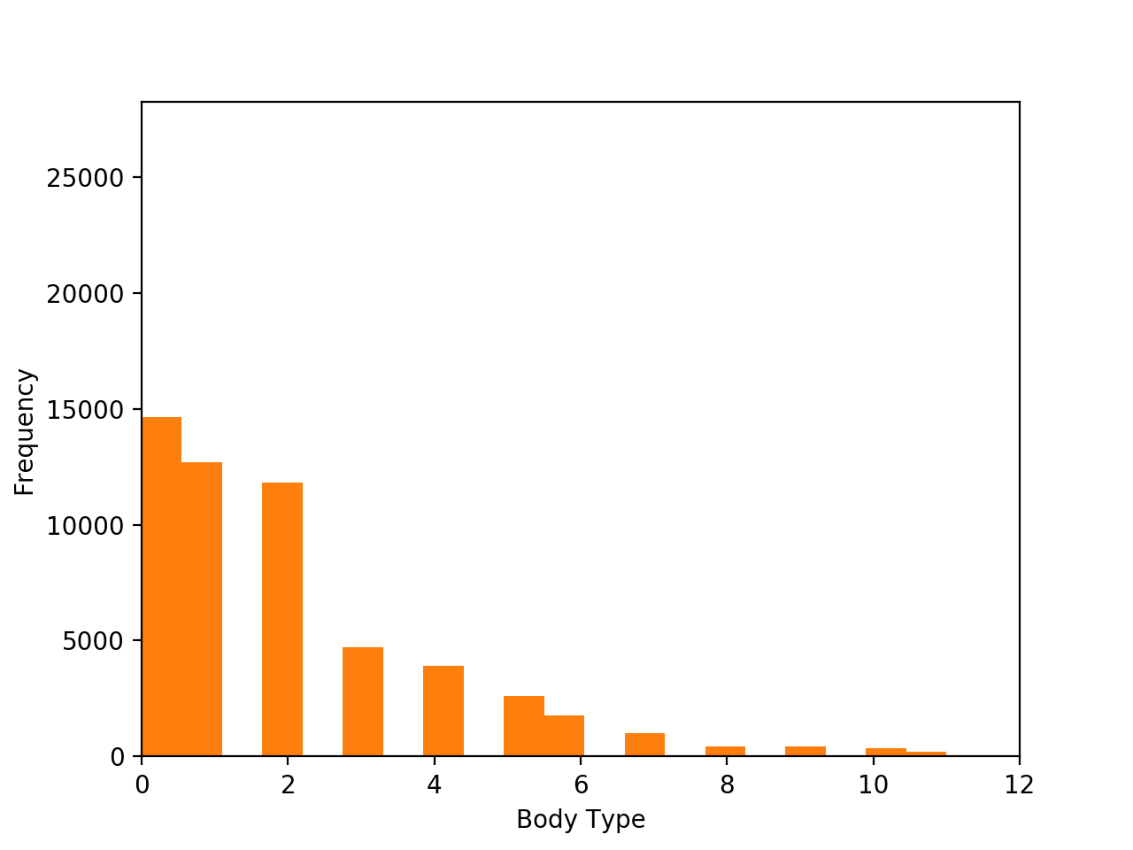
I wanted to see if we could predict body type
After normalizing and mapping the data. I wanted to see if we could predict a person’s body type based on their health habits and behavior

Slide 5
Unfortunately
My code does not run and I don’t know how to fix it so I was unable to complete the assignment
I hope that my code can be reviewed for I put a lot of work into it and at least receive some partial credit
Thank you

