Slide 1
LOS ANGELES
FOOTBALL CLUB
2026 – 2030
Business & Data Strategy
Fan Experience Analysis · Revenue Growth Framework
Strategic Roadmap · 2026 – 2030 Execution Plan
Analyst, Business & Data Strategy | Interview Assignment | April 2026 | Prepared for LAFC / Mike Manella

Slide 2
THE ASSIGNMENT
What I was asked to do — and how I approached it
THE BRIEF
MY APPROACH
Analyze post-event fan survey data from BMO Stadium
Identify revenue patterns, opportunities, and friction points
Build a data-driven 2026–2030 business plan
Deliver clear recommendations backed by specific data points
Record a 10-minute video walkthrough of findings
1. Parse and structure 9,246 raw survey records
2. Segment by year, seating tier, membership, spend level
3. Cross-reference feedback themes with revenue data
4. Build three strategic pillars from the findings
5. Model revenue scenarios across five years
Every recommendation in this presentation is anchored to a specific data point from the dataset.

Slide 3
THE DATA: 9,246 FAN VOICES | 2021 – 2025
Post-event surveys from BMO Stadium across MLS, ACFC, and concerts
9,246
$338
$2.26M
5,410
+114%
Total Surveys
Avg Fan Spend
Total Spend Captured
Feedback Responses
Spend Growth
Collected 2021–2025
Per event visit
All transactions
Open-ended questions
$206 (2021) → $441 (2025)
YEAR | SURVEYS | AVG SPEND | TOTAL SPEND | YoY GROWTH
2021 | 1,735 | $206 | $317K | —
2022 | 3,168 | $328 | $683K | +59%
2023 | 1,942 | $420 | $606K | +28%
2024 | 869 | $397 | $249K | -5%
2025 | 1,189 | $441 | $320K | +11%

Slide 4
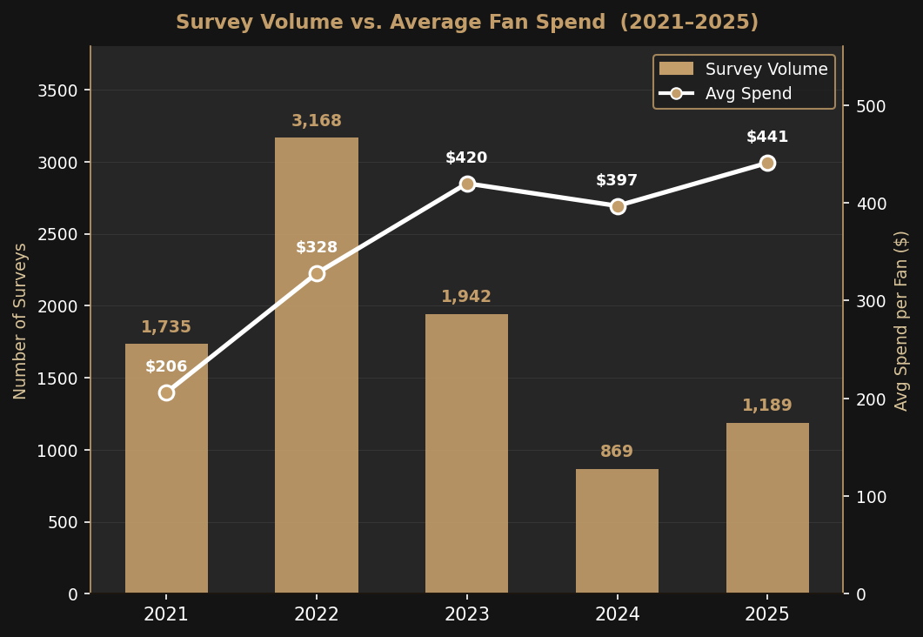
ANNUAL TRENDS: VOLUME DOWN, VALUE UP
Survey volume peaked in 2022 — but average spend per fan has grown every year
2021 COVID RECOVERY
$206 avg | Partial capacity (50–75%), fans cautious
2022 CHAMPIONSHIP PEAK
$328 avg | MLS Cup win + Blackpink. Record 3,168 surveys
2023 NORMALIZATION
$420 avg | Post-title dip. F&B upgrades drive +28% spend
2024 HIGH-VALUE CORE
$397 avg | Volume fell to 869, median spend still rising
2025 RECOVERY BEGINS
$441 avg | Volume up +37%, all-time high avg spend

Slide 5
UNDERSTANDING 2022: WHY IT WON'T JUST COME BACK ON ITS OWN
The championship year brought a flood of fans — analyzing who they were reveals the re-activation challenge
3,168 surveys in 2022 → 869 surveys in 2024. ~2,300 fans came for the championship cycle and have not returned.
WHAT CAUSED THE SURGE
WHO THOSE FANS WERE
WHAT THIS MEANS FOR 2026
• First MLS Cup Championship in club history
• Full venue capacity restored post-COVID
• Blackpink stadium concert (non-MLS audience)
• Pent-up demand from 2020–21 restrictions
• National media spotlight on the club
• High proportion of first-time visitors
• Event-driven, not season-ticket motivated
• Lower repeat-visit intent vs. core fans
• General Admission skew in seating
• Avg spend $328 — below 2023–25 levels
• 2022 peak was driven by unrepeatable events
• Organic recovery needs a new catalyst
• Re-activation is faster than new acquisition
• Marketing must target dormant 2022 fans
• Championship run = the most powerful lever
KEY SIGNAL: The fans LAFC lost between 2022–2024 are dormant, not gone. Re-activation — not new acquisition — is the fastest path back to 3,000+ surveys per year.

Slide 6
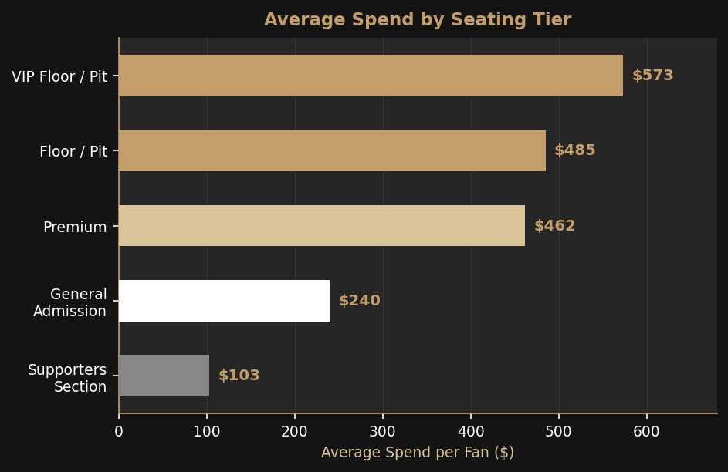
SEATING REVENUE: PREMIUM FANS DRIVE DISPROPORTIONATE VALUE
21.8% of fans in VIP/Floor tiers generate 43% of all revenue captured
SEATING TIER | FANS | AVG SPEND | REVENUE | % FANS
VIP Floor/Pit | 65 | $573 | $37K | 0.7%
Floor / Pit | 1,948 | $485 | $945K | 21.1%
Premium | 868 | $462 | $372K | 9.4%
General | 3,871 | $240 | $888K | 41.9%
Supporters Sec. | 157 | $103 | $15K | 1.7%
THE SPEND GAP
VIP fans spend $573 vs. General fans $240 — a 2.4x multiplier from a seat assignment alone.
THE CONCENTRATION
VIP + Floor = 21.8% of fans but 43% of revenue. Premium tiers punch far above their weight.
THE OPPORTUNITY
Converting just 5% of General fans to Premium adds ~$110K annually — without one new fan.

Slide 7
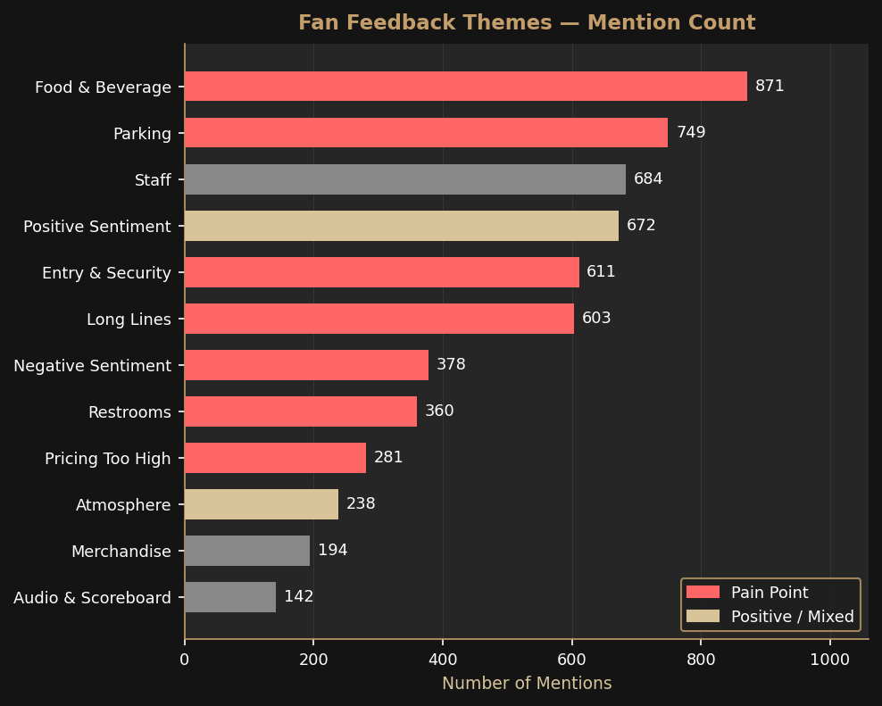
FAN FEEDBACK: THREE FRICTION POINTS COSTING LAFC REVENUE
5,410 open-ended responses — 72% describe a problem, not a compliment
5,410 fans left written feedback | Top 3 pain points account for 43.2% of ALL responses
#1 FOOD & BEVERAGE
871 mentions | 16.1%
• Prices 'too high' — fans skip F&B entirely
• Long lines cause purchasing abandonment
• Revenue impact: $60–80 less per skipped visit
#2 PARKING
749 mentions | 13.8%
• $50–60 fees cited as attendance deterrent
• 90-minute exit times reported repeatedly
• Revenue impact: reduces repeat visit intent
#3 ENTRY & LINES
1,214 mentions | 22.4%
• Entry described as 'stressful' and 'chaotic'
• Late arrivals miss 20–30 min of peak spend
• Revenue impact: fans arrive late, spend less

Slide 8
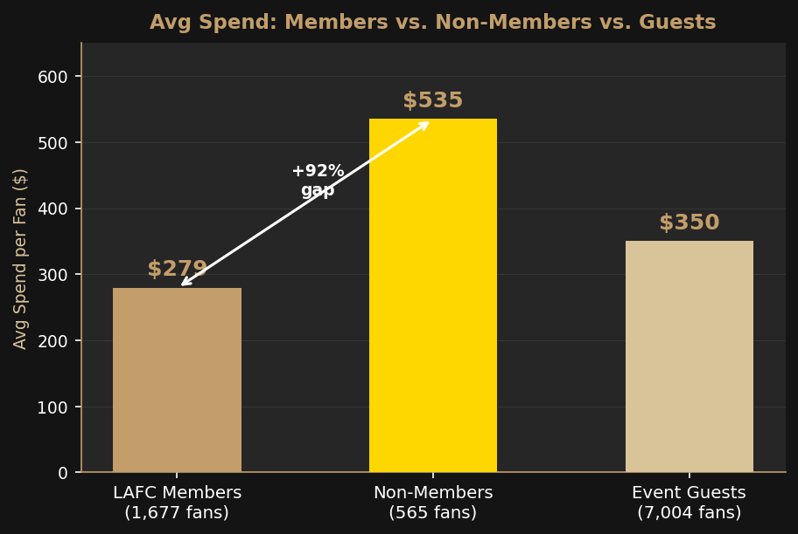
MEMBERSHIP PARADOX: NON-MEMBERS OUTSPEND MEMBERS BY 92%
The most loyal fans are spending the least per visit — and the data tells us why
LAFC MEMBERS
NON-MEMBERS
EVENT GUESTS
1,677 fans
565 fans
7,004 fans
$279
$535
$350
avg/visit
avg/visit
avg/visit
$322K captured
$14K captured
$1.93M captured
A non-member spends $256 MORE per visit. 500 members upgrading to non-member spend levels = +$128,000 annually.
HYPOTHESIS 1 — PERKS REDUCE SPEND
HYPOTHESIS 2 — HABIT VS. OCCASION
HYPOTHESIS 3 — NO SPEND INCENTIVE
Members receive bundled F&B or discounts. Out-of-pocket spend is lower because value is pre-captured in membership fee.
Regular attendees budget conservatively. Non-members treat each visit as a special occasion and spend freely.
Membership rewards attendance, not spend. No tiered benefit for purchasing more — members have no reason to upgrade.

Slide 9
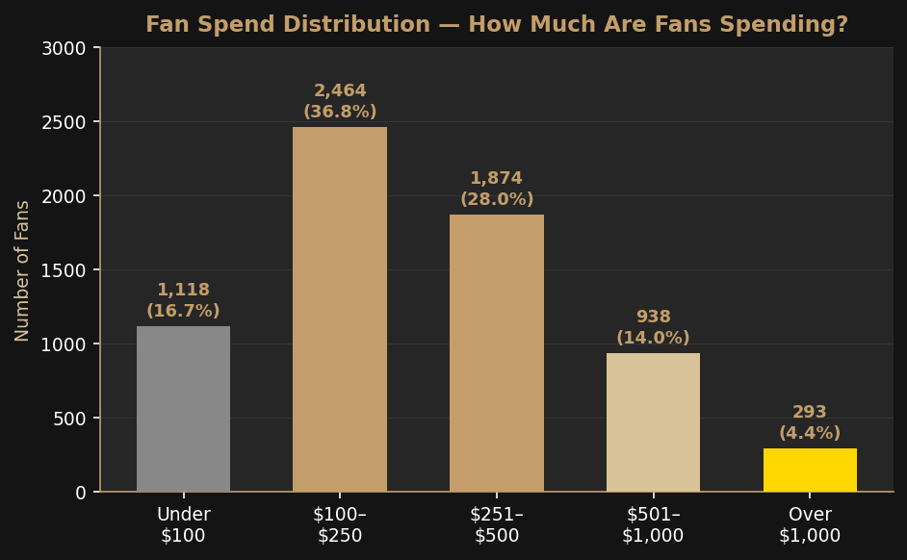
FAN SEGMENTS: WHO IS HERE, WHAT THEY SPEND, WHAT WE CAN DO
Revenue growth does not require more fans — it requires better conversion of fans already at BMO Stadium
SPEND RANGE | FANS | % TOTAL | CUMUL. | SEGMENT
Under $100 | 1,118 | 16.7% | 16.7% | Casual Visitor
$100–$250 | 2,464 | 36.8% | 53.5% | Core Fan
$251–$500 | 1,874 | 28.0% | 81.5% | Engaged Fan
$501–$1,000 | 938 | 14.0% | 95.6% | High-Value
Over $1,000 | 293 | 4.4% | 100% | Premium Fan
THE UPGRADE OPPORTUNITY: Modest per-visit spend increases from existing fans = $310,000+ in annual incremental revenue
Move 2,464 Core Fans up $50 each
Move 1,874 Engaged Fans up $75 each
Retain 50% of High-Value Fans at tier
COMBINED IMPACT
+$123,200/yr
+$140,550/yr
+$46,900/yr
+$310,650/yr

Slide 10
2026–2030 STRATEGIC FRAMEWORK: THREE PILLARS, ONE DIRECTION
Every pillar is grounded in data from the fan survey dataset
PILLAR 1
PILLAR 2
PILLAR 3
FIX THE EXPERIENCE
GROW PREMIUM REVENUE
REACTIVATE & RETAIN
Eliminate friction. Fans already told us what to fix.
Shift the seating and spend mix toward higher-value fans.
Bring back the 2022 fans. Keep the 2025 fans returning.
• F&B: mobile ordering, express lanes, bundle pricing
• Parking: pre-bundled packages, exit strategy overhaul
• Entry: member fast-track lanes, digital ticket expansion
• Target: top 3 complaint categories < 8% by end 2026
• Premium Day Pass: upgrade any ticket for select matches
• In-seat F&B service for Floor/Pit tier (launch 2027)
• Dynamic pricing and seating inventory restructure
• Target: Floor/Pit fans grow from 21.8% to 28% by 2030
• Win-back campaign for 2,300+ dormant 2022 fans
• Membership redesign: Silver → Gold → Platinum tiers
• CRM integration: Ticketmaster + Salesforce + POS
• Target: 600 lapsed fan re-activations in 2026 season
FASTEST ROI | ENABLES ALL OTHER PILLARS
HIGH VALUE | MULTI-YEAR BUILD
HIGH LOYALTY | COMPOUNDING RETURNS
FOUNDATION: Data infrastructure · Fan behavior tracking · Real-time feedback loops · CRM + Ticketmaster + POS integration

Slide 11
PILLAR 1 — FIX THE EXPERIENCE: ELIMINATE FRICTION, EVERY COMPLAINT IS A LOST DOLLAR
Operational fixes that directly address what 43.2% of all fan feedback is asking for
FOOD & BEVERAGE
PARKING & TRANSIT
ENTRY & SECURITY
871 mentions | 16.1%
749 mentions | 13.8%
1,214 mentions | 22.4%
• Mobile ordering via the LAFC app
• Express F&B lanes on each concourse level
• Review pricing on top 5 complaint items
• $15–20 combo bundles (food + drink)
• Local LA brand partnership for differentiation
• Pre-paid parking bundles in season packages
• Dedicated rideshare drop-off lane
• Staggered exit: early leavers get transit credit
• Metro partnership for game-day fares
• Post-match routing signage on all exits
• Digital ticket lane expansion at all gates
• Member-only fast-track entry gates
• Pre-match entertainment activation in queues
• Staffing increase at T-45 min window
• Staff communication and queue signage training
Investment: Medium | Timeline: 2026 season start
Investment: Low–Medium | Timeline: Q1 2026
Investment: Low | Timeline: 2026 Q1
KPI: F&B complaints < 8% (from 16.1%)
KPI: Parking mentions < 7% (from 13.8%)
KPI: Avg entry wait time < 8 minutes
Pillar 1 is the fastest and cheapest to execute. These operational fixes directly enable Pillars 2 and 3 — no premium program works when the baseline experience is broken.

Slide 12
PILLAR 2 — GROW PREMIUM REVENUE: SHIFT THE MIX, MOVE FANS UP THE VALUE LADDER
Floor/Pit fans spend 2.4x more than General — there is room to significantly grow this tier
CURRENT STATE
2026 — FOUNDATION
• Floor/Pit fans (21.8%) generate 43% of revenue
• VIP inventory: only 65 fans in the full dataset
• Floor fans avg $485 vs. General fans avg $240
• $245 gap in per-visit spend — from a seat alone
• No structured upsell or upgrade pathway in data
• Dynamic pricing: not yet reflected in dataset
Introduce Premium Day Pass — upgrade any ticket to Floor/Pit for select matches. Capture demand data and set price floors.
2027 — IN-SEAT PREMIUM
Launch curated F&B Premium Package: pre-match dining + in-seat service for Floor and Premium tiers. Target: +$75/fan/visit.
2028 — INVENTORY RESTRUCTURE
Restructure seating based on 2026–27 demand data. Expand Floor/Pit allocation. Begin dynamic pricing on premium inventory.
2029–30 — PLATINUM TIER
Platinum Membership: premium seating + curated experience + spend-based status. Price point: $5,000–$10,000 annually.
2030 TARGETS: Floor/Pit fans grow from 21.8% → 28% | Avg premium fan spend: $650+ | Premium Day Pass available for all home matches

Slide 13
PILLAR 3 — REACTIVATE & RETAIN: THE 2022 FANS ARE DORMANT, NOT GONE
Lapsed fans are the cheapest fans to win back — and the data tells us exactly who they are
2022 → 2024: Survey volume fell from 3,168 to 869. ~2,300 fans attended during the championship cycle and have not been tracked since.
TRACK A — WIN-BACK CAMPAIGN
TRACK B — MEMBERSHIP REDESIGN
TRACK C — CRM & DATA
Target: Fans who attended 2022, no activity in 2024
Problem: Members spend $279 vs. non-members at $535
Enable: Know your fans beyond the survey form
• Channel: Email + app push + targeted social
• Offer: Early 2026 season access + personalized match reel
• Incentive: $15 F&B credit on return visit
• Goal: Re-activate 600 lapsed fans in 2026
• Measurement: Survey volume vs. 2024 baseline
• SILVER (current): Access + ticket discounts
• GOLD: Silver + $20 F&B credit + upgrade windows
• PLATINUM: Gold + premium seating + exclusive events
• Reward: Points on F&B, merchandise, upgrades
• Goal: 30% of members upgrade by Gold/Platinum by 2027
• Integrate Ticketmaster with F&B POS spend data
• Build individual fan spend profiles in Salesforce
• Trigger personalized offers based on behavior
• ACFC cross-sell (shared fan database)
• Goal: 60% of fans with linked CRM profiles by 2027

Slide 14
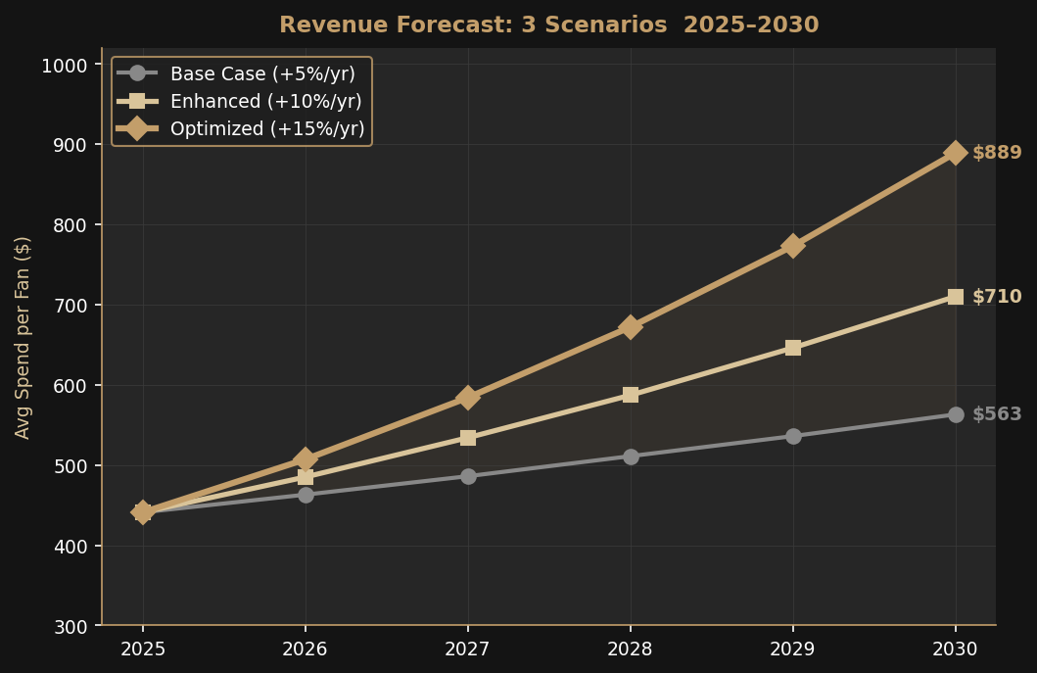
REVENUE FORECAST 2026–2030: THREE SCENARIOS
What strategic investment can unlock — modeled from 2025 baseline of $441 avg spend per fan
YEAR | BASE +5%/yr | ENHANCED +10% | OPTIMIZED +15% | DELTA
2025 (Actual) | $441 | $441 | $441 | —
2026 | $463 | $485 | $507 | +$44
2027 | $486 | $534 | $584 | +$98
2028 | $511 | $587 | $672 | +$161
2029 | $536 | $646 | $773 | +$237
2030 | $563 | $710 | $889 | +$326
BASE +5%/yr
ENHANCED +10%/yr
OPTIMIZED +15%/yr
Current trend. No major investment. Inflation-adjusted organic growth only.
Fix F&B, parking, entry. Launch mobile ordering. Reduce top-3 complaint rate by 50%.
All Enhanced + premium tier expansion + membership redesign + CRM integration.
Base → Optimized gap by 2030: +$326/fan | 18,000 fans × 17 matches × $326 = +$99.7M cumulative over 5 years

Slide 15
YEAR-BY-YEAR EXECUTION ROADMAP 2026 – 2030
Sequenced deliberately — fix the foundation before adding premium layers
2026 FOUNDATION
2027 ACCELERATION
2028 OPTIMIZATION
2029 PREMIUM GROWTH
2030 CONSOLIDATION
• Mobile ordering launch
• Parking bundled in season packages
• Member fast-track entry lanes
• Win-back campaign (target: 600 fans)
• CRM data audit and integration kick-off
• Quarterly feedback reporting cadence
• F&B Premium Package launch (in-seat)
• Membership: Silver/Gold/Platinum
• CRM fan profiles fully operational
• First dynamic pricing test
• ACFC cross-sell integration
• Seating inventory restructure
• Spend-based loyalty fully operational
• Personalized offer engine (behavioral)
• Vendor partnership renegotiation
• Mid-plan KPI review and recalibration
• Platinum Membership tier launch
• Premium Day Pass: all home matches
• Fan LTV dashboard for exec reporting
• Venue capital improvement plan
• Full premium seating expansion
• Season review: $700+ target met?
• 5-year retrospective for ownership
• Design next plan cycle with full data

Slide 16
HOW WE MEASURE SUCCESS — METRICS THAT ACTUALLY MATTER
Leading indicators and lagging outcomes — tracked quarterly from 2026 forward
FAN EXPERIENCE
REVENUE PERFORMANCE
FAN ENGAGEMENT
DATA INFRA
F&B complaint rate
Avg spend per fan
Survey volume YoY
Fans with CRM profile
< 8% by end 2026
$700 by 2030
2,500+ by 2028
60% by end 2027
from 16.1%
from $441 today
from 1,189 in 2025
baseline audit Q1 2026
Parking mention rate
Revenue per premium seat
Repeat attendance
Mobile ordering adoption
< 7% by end 2026
+20%/yr target
3+ matches/season
25% of F&B txns
from 13.8%
2026 baseline
% of total fans
by end 2026
Entry wait time
F&B revenue per fan
Lapsed fan re-activation
Survey → analysis time
< 8 minutes avg
separate tracking
600 in 2026
< 48 hours
new 2026 baseline
integration required
via win-back campaign
automated pipeline
Net Promoter Score
Total event revenue
Membership upgrade rate
Data integrations
per-event baseline
by event type
30% Gold/Plat
TM + SF + POS
measure from 2026
MLS/ACFC/concert
by end 2027
operational by 2027

Slide 17
WHY THIS PLAN. WHY NOW. WHY ME.
WHY THIS PLAN
WHY NOW
WHY ME
The data has already told us what fans want. Faster food. Less parking stress. A reason to spend more. None of that requires a new stadium or a $50M budget. It requires listening to the data, sequencing fixes correctly, and measuring relentlessly. This plan is built entirely from signals in LAFC's own dataset.
2025 is a recovery year — survey volume is up, spend per fan is at an all-time high of $441. This is the best possible moment to invest. Fan sentiment is not yet damaged. The window to build loyalty before the next championship cycle is open right now.
I approached this the same way I'd approach every project: with curiosity about what the data actually says, rigor about not overstating conclusions, and genuine interest in the business — not just the numbers. I built this from scratch, surfaced findings I didn't expect, and built a plan I can defend data point by data point.
THE 2030 GOAL
Average spend per fan per visit: $441 → $700+
Survey volume: 1,189 → 2,500+ per year
LAFC becomes the benchmark for fan experience in Major League Soccer

