Slide 1
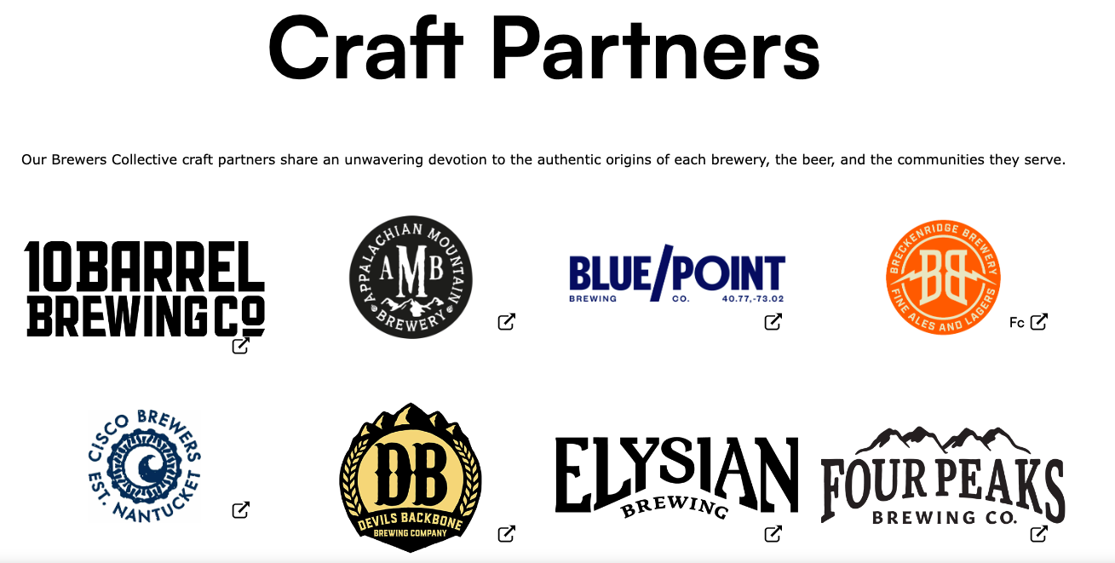
Craft Beer Breweries
in US market
Luis Garcia
The Beers dataset contains a list of 2410 US craft beers and Breweries dataset contains 558 US breweries.
sourced by https://www.anheuser-busch.com/about/brewers-collective/
Notes:
Good afternoon, thank you for having me to talk about craft beer breweries in US market.
I have received 2410 US craft beers and 558 US breweries data sets and here I want to share the statistical analysis and model predictions.
This is the craft partner of Budweiser and I hope this work gives great insight and ideas for Budweiser’s craft beer business.
I will share this slide and rmd, knit files after this presentation and please don’t hesitate to ask any question in the middle of my talk.

Slide 2
Agenda
Beer distribution by state
ABV and IBU distribution by state
Distribution of the ABV variable
Relationship between ABV and IBU variable
KNN model for Ale and IPA
Business suggestion for Budweiser

Slide 3
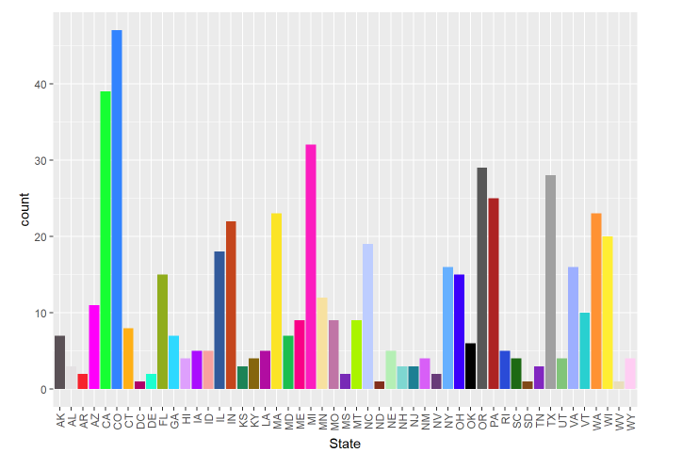
Breweries by States
Colorado has highest number of Breweries and North Dakota is lowest among 50 states and Washington DC.
Notes:
First of all, I want to show the Breweries by state chart for 50 states and DC.
As you can see here, Colorado is the highest number of breweries and North Dakota and some other states are lowest.

Slide 4
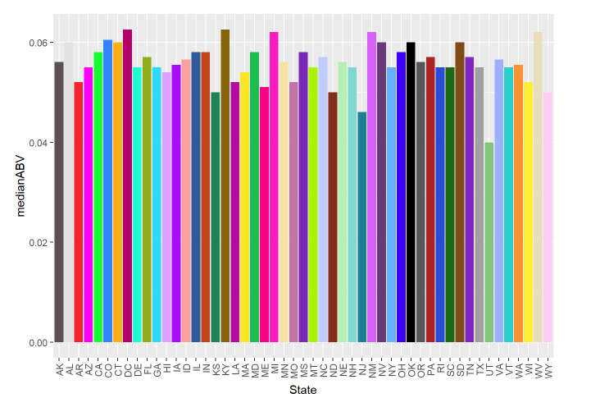
Median ABV by States
The median ABV values are from 0.04 to 0.06 over the states.
Notes:
Here I want to show the median ABV values by states and the range is from 0.04 to 0.06 and 0.055 is most popular alcohol contents over the states.

Slide 5
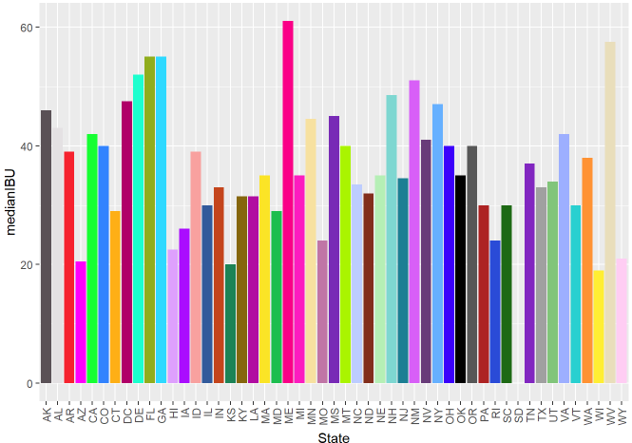
Median IBU by States
The median IBU is from 20 to 60 over the states. There is more variance for IBU.
Notes:
Also IBU is from 20 to 60 over the states.

Slide 6
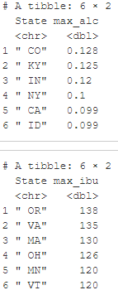
Maximum ABV and IBU
Colorado has the maximum ABV (0.128).
Oregon has the maximum IBU (138).
Notes:
The max ABV of beer is 0.128 in Colorado and also max IBU is 138 in Oregon

Slide 7
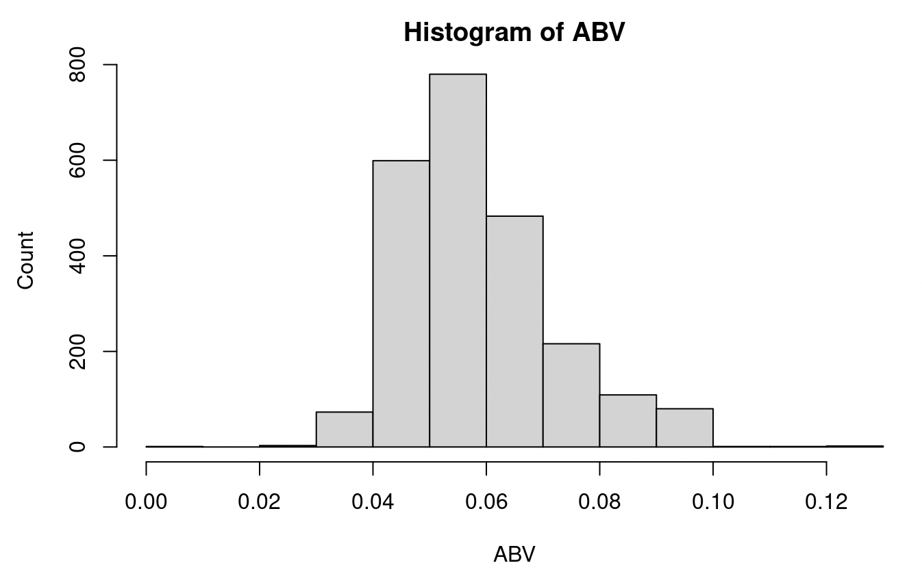
Summary Statistics
The ABV variable has a mode around .5, is right skewed, and has a range of about .11.
Notes:
In the summary statistics of ABV, The ABV variable has a mode around .5, is right skewed, and has a range of about .11.

Slide 8
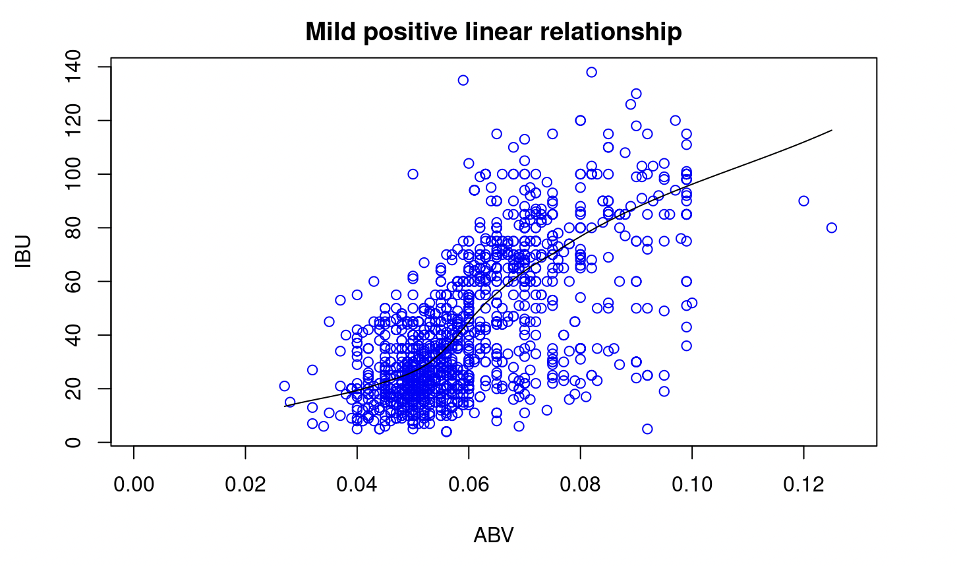
Relationship between ABV and IBU
This data shows mild positive linear relationship(3rd degree polynomial) between ABV and IBU, even though most of beer bitterness comes from hops.
Notes:
The relationship between ABV and IBU is mild positive linear relationship(3rd degree polynomial).
But the general idea of the beer bitterness is what kind hops are used for brewing process.
It is very interesting behavior that the bitterness has mild positive linear relationship with ABV.

Slide 9
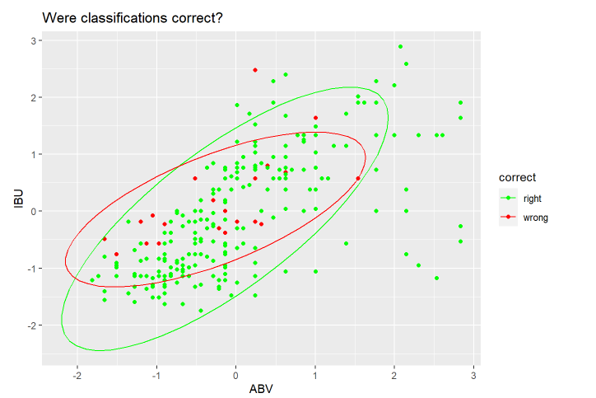
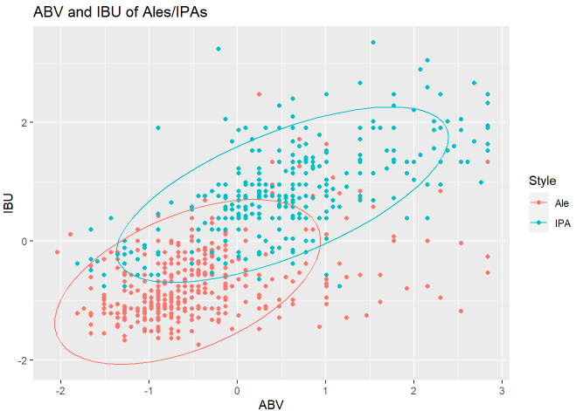
Classification Model for Beer Types
KNN Classifier for 2 types of beers IPA and Ale. A 70/30 training/testing is applied and optimal K is 17.
Notes:
In this slide, I want to share our classification model calculation for beer types.
We did two scenarios for 3 types of beers as IPA, ALE, others and 2 types as IPA others.
We applied 70/30 training and testing set strategy and optimal k is 5.
The 3 types of beers has lower accuracy than two type classification as expected but our 3 types of beers model gives good prediction with market beer samples.

Slide 10
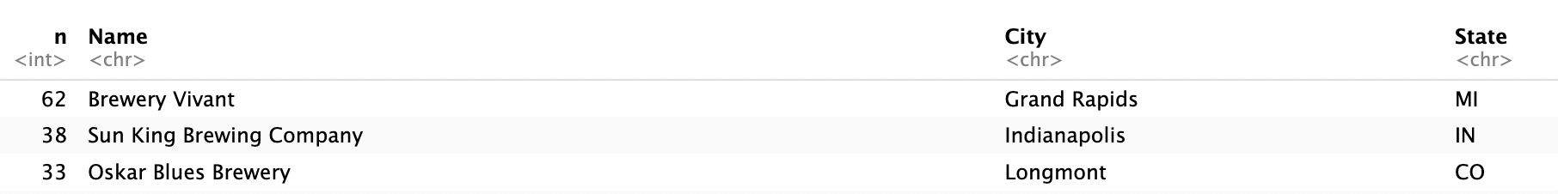
What beer styles should Budweiser brew in Texas?
n = number of beers
medianIBU = 54.65313
medianABV = 07107
Notes:
Additionally, I want to show the top3 breweries who has most beers in US market
it is Brewery Vivant in MI who has 62 beers and Sun king, Oskar Blues as follows.
I want to suggest to make a partnership with them for the future craft beer business.

Slide 11
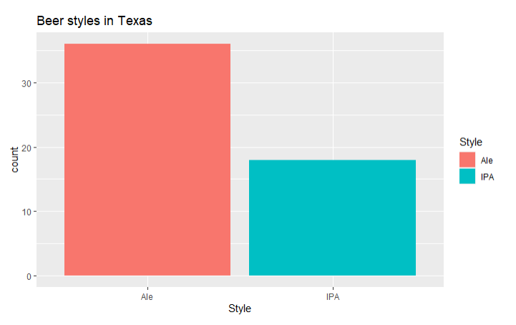

Popularity of Beer styles in Texas
Looking at only IPAs and Ales, it seems that Texas has more Ale breweries than IPA breweries

Slide 12
Summary
We have analyzed the alcohol contents(ABV) and bitterness(IBU) of craft beers in the breweries of United States.
Moreover, we introduced the classification model of beer types using ABV and IBU values and verified with beer samples in the market including Budweiser.
Additionally, we suggested a type of beer based the median ABV/IBU values of the top 3 breweries, the most popular beer types in Texas, and the fact the classification our model gives for the median values.
Notes:
We have analyzed the alcohol contents(ABV) and bitterness(IBU) of craft beers in the breweries of United States.
Moreover, we introduced the classification model of beer types using ABV and IBU values and verified with beer samples in the market including Budweiser.
Additionally, top 3 breweries suggested for the Budweiser craft partners.

