Slide 1


Computation of Standard Errors for Multistage Samples
Guide to the PISA Data Analysis Manual

Slide 2
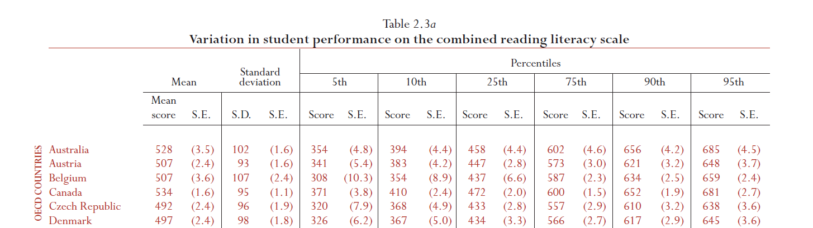
What is a Standard Error (SE)
In PISA, as well as in IEA studies, results are based on a sample
Published statistics are therefore estimates
Estimates of the means, of the standard deviations, of the regression coefficients …
The uncertainty due to the sampling process has to be quantified
Standard Errors, Confidence Intervals, P Value
OECD (2001). Knowledge and Skills for Life: First Results from PISA 2000. Paris: OECD.

Slide 3
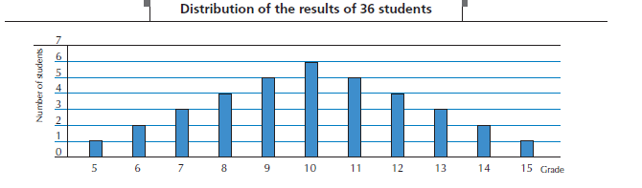
What is a Standard Error (SE)
Let us imagine a teacher willing to implement the mastery learning approach, as conceptualized by B.S. Bloom.
Need to assess students after each lesson
With 36 students and 5 lessons per day…

Slide 4
What is a Standard Error (SE)
Description of the population distribution
The teacher decides to randomly draw 2 student’s tests for deciding if a remediation is needed
How many samples of 2 students from a population of 36 students?

Slide 5
What is a Standard Error (SE)
Number of possible sample of size n from a population of size N
If the thickness of a coin is 1 mm, then 1 billion of coins on the edge corresponds to 1000 km

Slide 6
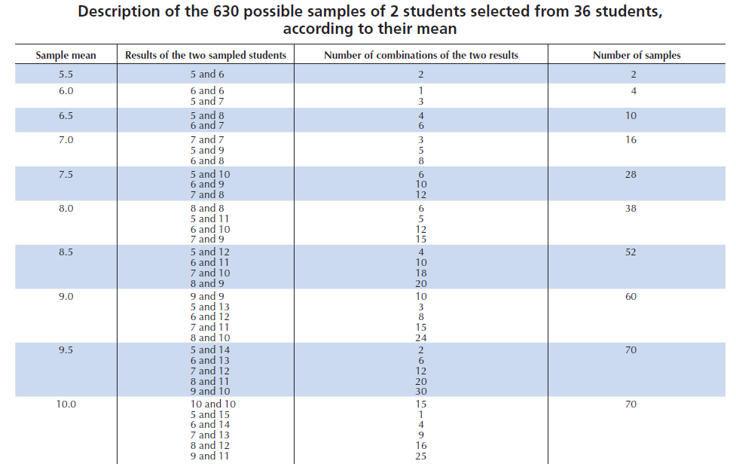
What is a Standard Error (SE)

Slide 7
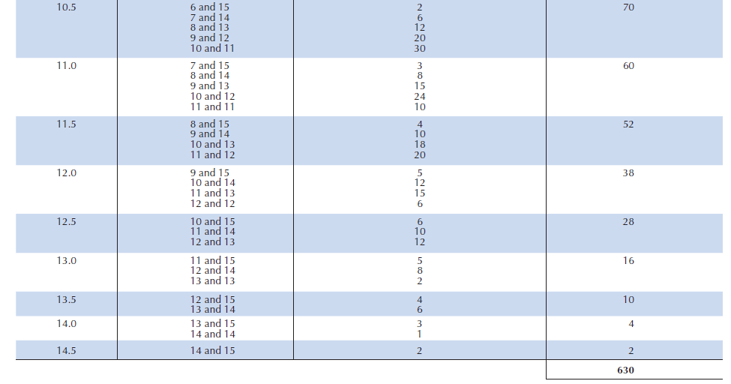
What is a Standard Error (SE)

Slide 8
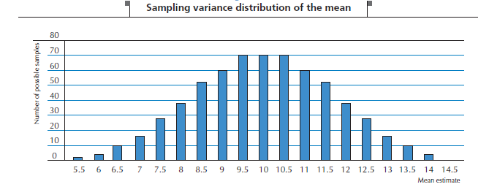
What is a Standard Error (SE)
Graphical representation of the population mean estimate for all possible samples

Slide 9
What is a Standard Error (SE)
The distribution of sampling variance on the previous slide has:
a mean of 10
a Standard Deviation (STD) of 1.7
The STD of a sampling distribution is denoted Standard Error (SE)

Slide 10
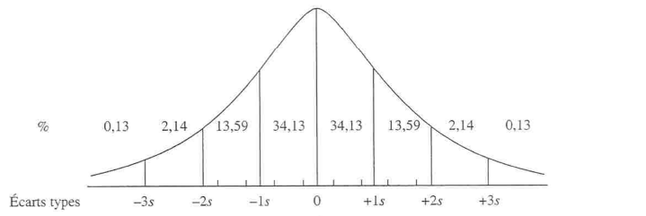
What is a Standard Error (SE)
The sampling distribution on the mean looks like a normal distribution

Slide 11
What is a Standard Error (SE)
Let us count the number of samples with a mean included between
[(10-1.96SE);(10+1.96SE)]
[(10-3.30);(10+3.30)]
[6.70;13.30]
There are: 6+28+38+52+60+70+70+70+60+52 +38+28+16=598 samples, thus 94.9 % of all possible samples
With a population N(10, 5, 83), 95% of all possible samples of size 2 will have a population mean estimate included between 6.70 and 13.30

Slide 12
What is a Standard Error (SE)
Sampling distribution of the mean estimates of all possible samples of size 4

Slide 13
What is a Standard Error (SE)
The distribution of sampling variance on the previous slide has:
a mean of 10
a Standard Deviation of 1.7

Slide 14
What is a Standard Error (SE)
Distribution of the scores versus distribution of the mean estimates

Slide 15
What is a Standard Error (SE)
The sampling variance of the mean is inversely proportional to the sample size:
If two students are sampled, then the smallest possible mean is 5.5 and the highest possible mean is 14.5
If four students are sampled, it ranges from 6 to 14
If 10 students are sampled, it ranges from 7 to 13
The sampling variance is proportional to the variance:
If the score are reported on 20, with a sample of size 2, then it ranges from 5,5 to 14,5
If the score are reported on 40 (multiplied by 2) then it ranges from 11 to 29

Slide 16
What is a Standard Error (SE)
 | Individual 1 | Individual 2 | Individual 3 | Individual 4 | Mean estimates
Sample 1 | X₁₁ | X₂₁ | X₃₁ | X₄₁ | û₁
Sample 2 | X₁₂ | X₂₂ | X₃₂ | X₄₂ | û₂
Sample 3 | X₁₃ | X₂₃ | X₃₃ | X₄₃ | û₃
Sample 4 | X₁₄ | X₂₄ | X₃₄ | X₄₄ | û₄
Sample 5 | X₁₅ | X₂₅ | X₃₅ | X₄₅ | û₅
Sample 6 | X₁₆ | X₂₆ | X₃₆ | X₄₆ | û₆
Sample 7 | X₁₇ | X₂₇ | X₃₇ | X₄₇ | û₇
Sample 8 | X₁₈ | X₂₈ | X₃₈ | X₄₈ | û₈
Sample 9 | X₁₉ | X₂₉ | X₃₉ | X₄₉ | û₉
……
Sample X | X_{1x} | X_{2x} | X_{3x} | X_{4x} | û_{x}

Slide 17
What is a Standard Error (SE)

Slide 18
What is a Standard Error (SE)
As we don’t know the variance in the population, the SE for a mean of θ as obtained from a sample is calculated as
similarly, the SE for a percentage P is calculated as

Slide 19
What is a Standard Error (SE)
Linear regression assumptions:
Homoscedasticity
the variance of the error terms is constant for each value of x
Linearity
the relationship between each X and Y is linear
Error Terms are normally distributed
Independence of Error Terms
successive residuals are not correlated
If not, the SE of regression coefficients is biased

Slide 20
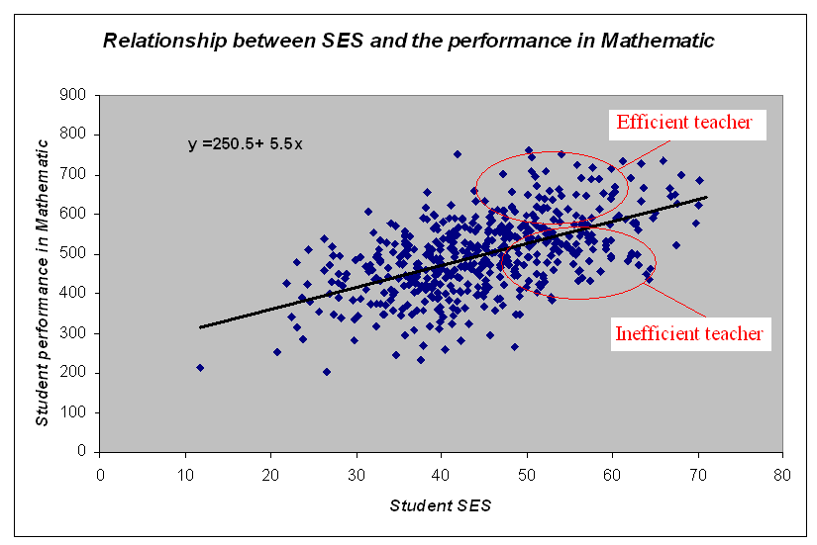
What is a Standard Error (SE)
With a multistage sample design, errors will be correlated

Slide 21
Standard Errors for multistage samples
Multistage samples are usually implemented in International Surveys in Education:
schools (PSU=primary sampling units)
classes
students
If schools/classes / students are considered as infinite populations and if units are selected according to a SRS procedures, then:

Slide 22
Standard Errors for multistage samples
PISA:
2 stage samples : schools and then students
IEA:
2 stage samples : schools and then 1 class per selected school

Slide 23
Standard Error for multistage samples
Three fictitious examples in PISA
If considered as a SRS or random assignment to schools

Slide 24
Standard Error for multistage samples

Slide 25
Variance Decomposition for Reading Literacy in PISA 2000
Standard Error for multistage samples

Slide 26
Standard Error for multistage samples
Impact of the stratification variables on sampling variance
N₁, N₂ considered as constant
Independent samples so COV=0

Slide 27
Standard Error for multistage samples
Effect | Sum of Squares | Degree of Freedom | Mean square
Gender (50F+50G) | 2500 | L-1 (1) | 2500
ERROR | 7500 | N-L (98) | 76.53
TOTAL | 10000 | N-1 (99) | 101.01

Slide 28
Standard Error for multistage samples
School and within school variances of the student performance in reading, intraclass correlation with and without control of the explicit stratification variables (OECD, PISA 2000 database)
Country | School variance | Within school variance | School variance under control of stratification | Rho | Rho under control of stratification
AUT | 6356 | 4243 | 624 | 0.60 | 0.13
BEL | 7050 | 4724 | 3489 | 0.60 | 0.42
CHE | 4517 | 5909 | 3119 | 0.43 | 0.35
CZE | 4812 | 4203 | 604 | 0.53 | 0.13
DNK | 1819 | 7970 | 1696 | 0.19 | 0.18
ESP | 1477 | 5649 | 823 | 0.21 | 0.13
FIN | 998 | 7096 | 869 | 0.12 | 0.11
FRA | 4181 | 4219 | 910 | 0.50 | 0.18
GBR | 2077 | 7637 | 1990 | 0.21 | 0.21
GRC | 4995 | 4907 | 3619 | 0.50 | 0.42
HUN | 6604 | 3230 | 4638 | 0.67 | 0.59
IRL | 1589 | 7349 | 1495 | 0.18 | 0.17
ISL | 652 | 7884 | 563 | 0.08 | 0.07
ITA | 4719 | 4028 | 2031 | 0.54 | 0.34

Slide 29
Standard Error for multistage samples
Consequences of considering PISA samples as simple random samples
In most cases, underestimation of the sampling variance estimates
Non significant effect will be reported as significant
How can we measure the risk?
Computation of the Type I error

Slide 30
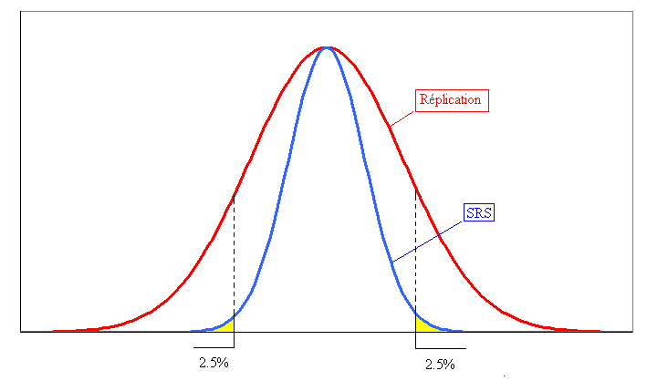
Standard Error for multistage samples
Consequences : Type I error underestimation

Slide 31
Standard Error for multistage samples
Consequences : Type I error underestimation
 | Sampling Variance | Standard Error | Ratio | Ratio x Z score | Type I Error
Unbiased estimate | 24 | 4.90
Biased estimate | 20 | 4.47 | 0.91 | 1.79 | 0.07
 | 16 | 4.00 | 0.82 | 1.60 | 0.11
 | 12 | 3.46 | 0.71 | 1.38 | 0.17
 | 8 | 2.83 | 0.58 | 1.13 | 0.26
 | 4 | 2.00 | 0.41 | 0.80 | 0.42

Slide 32
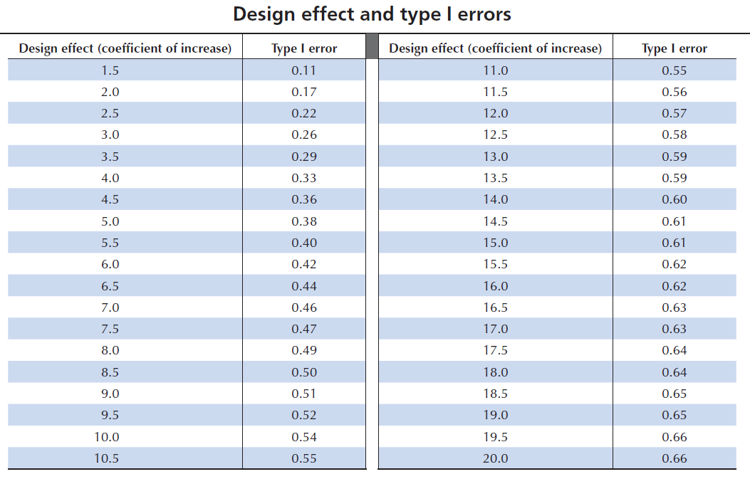
Sampling Design Effect
Standard Error for multistage samples

Slide 33
Standard Error for multistage samples
Sampling design effect in PISA 2000 Reading
Country | SDE | Type I | Country | SDE | Type I
Australia | 5.90 | 0.42 | Korea | 5.89 | 0.42
Austria | 3.10 | 0.27 | Latvia | 10.16 | 0.54
Belgium | 7.31 | 0.47 | Liechtenstein | 0.48 | 0.00
Brazil | 6.14 | 0.43 | Luxembourg | 0.73 | 0.02
Canada | 9.79 | 0.53 | Mexico | 6.69 | 0.45
Czech Republic | 3.18 | 0.27 | Netherlands | 3.52 | 0.30
Denmark | 2.36 | 0.20 | New Zealand | 2.40 | 0.21
Finland | 3.90 | 0.32 | Norway | 2.97 | 0.26
France | 4.02 | 0.33 | Poland | 7.12 | 0.46
Germany | 2.36 | 0.20 | Portugal | 9.72 | 0.53
Greece | 12.04 | 0.57 | Russian Federation | 13.53 | 0.59
Hungary | 8.64 | 0.50 | Spain | 6.18 | 0.43
Iceland | 0.73 | 0.02 | Sweden | 2.32 | 0.20
Ireland | 4.50 | 0.36 | Switzerland | 10.52 | 0.55
Italy | 1.90 | 0.16 | United Kingdom | 5.97 | 0.42
Japan | 19.28 | 0.66 | United States | 17.29 | 0.64

Slide 34
Standard Error for multistage samples
Factors influencing the SE other than the sample size
School Variance: depending on the variable
Usually high for performance
Low for other variables
Efficiency of the stratification variables
A stratification variable can be efficient for some variables and not for others
Population parameter estimates

Slide 35
Standard Error for multistage samples
A few examples (PISA2000, Belgium)
Intraclass correlation
Performance in reading: Rho=0.60 SDE=7.19
Social Background (HISEI): Rho= 0.24 SDE=3.45
Enjoyment for Reading: Rho=0.10 SDE=1.86
Statistics
Regression analyses: Reading = HISEI + GENDER
Intercept SDE= 5.50
HISEI SDE=3.78
GENDER SDE=3.91
Logistic regression Level (0/1 Reading below or above 500) =HISEI
Intercept SDE= 2.39
HISEI SDE=2.09

Slide 36
Standard Error for multistage samples
Very few mathematical solutions for the estimation of the sampling variance for multistage samples
For mean estimates under the condition
Simple Random Sample (SRS) and stratified
Probability Proportional to Size (PPS) sample but with no stratification variables
No mathematical solutions for other statistics
Use of replication methodologies for the estimation of sampling variance
For SRS:
Jackknife: n replications de n-1 cases
Bootstrap : an infinite number of samples of n cases randomly drawn with replacement.

Slide 37
Replication methods for SRS
Jackknife for SRS
Student |  | 1 | 2 | 3 | 4 | 5 | 6 | 7 | 8 | 9 | 10 |  | Mean
Value |  | 10 | 11 | 12 | 13 | 14 | 15 | 16 | 17 | 18 | 19 |  | 14.50
Replication 1 |  | 0 | 1 | 1 | 1 | 1 | 1 | 1 | 1 | 1 | 1 |  | 15.00
Replication 2 |  | 1 | 0 | 1 | 1 | 1 | 1 | 1 | 1 | 1 | 1 |  | 14.88
Replication 3 |  | 1 | 1 | 0 | 1 | 1 | 1 | 1 | 1 | 1 | 1 |  | 14.77
Replication 4 |  | 1 | 1 | 1 | 0 | 1 | 1 | 1 | 1 | 1 | 1 |  | 14.66
Replication 5 |  | 1 | 1 | 1 | 1 | 0 | 1 | 1 | 1 | 1 | 1 |  | 14.55
Replication 6 |  | 1 | 1 | 1 | 1 | 1 | 0 | 1 | 1 | 1 | 1 |  | 14.44
Replication 7 |  | 1 | 1 | 1 | 1 | 1 | 1 | 0 | 1 | 1 | 1 |  | 14.33
Replication 8 |  | 1 | 1 | 1 | 1 | 1 | 1 | 1 | 0 | 1 | 1 |  | 14.22
Replication 9 |  | 1 | 1 | 1 | 1 | 1 | 1 | 1 | 1 | 0 | 1 |  | 14.11
Replication 10 |  | 1 | 1 | 1 | 1 | 1 | 1 | 1 | 1 | 1 | 0 |  | 14.00

Slide 38
Replication methods for SRS
Jackknife for SRS
Estimation of the SE by replication
Estimation by using the mathematical formula

Slide 39
Replication methods for SRS

Slide 40
Replication methods for SRS
Bootstrap for SRS
Student |  | 1 | 2 | 3 | 4 | 5 | 6 | 7 | 8 | 9 | 10 |  | Mean
Value |  | 10 | 11 | 12 | 13 | 14 | 15 | 16 | 17 | 18 | 19 |  | 14.50
Structure 1 |  | 1 | 1 | 1 | 1 | 1 | 1 | 1 | 1 | 1 | 1 |  | 14.50
Structure 2 |  | 2 | 1 | 1 | 1 | 1 | 1 | 1 | 1 | 1 | 0 |  | From 13.7 to 15.4
Structure 3 |  | 2 | 2 | 1 | 1 | 1 | 1 | 1 | 1 | 0 | 0 |  | From 12.9 to 16.1
Structure |  | 5 | 1 | 1 | 1 | 1 | 1 | 0 | 0 | 0 | 0
Structure |  | 6 | 1 | 1 | 1 | 1 | 0 | 0 | 0 | 0 | 0
Structure |  | 7 | 1 | 1 | 1 | 0 | 0 | 0 | 0 | 0 | 0
Structure |  | 8 | 1 | 1 | 0 | 0 | 0 | 0 | 0 | 0 | 0
Structure |  | 9 | 1 | 0 | 0 | 0 | 0 | 0 | 0 | 0 | 0
Structure |  | 10 | 0 | 0 | 0 | 0 | 0 | 0 | 0 | 0 | 0 |  | From 10 to 19

Slide 41
Replication methods for multistage sample
Jackknife for unstratified Multistage Sample
Replicate | R1 | R2 | R3 | R4 | R5 | R6 | R7 | R8 | R9 | R10
School 1 | 0.00 | 1.11 | 1.11 | 1.11 | 1.11 | 1.11 | 1.11 | 1.11 | 1.11 | 1.11
School 2 | 1.11 | 0.00 | 1.11 | 1.11 | 1.11 | 1.11 | 1.11 | 1.11 | 1.11 | 1.11
School 3 | 1.11 | 1.11 | 0.00 | 1.11 | 1.11 | 1.11 | 1.11 | 1.11 | 1.11 | 1.11
School 4 | 1.11 | 1.11 | 1.11 | 0.00 | 1.11 | 1.11 | 1.11 | 1.11 | 1.11 | 1.11
School 5 | 1.11 | 1.11 | 1.11 | 1.11 | 0.00 | 1.11 | 1.11 | 1.11 | 1.11 | 1.11
School 6 | 1.11 | 1.11 | 1.11 | 1.11 | 1.11 | 0.00 | 1.11 | 1.11 | 1.11 | 1.11
School 7 | 1.11 | 1.11 | 1.11 | 1.11 | 1.11 | 1.11 | 0.00 | 1.11 | 1.11 | 1.11
School 8 | 1.11 | 1.11 | 1.11 | 1.11 | 1.11 | 1.11 | 1.11 | 0.00 | 1.11 | 1.11
School 9 | 1.11 | 1.11 | 1.11 | 1.11 | 1.11 | 1.11 | 1.11 | 1.11 | 0.00 | 1.11
School 10 | 1.11 | 1.11 | 1.11 | 1.11 | 1.11 | 1.11 | 1.11 | 1.11 | 1.11 | 0.00
Each replicate= contribution of a school

Slide 42
Replication methods for SRS
Jackknife for stratified Multistage Sample
Pseudo- stratum | School |  | R1 | R2 | R3 | R4 | R5
1 | 1 |  | 2 | 1 | 1 | 1 | 1
1 | 2 |  | 0 | 1 | 1 | 1 | 1
2 | 3 |  | 1 | 0 | 1 | 1 | 1
2 | 4 |  | 1 | 2 | 1 | 1 | 1
3 | 5 |  | 1 | 1 | 2 | 1 | 1
3 | 6 |  | 1 | 1 | 0 | 1 | 1
4 | 7 |  | 1 | 1 | 1 | 0 | 1
4 | 8 |  | 1 | 1 | 1 | 2 | 1
5 | 9 |  | 1 | 1 | 1 | 1 | 2
5 | 10 |  | 1 | 1 | 1 | 1 | 0
Each replicate= contribution of a pseudo stratum

Slide 43
Replication methods for multistage sample
Balanced Replicated Replication
Pseudo- stratum | School |  | R1 | R2 | R3 | R4 | R5 | R6 | R7 | R8
1 | 1 |  | 2 | 2 | 2 | 2 | 2 | 2 | 2 | 2
1 | 2 |  | 0 | 0 | 0 | 0 | 0 | 0 | 0 | 0
2 | 3 |  | 2 | 0 | 2 | 0 | 2 | 0 | 2 | 0
2 | 4 |  | 0 | 2 | 0 | 2 | 0 | 2 | 0 | 2
3 | 5 |  | 2 | 2 | 0 | 0 | 2 | 2 | 0 | 0
3 | 6 |  | 0 | 0 | 2 | 2 | 0 | 0 | 2 | 2
4 | 7 |  | 2 | 0 | 0 | 2 | 2 | 0 | 0 | 2
4 | 8 |  | 0 | 2 | 2 | 0 | 0 | 2 | 2 | 0
5 | 9 |  | 2 | 2 | 2 | 2 | 0 | 0 | 0 | 0
5 | 10 |  | 0 | 0 | 0 | 0 | 2 | 2 | 2 | 2
Each replicate= an estimate of the sampling variance

Slide 44
Replication methods for multistage sample
How to form the pseudo-strata, i.e. how to pair schools?
ID | Size | From | To | SAMPLED
1 | 15 | 1 | 15 | 1
2 | 20 | 26 | 35 | 0
3 | 25 | 36 | 60 | 0
4 | 30 | 61 | 90 | 0
5 | 35 | 91 | 125 | 1
6 | 40 | 126 | 165 | 0
7 | 45 | 166 | 210 | 0
8 | 50 | 211 | 260 | 1
9 | 60 | 261 | 320 | 0
10 | 80 | 321 | 400 | 1
Total | 400
Within explicit strata, with a systematic sampling procedure, schools are sequentially selected.
Pairs are formed according to the sequence
School 1 with School 5
School 8 with School 10

Slide 45
Replication methods for multistage sample
How to form the pseudo-strata, i.e. how to pair schools?
IEA TIMSS / PIRLS procedure
ID | Participation | Pseudo- Stratum
14 | 1 | 1
21 | 1 | 1
35 | 1 | 2
56 | 0
78 | 1 | 2
99 | 1 | 3
103 | 0
115 | 1 | 3
126 | 1 | 4
137 | 1 | 4
PISA procedure
ID | Participation | Pseudo- Stratum
14 | 1 | 1
21 | 1 | 1
35 | 1 | 2
56 | 0 | 2
78 | 1 | 3
99 | 1 | 3
103 | 0 | 4
115 | 1 | 4
126 | 1 | 5
137 | 1 | 5

Slide 46
Replication methods for multistage sample
Balanced Replicated Replication
With L pseudo-strata, there are 2^{L} possible combinations
If 4 strata, then 16 combinations
Same efficiency with an Hadamard Matrix of Rank 4
 | Stratum 1 | Stratum 2 | Stratum 3 | Stratum 4
1 | 1 | 1 | 1 | 1
2 | 1 | 1 | 1 | 2
3 | 1 | 1 | 2 | 1
4 | 1 | 2 | 1 | 1
5 | 2 | 1 | 1 | 1
6 | 1 | 1 | 2 | 2
7 | 1 | 2 | 1 | 2
8 | 2 | 1 | 1 | 2
9 | 1 | 2 | 2 | 1
10 | 2 | 1 | 2 | 1
11 | 2 | 2 | 1 | 1
12 | 1 | 2 | 2 | 2
13 | 2 | 1 | 2 | 2
14 | 2 | 2 | 1 | 2
15 | 2 | 2 | 2 | 1
16 | 2 | 2 | 2 | 2

Slide 47
Replication methods for multistage sample
Hadamard Matrix
Combination
1 | 1 | 1 | 1 | 1
2 | 1 | -1 | 1 | -1
3 | 1 | 1 | -1 | -1
4 | 1 | -1 | -1 | 1
Each row is orthogonal to all other rows, i.e. the sum of the products is equal to 0.
Selection of school according to this matrix

Slide 48
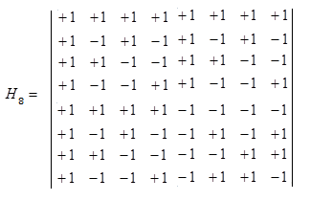
Replication methods for multistage sample

Slide 49
Replication methods for multistage sample
Fays method
Pseudo- stratum | School |  | R1 | R2 | R3 | R4 | R5 | R6 | R7 | R8
1 | 1 |  | 1.5 | 1.5 | 1.5 | 1.5 | 1.5 | 1.5 | 1.5 | 1.5
1 | 2 |  | 0.5 | 0.5 | 0.5 | 0.5 | 0.5 | 0.5 | 0.5 | 0.5
2 | 3 |  | 1.5 | 0.5 | 1.5 | 0.5 | 1.5 | 0.5 | 1.5 | 0.5
2 | 4 |  | 0.5 | 1.5 | 0.5 | 1.5 | 0.5 | 1.5 | 0.5 | 1.5
3 | 5 |  | 1.5 | 1.5 | 0.5 | 0.5 | 1.5 | 1.5 | 0.5 | 0.5
3 | 6 |  | 0.5 | 0.5 | 1.5 | 1.5 | 0.5 | 0.5 | 1.5 | 1.5
4 | 7 |  | 1.5 | 0.5 | 0.5 | 1.5 | 1.5 | 0.5 | 0.5 | 1.5
4 | 8 |  | 0.5 | 1.5 | 1.5 | 0.5 | 0.5 | 1.5 | 1.5 | 0.5
5 | 9 |  | 1.5 | 1.5 | 1.5 | 1.5 | 0.5 | 0.5 | 0.5 | 0.5
5 | 10 |  | 0.5 | 0.5 | 0.5 | 0.5 | 1.5 | 1.5 | 1.5 | 1.5

Slide 50
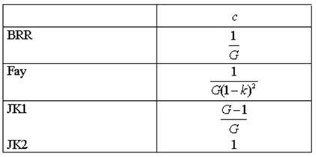
Replication methods for multistage sample
General formula
BRR / Fay : each replicate is an estimate of the sampling variance
C = average
Same number of replicate for each country
JK2 : each replicate corresponds of the pseudo-stratum to the sampling variance estimate
C = sum
Possibility of different number of replicates

Slide 51
Replication methods for multistage sample
In the case of infinite populations, the sampling variance of the mean estimate consists of 2 components in the case of a PISA sampling design:
Between school variance
Within school variance
Replication methods, by removing entire schools, only integrate the uncertainty due to the selection of schools, not due to the selection of students within schools

Slide 52
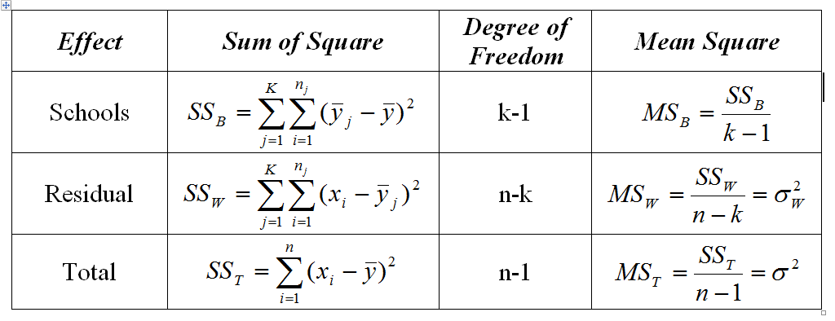
Replication methods for multistage sample
Let us image an educational system with no school variance and with infinite populations of students within schools

Slide 53
Replication methods for multistage sample
An illustration of this mathematical equality:
Estimation of the SE by JK1 replication method
School | Full | R1 | R2 | R3 | R4 | R5 | R6 | R7 | R8 | R9 | R10
1 | 100 |  | 100 | 100 | 100 | 100 | 100 | 100 | 100 | 100 | 100
2 | 110 | 110 |  | 110 | 110 | 110 | 110 | 110 | 110 | 110 | 110
3 | 120 | 120 | 120 |  | 120 | 120 | 120 | 120 | 120 | 120 | 120
4 | 130 | 130 | 130 | 130 |  | 130 | 130 | 130 | 130 | 130 | 130
5 | 140 | 140 | 140 | 140 | 140 |  | 140 | 140 | 140 | 140 | 140
6 | 150 | 150 | 150 | 150 | 150 | 150 |  | 150 | 150 | 150 | 150
7 | 160 | 160 | 160 | 160 | 160 | 160 | 160 |  | 160 | 160 | 160
8 | 170 | 170 | 170 | 170 | 170 | 170 | 170 | 170 |  | 170 | 170
9 | 180 | 180 | 180 | 180 | 180 | 180 | 180 | 180 | 180 |  | 180
10 | 190 | 190 | 190 | 190 | 190 | 190 | 190 | 190 | 190 | 190
Mean | 145.0 | 150.0 | 148.9 | 147.8 | 146.7 | 145.6 | 144.4 | 143.3 | 142.2 | 141.1 | 140.00
 |  | 25.00 | 15.12 | 7.72 | 2.78 | 0.31 | 0.31 | 2.78 | 7.72 | 15.12 | 25.00

Slide 54
Replication methods for multistage sample
An illustration of this mathematical equality:
Estimation of the SE by the formula
School | School mean
1 | 100 | 2025
2 | 110 | 1225
3 | 120 | 625
4 | 130 | 225
5 | 140 | 25
6 | 150 | 25
7 | 160 | 225
8 | 170 | 625
9 | 180 | 1225
10 | 190 | 2025
Mean | 145
 | SS | 8250
 | MS | 916.666667

