Slide 1


Sampling Design for International Surveys in Education
Guide to the PISA Data Analysis Manual

Slide 2
Why drawing a sample, but not a census
Finite versus Infinite
Most human populations can be listed but other types of populations (e.g. mosquitoes) cannot; however their sizes can be estimated from sample
If a sample from a finite population is drawn from a finite population with replacement, then the population is assimilated to an infinite population
Costs of a census
Time to collect, code or mark, enter the data into electronic files and analyze the data
Delaying the publication of the results, delay incompatible with the request of the survey sponsor
The census will not necessarily bring additional information

Slide 3
What is a simple random sample (SRS)?
Let us assume a population of N cases.
To draw a simple random sample of n cases:
Each individual must have a non zero probability of selection (coverage, exclusion);
All individuals must have the same probability of selection, i.e. a equi-probabilistic sample and self-weighted sample
Cases are drawn independently each others

Slide 4
What is a simple random sample (SRS)?
SRS is assumed by most statistical software packages (SAS, SPSS, Statistica, Stata, R…) for the computation of standard errors (SE);
If the assumption is not correct (i.e. cases were not drawn according to a SRS design)
estimates of SE will be biased;
therefore P values and inferences will be incorrect
In most cases, null hypothesis will be rejected while it should have been accepted

Slide 5
How to draw a simple random sample
There are several ways to draw a SRS:
The N members of the population are numbered and n of them are selected by random numbers, without replacement; or
N numbered discs are placed in a container, mixed well, and n of them are randomly selected; or
The N population members are arranged in a random order, and every N/n member is then selected or the first n individuals are selected.

Slide 6
Criteria for differentiating samples
Randomness : use of inferential statistics
Probabilistic sample
Non-probabilistic sample
Convenience sample, quota sample
Single-stage versus multi-stage samples
Direct or indirect draws of population members
Selection of schools, then classes, then students

Slide 7
Criteria for differentiating samples
Probability of selection
Equiprobabilistic samples
Samples with varying probabilities
Selection of farms according to the livestock size
Selection of schools according to the enrolment figures (PPS: Probability Proportional to Size)
Stratification
Explicit stratification ≈ dividing the population into different subpopulations and drawing independent samples within each stratum

Slide 8
Criteria for differentiating samples
Stratification
Explicit stratification
Implicit stratification ≈ sorting the data according to one or several criteria and then applying a systematic sampling procedure
Estimating the average weight of a group of students
sorting students according to their height
Defining the sampling interval (N/n)
Selecting every (N/n)^{th} students

Slide 9
Criteria for designing a sample in education
The target population (population of inference): a single grade cohort (IEA studies) versus age cohort, typically a twelve-month span (PISA)
Grade cohort
In a particular country, meaningful for policy makers and easy to define the population and to sample it
How to define at the international level grades that are comparable?
Average age
Educational reform that impact on age average

Slide 10
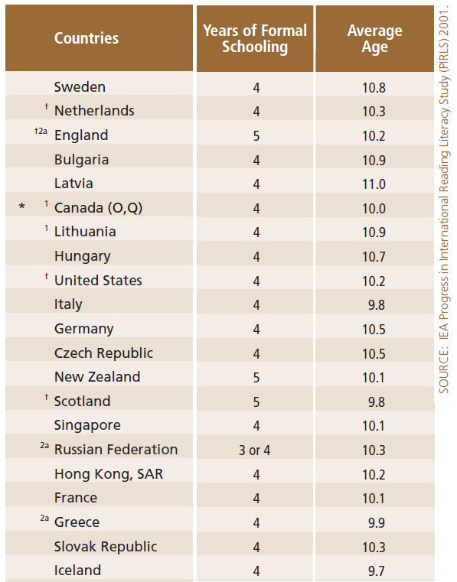
Criteria for designing a sample in education

Slide 11
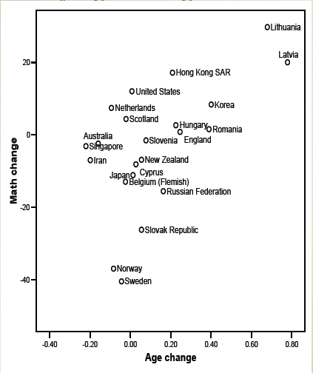
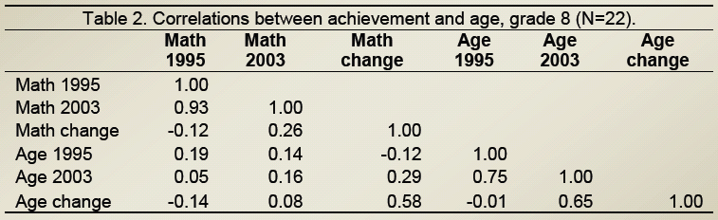
Criteria for designing a sample in education
TIMSS grade 8 : Change in performance between 1995 and 2003
Extract from the J.E. Gustafsson in Loveless, T (2007)

Slide 12
Criteria for designing a sample in education
Age cohort
Same average age, same one year age span
Varying grades
Not so interesting at the national level for policy makers
Administration difficulties
Difficulties for building the school frame

Slide 13
Criteria for designing a sample in education
Multi-stage sample
Grade population
Selection of schools
Selection of classes versus students of the target grade
Student sample more efficient but impossible to link student data with teacher / class data,
Age population
Selection of schools and then selection of students across classes and across grades

Slide 14
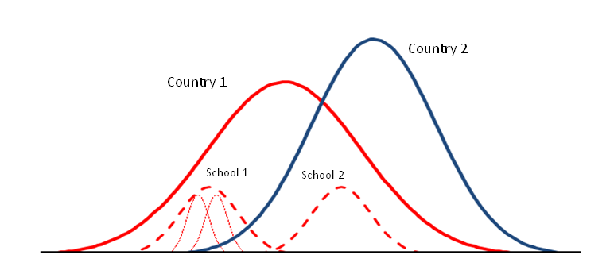


Criteria for designing a sample in education
School / Class / Student Variance
Notes:
Ai mis une majuscule à Representation, en général en anglais ils mettent une majuscule au titre des figures même après :

Slide 15
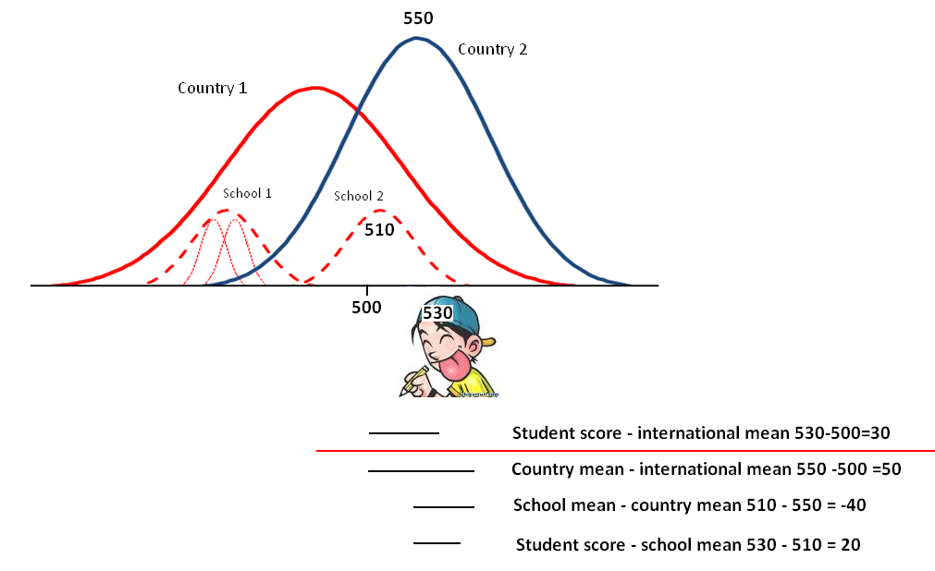
Criteria for designing a sample in education
School / Class / StudentVariance

Slide 16
Criteria for designing a sample in education
School / Class / StudentVariance

Slide 17
Criteria for designing a sample in education
School / Class / Student Variance

Slide 18
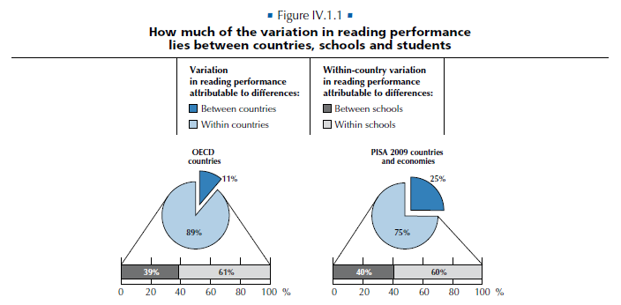
Criteria for designing a sample in education
OECD (2010). PISA 2009 Results: What Makes a School Successfull? Ressources, Policies and Practices. Volume IV. Paris: OECD.

Slide 19
Variance Decomposition Reading Literacy PISA 2000
Criteria for designing a sample in education

Slide 20
Criteria for designing a sample in education
What is the best representative sample:
100 schools and 10 students per school; OR
20 schools and 50 students per school?
Systems with very low school variance
Each school ≈ SRS
Equally accurate for student level estimates
Not equally accurate for school level estimates
In Belgium, about 60 % of the variance lies between schools:
Each school is representative of a narrow part of the population only
Better to sample 100 schools, even for student level estimates

Slide 21
Criteria for designing a sample in education
Data collection procedures
Test Administrators
External
Internal
Online data collection procedures
Cost of the survey
Accuracy
IEA studies: effective sample size of 400 students
Maximizing accuracy with stratification variables

Slide 22
Weights Simple Random Sample

Slide 23
Weights Simple Random Sample

Slide 24
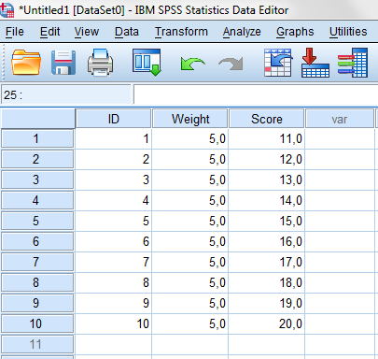
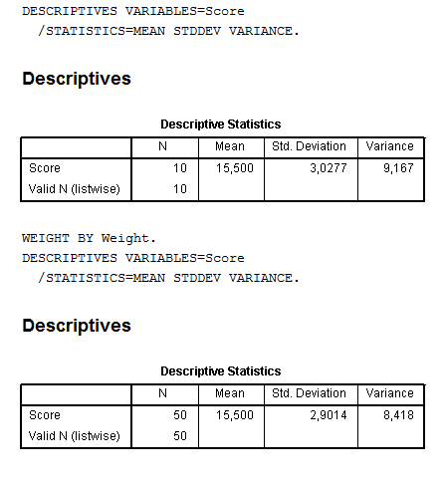
Weights Simple Random Sample (SRS)

Slide 25
Weights Multi-Stage Sample : SRS & SRS
Population of
10 schools with exactly
40 students per school
SRS Samples of
4 schools
10 students per school

Slide 26
Weights Multi-Stage Sample : SRS & SRS

Slide 27
Weights Multi-Stage Sample : SRS & SRS
Sch ID | Size | P_{i} | W_{i} | P_{j|i} | W_{j|i} | P_{ij} | W_{ij} | Sum(W_{ij})
1 | 40
2 | 40 | 0.4 | 2.5 | 0.25 | 4 | 0.1 | 10 | 100
3 | 40
4 | 40
5 | 40 | 0.4 | 2.5 | 0.25 | 4 | 0.1 | 10 | 100
6 | 40
7 | 40 | 0.4 | 2.5 | 0.25 | 4 | 0.1 | 10 | 100
8 | 40
9 | 40
10 | 40 | 0.4 | 2.5 | 0.25 | 4 | 0.1 | 10 | 100
Total |  |  | 10 |  |  |  |  | 400

Slide 28
Weights Multi-Stage Sample : SRS & SRS
Sch ID | Size | P_{i} | W_{i} | P_{j|i} | W_{j|i} | P_{ij} | W_{ij} | Sum(W_{ij})
1 | 10
2 | 15 | 0.4 | 2.5 | 0.66 | 1.5 | 0.27 | 3.75 | 37.5
3 | 20
4 | 25
5 | 30 | 0.4 | 2.5 | 0.33 | 3 | 0.13 | 7.5 | 75
6 | 35
7 | 40 | 0.4 | 2.5 | 0.25 | 4 | 0.1 | 10 | 100
8 | 45
9 | 80
10 | 100 | 0.4 | 2.5 | 0.1 | 10 | 0.04 | 25 | 250
Total | 400 |  | 10 |  |  |  |  | 462.5

Slide 29
Weights Multi-Stage Sample : SRS & SRS
Sch ID | Size | P_{i} | W_{i} | P_{j|i} | W_{j|i} | P_{ij} | W_{ij} | Sum(W_{ij})
1 | 10 | 0.4 | 2.5 | 1 | 1 | 0.4 | 2.5 | 25
2 | 15 | 0.4 | 2.5 | 0.66 | 1.5 | 0.27 | 3.75 | 37.5
3 | 20 | 0.4 | 2.5 | 0.5 | 2 | 0.2 | 5 | 50
4 | 25 | 0.4 | 2.5 | 0.4 | 2.5 | 0.16 | 6.25 | 62.5
Total |  |  | 10 |  |  |  |  | 175
Sch ID | Size | P_{i} | W_{i} | P_{j|i} | W_{j|i} | P_{ij} | W_{ij} | Sum(W_{ij})
7 | 40 | 0.4 | 2.5 | 0.250 | 4 | 0.10 | 10.00 | 100.0
8 | 45 | 0.4 | 2.5 | 0.222 | 4.5 | 0.88 | 11.25 | 112.5
9 | 80 | 0.4 | 2.5 | 0.125 | 8 | 0.05 | 20.00 | 200.0
10 | 100 | 0.4 | 2.5 | 0.100 | 10 | 0.04 | 25.00 | 250.0
Total |  |  | 10 |  |  |  |  | 662.5

Slide 30
Weights Multi-Stage Sample : PPS & SRS

Slide 31
Weights Multi-Stage Sample : PPS & SRS
Sch ID | Size | P_{i} | W_{i} | P_{j|i} | W_{j|i} | P_{ij} | W_{ij} | Sum(W_{ij})
1 | 10
2 | 15
3 | 20 | 0.2 | 5.00 | 0.500 | 2.0 | 0.1 | 10 | 100
4 | 25
5 | 30
6 | 35
7 | 40 | 0.4 | 2.50 | 0.250 | 4.0 | 0.1 | 10 | 100
8 | 45
9 | 80 | 0.8 | 1.25 | 0.125 | 8.0 | 0.1 | 10 | 100
10 | 100 | 1 | 1.00 | 0.100 | 10.0 | 0.1 | 10 | 100
Total | 400 |  | 9.75 |  |  |  |  | 400

Slide 32
Weights Multi-Stage Sample : PPS & SRS
Sch ID | Size | P_{i} | W_{i} | P_{j|I} | W_{j|i} | P_{ij} | W_{ij} | Sum(W_{ij})
1 | 10 | 0.10 | 10.00 | 1.00 | 1.00 | 0,10 | 10 | 100
2 | 15 | 0.15 | 6,67 | 0.67 | 1.50 | 0,10 | 10 | 100
3 | 20 | 0,20 | 5.00 | 0.50 | 2.00 | 0,10 | 10 | 100
4 | 25 | 0.25 | 4.00 | 0.40 | 2.50 | 0,10 | 10 | 100
Total |  |  | 25.67 |  |  |  |  | 400
Sch ID | Size | P_{i} | W_{i} | P_{j|i} | W_{j|i} | P_{ij} | W_{ij} | Sum(W_{ij})
7 | 40 | 0.40 | 2.50 | 0.25 | 4.00 | 0,10 | 10 | 100
8 | 45 | 0.45 | 2.22 | 0.22 | 4.50 | 0,10 | 10 | 100
9 | 80 | 0.80 | 1.25 | 0.13 | 8.00 | 0,10 | 10 | 100
10 | 100 | 1.00 | 1.00 | 0.10 | 10.00 | 0,10 | 10 | 100
Total |  |  | 6.97 |  |  |  |  | 400

Slide 33
How to draw a Multi-Stage Sample : PPS & SRS
Several steps
1. Data cleaning of school sample frame;
2. Selection of stratification variables;
3. Computation of the school sample size per explicit stratum;
4. Selection of the school sample.

Slide 34
How to draw a Multi-Stage Sample : PPS & SRS
Step 1:data cleaning:
Missing data
School ID
Stratification variables
Measure of size
Duplicate school ID
Plausibility of the measure of size:
Age, grade or total enrolment
Outliers (+/- 3 STD)
Gender distribution …

Slide 35
How to draw a Multi-Stage Sample : PPS & SRS
Step 2: selection of stratification variables
Improving the accuracy of the population estimates
Selection of variables that highly correlate with the survey main measures, i.e. achievement
% of over-aged students (Belgium)
School type (Gymnasium, Gesantschule, Realschule, Haptschule)
Reporting results by subnational level
Provinces, states, Landers
Tracks
Linguistics entities

Slide 36
How to draw a Multi-Stage Sample : PPS & SRS
Step 3: computation of the school sample size for each explicit stratum
Proportional to the number of
students
schools

Slide 37
How to draw a Multi-Stage Sample : PPS & SRS
Stratum | School ID | Size
1 | 1 | 20
1 | 2 | 20
1 | 3 | 20
1 | 4 | 20
1 | 5 | 20
2 | 6 | 60
2 | 7 | 60
2 | 8 | 60
2 | 9 | 60
2 | 10 | 60
5 schools and 100 students
5 schools and 100 students

Slide 38
Proportional to the number of schools (i.e. 2 schools per stratum and 10 students per school)
How to draw a Multi-Stage Sample : PPS & SRS
Stratum | School ID | Size | W_{i} | W_{j|i} | W_{ij}
1 | 1 | 20
1 | 2 | 20 | 2.50 | 2 | 5
1 | 3 | 20
1 | 4 | 20 | 2.50 | 2 | 5
1 | 5 | 20
2 | 6 | 60
2 | 7 | 60 | 2.50 | 6 | 15
2 | 8 | 60
2 | 9 | 60 | 2.50 | 6 | 15
2 | 10 | 60

Slide 39
Proportional to the number of students
How to draw a Multi-Stage Sample : PPS & SRS
Stratum | Number of schools | Number of students | % | Schools to be sampled | W_{i} | W_{j|i} | W_{ij}
1 | 5 | 100 | 25% | 1 | 5 | 2 | 10
2 | 5 | 300 | 75% | 3 | 5/3 | 6 | 10
This is an example as it is required to have at least 2 schools per explicit stratum

Slide 40
How to draw a Multi-Stage Sample : PPS & SRS
Step 4: selection of schools
Distributing as many lottery tickets as students per school and then SRS of n tickets
A school can be drawn more than once
Important sampling variability for the sum of school weights
From 6.97 to 25.67 in the example
Sch ID | Size | P_{i} | W_{i} | Sch ID | Size | P_{i} | W_{i}
1 | 10 | 0.10 | 10.00 | 7 | 40 | 0.40 | 2.50
2 | 15 | 0.15 | 6.67 | 8 | 45 | 0.45 | 2.22
3 | 20 | 0.20 | 5.00 | 9 | 80 | 0.80 | 1.25
4 | 25 | 0.25 | 4.00 | 10 | 100 | 1.00 | 1.00
Total |  |  | 25.67 | Total |  |  | 6.97

Slide 41
How to draw a Multi-Stage Sample : PPS & SRS
Step 4: selection of schools
Use of a systematic procedure for minimizing the sampling variability of the school weights
Sorting schools by size
Computation of a school sampling interval
Drawing a random number from a uniform distribution [0,1]
Application of a systematic procedure
Impossibility of selecting the n_{sc} smallest schools or the n_{sc} biggest schools

Slide 42
How to draw a Multi-Stage Sample : PPS & SRS
Computation of the sampling interval, i.e.
Random draw from a uniform distribution [0,1], i.e. 0.125
Multiplication of the random number by the sampling interval
The school that contains 12 is selected
Systematic application of the sampling interval, i.e. 112, 212, 312
ID | Size | From | To | SAMPLED
1 | 15 | 1 | 15 | 1
2 | 20 | 16 | 35 | 0
3 | 25 | 36 | 60 | 0
4 | 30 | 61 | 90 | 0
5 | 35 | 91 | 125 | 1
6 | 40 | 126 | 165 | 0
7 | 45 | 166 | 210 | 0
8 | 50 | 211 | 260 | 1
9 | 60 | 261 | 320 | 0
10 | 80 | 321 | 400 | 1
Total | 400

Slide 43
How to draw a Multi-Stage Sample : PPS & SRS
Certainty schools
ID | Size | P_{i} | W_{i}
1 | 10 | 0.10 | 10.00
2 | 15 | 0.15 | 6.67
3 | 20 | 0.20 | 5.00
4 | 25 | 0.25 | 4.00
5 | 30 | 0.30 | 3.33
6 | 35 | 0.35 | 2.86
7 | 40 | 0.40 | 2.50
8 | 45 | 0.45 | 2.22
9 | 50 | 0.50 | 2.00
10 | 130 | 1.30 | 0.77
Total | 400
 | ID | Size | P_{i} | W_{i}
1 | 1 | 10 | 0.11 | 9.00
 | 2 | 15 | 0.17 | 6.00
 | 3 | 20 | 0.22 | 4.50
 | 4 | 25 | 0.28 | 3.60
 | 5 | 30 | 0.33 | 3.00
 | 6 | 35 | 0.39 | 2.57
 | 7 | 40 | 0.44 | 2.25
 | 8 | 45 | 0.50 | 2.00
 | 9 | 50 | 0.56 | 1.80
 | Total | 270
2 | 10 | 130 | 1 | 1
3
4

Slide 44
Weight variability (w_fstuwt)
OECD (PISA 2006)
Country | Mean | P5 | P95 | STD | CV
AUS | 16.6 | 3.1 | 29.1 | 9.0 | 54.3
AUT | 18.3 | 10.2 | 33.4 | 6.6 | 36.0
BEL | 13.9 | 1.1 | 22.3 | 6.3 | 45.5
CAN | 16.4 | 1.1 | 66. | 21.5 | 131.5
CHE | 7.4 | 1.0 | 20.8 | 7.1 | 96.8
CZE | 21.7 | 2.2 | 49.8 | 14.5 | 66.8
DEU | 184.7 | 127.4 | 273.3 | 46.1 | 25.0
DNK | 12.6 | 7.7 | 20.1 | 3.7 | 29.3
ESP | 19.5 | 2.1 | 83.1 | 26.8 | 137.5
FIN | 13.0 | 10.9 | 15.8 | 2.2 | 16.6
FRA | 156.8 | 136.7 | 193.3 | 19.1 | 12.2
GBR | 55.7 | 7.0 | 152.9 | 56.3 | 101.2
GRC | 19.8 | 11.5 | 33.1 | 6.4 | 32.4
HUN | 23.6 | 15.4 | 39.5 | 7.2 | 30.6
IRL | 12.0 | 10.0 | 15.2 | 1.8 | 15.2
ISL | 1.2 | 1.0 | 1.5 | 0.1 | 12.2
ITA | 23.9 | 1.2 | 93.5 | 27.7 | 116.1

Slide 45
Weight variability
Why do weights vary at the end?
Oversampling (Ex: Belgium, PISA 2009)
Belgian Communities | Sample size | Average weight | Sum of weights
Flemish | 4596 | 14.33 | 65847
French | 3109 | 16.87 | 52453
German | 796 | 1.05 | 839
Non-response adjustment
Lack of accuracy of the school sample frame
Changes in the Measure of Size (MOS)

Slide 46
Weight variability
Lack of accuracy / changes.
PISA 2009 main survey
School sample drawn in 2008;
MOS of 2006
Ex: 4 schools with the same p_{i}, selection of 20 students
ID | Old Size | P_{i} | W | New size | P_{j|i} | W_{j|i} | P_{ij} | W_{ij} | Sum(W_{ij})
1 | 100 | 0.20 | 5 | 200 | 0.10 | 10 | 0.020 | 50 | 1000
2 | 100 | 0.20 | 5 | 140 | 0.14 | 7 | 0.028 | 35 | 700
3 | 100 | 0.20 | 5 | 80 | 0.25 | 4 | 0.050 | 20 | 400
4 | 100 | 0.20 | 5 | 40 | 0.50 | 2 | 0.100 | 10 | 200
Larger risk with small or very small schools

Slide 47
Weight variability
Non-response adjustment (school / student ) : ratio between the number of units that should have participated and the number of units that actually participated
Stratum | ID | Size | W_{i} | Parti. | W_{i}_ad | W_{j|i} | W_{ij} | Parti. | W_{ij}_ad | Sum
1 | 1 | 20
 | 2 | 20 | 5.00 | 1 | 5.00 | 2.00 | 10 | 8 | 12.5 | 100
 | 3 | 20
 | 4 | 20
 | 5 | 20
 | Total | 100 |  |  |  |  |  |  |  | 100
2 | 6 | 60 | 1.66 | 1 | 2.50 | 6.00 | 15 | 8 | 18.75 | 150
 | 7 | 60
 | 8 | 60 | 1.66 | 0
 | 9 | 60 | 1.66 | 1 | 2.50 | 6.00 | 15 | 10 | 15 | 150
 | 10 | 60
 | Total | 300 | 5 |  |  |  |  |  |  | 300

Slide 48
Different types of weight
3 types of weight:
TOTAL weight: the sum of the weights is an estimate of the target population size
CONSTANT weight : the sum of the weights for each country is a constant (for instance 1000)
Used for scale (cognitive and non cognitive) standardization
SAMPLE weight : the sum of the weights is equal to the sample size

