Slide 1


Scaling of the Cognitive Data and Use of Student Performance Estimates
Guide to the PISA Data Analysis Manual

Slide 2
Classical Test Theory versus Item Response Theory
Questions
What is the Rasch model?
Why do International Surveys use the Rasch model or another IRT model?
Which kind of information do we get from the Rasch model?
Test design
Experts groups request lots of items
School principals want to limit testing time
⇒ Incomplete design

Slide 3
Classical Test Theory versus Item Response Theory
Incomplete Block Design
Booklet | Part 1 | Part 2 | Part 3 | Part 4
1 | M1 | M2 | M4 | S1
2 | M2 | M3 | M5 | S2
3 | M3 | M4 | M6 | P1
4 | M4 | M5 | M7 | P2
5 | M5 | M6 | R1 | M1
6 | M6 | M7 | R2 | M2
7 | M7 | R1 | S1 | M3
8 | R1 | R2 | S2 | M4
9 | R2 | S1 | P1 | M5
10 | S1 | S2 | P2 | M6
11 | S2 | P1 | M1 | M7
12 | P1 | P2 | M2 | R1
13 | P2 | M1 | M3 | R2
UH | M-R-S-P | M-R-S-P

Slide 4
Classical Test Theory versus Item Response Theory
Impossible comparisons
How can we compare the difficulty of two items from two different test booklets?
How can we compare the performance of two students who have answered two different test booklets?
Long time ago
Test booklets have exactly the same difficulty and therefore the differences in score reflects differences in abilities
OR / AND
The randomization of test allocation guarantees the comparability of the sub-populations and therefore differences in item parameters reflect differences in item difficulties

Slide 5
Item Response Theory
IRT models solve this problem:
None of the above assumptions has to be made
As far as there is a link between the test booklets
Item difficulties can be compared
Student performances can be compared

Slide 6
Item Response Theory
What is the performance of the jumper? Is it…
Individual record?
Individual record during an official event?
The mean of performance during a particular period of time?
The most frequent performance during a particular period of time?
Use of the logistic regression

Slide 7
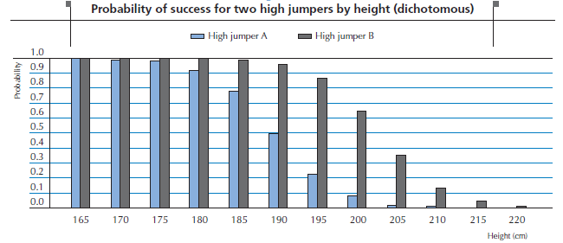
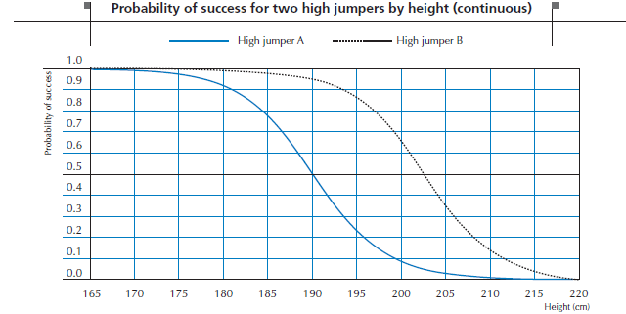
Rasch Item Response Theory

Slide 8
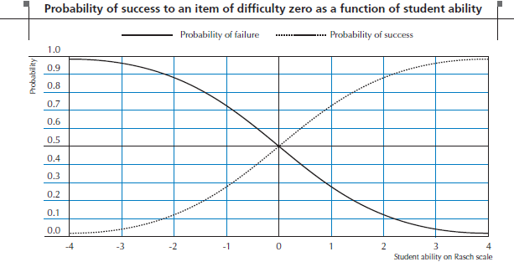
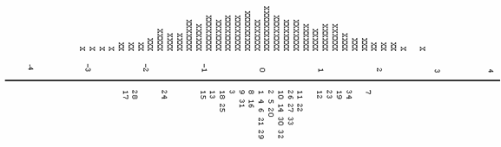
Rasch Item Response Theory

Slide 9
Rasch Item Response Theory
How can we predict a probability of success or failure?
Linear regression
The dependent variable can vary from -∞ to + ∞

Slide 10
Rasch Item Response Theory
Rasch IRT Model
One-parameter logistic model

Slide 11
Rasch Item Response Theory
Item Characteristics Curves (ICC)

Slide 12
Rasch Item Response Theory
Student performance | Item Difficulty | Probability | Student performance | Item Difficulty | Probability
-2 | -2 | 0.50
-1 | -1 | 0.50
0 | 0 | 0.50
1 | 1 | 0.50
2 | 2 | 0.50
-2 | -3 | 0.73 | -2 | -1 | 0.27
-1 | -2 | 0.73 | -1 | 0 | 0.27
0 | -1 | 0.73 | 0 | 1 | 0.27
1 | 0 | 0.73 | 1 | 2 | 0.27
2 | 1 | 0.73 | 2 | 3 | 0.27
-2 | -4 | 0.88 | -2 | 0 | 0.12
-1 | -3 | 0.88 | -1 | 1 | 0.12
0 | -2 | 0.88 | 0 | 2 | 0.12
1 | -1 | 0.88 | 1 | 3 | 0.12
2 | 0 | 0.88 | 2 | 4 | 0.12

Slide 13
Rasch Item Response Theory
Item Characteristics Curves (ICC) Partial Credit Item

Slide 14
Rasch Item Response Theory
Partial Credit Item

Slide 15
Rasch Item Response Theory
|
|
X|
|
X|
2 XX|
XX|7
XX|
XXX|34
XXX|19
XXXX|23
1 XXXXXX|12
XXXXXX|
XXXXX|11 22
XXXXXX|26 27 33
XXXXXXX|10 14 30 32
XXXXXXX|2 5 20
0 XXXXXXXX|1 4 6 21 29
XXXXXXXXXX|8 16
XXXXXXX|9 31
XXXXXXXXX|3
XXXXXXXX|18 25
XXXXXXXX|13
-1 XXXXXXX|15
XXXXXXXX|
XXXXXX|
XXXXXXX|
XXXX|24
XXXX|
-2 XXXXX|
XXX|28
XX|17
XX|
XX|
X|
-3 X|
X|
X|
|
High Achievers
Difficult items
Low Achievers
Easy items

Slide 16
Rasch Item Response Theory
Step 1: item calibration
Different methods
1) Joint Maximum Likelihood (JML)
2) Conditional Maximum Likelihood (CML)
3) Marginal Maximum Likelihood (MML)
4) Bayesian modal estimation
5) Markov Chain Monte Carlo (MCMC).
Relative scale (Celsius scale)

Slide 17
Rasch Item Response Theory
Step 2: Student proficiency estimates
Test of 4 items
Raw score | Response patterns
0 | (0,0,0,0)
1 | (1,0,0,0), (0,1,0,0), (0,0,1,0), (0,0,0,1)
2 | (1,1,0,0), (1,0,1,0), (1,0,0,1), (0,1,1,0), (0,1,0,1), (0,0,1,1)
3 | (1,1,1,0),(1,1,0,1), (1,0,1,1), (0,1,1,1)
4 | (1,1,1,1)

Slide 18
Rasch Item Response Theory
Step 2: Student proficiency estimates
Probability to observe a response pattern (1100)
 |  |  | B=-1 | B=0 | B=1
Item 1 | D=-1 | Response=1 | 0.50 | 0.73 | 0.88
Item 2 | D=-0.5 | Response=1 | 0.38 | 0.62 | 0.82
Item 3 | D=0.5 | Response=0 | 0.82 | 0.62 | 0.38
Item 4 | D=1 | Response=0 | 0.88 | 0.73 | 0.50
Global P |  |  | 0.14 | 0.21 | 0.14

Slide 19
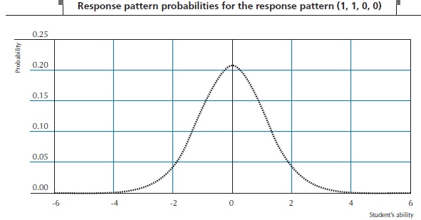
Rasch Item Response Theory
Step 2: Student proficiency estimates
Likelihood function for a response pattern (1, 1, 0, 0)

Slide 20
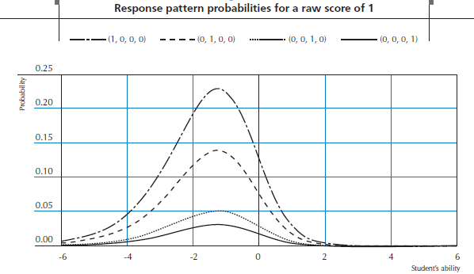
Rasch Item Response Theory
Step 2: Student proficiency estimates
Likelihood functions for a score of 1

Slide 21
Rasch Item Response Theory
Step 2: Student proficiency estimates
Likelihood functions for a score of [0,0,0,0], [1,0,0,0], [1,1,0,0], [1,1,1,0], [1,1,1,1]

Slide 22
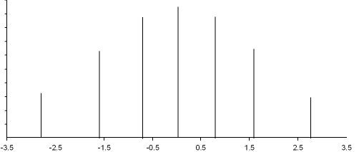
Distribution of MLE : test of 6 items
Rasch Item Response Theory
Score 3
Score 4
Score 2
Score 1
Score 5
Score 0
Score 6
Proficiency on Logit Scale

Slide 23
Rasch Item Response Theory
Easy test administered to low achievers, difficult test administered to high achievers
Likelihood functions for response pattern [1,0]
 |  |  | B=-1 | B=1
Item 1 | D=-1 | Response=1 | 0.50
Item 2 | D=-0.5 | Response=0 | 0.62
Item 3 | D=0.5 | Response=1 |  | 0.62
Item 4 | D=1 | Response=0 |  | 0.50
Global P |  |  | 0.31 | 0.31

Slide 24
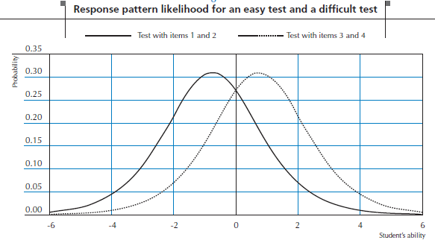
Rasch Item Response Theory
Easy test administered to low achievers, difficult test administered to high achievers
Likelihood functions for response pattern [1,0]

Slide 25
Other IRT models
Models with 1, 2 or 3 parameters (1-, 2- or 3-Parameter Logistic Models)
1 parameter:
Item difficulty
2 parameters :
Item difficulty
Item discrimination
3 parameters :
Item difficulty
Item discrimination
Guessing

Slide 26
Other IRT models
1, 2 and 3 PL IRT models

Slide 27
Other IRT models
1, 2 and 3 PL IRT models

Slide 28
Other IRT models
Generalized Partial Credit Model

Slide 29
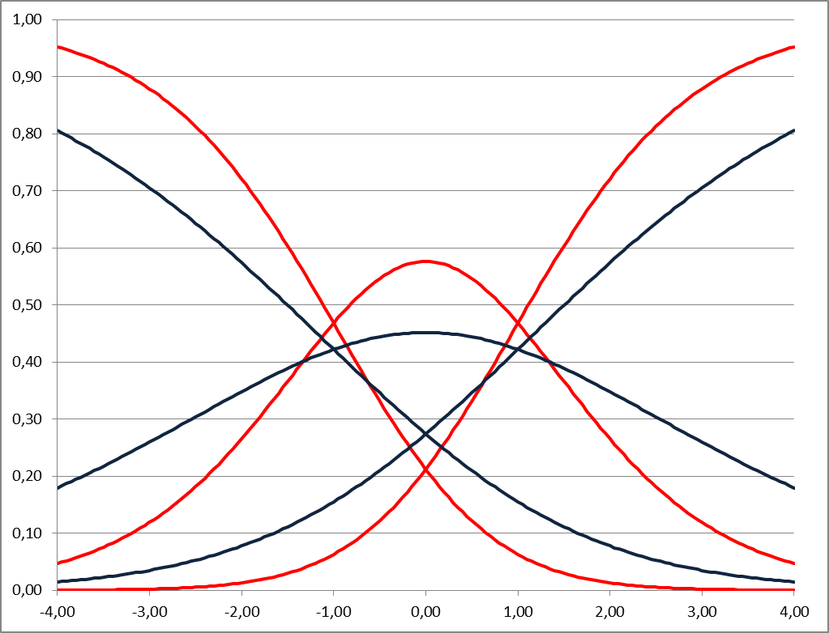
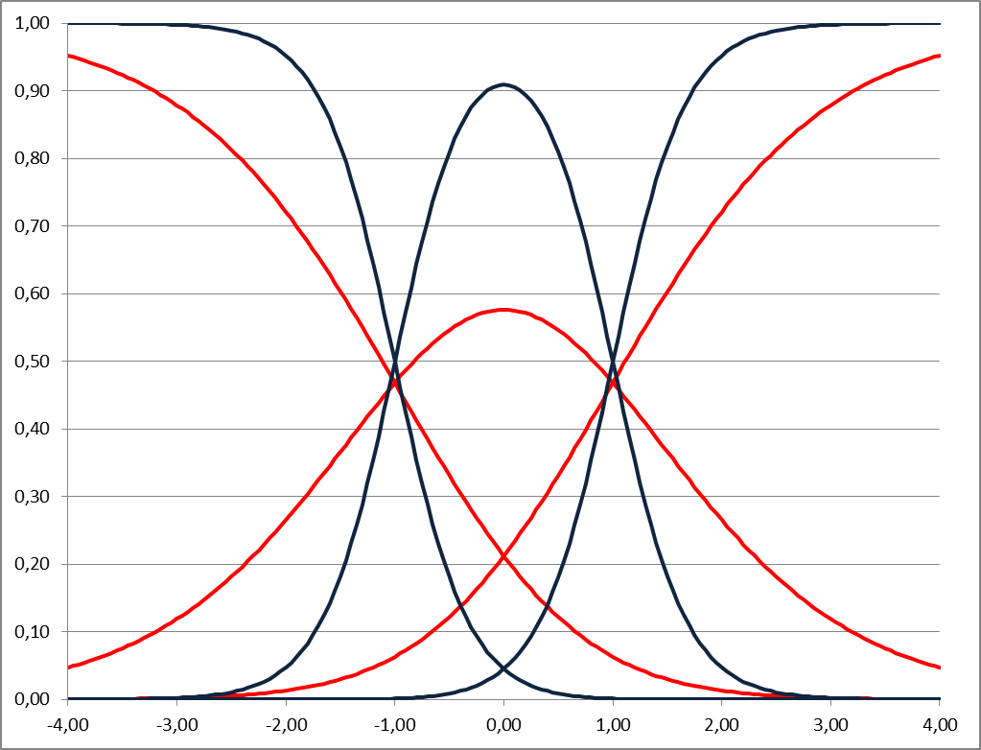
Other IRT models
Generalized Partial Credit Model
a=0.5
a=3

Slide 30
Item Response Theory
Student IRT estimates in PISA
Non Cognitive scales : Weighted Likelihood Estimate (WLE)
Student Contextual Questionnaire data
Student Reading Enjoyment, Sense of Belonging, Self Concept in Mathematics, Self Efficacy in Mathematics
School Contextual Questionnaire data
Shortage of teachers, Teacher morale
Cognitive scales : Plausible Values
What are plausible values?
Why do we use them?
How to analyze plausible values?

Slide 31
Plausible Values (PVs)
Purpose of Educational Assessments
Estimating the proficiency of particular students (minimize measurement error of individual estimates)
Estimating the population proficiency (mean, STD…) (minimize error when generalizing to the population)

Slide 32
Plausible Values
New tax on the façade length of the building

Slide 33
Plausible Values
Real length

Slide 34
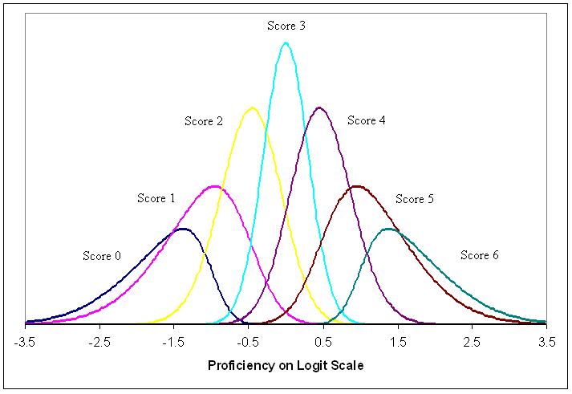
Plausible Values
Posterior distributions for test scores on 6 dichotomous items

Slide 35
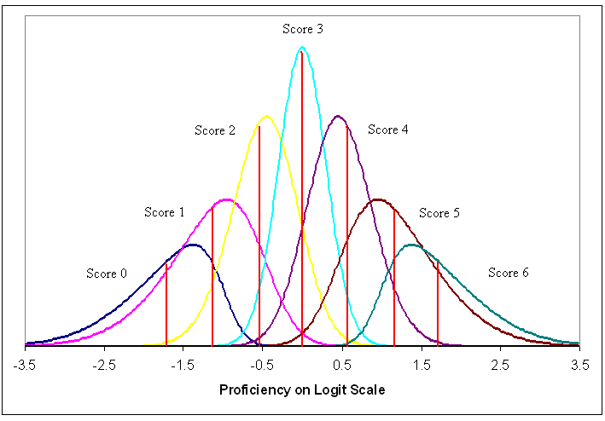
Plausible Values
EAP – Expected A Posteriori Estimator

Slide 36
Plausible Values
Methodology of PVs
Aim is building a continuum from a discontinuous variable to prevent biased inferences
Mathematically computing posterior distributions around test scores
Drawing 5 random values for each assessed individual from the posterior distribution for that individual
Individual estimates from PVs
Expected A Posteriori estimate (EAP), i.e. the mean of posterior distribution
Not a one to one relationship with raw score, unlike WLE
Notes:
EAP = ?

Slide 37
Plausible Values
Assuming normal distribution:
Model sub-populations:
X=0 for boy
X=1 for girl
Generalization

Slide 38
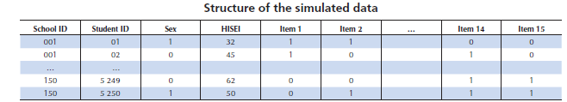
Plausible Values
Simulating data for assessing biases in WLE, EAP, PVs estimates
Generating item responses
True abilities are known
True relationships between abilities and background variables are known
Within- and between-school variances are known
Simulated item responses are used to estimate WLEs, EAPs and PVs with ConQuest

Slide 39
Plausible Values
Data file
150 schools with 35 students each
TRUE ability scores
Background variables:
HISEI
Gender (dichotomous), Gender (continuous)
School mean
Raw Score, WLE, EAP and PVs without conditioning, EAP and PVs with conditioning

Slide 40
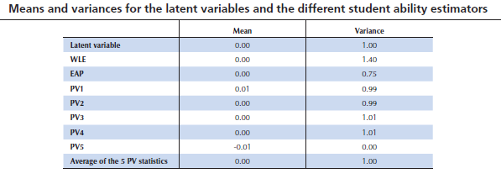
Plausible Values

Slide 41
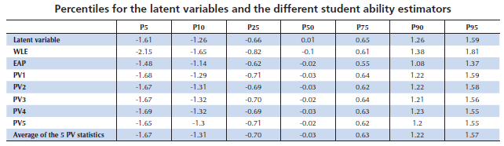
Plausible Values

Slide 42
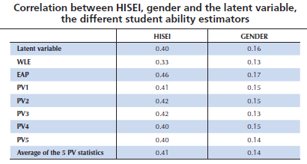
Plausible Values

Slide 43
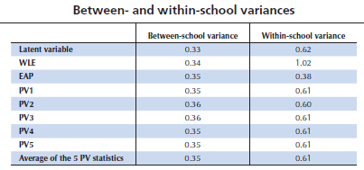
Plausible Values

Slide 44
Plausible Values
Note on conditioning
When analyzing relationships between ability and background variables, only PVs derived from a conditional model that includes the background variables as regressors give reliable population estimates.

Slide 45
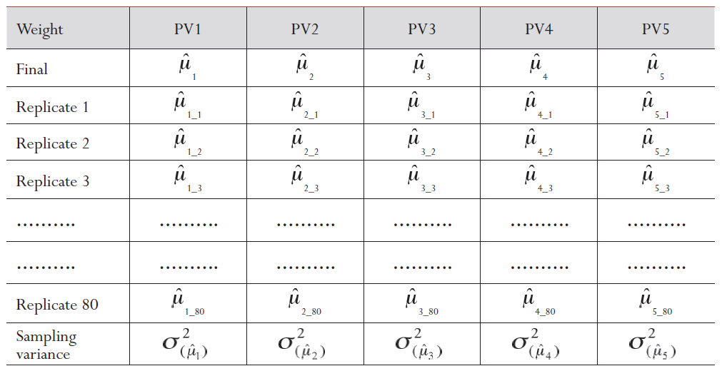
Plausible Values
How to analyze Plausible Values?

Slide 46
Plausible Values
Estimated mean is the AVERAGE of the mean for each PV
Sampling variance is the AVERAGE of the sampling variance for each PV
Where

Slide 47
Plausible Values
Measurement variance computed as:
Total Standard Error computed from measurement and Sampling Variance as:

Slide 48
Plausible Values
How to analyze Plausible Values?
can be replaced by any statistic, - SD - Percentile - Correlation coefficient - Regression coefficient - R-square - etc.

Slide 49
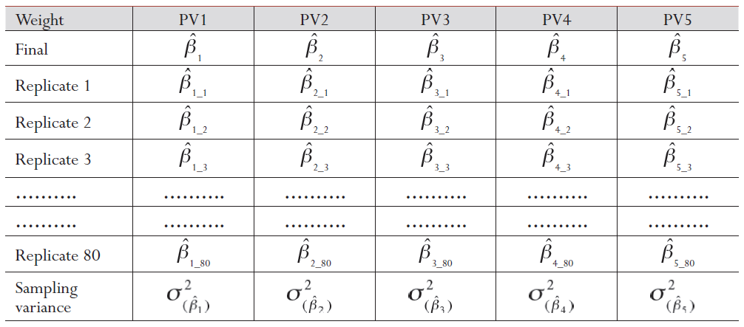
Plausible Values
How to analyze Plausible Values?

Slide 50
Plausible Values
Five steps for analyzing Plausible Values
Compute estimate for each PV
Compute final estimate by averaging 5 estimates from (1)
Compute sampling variance (average of sampling variance estimates for each PV)
Compute imputation variance (measurement error variance)
Compute final standard error by combining (3) and (4)

Slide 51
Remaining issues with PVs
Use of Proficiency levels
Biased / unbiased shortcuts
Correlations between PVs
Computation of trend indicators

Slide 52
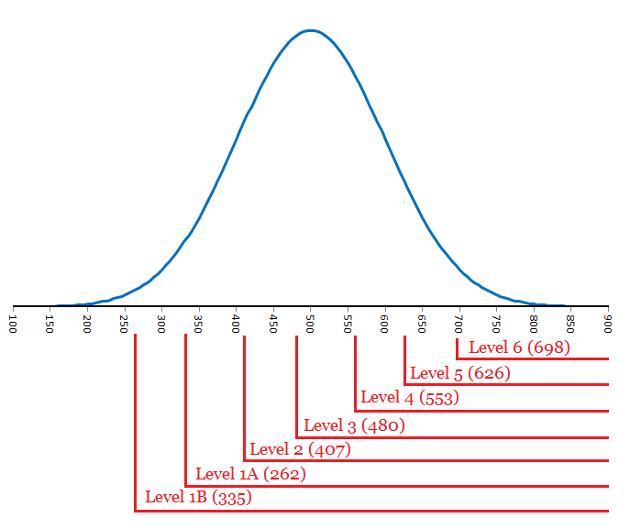
Proficiency levels
Proficiency level in reading (PISA 2009)

Slide 53

Proficiency levels
Top level
62 %
Average 70 %
78 %
Width = 0.72 logits
42 %
Average 52 %
Bottom level
62 %
One proficiency level (RP62)

Slide 54
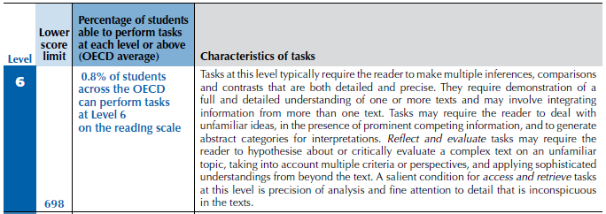
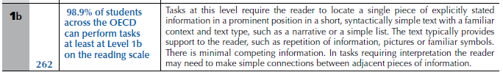
Proficiency levels

Slide 55
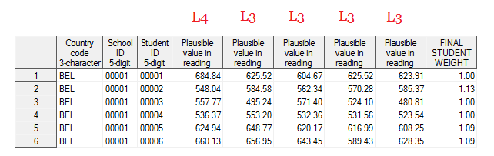
Proficiency levels
How to analyze the proficiency levels:

Slide 56
Proficiency levels
 | PVs | ≈EAP
Mean | 505.9 | 505.9
STD | 101.8 | 99.16
Level 6 | 1.12 | 0.97
Level 5 | 9.95 | 4.76
Level 4 | 25.03 | 11.61
Level 3 | 25.97 | 20.17
Level 2 | 20.31 | 26.06
Level 1A | 11.71 | 26.34
Level 1B | 4.76 | 9.56
Below | 1.15 | 0.52

Slide 57
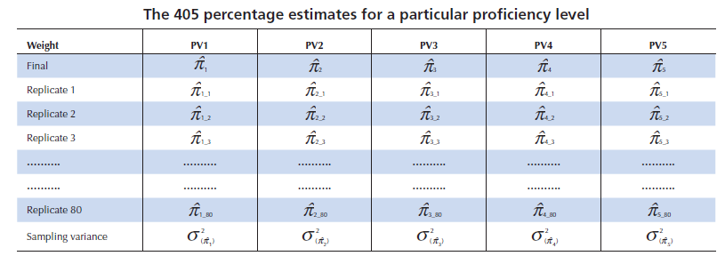
Proficiency levels
Recoding of 5 PVs into 5 Plausible Levels

Slide 58
Proficiency levels
Estimated percentage is the AVERAGE of the percentage for each PV
Sampling variance is the AVERAGE of the sampling variance for each PV
Where

Slide 59
Proficiency levels
Measurement variance computed as:
Total standard error computed from measurement and sampling variance as:

Slide 60
Biased / unbiased shortcut
Plausible values should never be aggregated at the student level:
Underestimation of the STD
Underestimation of the % of students at the lowest and highest proficiency levels and overestimation of median proficiency levels
Overestimation of lowest percentiles and underestimation of highest percentiles
Overestimation of correlation coefficients
…

Slide 61
Biased / unbiased shortcut
Mean estimates are not biased if PVs aggregated at the student level but Standard Errors
Will be underestimated
Will not incorporate measurement errors
 | BEL N=8501 | BEL 05611 N=1723 | BEL 05602 N=208
PV1 | 2.30 | 6.00 | 8.24
PV2 | 2.31 | 6.07 | 7.24
PV3 | 2.31 | 6.07 | 5.59
PV4 | 2.24 | 5.87 | 7.60
PV5 | 2.32 | 6.07 | 8.67
5PV | 2.35 | 6.06 | 7.86
≈EAP | 2.29 | 5.99 | 7.40

Slide 62
Biased / unbiased shortcut
Computing 405 estimates sometimes is too time consuming
Using one PV :
gives unbiased population estimates
gives unbiased sampling variance
does not allow the computation of the imputation variance
Therefore, with one PV only, SE does only reflect sampling variance, not measurement / imputation variance

Slide 63
Biased / unbiased shortcut
Therefore, an unbiased shortcut consists of :
Computing one sampling variance (i.e. PV1)
Computing 5 population estimates using full student weight (one on each PVs)
Averaging 5 estimates from (2) to obtain final population estimate
Computing imputation variance
Combining (1) and (4) to obtain final standard error

Slide 64
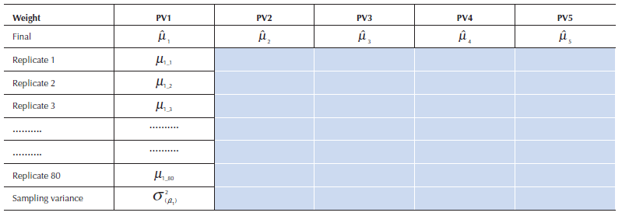
Biased / unbiased shortcut
In summary
It saves 4 times 80 replicates, i.e. 320 estimates → This unbiased shortcut requires 85 estimates instead of 405

Slide 65
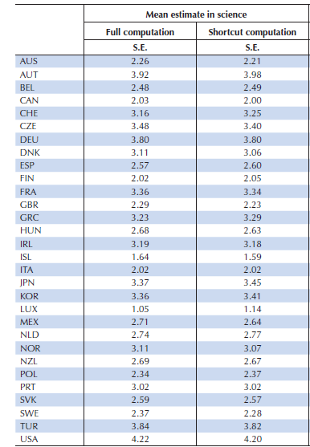
Biased / unbiased shortcut
A comparison between the full computation and the shortcut computation

Slide 66
Correlation / regression between PVs
What are the correlations between student proficiency estimates in mathematics and in science?
Should we compute 5 by 5 correlation coefficients?
What is the relationship between mathematic proficiency estimates and student social background, under control of student proficiency estimates in reading?
Partial correlation
Should we compute 5 by 5 correlation coefficients?
Regression coefficient
Should we compute 5 by 5 regression coefficients?

Slide 67
Correlation / regression between PVs
Correlation coefficients between PVs in Reading and:
Mathematic subdomain Space and Shape (SS1-SS5)
Combined mathematics (Math1-Math5)
PISA 2003, Belgium
 | SS1 | SS2 | SS3 | SS4 | SS5 | Math1 | Math2 | Math3 | Math4 | Math5
Read1 | 0.722 | 0.720 | 0.717 | 0.715 | 0.715 | 0.820 | 0.805 | 0.801 | 0.801 | 0.801
Read2 | 0.716 | 0.718 | 0.718 | 0.716 | 0.716 | 0.802 | 0.821 | 0.802 | 0.801 | 0.801
Read3 | 0.717 | 0.720 | 0.716 | 0.712 | 0.712 | 0.807 | 0.809 | 0.822 | 0.802 | 0.802
Read4 | 0.724 | 0.721 | 0.723 | 0.720 | 0.720 | 0.803 | 0.807 | 0.803 | 0.821 | 0.821
Read5 | 0.718 | 0.724 | 0.721 | 0.719 | 0.719 | 0.803 | 0.804 | 0.801 | 0.802 | 0.802

Slide 68
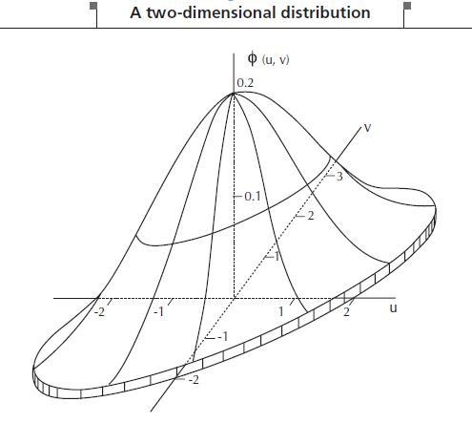
Correlation / regression between PVs
Two-dimensional distribution
Z
Y
X

Slide 69
Correlation / regression between PVs
PISA 2000
3 D scaling M/R/S
5 D scaling R1/R2/R3/M/S
PISA 2003
4 D scaling M/R/S/PS
7 D scaling M1/M2/M3/M4/R/S/P
PISA 2006
5 D scaling M/R/S & 2 attitudinal dimensions
5D scaling M/R/S1/S2/S3
PISA 2009
3 D scaling M/R/S
5 D scaling R1/R2/R3/M/S
4 D scaling R4/R5/M/S

Slide 70
Correlation / regression between PVs
In summary, this means that:
The correlation between the major combined scale and minor domain scales can be computed;
The correlation between minor domain scales can be computed;
The correlation between subdomain scales can be computed (except in 2009: correlation can be computed between processes or between type of texts, but not between a type of text and a reading process);
The correlation between a subdomain scale and the combined major domain scale should not be computed;
The correlation between any subdomain scale and any minor domain should not be computed.

Slide 71
Trend estimates
A subset of items from major domains are selected as link items for subsequent PISA cycles.
PISA 2000 reading material: 37 units and 129 items
PISA 2003 reading material: 8 units and 28 items
Item by Country interactions
In a country, some items might be easier/harder than expected due to:
Mistranslation
More curriculum emphasis
Cultural bias
…

Slide 72
Trend estimates
PISA 2000 DEU & international IRT item parameters in Reading

Slide 73
Trend estimates
Easier/harder at the item level and at the unit level
 | Changes in the 2003 Reading mean estimates without…
Pays | Unit 1 | Unit 2 | Unit 3 | Unit 4 | Unit 5 | Unit 6 | Unit 7 | Unit 8
AUS | 1.82 | -3.32 | -1.09 | 4.07 | -3.60 | -6.17 | 4.30 | 2.77
AUT | 3.34 | -2.66 | 2.48 | 1.58 | 0.40 | -4.17 | -4.79 | 2.13
BEL | 6.79 | -1.03 | 0.07 | 1.87 | 1.67 | -0.53 | -5.54 | 0.24
CAN | -0.06 | -6.64 | 1.41 | 3.87 | -6.64 | -5.31 | 3.32 | 6.62
CHE | 5.60 | -3.40 | 3.68 | 3.21 | 1.68 | -2.21 | -6.66 | -3.05
CZE | 0.60 | -3.31 | -0.21 | -0.93 | 0.37 | 2.82 | -3.90 | 7.44
DEU | 5.73 | -0.79 | 1.07 | 4.39 | 1.77 | -2.25 | -6.24 | -1.70
 | Average differences at the unit level between International and DEU item parameters
DEU | -0.384 | 0.083 | -0.039 | -0.286 | 0.093 | 0.135 | 0.214 | 0.041

Slide 74
Trend estimates
Depending on the selected items for the linking, countries might be advantaged or disadvantaged.
To reflect this additional uncertainty, PISA computes Linking Errors:
Based on the shift in the international item parameter estimates between two PISA cycles, i.e. Item by Cycle Interactions;
Take into account the hierarchical structure of the data (i.e. items embedded within units);
Do not take into account the Item by Country Interaction

Slide 75
Trend estimates
Linking errors estimates
Domains | PISA cycles | Linking errors
Reading | 2000-2003 | 5.32
 | 2000-2006 | 4.96
 | 2000-2009 | 5.39
 | 2003-2006 | 4.48
 | 2003-2009 | 4.09
 | 2006-2009 | 4.07
Math | 2003-2006 | 1.35
 | 2003-2009 | 1.99
 | 2006-2009 | 1.33
Science Interim | 2000_2003 | 3.11
Science | 2006-2009 | 2.57

Slide 76
Trend estimates
How to use the linking errors?
Mean estimates in Reading for Poland:
PISA 2000 : 479 (4.5)
PISA 2003 : 497 (2.9)
Linking Error Reading (2000, 2003) : 5.307

Slide 77
Trend estimates
When should we inflate the standard errors by the linking errors?
Linking errors need only to be considered when comparisons are being made between results from different data collections and then usually when group means are being compared;
Ex:
Differences in country mean estimates from 2 cycles
Differences in subgroup (boys or girls, natives …) mean estimates from 2 cycles
But not in the gender difference shift between 2 cycles

